Slide 1
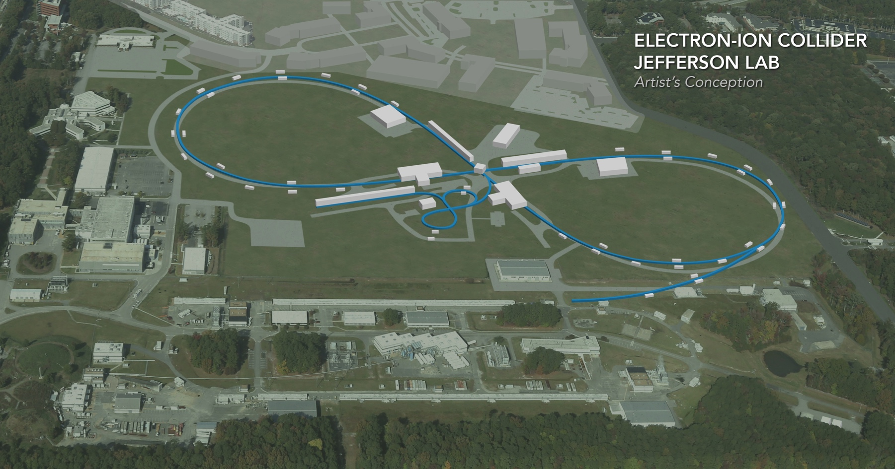
JLEIC ERL BOOSTER
R. Rimmer
for the JLEIC team
RIP
PERLE collaboration meeting 5/15/20

Slide 2
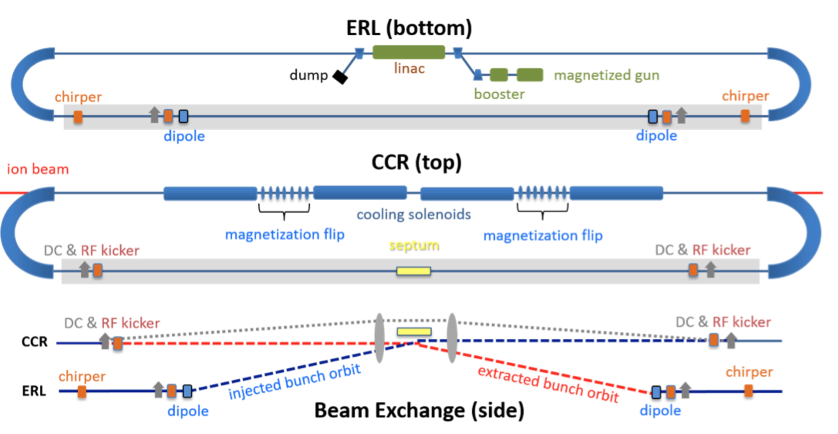
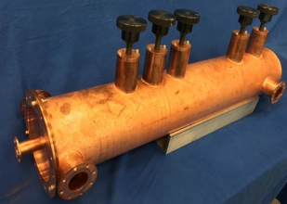
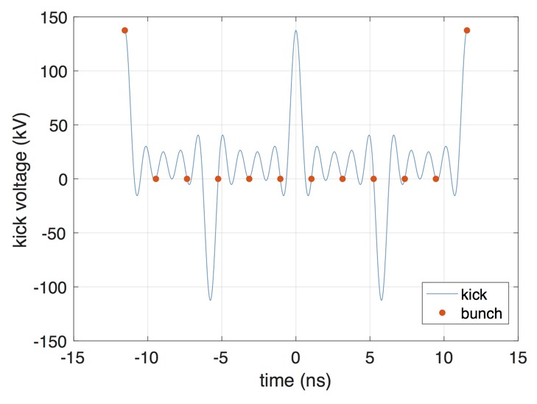
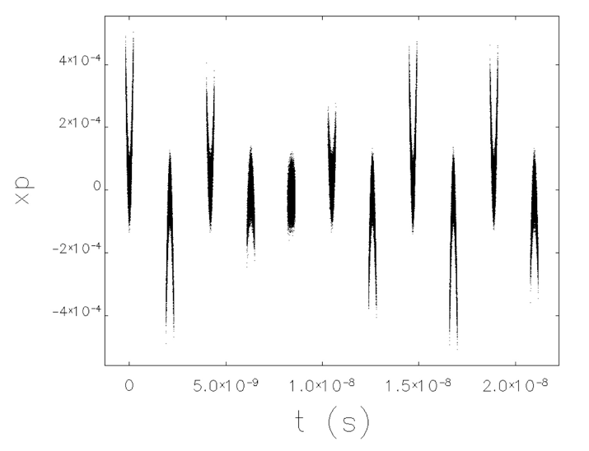
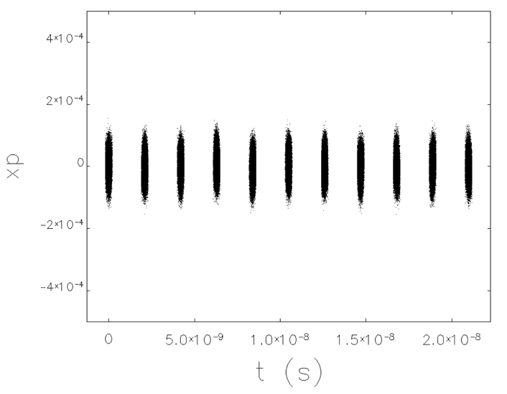
HE Cooler and CCR: Harmonic kicker
G. Park et. al.
High current ERL and injector
Updated Harmonic fast kicker
Magnetized beam
Compensated multipoles
Harmonic RF driver
Harmonic kicker
Harmonic waveform
No pre-kicker
With pre-kicker

Slide 3
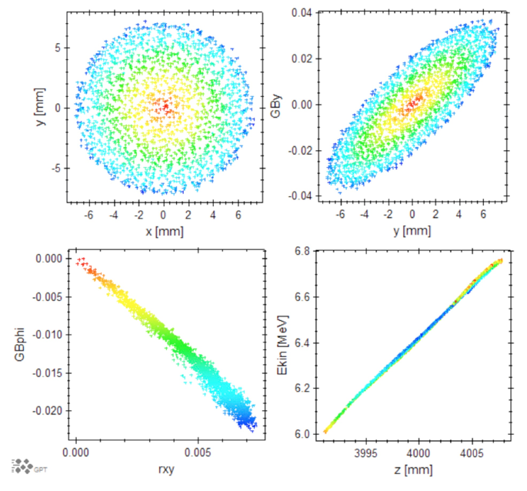
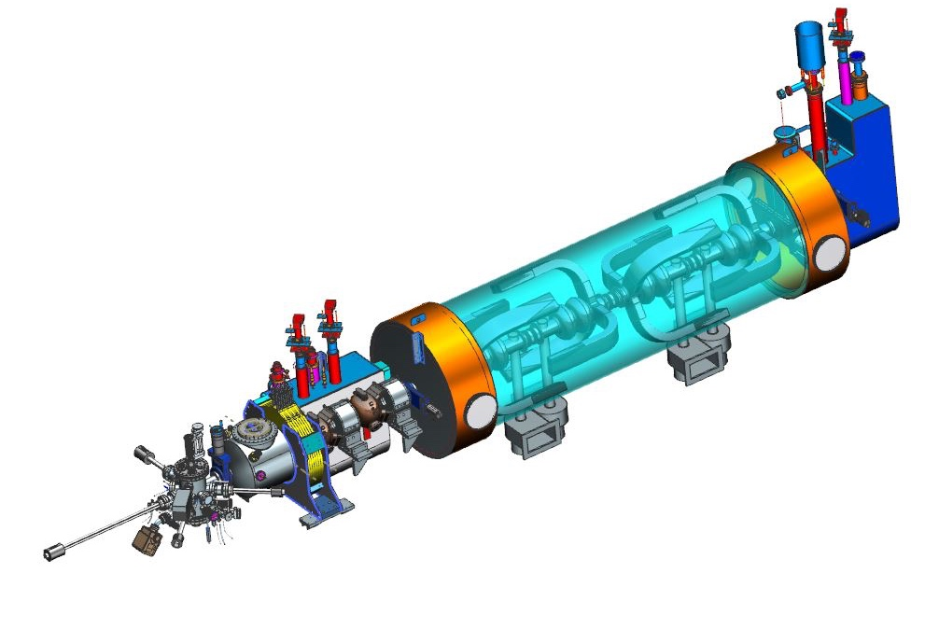
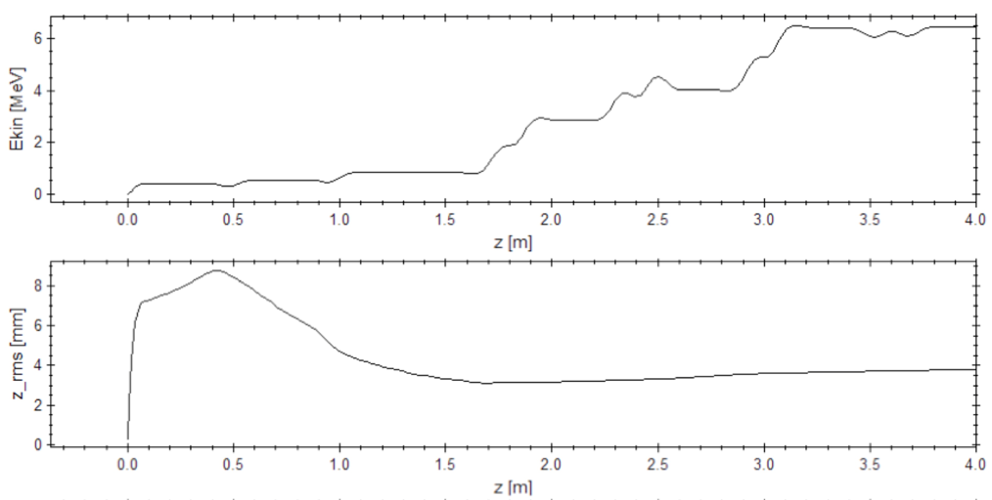
HE ERL injector (JLEIC pre-CDR)
F. Hannon
Magnetized DC gun
NC capture and buncher
952.6 MHz SRF booster
High-current non energy recovered
Several merger options considered
433 MHz option also considered
1.6 nC

Slide 4
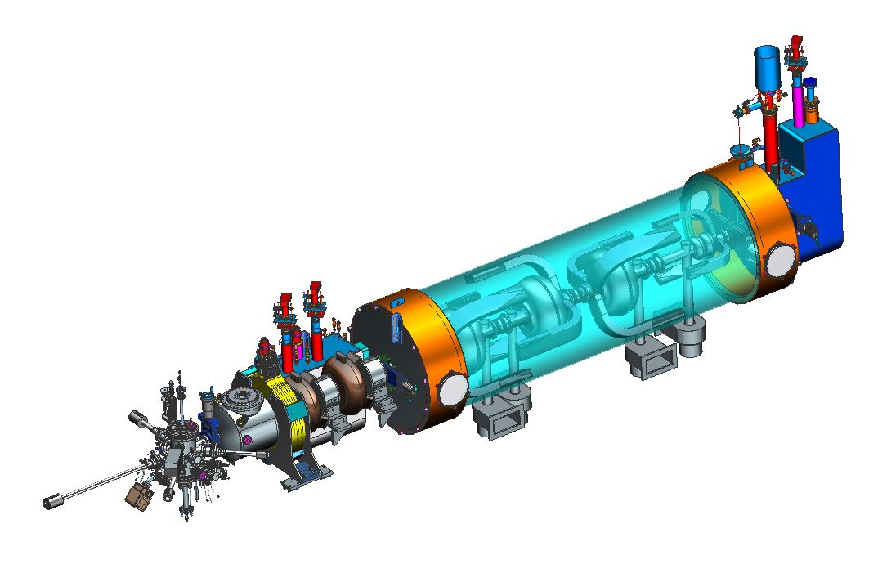
HE ERL injector
F. Hannon
Magnetized DC gun
NC capture and buncher
433 MHz SRF booster
High-current non energy recovered
1299 MHz 3rd harmonic linearization

Slide 5
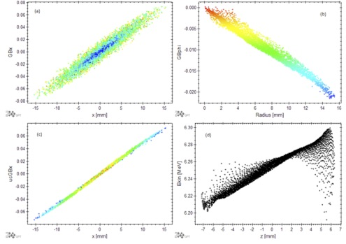
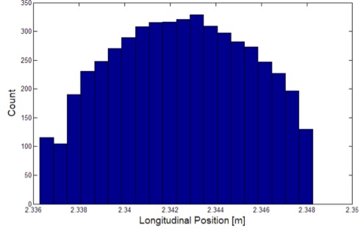
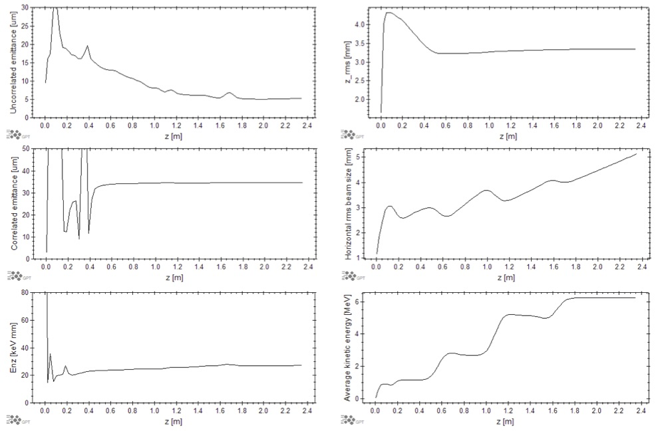
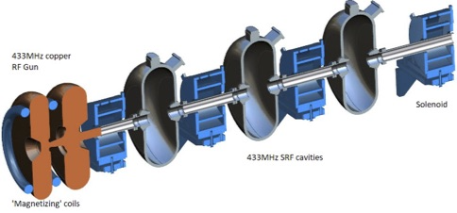
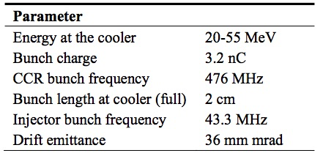
RF gun option, 433 MHz
F. Hannon
Magnetized RF gun (Boeing type)
433 MHz SRF booster
No 3rd harmonic linearization
A Normal Conducting RF Gun as an Electron Source for JLEIC Cooling, F. Hannon, IPAC19, Melbourne

Slide 6
Thank You

Slide 7
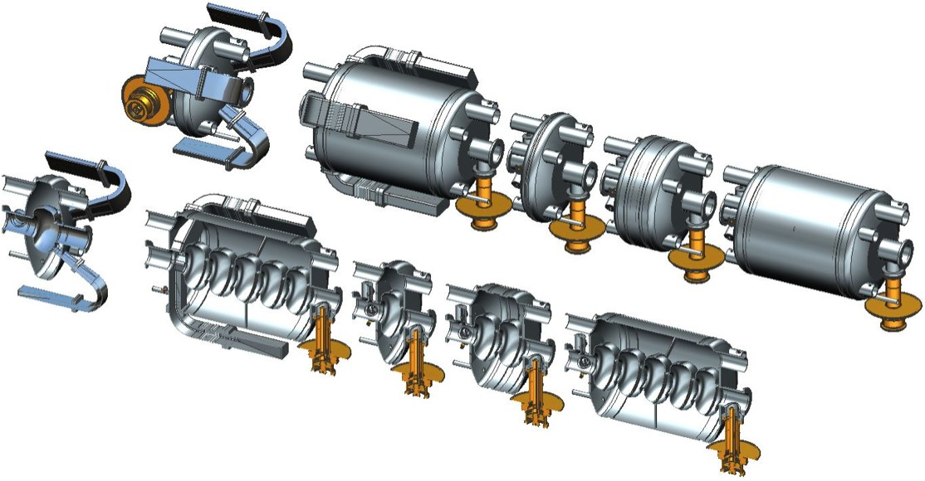
Jlab modular cryostat
Dimensions loosely based on SNS cryomodule

