Slide 1

HL-LHC IP and Ring BPMs:
Read-out Technology and expected Performance
Manfred Wendt (BE-BI-BP) for the LHC BPM team:
Manoel Barros Marin, Douglas Bett, Andrea Boccardi, Irene Degl’Innocenti, Michal Krupa,
and many other colleagues
176th WP2 meeting, 6/2/2020

Slide 2
Outline
Overview on LHC BPM activities
The LHC BPM status quo
The LHC ring BPM consolidation project
The HL-LHC IR BPM system
Summary

Slide 3
Overview of LHC BPM Activities
Interlock BPM consolidation
  8 stripline BPMs left & right of point 6
  New read-out electronics consolidation
    initially triggered by operational problems with doublet-bunches
  Prototype tested with beam during run 2
    on BPMS.4L5v
    Time-multiplexed BPM electrode signals
    Band-pass comb filter allows doublet bunch signal processing
      However, with reduced performance
    VFC-based commercial 14-bit FMC ADC operating at 2.6 GB/s
  Final prototype to be installed end of LS2
    Details have been worked out in close collaboration with MPP
  Deployment of the entire system during an upcoming YETS…

Slide 4
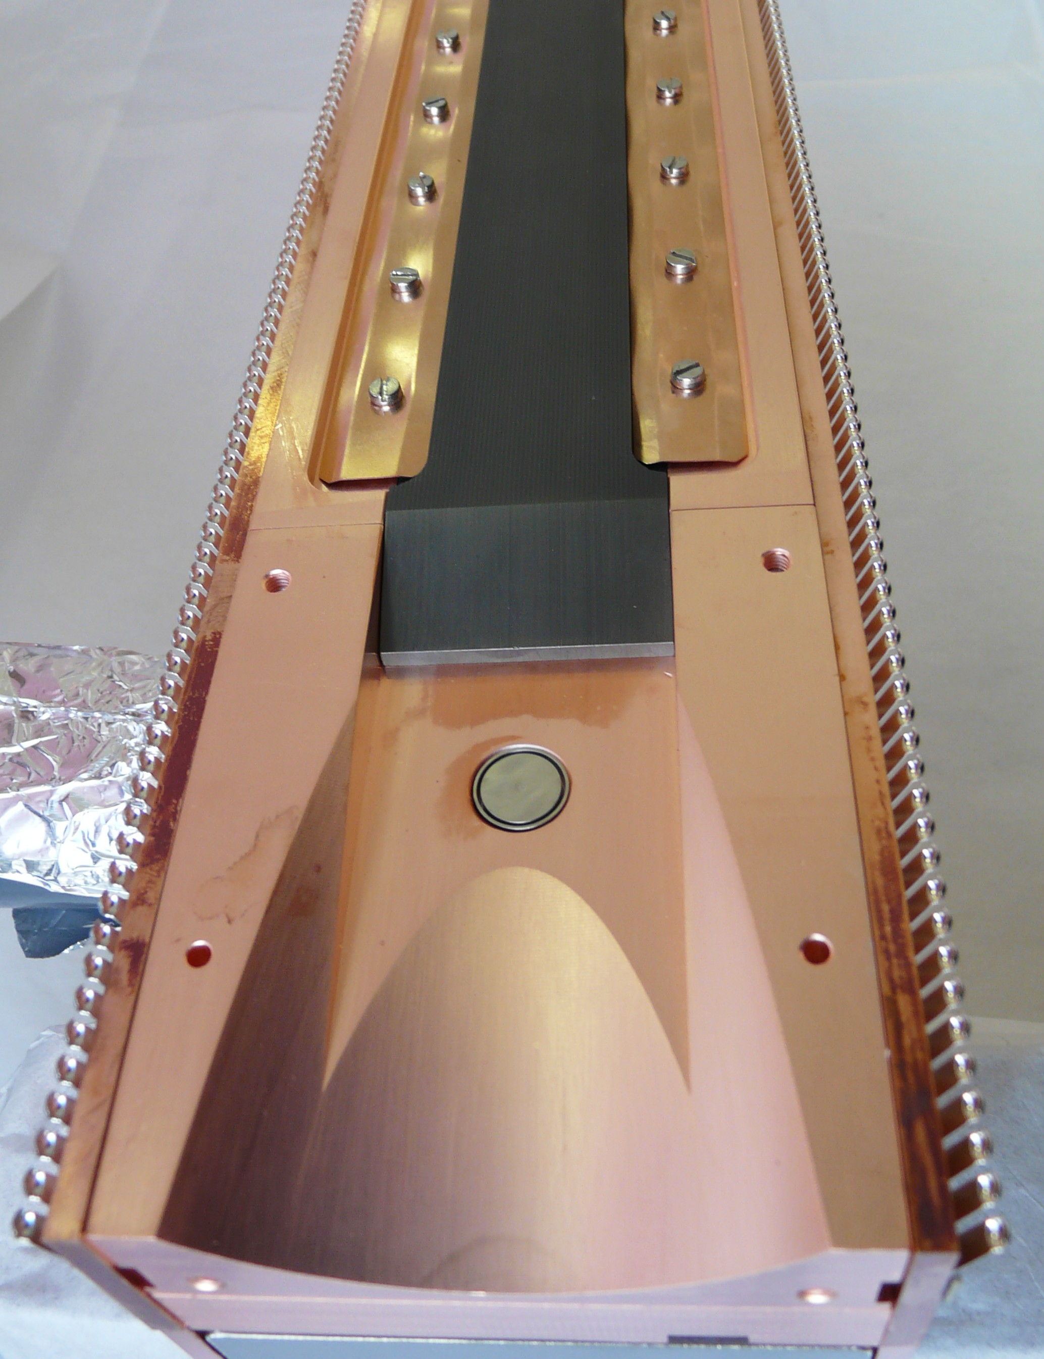
Overview of LHC BPM Activities (cont.)
Integrated Collimator BPMs
  Buttons embedded in collimator jaws
  to speed up set up since 2013
  Uses high-precision
  DOROS BPM acquisition system
  Collimator jaw position now interlocked
  on BPM readings
  Challenging integration and component procurement: coaxial SiO₂ RF cables
  All HL-LHC collimators
  will be equipped with BPMs
HEL Stripline BPM
  Needs to monitor the hollow-electron beam
  and the LHC proton / ion beams
Embedded
button

Slide 5

Overview of LHC BPM Activities (cont.)
HL-BPMs (IR BPMs)
  32 new BPMs
    “cold” BPMs inside the cryostat
    24 stripline BPMs to monitor of both beams in the same beam pipe
    8 button BPMs in separate beam pipes (D2)
  Requires a new read-out system
    Final prototyping with beam before LS3!
    Deployment of the entire system by end of LS3!
Ring BPM consolidation
  New read-out electronics for ~1100 LHC BPMs
    Based on the given infrastructure
    Radiation tolerant tunnel electronics
    Prototyping during run 3
    Deployment LS3/LS4?

Slide 6
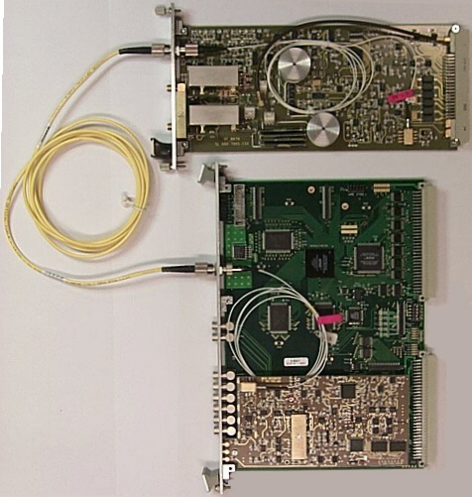
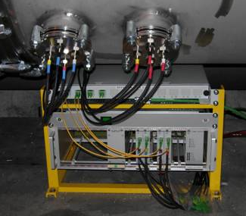
LHC BPM Read-out Systems: Status Quo in LS2
WBTN board
(single plane)
DAB board
(dual plane)
1310 nm
single-mode
fiber
tunnel installation
WBTN BPM System
  Time encoded bunch-by-bunch signal processing
  2 optical fibers per BPM
DOROS BPMs
  Narrowband electronics
  Collimator & IR BPMs

Slide 7
LHC BPM Wide-Band Time-Normalizer (WBTN) Functional Principle

Slide 8
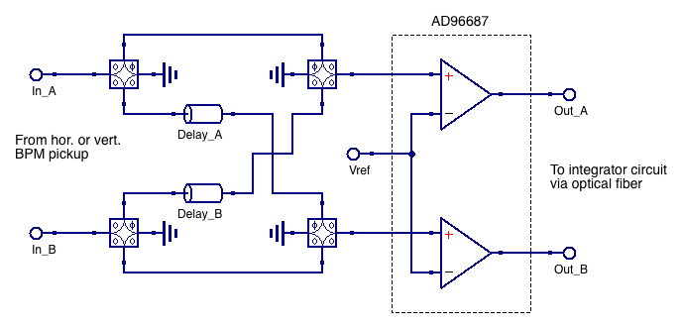
WBTN BPM Performance and Limitations
70 MHz LPF & AD96687 analog comparator
define the core performance of the LHC BPMs
  <=46 dB dynamic range (single bunch intensity)
  Vref set to
    2mV: HI sensitivity
    67mV: LO sensitivity
  50…100 μm single-bunch resolution
    Adaptive orbit-mode IIR filter BW: 20…40 Hz,
    typically few μm resolution in orbit-mode
Still fulfills most requirements, BUT:
  Residual temperature sensitivity
    Despite temperature controlled racks for the VME-based analog integrators
  Aging effects, e.g. “electronic” offset drifts
    Analog electronics components
  Sensitive to signal reflections between BPM pickup and read-out electronics
  Dynamic range limitations
    Defined by the dual analog comparator circuit
  Long-term maintainability, spares, calibration, etc.
    Complex analog signal conditioning circuit
    Will be 20 years in operation after LS3

Slide 9
LHC Ring BPM Consolidation
Requirements
  Should meet ALL requirements
  of the present LHC BPM read-out system
  PLUS some improvements, e.g.
    Resolution, reproducibility over long time periods,
    additional flexibility through gateware-based signal processing
  Two main “customers”:
    LHC OP: pilot, but mostly full machine with nominals, beam orbit mode, OFB, stability, reproducibility
    ABP: (fat) pilot, TbT mode, SB resolution
Boundaries
  Keep the existing infrastructure
    BPM pickups, optical fibers
  Requires radiation tolerant components!

Slide 10
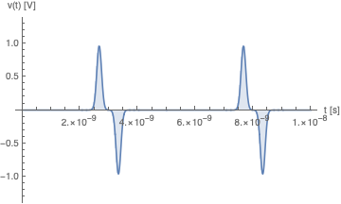
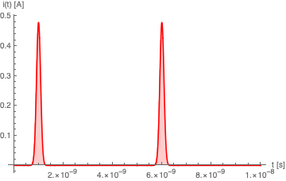
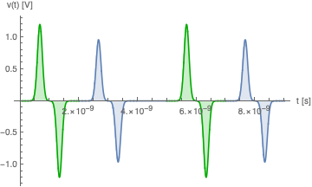
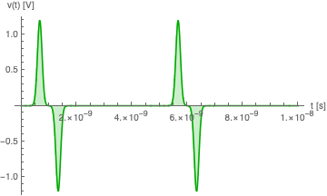
Concept: Time-multiplexed BPM signal processing
signal delay,
e.g. coaxial cable
A_{elec} signal,
delayed
Single channel read-out improves symmetry and
long-term stability
Electrode A
+
signal conditioning
ADC
DAQ
Electrode B
B
A
B
A
bunched beam current
B_{elec} signal,
direct
combined A & B signal

Slide 11
LHC Ring BPM Consolidation: Proposed Layout

Slide 12
LHC Ring BPM Consolidation (cont.)
Challenges
  Radiation tolerant components
  for the in-tunnel hardware
    Space-grade, radiation-tolerant
    12 or 14-bit multi GB/s ADCs
      Teledyne e2v EV12AQ600
      12-bit, 6.4 GS/s, 4-cores, ~8.7 ENOB
      TI ADC12DJ3200QML-SP
      12-bit, 6.4 GB/s, 2-cores, ~8.7 ENOB
    Low-jitter clock generator & PLL
    VTRx transceiver
      Currently under development
  Maximum raw data throughput
  limited by existing fiber installation
    With 4x coarse wavelength
    division multiplexer ≤40.96 GB/s
Expected Performance
  Single bunch resolution 10…15 μm
    Depending on ADC ENOB and CLK rate,
    and 2-in-1 or 4-in-1 time multiplexing schema
    “fat” pilot bunch, ~2e10 cpb

Slide 13
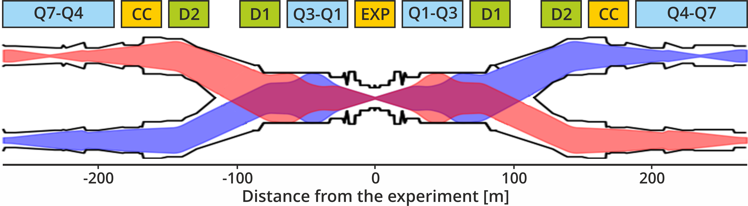
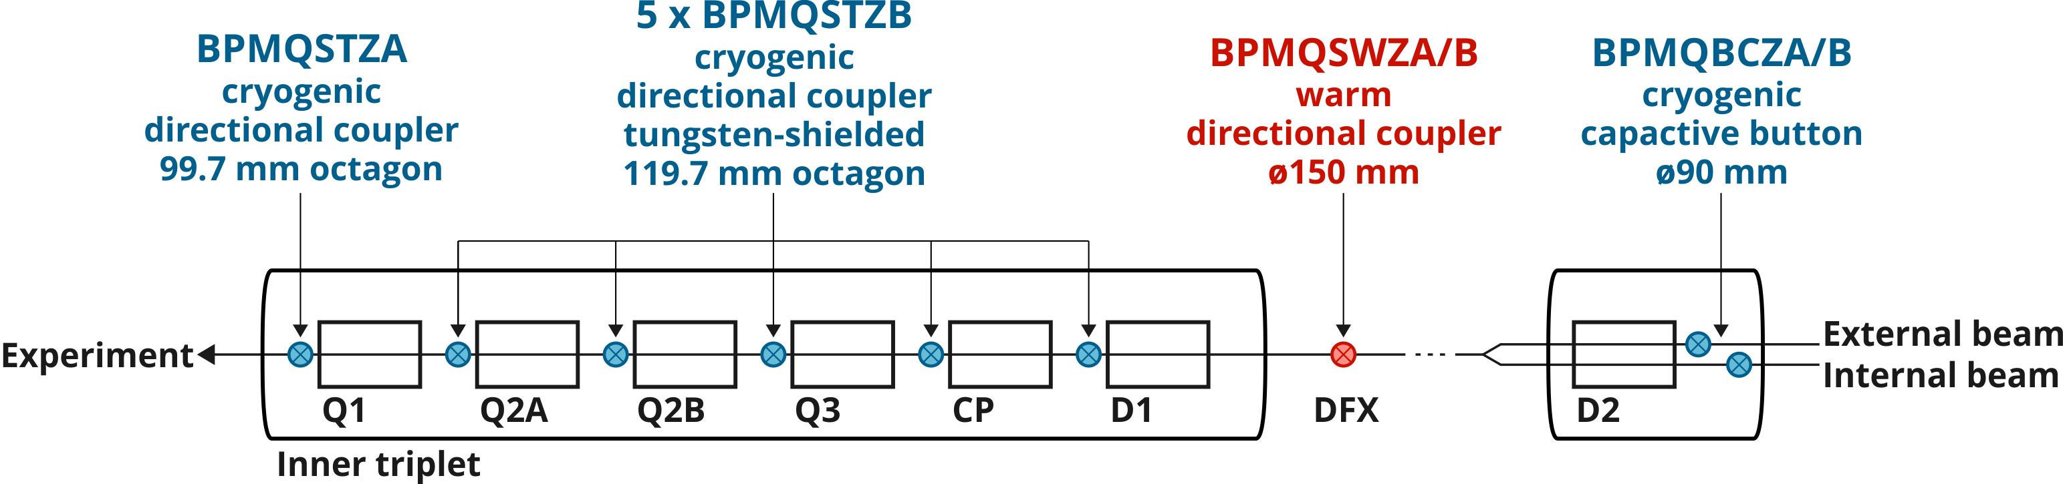
BPMs for Interaction Regions
Beam 1
Beam 2
Will be removed
ECR in preparation

Slide 14
HL-LHC BPM overview
Code | Location | Distance to IP [m] | Aperture [mm] | Type | Tungsten shielding | Electrode position | Beam time separation [ns]
BPMQSTZA | Q1 (IP side) | 21.853 | Octagonal 101.7 / 99.7 | Stripline | No | 0° / 90° | 3.92
BPMQSTZB | Q2A (IP side) | 33.073 | Octagonal 112.7 / 119.7 | Stripline | Yes | 45° / 135° | 3.92
BPMQSTZB | Q2B (IP side) | 43.858 | Octagonal 112.7 / 119.7 | Stripline | Yes | 45° / 135° | 6.82
BPMQSTZB | Q3 (IP side) | 54.643 | Octagonal 112.7 / 119.7 | Stripline | Yes | 45° / 135° | 9.72
BPMQSTZB | CP (IP side) | 65.743 | Octagonal 112.7 / 119.7 | Stripline | Yes | 45° / 135° | 10.52
BPMQSTZB | D1 (IP side) | 73.697 | Octagonal 112.7 / 119.7 | Stripline | Yes | 45° / 135° | 7.36
BPMQBCZA BPMQBCZB | D2 (arc side) | 151.930 | Round Ø 90 | Button | No | 0° / 90° | N/A

Slide 15
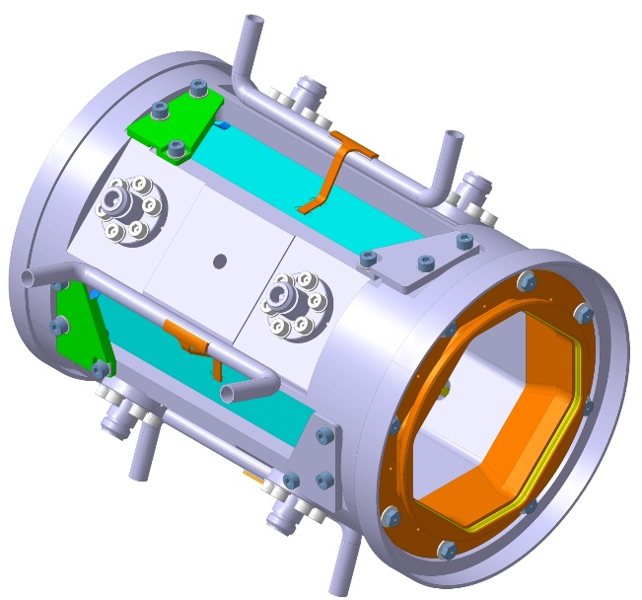
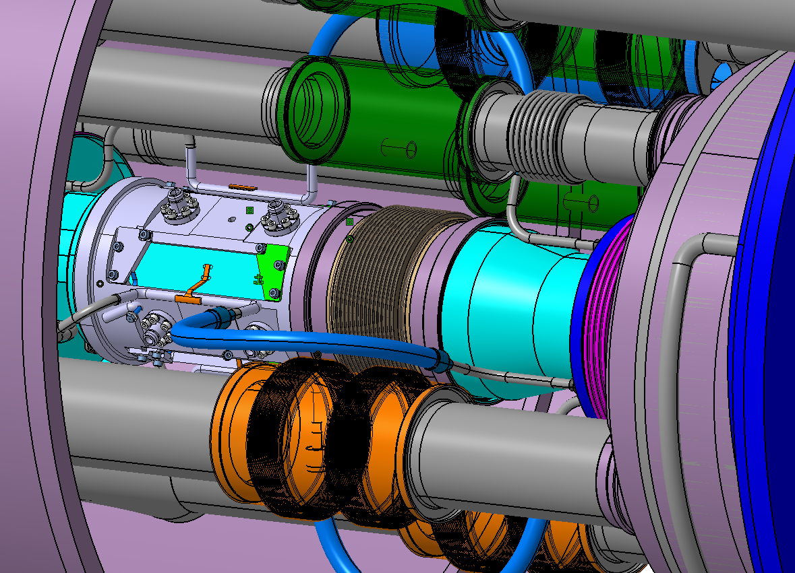
“Cold” Directional-Coupler BPMs
Technology
  125 mm long stripline electrodes,
  “45⁰ rotated” installation (type B BPMs)
  ~26 dB directivity to improve the disentanglement
  of the B1/B2 signals
  Tungsten shielding:
  lower TID on Q2B magnet by ~15 %
  Amorphous carbon coating:
  Electron cloud effects decreased by 40x
  Active cooling with liquid He:
  To evacuate up to 6 W of head load
Status / Milestones
  BPM prototype production launched
  Started procurement of tungsten absorbers (with WP12) and cryogenic RF feedthroughs
    Qualification of RF feedthroughs in 2020 (?!)
  In-kind contribution of BPM body manufacturing
    Collaboration agreement with Russia finalized
  Coaxial SiO₂ RF cables
    Market survey and procurement start for mid 2020
    In combination with cables required for the collimator BPMs

Slide 16
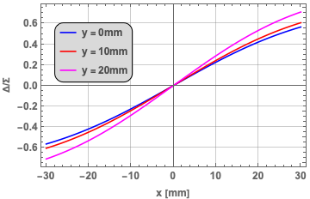
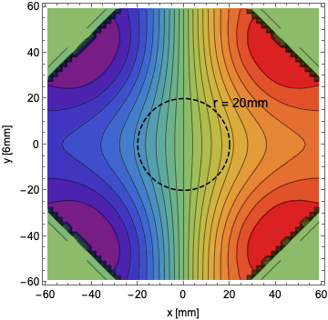
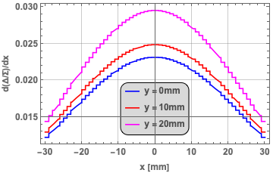
Impact of large aperture, rotated BPMs
Reduced coupling, 7.5 % for a centered beam
Reduced BPM sensitivity, 0.4 dB/mm at the BPM center
Increased position non-linearities

Slide 17
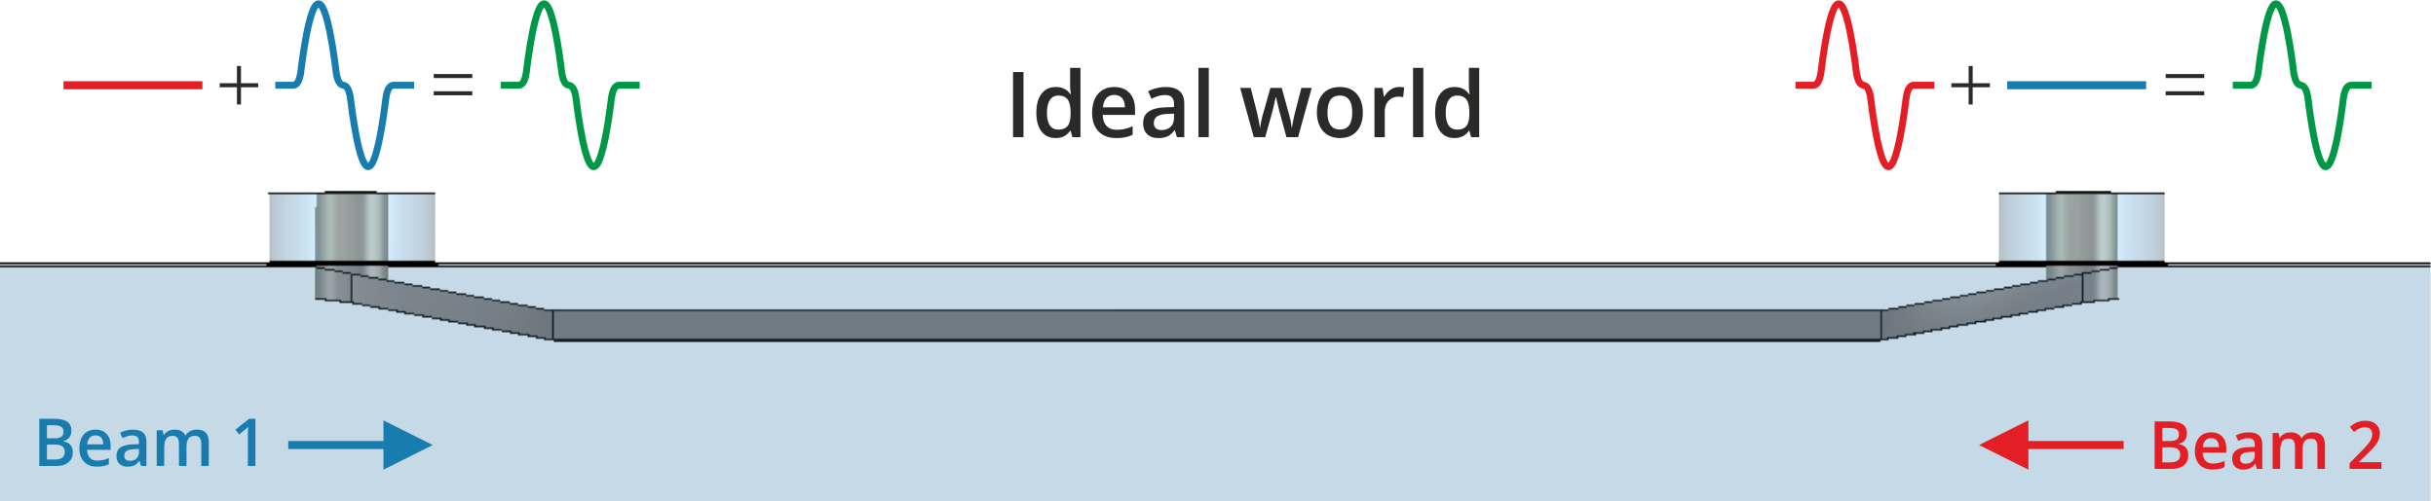
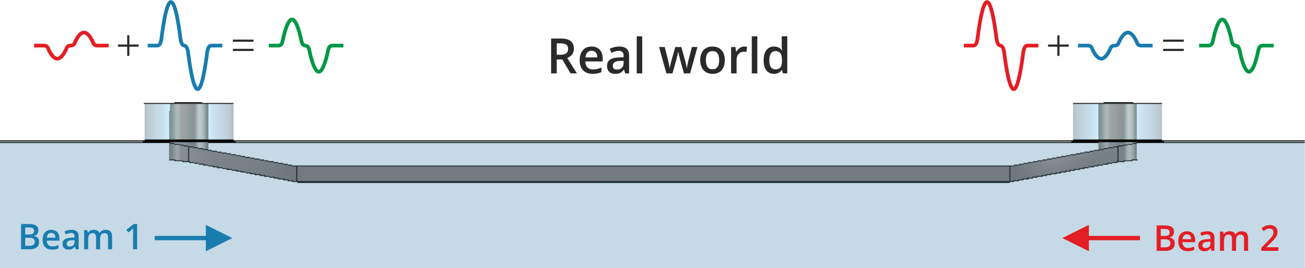
Directional couplers have a finite “directivity”
Unwanted parasitic signal

Slide 18
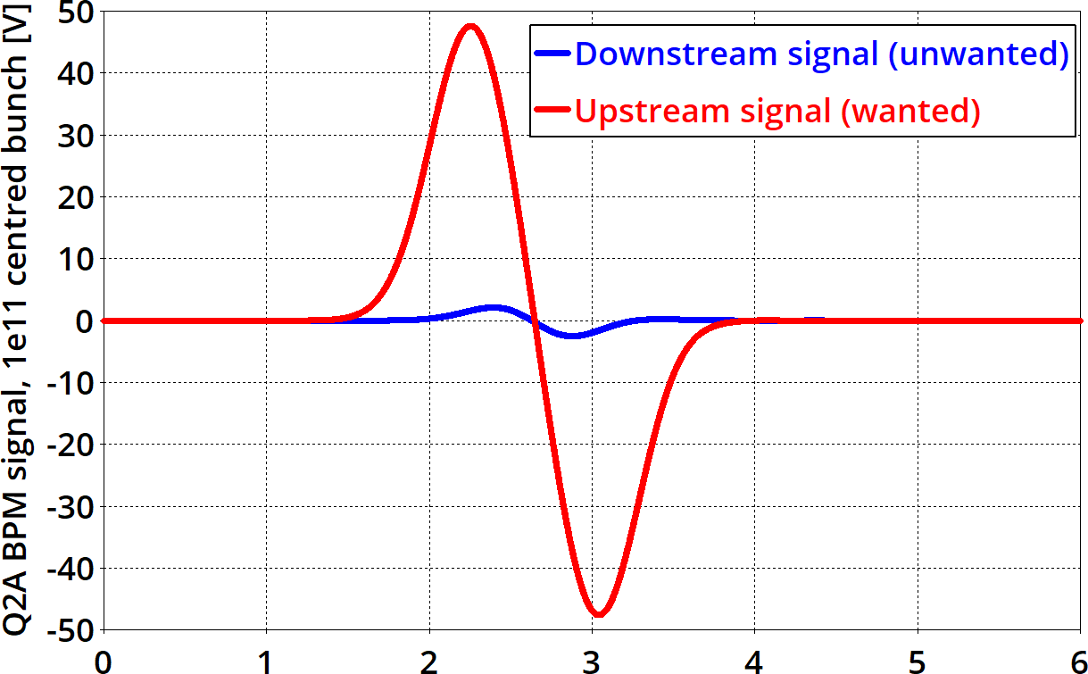
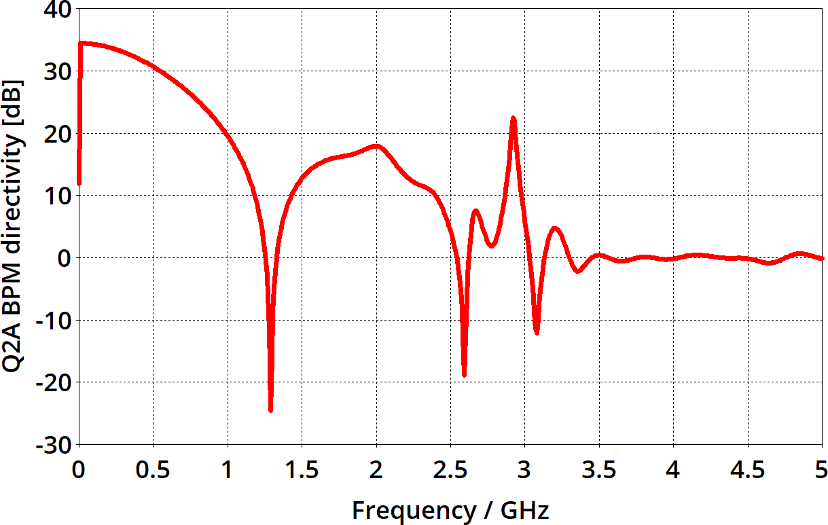
Directivity
Directivity – the ratio of the upstream (wanted) signal to the downstream (unwanted) signal
Ways of improving the directivity:
  Careful RF design of the BPM (constant 50 Ω impedance)
  Operating at lower frequencies
  Installing the BPM in a location where the two beams are separated in time
HL-LHC BPM directivity: ~ 26 dB
Time / ns

Slide 19
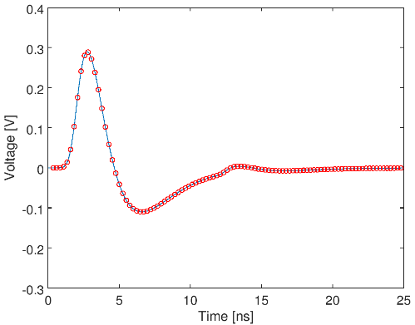
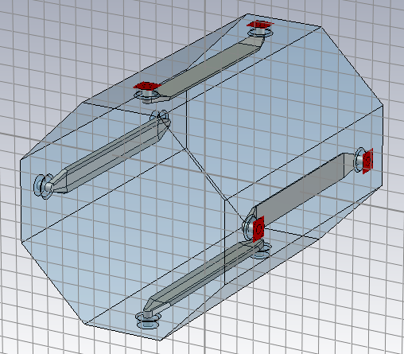
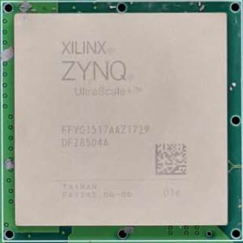
IR BPM Signal Processing
Study or B1-B2 compensation schemas
  Bunch-by-bunch signal processing
    25 ns time window
  Up to 10x intensity variation
    Between counterrotating bunches
  up to 17 mm beam offsets
    Injection orbit at IR1
  Uncompensated bunch lengthening
  Accuracy errors, resolution
Typical digitized signal
  UR electrode
  Same bunch intensities
  0 mm beam offset (both beams)
  10.5 ns bunch time difference
  12-bit, 4.096 GB/s async clock
B2 error signal
pickup
long cable
(60-140 m)
Low-pass filter
variable attenuator
Digital processor
Stripline BPM
Processor is not rad-hard, electronics must be located in the service gallery
Anti-aliasing filter also stretches signal to make efficient use of the digitizer
Match signal level to ADC range

Slide 20
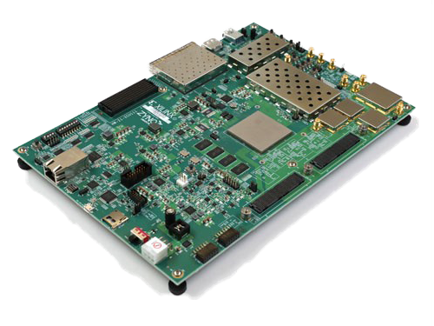
Candidate Digital Signal Processor
Processing System Features
Application Processing Unit | Quad-core Arm Cortex-A53 up to 1.33 GHz
Real-Time Processing Unit | Dual-core Arm Cortex R5 up to 533 MHz
Xilinx Zynq RFSoC (= radio frequency system on a chip)
Model ZU28DR (Zynq UltraScale architecture)
Processing System
Quad Arm Cortex-A53
Dual Arm Cortex-R5
Direct-RF Signal Chain Features
Max. RF input Frequency (GHz) |  | 4
Decimation / Interpolation |  | 1x, 2x, 4x, 8x
12-bit RF-ADC | # of ADCs | 8
 | Max Rate (GSPS) | 4.096
14-bit RF DAC | # of DACs | 8
 | Max Rate (GSPS) | 6.554
RF-ADC
DDC
RF in
RF-ADC
GTY Transceiver
RF-DAC
DUC
RF Out
Programmable Logic
System Logic Cells (K) | 930
DSP Slices | 4,272
Memory (Mb) | 60.5
33G Transceivers | 16
Maximum I/O Pins | 347
RF-DAC
Programmable Logic
Zynq RFSoC
ZCU111 Evaluation Board

Slide 21

Digital Signal Processing Simulation Framework
Studied different compensation algorithms
  No compensation
    Really bad!
  VNA-style
    Based on FD pickup S-parameters
    Not very promising
  Waveform compensation
    TD signal sample-by-sample
    Computing intensive
  Bunch signal power compensation
    TD signal integration
    Studied two different different methods
    Most promising!
Standard BPM processing operations
e.g. root of sum of squares (RSS)
Polynomial adjustment (2D)
Digitize waveforms
Compensate
for other beam
Integrate channels
Calculate position
Correct
non-linearity
Calibrate, acount for BPM roll & offset
Order of compensation and integration could swap
$Δ/Σ$ algorithm

Slide 22
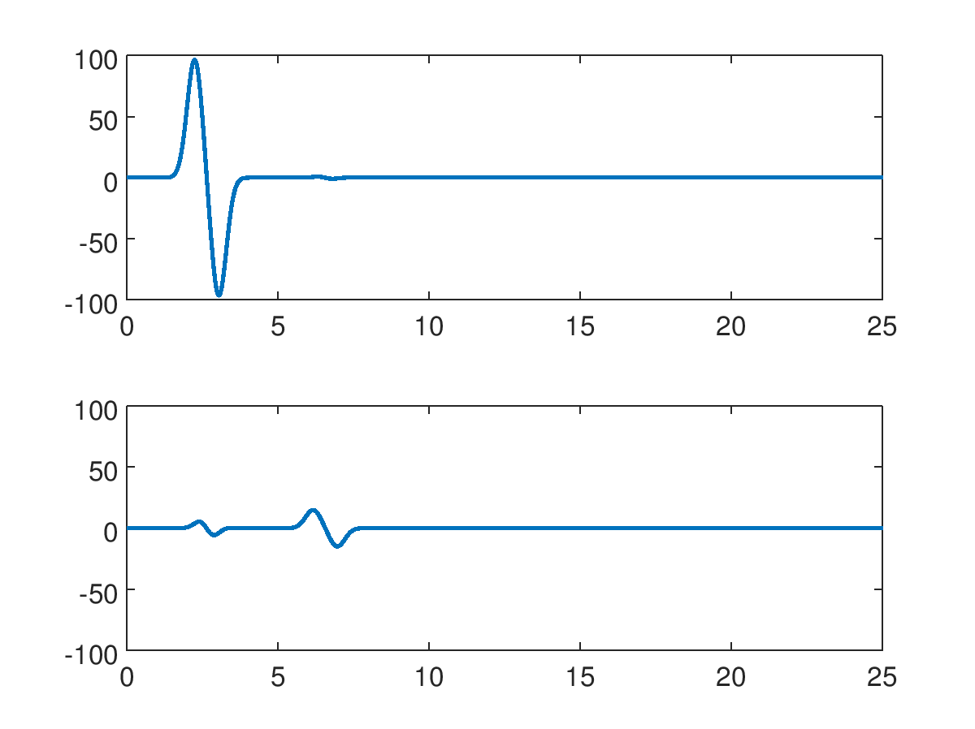
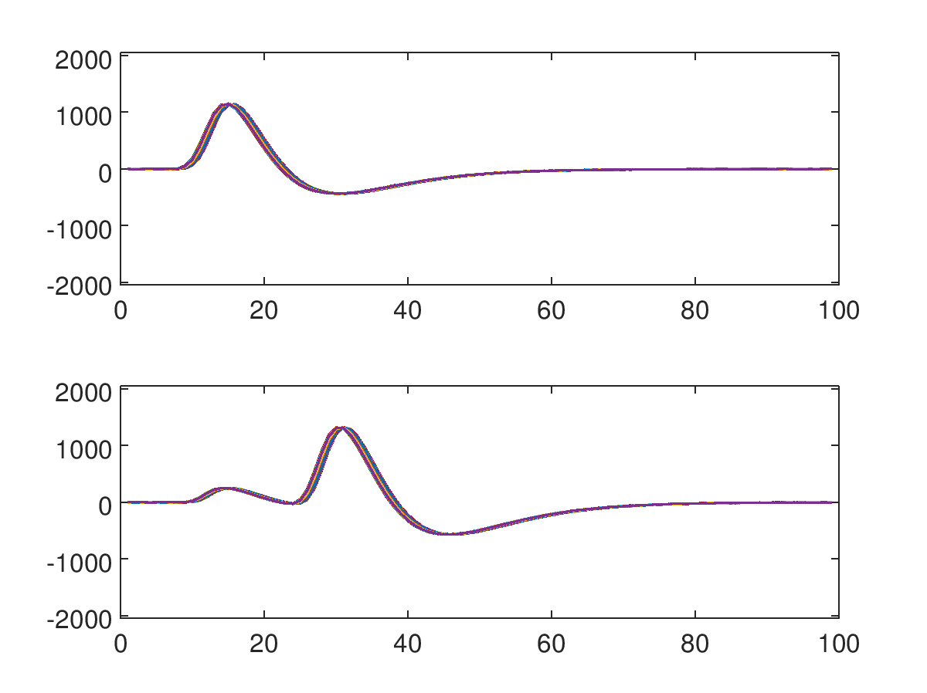
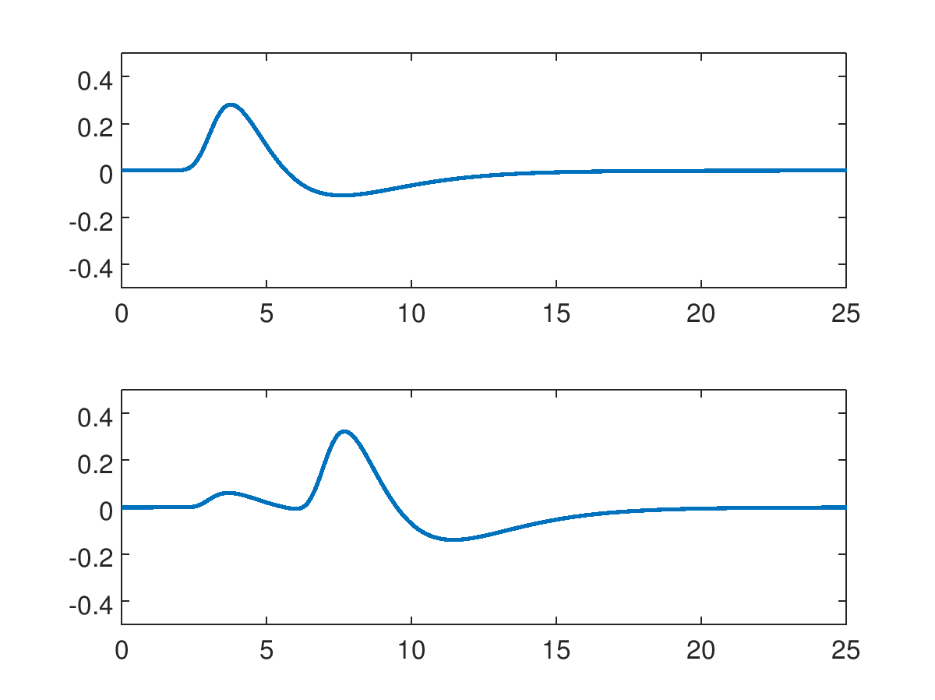
Simulation Methodology
BPM pickup signals
digitized waveforms
Calculate the signals expected on the stripline ports for a given pair of beam bunches, characterized by their:
  Positions in the BPM plane
  Bunch crossing timing
  Intensities
  (Gaussian) bunch lengths
Also include the effects of:
  long coaxial cables
  filter stage
  variable attenuator (given step size)
The resulting signals are used as the basis for an ensemble of waveforms generated from a digitizer with an asynchronous clock with given:
  sample frequency
  random noise amplitude
Port 1 (R upstream)
voltage [V]
ADC counts
Port 5 (R downstream)
time [ns]
ADC sample
Signals at the digitizer input
Transformed by cable and filter, attenuated
Down-sampled and quantized, random noise added

Slide 23
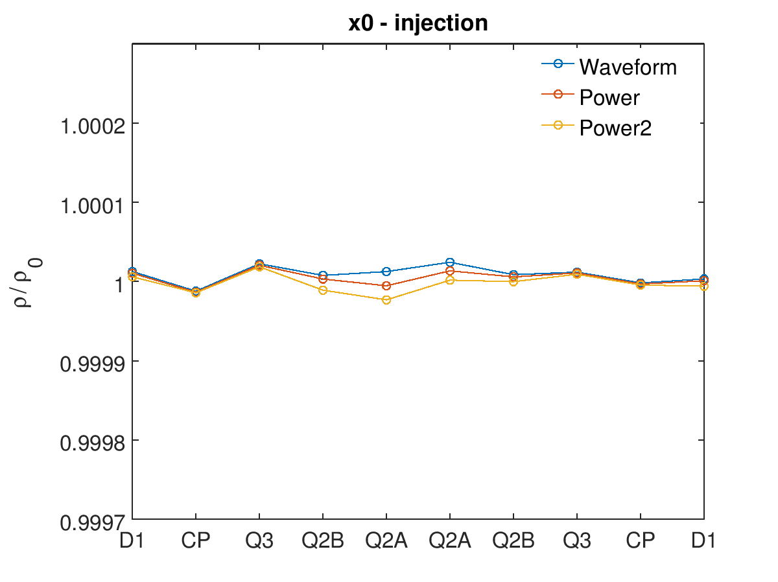
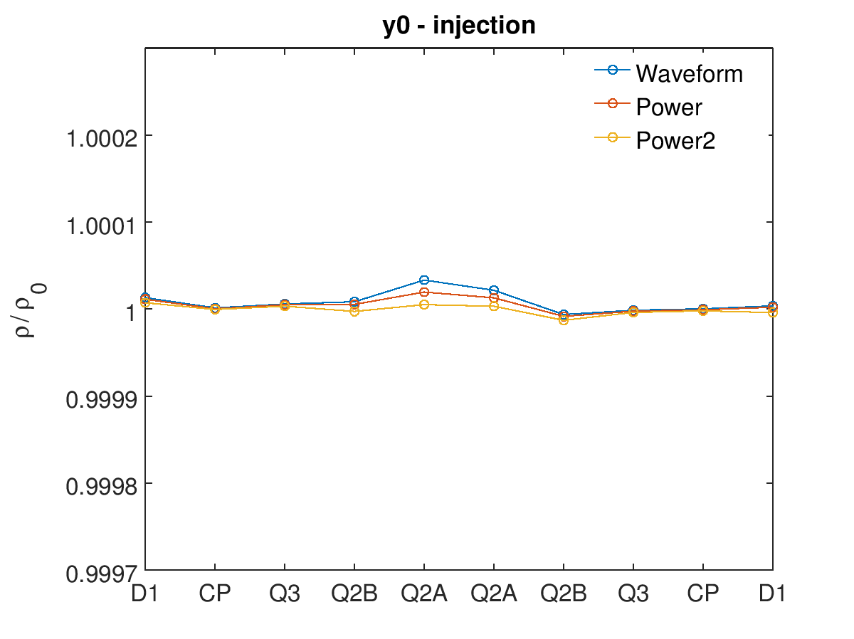
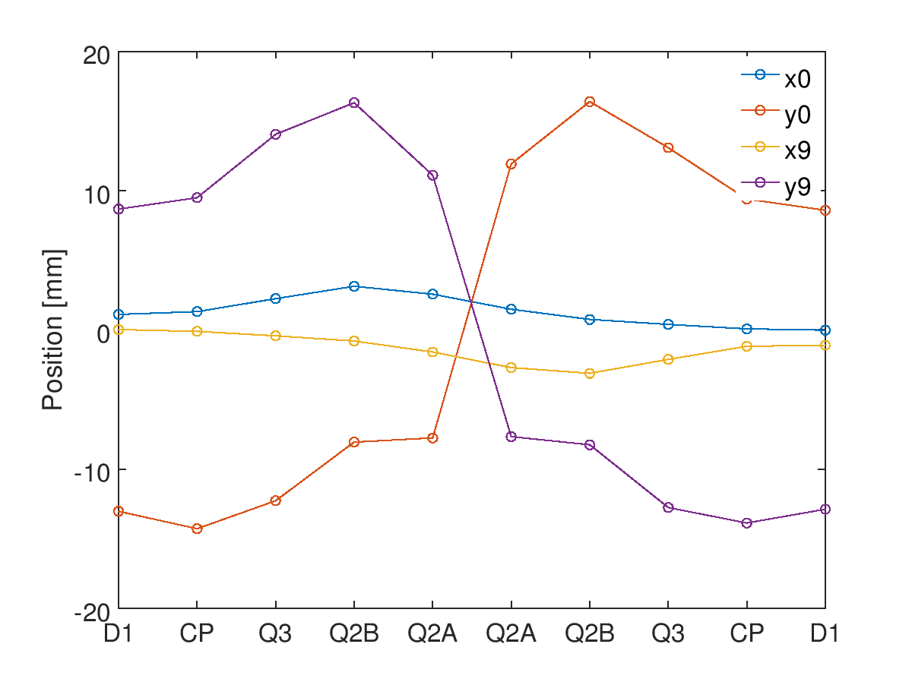
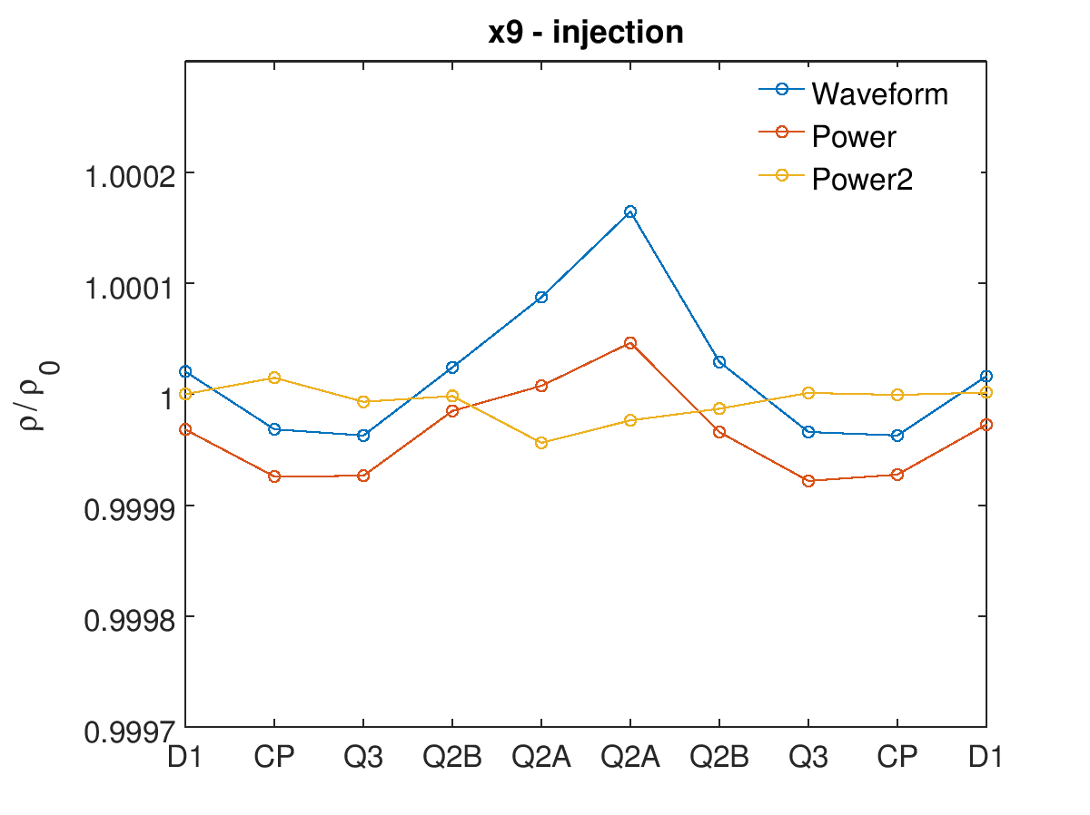
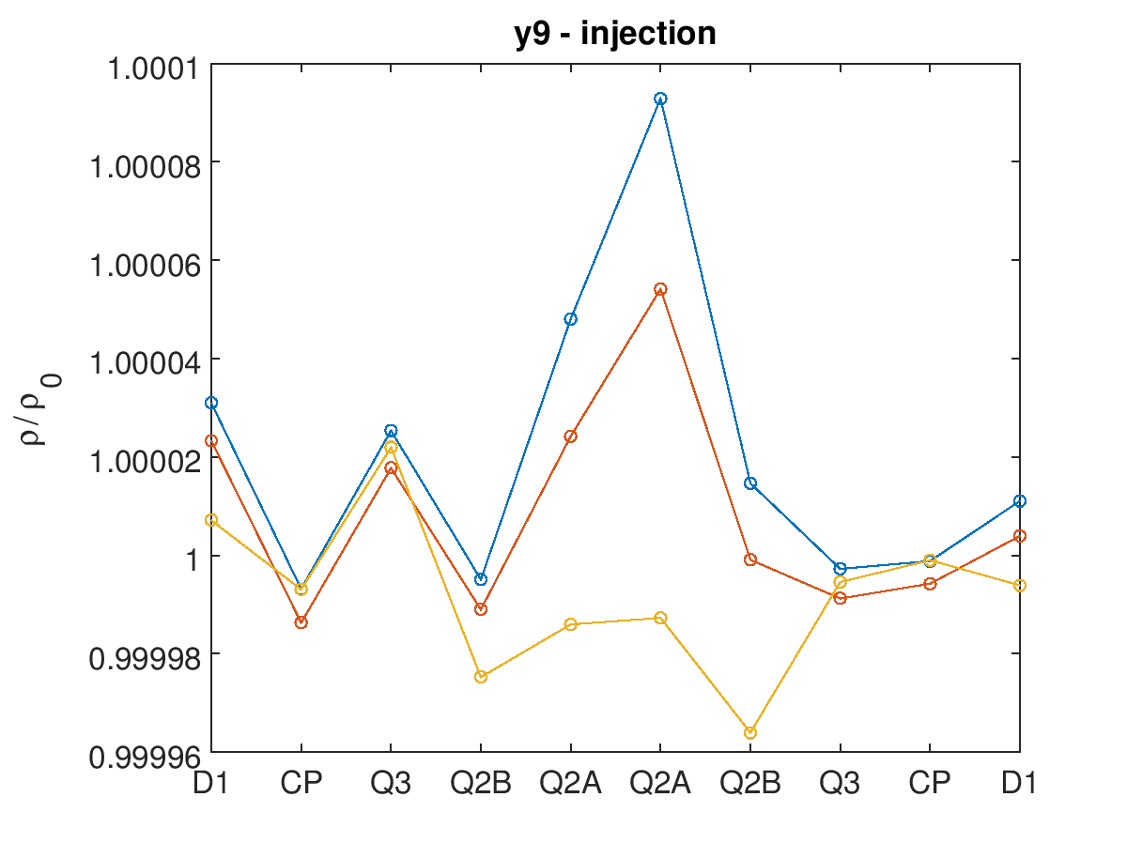


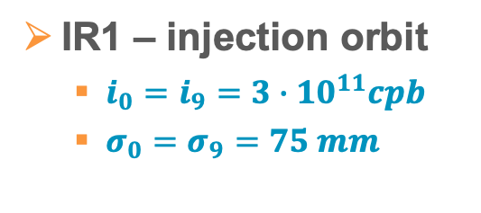


Typical Results – Relative Accuracy Errors
IR1 – injection orbit
  $i_{0}=i_{9}=3∙{10}^{11}cpb$
  $σ_{0}=σ_{9}=75 mm$
$$\left\langle x_{0}\right\rangle /X_{0}$$
$$\left\langle y_{0}\right\rangle /Y_{0}$$
7.36 ns
9.72 ns
10.52 ns
9.72 ns
10.52 ns
6.82 ns
3.92 ns
6.82 ns
7.36 ns
7.36 ns
9.72 ns
10.52 ns
9.72 ns
10.52 ns
6.82 ns
3.92 ns
6.82 ns
7.36 ns
$$\left\langle x_{9}\right\rangle /X_{9}$$
$$\left\langle y_{9}\right\rangle /Y_{9}$$
7.36 ns
9.72 ns
10.52 ns
9.72 ns
10.52 ns
7.36 ns
9.72 ns
6.82 ns
3.92 ns
6.82 ns
7.36 ns
10.52 ns
9.72 ns
10.52 ns
6.82 ns
3.92 ns
6.82 ns
7.36 ns

Slide 24
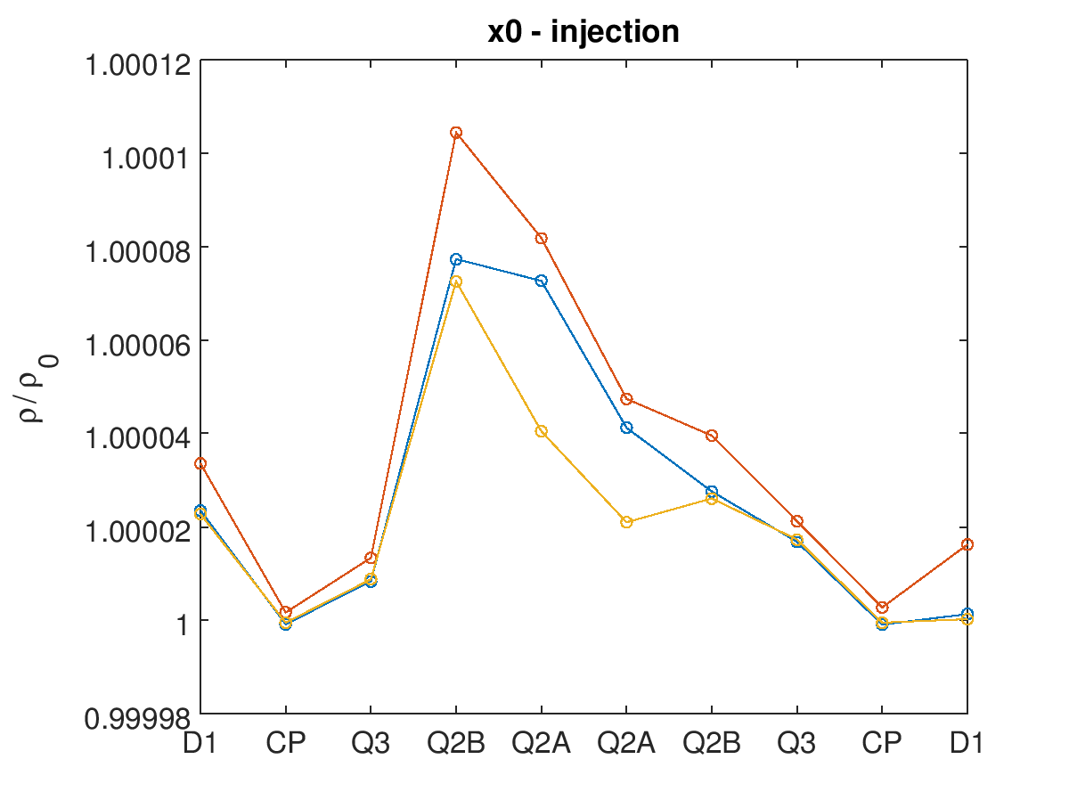
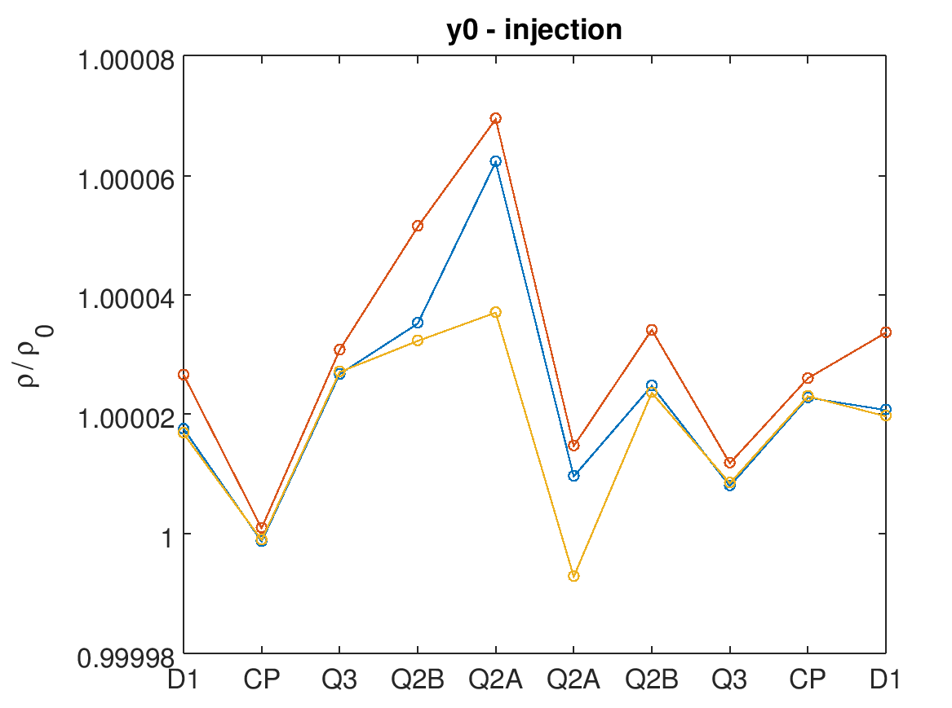
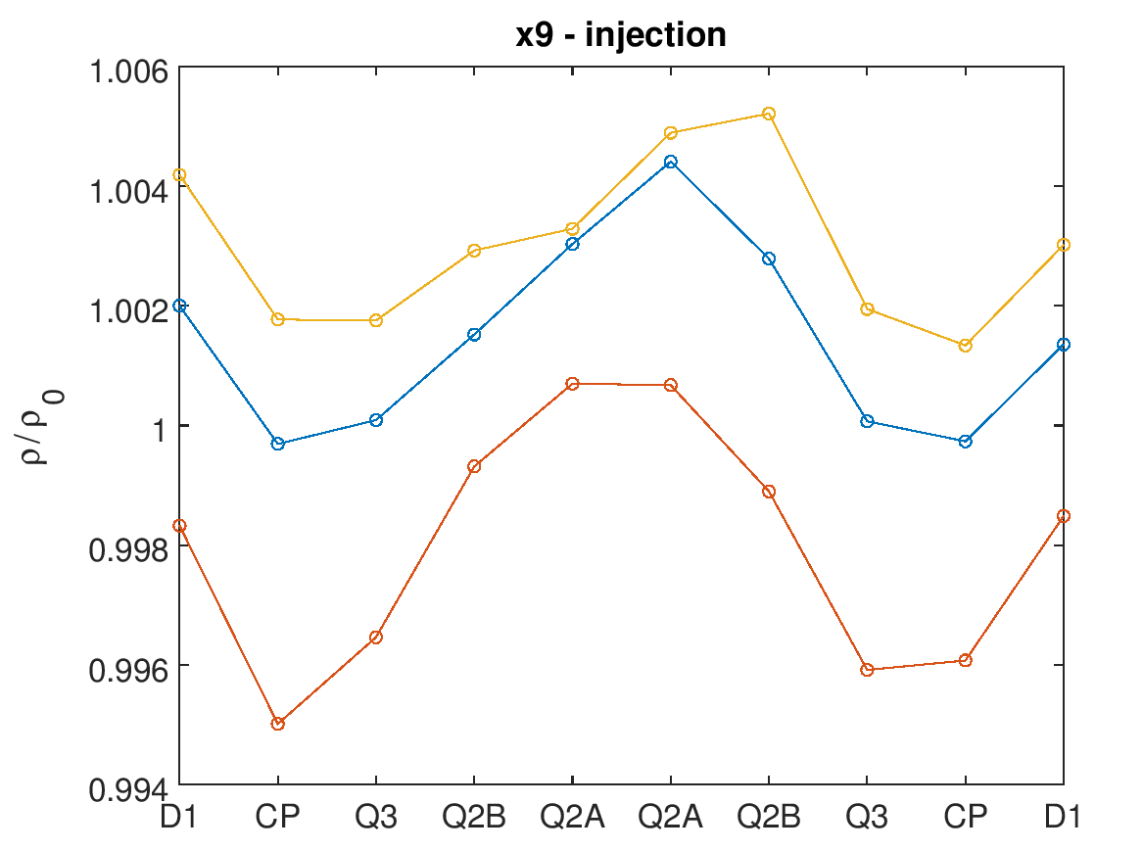
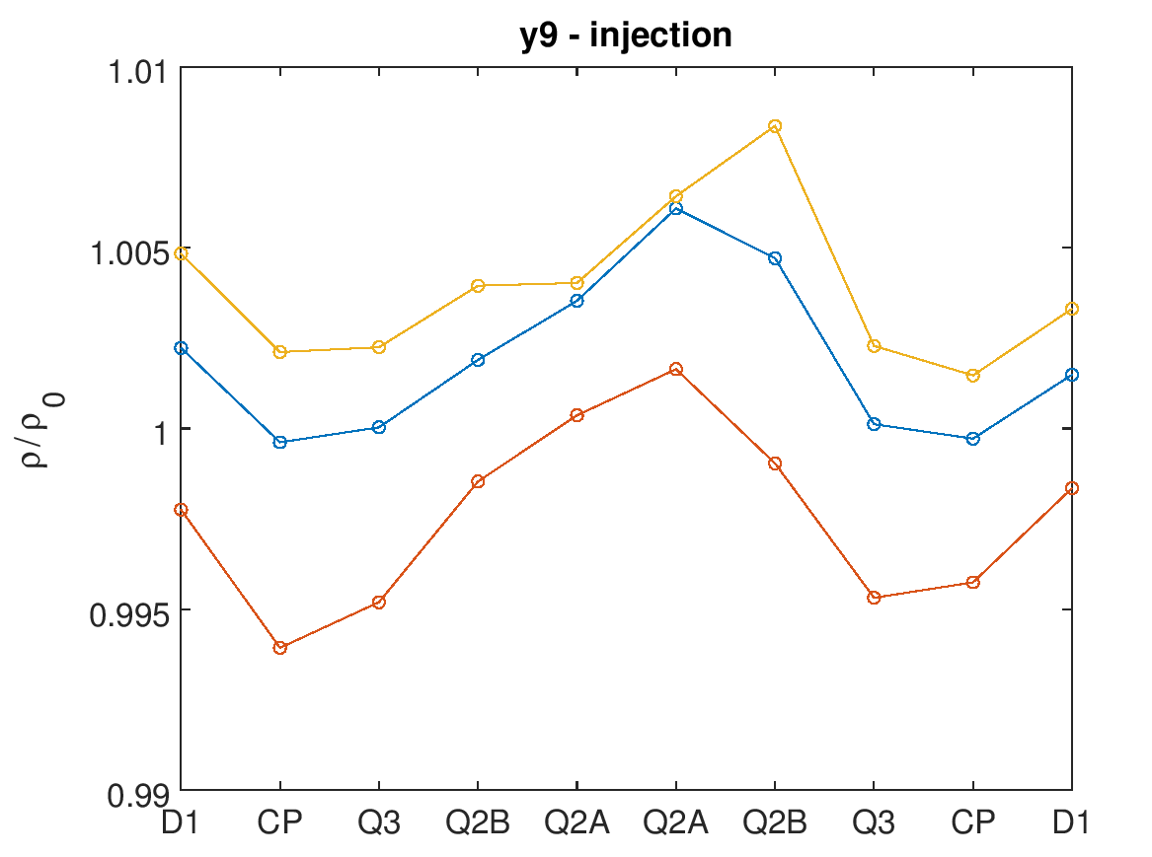
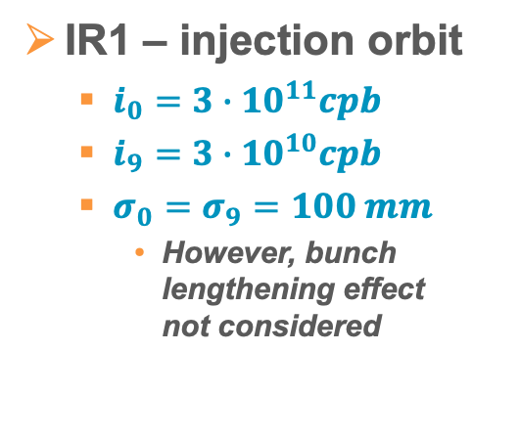
Typical Results – Relative Accuracy Errors
$$\left\langle x_{0}\right\rangle /X_{0}$$
$$\left\langle y_{0}\right\rangle /Y_{0}$$
IR1 – injection orbit
  $i_{0}=3∙{10}^{11}cpb$
  $i_{9}=3∙{10}^{10}cpb$
  $σ_{0}=σ_{9}=100 mm$
    However, bunch lengthening effect
    not considered
7.36 ns
9.72 ns
10.52 ns
9.72 ns
10.52 ns
6.82 ns
3.92 ns
6.82 ns
7.36 ns
7.36 ns
9.72 ns
10.52 ns
9.72 ns
10.52 ns
6.82 ns
3.92 ns
6.82 ns
7.36 ns
$$\left\langle x_{9}\right\rangle /X_{9}$$
$$\left\langle y_{9}\right\rangle /Y_{9}$$
7.36 ns
9.72 ns
10.52 ns
9.72 ns
10.52 ns
7.36 ns
9.72 ns
6.82 ns
3.92 ns
6.82 ns
7.36 ns
10.52 ns
9.72 ns
10.52 ns
6.82 ns
3.92 ns
6.82 ns
7.36 ns

Slide 25
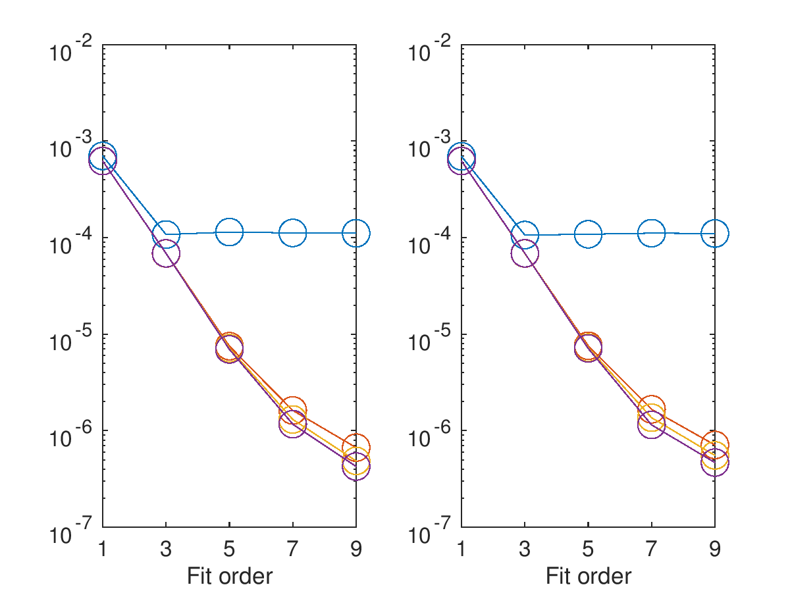
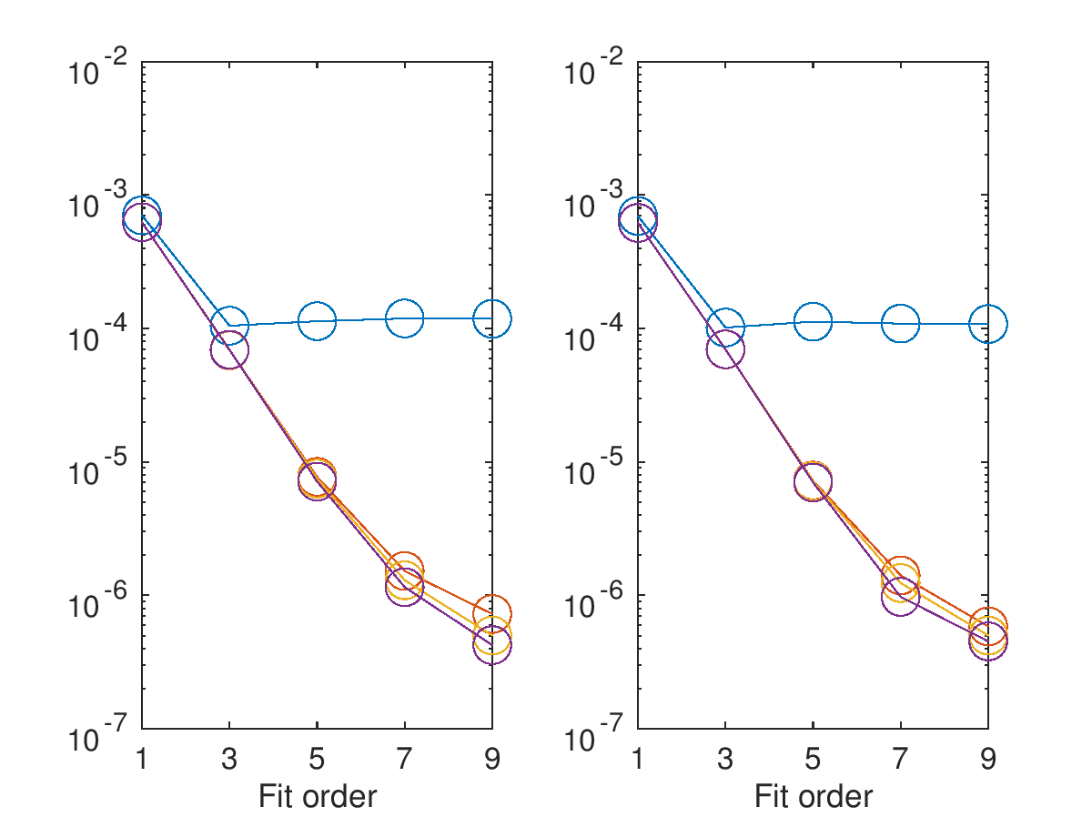
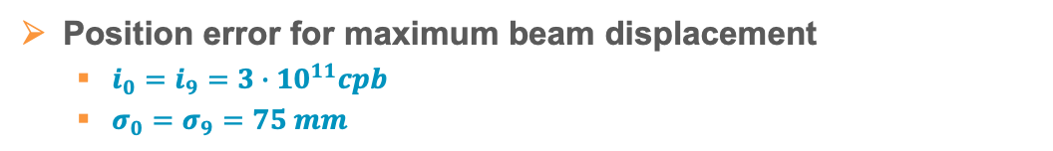






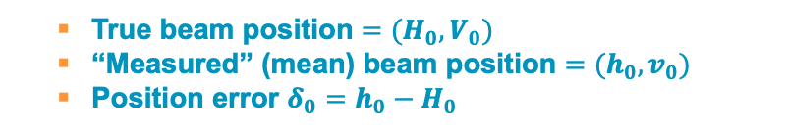
Typical Results – Absolute Position Errors
Compensation
  none
  waveform
  power
  power (alt)
Position error for maximum beam displacement
  $i_{0}=i_{9}=3∙{10}^{11}cpb$
  $σ_{0}=σ_{9}=75 mm$
  True beam position $=(H_{0},V_{0})$
  “Measured” (mean) beam position $=(h_{0},v_{0})$
  Position error $δ_{0}=h_{0}−H_{0}$
$$h_{0}$$
$$v_{0}$$
$$h_{9}$$
$$v_{9}$$
$$δ [m]$$
$$δ [m]$$

Slide 26
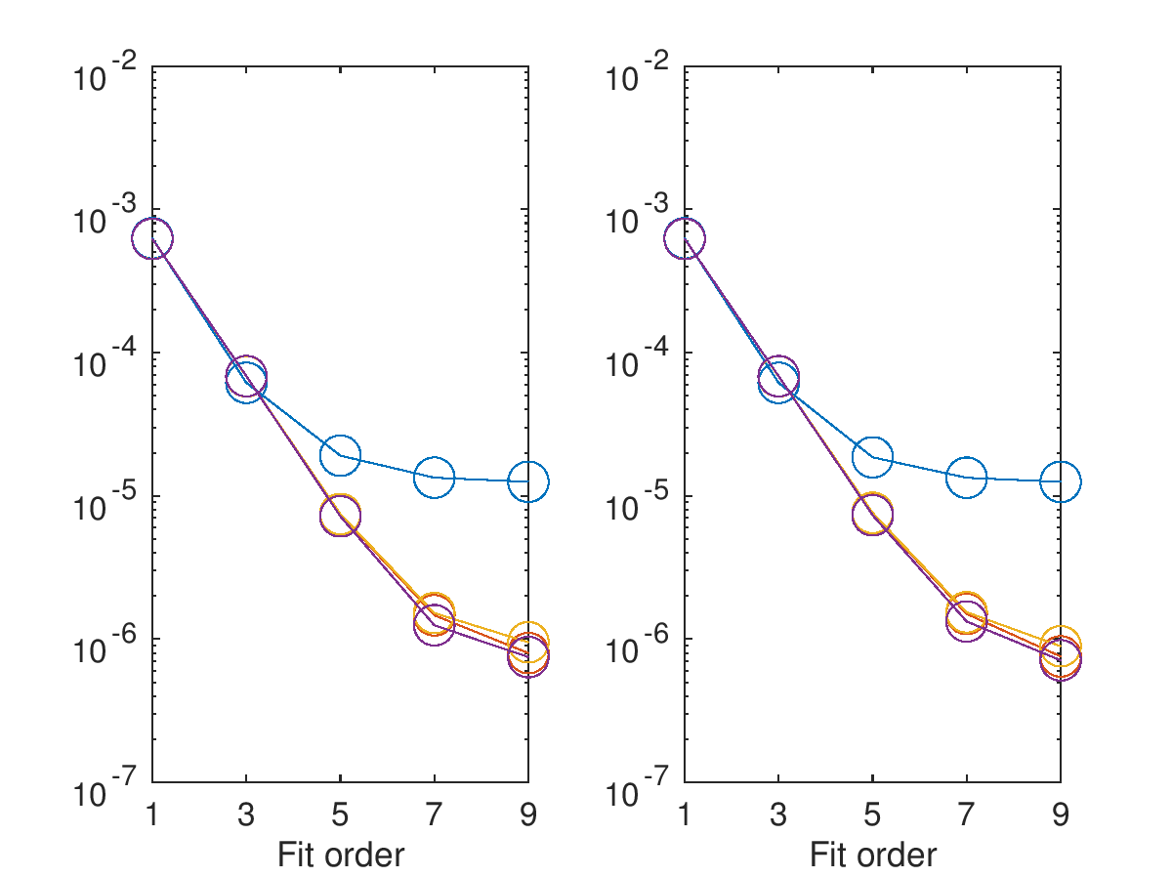
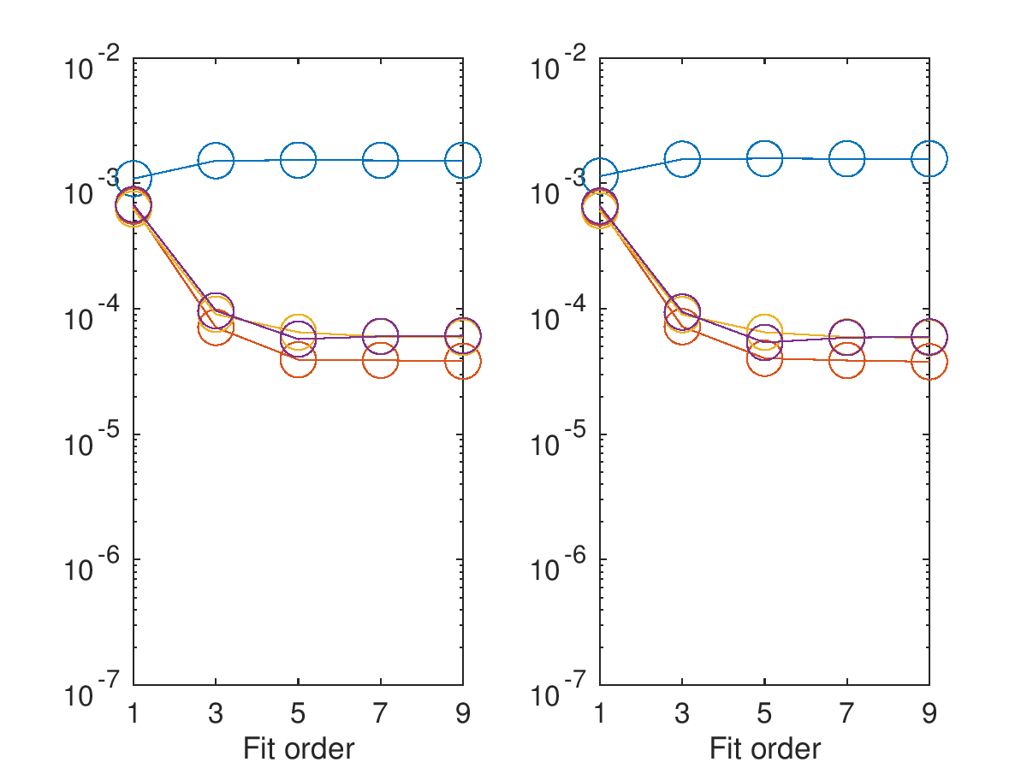
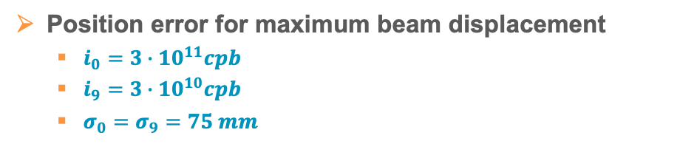
Typical Results – Absolute Position Errors
Position error for maximum beam displacement
  $i_{0}=3∙{10}^{11}cpb$
  $i_{9}=3∙{10}^{10}cpb$
  $σ_{0}=σ_{9}=75 mm$
Compensation
  none
  waveform
  power
  power (alt)
  True beam position $=(H_{0},V_{0})$
  “Measured” (mean) beam position $=(h_{0},v_{0})$
  Position error $δ_{0}=h_{0}−H_{0}$
$$h_{0}$$
$$v_{0}$$
$$h_{9}$$
$$v_{9}$$
$$δ [m]$$
$$δ [m]$$

Slide 27
Summary
Various LHC BPM activities are underway
  Collimator BPMs, interlock BPM CONS, HL-LHC IR BPMs, LHC ring BPM CONS
  An (incomplete) snapshot of the ongoing R&D efforts was presented
Digital signal processing is a key element for any future LHC BPM read-out system
  Reproducibility and performance improvements
  Signal processing schema assumes 25 ns bunch spacing
    Except interlock BPM consolidation can also handle doublet bunches
Expected performance
  Single bunch resolution 10…15 μm, orbit resolution <1 μm
    Sampling in the 1st Nyquist passband, >8.7 ENOB, slow AGC
  IR BPM accuracy:
  ~7 μm for compensation of same intensity counterrotating bunch
  ~70 μm for compensation of 10x lower intensity counterrotating bunch
  (assuming 2D 5th order polynomial for correcting non-linearities)
During run 3…
  Parasitic and dedicated beam studies with prototype hardware
    Xilinx Zynq RFSoC evaluation-board with modified input stage
  Dedicated MD on stripline BPMS.4L5
    Single bunch in B1 and B2 with cogging between them

