Slide 1
Transverse stability margins from non-conformities and/or beam damage
N. Mounet
Acknowledgements: C. Accettura, S. Antipov, N. Biancacci, C. Bracco, F. Carra, A. Kurtulus, A. Lechner, A. Mereghetti, E. Métral, S. Redaelli, B. Salvant, A. Waets.

Slide 2
Transverse stability margins (from impedance)
Motivation:
  Up to now, the impedance of the HL-LHC machine is assumed “ideal”, i.e. without any imperfections.
  The usual “factor of 2” currently applied to instability predictions (made with the DELPHI Vlasov solver) is NOT a margin but part of the full model itself – it represents the discrepancy currently observed between the Vlasov model and measurements.
  ⟹ What is the sensitivity of the stability situation to impedance imperfections or non-conformities?

Slide 3
Transverse stability margins – non-conformities
How to study this:
  The most critical part of the impedance is due to the resistivity of a few collimator materials, in a handful of collimators.
  Most of the remaining impedance is geometric, and comes from a collection of geometric features distributed around the ring (e.g. pumping holes & tapers), rather than single objects.
  ⟹ we chose to study the impact of unforeseen changes of collimator materials resistivity, rather than that of geometric non-conformities which would typically be less dramatic if a single object is affected.
  ⟹ such resistivity modifications could actually occur because of irradiation or beam damage.
DISCLAIMER: this is a very VERY preliminary study.

Slide 4
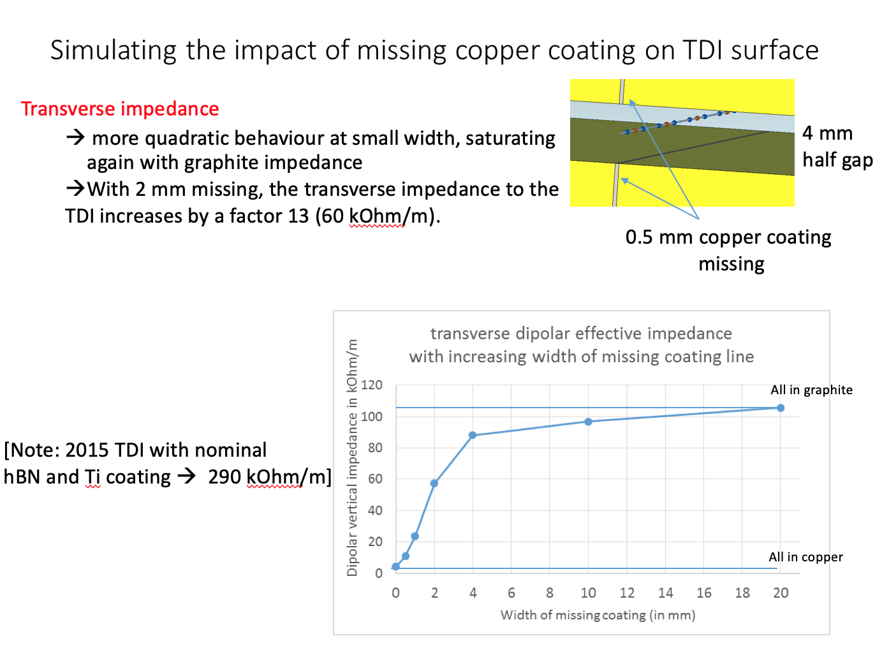
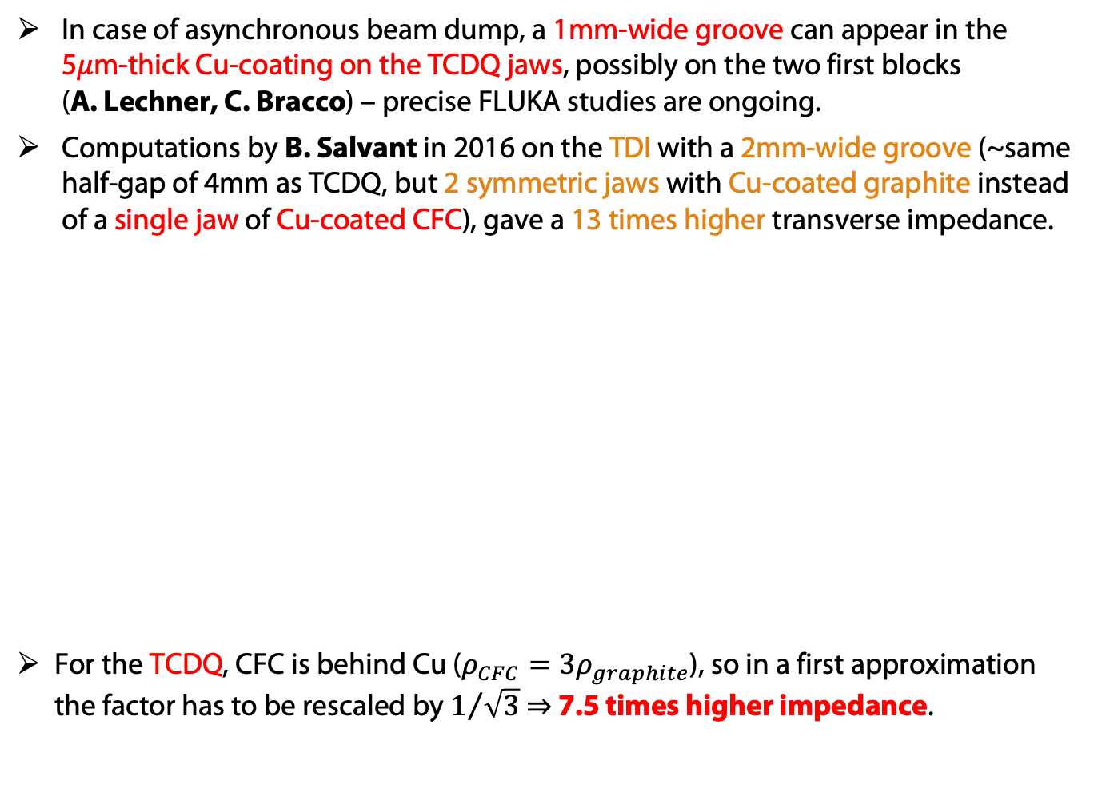
First scenario – TCDQ grazing
In case of asynchronous beam dump, a 1mm-wide groove can appear in the 5𝜇m-thick Cu-coating on the TCDQ jaws, possibly on the two first blocks (A. Lechner, C. Bracco) – precise FLUKA studies are ongoing.
Computations by B. Salvant in 2016 on the TDI with a 2mm-wide groove (~same half-gap of 4mm as TCDQ, but 2 symmetric jaws with Cu-coated graphite instead of a single jaw of Cu-coated CFC), gave a 13 times higher transverse impedance.
For the TCDQ, CFC is behind Cu ($ρ_{CFC}=3ρ_{graphite}$), so in a first approximation the factor has to be rescaled by $1/{\sqrt{3}}$ ⇒ 7.5 times higher impedance.
B. Salvant, TDI coating,
HSC meeting 04/04/2016

Slide 5
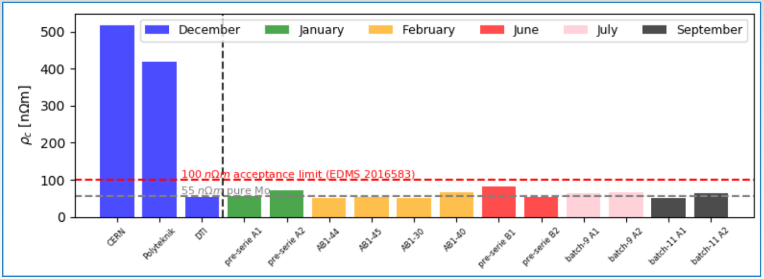

Second scenario: Mo coating resistivity
According to the current specification (EMDS n° 2016583), Mo coating should have a smaller resistivity than 100 n𝛺m.
In current measurements (and model): ~half this value: $ρ_{Mo}≈54 nΩ$.
⟹ But what if we really have $ρ_{Mo}=100 nΩm$?
⟹ This is also an interesting scenario to study in case of degradation of the resistivity through irradiation along the run (see next slides).
S. Antipov et al,
WP2 #161, 29/10/2019

Slide 6
Third scenario: fall back to CFC collimator
We can imagine that we have to put back an old CFC collimator instead of an upgraded (Mo-coated Mo-graphite) one.
⟹ Let’s imagine we are not lucky and this happens for the worst (upgraded) TCSG collimator, namely the TCSG.D4L7 (here for B1).

Slide 7
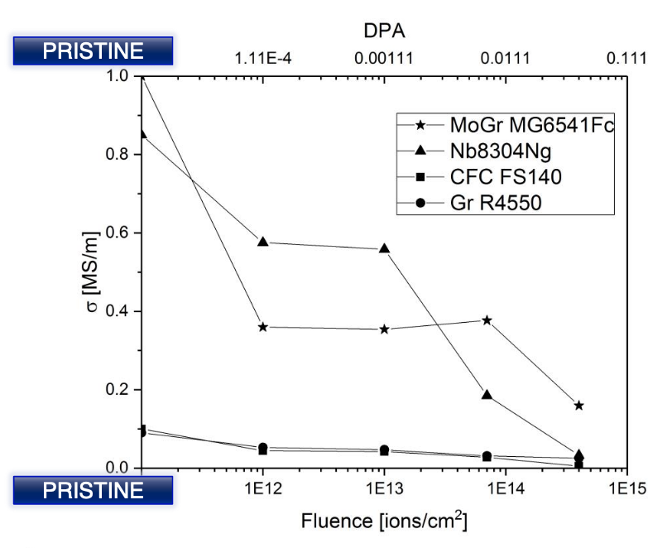
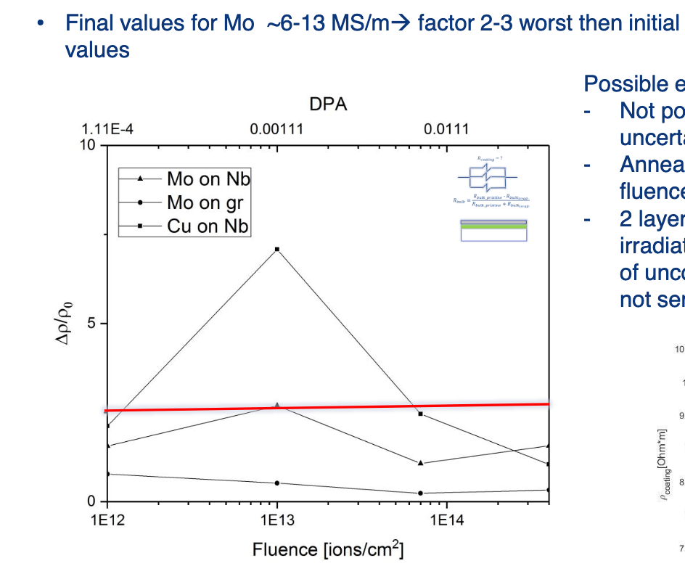
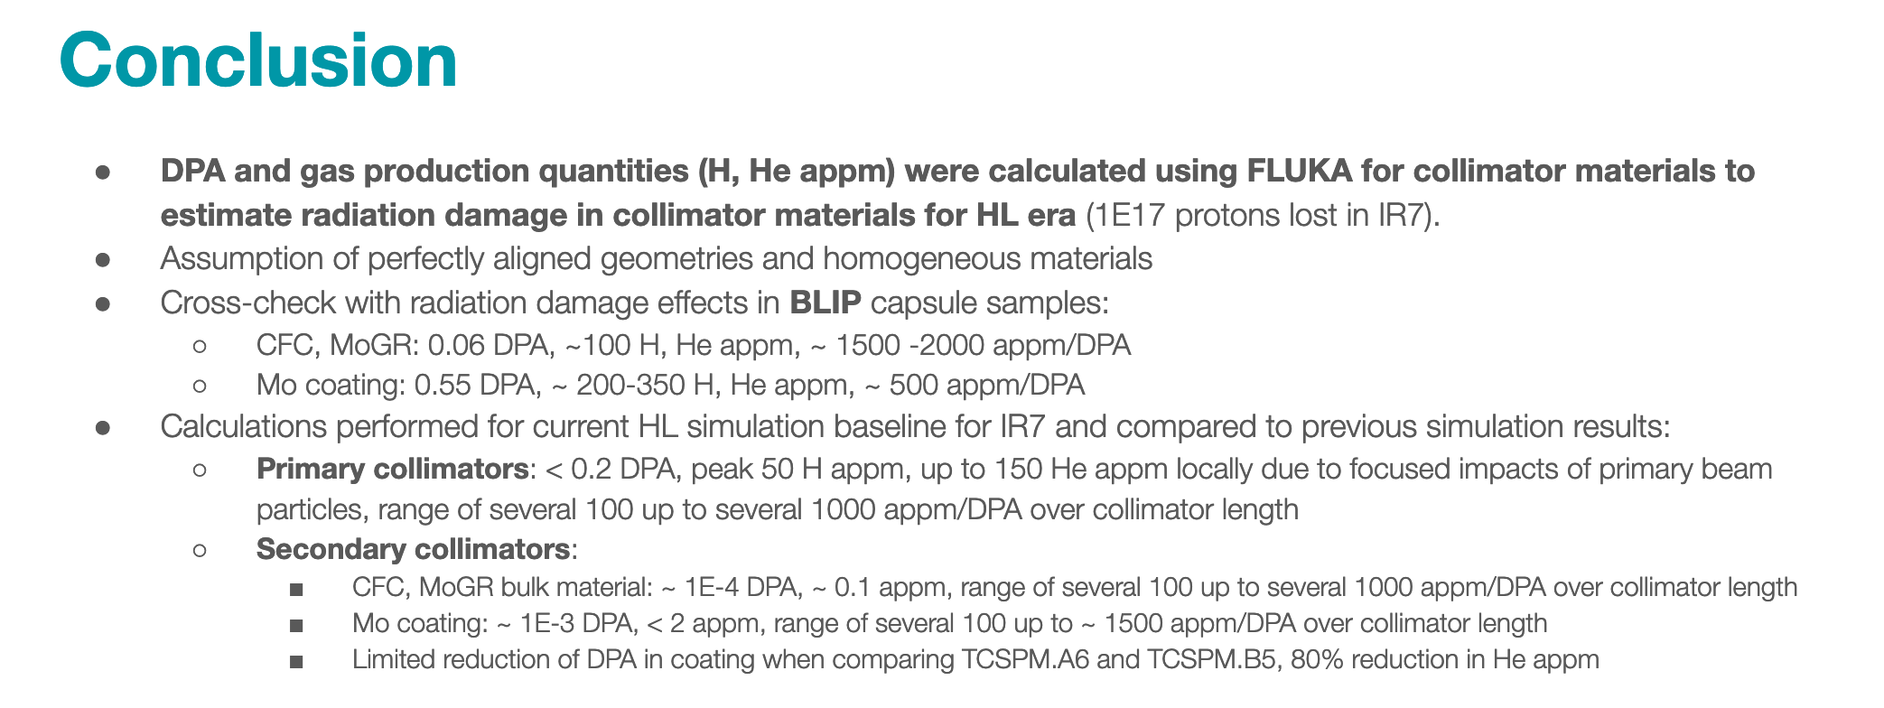
More scenarios : effect of irradiation
Resistivity of collimator might be affected by irradiation:
C. Accettura, ColUSM #119, 13/09/2019
See also summary talk by N. Biancacci, WP2 #173, 21/04/2020
A. Waets et al, ColUSM #123, 31/01/2020

Slide 8
More scenarios : effect of irradiation
Resistivity of collimator might be affected by irradiation:
C. Accettura, ColUSM #119, 13/09/2019
See also summary talk by N. Biancacci, WP2 #173, 21/04/2020:
A. Waets et al, ColUSM #123, 31/01/2020

Slide 9
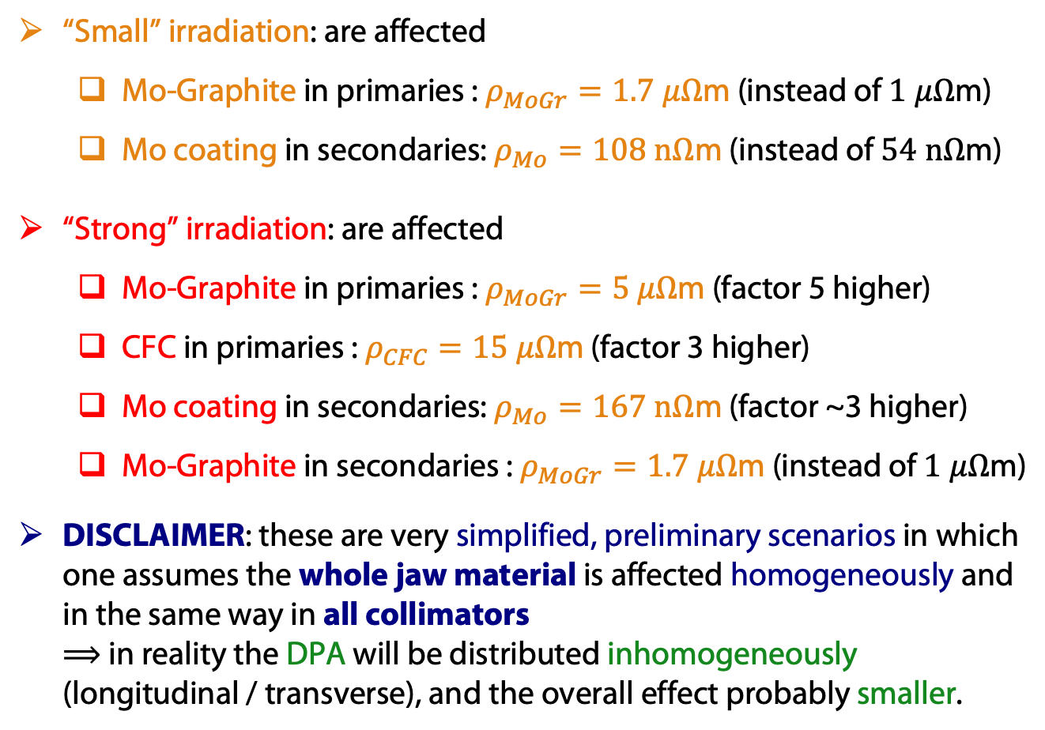
More scenarios: effects of irradiation
“Small” irradiation: are affected
  Mo-Graphite in primaries : $ρ_{MoGr}=1.7 μΩ$m (instead of $1 μΩ$m)
  Mo coating in secondaries: $ρ_{Mo}=108 nΩ$m (instead of $54 nΩ$m)
“Strong” irradiation: are affected
  Mo-Graphite in primaries : $ρ_{MoGr}=5 μΩ$m (factor 5 higher)
  CFC in primaries : $ρ_{CFC}=15 μΩ$m (factor 3 higher)
  Mo coating in secondaries: $ρ_{Mo}=167 nΩ$m (factor ~3 higher)
  Mo-Graphite in secondaries : $ρ_{MoGr}=1.7 μΩ$m (instead of $1 μΩ$m)
DISCLAIMER: these are very simplified, preliminary scenarios in which one assumes the whole jaw material is affected homogeneously and in the same way in all collimators
⟹ in reality the DPA will be distributed inhomogeneously (longitudinal / transverse), and the overall effect probably smaller.

Slide 10
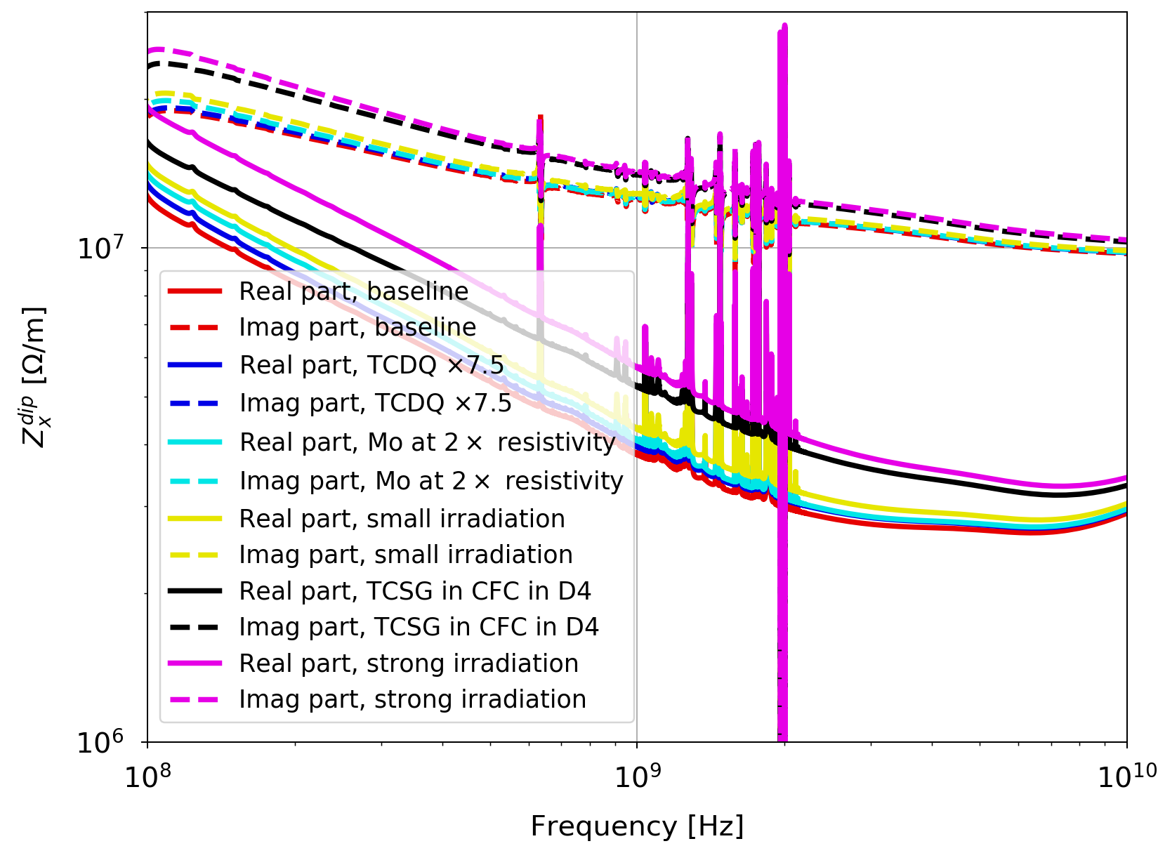
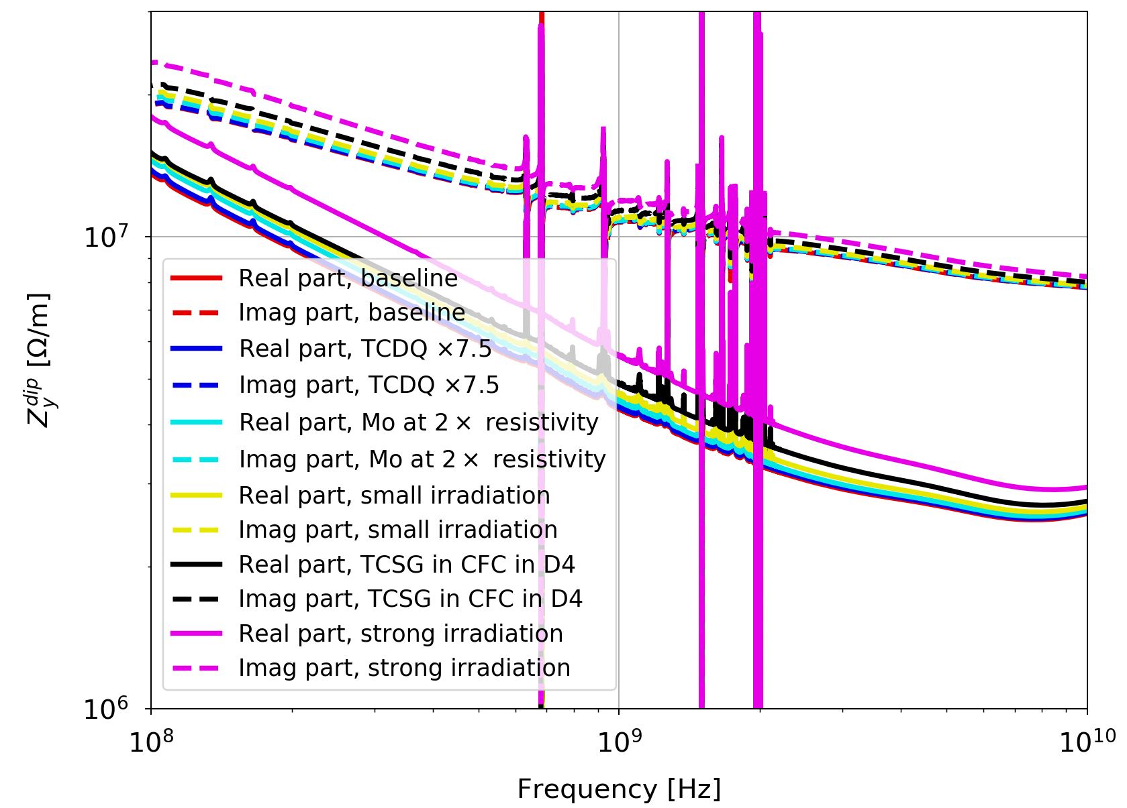
Impact on transverse impedance
Impedance vs. frequency (zoomed around the main freq. of interest):
Horizontal
Vertical
⟹ Clear impact on impedance of the most pessimistic scenarios: strong irradiation and fall back to CFC for TCSG in D4.
⟹ Much less impact for the others scenarios.

Slide 11
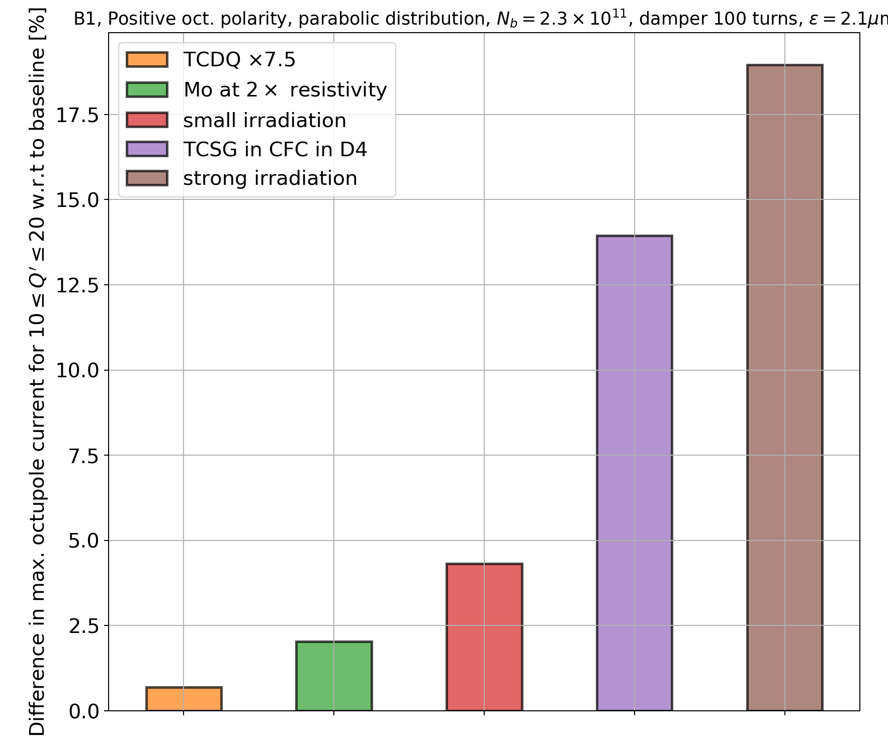
Impact on single-beam stability
Relative difference in octupole threshold (with positive polarity) with HL-LHC parameters:
25 ns beam
N_{b}=2.3e11 p+/b
𝜀=2.1 𝜇m
ADT gain: 100 turns
bunch length (4xRMS)=1.2 ns
Distribution cut at 3.2𝜎
⟹ No more than 20% impact on octupole current.
⟹ TCDQ grazing has a negligible impact.
⟹ Mo resistivity at spec. or small irradiation have an impact at the level of a few percents.

Slide 12
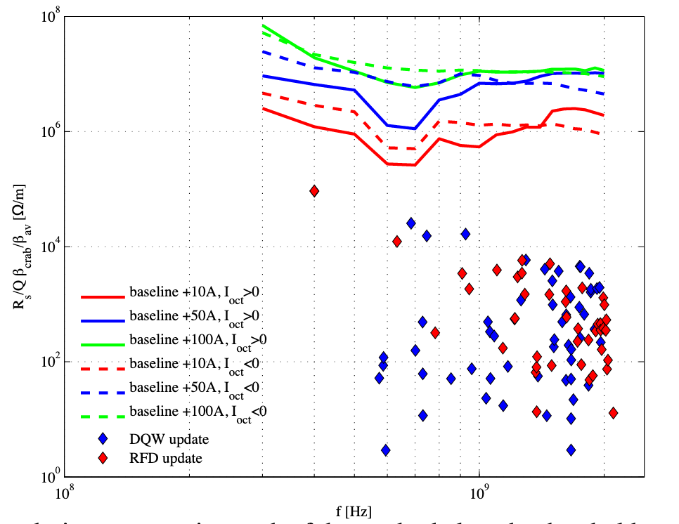
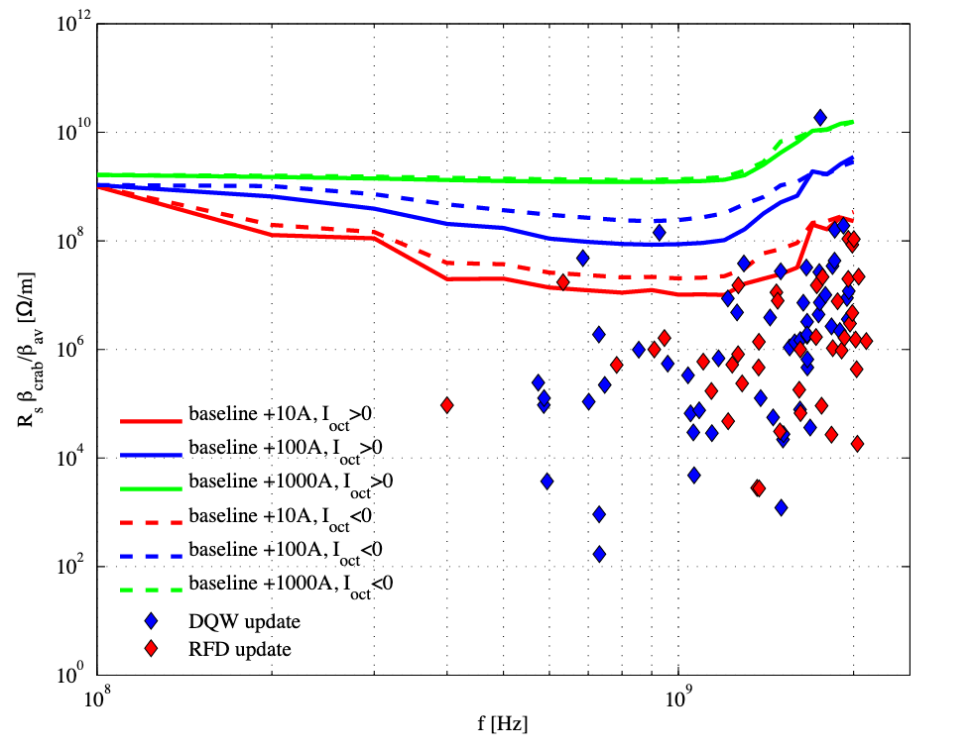
Other examples of non-conformity - HOM
Unforeseen high order mode(s) in e.g. a cavity or collimator, whatever the reason, is a potential source of impedance, hence instability.
Analysis (in the case of crab cavities) by N. Biancacci : limit in terms of shunt impedance, vs. frequency of the mode, to get a given, additional amount of octupole current needed to stabilize the beam:
Multibunch
Single-bunch
N. Biancacci et al,
WP2 #56, 02/10/2015

Slide 13
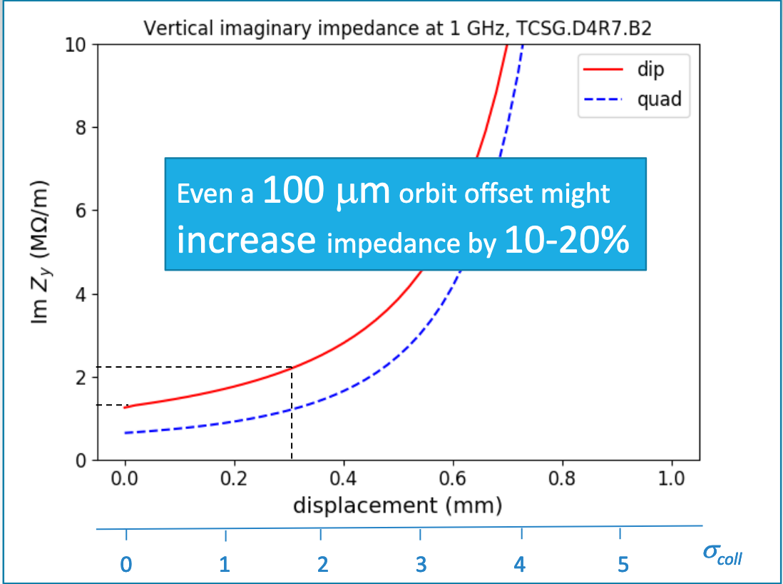
Example of non-conformity - misalignment
Unforeseen collimator misalignment, is a potential source of increased impedance, hence instabilities
⟹ to be further investigated by simulations, and an MD during Run 3.
S. Antipov et al,
WP2 #161, 29/10/2019

Slide 14
Conclusions
A number of non-conformity scenarios, in terms of materials resistivity, were preliminary investigated.
Several are found to be marginally affecting the stability situation:
  TCDQ grazing due to asynchronous dump,
  a small irradiation of Mo coating and Mo-graphite of primaries,
  Mo-coating at twice the currently measured resistivity (as in spec.).
More pessimistic scenarios are instead affecting stability (in terms of oct. currents) by up to ~15-20%:
  fall back to an non-upgraded CFC collimator (TCSG.D4),
  a strong irradiation in primaries and also secondaries.
Other examples of non-conformities:
  high order modes (studied by N. Biancacci et al, for crab cavities),
  collimator misalignments (to be further studied).

