Slide 1

Offsets at collimators and radiation considerations during the measurements of tune shifts in 2018
C. Accettura, A. Mereghetti, S. Redaelli, A. Waets
With contributions from A. Bertarelli, F. Carra, A. Lechner, M. Tomut
176th WP2 Meeting – CERN (CH) – 2nd June 2020

Slide 2
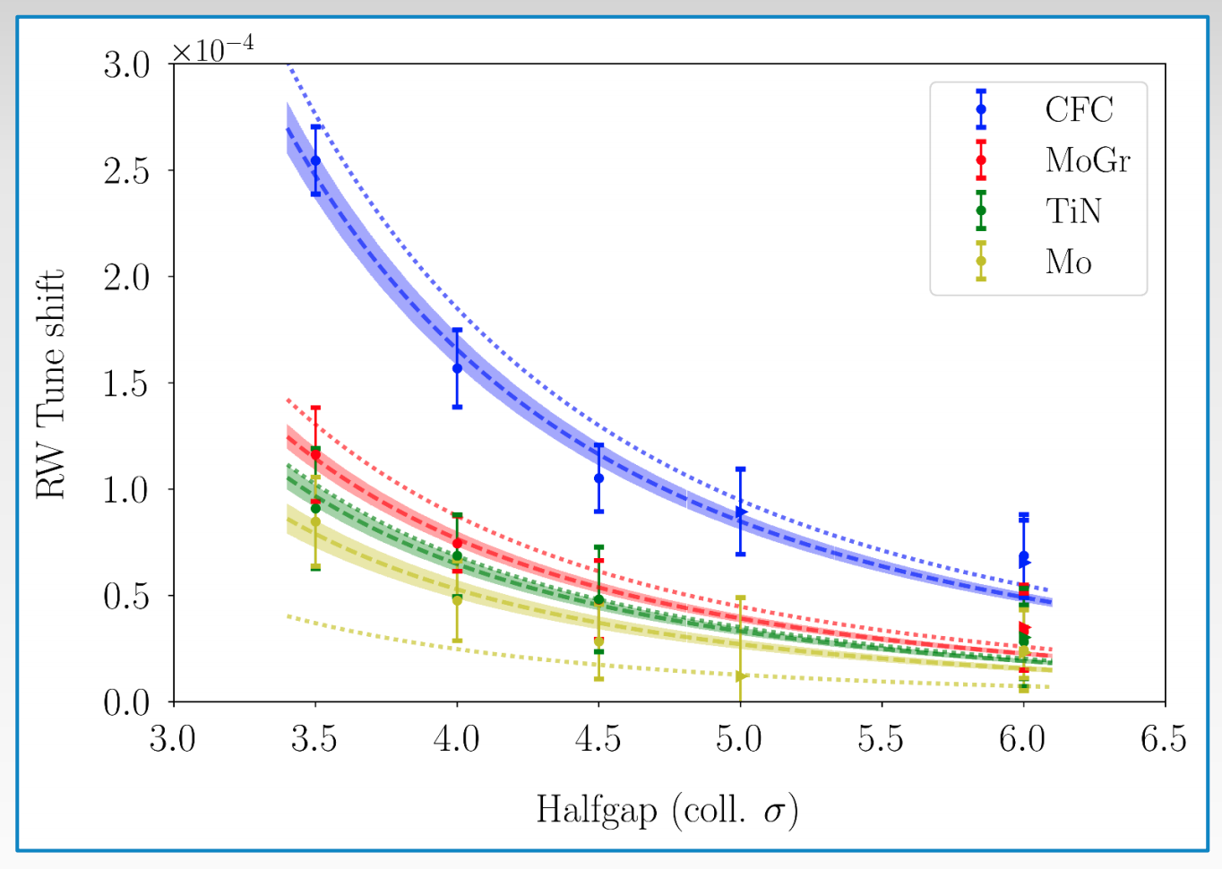
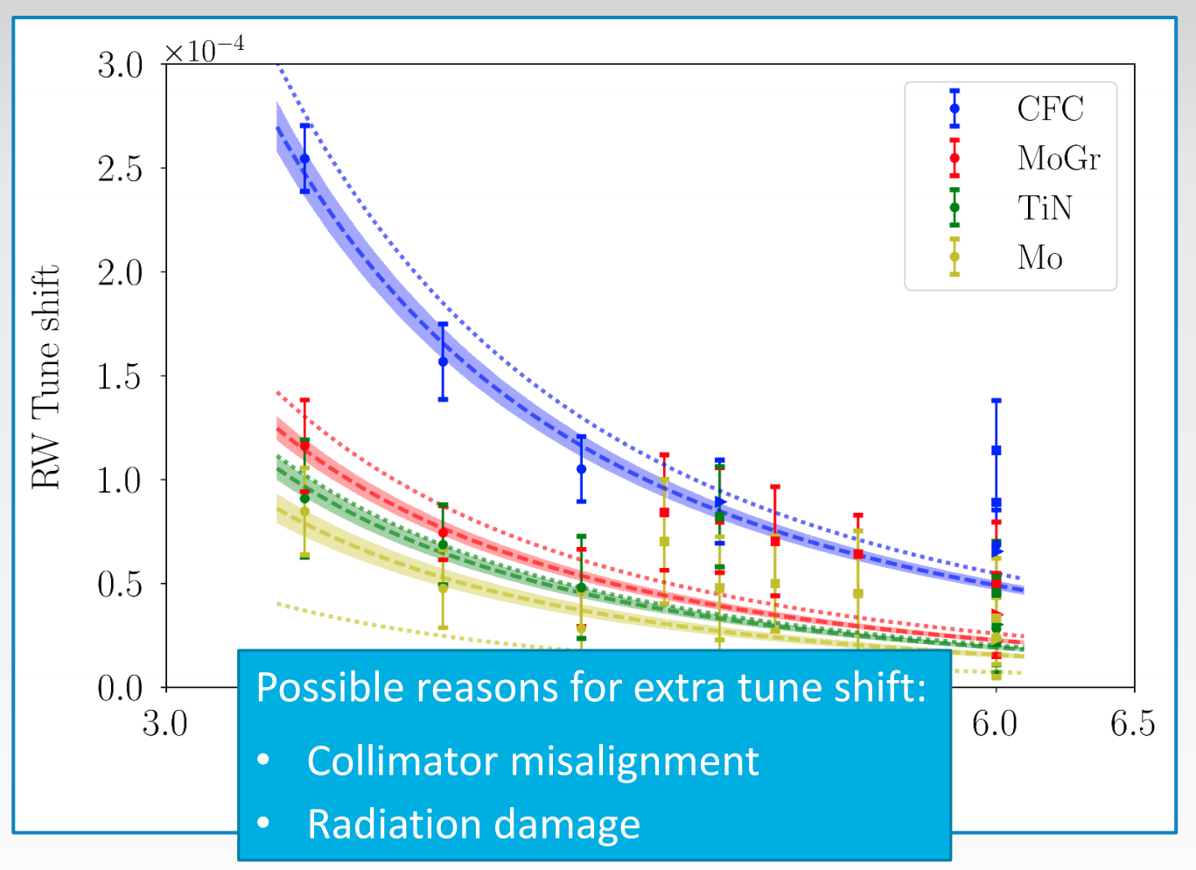
Introduction
S. Antipov, 161st WP2 WG Meeting
Relevant discrepancies in the impedance measurements, in particular those performed with TCSPM.D4R7.B2 (three-stripes HL-LHC prototype) and the companion TCSG.D4R7.B2 in 2018 wrt 2017:
  2017: reasonable agreement between measurements and simulations for all materials but Mo-stripe;
    Importance of microstructure of substrate surface and coating;
  2018: measurements show significantly larger tune shifts than those predicted by simulations;
    Possible effect of non-optimal alignment of measured collimators;
Nota bene:
  2017: TCSPM used only in MD → at parking position during data taking;
  2018: TCSPM deployed for data taking as a regular IR7 TCSG;

Slide 3
Summary of Measurement Sessions
2017: performed in 2 MD slots, dedicated to TCSPM + companion TCSG measurements:
  2017-06-30-2017-07-01: impedance measurements with LHC Nominal(-ish) bunches;
    TCSG: BLM-based alignment;
    TCSPM: BPM-based and BLM-based alignments, though procedures not really by the book;
    Very stable beam closed orbit at these collimators throughout MD activity;
  2017-09-17-2017-09-18: impedance measurements with HL-LHC(-ish) bunches;
    TCSG: NOT aligned;
    TCSPM: BPM-based alignment, though procedure not fully by the book;
    Stable beam closed orbit at these collimators throughout MD activity;
2018: performed in 1 MD slot measurements of 18 collimators (TCTs/TCSGs/TCPs) + 3-stripes TCSPM prototype:
  2018-10-27: impedance measurements with LHC Nominal(-ish) bunches;
    Alignment NOT performed on all collimators;
    Beam orbit slowly degrading throughout MD activity;

Slide 4
Estimated Collimator Misalignments
Estimated misalignments (beam pos/angle) | July 2017 | September 2017 | October 2018
TCSPM (BPMs, 5th axis at 0 mm) | Aligned: +150 μm, -100 μrad (downwards) | Aligned: -50 μm, 10 μrad (upwards) | NOT aligned: +150 μm, -100 μrad (downwards)
TCSG | Aligned (nominal accuracy: ~50 μm) | NOT aligned | NOT aligned
More info: A. Mereghetti, ColUSM, 29 May 2020
Not sure that misalignment can explain the change observed in measurements when compared to numerical predictions:
  2017: the two sets of measurements seem to be consistent even though quite different quality of alignment;
  2018 vs 2017: on TCSPM, similar misalignment figures;

Slide 5
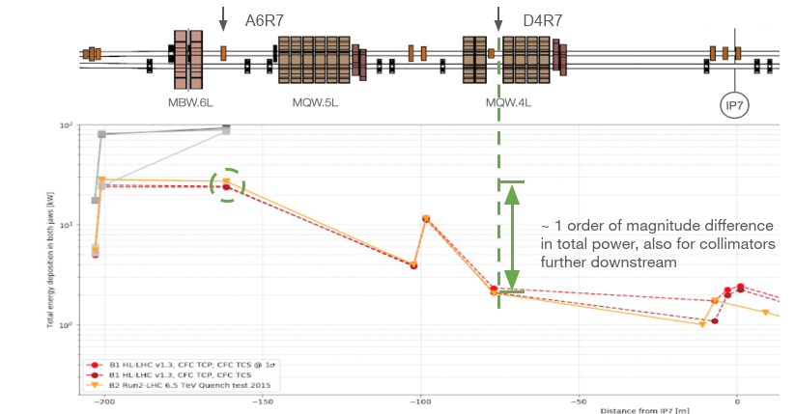
Estimation of Cumulated Dose on Collimators
DPA scaling process:
Peak DPA value simulated for CFC TSCG secondary collimator in slot A6R7 for HL-LHC optics (1E17protons lost ):1.5e-4
Scaling by proton losses
A6R7
○ All of Run 2 (7.1E15 protons lost): 1.1E-5
○ 2018 (w/ TCSPM prototype in slot D4R7.B2), ( 4.5E15 protons lost): 6.75E-6
D4R7
Scaling by total power
○ All of Run 2: ~ 1E-6
○ 2018: ~ 5E-7
More info: C. Accettura, ColUSM, 29 May 2020

Slide 6
Estimated Cumulated Dose on Collimators
Dose estimated with Fluka simulations on slot A6R7 for HL-LHC simulations, scaled down to:
  Total integrated losses in all of Run 2 and 2018 only;
  D4R7 slot;
Expected dose on TCSPM two orders of magnitude lower than first measured point;
Not sure that dose alone can explain the change observed in measurements when compared to numerical predictions;
More info: C. Accettura, ColUSM, 29 May 2020

Slide 7
Thanks a lot!

