Slide 2
PicoTDCv2:
Pico-second TDC for HEP
Moritz Horstmann, Jorgen Christiansen, Samuele Altruda,
Gill Lumer-Klabbers, Jeffrey Prinzie (KU Leuven)
CERN/EP-ESE

Slide 3
PicoTDC architecture
25/05/2020
Samuele Altruda
3

Slide 4
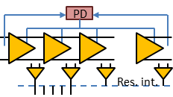
PicoTDC Architecture
Pulse generator
Pulse out
40MHz
Ext ref.
PLL
40MHz
Trigger
interface
Trigger,
Resets
80MHz
160MHz
320MHz
1.28GHz …
40MHz
Trigger
buffer: 512
Control,
Programming,
Monitoring
1.28GHz
Trigger
buffer: 512
Trigger
buffer: 512
Counters
Trigger
buffer: 512
I²C
320MHz
x16
TDC channel
Readout
buffer: 512
8 bit
40,80,160,320M
x8
Ch 0
D
Hit register
D
Hit register
D
Interpolation decoder
D
Hit register
Buffer: 512
Trigger matching
Interpolation decoder
Hit register
Interpolation decoder
Interpolation decoder
x16
x16
Readout
1/4 Ports
Data rate
320Mbps
-10Gbps
(5MHit/s
per channel)
Hits
x64
Leading
Trailing
TOT
D
Hit register
D
Hit register
x8
D
Interpolation decoder
D
Hit register
Interpolation decoder
Hit register
Interpolation decoder
Interpolation decoder
x16
x8
D
Hit register
D
Hit register
D
Interpolation decoder
D
Hit register
Interpolation decoder
Hit register
Interpolation decoder
Interpolation decoder
x16
8 bit
40,80,160,320M
x8
D
Hit register
TDC channel
Readout
buffer: 512
D
Hit register
D
Interpolation decoder
D
Hit register
Interpolation decoder
Hit register
Interpolation decoder
Buffer: 512
Trigger matching
Interpolation decoder
Sync
x16
64 channels, 3ps or 12ps time binning, 200us dynamic range
25/05/2020
Samuele Altruda
4
Notes:
64 inputs in 4 groups
1.28Ghz main frequency for running the delay locked loop 781ps, max frequency of hit acceptance.
Each channel has hit registers and interpolation logic decoder to store timing value.
Each channel can store 4 measurement, in a FIFO buffer derandomizer for going to a frequency of 320MHz. Second part driven at 320Mhz, ¼ data rate, buffering needed, 512 word(32 bit) buffer also as trigger delay buffer.
Can keep 16x512+512 measurement per channel group = 8704 per channel group
Bottleneck in readout buffer, 1hit/25ns using 1 channel at 320Mhz, 4 clock cycle for 1 measurement
Bandwidth:
Min 320Mbits/s (8bits/25ns(40MHz) = 1 bits/3.125ns = 320Mbits/s)( ~0.15 Mhits/s per channel) (320MBits/32 bits/64ch)
Max 10Gbits/s (8bits/3.125ns(320MHz) = 1 bits/0.39ns = 256Mbits/s*4channel(max)= 10Gbits)( ( ~4 Mhits/s per channel) (10GBits/32 bits/64ch)
Trigger interface, 4 buffer , 1 buffer per channel for triggering.
I2C configuration interface
4

Slide 5
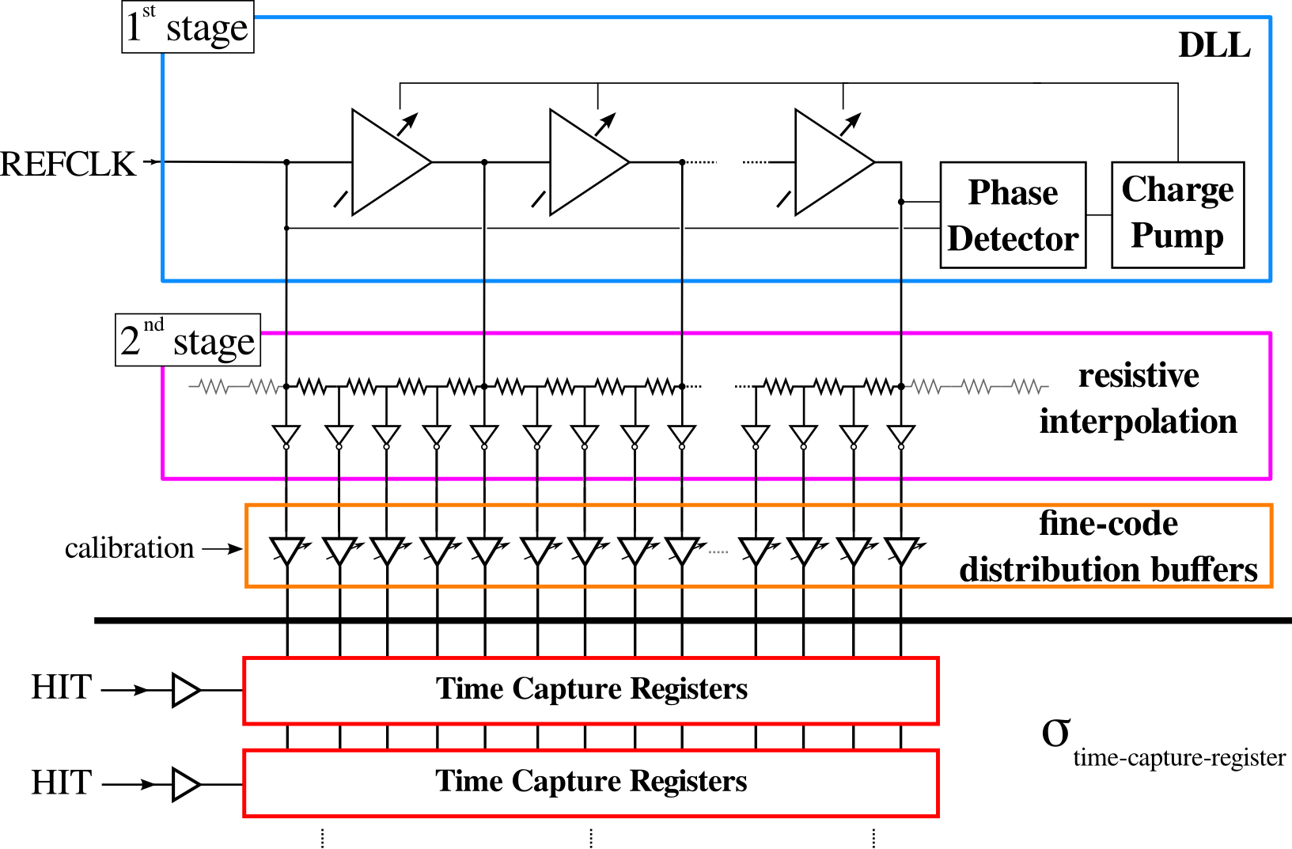
Two Stage Time Interpolation
12.2ps delay
(Coarse time)
1.28GHz
3.05ps delay
(Fine time)
Phase
Adjustment
32 steps each with
0.6ps resolution
25/05/2020
Samuele Altruda
5
Notes:
Unexpected mismatch between flipflops, which leads to leading trailing misdetection, problem in fine time mode acquisition.
Mismatch also between channels, visible in top part acquisition, causing some issues at the moment.
5

Slide 6
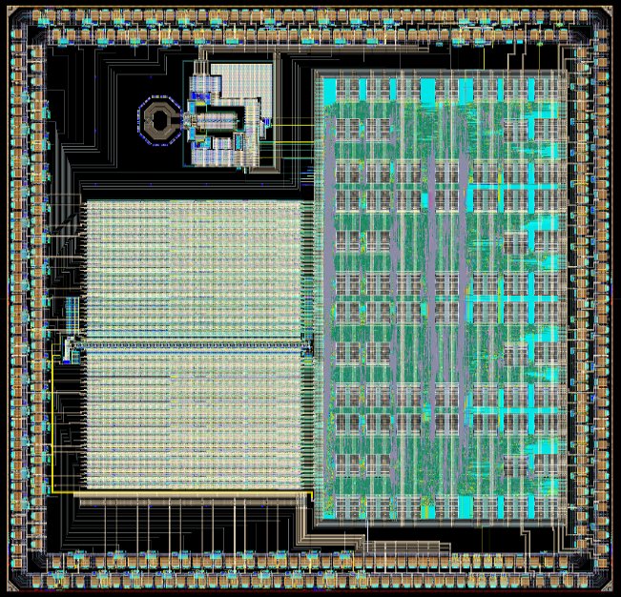
PLL
Top hit receivers
Logic
DLL
Bottom hit receivers
25/05/2020
Samuele Altruda
6
Notes:
One DLL line, top bottom part with different fine adjustment buffers
6

Slide 7
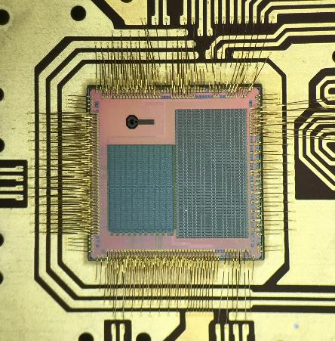
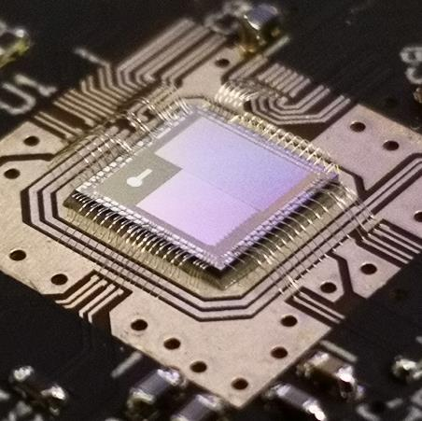
PicoTDC on Test Card first version
25/05/2020
Samuele Altruda
7

Slide 8
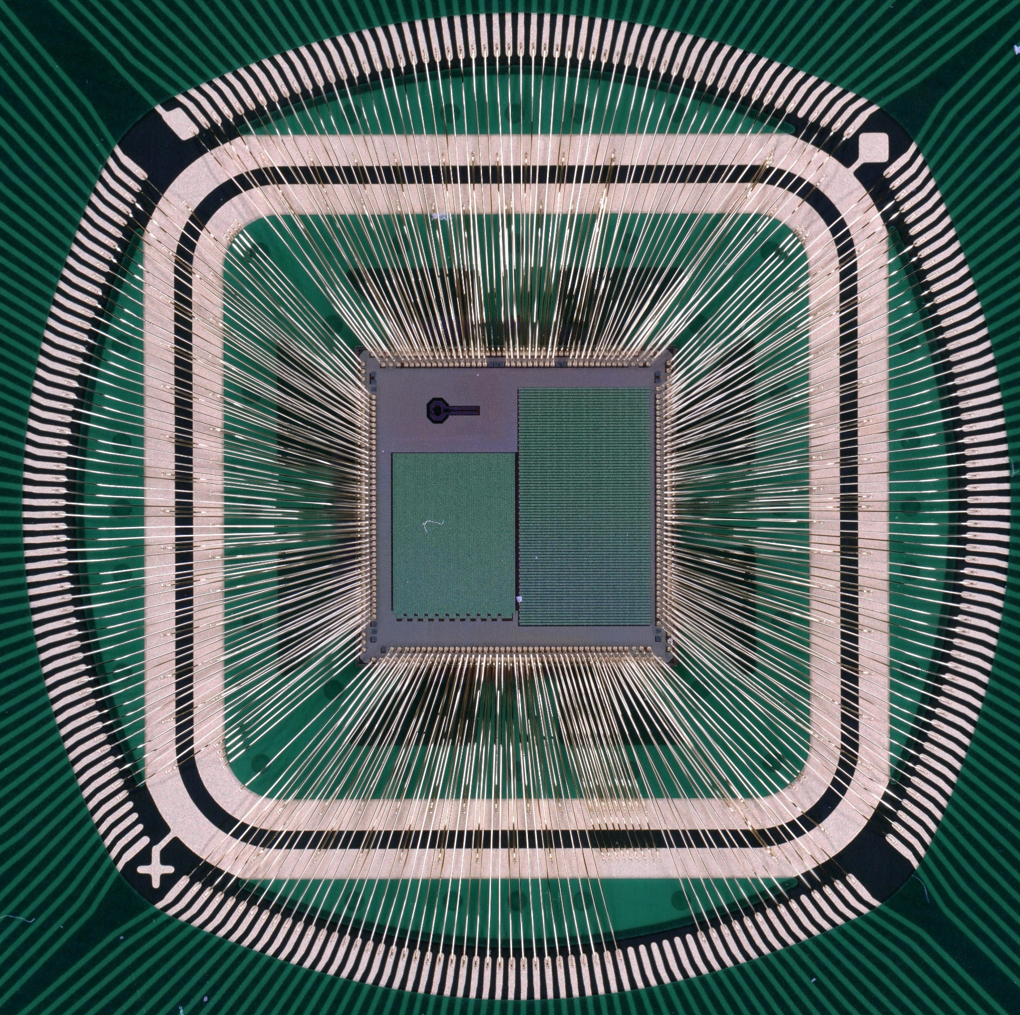
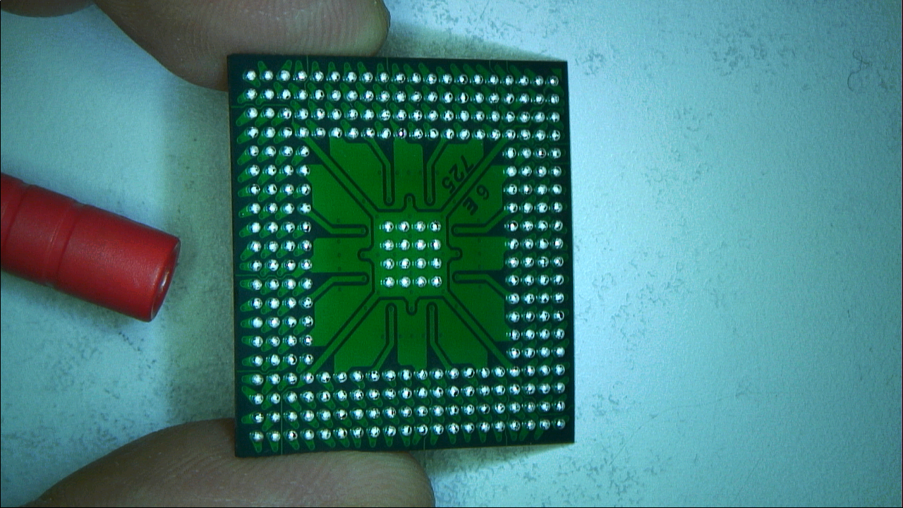
PicoTDC on Generic Package
25/05/2020
Samuele Altruda
8

Slide 9
PicoTDC testing system
25/05/2020
Samuele Altruda
9

Slide 10
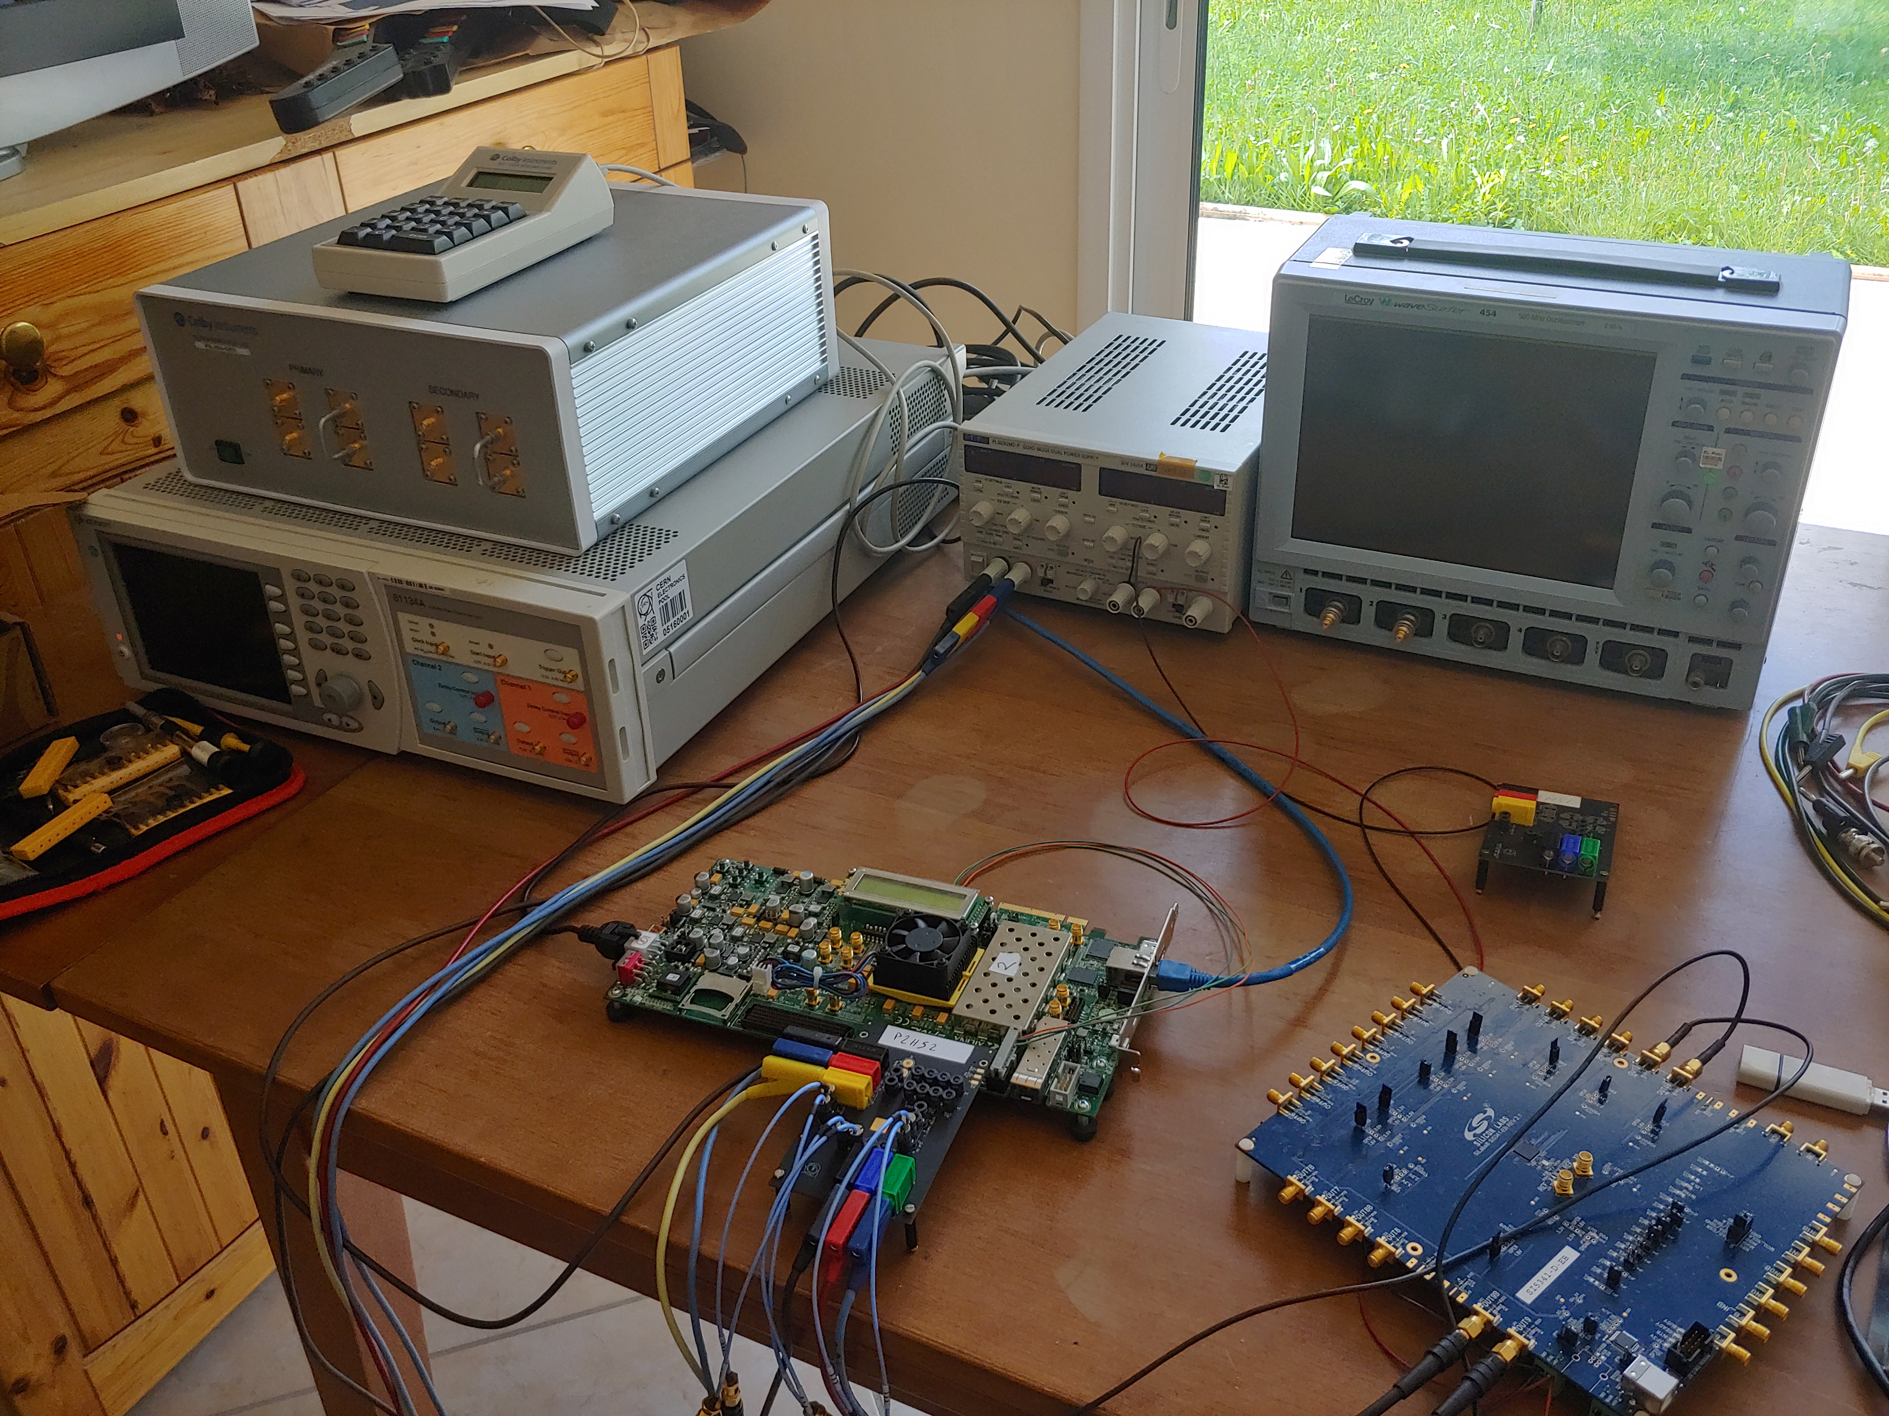
Instrumentation for testing
Trombone
oscilloscope
Power supply
Keysight Pulse generator
FPGA Board VC707
Silicon Lab clock generator
PicoTDC carrier board
Adapter cable to SMA:
Samtec RF25S-01BJ1-SCC21-0200
(Supplied by SAMTECH directly)
Samtec CCH-J-02 (2 Pin)
Samtec CCH-J-04 (4 Pin)
Female connector​
(Supplied by SAMTECH directly)
07/05/2020
Samuele Altruda
10
Notes:
Mention different instruments and purpose of its use
10

Slide 11
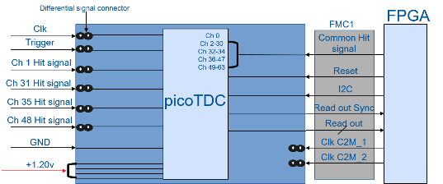
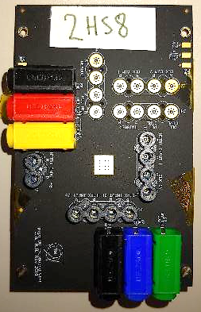
PCB mezzanine test board
Differential signal connection through SAMTEC connector
25/05/2020
Samuele Altruda
11
Notes:
Present briefly what we have
11

Slide 12
FPGA Board (VC707 Xilinx commercial board)
picoTDC
Pulse generator
Common Hit signal
SMA input
Buffer
PicoTDC I2C
IPBUS
Firmware
Writing FIFO
SDA / SCL
1 Gbit Ethernet
Reading FIFO
Sync
FIFO
Readout
TDC data
FPGA firmware
Trigger
Reset
40 Mhz clock
Trigger
SMA input
Timing
Sequencer
Hit
ODelay
25/05/2020
Samuele Altruda
12
Notes:
IPBUS communication to computer through Ethernet.
Readout interface with FIFO to IPBUS block.
Trigger tester with fine delay generator inside FPGA.
I2C communication for picotdc c
Configuration register programming.
12

Slide 13
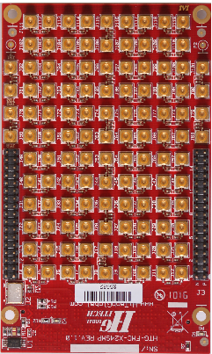
New Mezzanine Card
FMC1
DIF HPC + DIF LPC
Trigger
ADAPTOR CARD WITH SMAs CONNECTORS
Picotdc pulse generator
EID Reset
BX Reset
PLL HF
Reset
Differential signal connection through SMA
Ch 0 -63
64DIF + 6 DIF
PLL CTRL
I2C expander
I2C
VCC3V3 VCC1V2 3A
DLL CTRL
FMC2
picoTDC
Read out 4
8DIF
Read out 3
Read out 2
8DIF
24 DIF HPC
8DIF
Reset
8DIF
Mux
I2C
1DIF
Mux
BX Reset
2 SIG
EID Reset
1DIF
Mux
Read out Sync
1DIF
Read out 1
1DIF
17 DIF LPC
FPGA
Clk C2M_1
8DIF
Clk C2M_2
1DIF
(1 USER CLK)
Mux
Trigger
1DIF
40 Mhz Clk
1DIF
(USER CLK)
40 Mhz Clk
3.3V I2C level
I2C Board
2 SIG
Power module
VCC3V3 VCC1V2 3A
GND
I2C expander
+1.20v
GND
25/05/2020
Samuele Altruda
13

Slide 14
New Mezzanine Card
All SMA connectors (NO Samtec CCH-J-02 , or Samtec CCH-J-04)
Power lines available on FMC1 directly from FMC2
Future version with final package will include some connections between FMC1 and FMC2, a bridge between the FPGA and the Adaptor card. Currently users can have some generic output pin availability from XADC Header or FMC2 from the VC707 evaluation board.
Availability:
  With chip in generic package: ~June
  With chip in final package: ~ autumn (depending on when final package available)
Share point link for the new mezzanine card and adaptor card PCB and schematic:
http://cern.ch/PicoTDC
25/05/2020
Samuele Altruda
14

Slide 15
PicoTDC test routines
25/05/2020
Samuele Altruda
15

Slide 16
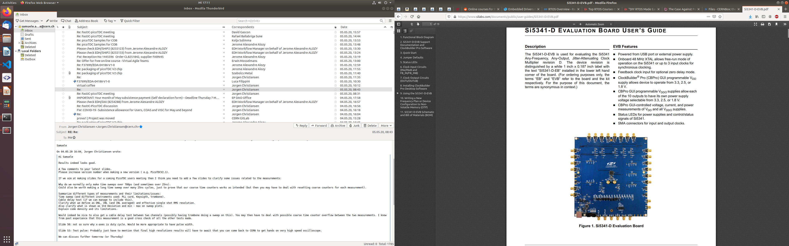
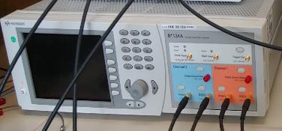

PicoTDC: Delay sweep test
Sweep test is performed to measure effective single shot RMS resolution covering linearities and jitter
The silicon lab board (Si5341-D-EVB with sub-100 fs rms phase jitter) is used to perform sweep test providing the clock signal and the hit signal which is then delayed by the trombone, or by the board itself.
The limitation of the silicon lab board is the fact that it is able only to generate clock, which are then shifted in phase of 0.3ps to obtain a hit signal delayed in time.
The trombone is a very precise and repeatable programmable delay line, but with maximum 600ps delay.
The Keysight generator can overcome the limitations of the trombone and the silicon lab board. The Keysight generator is more flexible in generating delay and pulses, but with higher internal non-linearity and jitter.
25/05/2020
Samuele Altruda
16
Notes:
Sweep test is performed to quantify the linearity of picoTDC.
To perform sweep test we use a dual channel pattern generator to provide the clock signal and the hit signal which is then delayed by the trombone.
The trombone is a very precise and repeatable, mechanical, programmable delay line.
We provide a hit signal synchronized and delayed with the clock source. We can provide than a measurement of the hit time.
16

Slide 17
PicoTDC: Delay sweep test
The pulse is generated in sync with the clock and is going to the hit input of the picoTDC. There is a delay between the 2 signals, which goes with steps of 0.3 ps.
PicoTDC main DLL clock cycle is 1.28 Ghz, 780ps, the course time counter clock cycle is 40 Mhz, 25ns, so usually delay sweep measurements are provided in this 2 forms to check any non-linearity in both elements.
500 hits per delay step are acquired, calculating from them: Standard deviation (std in red), minimum (min in green), maximum (max in green)
INL or RMS_resolution or also called single shot RMS resolution, comprise:
  Jitter
  Quantization
  INL (standard INL calculated in code density test, not including jitter and quantization).
This value is calculated as RMS value through all the measurements taken without any averaging.
25/05/2020
Samuele Altruda
17
Notes:
Sweep test is performed to quantify the linearity of picoTDC.
To perform sweep test we use a dual channel pattern generator to provide the clock signal and the hit signal which is then delayed by the trombone.
The trombone is a very precise and repeatable, mechanical, programmable delay line.
We provide a hit signal synchronized and delayed with the clock source. We can provide than a measurement of the hit time.
17

Slide 18
PicoTDC: Code density test
Code density test is performed to measure the effective bin size. The code density test is in principle made with uncorrelated random hit generator (or systematic sweep with silicon labs card)
The system can provide the same amount of expected pulses in each bin.
The resulting histogram is the result of the measured amount of hits collected per each bin. This test could be done with bin size of 3 ps (fine time), 12 ps (coarse time).
The measurements don’t include jitter and quantization, INL and DNL don’t include jitter and quantization too.
25/05/2020
Samuele Altruda
18
Notes:
Code density test is performed to measure the effective bin size. The measurement doesn’t include jitter and quantization.
To perform code density test we use an old RC based generator, which provides us random hits.
As a random source we expect the same amount of hits in each bin.
18

Slide 19
PicoTDC delay sweep test
25/05/2020
Samuele Altruda
19

Slide 20
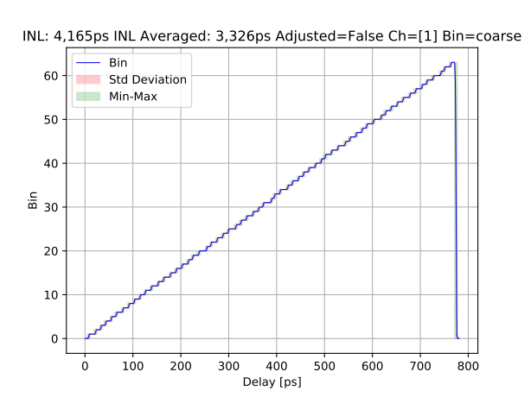
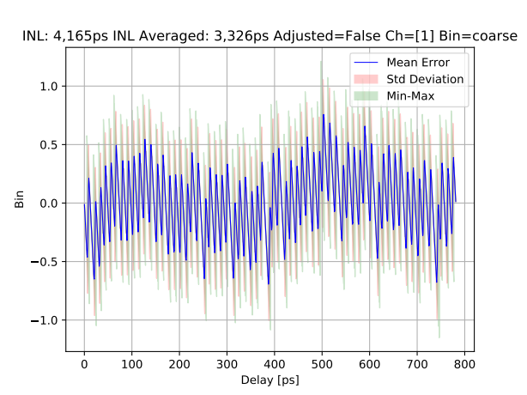
PicoTDC: Delay sweep test
Ch 1, not adjusted, coarse mode, bin 12ps, RMS_resolution = 4,165ps
*RMS_resolution includes jitter, quantization and INL
*RMS_resolution includes jitter, quantization and INL
https://cernbox.cern.ch/index.php/s/4Jc4wv68w8V4Ofi
https://cernbox.cern.ch/index.php/s/GvY7rTUIu6CgGBx
* Link for interactive web plot
* Link for interactive web plot
25/05/2020
Samuele Altruda
20
Notes:
CH, adjustment, bin size
The measurement of the hit time includes also jitter from picotdc and pattern generator.
X axis delay introduced by the trombone, Y axis LSB of measurement.
Right zoom look bin size, min max and std increasing at bin intersection, while reducing in the middle of a bin.
Black line is the interpolation line, so the expected measurement line
Mention adjustment, mode, INL
20

Slide 21
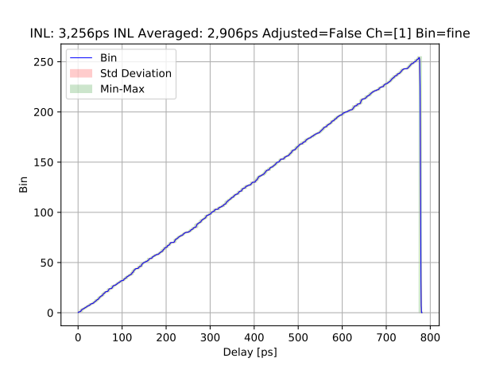
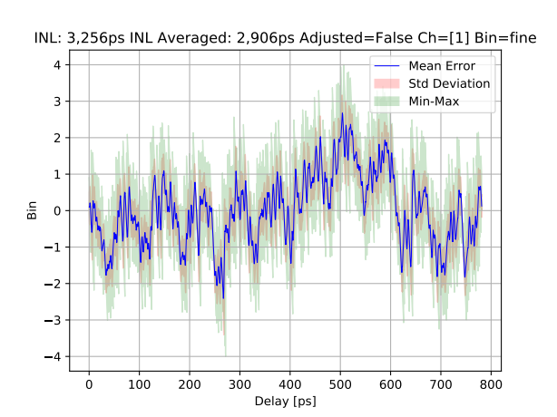
PicoTDC: Delay sweep test
Ch 1, not adjusted, fine mode, bin 3ps, RMS_resolution = 3,256ps
*RMS_resolution includes jitter, quantization and INL
https://cernbox.cern.ch/index.php/s/zbxF6ikAMAB0BAu
https://cernbox.cern.ch/index.php/s/fpqJKaSbkbPG0vX
* Link for interactive web plot
* Link for interactive web plot
25/05/2020
Samuele Altruda
21
Notes:
CH, adjustment, bin size
The measurement of the hit time includes also jitter from picotdc and pattern generator.
X axis delay introduced by the trombone, Y axis LSB of measurement.
Right zoom look bin size, min max and std increasing at bin intersection, while reducing in the middle of a bin.
Black line is the interpolation line, so the expected measurement line
Mention adjustment, mode, INL
21

Slide 22
PicoTDC: performances summary
 |  |  | Sweep Test (PicoTDCV2) | Sweep Test (PicoTDCV1)
 | Ch | adjusted | RMS_resolution | RMS_resolution
Coarse time | 1 | NO | 4,165ps | X
 | 31 | NO | 4,066ps | 4,129ps
 | 35 | NO | 4,085ps | X
 | 48 | NO | 4,015ps | X
Fine time | 1 | NO | 3,256ps | X
 | 31 | NO | 2,904ps | 3,416ps
 | 35 | NO | 2,822ps | X
 | 48 | NO | 2,707ps | X
*RMS_resolution includes jitter, quantization and INL
25/05/2020
Samuele Altruda
22
Notes:
Coarse time we expect to have the same result with common adjustment correction, but with new chip version with less mismatch
Fine time we expect to have a final result with common adjustment betwenn adjusted and not adjusted
22

Slide 23
PicoTDC code density test comparison old/new PicoTDC
25/05/2020
Samuele Altruda
23

Slide 24
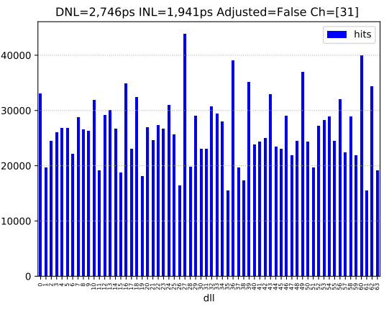
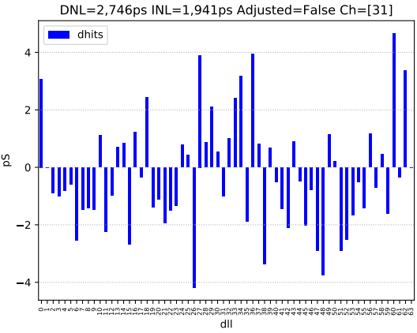
PicoTDC: Code density test comparison
Ch 31, not adjusted, coarse mode, bin 12ps
PicoTDC v1
PicoTDC v2
25/05/2020
Samuele Altruda
24
Notes:
As a random source we expect the same amount of hits in each bin, the deviation from a flat histogram means we need to adjust the bin size.
Mention DNL and INL
24

Slide 25
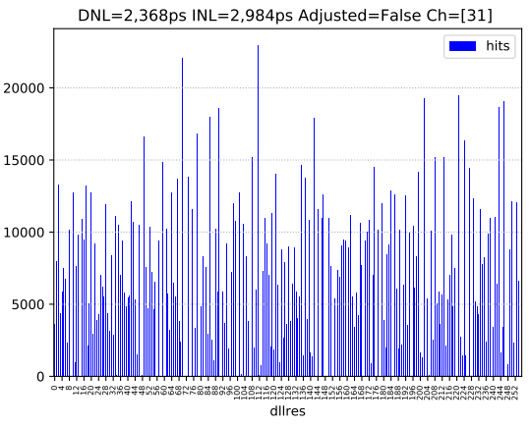
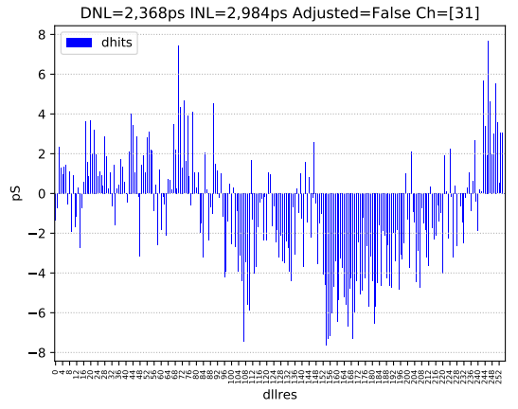
PicoTDC: Code density test comparison
Ch 31, not adjusted, fine mode, bin 3ps
PicoTDC v1
PicoTDC v2
25/05/2020
Samuele Altruda
25
Notes:
As a random source we expect the same amount of hits in each bin, the deviation from a flat histogram means we need to adjust the bin size.
Not visible but remind that we have mismatch which in fine mode create misdetection of trailing and leading edge.
Mention DNL and INL
25

Slide 26
PicoTDC Focus on
channel 48
25/05/2020
Samuele Altruda
26

Slide 27
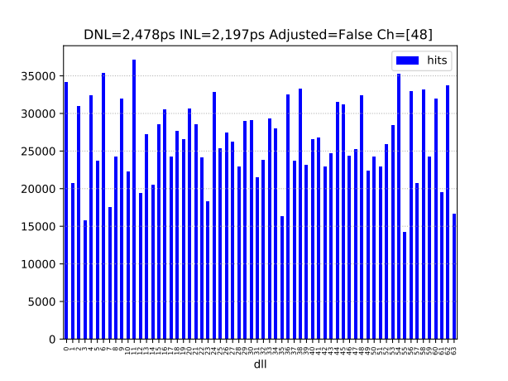
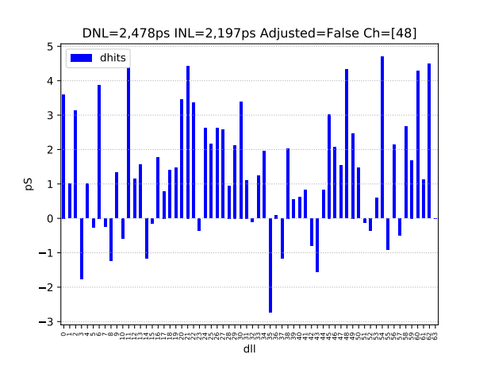
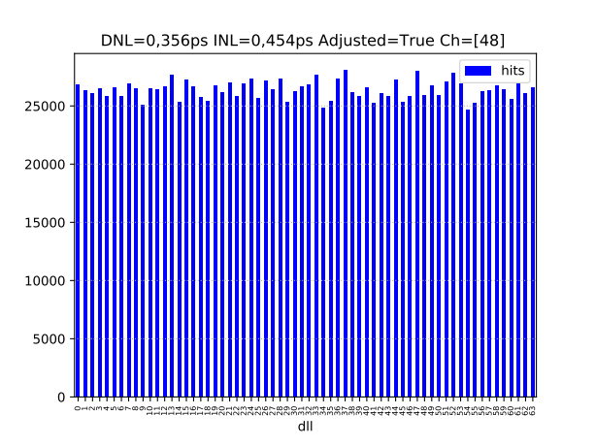
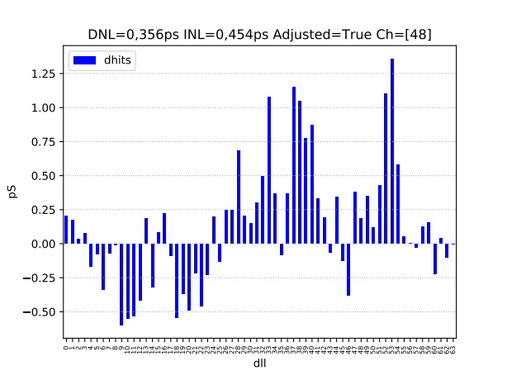
PicoTDC: Code density test
Ch 48, not adjusted, coarse mode, bin 12ps, RMS_dnl= 2,478ps, RMS_inl= 2,192ps
Ch 48, adjusted, coarse mode, bin 12ps, RMS_dnl= 0,356ps, RMS_inl= 0,454ps
Adjustment for Ch 48 is performed for this channel alone
Samuele Altruda
27
Notes:
As a random source we expect the same amount of hits in each bin, the deviation from a flat histogram means we need to adjust the bin size.
Mention DNL and INL
27

Slide 28

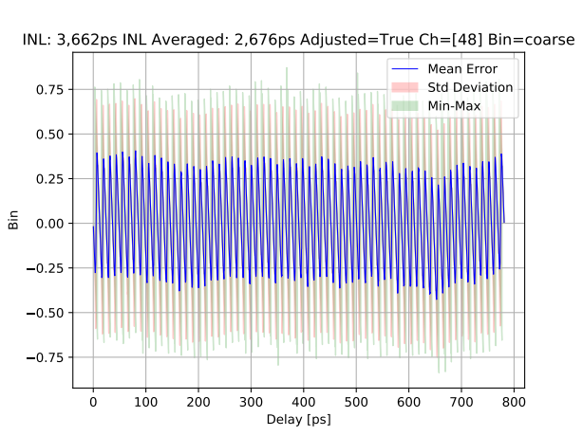
PicoTDC: Delay sweep test
Ch 48, adjusted, coarse mode, bin 12ps, RMS_resolution = 3,662ps
*RMS_resolution includes jitter, quantization and INL
https://cernbox.cern.ch/index.php/s/wH7CpS2kFXkOHOs
https://cernbox.cern.ch/index.php/s/yeXL80r9OfnLc9U
* Link for interactive web plot
* Link for interactive web plot
25/05/2020
Samuele Altruda
28
Notes:
CH, adjustment, bin size
The measurement of the hit time includes also jitter from picotdc and pattern generator.
X axis delay introduced by the trombone, Y axis LSB of measurement.
Right zoom look bin size, min max and std increasing at bin intersection, while reducing in the middle of a bin.
Black line is the interpolation line, so the expected measurement line
Mention adjustment, mode, INL
28

Slide 29
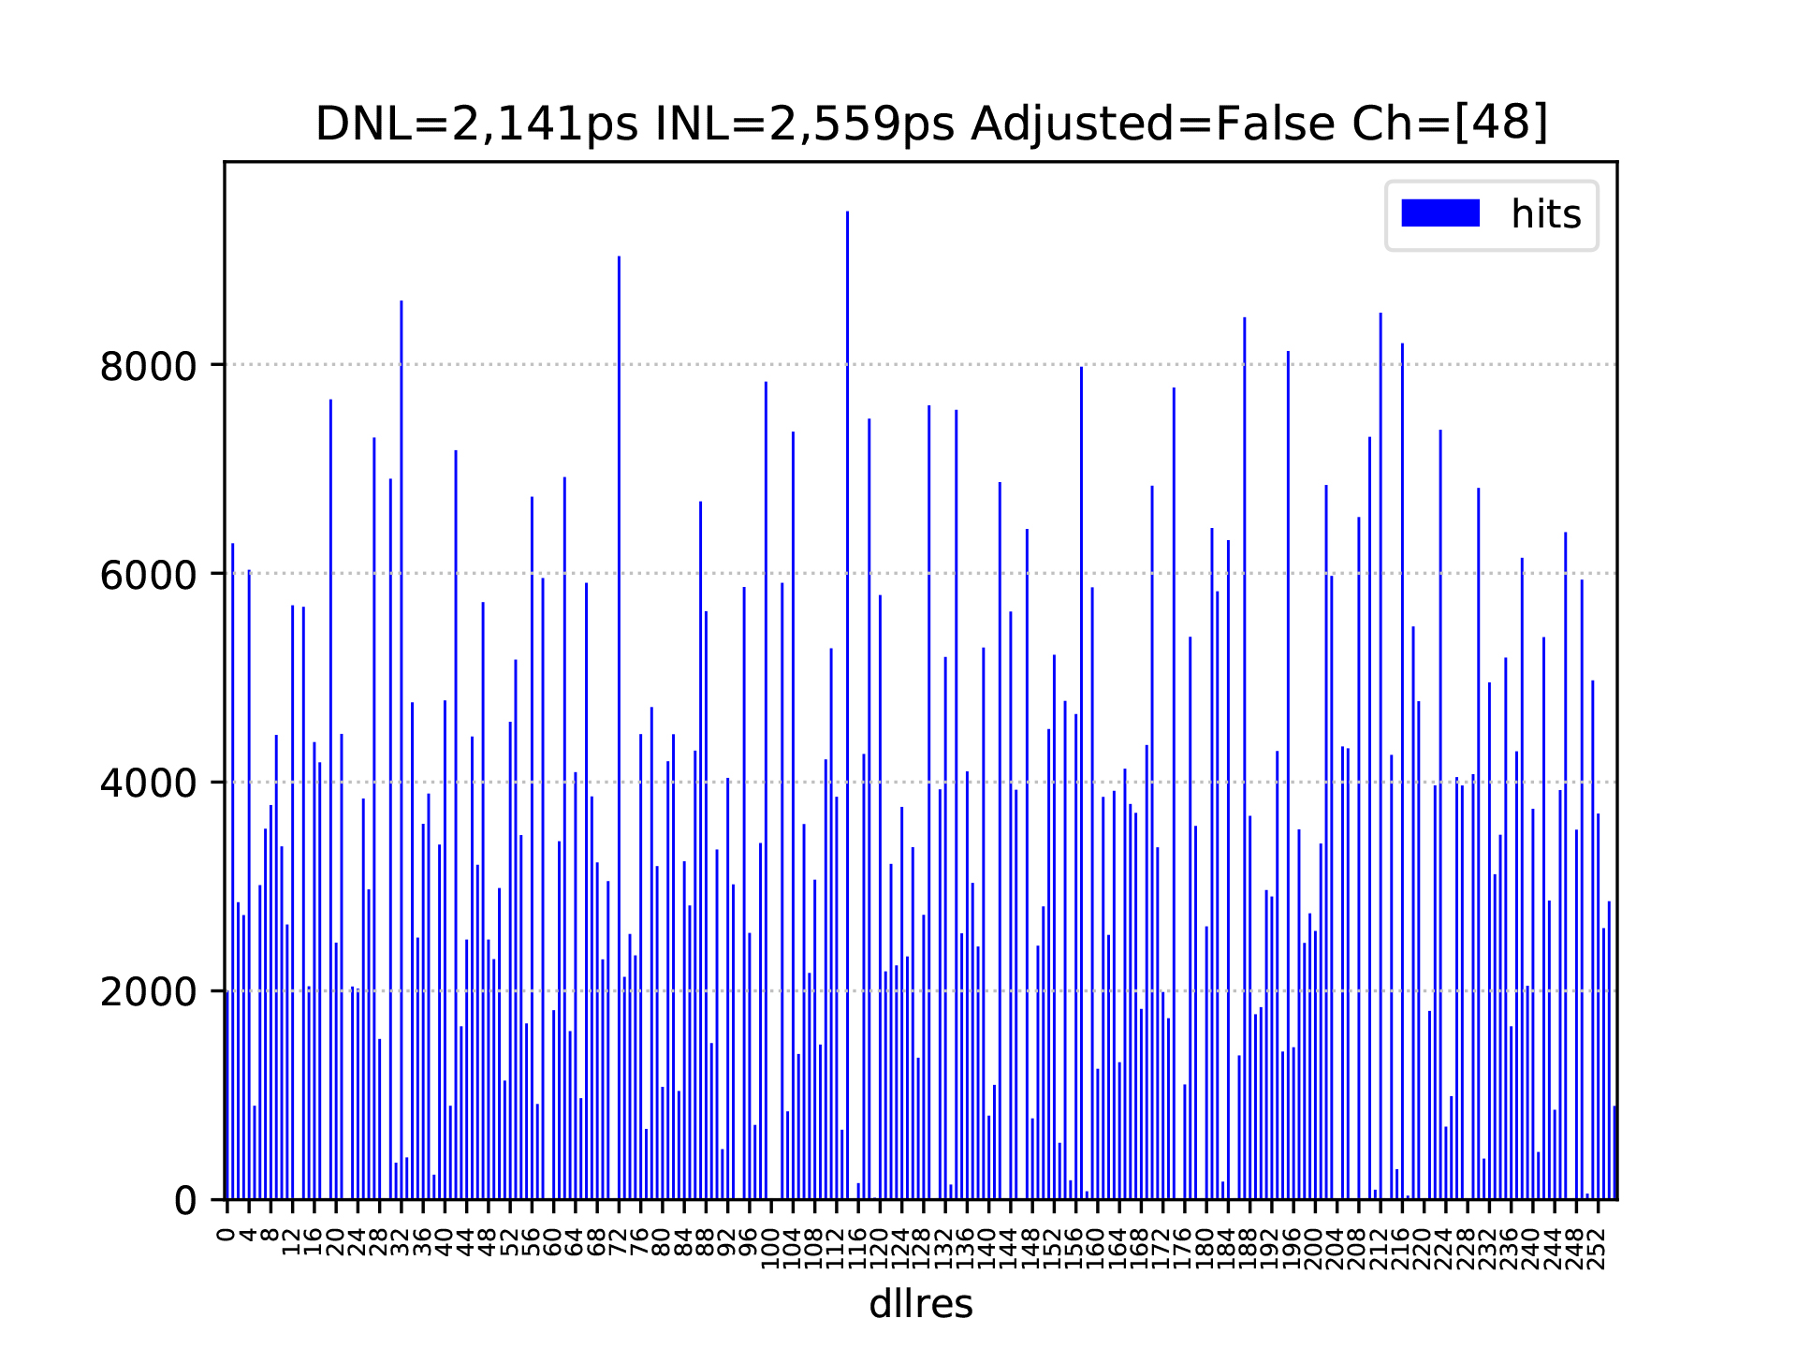
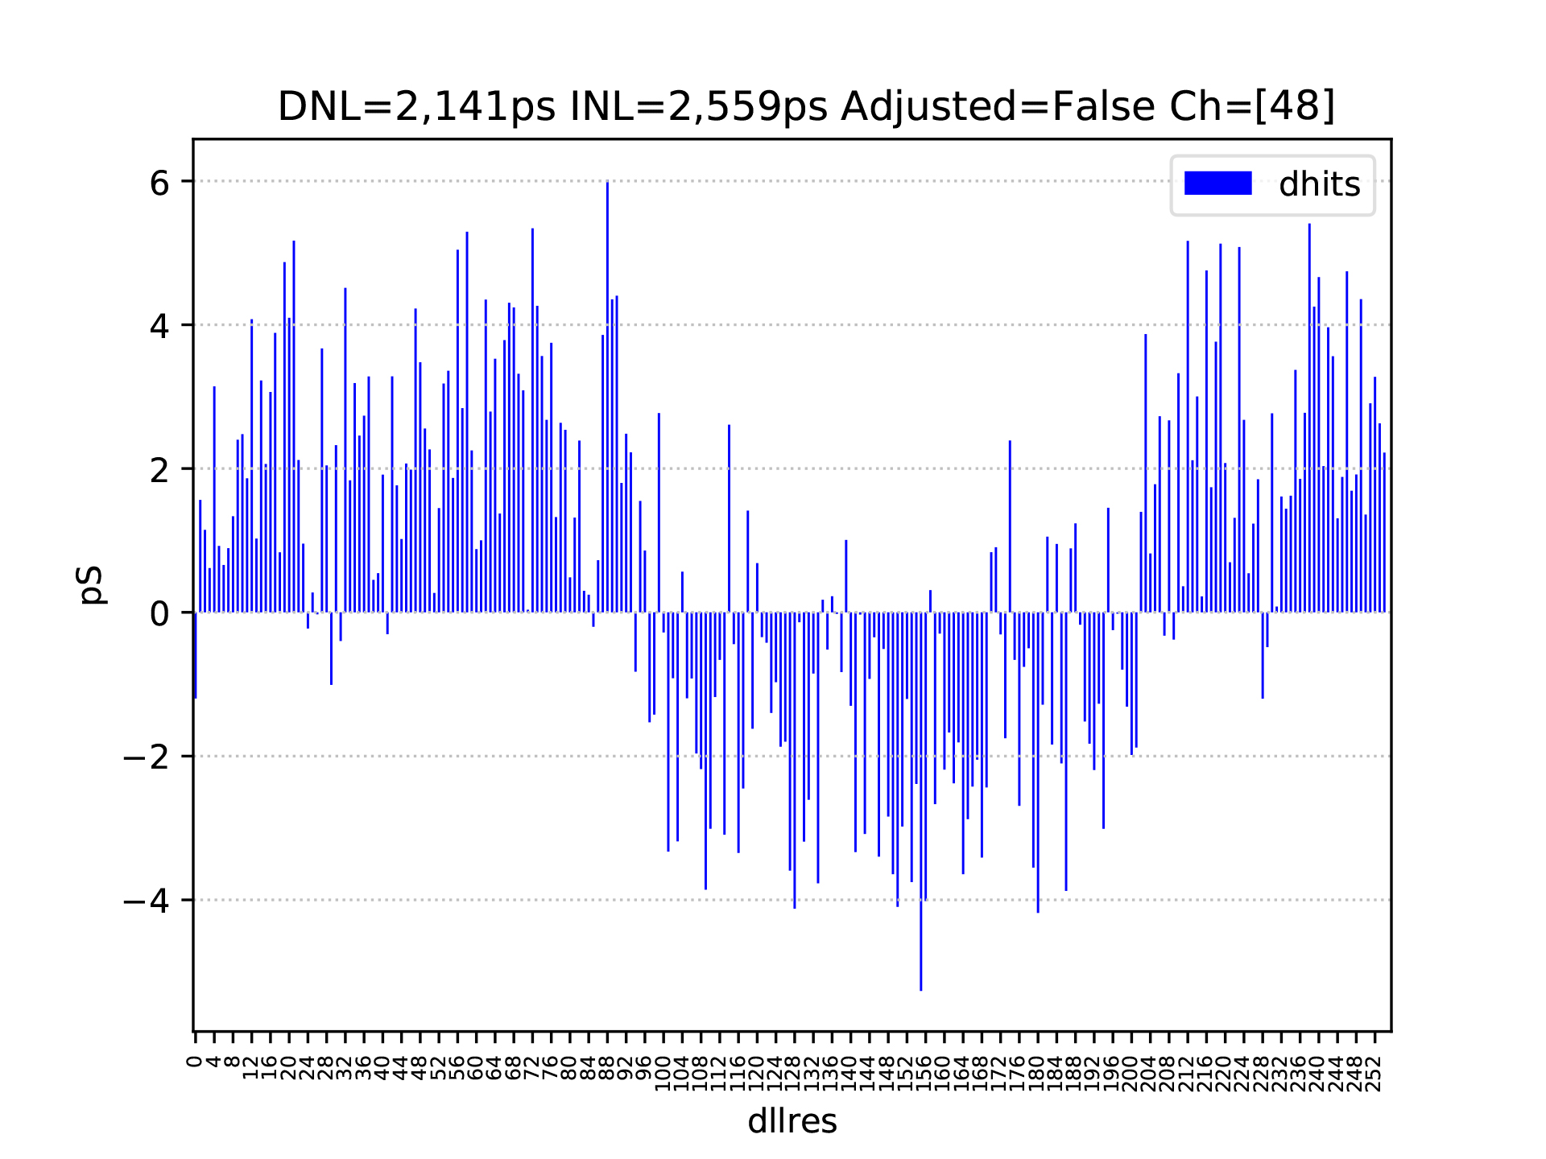
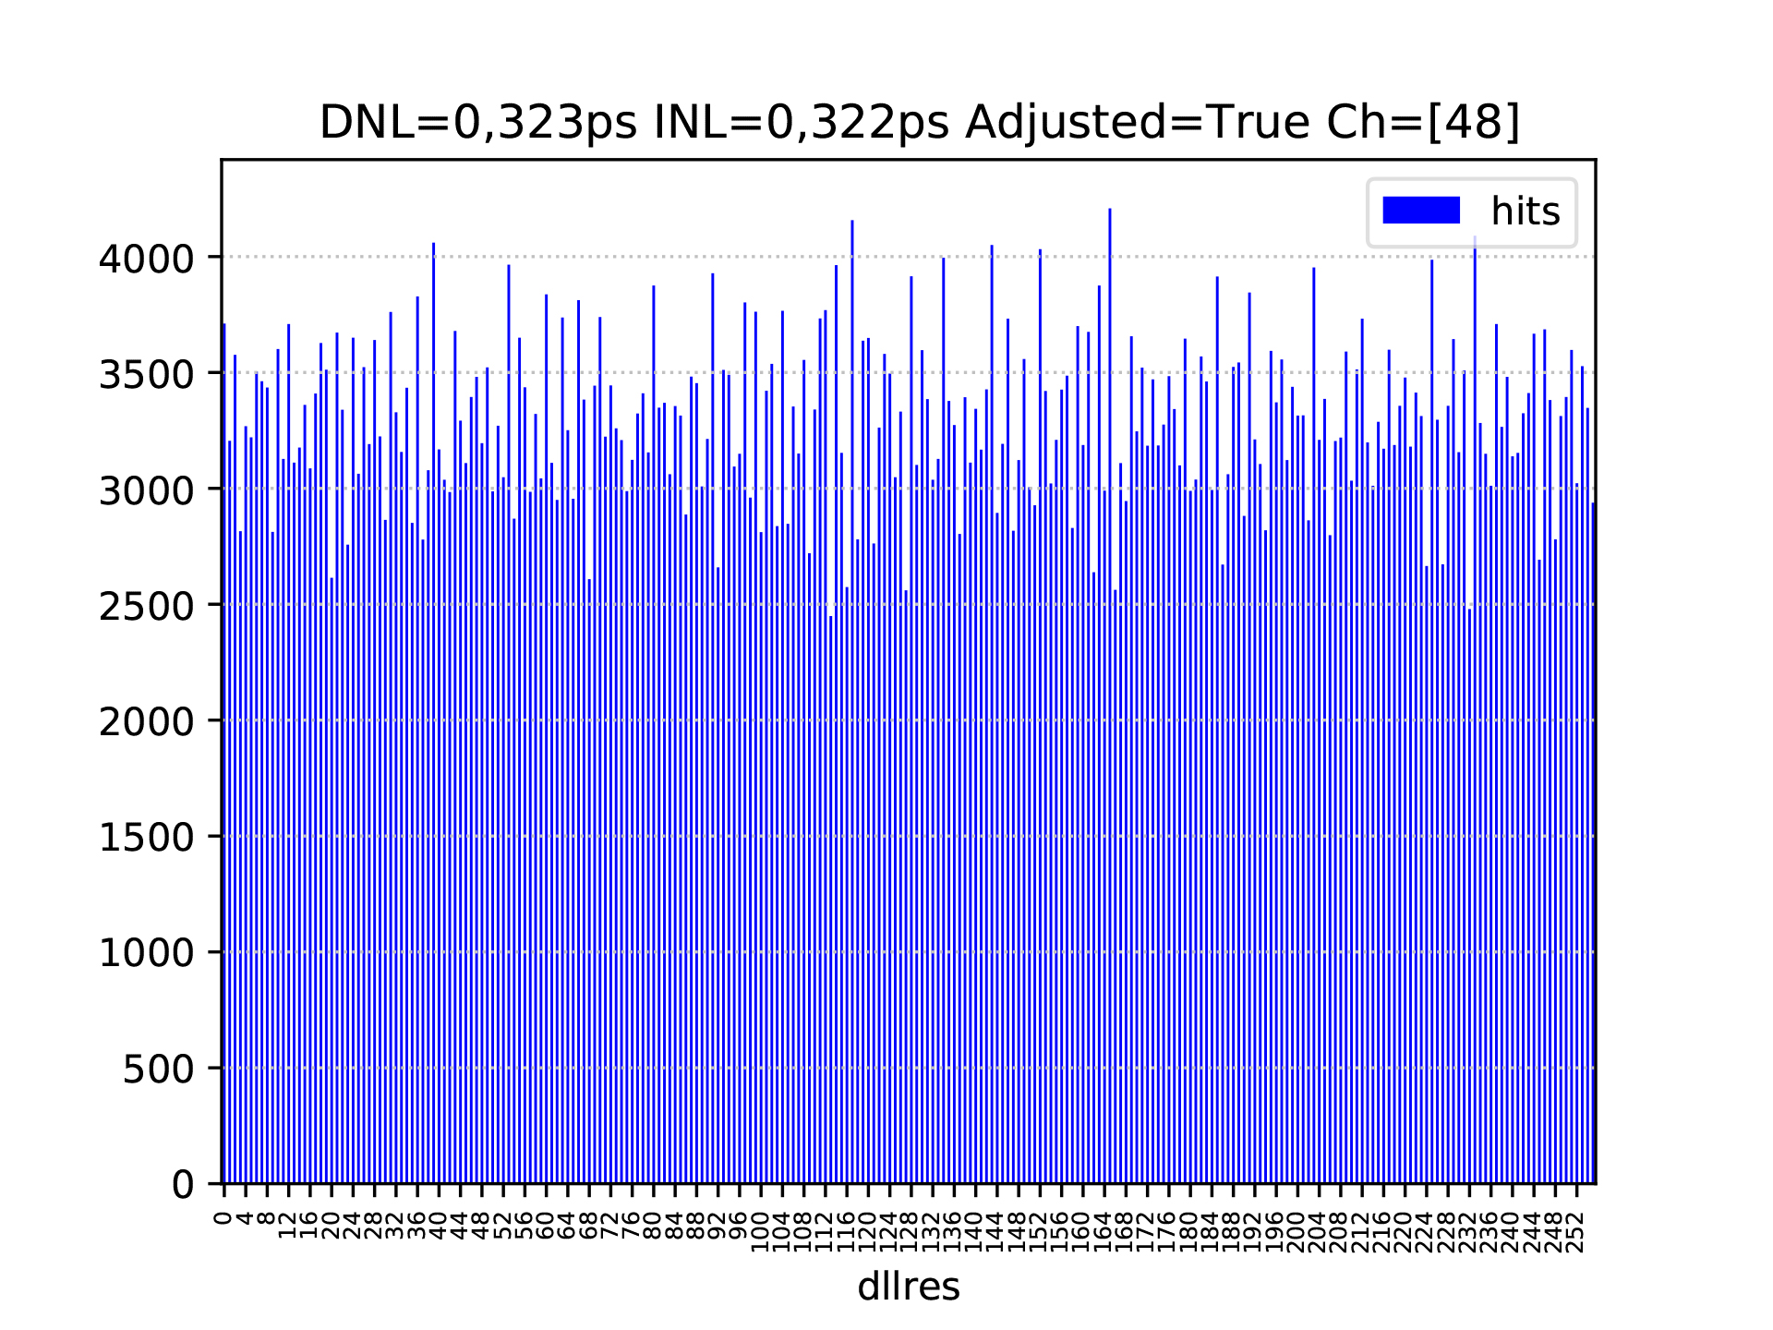
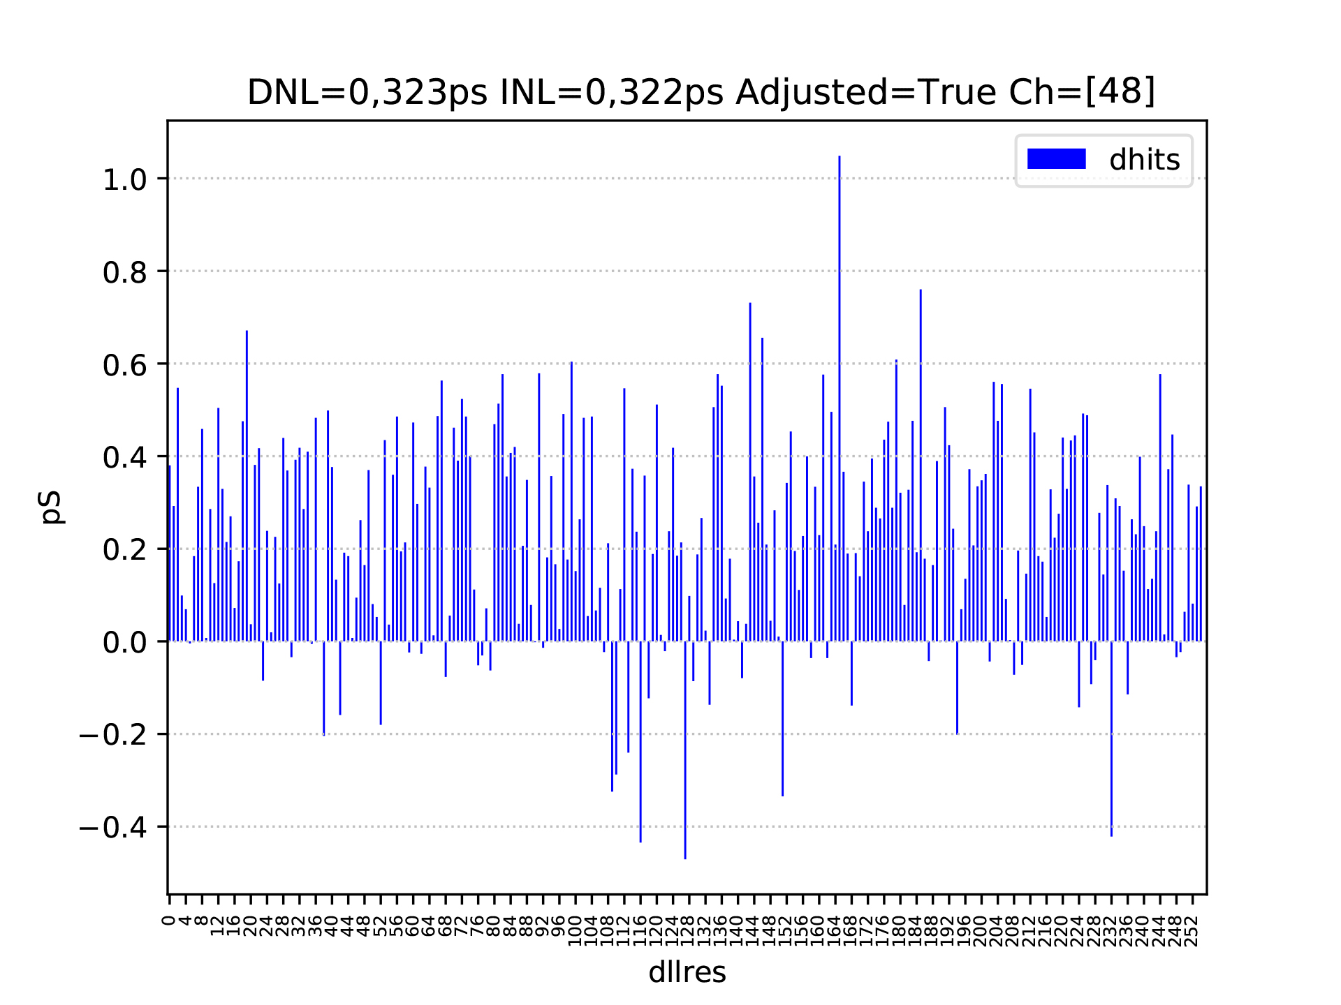
PicoTDC: Code density test
Ch 48, not adjusted, fine mode, bin 3ps, RMS_dnl= 2,141ps, RMS_inl= 2,559ps
Ch 48, adjusted, fine mode, bin 3ps, RMS_dnl= 0,323ps, RMS_inl= 0,322ps
Adjustment for Ch 35 is performed for this channel alone
Samuele Altruda
29
Notes:
As a random source we expect the same amount of hits in each bin, the deviation from a flat histogram means we need to adjust the bin size.
Not visible but remind that we have mismatch which in fine mode create misdetection of trailing and leading edge.
Mention DNL and INL
29

Slide 30
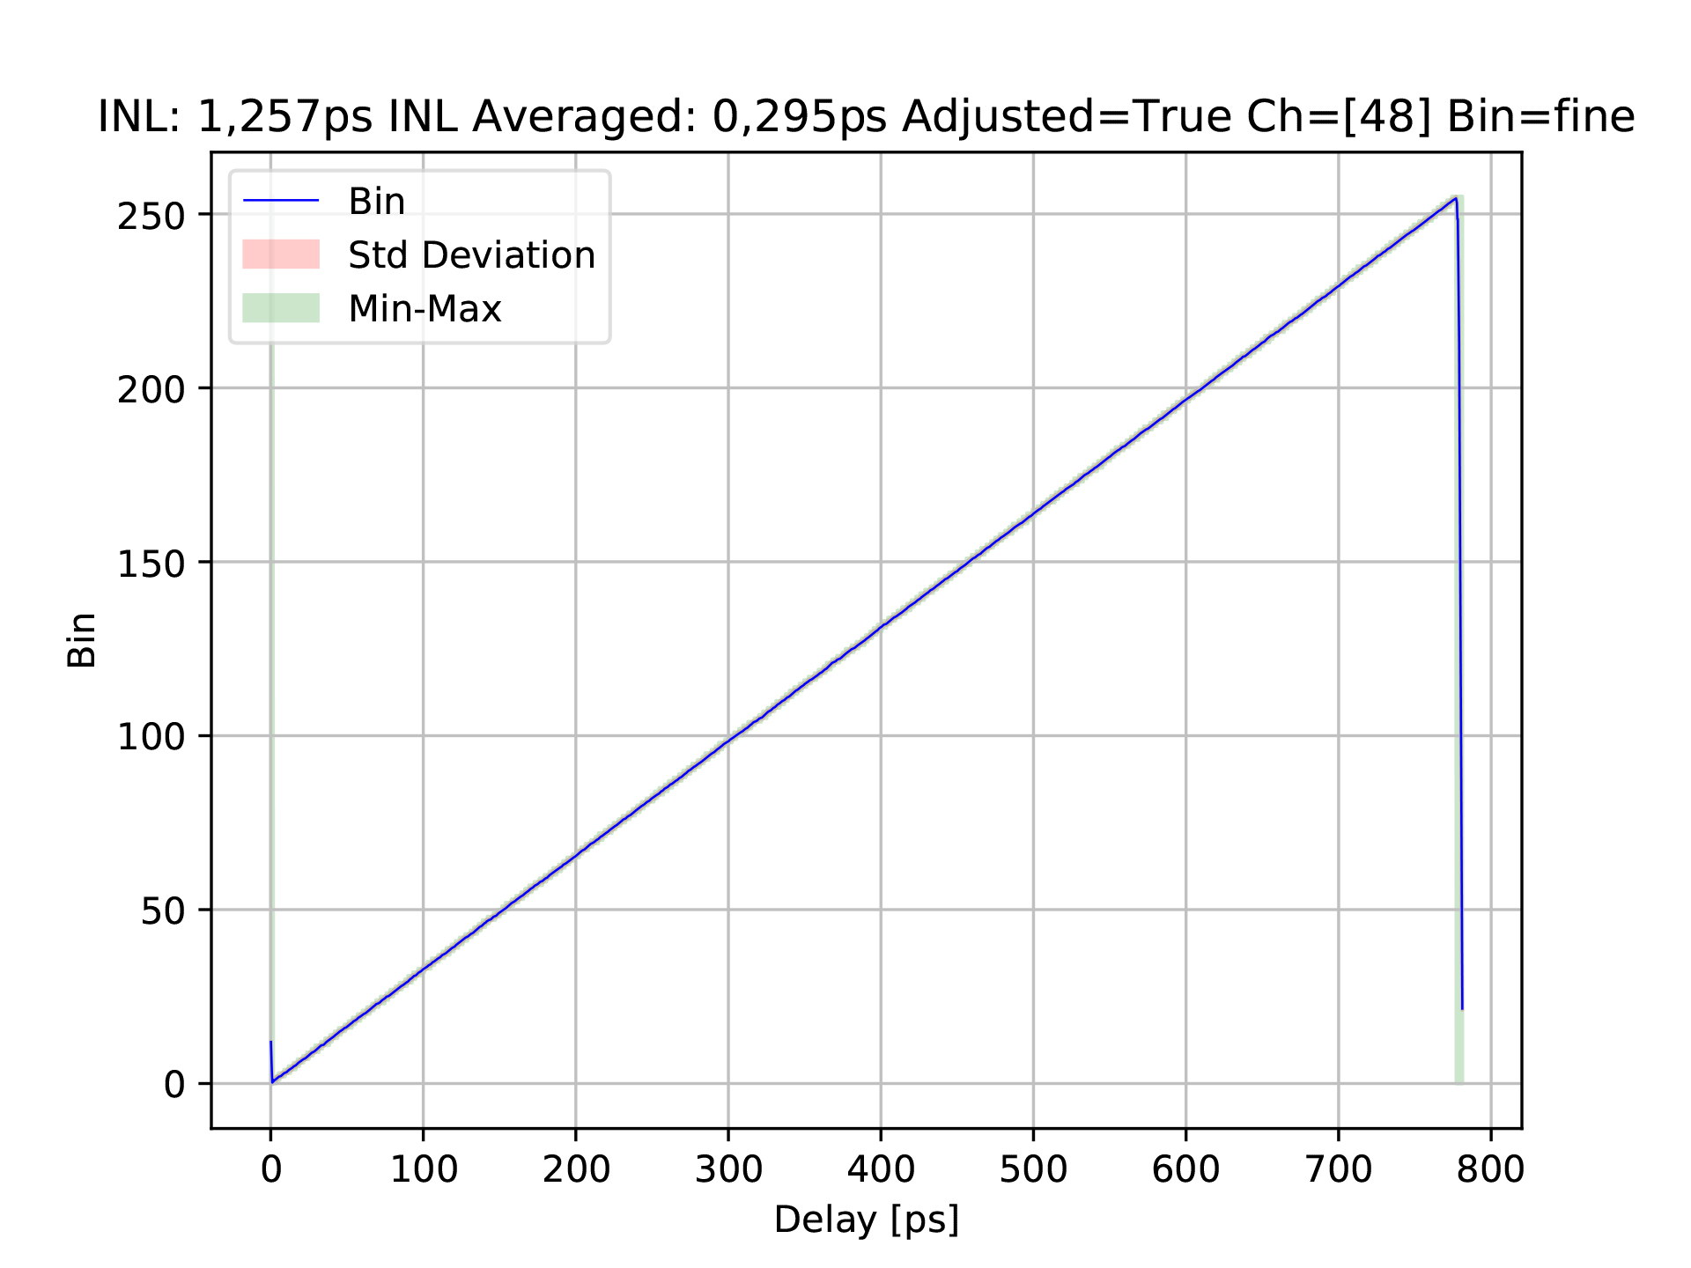
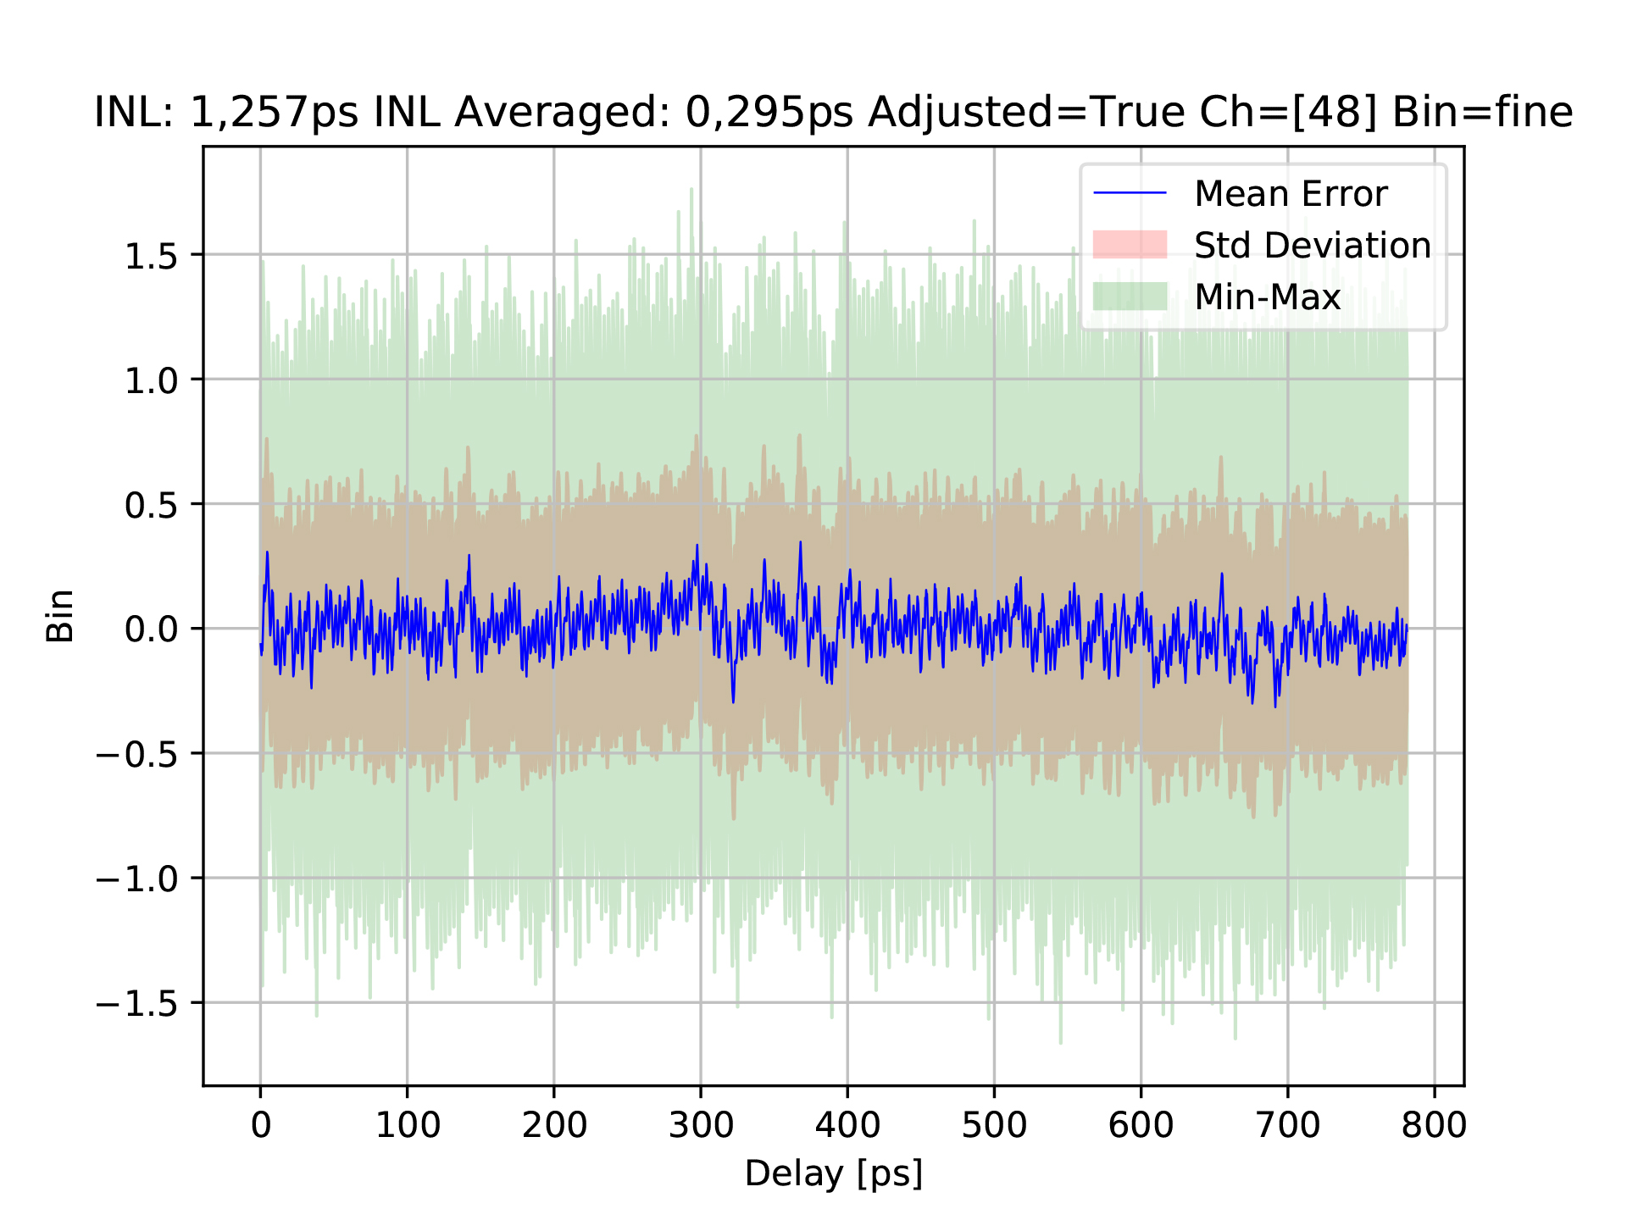
PicoTDC: Delay sweep test
Ch 48, adjusted, fine mode, bin 3ps, RMS_resolution = 1,257ps
*RMS_resolution includes jitter, quantization and INL
https://cernbox.cern.ch/index.php/s/3OFMDr2Mz4brwMA
https://cernbox.cern.ch/index.php/s/bL1LSva2binJkb7
* Link for interactive web plot
* Link for interactive web plot
25/05/2020
Samuele Altruda
30
Notes:
CH, adjustment, bin size
The measurement of the hit time includes also jitter from picotdc and pattern generator.
X axis delay introduced by the trombone, Y axis LSB of measurement.
Right zoom look bin size, min max and std increasing at bin intersection, while reducing in the middle of a bin.
Black line is the interpolation line, so the expected measurement line
Mention adjustment, mode, INL
30

Slide 31
PicoTDC Common adjustment
25/05/2020
Samuele Altruda
31

Slide 32
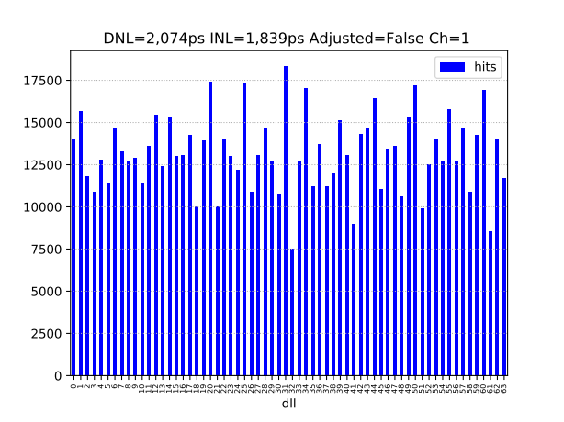
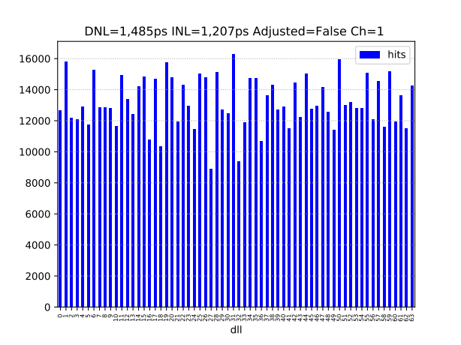
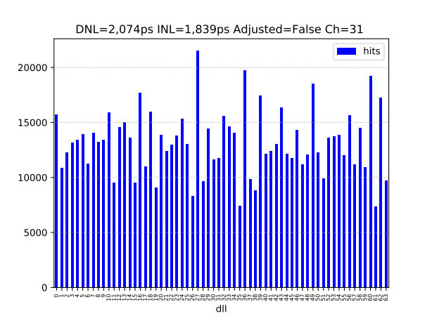
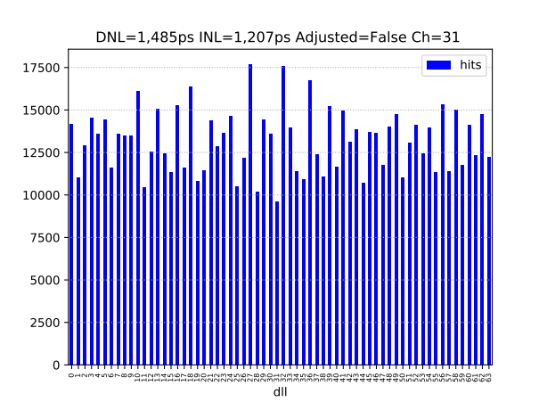
PicoTDC: Common adjustments
Ch 1-31, coarse mode, bin 12ps, RMS_dnl_notadj= 2,074ps, RMS_dnl_adj= 1,485ps
NOT ADJUSTED
COMMON ADJUSTMENT
25/05/2020
Samuele Altruda
32
Notes:
As a random source we expect the same amount of hits in each bin, the deviation from a flat histogram means we need to adjust the bin size.
Mention DNL and INL
32

Slide 33
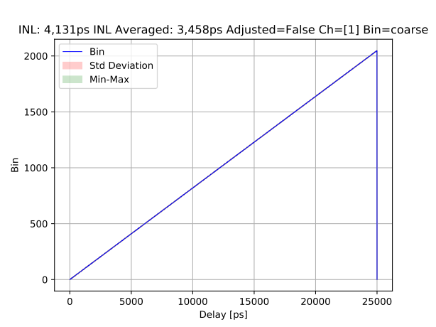



PicoTDC: Common adjustments
Ch 1-31, coarse mode, bin 12ps,
NOT ADJUSTED
COMMON ADJUSTMENT
Samuele Altruda
33
Notes:
X axis delay introduced by the trombone, Y axis INL in LSB of measurement.
Specify min max values.
INL in rms mode, not averaged, but calculated through all the measurement points, around 16000 per delay step
33

Slide 34
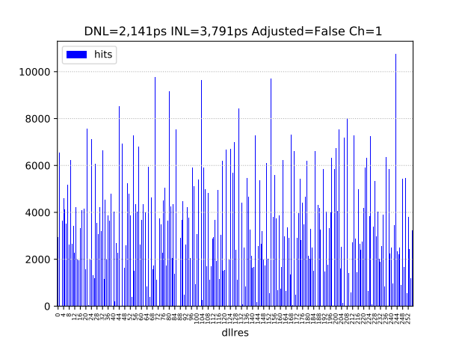
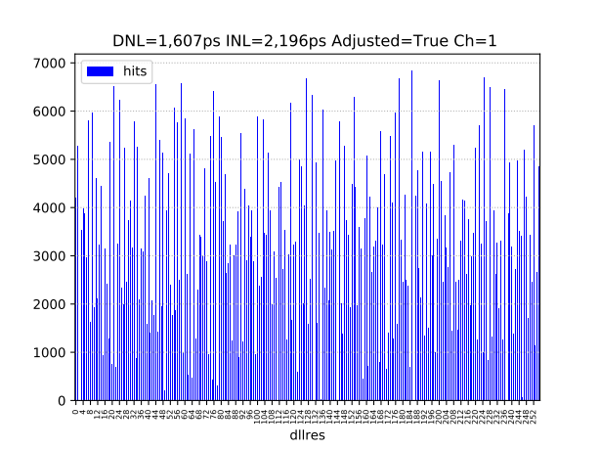
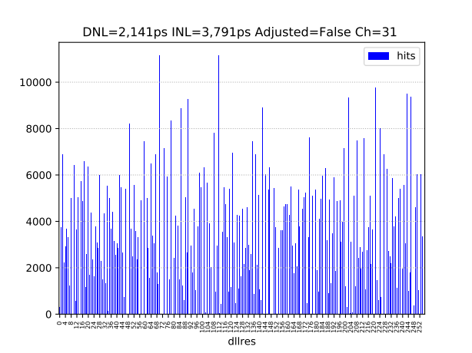
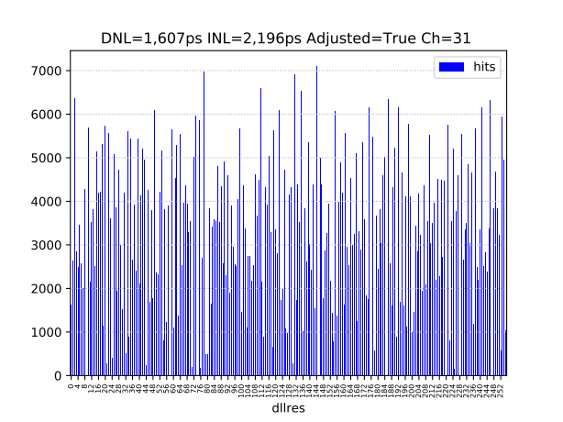
PicoTDC: Common adjustments
Ch 1-31, fine mode, bin 3ps, RMS_dnl_notadj= 2,141ps, RMS_dnl_adj= 1,607ps
NOT ADJUSTED
COMMON ADJUSTMENT
Samuele Altruda
34
Notes:
As a random source we expect the same amount of hits in each bin, the deviation from a flat histogram means we need to adjust the bin size.
Mention DNL and INL
34

Slide 35


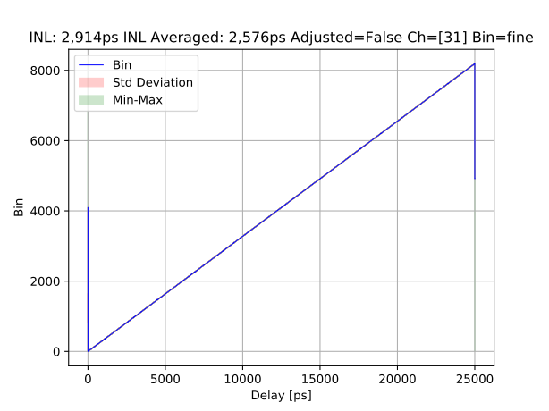
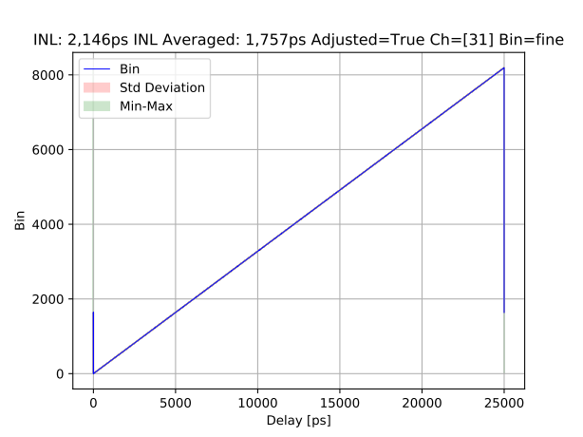
PicoTDC: Common adjustments
Ch 1-31, fine mode, bin 3ps,
NOT ADJUSTED
COMMON ADJUSTMENT
Samuele Altruda
35
Notes:
X axis delay introduced by the trombone, Y axis INL in LSB of measurement.
Specify min max values.
INL in rms mode, not averaged, but calculated through all the measurement points, around 16000 per delay step
35

Slide 36
PicoTDC TOT measurements
25/05/2020
Samuele Altruda
36

Slide 37
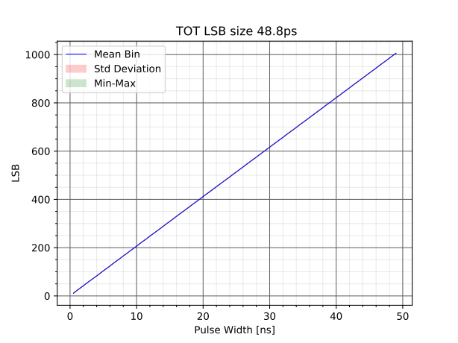
PicoTDC: TOT test
Ch 1, fine mode, bin 3ps, LSB TOT 24.4 ps Clock period 20Mhz
In TOT mode, both leading edge and TOT have programmable resolution.
25/05/2020
Samuele Altruda
37
Notes:
Adjustment worked very well.
Mention DNL and INL
37

Slide 38
PicoTDC Crosstalk test
25/05/2020
Samuele Altruda
38

Slide 39
PicoTDC: Crosstalk test
Cross talk test is performed to quantify the noise introduced by the others channels against one. Worst case in exam: one against all.
Test scheme simplified
FMC1
FPGA
Ch 0
Ch 2-30
Ch 32-34
Ch 36-47
Ch 49-63
Common Hit signal
Ch 1 Hit signal
picoTDC
Common Hit signal delay sweep from 0ps to 60000ps
Ch 1 Hit signal at fixed delay
25/05/2020
Samuele Altruda
39
Notes:
Cross talk test is performed to quantify the noise introduced by the others channels against one. Worst case in exam: one against all.
Common Hit signal delay sweep from 0ps to 60000ps. Ch 31 Hit signal at fixed delay
39

Slide 40
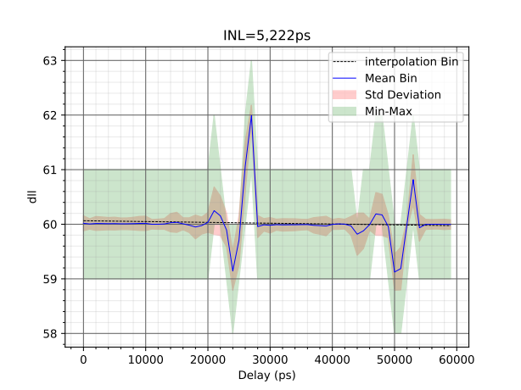
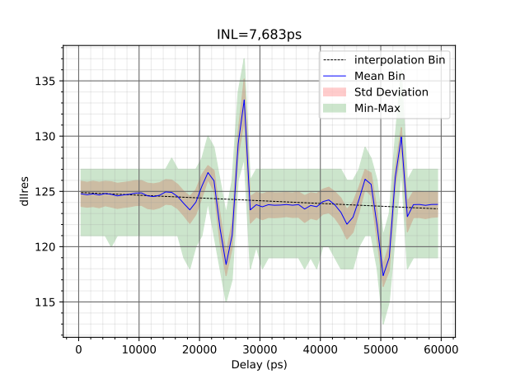
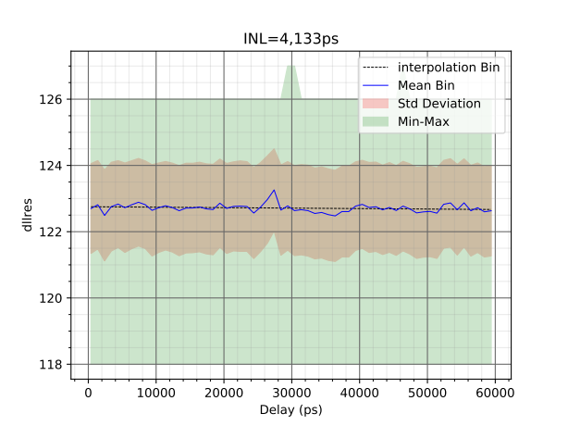
PicoTDC: Crosstalk test
Ch 1, coarse mode, bin 12ps, 1 channel vs all
Ch 1, fine mode, bin 3ps, 1 channel vs all
Ch 1, fine mode, bin 3ps, 1 channel vs 1 channel adjacent (ch 2)
Samuele Altruda
40
Notes:
As a random source we expect the same amount of hits in each bin, the deviation from a flat histogram means we need to adjust the bin size.
Not visible but remind that we have mismatch which in fine mode create misdetection of trailing and leading edge.
Mention DNL and INL
40

Slide 41
PicoTDC Cable delay test
25/05/2020
Samuele Altruda
41

Slide 42
PicoTDC: Cable delay test
Cable delay test is performed to quantify the linearity of the system over multiple clock cycle, around 200ms
Hit Generator
Test scheme simplified
Ch 48 Hit signal
Ch 0
Ch 2-30
Ch 32-34
Ch 36-47
Ch 49-63
picoTDC
Ch 31 Hit signal
Hit generator outputs a delay sweep hits.
Hits go through different cables with different lengths to channel 31 and 48. Our TDC will measure the time of arrival of the two hits.
25/05/2020
Samuele Altruda
42
Notes:
42

Slide 43
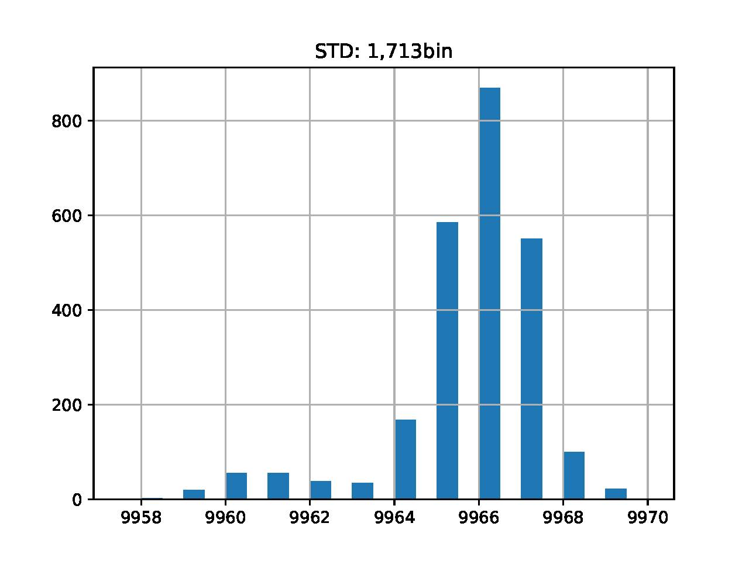
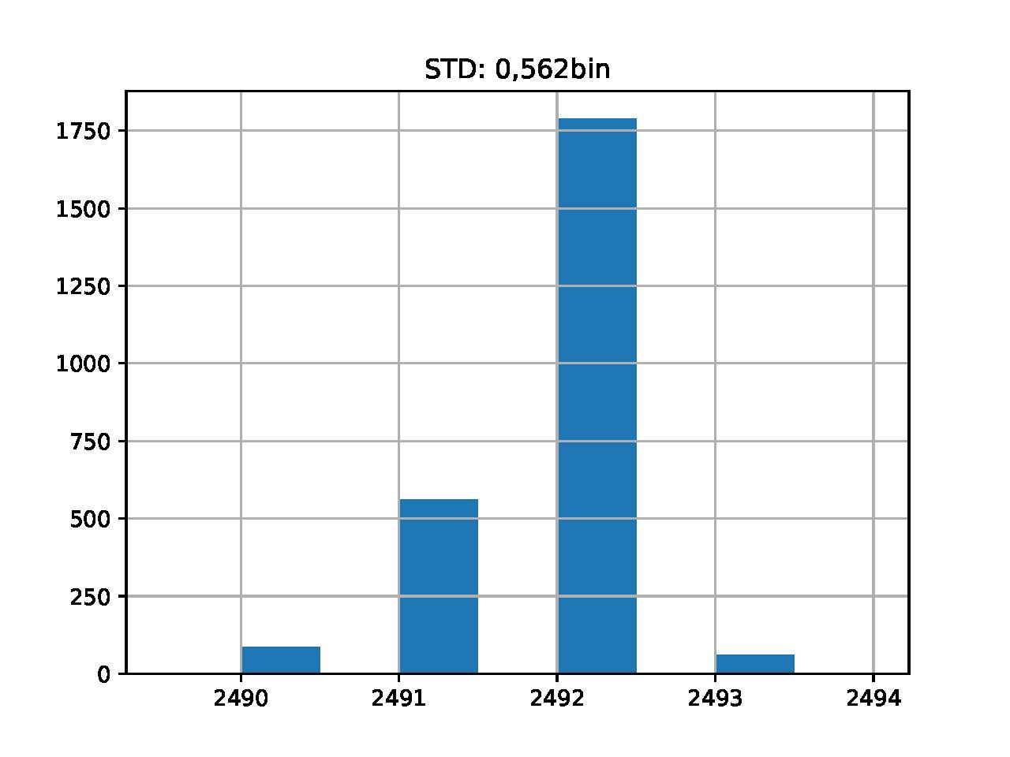
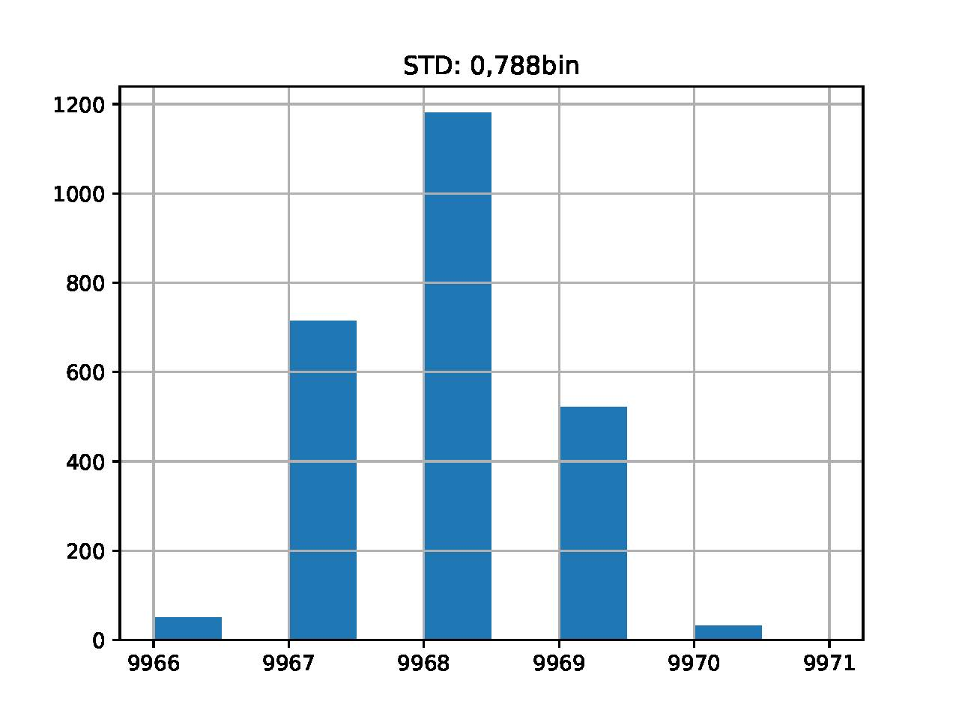
PicoTDC: Cable delay test
Ch 31, Ch 48, not adjusted , coarse mode
Ch 31, Ch 48, not adjusted , fine mode
Bin 2492 ~30 ns
Cable length difference
Bin 9966 ~30 ns
Cable length difference
Ch 31, Ch 48, adjusted each half , fine mode
Bin 9968 ~30 ns
Cable length difference
25/05/2020
Samuele Altruda
43
Notes:
43

Slide 44
PicoTDC Integrated Pulse Generator
25/05/2020
Samuele Altruda
44

Slide 45

PicoTDC: Integrate Pulse Generator test
The PicoTDC contains a pulse generator for system testing purposes, able to generate a differential output signal.
The output can either be a 1.28GHz clock with selectable phase shift or a configurable pulse.This works internally with a selection of one of the 256 clock phases of the upper half of the timing macro.
In this example, the pulse generator was configured to use clock phase 192 (relation to the 40MHz clock), the time of the rising edge is set to 1, the falling edge to 4 and the repetition time to 7.
25/05/2020
Samuele Altruda
45
Notes:
Adjustment worked very well.
Mention DNL and INL
45

Slide 46

PicoTDC: Integrate Pulse Generator test
Ch 1, phase 3, rising 513(LSB), falling 1027(LSB), reload 1028(LSB)
Period= reload(LSB)*0.78125ns=803 ns
Measurement done with limited bandwidth and sampling frequency scope.
More measurements to be done with high speed scope back to CERN.
25/05/2020
Samuele Altruda
46
Notes:
Adjustment worked very well.
Mention DNL and INL
46

Slide 47
PicoTDC new version
25/05/2020
Samuele Altruda
47

Slide 48
PicoTDC v2
New features available on version 2:
Configurable pulse generator on chip
Trigger from channel 1
Production schedule:
PicoTDCv2 at CERN bonded on old test board available and tested
Functional and timing performance test of PicoTDCv2 bonded on old PCB ongoing
Functional and timing performance test of PicoTDCv2 on generic package in April - May 2020
Functional and timing performance test of PicoTDCv2 in final package in July - September 2020
Share point link for info and material: http://cern.ch/PicoTDC
For more info and request access to the material write to:
Jorgen Christiansen <Jorgen.Christiansen@cern.ch>
Samuele Altruda <samuele.altruda@cern.ch>
25/05/2020
Samuele Altruda
48
Notes:
48

Slide 50


PicoTDC: Delay sweep test
Ch 31, not adjusted, coarse mode, bin 12ps, RMS_resolution = 4,066ps
*RMS_resolution includes jitter, quantization and INL
https://cernbox.cern.ch/index.php/s/b2bdVf2JDZU1wPc
https://cernbox.cern.ch/index.php/s/MVsmlaZT0ztRpNQ
* Link for interactive web plot
* Link for interactive web plot
Samuele Altruda
50
Notes:
CH, adjustment, bin size
The measurement of the hit time includes also jitter from picotdc and pattern generator.
X axis delay introduced by the trombone, Y axis LSB of measurement.
Right zoom look bin size, min max and std increasing at bin intersection, while reducing in the middle of a bin.
Black line is the interpolation line, so the expected measurement line
Mention adjustment, mode, INL
50

Slide 51


PicoTDC: Delay sweep test
Ch 35, not adjusted, coarse mode, bin 12ps, RMS_resolution = 4,085ps
*RMS_resolution includes jitter, quantization and INL
https://cernbox.cern.ch/index.php/s/Od3gfXKGbDd4gGA
https://cernbox.cern.ch/index.php/s/9bvaWodjuWe0puq
* Link for interactive web plot
* Link for interactive web plot
Samuele Altruda
51
Notes:
CH, adjustment, bin size
The measurement of the hit time includes also jitter from picotdc and pattern generator.
X axis delay introduced by the trombone, Y axis LSB of measurement.
Right zoom look bin size, min max and std increasing at bin intersection, while reducing in the middle of a bin.
Black line is the interpolation line, so the expected measurement line
Mention adjustment, mode, INL
51

Slide 52


PicoTDC: Delay sweep test
Ch 48, not adjusted, coarse mode, bin 12ps, RMS_resolution = 4,015ps
*RMS_resolution includes jitter, quantization and INL
https://cernbox.cern.ch/index.php/s/u2E7sgOQ92txr6i
https://cernbox.cern.ch/index.php/s/ft5glBUL7PSWP4k
* Link for interactive web plot
* Link for interactive web plot
Samuele Altruda
52
Notes:
CH, adjustment, bin size
The measurement of the hit time includes also jitter from picotdc and pattern generator.
X axis delay introduced by the trombone, Y axis LSB of measurement.
Right zoom look bin size, min max and std increasing at bin intersection, while reducing in the middle of a bin.
Black line is the interpolation line, so the expected measurement line
Mention adjustment, mode, INL
52

Slide 53


PicoTDC: Delay sweep test
Ch 31, not adjusted, fine mode, bin 3ps, RMS_resolution = 2,904ps
*RMS_resolution includes jitter, quantization and INL
https://cernbox.cern.ch/index.php/s/fskC5r9l2V7ZMVq
https://cernbox.cern.ch/index.php/s/QtcVm2R0UYcXNNa
* Link for interactive web plot
* Link for interactive web plot
Samuele Altruda
53
Notes:
CH, adjustment, bin size
The measurement of the hit time includes also jitter from picotdc and pattern generator.
X axis delay introduced by the trombone, Y axis LSB of measurement.
Right zoom look bin size, min max and std increasing at bin intersection, while reducing in the middle of a bin.
Black line is the interpolation line, so the expected measurement line
Mention adjustment, mode, INL
53

Slide 54


PicoTDC: Delay sweep test
Ch 35, not adjusted, fine mode, bin 3ps, RMS_resolution = 2,822ps
*RMS_resolution includes jitter, quantization and INL
https://cernbox.cern.ch/index.php/s/kFmKMVg7X0JlZzC
https://cernbox.cern.ch/index.php/s/ZdxoMEgEyYxAXc4
* Link for interactive web plot
* Link for interactive web plot
Samuele Altruda
54
Notes:
CH, adjustment, bin size
The measurement of the hit time includes also jitter from picotdc and pattern generator.
X axis delay introduced by the trombone, Y axis LSB of measurement.
Right zoom look bin size, min max and std increasing at bin intersection, while reducing in the middle of a bin.
Black line is the interpolation line, so the expected measurement line
Mention adjustment, mode, INL
54

Slide 55


PicoTDC: Delay sweep test
Ch 48, not adjusted, fine mode, bin 3ps, RMS_resolution = 2,707ps
*RMS_resolution includes jitter, quantization and INL
https://cernbox.cern.ch/index.php/s/j1Q6Kxats3H8L2L
https://cernbox.cern.ch/index.php/s/g3sH0f4zMbw4KOf
* Link for interactive web plot
* Link for interactive web plot
Samuele Altruda
55
Notes:
CH, adjustment, bin size
The measurement of the hit time includes also jitter from picotdc and pattern generator.
X axis delay introduced by the trombone, Y axis LSB of measurement.
Right zoom look bin size, min max and std increasing at bin intersection, while reducing in the middle of a bin.
Black line is the interpolation line, so the expected measurement line
Mention adjustment, mode, INL
55

Slide 56

Electrical Interfaces
Hits: Differential (LVDS “compatible”, common mode from 0.2V to 1.2V)
  Highest speed (resolution) @ ~800mV common mode
Time reference: 40MHz differential
  Low jitter reference critical for high time resolution
Trigger/Event-Rst/BX-Rst/Reset: Sync Yes/No
Control/monitoring: I²C at CMOS 1.2V-levels
Readout: 4 readout ports of 8 differential signals
  Common mode 0.6V, programmable current 1-5mA
  Compatible with LpGBT and FPGAs
Packaging: 400 BGA (1mm pitch)

Slide 57
Config / Control / Status Interface
I²C Interface, up to 1MBit/s
1.2V CMOS Levels
348 Bytes configuration / control
  Additional 322 bytes delay adjust
300 Bytes status

Slide 58
Readout
1 or 4 differential readout ports with 8 bits
  40 - 320MHz
  Bandwidth:
    Min 320Mbits/s ( ~0.15 Mhits/s per channel)
    Max 10Gbits/s ( ~4 Mhits/s per channel)
Readout data: 32 bit words
  TDC data, headers, trailers etc.

Slide 59
32 Bit Frames
TDC measurement
Type (1)=0
TDC data (31)
Event headers (up to two)
Type (4)=100?
Field A (13)
Field B (13)
00
Possible fields: Event ID, Bx ID, Natural ID
Event trailers
Type (4)=1010
Event ID (13)
Hit Count (13)
00
Channel group separator (for single readout port)
Type (4)=1111
Chan-Grp-ID (2)
0x0000000 (26)
Idle frame
Type (4)=1101
0x0D0D0D0 (28)
59

Slide 60
Absolute TDC data
FULL TDC data, DEFAULT FORMAT
Type (1)
Channel (4)
Edge (1)
Coarse cnt (13)
Med. cnt (5)
DLL int (6)
Res int (2)
Relative to Trigger
Triggered with relative time: Same as absolute
Type (1)
Channel (4)
Edge (1)
Coarse cnt (13)
Med. cnt (5)
DLL int (6)
Res int (2)
B: Triggered with relative leading and TOT: Same as absolute Lead. + TOT
Type (1)
Channel (4)
Leading (16)
TOT(11)
Type (1)
Channel (4)
Leading (19)
TOT(8)

Slide 61
Leading + TOT
Packet Type: 1bit
Channel ID: 4 bits, for single port readout +2 bit group separator
Leading: 16/19 bits
  Large dynamic range
    16bit 3ps resolution: 200ns
    19bit 3ps resolution: 1600ns
  Programmable part of full 25bits leading TDC
  (Relative to trigger to be useable)
TOT (Relative to leading): 11/8 bits
  Short dynamic range:
    8bit 3ps resolution: 780ps
    11bit 3ps resolution: 6.1ns
  Programmable part of full 25bits TOT difference
    TOT assumed to be used for offline time-walk correction of leading.
Alternative: Readout of Individual Leading and Trailing edges with full range/resolution
  2x readout bandwidth
Type (1)
Channel (4)
Leading (16)
TOT(11)
Type (1)
Channel (4)
Leading (19)
TOT(8)

Slide 62
Estimated Power Consumption
Highly dependent on hit rate, values based on 1 MHz per channel
High resolution, 64 channels: 1300mW
High resolution, 32 channels: 900mW
Low Resolution, 64 channels: 850mW
Low Resolution, 32 channels: 550mW

