Slide 1
PicoTDC Requirements in TORCH
Rui Gao
University of Oxford

Slide 2
Overview of TORCH
TORCH (Time Of internally Reflected CHerenkov light) is an R&D project to develop a large-area time-of-flight system
To achieve π-K separation, the σ_{TOF} requirement dictates timing single photons to a precision of 70 ps for ~30 detected photons
Current status: Test-beams have been carried out with a prototype instrumented with two MCPs, NINO and HPTDC electronics, 1024 channels in total. The prototype is to be fully instrumented with 11 MCPs.

Slide 3
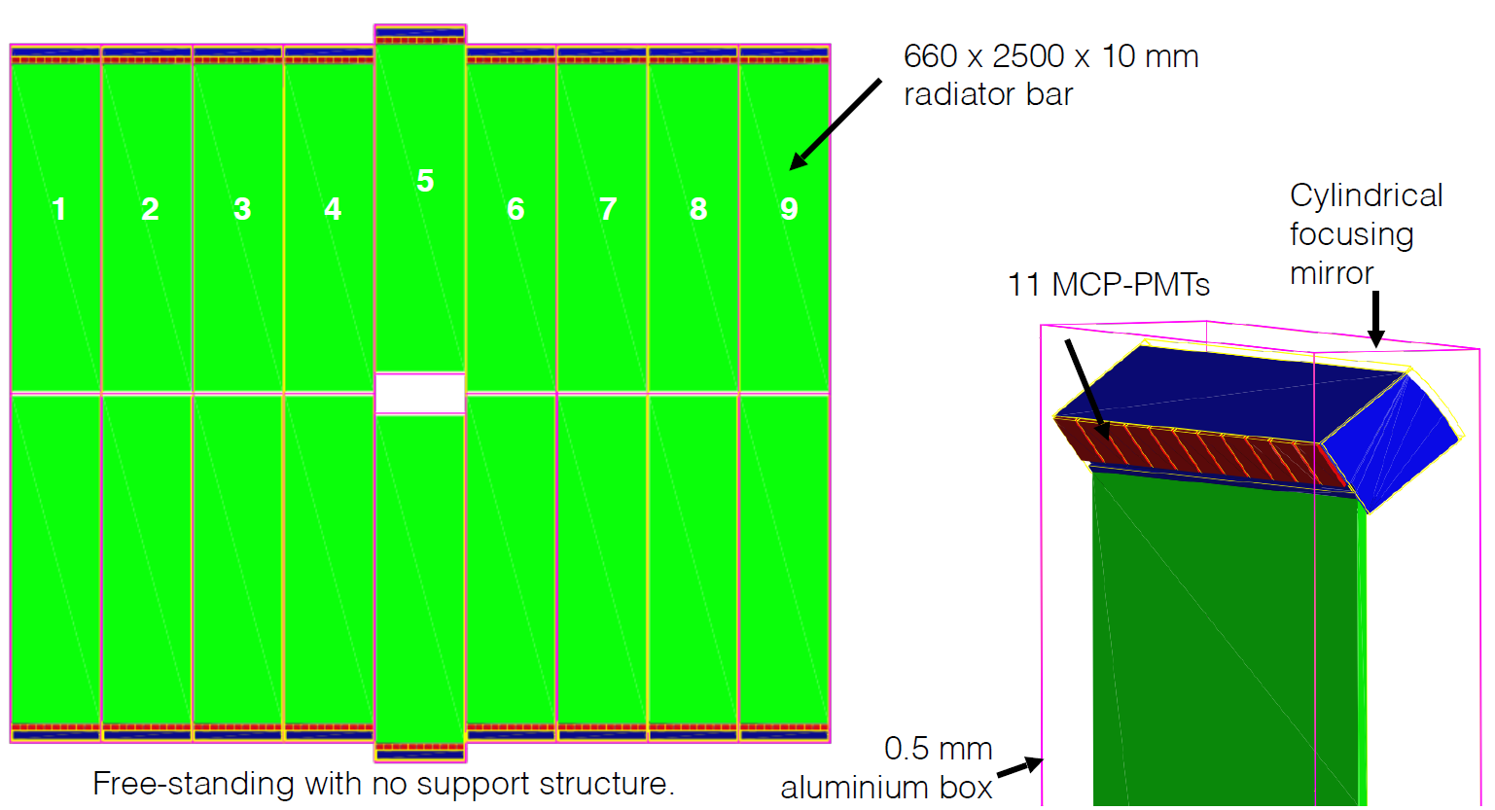
Module Geometry

Slide 4
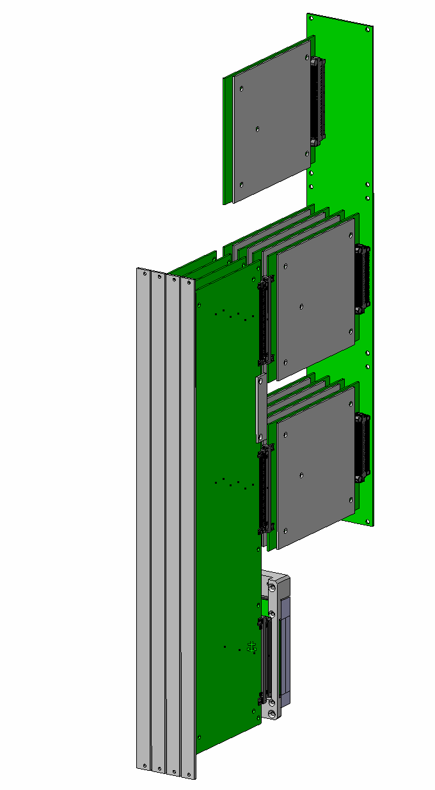
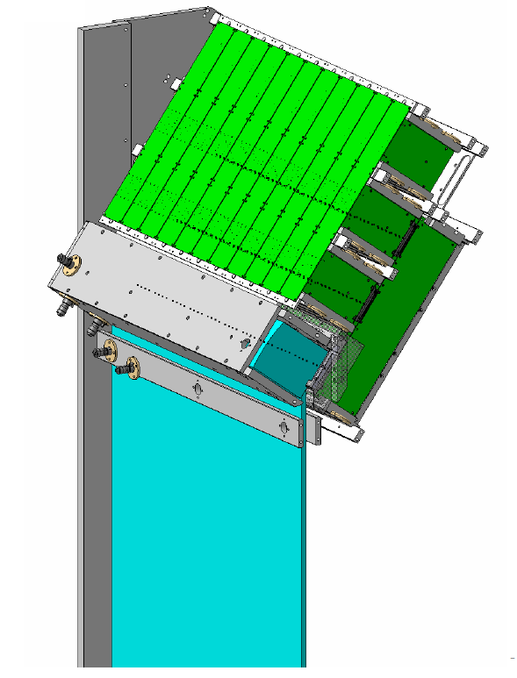
TORCH electronics
Current prototype system:
  10 MCPs
  64 x 8 channels per MCP
  NINO + HPTDC technology
Proposed full TORCH detector:
  Requires 18 x 11 x 64 x 8 = 101,376 channels – 1584 PicoTDC + spares
  TOT measurement using PicoTDC, 12.2ps resolution
  40Mhz continuous readout with LpGBT
Readout
HPTDC
NINO
MCP
Electronics in TORCH
prototype

Slide 5
Diagram of TORCH PicoTDC system
2 x PicoTDC,
1 x FPGA (240 I/O at least), 3 x lpGBT
SEU mitigation on FPGA may needed
4 x 8-bit e-link interface
7 x 4-bit interface
Front-end
picoTDC
FPGA
lpGBT
Uplink fiber
…
…
picoTDC
lpGBT
I2C
Master
lpGBT
Downlink
GPIO
clocks
JTAG

Slide 6
Short / medium term requirements
1 x PicoTDC evaluation board – already ordered
20 x packaged PicoTDC chips to upgrade HPTDC in TORCH prototype
  25ps mode in HPTDC showed better results compared to normal operation under 100ps mode

Slide 7
Backup slides

Slide 8
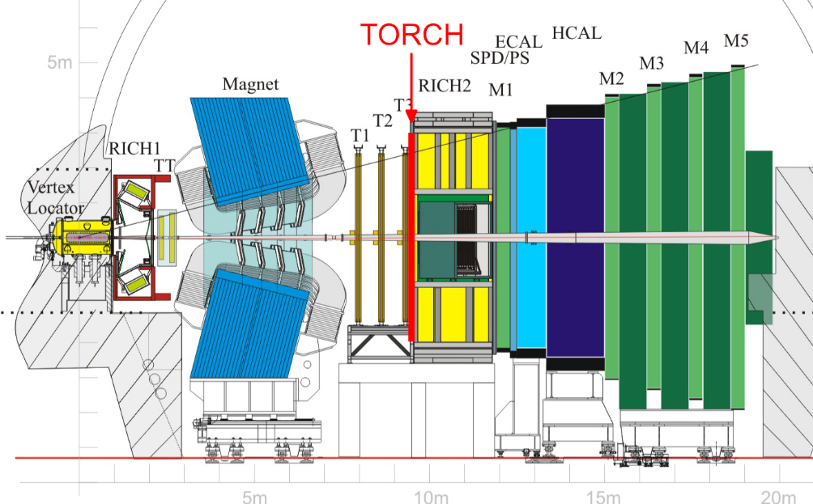
TORCH in LHCb

