Slide 1

New Beryllium Beampipe for a 4-layer PIXEL
Ray VENESS
with thanks to
Patrick LEPEULE

Slide 2
Contents
The currently installed central beampipe
Consolidation and Upgrade Project organisation
Beampipe diameter
Schedule
Open issues and next steps
Conclusions

Slide 3
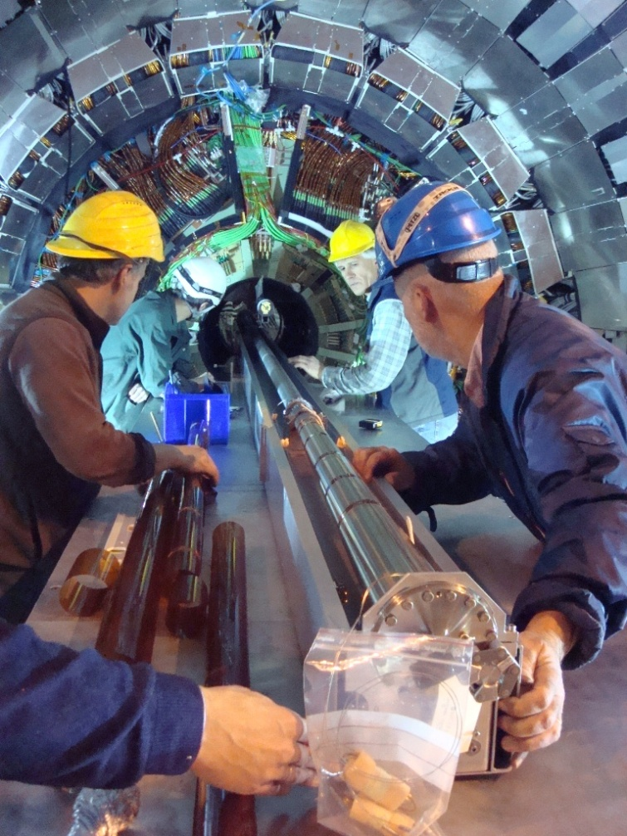
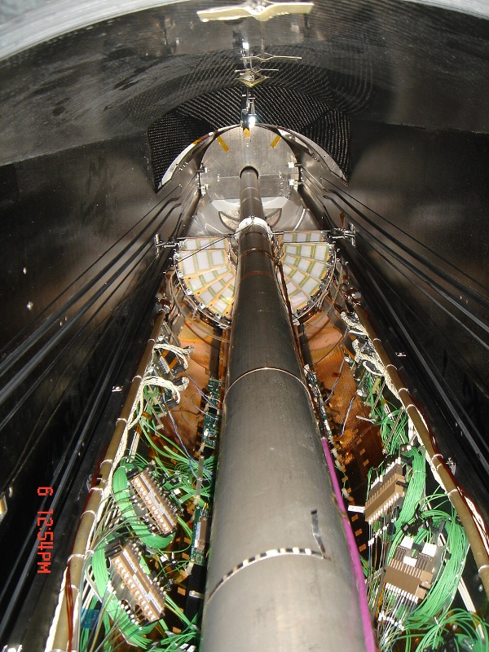
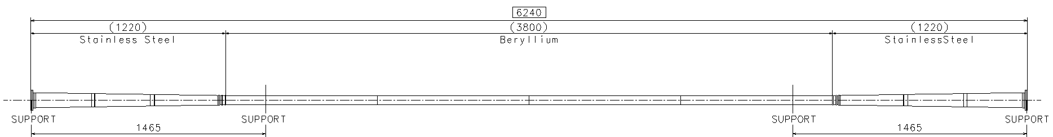
Installed beampipe
Integration test June ‘07
Installation in CMS Sept ‘07

Slide 4
Organisation of the Beampipe Upgrade Project
LEB (LHC Experimental Beampipes) working group
  Re-started in Jan ’09 following presentations to LHCC and CARE Workshop
  Mandate to “Define, set priorities and follow-up the activities for the consolidation and upgrade (phase I and II) of the experimental vacuum sectors in the LHC”
  Members proposed from all 5 experiments, plus machine groups and machine coordination, chaired by R.Veness
    CMS represented by the Technical Coordinator (A.Ball)
LEB action plan
  Step 1: Prepare list of priorities, with budgets and resources [done]
    CMS priorities include a new, smaller diameter beryllium pipe for the 4-layer PIXEL
  Step 2: Agree baseline diameter for upgrade central pipes [done]
    Common request from ATLAS and CMS
  Step 3: Agree layouts for 1st generation upgrades (ATLAS and CMS) [in progress]
  Step 4: Follow-up R&D and design of upgrades [in progress]

Slide 5
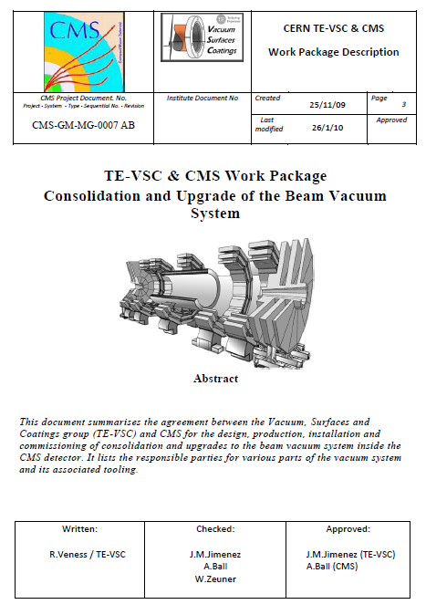
Organisation of the Beampipe Upgrade Project
Agree the scope
  Work package document (in final stages of editing), summarises:
    All CMS requested activities (including new beryllium pipe for the tracker)
    Overview of the work required
    VSC group resources needed
    Expected spending profiles for CMS and VSC
Project responsibilities
  VSC
    Detailed design (with input from CMS), production of the chamber, supports and any handling tooling
    Installation and commissioning
  CMS
    Integration in the detector (with input from VSC)
    Tooling and infrastructure to access the beamline

Slide 6
Review of Central Beampipe Radius
Review of machine upgrade status, requests from experiments, agreement of timeline
  http://indico.cern.ch/conferenceDisplay.py?confId=50854
Re-evaluation of ‘non-beam aperture’ related parts of the beampipe radius
  http://indico.cern.ch/conferenceDisplay.py?confId=53606
Re-evaluation of the beam aperture requirement and preparation of open issues
  http://indico.cern.ch/conferenceDisplay.py?confId=57013

Slide 7
Current Situation
‘Baseline’ established 28/5/09 in the LEB-WG
  Considering: Phase I upgrade machine, 14 TeV collisions, high-luminosity (low-β) optics, in the region ± 2 m from the IP
  25 mm beampipe radius is compatible with ‘upgrade’ aperture and mechanics
    Aperture for the ‘baseline’ optics and beampipe was confirmed in a LEB meeting in Sept ‘09
    http://indico.cern.ch/getFile.py/access?contribId=0&resId=1&materialId=slides&confId=67351
There are some issues
  Very high-β operation is not compatible with 25 mm radius for currently achievable emmitances
  Radii of forward chambers (eg, CT2) must be re-evaluated for Phase I upgrade
A number of open questions remain to validate this number
  Machine protection (larger TAS, smaller diameter central pipe)
  Machine-induced background
  Impedance requirements (smaller diameter central pipe)
  Re-evaluation of vacuum performance (smaller diameter, less conductance)

Slide 8
Contract timeline for installed beryllium pipes
CMS Chamber assembled ready for installation
Market survey placed
Installation in CMS starts
Call for tenders
Contract placed
2001
2002
2003
2004
2005
2006
2007
Engineering design approved
Finance committee approval for contract placement
ATLAS chamber delivered to CERN
CMS chamber delivered to CERN

Slide 9
Contract timeline for Installed beryllium pipes
CMS Chamber assembled ready for installation
Market survey placed
Installation in CMS starts
Call for tenders
Contract placed
2001
2002
2003
2004
2005
2006
2007
Engineering design approved
Finance committee approval for contract placement
ATLAS chamber delivered to CERN
CMS chamber delivered to CERN
Total contracting and manufacture time for one chamber: 2 years, 9 months
Total project duration: 6 years, 2 months

Slide 10
Next Steps for LEB
(relevant to CMS)
CMS upgrade layout is needed
  Agree beampipe diameters and materials for whole CMS sector
    Include estimates of alignment and stability tolerances for final aperture study
  Use as input for confirmation of baseline design
    Re-verify 25 mm radius beampipe for baseline LHC optics
    Machine protection, Background, Impedance, vacuum
    Some months will be required for these studies
Official approval of layout by LHC Machine Committee (LMC)
Advance in parallel with design

Slide 11
Conclusions
Project structure in place
  We have a forum for ‘formal’ information exchange between CMS and the machine (LEB working group)
  CMS have requested this new chamber, and the discussions over resources are (hopefully) nearly complete
Design ongoing
  We have agreed a common ‘next-step’ central radius of 25 mm with all concerned parties
  CMS must formally propose a layout request for analysis and approval
Schedule
  Experience shows us that we need at least 3 years from final design approval to delivery of the chamber to CMS

