Slide 1
RF systems and C-band structures
CompactLight "Glasgow Virtual" Meeting, 16-18 June 2020
M. Diomede (INFN-LNF)
on behalf of the WP3 C-band injector working team*
* D. Alesini, A. Vannozzi, G. Muti, F. Cardelli, E. Gazis, E. Trachanas, M. Croia, A. Gallo, M. Diomede, M. Ferrario, C. Vaccarezza, A. Giribono, L. Ficcadenti, J. Scifo, L. Pellegrino, G. di Raddo, B. Spataro.

Slide 2
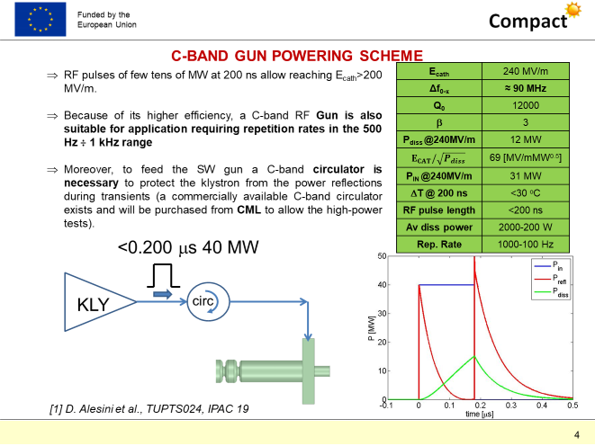
1.6 cell gun
Athens

Slide 3
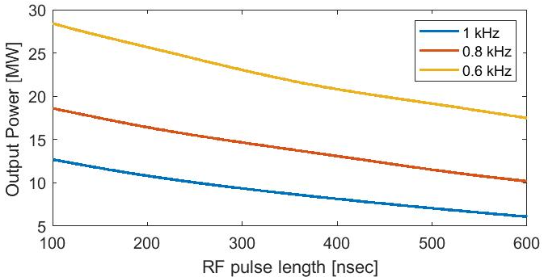
C-band klystron at high rep. rate
The CANON E37212 klystron is the only available option.
Looking at the values of the high-power C-band klystron Canon (Toshiba) E37212 that are specified for 100 Hz, 50 MW, t_{RF_MAX}=2.5 µs, t_{trans}=2.5 µs, we obtain P_{coll_MAX}=58kW.
Assuming equivalent transients given by solid state modulators similar to that measured on SPARC C-band klystrons (t_{trans}=1.2 µs) we obtain:
GUN:
300 ns
TWS:
460 ns
9 MW
7 MW

Slide 4
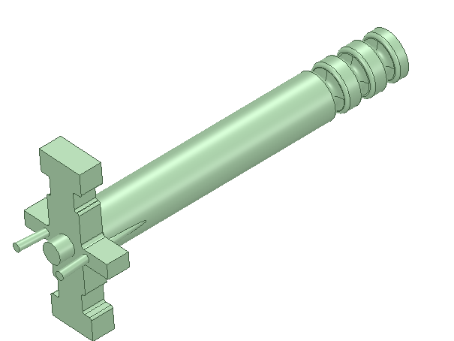
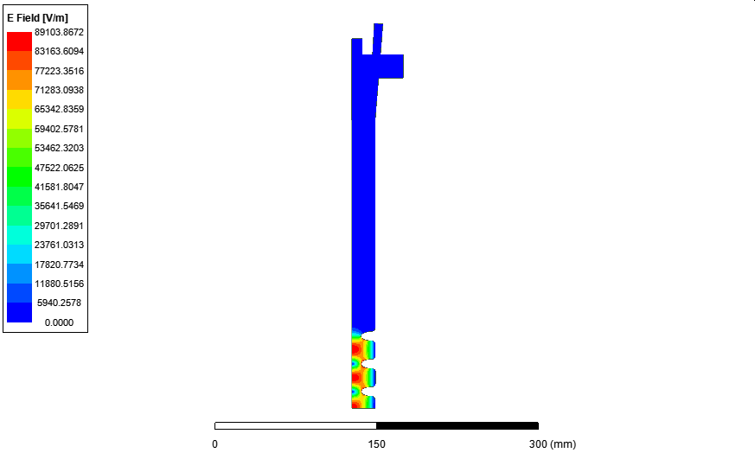
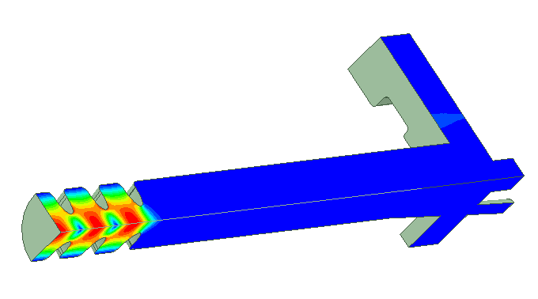
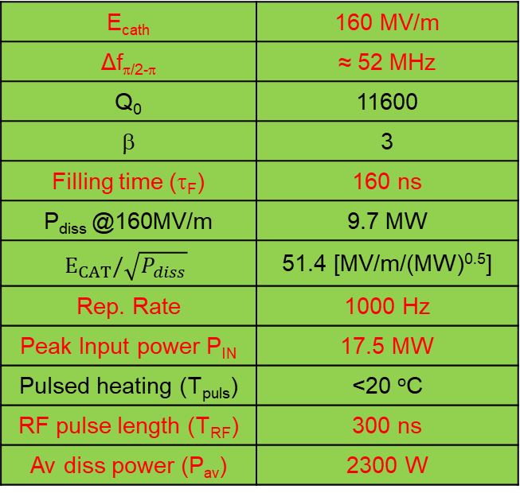
2.5 CELL GEOMETRY ELECTROMAGNETIC SIMULATIONS AND FINAL PARAMETERS
Accelerating cells
E_{cath} | 160 MV/m
Δf_{π/2-π} | ≈ 52 MHz
Q₀ | 11600
β | 3
Filling time (τ_{F}) | 160 ns
P_{diss} @160MV/m | 9.7 MW
$$E_{CAT}/\sqrt{P_{diss}}$$ | 51.4 [MV/m/(MW)^{0.5}]
Rep. Rate | 1000 Hz
Peak Input power P_{IN} | 17.5 MW
Pulsed heating (T_{puls}) | <20 ºC
RF pulse length (T_{RF}) | 300 ns
Av diss power (P_{av}) | 2300 W
RF ports
Pumping ports
Laser ports
Optimum value to maximize the peak field on cathode
solenoid
NB: in the present configuration 2 klystrons are needed to reach 160 MV/m on the cathode at 1 kHz.
With 1 klystron, simply scaling the performances of the present C-band sources (w/o R&D), we obtain 120 MV/m at 1 KHz

Slide 5
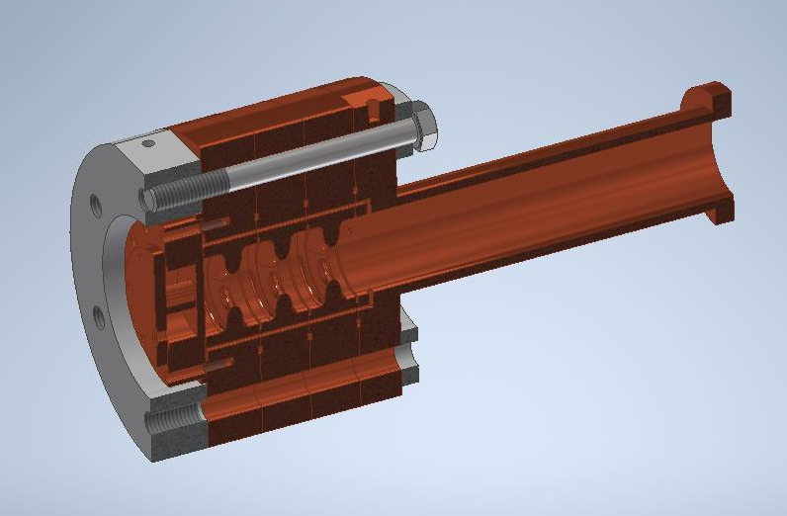
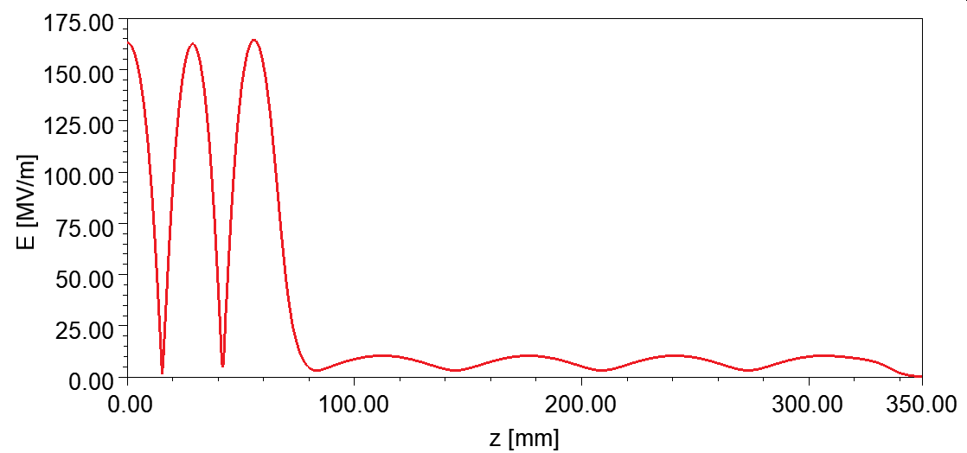
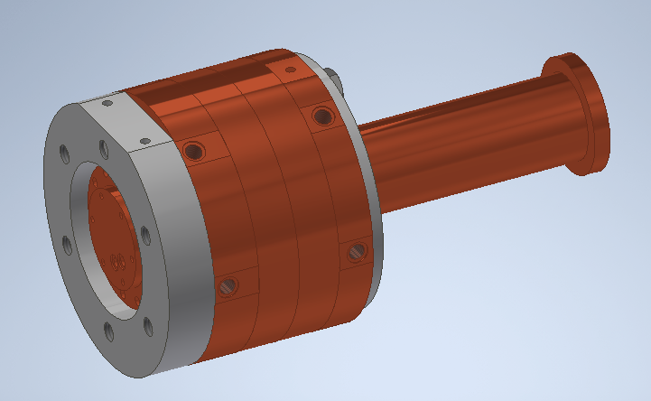
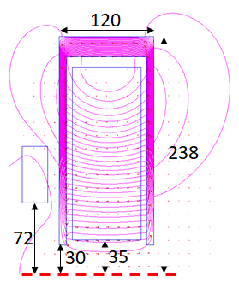
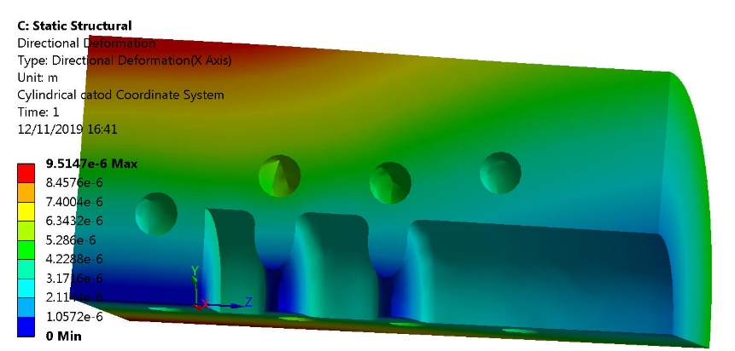
RF SIMULATION RESULTS AND MECHANICAL DRAWING
G. Di Raddo
1.5 cells
Bucking Coil
mm
In progress:
Mechanical drawing of the gun and solenoid and final termo-mechanical analisis
L. Pellegrino
A. Vannozzi

Slide 6
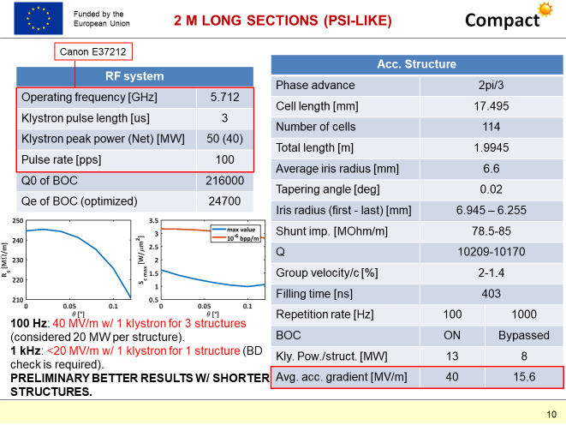
C-Band ACC. module
(@240 MV/m)
Athens

Slide 7
C-Band ACC. module
(@240 MV/m)
(@200 MV/m)
Canon E37212
Operating frequency [GHz] | 5.712
Klystron pulse length [us] | 3
Klystron peak power [MW] | 50
Pulse rate [pps] | 100
Acc. Structure
Phase advance | 2pi/3
Cell length [mm] | 17.495
Number of cells | 115
Total length [m] | 2
Average iris radius [mm] | 6.6
Tapering angle [deg] | 0.08
Iris radius (first - last) [mm] | 7.980 - 5.220
Shunt imp. [MOhm/m] | 70 - 96
Q | 10280 - 10123
Group velocity/c [%] | 3.2 -0.7
Filling time [ns] | 464
Repetition rate [Hz] | 100 | 1000
Avg. acc. gradient [MV/m] | 40 | 15
Wrt Athens, a pulse compressor is not needed with this new design (no margin)
In progress: calculations with smaller iris radii in order to have more margin

Slide 8
C-Band ACC. module
(@240 MV/m)
(@200 MV/m)
7 MW, 0.5 µs,
1 kHz
Canon E37212
50 MW, 3 µs,
100 Hz
MODULATOR HALL
LINAC HALL
2 m
Simple layout
Expensive: 1/2 kly/m (0.56 kly/m for the X-band module)
X-band module: more efficient (potential drawback: iris radius)

Slide 9
(@240 MV/m)
Conclusions
The EM design of a 2.5 cell gun has been performed
Wrt to the 1.5 one, it requires 2 klystrons for the 1 kHz operation
The design of the new solenoid has been performed
Mechanical drawings and thermo-mechanical analyses are ongoing
The design of the C-band module has been optimised for the 1 kHz operation
No need of pulse compressor
In progress: calculations with smaller iris radii in order to have more margin
(@200 MV/m)

