Slide 1
A Laser Heater for CompactLight FEL
S. Di Mitri, G. Perosa
Elettra Sincrotrone Trieste & University of Trieste

Slide 2
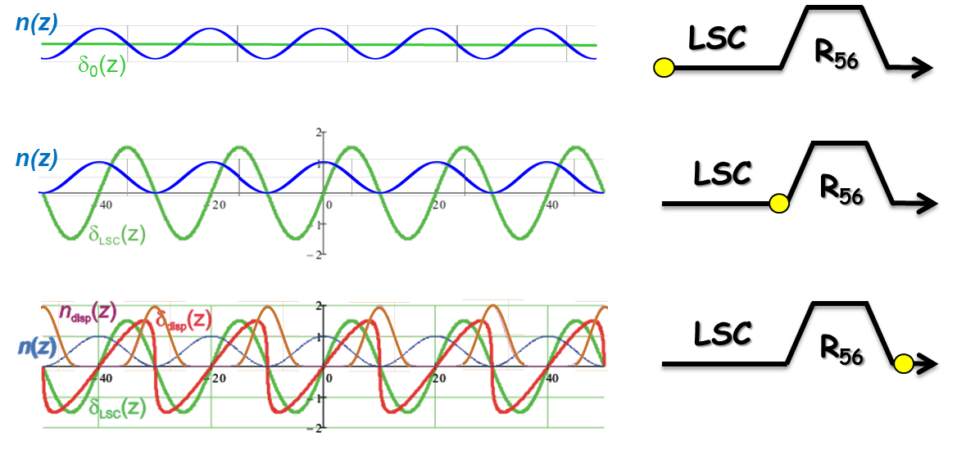
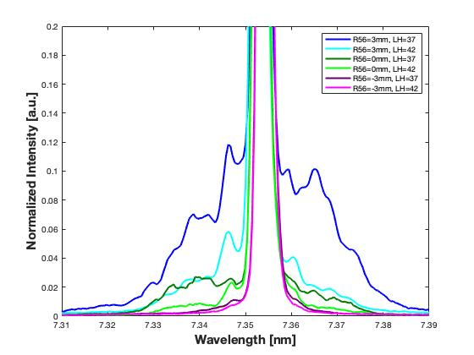
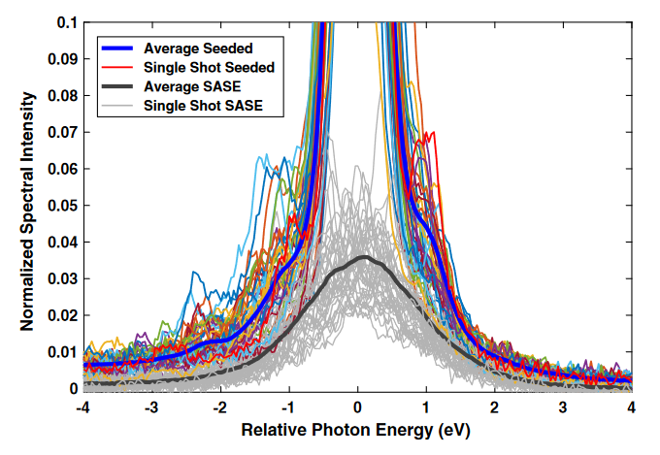

The problem
compression & amplification
σ_{δ,slice} > ρ_{FEL,}
_{Lower FEL intensity}
Peak at $\frac{r_{b}k}{γ}≃1$
energy mod.
λ ∼ 1 – 10 μm
R₅₆, CSR
λ_{MBI} ≈ λ_{coh,}
_{Larger FEL bandwidth}
LSC
density mod.
magnetic compressor
Self-seeding
linac
@ FERMI
λ_{uBI} ∼ 4 μm
λ_{uBI} ∼ 7 μm
k_{FEL} = hk_{seed} ± mk_{ubi}
SASE
G. Marcus et al., PRAB 22 (2019)

Slide 3
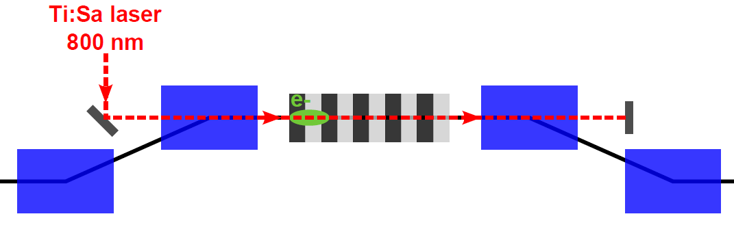
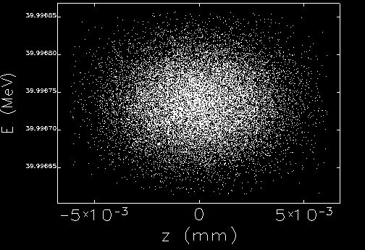
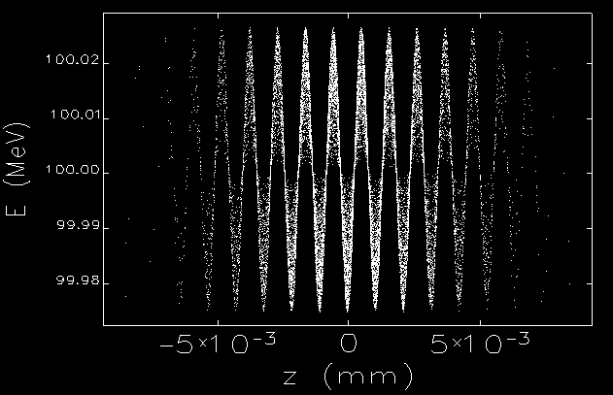
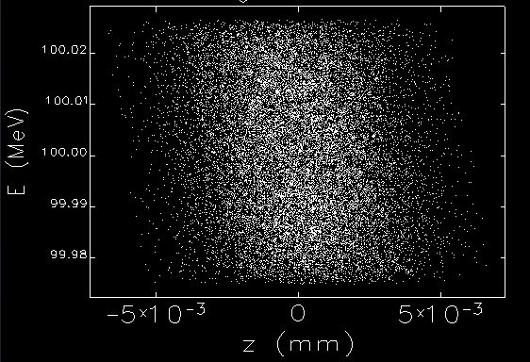

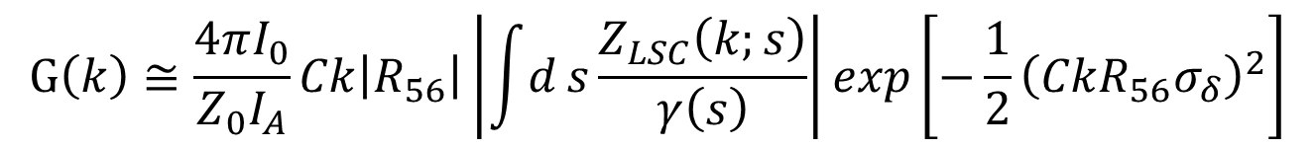

A solution
A tool to increase the initial beam uncorrelated energy spread, σ_{δ}
Gain = amplification of modulations
$$G\left(k\right)≅\frac{4πI_{0}}{Z_{0}I_{A}}Ck\left|R_{56}\right|\left|\int{d}s\frac{Z_{LSC}\left(k;s\right)}{γ\left(s\right)}\right|exp\left[−\frac{1}{2}{\left(CkR_{56}σ_{δ}\right)}^{2}\right]$$
amplification
damping
Why in a chicane ?
To wash out the laser modulation,
For laser injection collinear to the e-beam, and extraction.
  $$\left|R_{52}\right|σ_{x′}≫λ_{L}/2π$$
$$λ_{L}$$

Slide 4
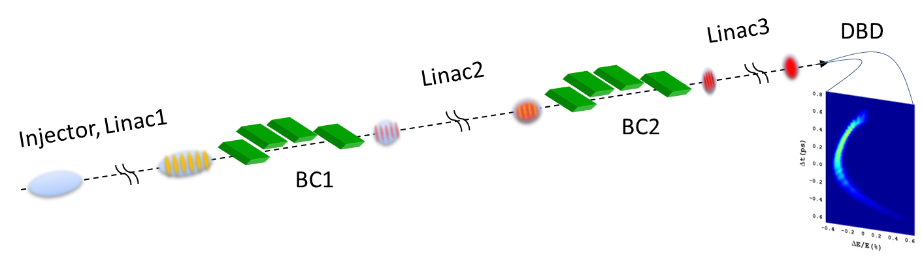
Modelling the microbunching instability
Input:
beam parameters at ∼100 MeV;
initial SES from tracking runs (2 keV @ 75 pC);
Linac gradients;
Compression factors (bunch core);
Emittance and average betatron functions.
Collective effects:
1.5-D LSC and CSR impedance;
2-D laser heater;
Intrabeam scattering;
transverse and longitudinal Landau damping.
Output:
spectral gain;
energy modulation;
SES (equivalent)

Slide 5
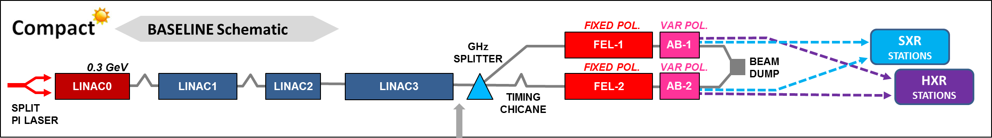
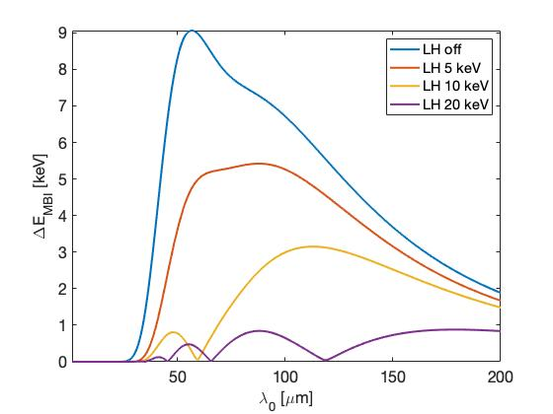
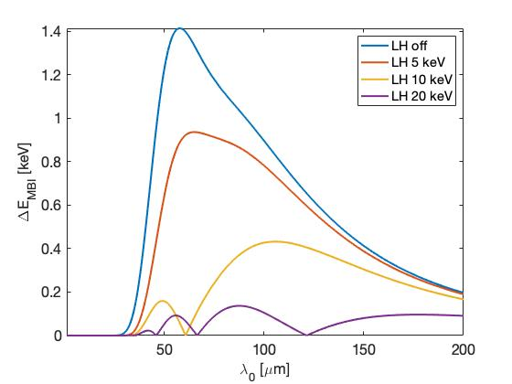
Do we really need a LH ?
HX FEL: ∼4 kA @ 5.5 GeV
SX FEL: ∼4 kA @ 1.9 GeV

Slide 6
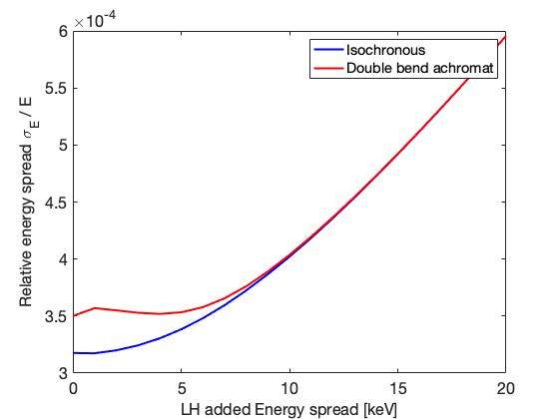
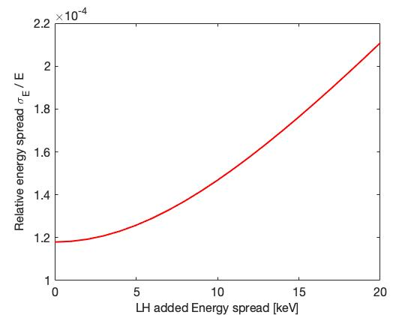
A closer look to the energy spread
SX FEL: SES vs. LH at the spreader end
HX FEL: SES vs. LH at the linac end
Although not essential for lasing, LH is highly recommended for an optimized brilliance
The linear trend (---) corresponds to MBI fully damped.
Deviation from it (-.-.-) sets the minimum LH level for damping.

Slide 7
Guidelines to LH design
Beam energy:
at as low energy as possible since damping ∼ ΔE_{LH}/E₀ (< 200 MeV or so)
better control if out of the beam space charge regime (> 80 MeV or so)
Laser:
short lambda for more efficient smearing of the laser modulation (1 or 0.5 micron)
must tolerate 1 kHz rep. rate (expected ∼10 mW average power)
Chicane:
bending angle is a compromise between length, laser injection, smearing and CSR-induced emittance growth (typically < 6 deg)
Should include 2 view screens and 2 BPMs
Undulator:
undulator period has to match the beam energy (typically, few cm)
the number of periods is a compromise between max. heating and coupling to the laser bandwidth (∼10 periods are usually enough)

Slide 8
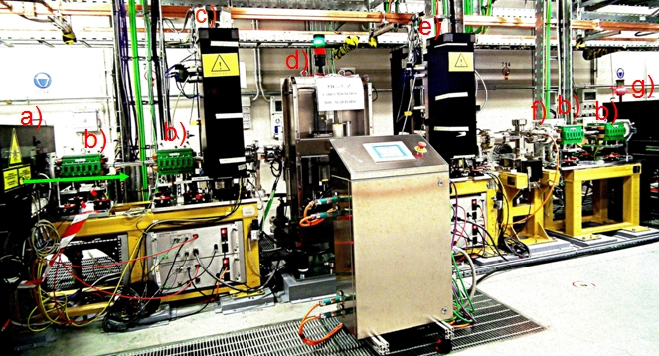
Design – educated assumptions
Educated assumption: N_{und}=8, B_{und} = 0.4 T
(depends on gap and period length)
On the shelf: Yb laser @ 1064 nm. Spill 2nd harmonic from the PIL
From instability model: σ_{E,LH} ≤ 30 keV
(larger values from higher laser energies)
From simulations:
σ^{e}_{x,y} = 70 μm, E=110 MeV @ und (still ok up to 130 μm, 150 MeV)

Slide 9
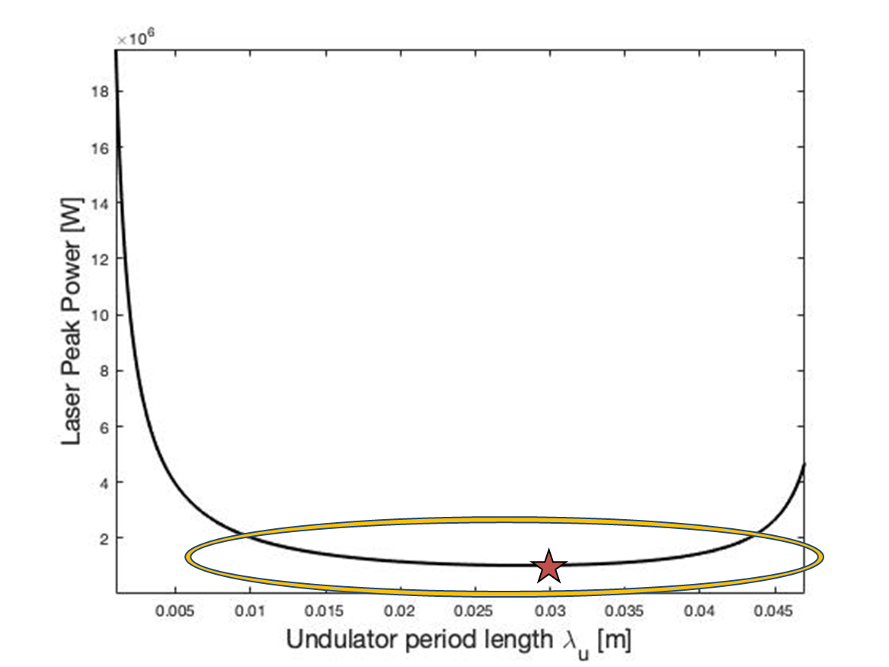
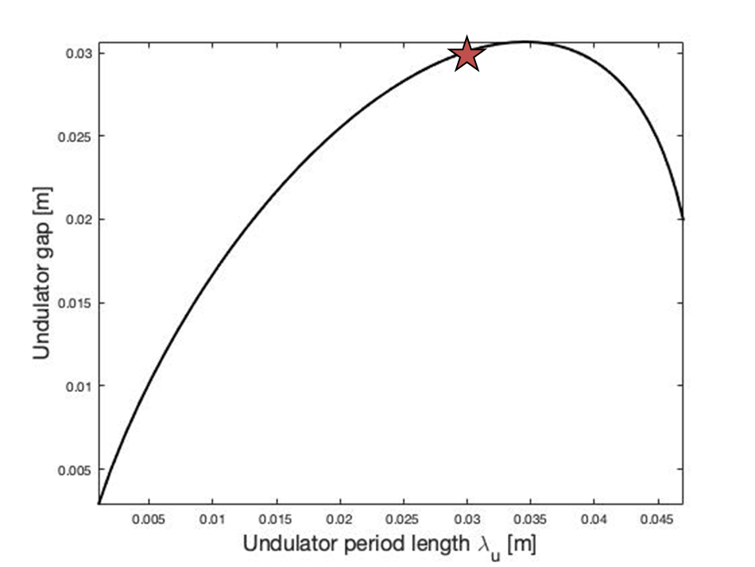
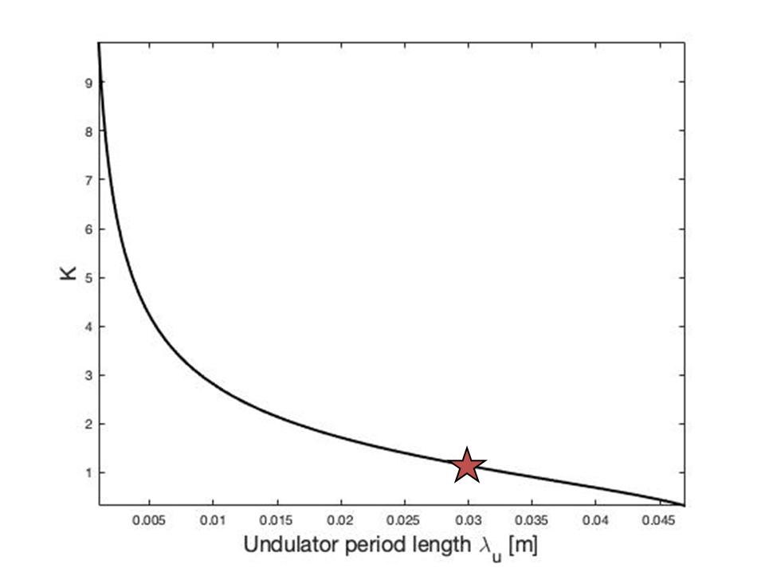
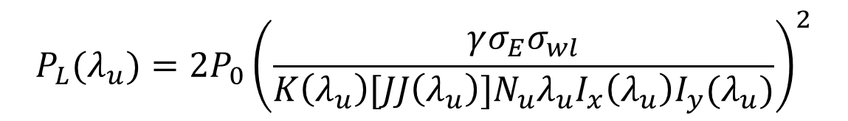
Design – optimization
With assumptions in the previous slide, the laser power only depends on the undulator period:
$$P_{L}(λ_{u})=2P_{0}{\left(\frac{γσ_{E}σ_{wl}}{K\left(λ_{u}\right)[JJ\left(λ_{u}\right)]N_{u}λ_{u}I_{x}{\left(λ_{u}\right)I}_{y}(λ_{u})}\right)}^{2}$$
gap = 30 mm
K = 1.2 (0.4 T)
Power = 1 MW

Slide 10
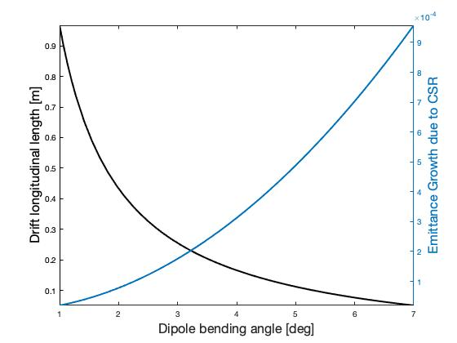
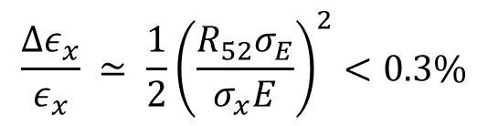


Design – chicane
For large smearing of the laser modulation, we impose: $R_{52}≈3× \frac{λ_{laser}}{2πσ_{x}^{′}}≈$ 18 mm.
$$\frac{Δε_{x}}{ε_{x}} ≃ {\frac{1}{2}\left(\frac{R_{52}σ_{E}}{σ_{x}E}\right)}^{2}<0.3\%$$
emittance growth from laser interaction in a dispersive region
$$l_{drift}=f(R_{52},θ)$$
emittance growth CSR in a chicane
$${Δε}_{x,CSR}=g(R_{52},θ)$$
Total LH length including diagnostics is ≤ 1.5 m
Does not need dedicated matching quads
At least 30 keV added
Δε_{x} = 0.05%
L = 0.1 m
θ = 5.2 deg → L_{dip} = 0.1 m

Slide 11
Conclusions
Microbunching instability in CompactLight is not expected to be a show stopper.
A laser heater is highly recommended to maximize the FEL brilliance, especially for seeded schemes.
Tens’ of keV energy spread at 1 kHz are guaranteed in a 1.5 m-long insertion.
Thank you for Your kind attention – questions are very welcome

