Slide 1

XLS CAD model
Nick Gazis, Eugene Tanke,
Andrea Bignami, Emmanouil Trachanas, Evangelos Gazis
IASA & ESS Team
16 June 2020

Slide 2
Outline
Introduction of 3D CAD MODEL
2. CAD/CAM System CATIA V5 & V6
3. 3D CAD: Study Case the XLS-Injector
4. 3D CAD model for XLS based on the baseline layout
5. Girder Analysis
6. Requests from CAD modelers to XLS Collaboration

Slide 3
1. Introduction of 3D CAD MODEL
Why a 3D CAD XLS model?
A 3D model provides benefits such as:
It aids in planning and design (e.g.– conceptual design during the conceptual phase)
It aids in integration activities:
  The 3D models can be used to support vision sharing, and they help discovering, resolving design issues early (e. g. clashes, interfaces, assembly clearances etc.) and the models can be readily available for FEA simulations
It is the smart modern way of design – avoiding the need for an army of designers and engineers
Our 3D model can range from the overall XLS layout down to detailed models of individual accelerator components
It can serve as a repository of the 3D designs (XLS Engineering Data Management System-EDMS repository)
This presentation explains the modeling technique and shows examples of model usage

Slide 4
2. CAD/CAM System CATIA V5 & V6
Our CAD team has been using CATIA V5 & V6 and is available to support XLS at the appropriate level of detail for design studies.
This platform is typically used for medium or large technical designs as it can handle tenths of thousands of unique designs and specs.
User Friendly (light representations) of the models can be imported in freeware software (Navisworks) for simple use (e.g. distance measurements, presentation discussions) in different OS (Windows, Mac etc).
3D-models and 2D-drawings can be produced on the same platform with the capability of using version control and design evolution validation

Slide 5
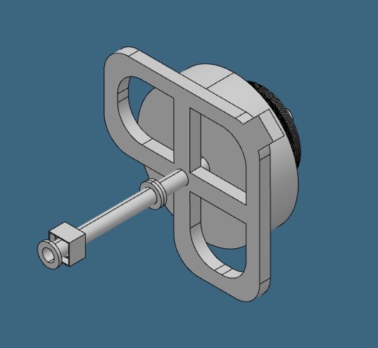
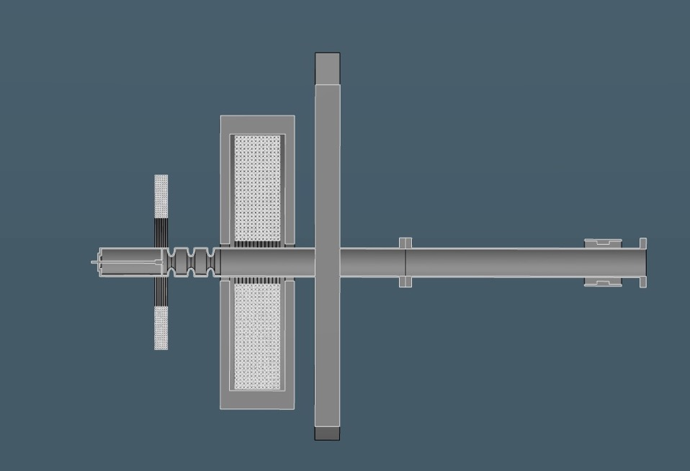
3. 3D CAD: Study Case the XLS-Injector
2.5 Cell Gun
2.5 cells gun
Mode Launcher
Cathode plug
Coupler location
Drift 0.7m for diagnostics
Gun solenoid, bucking coil

Slide 6
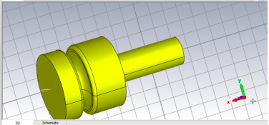
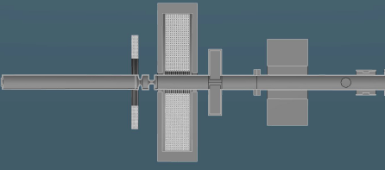
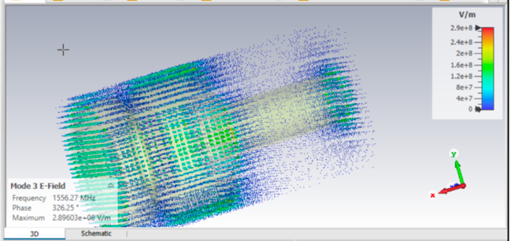
3. 3D CAD: Study Case the XLS-Injector
1.6 Cell Gun
CST Eigenmode analysis
A preliminary 1.6 cell cavity was used
to perform first Eigenvalue simulations
without excitation.
Tetrahedral Mesh was used with the method AKS (Advanced Kyrlov Subspace) for the first 35 EM modes.

Slide 7
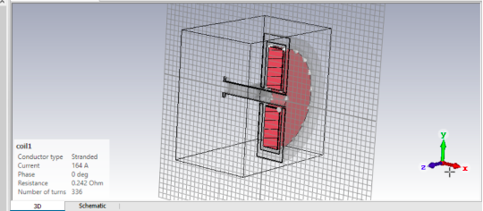
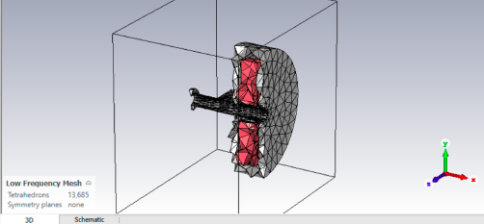
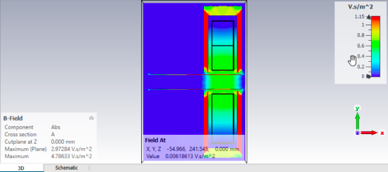
3. 3D CAD: Study Case the XLS-Injector
Gun Solenoid
CST Magneto-Static analysis
Field distribution
Result is in between Emmanouil’s and Alessandro’s field values

Slide 8
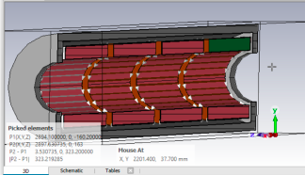
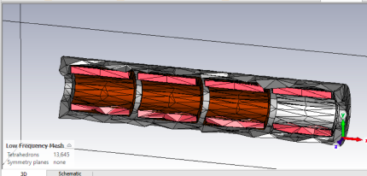
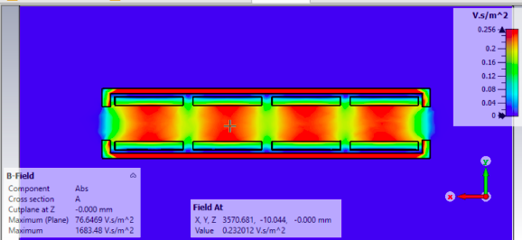
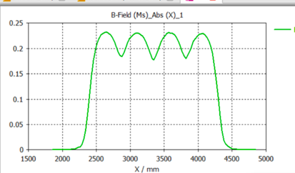
3. 3D CAD: Study Case the XLS-Injector
TW Solenoids
CST Magneto-Static analysis
The 3D file was imported in CST studio to perform a magneto-static simulation.
Steel-1008 was chosen for yoke material, as the lowest carbon-steel percentage available in CST library. Annealed Cu was chosen for the coil material. Coils were defined with the CST coil tool, inserting the same amount of current, ampere turns and resistivity as presented in the solenoid parameters. The result in the center of the solenoid on the beam axis is 0.22 T (magnetic flux density), same value obtained by SUPERFISH also.
Field distribution
Results H filed, B filed, Magnetic Energy Density and comparison with SUPERFISH results:

Slide 9
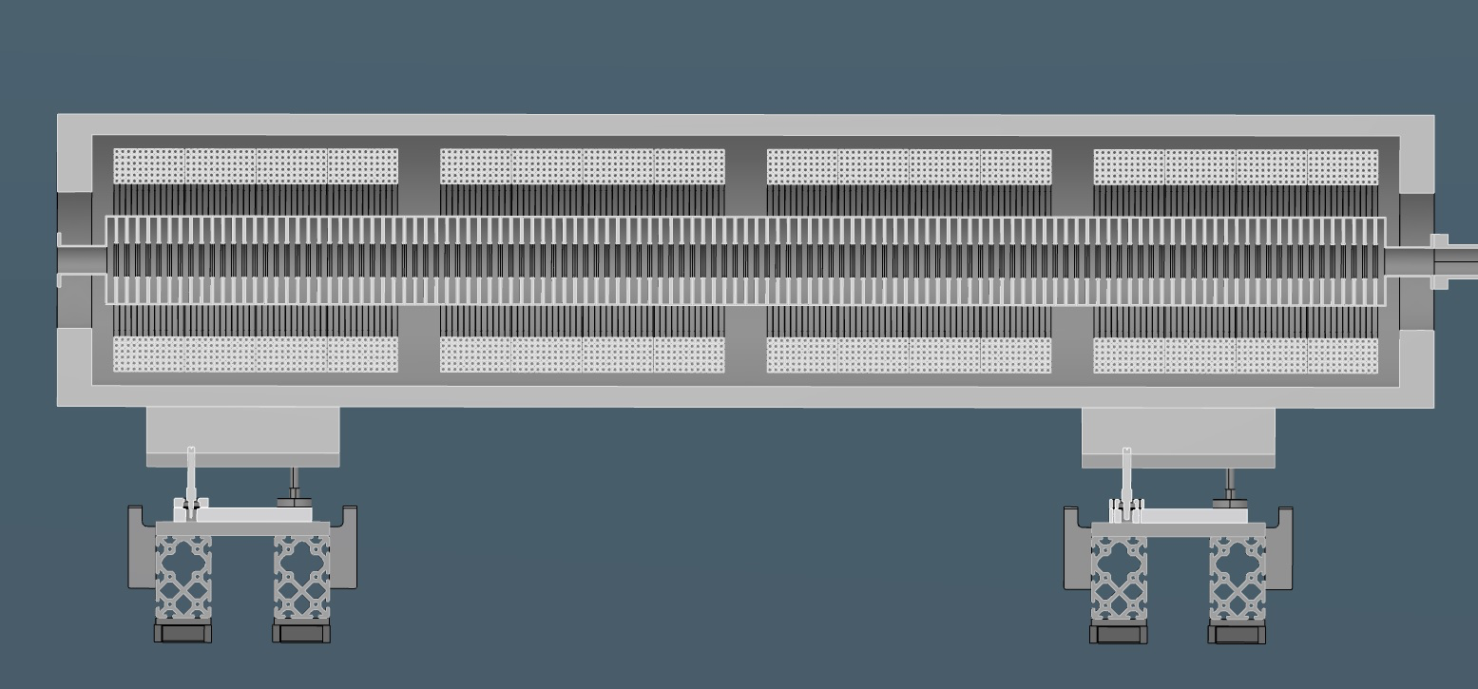
3. 3D CAD: Study Case the XLS-Injector
Injector TWS
Low carbon steel yoke
120 cells TWS
Solenoids with common yoke
4 coils ~0,5m -> 0.22 T field

Slide 10
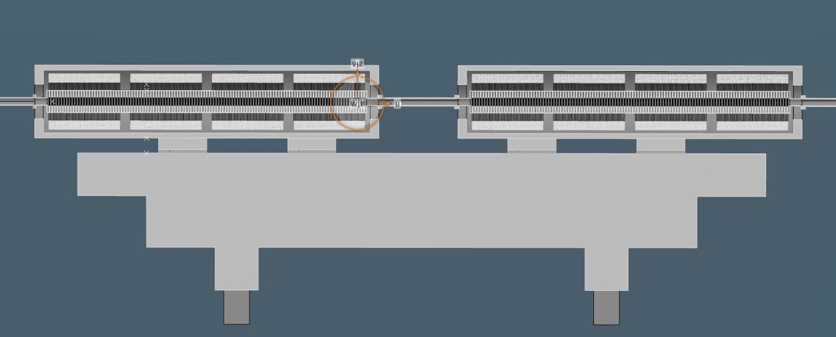
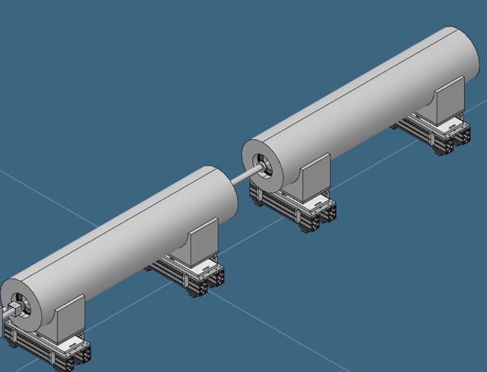
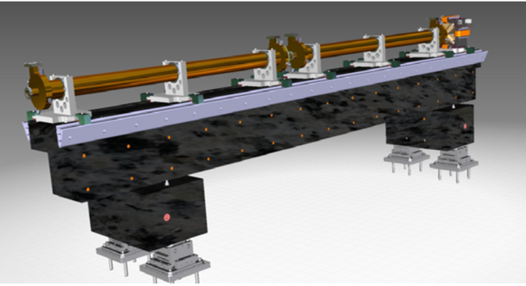
3. 3D CAD: Study Case the XLS-Injector
Injector TWS
Girder design for XLS inspired by SwissFEL girder
Travelling wave structures with solenoids on Linac 0
SwissFEL girder
Reference: SwissFEL Conceptual Design Report

Slide 11
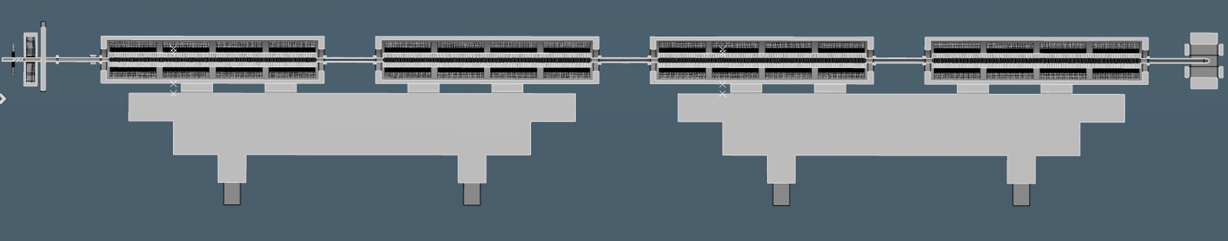
3. 3D CAD example XLS-Injector with Girder
2.5 cell gun
Section view until laser heater
120 cell TWS
girder

Slide 12
3. 3D CAD example with XLS-Injector for our next steps

Slide 13
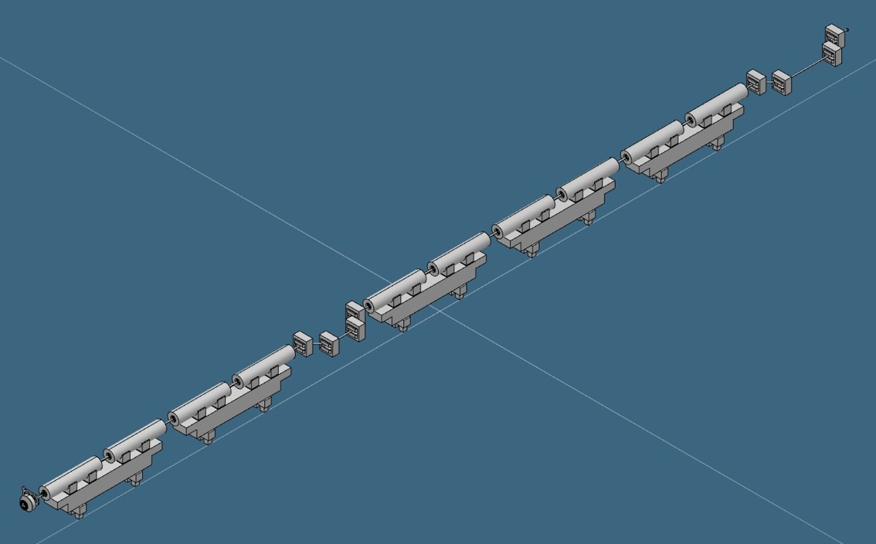
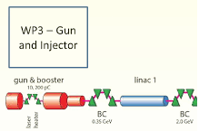
3. 3D CAD: XLS-Injector case study
K-linearizer and X-band deflector to be included
Gun and injector setup
BC1
~25 m
Laser Heater location
Gun

Slide 14
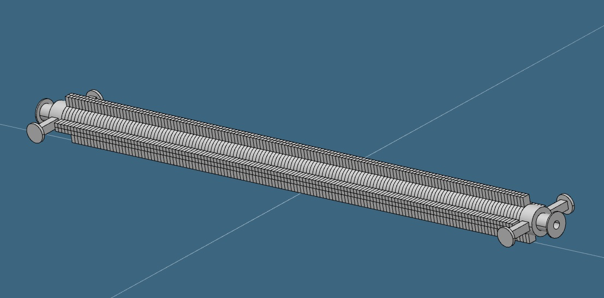
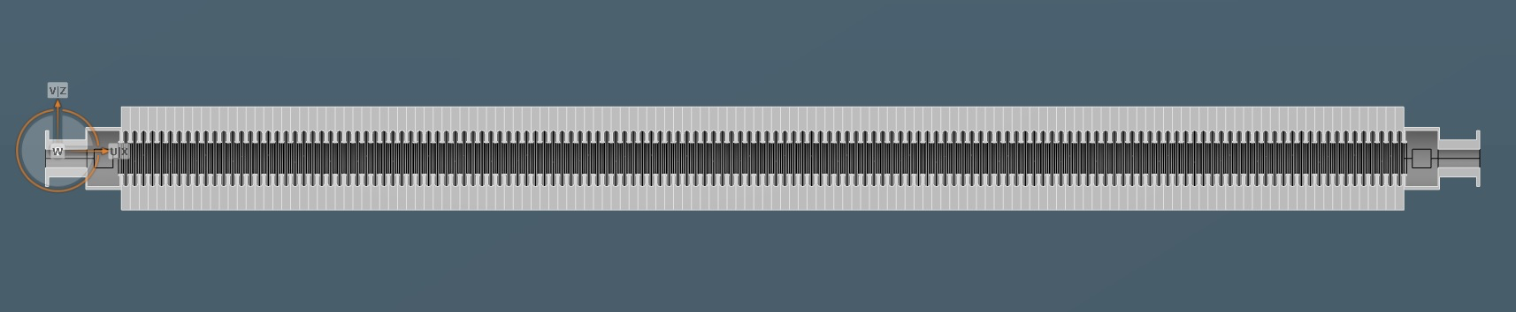
3. 3D CAD example with XLS-Injector
X-band structure

Slide 15

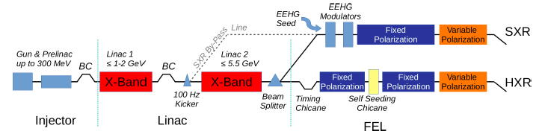
4. 3D CAD model for XLS based on full baseline layout
This baseline layout will be followed; taking into account any further improvement.

Slide 16
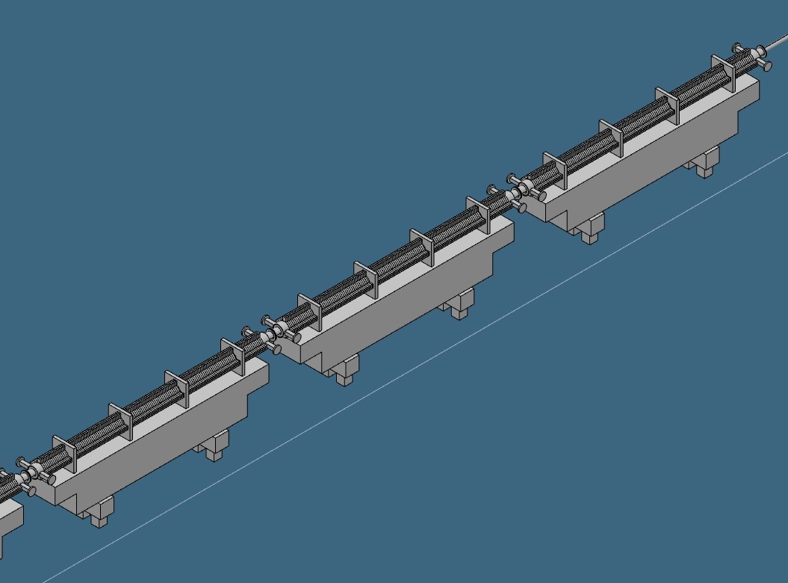
3. 3D CAD example with XLS-Injector linac with Girder
Example of Linacs 1, 2 & 3 X-band structures on girders

Slide 17
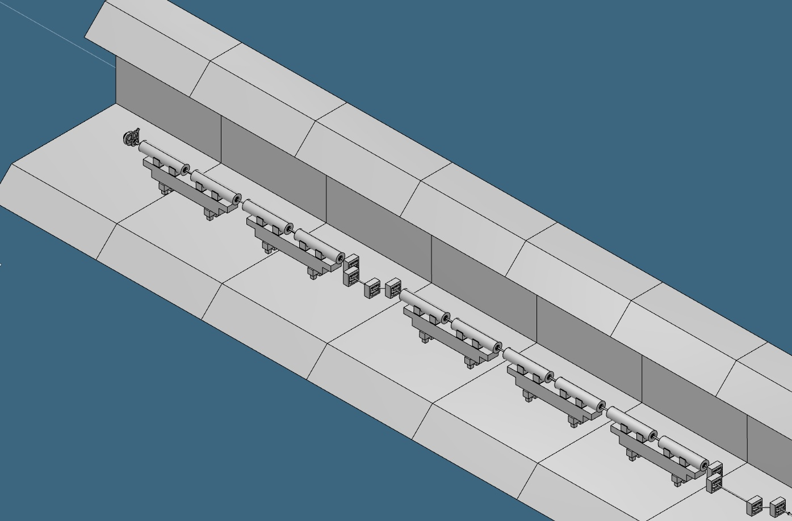
4. 3D CAD MODEL for XLS injector in the tunnel
3.5 m
5 m
Tunnel roof,
in this example shown at
3.5 meters from the tunnel floor
MCS*
(0,0,0)
Y axis
(vertical)
X axis
(transversal)
Z axis
(beam)
*MCS: Machine Coordinate System
(as well as the location of the Interaction Point with X-ray generation) will need to be defined for XLS

Slide 18
5. Girder Choice: Points to keep in mind
Modular design of component “clusters” is imperative for a compact machine
Common girders allow for compact pre-assembly, extensive part testing and reduce drastically the installation time
Tolerances, machine precision and alignment degrees of freedom will seriously impact the cost profile of the accelerator
Active repositioning or passive alignment is a choice dictated by beam tolerance and machine alignment budget
Investing in CAD design & integration combined with supporting system study in this stage will reduce errors of manufacturing, assembly and future needs for spares
This implies that analysis of the girders will be required

Slide 19
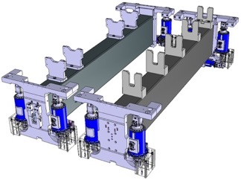
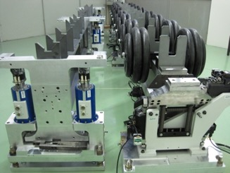
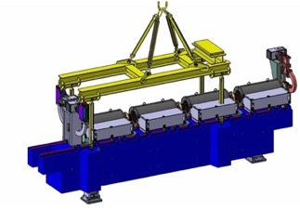
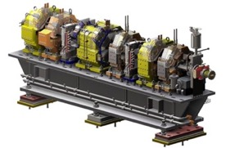
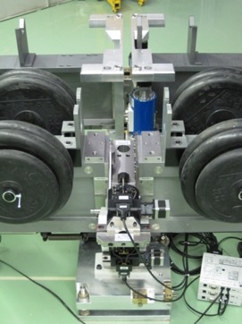
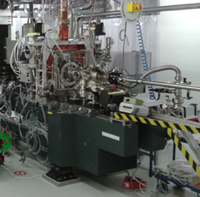
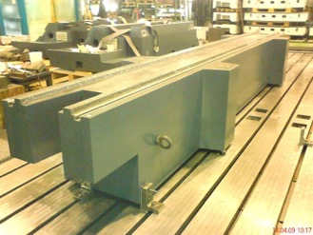
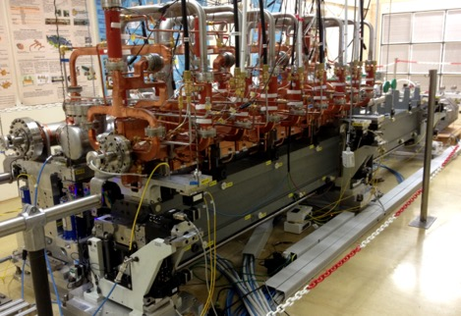
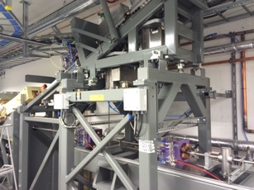
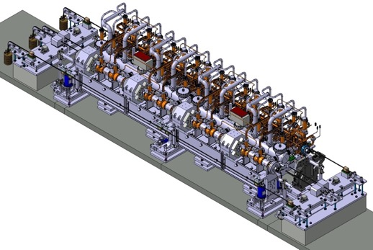
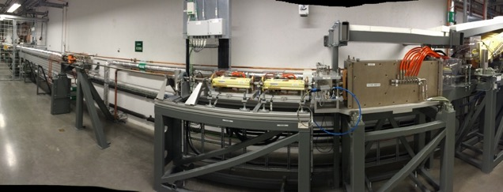
5. Girder Analysis: Few options for supports and alignment
PSI
Damping girders with high-frequency absorption capacity
Prestressed isolating girders with active alignment
MAX IV
Individual girders
CERN CLIC
CTF & CLEX

Slide 20
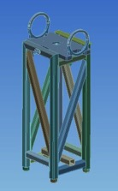
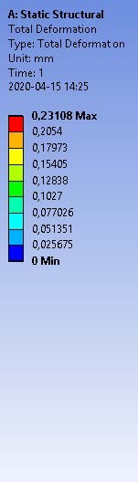
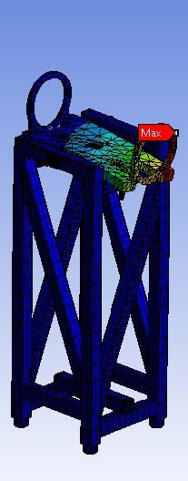
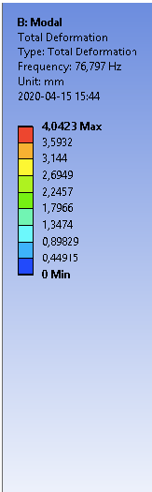
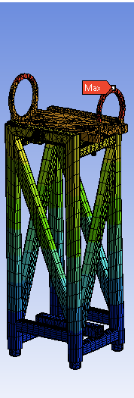
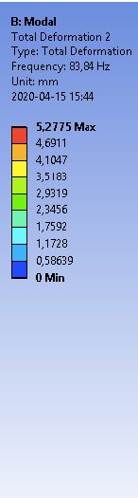
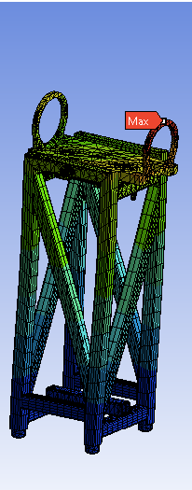
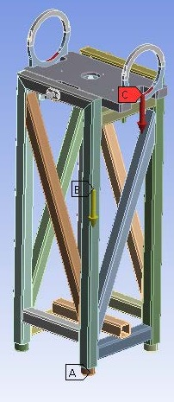
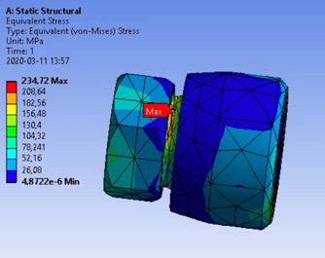
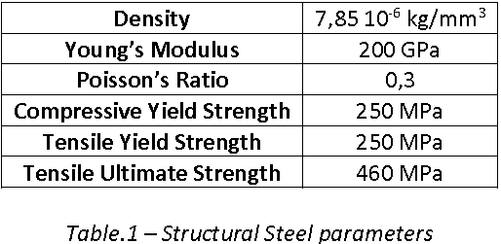
5. Girder ANSYS simulation
Material: ANSYS Structural Steel for girder material
Geometry: This version of XLS girder is the exact transposition from the MAX IV’s girder model
Max stress concentration on the spherical joint, between the horizontal support and the legs that allows to orient the horizontal plane on which the round supports are mounted

Slide 21
6. Requests from CAD modelers to XLS Collaboration
In order to efficiently integrate the XLS accelerator beam line elements in the 3D model, the following information would be needed:
Quantity and types of beam line elements
Size and Position (e.g. relative to e-gun cathode) of each beam line element and of their internal structure, where possible
Space needed for the beam instrumentation parts, deflectors, etc.
In order to have a 3D model of the entire facility, the scale of the model should be given by the collaboration
All colleagues are welcome to contact us and request CAD modelling of their parts, integration of designs, etc.!

Slide 22
References
L. Hagge, J. Kreutzkamp, S. Lang, S. Suehl, N. Welle, Examples for 3D CAD Models at the European XFEL, Conf.Proc.C 1205201 (2012) 3266-3268
L. Hagge, J. A. Dammann, T. Hongisto, D. Käfer, J. Kreutzkamp, B. List, S. Rohwedder, S. Sühl, N. Welle, ENGINEERING DOCUMENTATION AND ASSET MANAGEMENT FOR THE EUROPEAN XFEL ACCELERATOR, Proc. IPAC2017, 3960-3962
N. Bergel, L. Hagge*, T. Hott, J. Kreutzkamp, S. Sühl, N. Welle, INTER-DISCIPLINARY MECHANICAL AND ARCHITECTURAL 3D CAD DESIGN PROCESS AT THE EUROPEAN XFEL, Proc. EPAC08 1467-1469
R. Dubovska, J. Jambor, J. Majerik, Implementation of CAD/CAM system CATIA V5 in Simulation of CNC Machining Process, Procedia Engineering 69 (2014) 638 – 645
N.Gazis, E.Tanke, M.Lindroos, M.Tacklind, P.Radahl, K.Jonsdottir, Mechanical Engineering, Design and Structural Health Monitoring at the ESS facility to enable science, Int. J. Mod. Phys., World Scientific, under publishing

Slide 24
Back-up slides

Slide 25
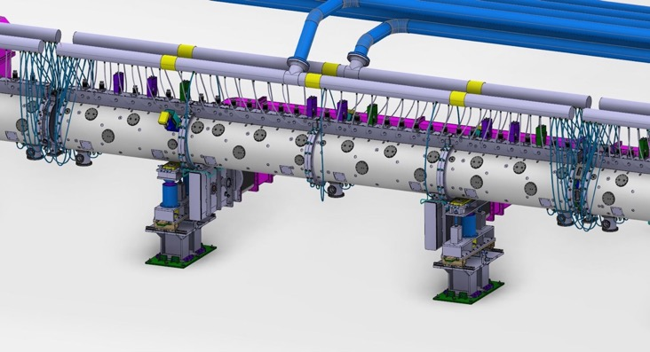
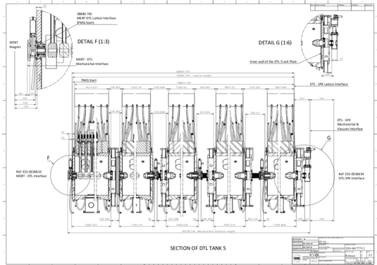
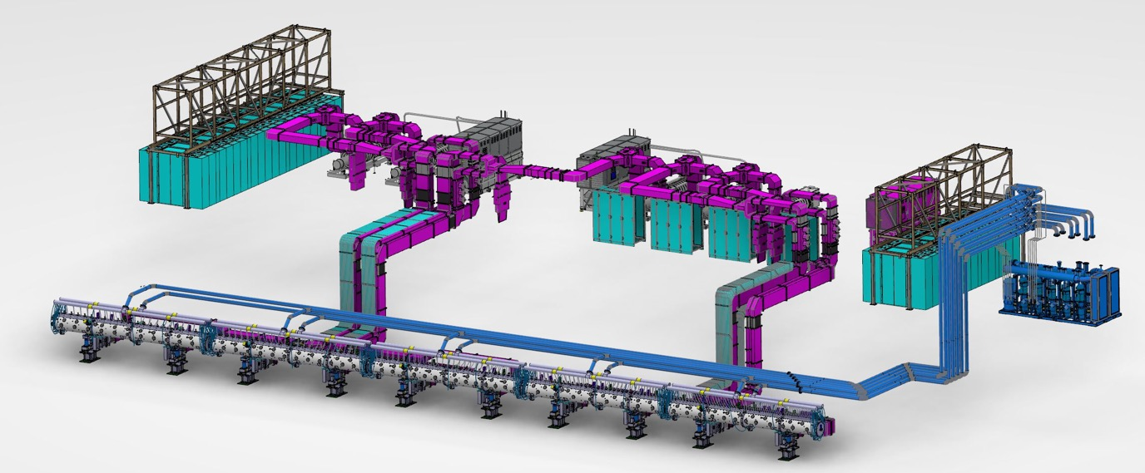
Engineering considerations
A compact linac does not only contain the accelerating parts but also the power sources, electronics, controls, waveguides, cooling sources etc. and assembly that need design and space to fit in
DTL
DTL assy dwg
Operational DTL

Slide 26
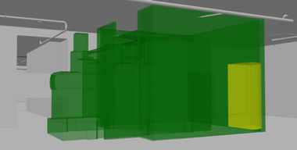
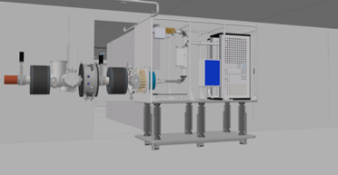






Machine design maturing cycle
1. Space reservation
2. Preliminary Design
3. Detailed Design
4. Manufacturing launch
5. Installation Review
6. Testing
26
7. As-Scanned
8. As-Built & Commissioned

