Slide 1
Two-bunch operation for Compact Light:
Sub-harmonic deflector design progress
Xiaowei Wu, Walter Wuensch
xiaowei.wu@cern.ch
17.6.2020

Slide 2
Outline
1. Introduction to sub-harmonic deflector
2. Sub-harmonic transverse deflecting cavity design
3. Sub-harmonic transverse deflector system
4. Summary

Slide 3
Outline
1. Introduction to sub-harmonic deflector
2. Sub-harmonic transverse deflecting cavity design
3. Sub-harmonic transverse deflector system
4. Summary

Slide 4
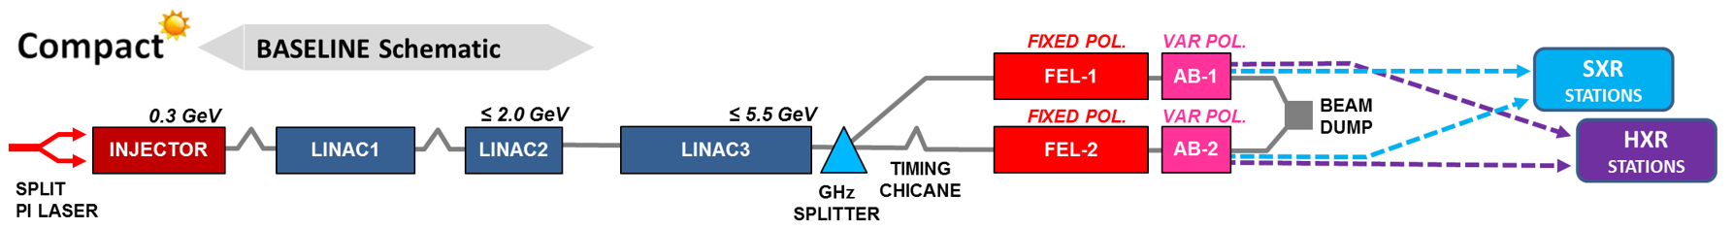
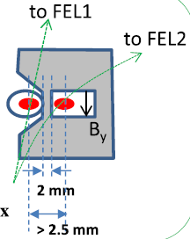
Bunch splitter before FEL structure
1000 Hz soft X-ray
100 Hz hard X-ray
Need a splitter to separate the two bunches into two FEL lines
Distance between the two bunches should be over 2.5 mm at the entrance of septum
Use transverse deflecting cavity to spit the two bunches
Splitter
x=2.5 mm
y=drifting length

Slide 5
Sub-harmonic delfector and spacing between two bunches
Δt = n τ_{gun}, n = 1,3,5...
Δs = n λ_{gun}
n (C-band) | Δt | Δs
1 | 166 ps | 50 mm
3 | 500 ps | 150 mm
5 | 833 ps | 250 mm
7 | 1.16 ns | 350 mm
9 | 1.5 ns | 450 mm
n (X-band) | n (S-band)
2 | 0.5
6 | 1.5
10 | 2.5
14 | 3.5
18 | 4.5
Gun 6 GHz C-Band
E
Linac
12 GHz X-Band
E
Spacing between the two bunches should be 2, 6, 10, 14… X-band rf cycles
Sub-harmonic delfector
3GHz
S-band
E┴
Sub-harmonic delfector
2.5 mm
drifting length
* Courtesy by N. Thompson

Slide 6
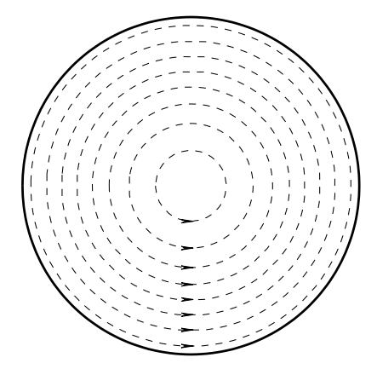
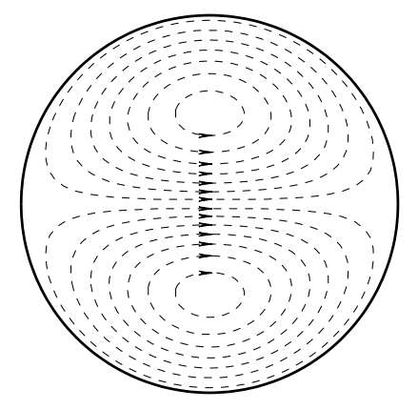
TM110 mode in transverse deflecting cavity
Transverse magnetic field of TM010 and TM110 in pillbox cavity
TM010 mode
TM110 mode
Accelerating mode
Dipole mode
Transverse kick to beam

Slide 7
Outline
1. Introduction to sub-harmonic deflector
2. Sub-harmonic transverse deflecting cavity design
3. Sub-harmonic transverse deflector system
4. Summary

Slide 8
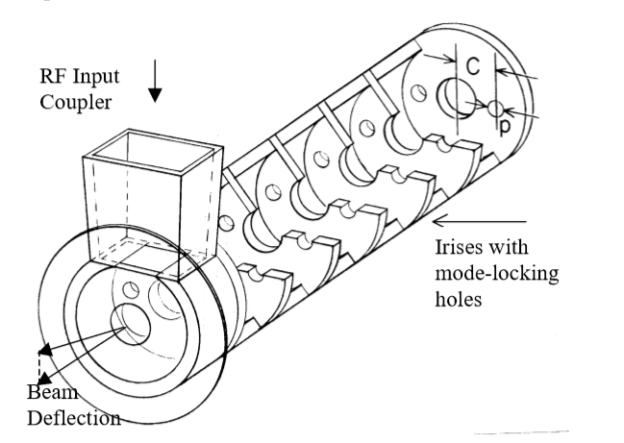
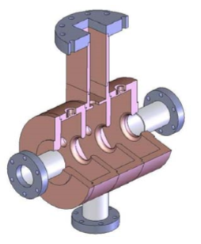
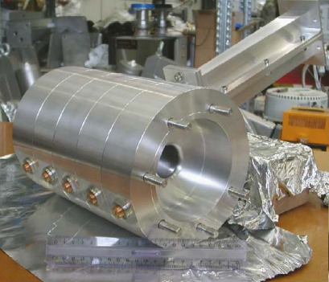
Transverse deflecting cavity (TDC) design
Traveling-wave structure
Hard X-ray mode: 5.5 GeV bunch
x=2.5 mm, y is drift length
SLAC type LOLA TDC
TM110, 2π/3 mode
Length=2.4 m
Filling time~ 300 ns
TDC
x=2.5 mm
y=drifting length
Standing-wave structure
Voltage of deflector could be reduced if we increase the drift length
Longer drift length makes standing-wave deflecting cavity possible
Three options for the transverse deflecting cavity
1. Traveling-wave structure
2. Standing-wave structure, 3-cell structures
3. Standing-wave structure, 5-cell structures
Loew, G. A., & Altenmueller, O. H. DESIGN AND APPLICATIONS OF RF DEFLECTING STRUCTURES AT SLAC. 1965
Shi, J. phD thesis. 2009
Alesini, D., et al. RF deflector design and measurements for the longitudinal and transverse phase space characterization at SPARC. Nucl. Instrum. Methods Phys. Res. A, 568(2), 488-502. 2006
Tsinghua University type 3-cell structure
INFN type 5-cell structure
Notes:
700 ns SW filling time

Slide 9
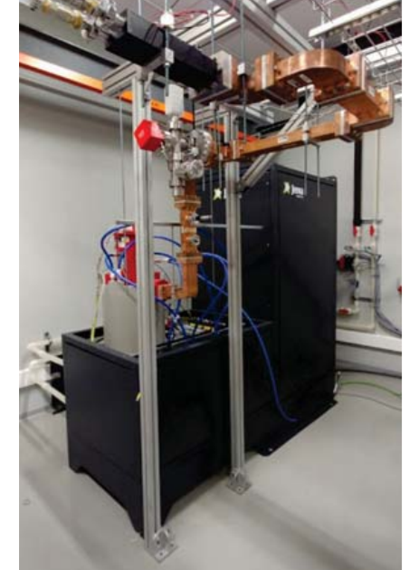
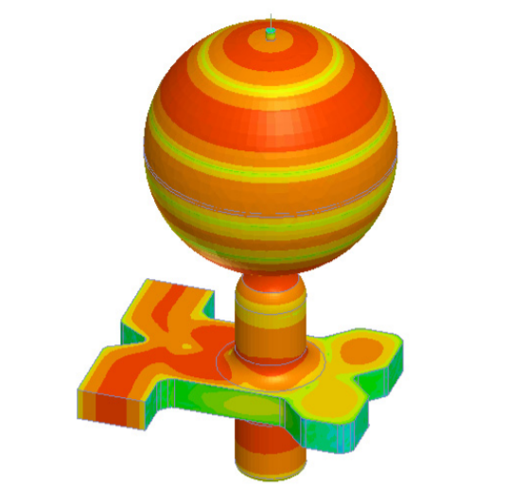
Power capability
CPI S-band Klystron (VKS8262G1):
7.5 MW, 5.0 μs, 400 Hz flat pulse
already applied in IFIC S-band test stand in Valencia
With spherical pulse compressor:
39.7 MW, 300 ns (Avg. without loss) compressed pulse
Spherical pulse compressor
frequency | 2.998 GHz
Q0 | 100000
Coupling factor | 7
Compression ratio | 15
Peak power gain | 7.15
Average power gain | 5.29
Esperante Pereira, Daniel, et al. "Construction and Commissioning of the S-Band High-Gradient RF Laboratory at IFIC." J. Phys. Conf. Ser.. Vol. 1067. 2018.

Slide 10
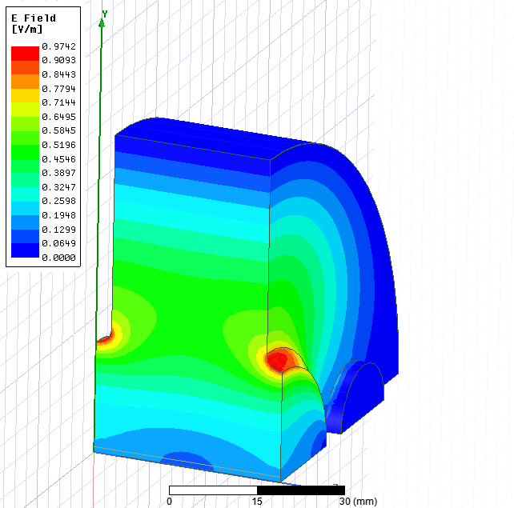
Traveling-wave transverse deflecting structure design
Increasing the drift length can reduce the length of traveling-wave structure
Work at 2π/3 mode
6 MW, 4.5 μs klystron pulse
30 MW, 300 ns compressed pulse
TDC
x=2.5 mm
y=drifting length
Freq [GHz] | 2.998
R [MΩ/m] | 20
Q | 12000
v_{g}/c [%] | 3
Drift length [m] | Deflecting voltage [MV] | Traveling wave (2π/3)
 |  | klystron power [MW] | Stru. Length w/ PC [m] | Stru. Length w/o PC [m]
0.5 | 13.75 | 6 | 1.45 | 3.65
1.0 | 6.875 | 6 | 0.70 | 1.64
1.5 | 4.583 | 6 | 0.46 | 1.06
2.0 | 3.438 | 6 | 0.35 | 0.79
Notes:
1 m=111 ns

Slide 11
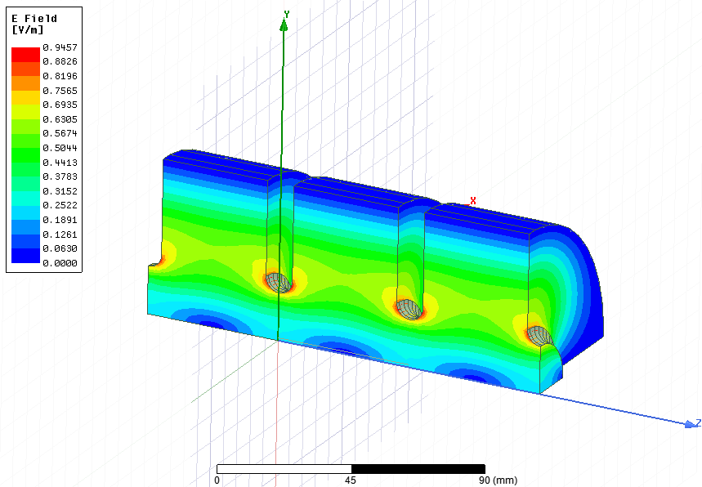
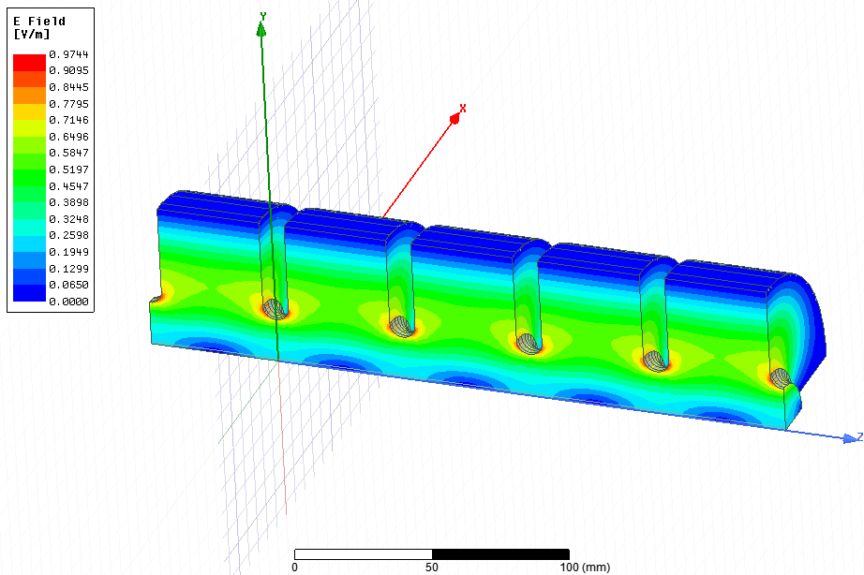
Standing-wave transverse deflecting structure design
TM110 Eigen mode results
3-cell structure
5-cell structure
R [MΩ] | Freq [MHz] | Q
3.03 | 2996 | 15337
R [MΩ] | Freq [MHz] | Q
5.02 | 2996 | 15271

Slide 12
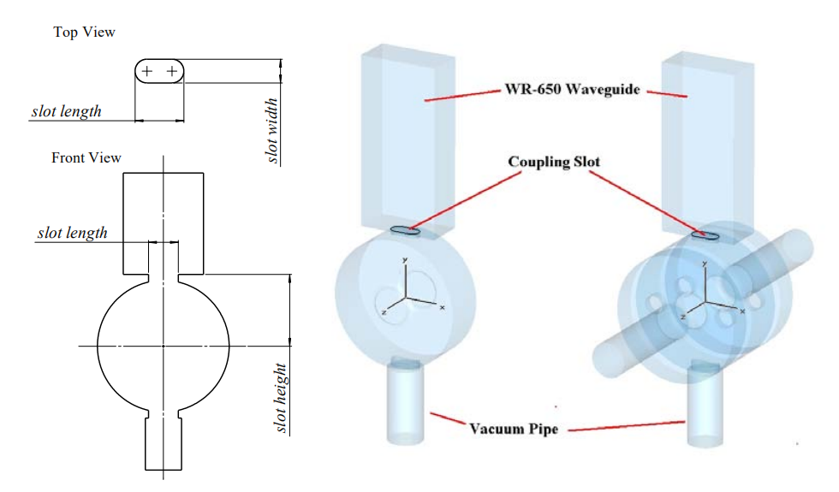
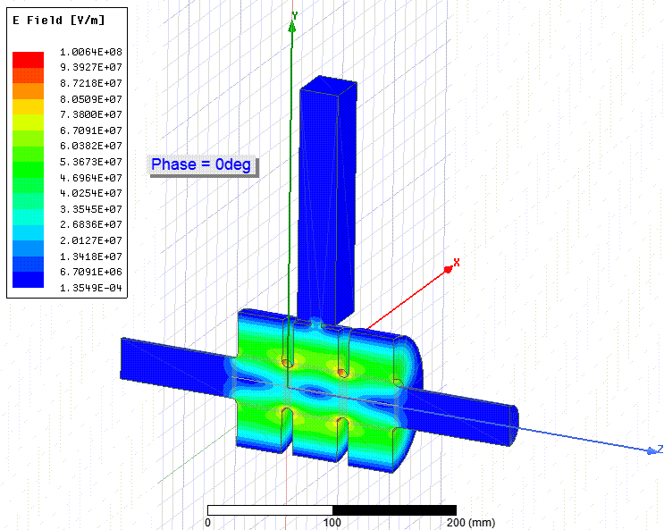
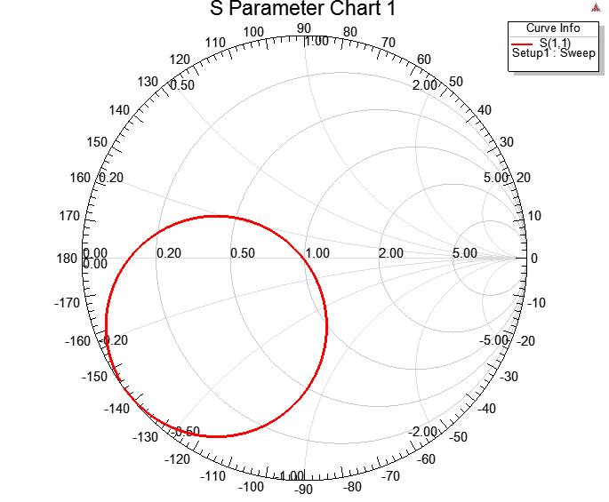
3-cell standing-wave TDC coupler design
Use race track shape coupling hole
4.14 MV deflecting voltage @ 6 MW input power
Maximum surface field around 100 MV/m
Filling time~820 ns

Slide 13
Outline
1. Introduction to sub-harmonic deflector
2. Sub-harmonic transverse deflecting cavity design
3. Sub-harmonic transverse deflector system
4. Summary

Slide 14
TDC System design
HXR mode: 5.5 GeV bunch
x=2.5 mm, y is drift length
Traveling-wave structure
Standing-wave structure
TDC
x=2.5 mm
y
Two options for the transverse deflecting cavity
1. Traveling-wave structure
2. Standing-wave structure
RF parameters
Power capability
2998 MHz | Traveling-wave (2π/3) | Standing-wave
Cell number | N | 3/5
Single cell length [m] | 0.033 | 0.05
Structure length [m] | N*0.033 | 0.15/0.25
Shunt impedance [MΩ/m] | 15.3 | 20
Filling time [ns] | 111/meter | ~820
Klystron: VKS8262G1 model built by CPI
Maximum rf peak power of 7.5 MW→6 MW within loss
Pulse length of up to 5 μs
Repetition rate of 400 Hz
Pulse compressor: spherical pulse compressor
Increase the average power:
6 MW, 4.5 us →40 MW, 300 ns (Avg.)
Notes:
800 ns SW filling time

Slide 15
Traveling-wave vs Standing-wave deflecting system
Drift length [m] | Deflecting voltage [MV] | Input power [MW] | Traveling-wave (2π/3) |  | Standing-wave
 |  |  | Stru. Length w/ PC [m] | Stru. Length w/o PC [m] | Stru. length 3-cell [m] | Stru. length 5-cell [m]
1.66 | 4.14 | 6 | 0.42 | 0.96 | 0.15 | X
1.30 | 5.30 | 6 | 0.54 | 1.24 | X | 0.25
Traveling-wave
30 MW
70 ns (AVG)
Use the maximum output power (6 MW with loss) from VKS8262G1
1. Klystron, pulse compressor, 0.54 m traveling-wave structure@1.30 m drifting length
2. Klystron, circulator, 0.15 m standing-wave structure (3-cell) @1.66 m drifting length
3. Klystron, circulator, 0.25 m standing-wave structure (5-cell) @1.30 m drifting length
6 MW
0.8~1 us
PC
Klystron
TW
0.54+1.30=1.84 m
Standing-wave+Circulator
6 MW
0.8~1 us
Klystron
Cir
SW
3-cell: 0.15+1.66=1.81 m
5-cell: 0.25+1.30=1.55 m
Notes:
700 ns~800 ns SW filling time
47~50 ns 0.42 m TW filling time

Slide 16
Double standing-wave structures deflecting system
Drift length [m] | Deflecting voltage [MV] | Input power [MW] | Traveling-wave (2π/3) |  | Standing-wave*2
 |  |  | Stru. Length w/ PC [m] | Stru. Length w/o PC [m] | Stru. length [m]
1.17 | 5.85 | 6 | 0.59 | 1.38 | 0.15*2
0.83 | 8.27 | 6 | 0.85 | 2.02 | 0.25*2
Use 3 dB hybrid and two standing-wave structures to avoid circulator
Use the maximum output power (6 MW with loss) from VKS8262G1
1. Klystron, pulse compressor, 0.59 m traveling-wave structure @1.17 m drifting length
2. Klystron, 3dB hybrid, 0.15 m standing-wave structure*2 @1.17 m drifting length
3. Klystron, 3dB hybrid, 0.25 m standing-wave structure*2 @0.83 m drifting length
Standing-wave*2+3dB Hybrid
6 MW
0.8~1 us
Klystron
Hybrid
SW
SW
0.3+1.17=1.47 m
Notes:
700 ns~800 ns SW filling time
47~50 ns 0.42 m TW filling time

Slide 17
Summary
Sub-harmonic deflecting system was proposed to separate the two bunches before the FELs
Three promising deflecting system options (within 2 meters)
Pulse compressor + traveling-wave structure
circulator + standing-wave structure
3 dB hybrid+ standing-wave structure*2
Decision to be made by taking the followings in to account
cost calculation
beam dynamics verification
availability of the RF components

