Slide 1
RF module update
CompactLight "Glasgow Virtual" Meeting, 16-18 June 2020
M. Diomede, D. Alesini, M. Bellaveglia,
A. Gallo, L. Piersanti (INFN-LNF)

Slide 2
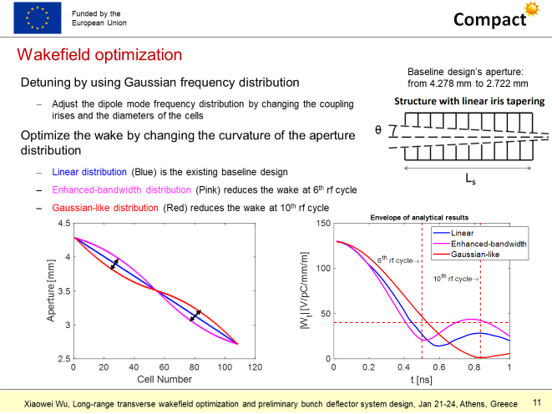
X-Band: COMPARISON BETWEEN TAPERINGS
X. Wu

Slide 3
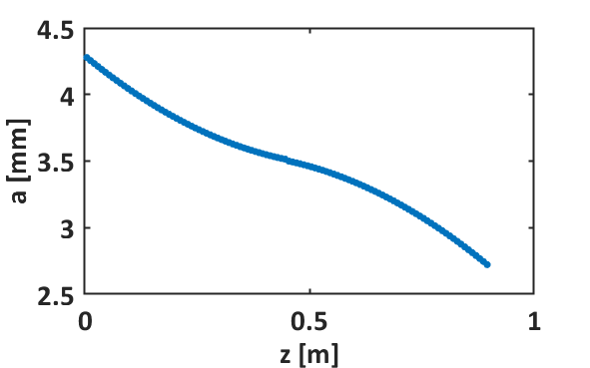
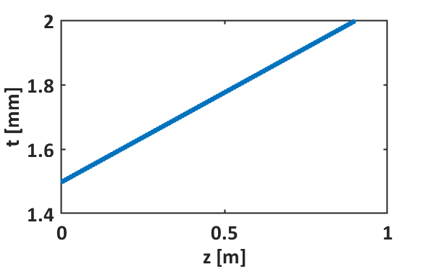
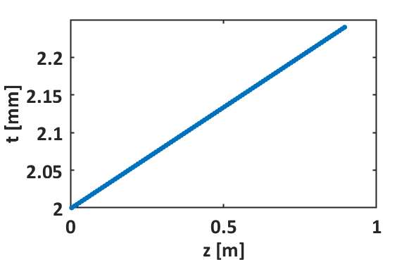
COMPARISON BETWEEN TAPERINGS
New geometries from Xiaowei: gaussian distribution of iris radius and linear distribution of iris thickness
1
2

Slide 4
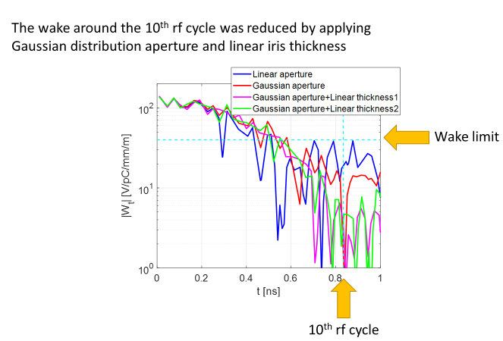
COMPARISON BETWEEN TAPERINGS
X. Wu

Slide 5
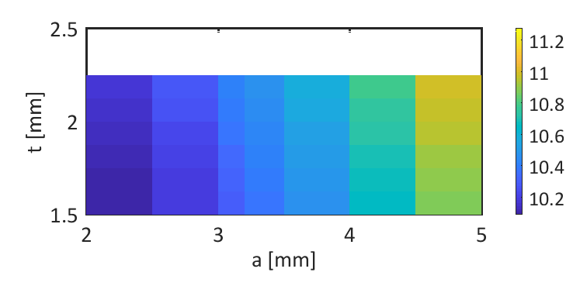
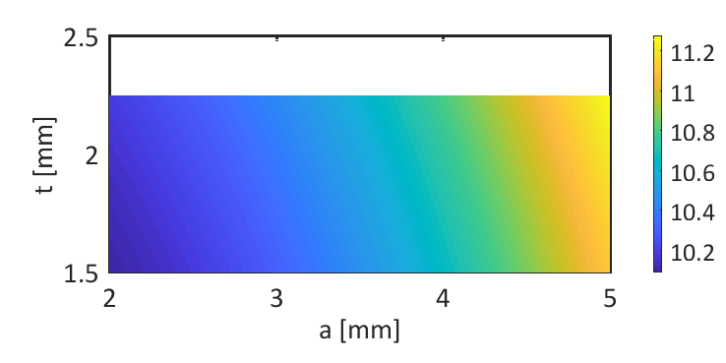
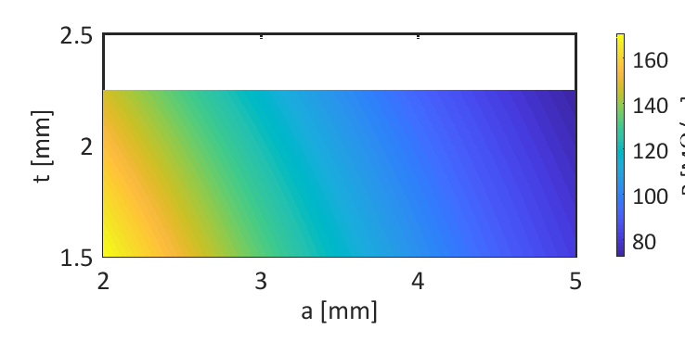
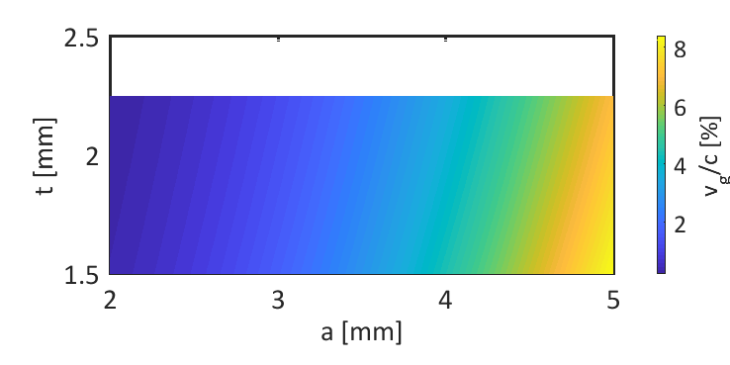
CELL PARAMETERS
As a function of iris radius a and iris thickness t
b [mm]
b [mm]
r [MOhm/m]
v_g/c [%]

Slide 6
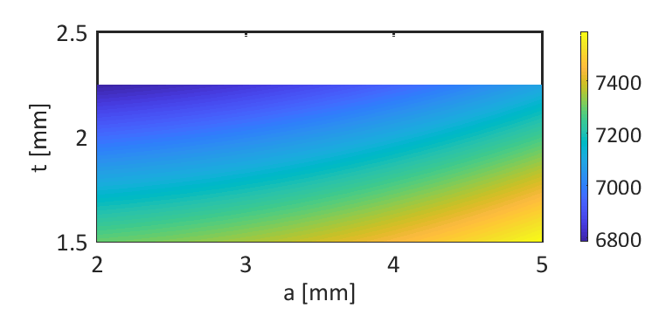
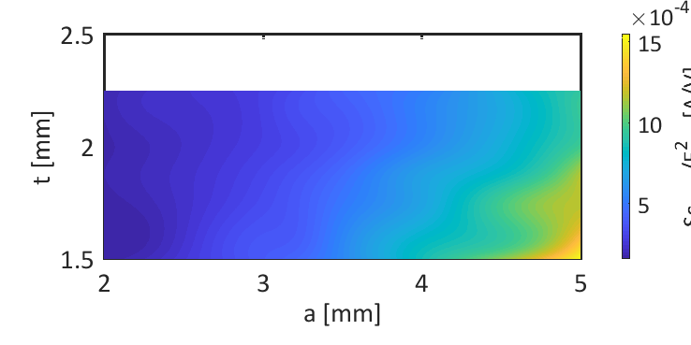
CELL PARAMETERS
As a function of iris radius a and iris thickness t
Q
Sc_max/Eacc^2 [A/V]

Slide 7
COMPARISON BETWEEN TAPERINGS
CompactLight | Linear tapering | Gaussian | E. Bandwidth | Gaussian w lin. iris thickness 1 | Gaussian w lin. iris thickness 2
Frequency [GHz] | 11.9942
RF pulse [µs] | 1.5
Net kly. power (@ 1 kHz) [MW] | ≈40 (8)
Average iris radius <a> | 3.5
Iris radius a [mm] | 4.3-2.7
Iris thickness t [mm] | 2.0 |  |  | 1.5-2.0 | 2.0-2.24
Average gradient <G> (@1 kHz) [MV/m] | 65 (30) (w/ margin) | 65 (30) (w/ margin) | 65 (30) (no margin) | 65 (30) (w/ margin) | 65 (30) (no margin)
Structure length L_{s} [m] | 0.9
Unloaded SLED Q-factor Q₀ | 180000
External SLED Q-factor Q_{E} | 23000 | 22500 | 24300 | 21900 | 23200
Shunt impedance R [MΩ/m] | 90-131 |  |  | 97-131 | 90-125
Effective shunt Imp. R_{s} [MΩ/m] | 387 | 388 | 380 | 400 | 378
Group velocity v_g/c [%] | 4.7-1 |  |  | 5.4-1 | 4.7-0.9
Filling time [ns] | 144 | 138 | 157 | 129 | 146
Max. Mod. Poy. Vec. - 10⁻⁶ bpp/m limit [%] | -32.7 | -31.3 | -30.5 | -12.3 | -29.7
Max. Mod. Poy. Vec. [W/um²] | 2.85 | 3.1 | 3.0 | 4.1 | 3.1

Slide 8
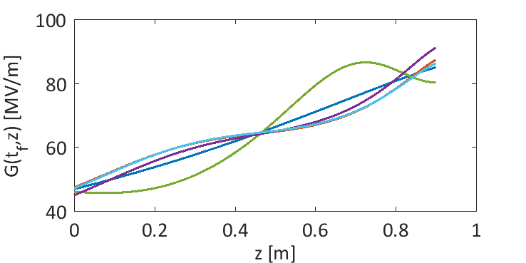
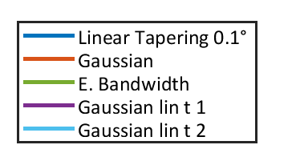
COMPARISON BETWEEN TAPERINGS

Slide 9
X-Band Module
Module (linear t No. 2)
Frequency [GHz] | 11.994
RF pulse (250 Hz) [µs] | 1.5 (0.15)
Average iris radius <a> [mm] | 3.5
Iris radius a [mm] | 4.3-2.7
Iris thickness t [mm] | 2.0-2.24
Structure length L_{s} [m] | 0.9
Unloaded SLED Q-factor Q₀ | 180000
External SLED Q-factor Q_{E} | 23200
Shunt impedance R [MΩ/m] | 90-125
Effective shunt Imp. R_{s} [MΩ/m] | 378
Group velocity v_g/c [%] | 4.7-0.9
Filling time [ns] | 146
Repetition rate [Hz] | 100 | 250 | 1000
SLED | ON | OFF | ON
Net kly. power (w/ loss) [MW] | 40 | 40 | 8
Avg. acc. gradient [MV/m] | 65 | 30 | 30
10 MW, 1.5 µs,
1 kHz
50 MW, 1.5 µs,
100 Hz
RF switch
CPI VKX-8311A
MODE CONVERTER
MODULATOR HALL
CIRCULAR WAVEGUIDE
MODE CONVERTER
SLED
LINAC HALL
X-Band (11.994 GHz)

Slide 10
(@240 MV/m)
Conclusions
RF performances of TW structures with 2 new iris tapering profiles have been calculated
Both cases allow to minimize transverse wakefields
Case No. 1 has the highest efficiency but a breakdown rate close to 10⁻⁶ bpp/m
Case No. 2 has a better expected breakdown rate but a lower efficiency, still able to guarantee the reference acc. gradients but with no margin
Next: EM simulations of the whole structure + tuning
(@200 MV/m)

