Slide 1
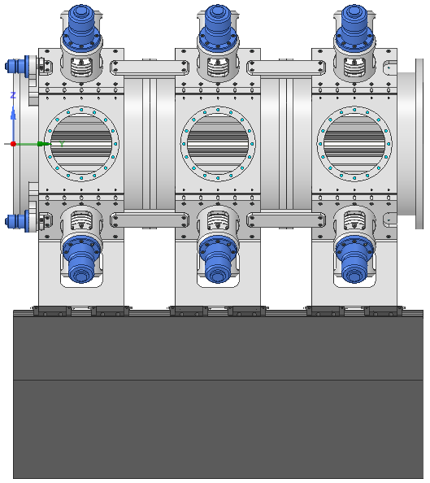
Afterburner layout considerations
Mechanical Conceptual Design for The Compact Light Source Afterburner
Glasgow virtual meeting on 17th June 2020
Tadej Milharčič, Kyma Tehnologija d.o.o.
1

Slide 2
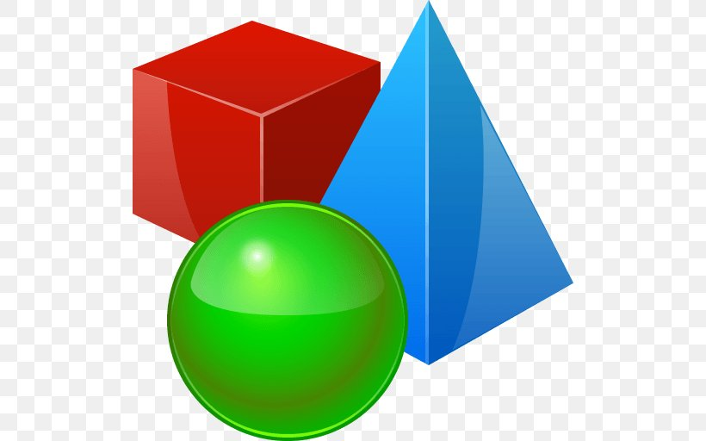
Kyma involvement
Conceptualization:
  Identification of realistic technical solutions to design objectives.
  Realistic final dimensions, components, care for aspects of assembly, tuning and measurement … realized in 3D.
  Considerations about load management, but no numerical analysis.
  No fabrication information (drawings, tolerances, planarities, surface treatments, etc.).
2

Slide 3

Disclaimer
A lot of innovative (radical) solutions.
Toolbox for later design process.
Some innovation is inevitable for this project.
Have to risk to be naive in some proposals.
Will not go deep in technical detail in this presentation.
3

Slide 4
Design options
Partially addresed in Technologies for the CompactLight undulator XLS Deliverable D5.1
Out of vacuum / in-vacuum
Room temperature / cryo-cooled
Individual magnets / magnet soldering
Traditional mag. structure / magnetic compensation
Traditional VC / segmented VC as support structure
4

Slide 5
Design options
Out of vacuum / in-vacuum
Room temperature / cryo-cooled
Individual magnets / magnet soldering
Traditional mag. structure / magnetic compensation
Traditional VC / segmented VC as support structure
Opt 1
Opt 2 and Opt 3
5

Slide 6
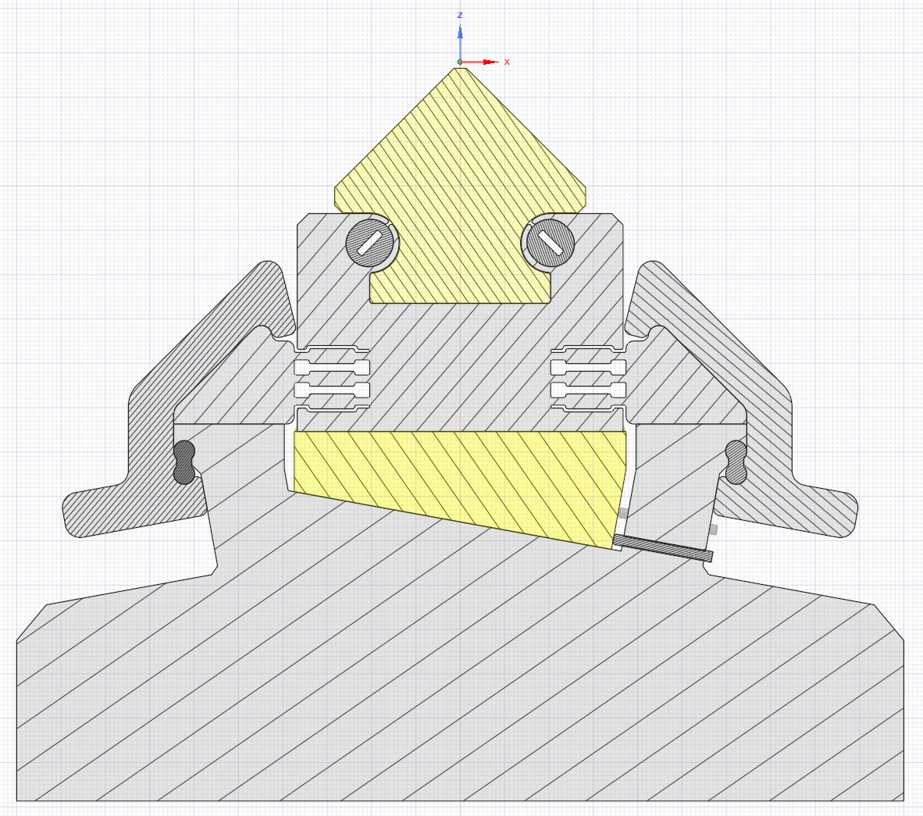
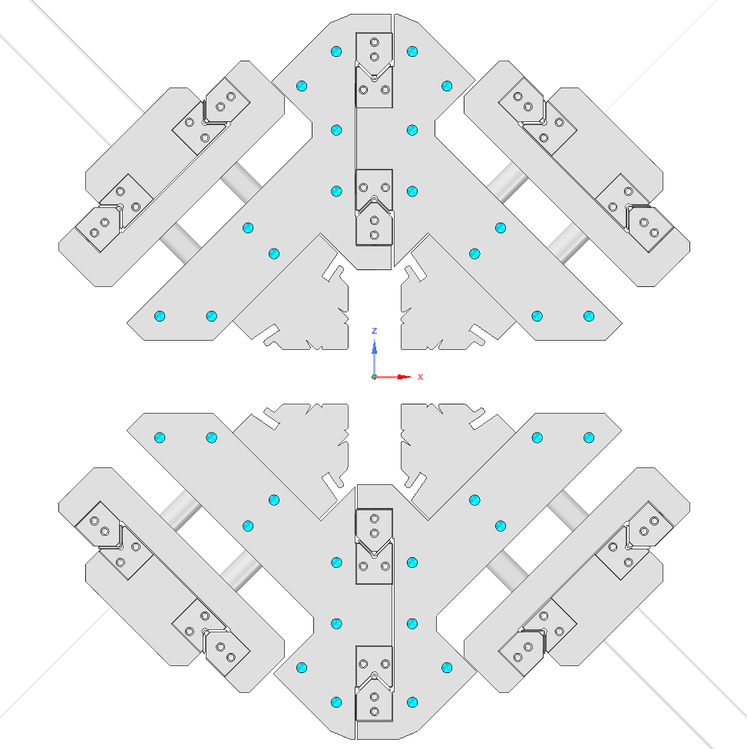
Critical design areas
Magnetic holder and girder design.
Radial and phase mechanism design (has to include some VC and frame features).
6

Slide 7
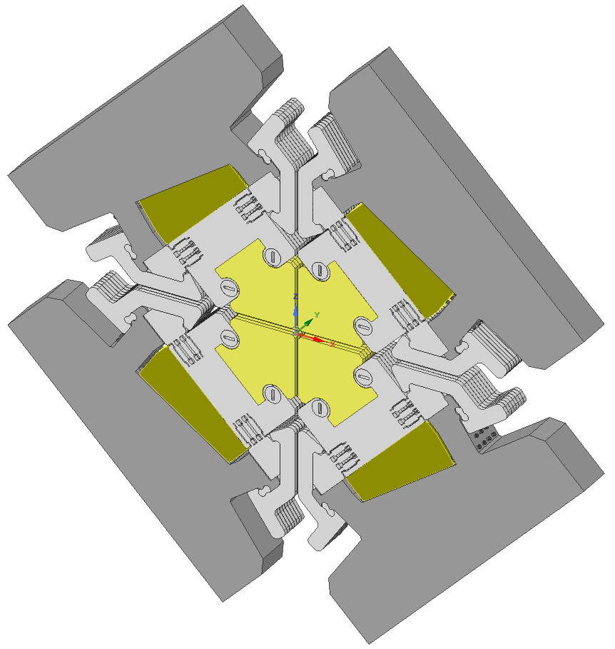
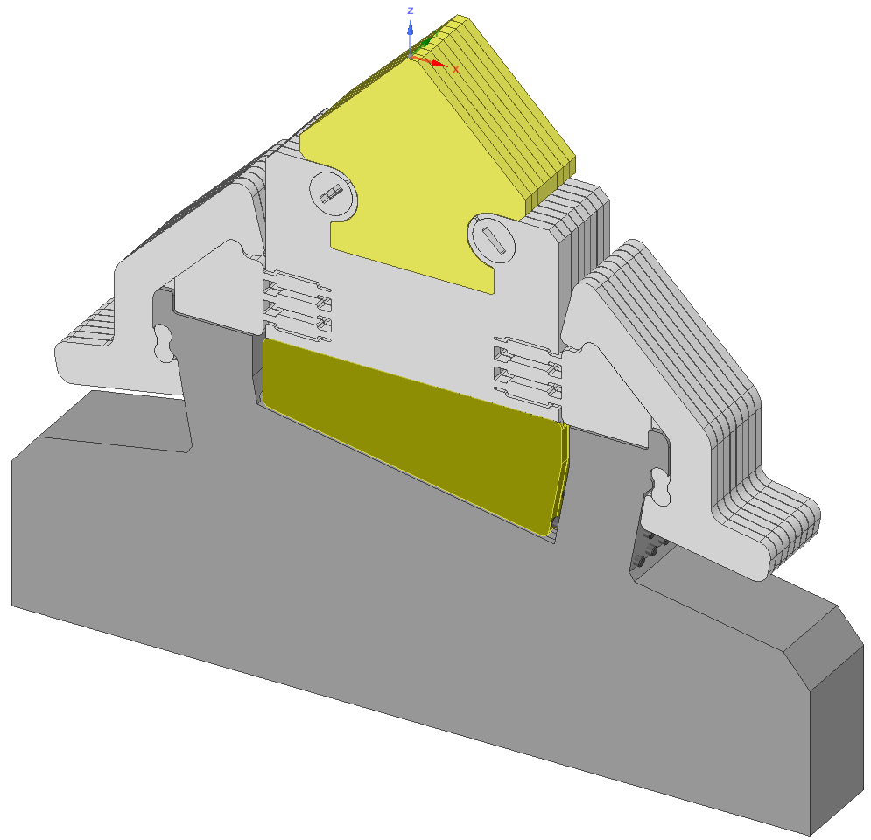
Holder Design 1
Individual magnets (no soldering).
Every magnet is shimable.
Clamping mechanism (magnets to thin thin for screws).
Wedge mechanism.
Cryo-cooled version?
7

Slide 8
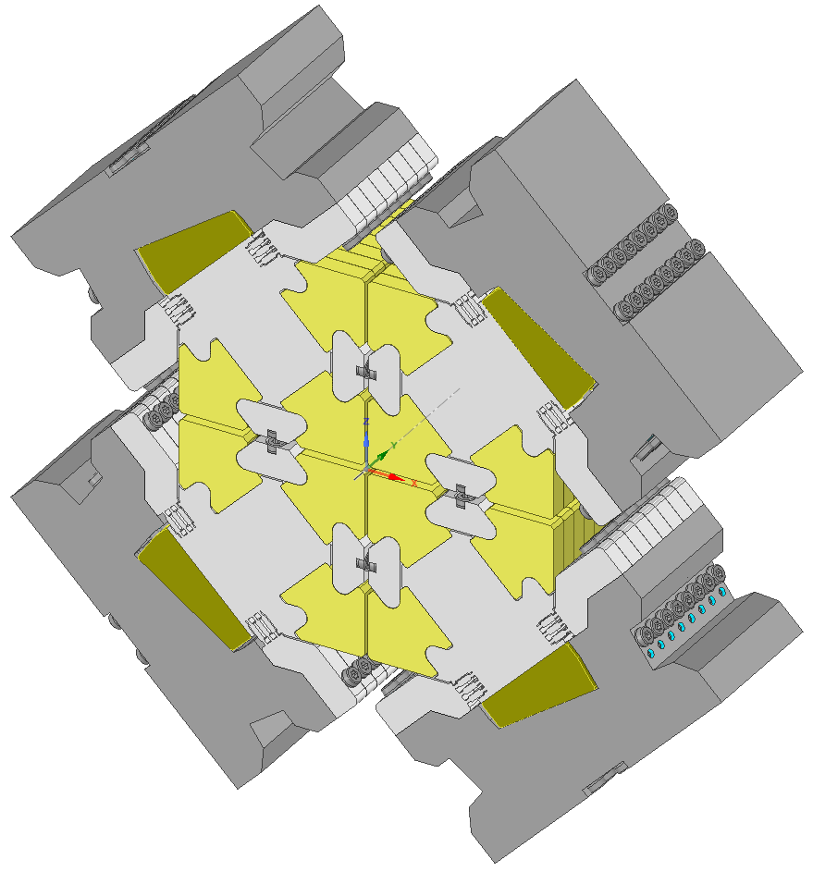
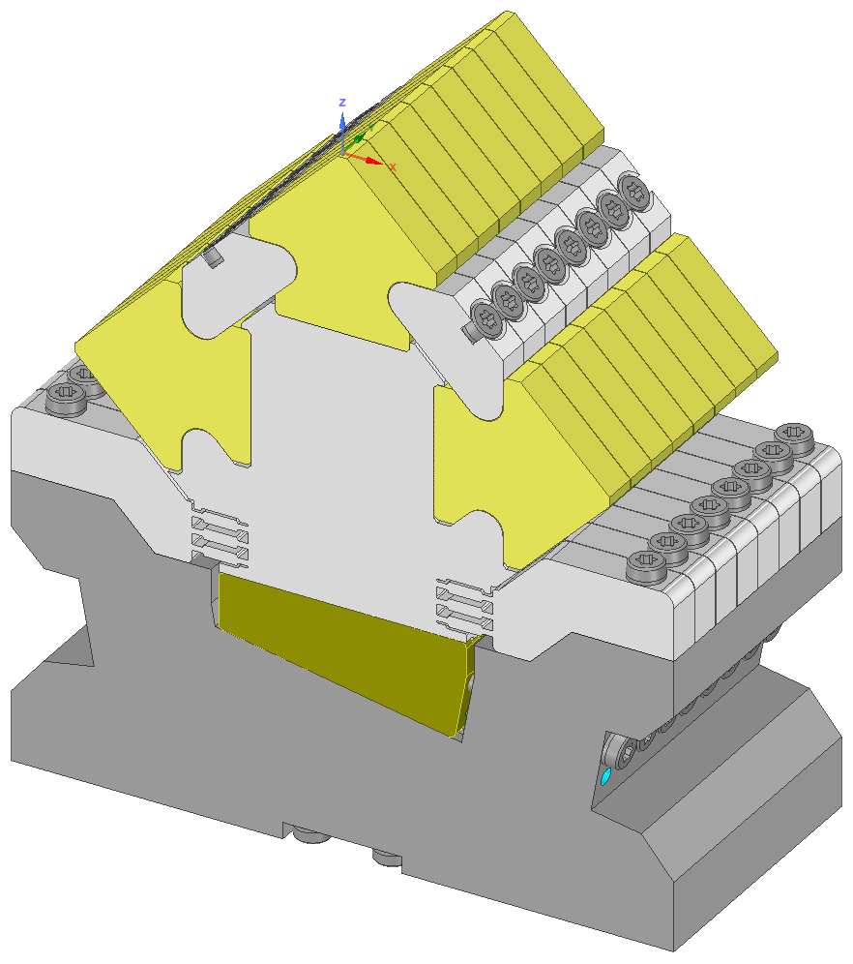
Holder Design 2
4 magnets soldered (half period)
Magnetic compensation
Compensation magnets have the same cross section
No clamping, magnetic material can be screwed.
Wedge mechanism.
Cryo-cooled version?
8

Slide 9
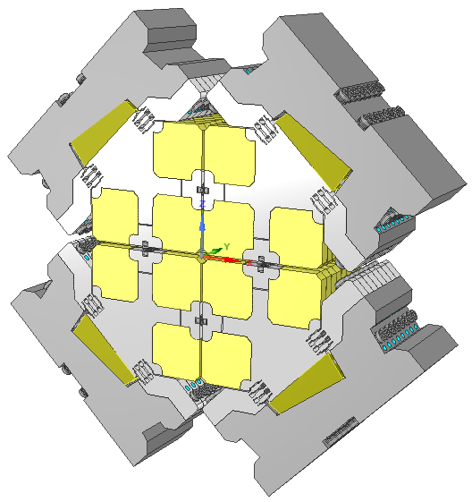
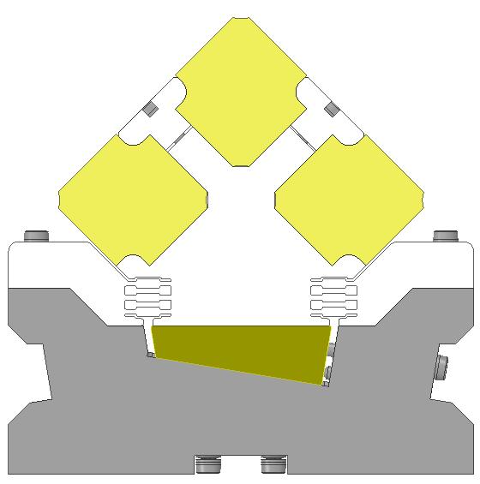
Holder Design 2+
Recent developement proposed by Thomas Schmidt
Smaller cross section
Further reduction of VC diameter.
Is compatible with cryo-features?
9

Slide 10
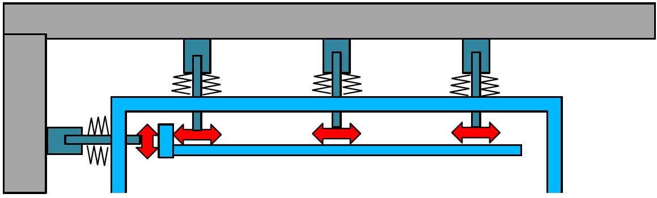
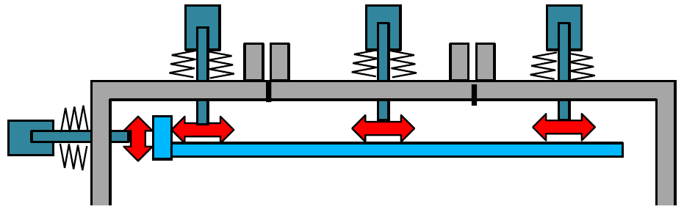
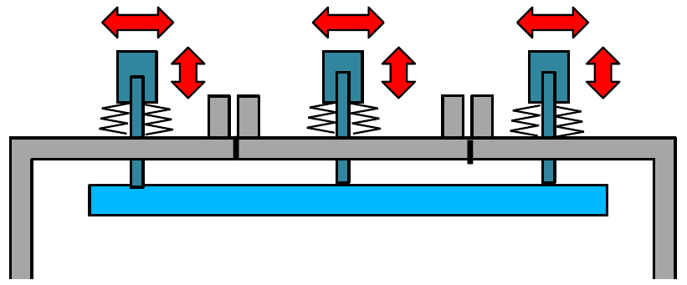
Radial and Phase Motion
Developement directions proposed by Thomas Schmidt (WP5)
Provisional set of undulator parameters
Three possible solutions for Radial and Phase Motion realization
  Fixed frame, traditional VC
  Segmented VC as support structure, separate radial and phase motion
  Segmented VC as support structure, combined radial and phase motion
10

Slide 11
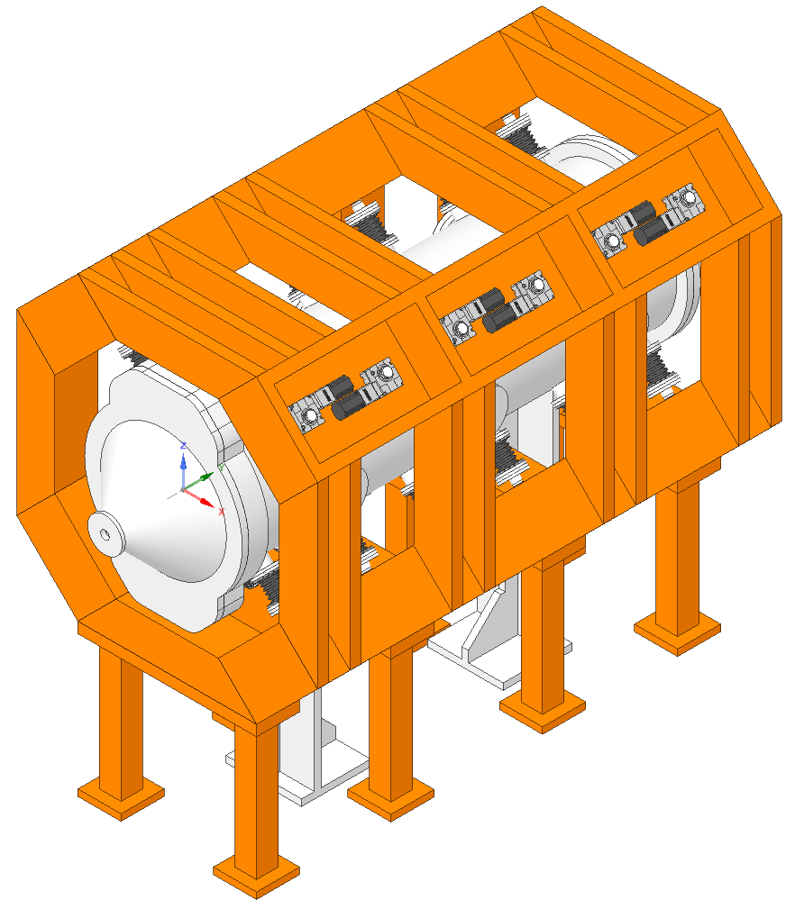
Radial and Phase Motion (opt. 1)
Rigid external frame with traditional vacuum chamber
Approach familiar to current EPU implementations.
Suitable solution for non-compensated magnetic structure:
  forces in all directions,
  frame can deform (fighting forces with material is costly),
  VC does not deform - good reference for position read-backs.
11

Slide 12
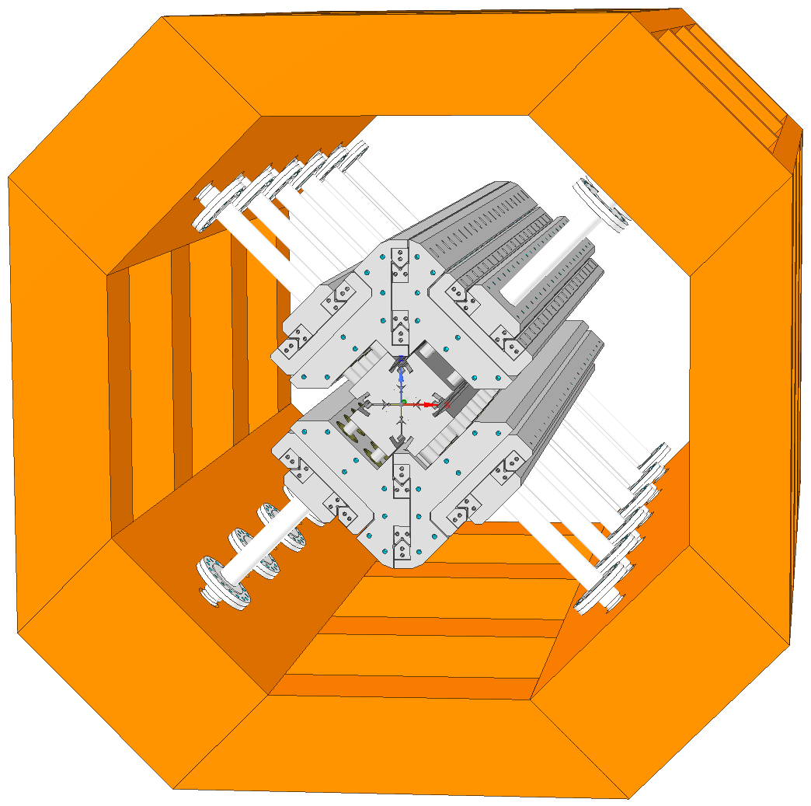
Radial and Phase Motion (opt. 1)
Conceptually similar to classical undulators (top and bottom arrays are separate units).
Left and right quadrant of top and bottom pair stabilize through central connection that permits phase motion.
A series of pillars (conical rails) connect through this middle connection to the radial rail.
12

Slide 13
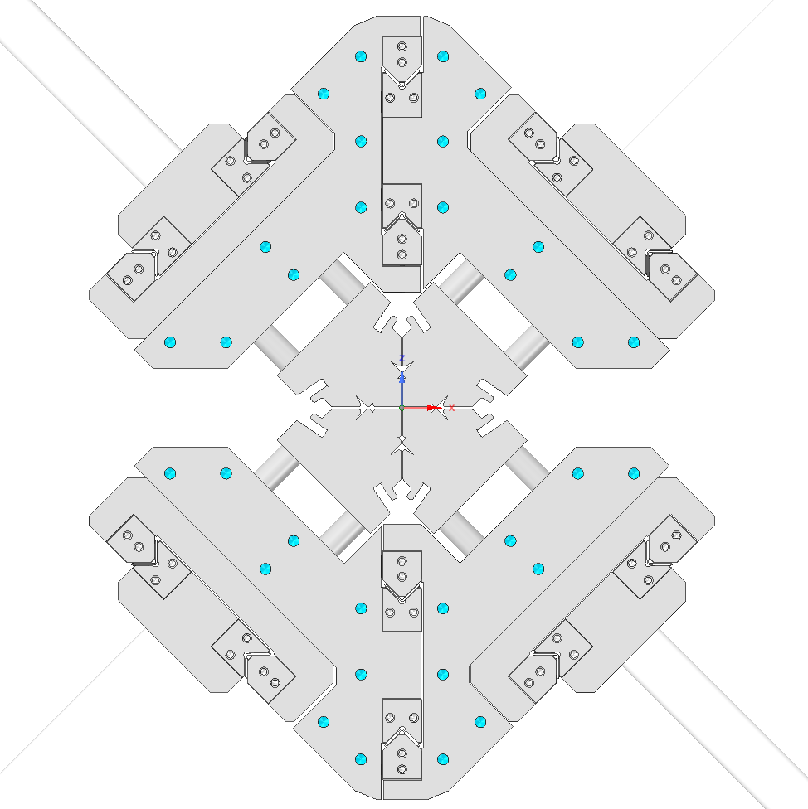
Radial and Phase Motion (opt. 1)
The middle connection is suspended. It does not need additional support.
External radial actuation should compensate for sheer forces in X axis between top and bottom array.
This gives lots of free space on axis for measurement systems etc.
13

Slide 14
Radial and Phase Motion (opt. 1)
The middle connection is suspended. It does not need additional support.
External radial actuation should compensate for sheer forces in X axis between top and bottom array.
This gives lots of free space on axis for measurement systems etc.
14

Slide 15
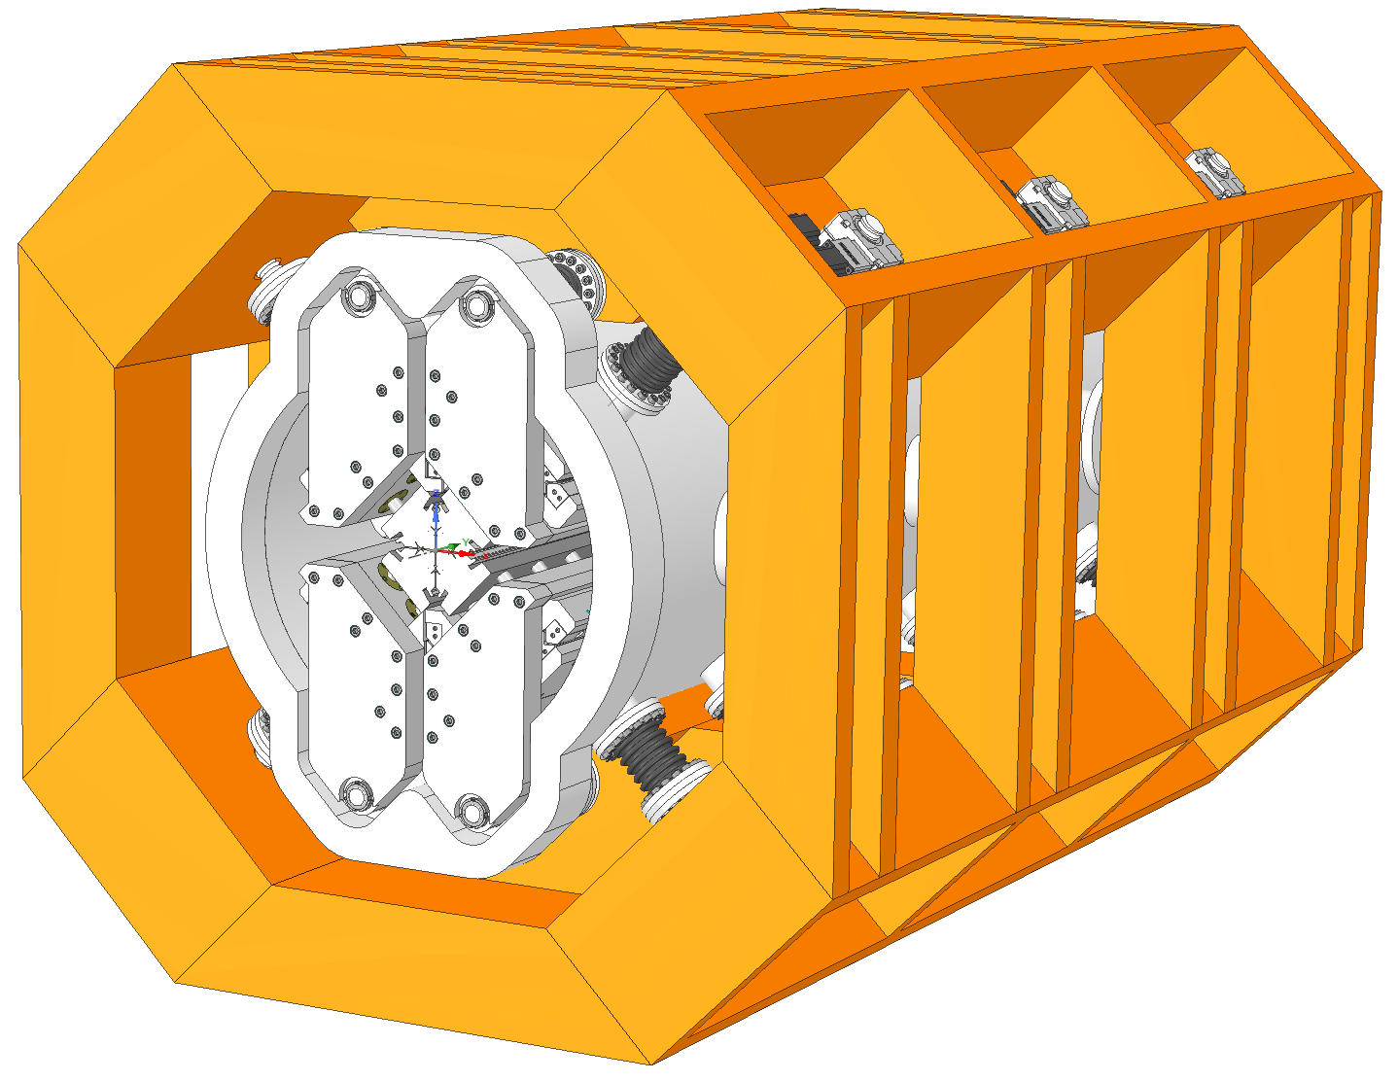
Radial and Phase Motion (opt. 1)
The phase movement is transferred to the structure through a special flange - single solid piece.
Again, forces are transferred only to the external frame and not to the VC.
15

Slide 16
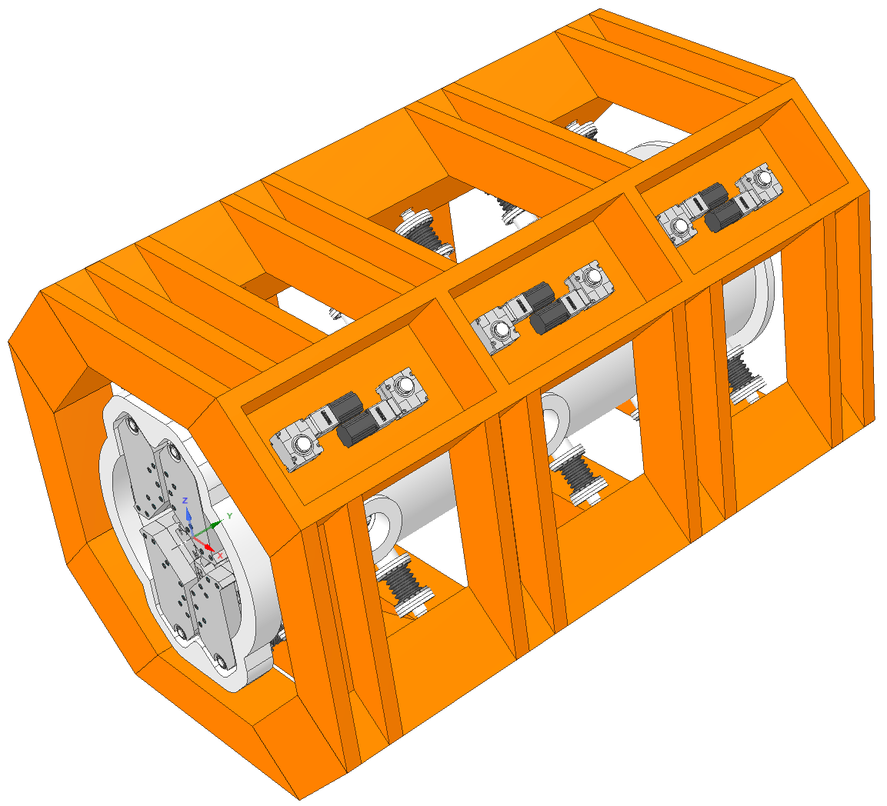
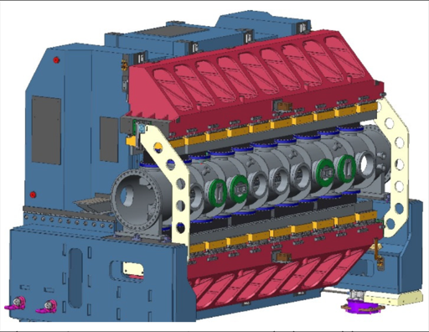
Multiple actuators (opt. 1, 2 and 3)
Multiple actuators per quadrant.
Proposed already by Thomas Schmidt.
Increased cost for actuators, more complex control system.
Avoid bulky beam and rails to guide the beam, much cheaper support structure.
BESSY APPLE III IVU
16

Slide 17
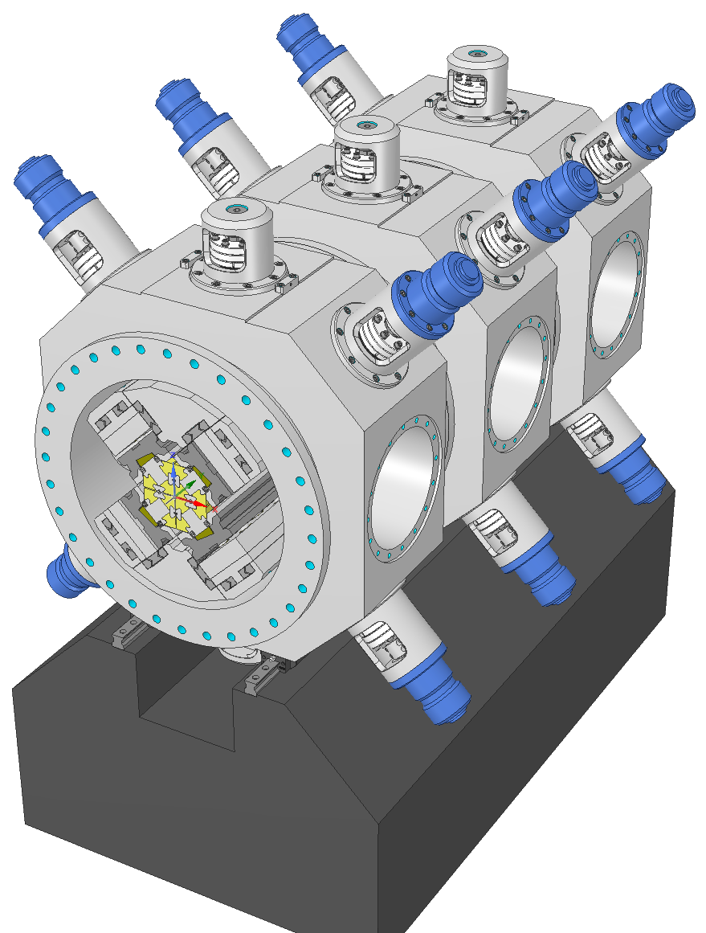
Radial and Phase Motion (opt. 2)
Segmented vacuum chamber
  vacuum chamber acts as support structure
  machined from bulk Al solids (faster, cheaper),
Suitable for compensated structure - only radial forces,
Radial action as opt. 1 + middle connection between quadrants.
  Easier installation and alignment,
Lighter structure, more compact solution.
17

Slide 18
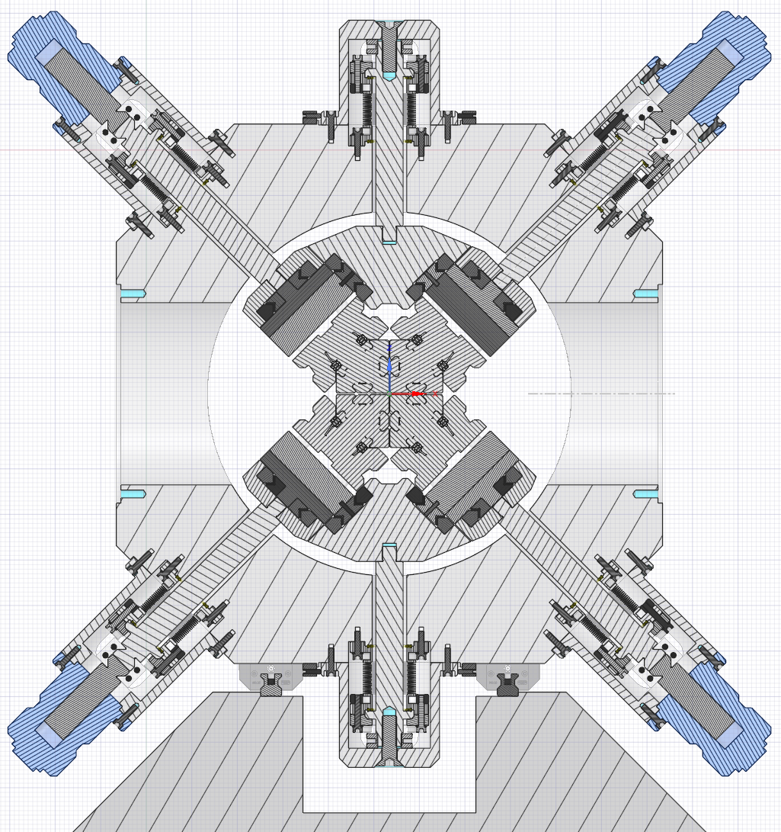
Radial and Phase Motion (opt. 2)
Segmented vacuum chamber
  vacuum chamber acts as support structure
  machined from bulk Al solids (faster, cheaper),
Suitable for compensated structure - only radial forces,
Radial action as opt. 1 + middle connection between quadrants.
  Easier installation and alignment,
Lighter structure, more compact solution.
18

Slide 19
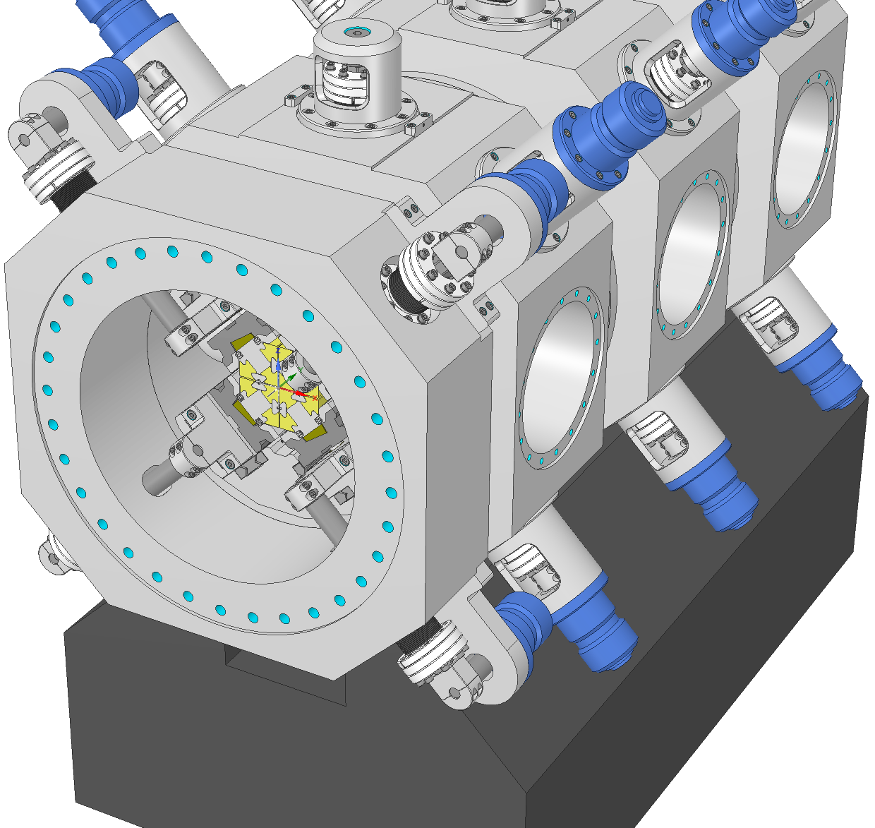
Radial and Phase Motion (opt. 2)
Challenging phase motion mechanism.
Additional VC segment with phase motion.
Current implementation not elegant.
It affects the terminal sections of the girder!
19

Slide 20
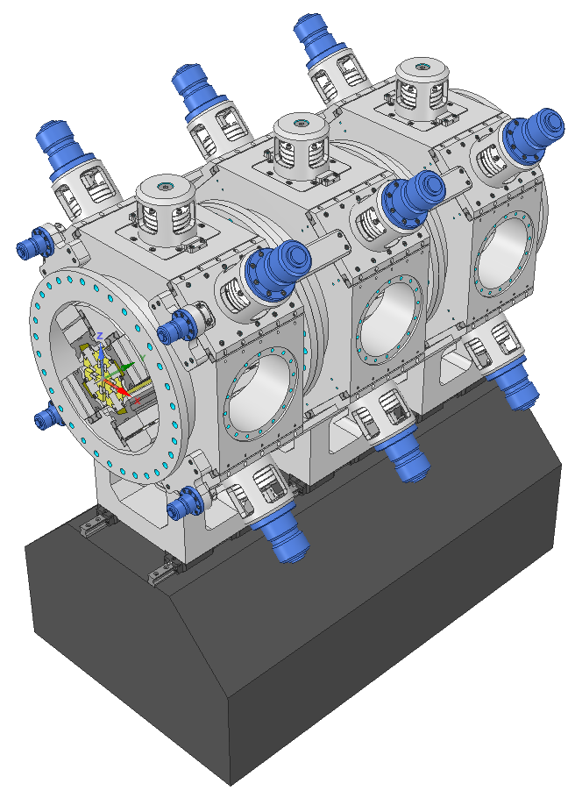
Radial and Phase Motion (opt. 3)
Segmented vacuum chamber.
Suitable for compensated structure - only radial forces.
Focus on combining the radial and phase motion.
Elegant external phase actuation.
Smaller vacuum chamber.
Fewer guiding elements inside the vacuum.
Liberates extremities for features like flexible taper.
Taper could be non-flexible!
20

Slide 21
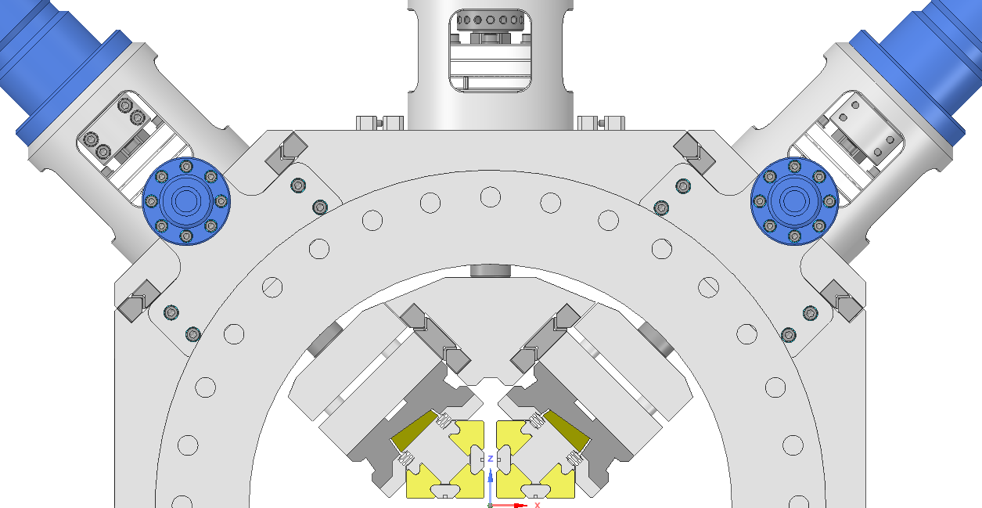
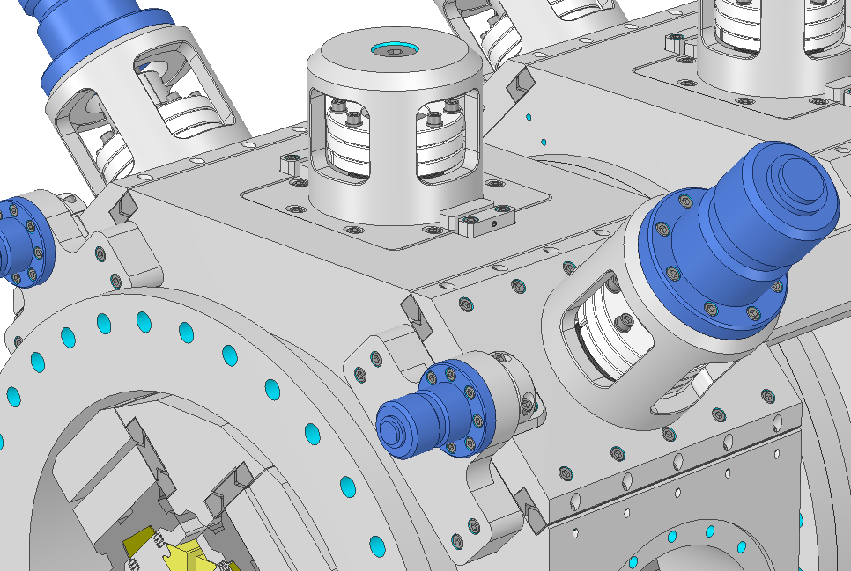
Radial and Phase Motion (opt. 3)
Segmented vacuum chamber.
Suitable for compensated structure - only radial forces.
Focus on combining the radial and phase motion.
Elegant external phase actuation.
Smaller vacuum chamber.
Fewer guiding elements inside the vacuum.
Liberates extremities for features like flexible taper.
Taper could be non-flexible!
21

Slide 22
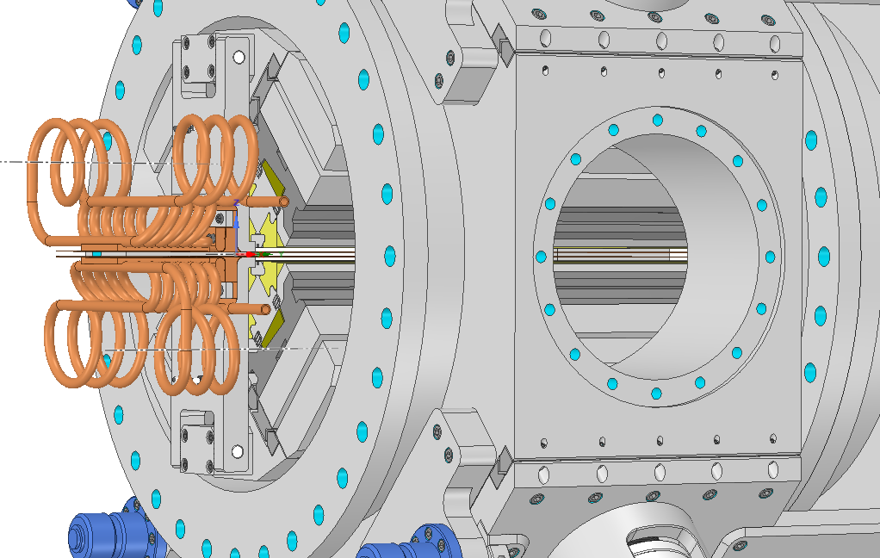
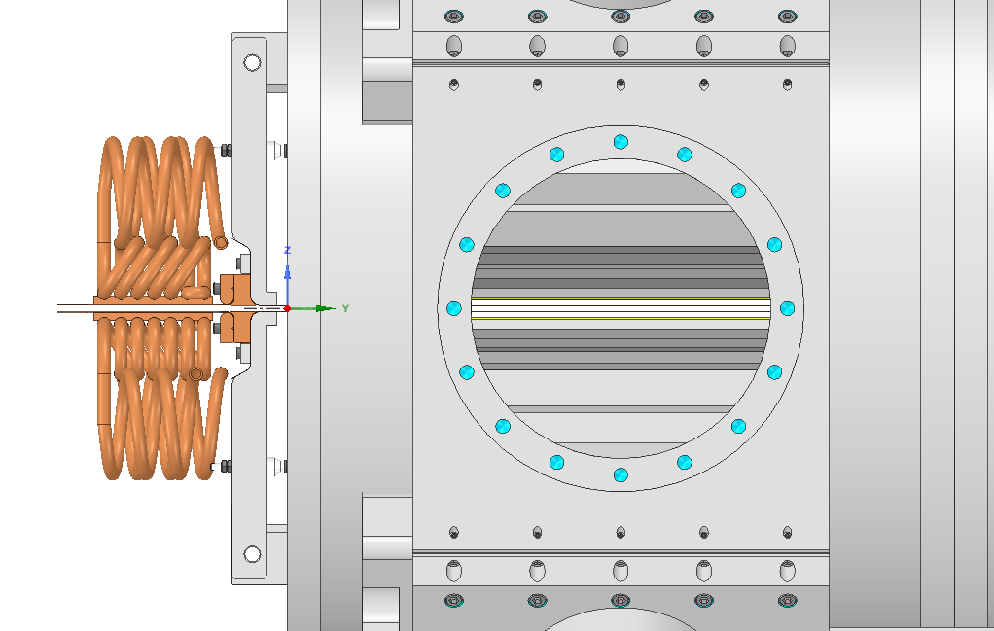
Radial and Phase Motion (opt. 3)
Segmented vacuum chamber.
Suitable for compensated structure - only radial forces.
Focus on combining the radial and phase motion.
Elegant external phase actuation.
Smaller vacuum chamber.
Fewer guiding elements inside the vacuum.
Liberates extremities for features like flexible taper.
Taper could be non-flexible!
22

