Slide 1

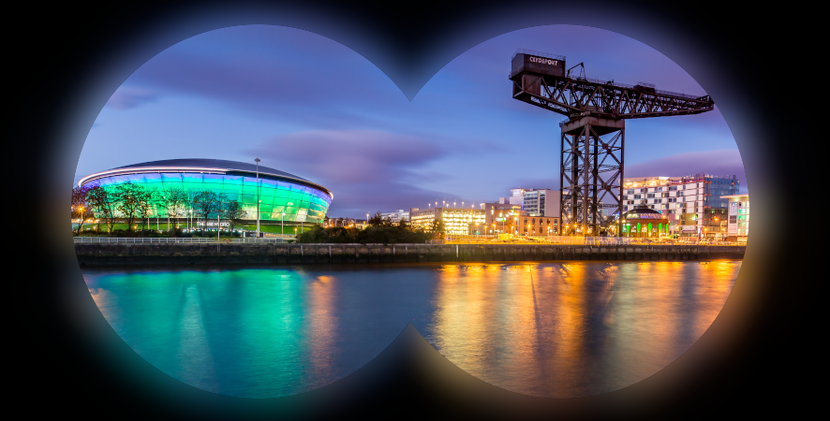
Third CompactLight Midterm Meeting
‘Virtual Glasgow’
WP2: Planning for the CDR
Neil Thompson, STFC, 17/06/20

Slide 2
Contents
Purpose and scope of the CDR
Contents
Production method
Schedule

Slide 3
What is the purpose of a Conceptual Design Report?
To state the project goals
To justify and present a self-consistent description of the design choices made for each component of the facility
To make a convincing case that
  the facility design will meet the required output specification
  the feasibility and risk of the design choices is well understood
  remaining technical challenges are identified with a clear R&D path to overcoming them
To provide a cost estimate
A CDR is NOT a detailed technical description of each system and subsystem.
Please everyone keep these points at the forefront of your conciousnesses when writing material.
We also propose to submit the CDR to an open-access journal in 2022 to create a master reference for the project.
  For example the CLARA CDR was submitted to the Journal of Instrumentation:
  https://iopscience.iop.org/article/10.1088/1748-0221/9/05/T05001

Slide 4
Contents
SECTION | SUB-SECTION | WPs | PAGES | RELEVANT REPORTS
1. Exec. summary |  | 1,2 | ~ 10 | D1.3 Production of a short monograph summarizing the Conceptual Design Report. (M48)
2. Introduction |  | 1,2 | ~ 10 | All
3. Science Goals and Photon Output Requirements | 1. Summary of Science Case | 2 | ~ 10 | D2.1 Report providing users requirements and FEL performance specification (M12)
 | 2. Photon Output Requirements | 2 | ~ 10 | D2.1 Report providing users requirements and FEL performance specification (M12)
4. Systems design and Performance | 1. Facility Layout | 2,6 | ~ 10 | D2.2 Report summarizing the FEL design with accelerator and undulator requirements (M24)
 | 2. Injector | 3 | ~ 20 | D3.1 Evaluation report of the optimum e-gun and injector solution for the CompactLight CDR. (M18) D3.2 A review report on the bunch compression techniques and phase space linearization (M18) D3.3 Design report of the injector diagnostics/beam manipulations (M39) D3.4 E-gun and injector Design Report with diagnostics and phase space linearizer (M39)
 | 3. RF Systems | 4 | ~ 20 | D4.1 Computer code report for RF power unit design and cost optimization. (M18) D4.2 Design report of the optimized RF unit (M39) D4.3 Report on RF unit design and fabrication (M39)
 | 4. Undulators | 5 | ~ 20 | D5.1 A review report comparing the different technologies for the CompactLight undulator. (M18) D5.2 Conceptual Design Report of the undulator (M39)
 | 5. Lattice Design and FEL Performance | 6 | ~ 20 | D6.1 Review report on the most advanced computer codes for the facility design (M18) D6.2 Final report with start to end facility simulations (M42)
 | 6. Diagnostics | 8 | ~ 5 | D8.1 XLS electron and photon beam diagnostics: layout and machine implementation (M42)
 | 7. Photon Beamlines | 8 | ~ 10 | D8.1 XLS electron and photon beam diagnostics: layout and machine implementation (M42)
 | 8. Building and Site | 2 | ~ 10
5. Strategic Issues | 1. Global Integration | 7 | ~ 15 | D7.1 Mid-term report with CompactLight global integration and cost analysis (M24) D7.2 Global integration analysis, services and cost (M48) - can this be completed earlier?
 | 2. Cost Estimates | 7 | ~ 15 | D7.1 Mid-term report with CompactLight global integration and cost analysis (M24) D7.2 Global integration analysis, services and cost (M48) - can this be completed earlier?
 | 3. Technology Transfer | 7 | ~ 15
6. Appendices | 1. Parameter Tables | 1 | ~ 5
 | 2. Publications | 1 | ~ 5
 | 3. Institutes |  | ~ 5

Slide 5
CDR Production
  Approximate page count ~200
  Page counts for each section/subsection shown as a guide only - but please aim to be concise throughout.
  Each WP leader to be responsible for writing/compiling relevant sections, as described in table on previous slide.
  Material from any WP reports already produced as deliverables can be reused in the CDR, probably with some editing down to make more concise.
  WP2 will take responsibility for editing the style/language as necessary, so WP leaders can concentrate mainly on technical content, justification for parameter choices, etc…
  We are using Overleaf which has worked well so far for WP reports
I need advice on how to set up automated backups

Slide 6
Overleaf Guidance
  The CDR is here:
    https://www.overleaf.com/project/5e5789379d81750001e7cc9a
  Top Level
    The file <main.tex> is the top level file.
    Mostly this shouldn’t need to be edited. However, if you need to add extra packages or definitions this is the place to put them, NOT in the chapter files.
    The chapter files ONLY need to contain the content, which is to be added between \begin{document} and \end{document}.
  Chapters
    The folder <chapters> contains a blank file for each chapter, ready for us all to start writing…..
    Each chapter file can be compiled independently – in this case you will just see a pdf of that chapter, not the whole document. If you want to see the whole document you can compile <main.tex>. This will be a lot slower so mostly it will be best to compile chapters independently.
  Images
    All images should be put in the <figures> folder.
    Please include the chapter title in the image filename, or else set up an image subfolder for your chapter (in which case you will have to give the full path to the image when you include it in the document).
    Vector-based graphics files are strongly preferred to bitmap formats as they reproduce at full resolution irrespective of scaling.
  References
    Add references vis Mendeley: for those of us a bit rusty on how to do this here is the refresher presented by Markus in Helsinki
    https://indico.cern.ch/event/804400/contributions/3483974/

Slide 7
CDR Production – Style Guide
To help obtain a uniform style, we propose the following guidelines and would encourage you to follow them to make the editing more efficient….
  We write about the CompactLight finished design in the present tense and in the third person. For example,
    we do say “the undulators for the hard X-ray beamline are superconducting helical devices with a 2mm aperture and a 4mm period”
    we don’t say “we decide that the undulators will be....”
  However, in discussing the process that led to the final design, we use the past tense and the third person. For example,
    we do say “a number of different technology options were evaluated”
    we don’t say “we consider a number of technology options”
  The idea is that this helps distinguish between the process of designing CompactLight and the final result and by presenting the finished design in the present tense it makes it seem ‘more real’
Please also bear in mind the points made earlier on the purpose and scope of the CDR – we are aiming for concise, well reasoned arguments and well justified parameter specifications rather than massive dumps of data and technical details- we can always refer the reader to the earlier WP reports for more detail!

Slide 8


2021 CDR Proposed Schedule
Date | Task/Milestone | Responsibility of..
March 31 | ALL WP3, WP4, WP5 deliverables now submitted to EU and technical work complete. All WPs start CDR writing where possible! | All
June 30 | All technical work complete and WP reports submitted | All
July 30 | 1st complete draft which includes all material submitted by WP leaders | All
During August/September | Cross checking for consistency, errors and omissions | All
 | Layout editing, style editing, editing for consistency | WP2
September 30 | 1st complete edited draft. | WP2
During October | Corrections | WP2 + All
October 30 | 2nd complete edited draft | WP2
December 1 | Submission to EU (pre-Christmas) | WP1
January 2022 | Online publication (and printed copy?) once approved by EU. | WP1/2
Later 2022 | Journal submission | WP1/2

