Slide 1

Glasgow Meeting 16-18 June
WP3 – Gun and Injector
Main goal: define baseline injector layout
Massimo.Ferrario@LNF.INFN.IT

Slide 2
Full C—band XLS Injector
One injector for all the operational modes (HRR and LRR)
  2.5 C-band gun with 160 MV/m cathode peak field => longer drift for diagnostics
  Copper cathode and TiSa Laser
  Same gradients 15 MV/m in the 2 m long C-band structures, 0.4 m spacing, max gain 30 MeV/structure
  Same diagnostics positions (@ gun exit 7 MeV and in the drift parallel to the LH @ 120 MeV)
  Same beam parameters at the linac exit
  Solenoid around first C-band accelerating structure, allows also possible VB operation
Optimal BC1 input energy (=> and position)
  Without Velocity Bunching
  With Laser Heater
  K-band Linearizer just before the BC1, X-band RFD downstream BC1
  Same beam parameters at the BC1 exit
2.5 C-band Gun
160 MV/m
Diagnostics Section
@ ~120 MeV
3 m
2 m long C-band structures =15 MV/m
2 m long C-band structures =15 MV/m
Bunch Compressor 1
@ < 300 MeV
Diagnostics Section
@ 7 MeV
Laser Heater @ ~120 MeV
with matching 1.5 m
~29.5 m
K-band Linearizer
X-band Deflector

Slide 3
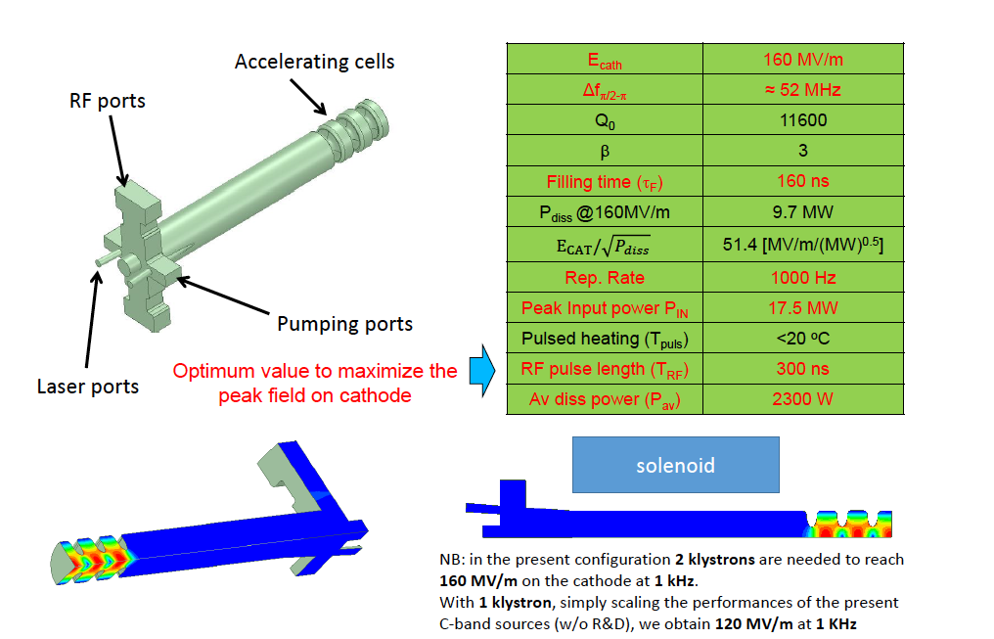
C-band gun design
Courtesy M. Diomede

Slide 4
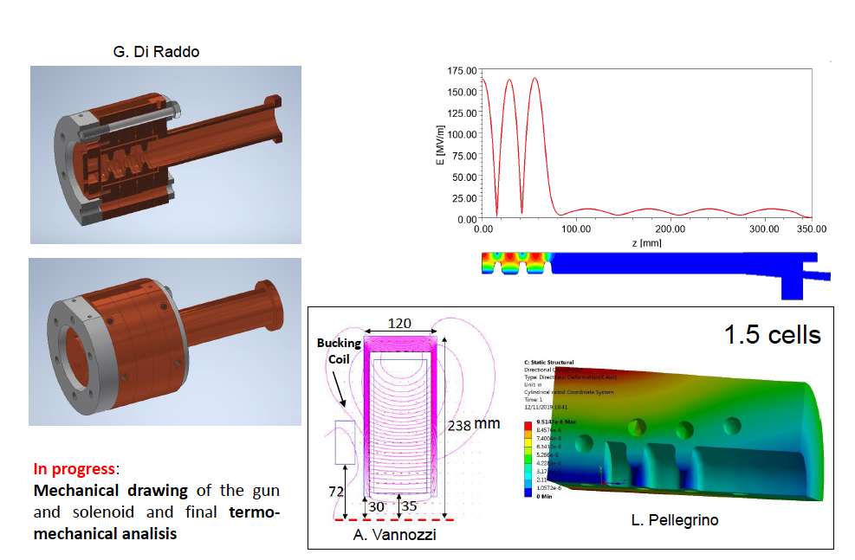
C-band gun design
Courtesy M. Diomede

Slide 5
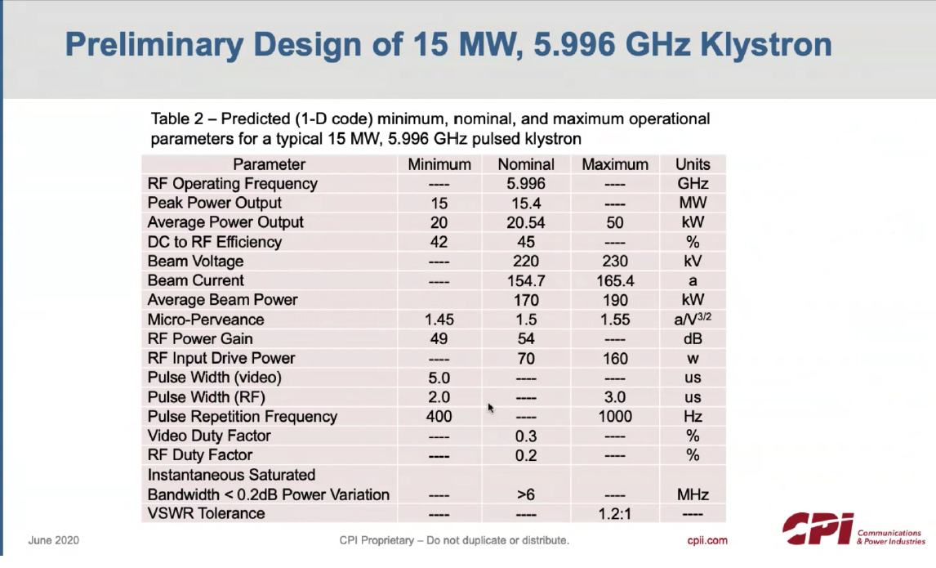
1 Kly for the Gun
1 Kly for 2 accelerating structures => 5 Kly

Slide 6
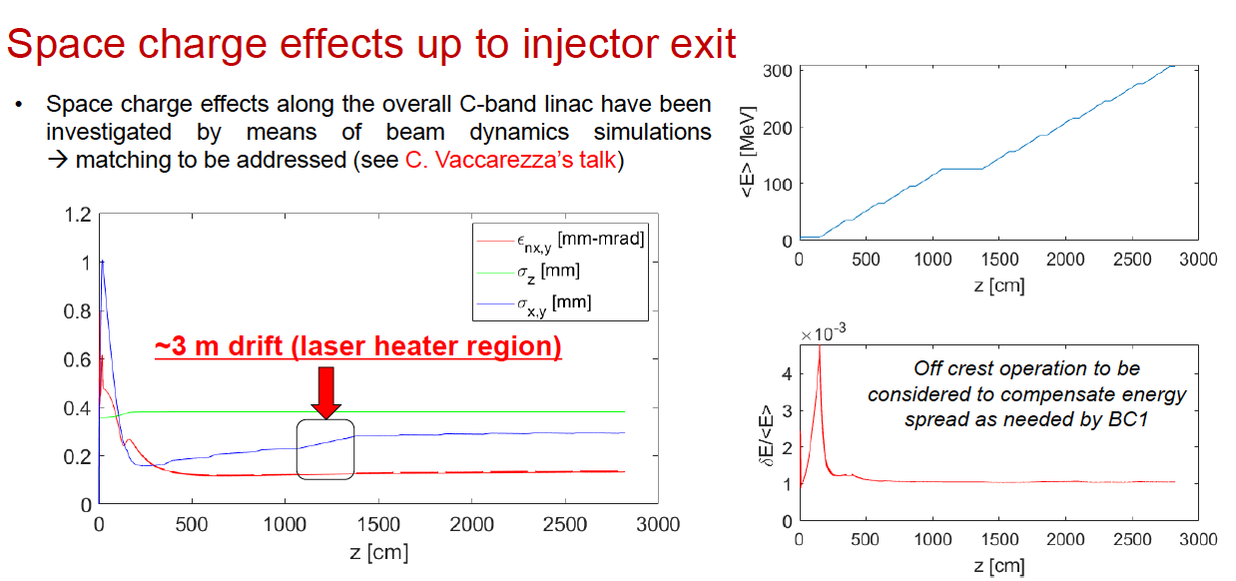
Injector SC Simulations
Courtesy A. Giribono

Slide 7
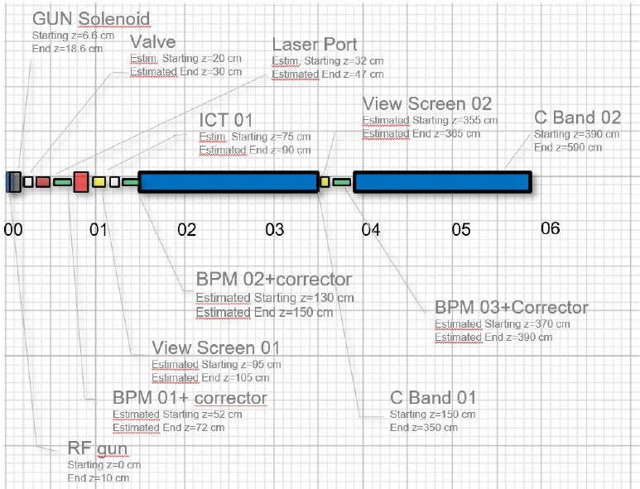
Injector Diagnostics
Courtesy A. Cianchi

Slide 8
Charge Scaling Procedure
If the charge density remains constant => the beam line does not change
J. B. Rosenzweig, E. Colby, report TESLA-95-04

Slide 9
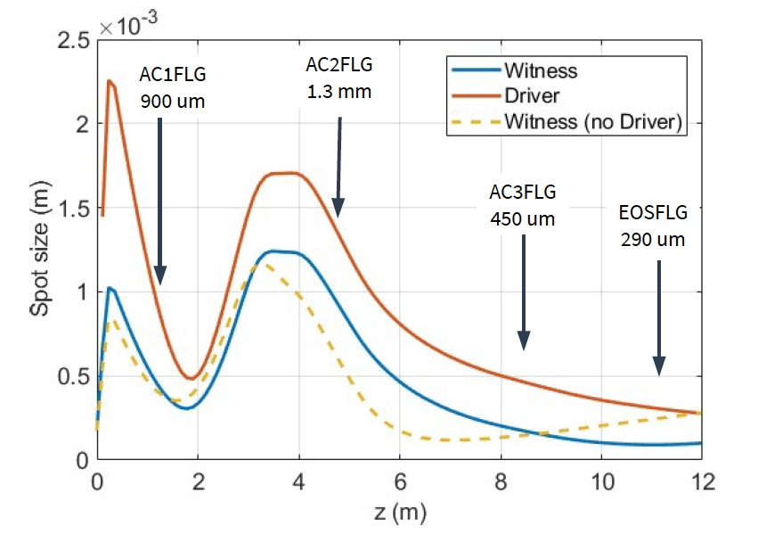
SPARC_LAB example
Using scaling laws we can accelerate two beams 1 ps apart with 200 pC (Driver) and 20 pC (Witness) running together in the same SPARC_LAB beam line
Courtesy R. Pompili

Slide 10
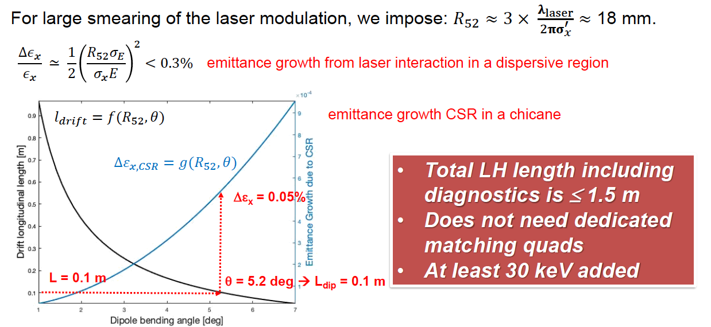
Laser Heater
Courtesy S. Di Mitri

Slide 11
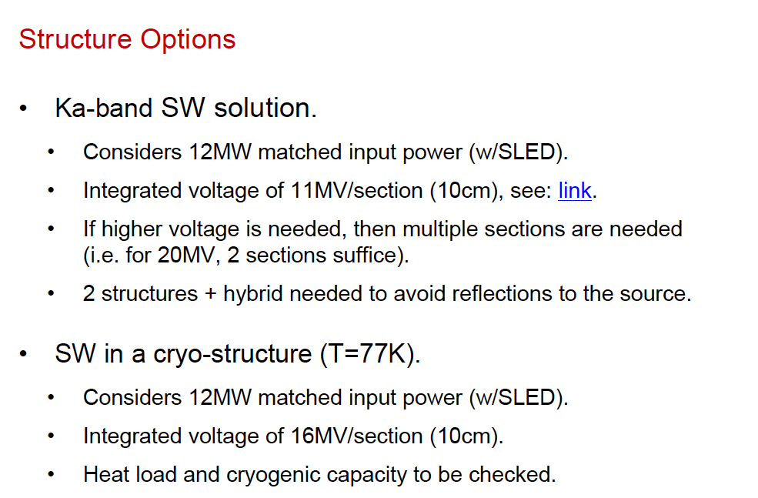
Ka Linearizer
Courtesy A. Castilla

Slide 12
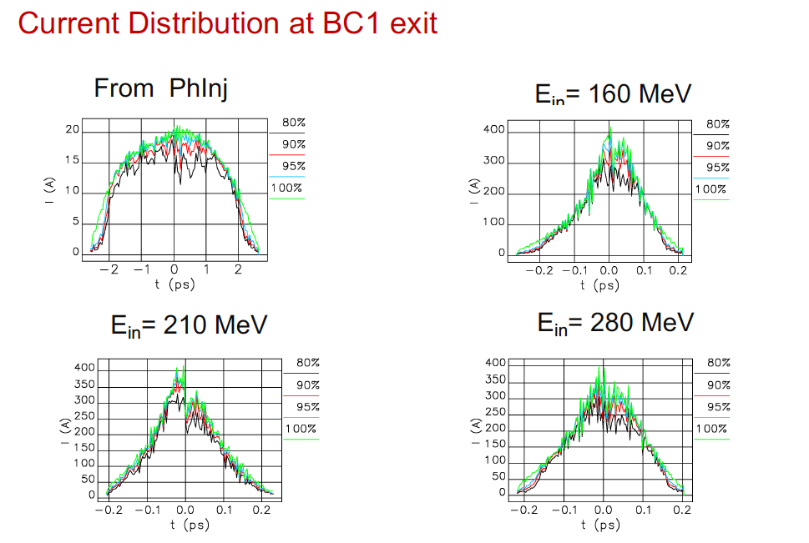
BC1 Simulations
Courtesy C. Vaccarezza

Slide 13
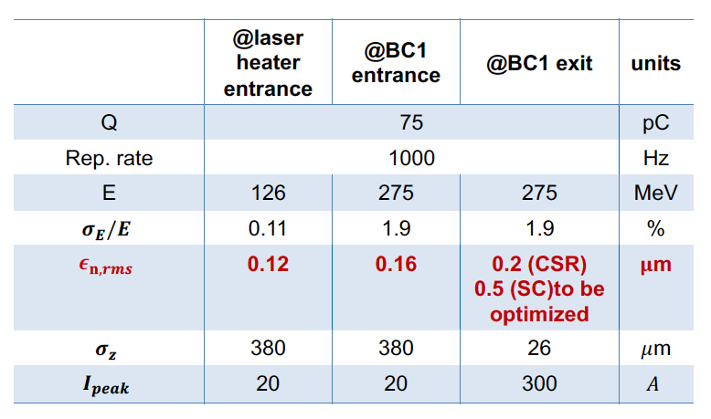
Achieved parameters
Courtesy Giribono & Vaccarezza

Slide 14
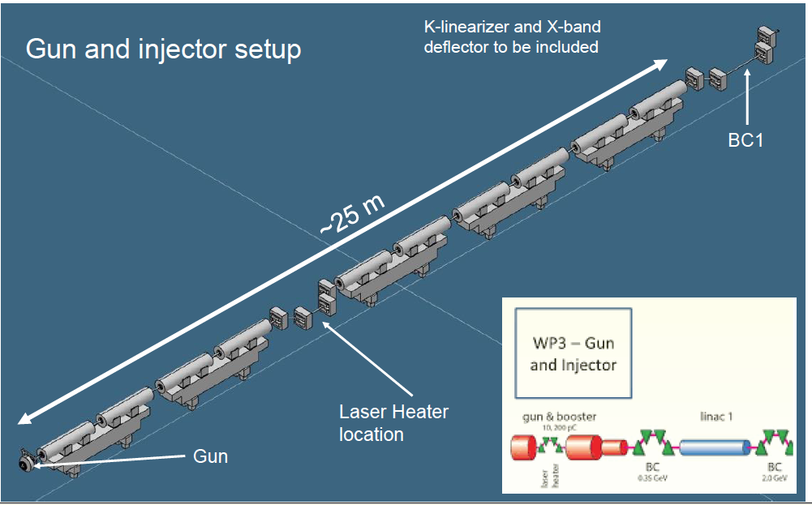
CAD Injector Model
Courtesy N. Gazis

Slide 15
To Do
Laser/Cathode system survival at 1 kHz
Include fringing fields in the gun region
C-band Power source OK?
Verify LH energy, not excluding possible VB
X-band module @ 30 MV/m after LH =>7.5 m less?
Fix the voltage in the k-band linearizer
Injector CAD model very welcome

Slide 16
New XLS Gantt Chart
Nov.
2020
May
2021
Nov.
2021
D3.3 & D3.4
03-21
New WP8

Slide 17
WP3 Deliverables
D3.1 - Preliminary assessments and evaluations of the optimum e-gun and injector solution for the CompactLight design, (=>M18).
D3.2 – A review report on the bunch compression techniques and phase space linearization, (=>M18).
D3.3 – Design of the injector diagnostics/beam manipulations based on a X-band cavities, (=>M39).
D3.4 - Design of the CompactLight e-gun and injector, with phase space linearizer (=>M39).
WP3 CDR Contribution

Slide 18


