Slide 1
WP6 Summary
Avni Aksoy
On Behalf of WP6 team

Slide 2
Introduction
WP6: XLS simulation from cathode to linac end
Operational modes
  Hard X-rays mode
  Soft X-rays mode
  Simultaneous Soft + Hard X-rays

Slide 3
Main Electron Beam Parameters
Parameter | Unit | 100 Hz | 250 Hz | 1000Hz
Beam Energy | GeV | 2.75-5.5 | 1-2.5 | 1-2
Bunch Charge | pC | 75 | 75 | 75
Number of bunch per RF pulse | # | 1-2 | 1-2 | 1-2
RMS Slice Energy Spread | % | 0.01 | 0.02 | 0.02
Minimum Electron bunch length rms | fs | 15 | 30 | 30
Peak Current | kA | 5 | 1 | 1
Normalised Emittance | mm-mrad | 0.2 | 0.2 | 0.2
When we operate low rep-rate bunch length will be defined by HXR requirement
The second bunch going to SXR BL will have same bunch length

Slide 4
Machine Layout
8-Xband
BC1
BC2
Linac4
H/S XR
Linac0
Linac1
Linac2
Linac3
H/S XR
8-Cband + Kband
16- Xband
8-Xband
68-Xband
1-str beween quads
2-str beween quads
2-str beween quads
4-str beween quads
Low repetition
~300 MeV
~1 GeV
2.75-5.5 GeV
High repetition
~300MeV
~0.7 GeV
1-2 GeV
Dedicated 4 diagnostic sections would be suitable for control off all beam parameters

Slide 5
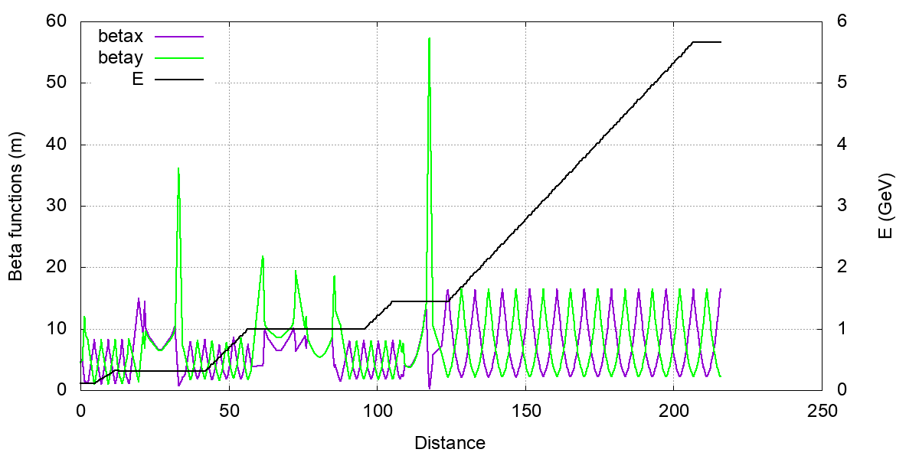
Twiss Functions Along Hard Xray
SXR Bypass
Diagnostic section
BC1
BC2
Linac0
1-str beween quads
Linac1
2-str beween quads
Linac3
4-str beween quads
Linac2
2-str beween quads

Slide 6
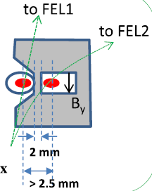
SXR bypass Line
Δt = n τ_{gun}, n = 1,3,5...
Δs = n λ_{gun}
Septum Magnet
0.5m 2.5°
Gun
6 GHz
C-Band
E
Sub-harmonic delfector
2.5 mm
25 cm
Linac
12 GHz
X-Band
E
0.25m
1.5m
~3m
E┴
Sub-harmonic delfector
3GHz
S-band
~6m
Sub-harmonic delfector
2.5 mm
drifting length
Xiaowei Wu

Slide 7
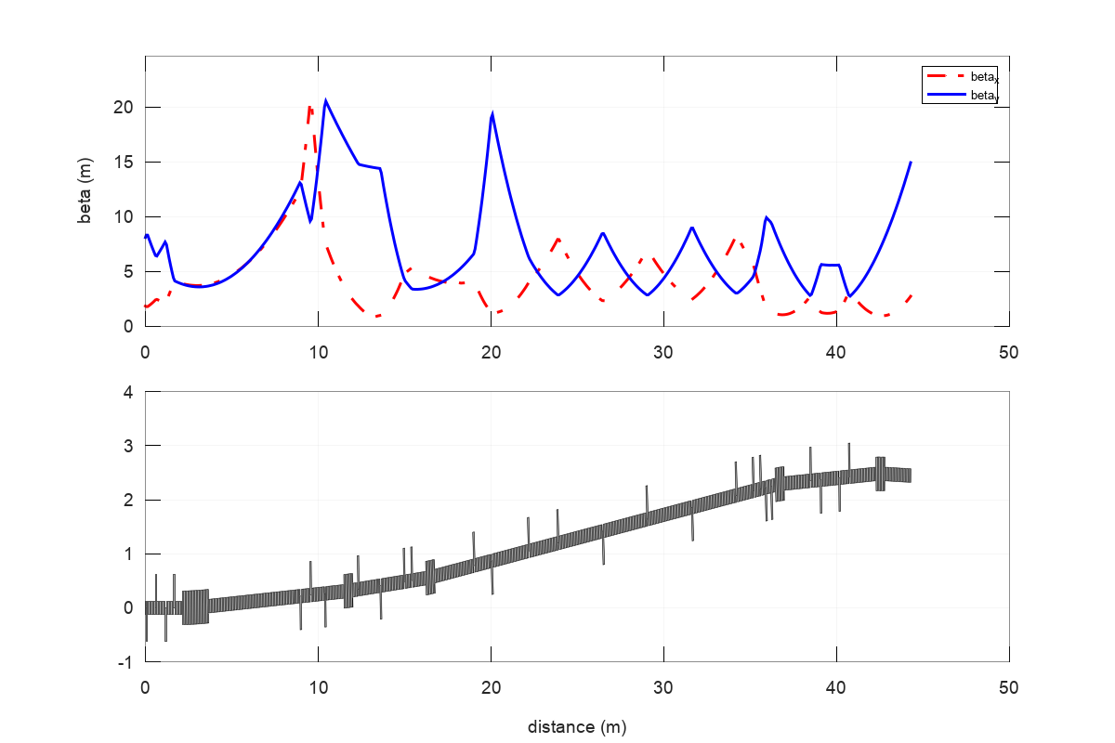
SXR by-pass Line
Needs to be reoptimized
İscocronous beamline
İdenticial bending magnets
Opposite R56 to avoid CSR?

Slide 8
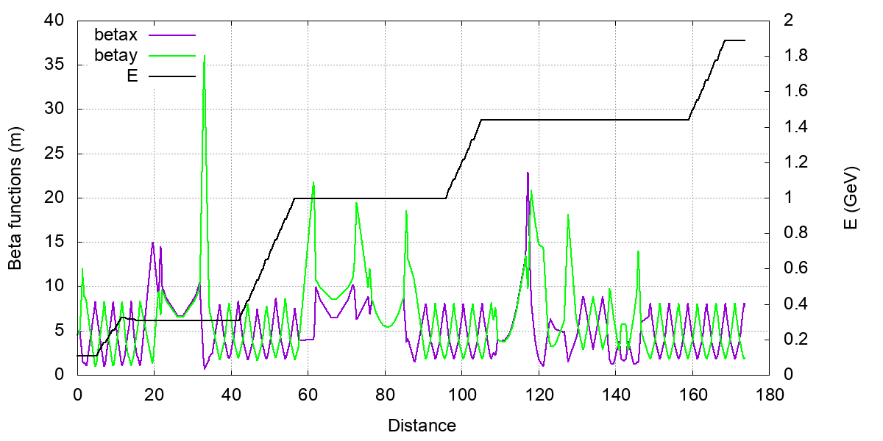
Twiss Functions Along Soft Xray
SXR Bypass
Diagnostic section
BC1
BC2
Linac0
1-str beween quads
Linac1
2-str beween quads
Linac2
2-str beween quads
Linac4
2-str beween quads
da

Slide 9
Operation Modes for HXR BL
Energy Bunch Length
A.Latina

Slide 10
Beam Based Alignment (HXR BL)
Hard X-rays (5.5 GeV @ 100 Hz) Soft X-rays (0.97 GeV @ 1000 Hz)

Slide 11
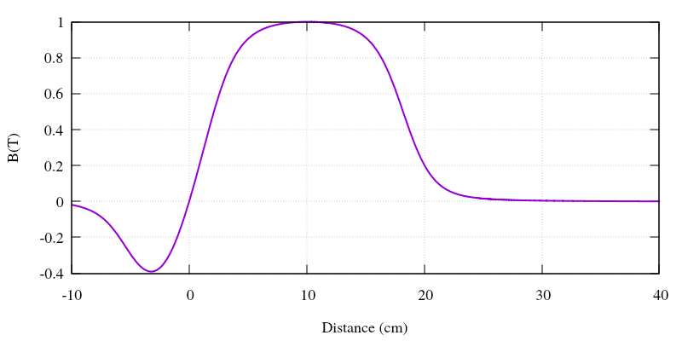
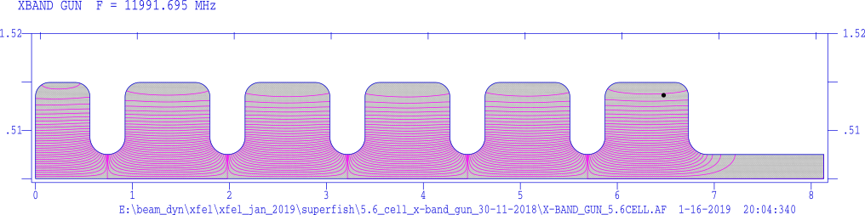
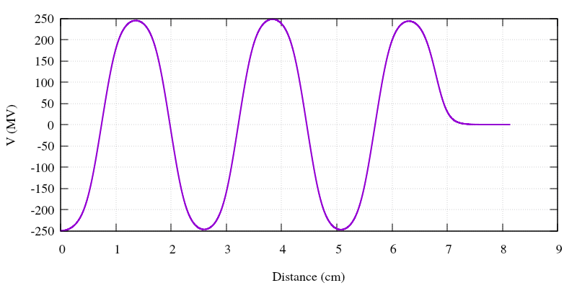
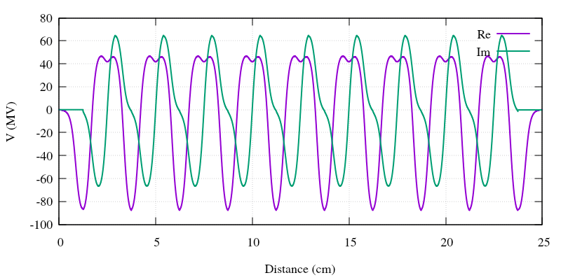
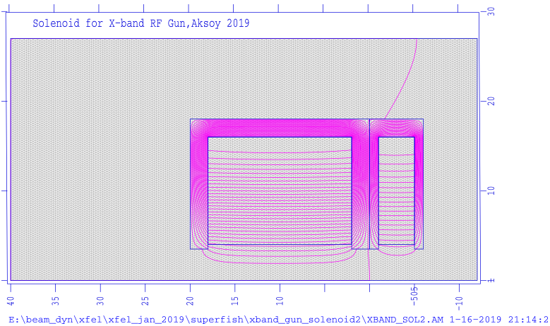
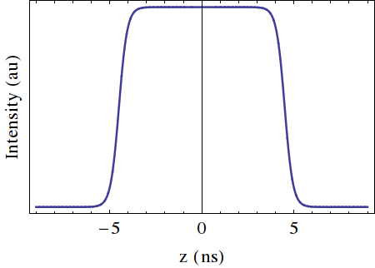
X-band based Injector
Laser
Parameter | Value | Unit
Frequency | 12 | GHz
Gradient | 65 | MV/m
Total lengt | ~1 | m
Cell number | 108 | #
12 GHz RF Gun
5.6 Cell, 200 MV/m
12 GHz Traveling wave structures
108 cell, ~0.9 m, 65MV/m, 120 degree
σ_{z} = 2 ps (FWHM)
σ_{x,y} = 0.25 mm
Parameter | Value | Unit
Frequency | 12 | GHz
Gradient | 200 | MV/m
Cell number | 5.6 | #

Slide 12
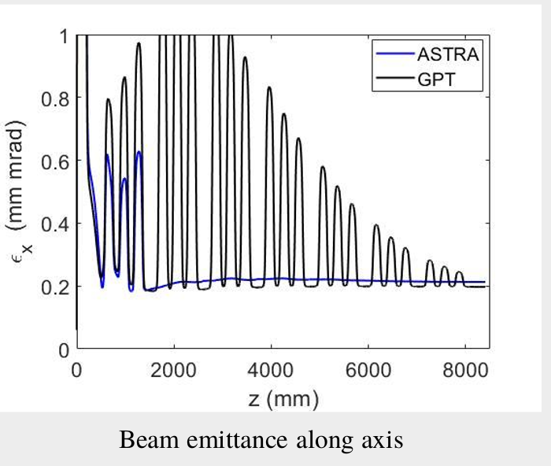
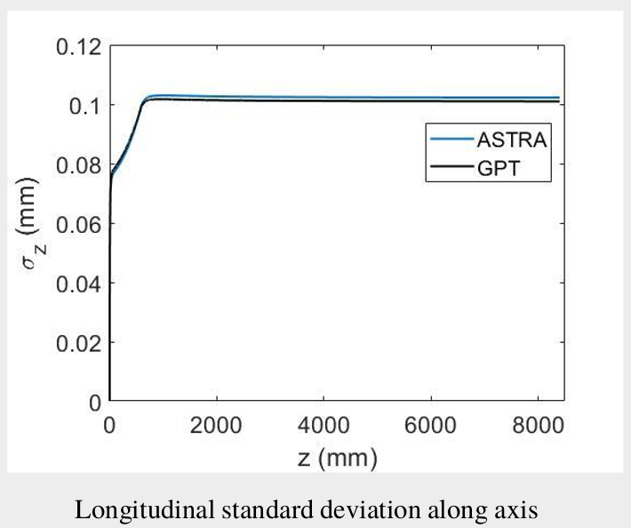
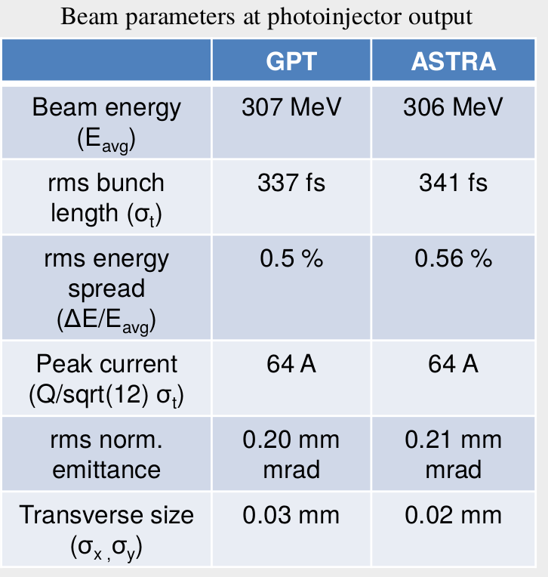
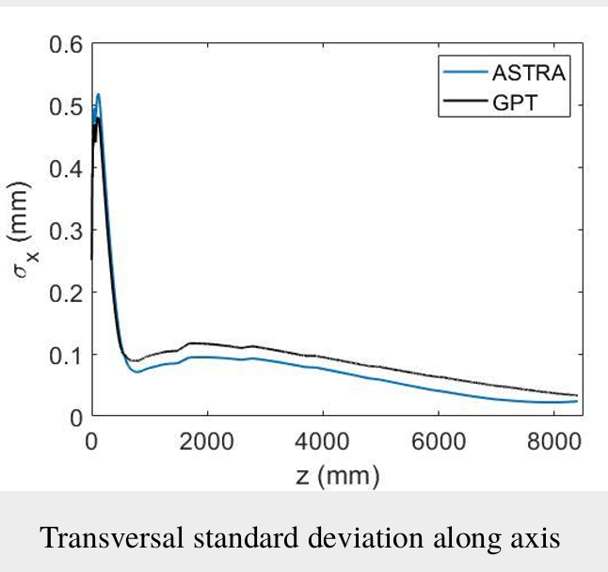
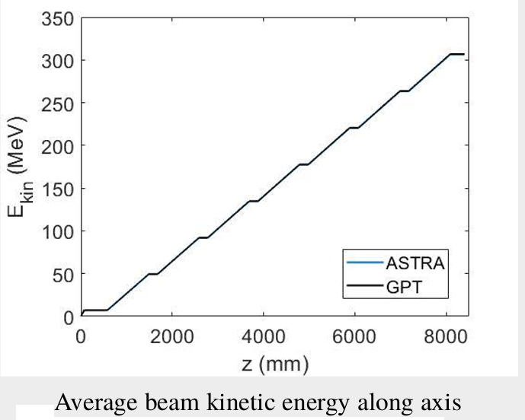
Beam From X-Band Gun
Daniel González-Iglesias1

Slide 13
To-do list, urgent items
The layout of C-band injector
  Simulation runs for beam manipulation in main linac and BCs
Designing final bunch compressors including high order corrections
Reshape the beamline in accordance with diagnostic…
Design the high energy transfer line(s)
CSR effects, microbunching instability, and laser heater
2-bunches simulations including long range wakefields, machine errors and BBA
Consistent S2E run from cathode to FEL emission
….
Shall we repeat same for X-Band based injector?

