Slide 1
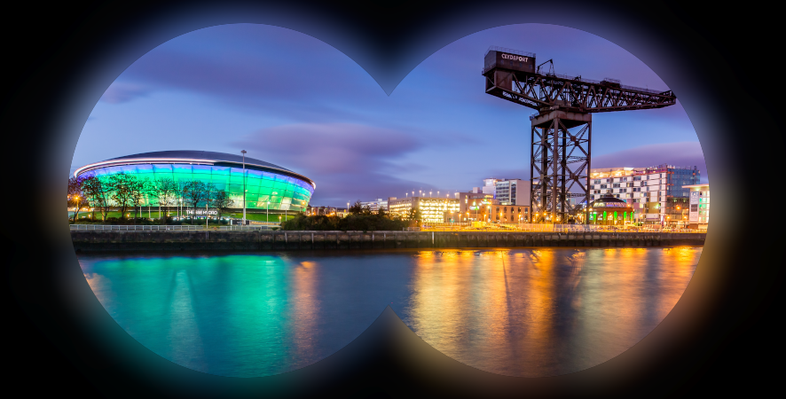
CompactLight Glasgow Virtual Meeting Concluding Remarks
Project Update G. D’Auria

Slide 2
Concluding remarks I
Workshop numbers:
Number of registrations on the indico web page 79
Average number of participants/day 55
Total number of presentations 30
Note: typical numbers of a face-to-face meeting!

Slide 3
Concluding remarks II
Project areas that need further evaluations/studies:
Injector and C-band photoinjector:
  Further BD simulations to evaluate the beam effects of the mode launcher “field tails“
  Check the possibility to operate at higher bunch charge, i.e. 100-150 pC.
Start-to-end simulations:
  Check in detail the overall linac design using the new injector layout (C-band).
Beam diagnostics:
  Evaluate the space needed for instrumentation and BD, in particular after the TDCs (in collaboration with WP3-WP4-WP6).
  Two bunches emittance measurements.

Slide 4
Concluding remarks III
XLS CAD model:
  Please support Nick with the requested information.
  For each component/element it is not necessary to provide mechanical and construction details.
  The XLS 3D model will be used to support sharing the facility view, avoiding interference between components, missing elements, etc.
Cost analysis and Cost-Benefits analysis:
  Considerable progress has been made since Athens meeting, but it will be very important to continue support Carlo to complete the data collection and to refine numbers within October-November 2020.
  The same recommendations are valid for the CBA (Evangelos)

Slide 5
Concluding remarks IV
Good news from CPI:
Ongoing activities on the X-band klystrons (10 MW, 1 KHz and 50 MW 100 Hz).
New CERN design for the high efficiency 50 MW tube.
Preliminary data on the EU C-band high repetition rate klystron.

Slide 6
Concluding remarks V
Further enchouragements and suggestions:
Reinforce dialogue and information transfer among WPs.
Organize WP meetings regularly.
Considering this “semi-lockdown” period, increase synergies among groups is fundamental!!!
Thanks again for your participation
and
hope to see you in Glasgow
in November!

