Slide 1
SCADA Upgrade & feedback from users New Notification system
G. Pigny, P. Prieto, L. Zygaropoulos, A. Gutierrez, J. De La Gama,
H. Vestergard, N. Chatzigeorgiou, S. Blanchard, A. Rocha, R. Ferreira

Slide 2
Upgrade of the Notification system New features:
Pre-defined configurations managed by group
Do not send notifications for short duration events

Slide 3
Upgrade of the Notification system How to set up group:

Slide 4
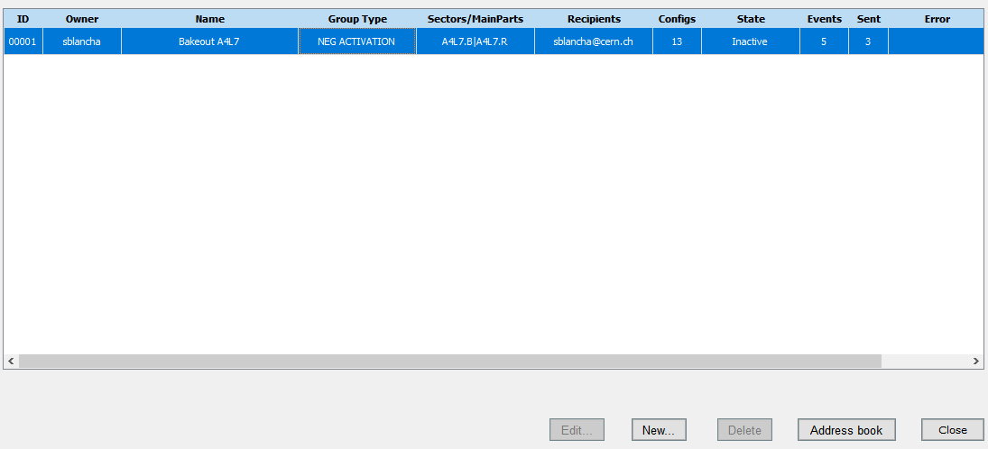
Upgrade of the Notification system How to set up group:

Slide 5
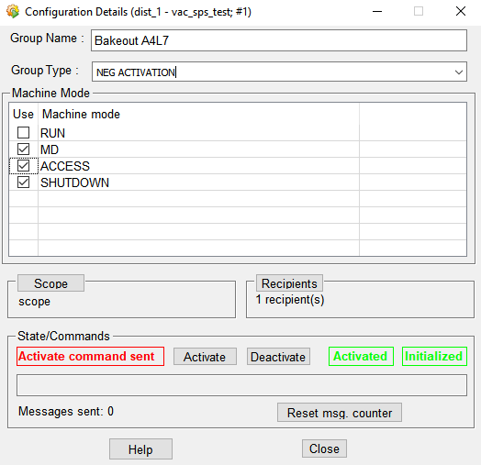
Upgrade of the Notification system How to set up group:

Slide 6
Upgrade of the Notification system Example of the pre-defined configurations:
“NEG Activation” Group configurations:

