Slide 1
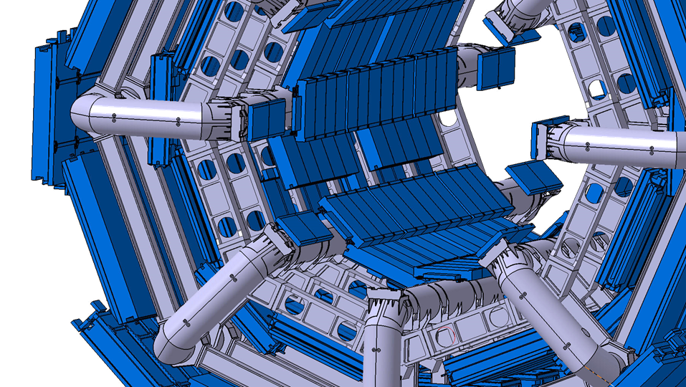
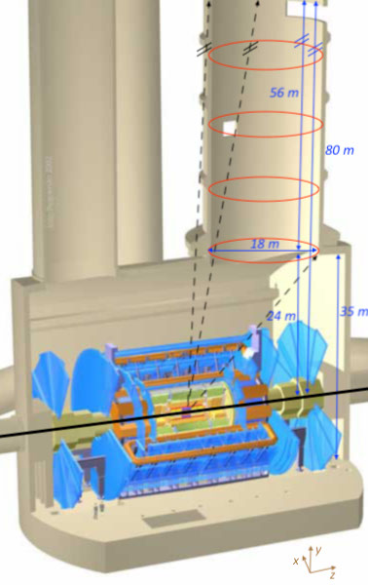
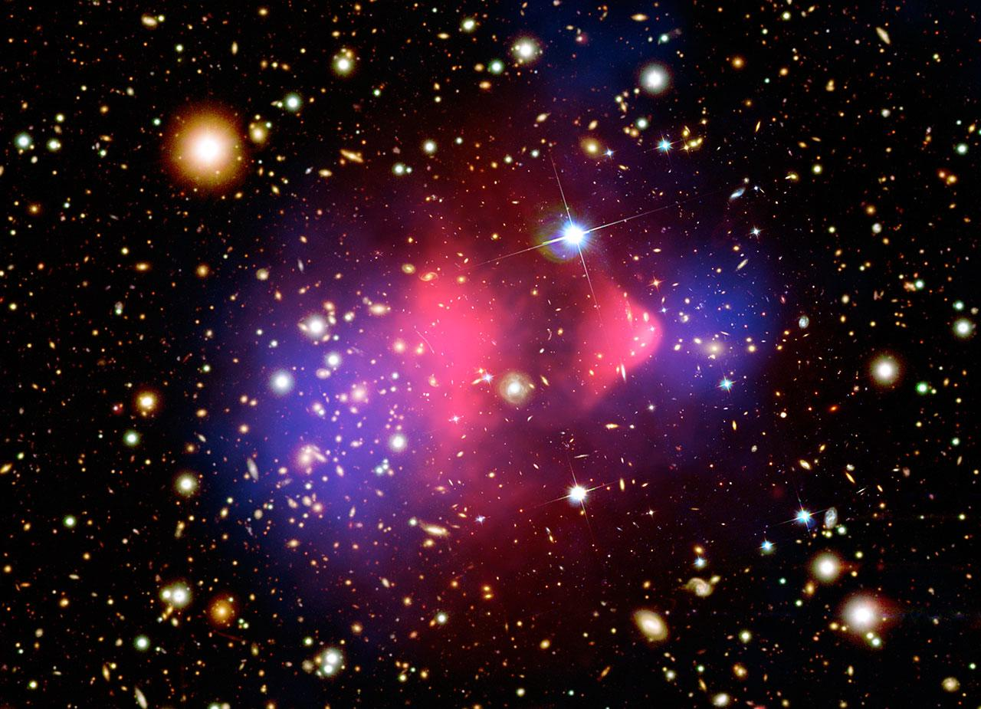

ANUBIS layout and technology
AN Underground Belayed In-Shaft search experiment
Giulio Aielli • Martin Bauer • Oleg Brandt • Lawrence Lee • Christian Ohm • Bálint Szepfalvi
LLP Workshop, 16 Nov 2020

Slide 2

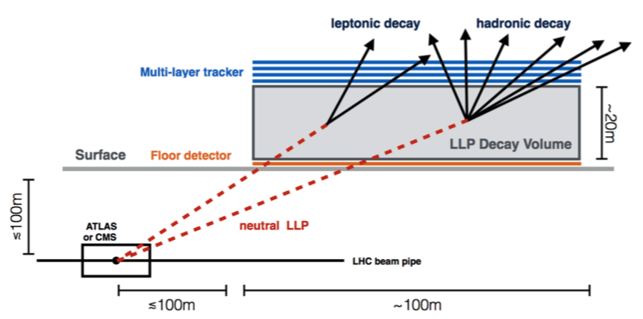

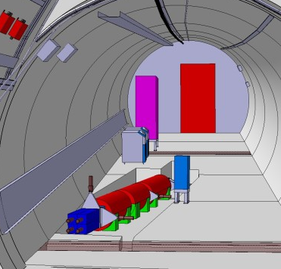

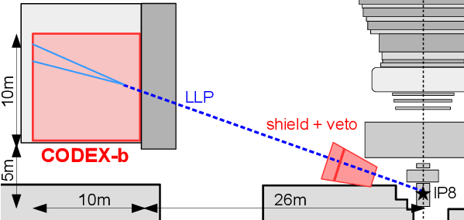

Where to look for long-lived particles?
ANUBIS
Bauer, OB, Lee, Ohm 1909.13022
Chou et al 1606.06298
Feng, et al 1710.09387
weakly coupled light particles with high statistics
along the beam axis
LLPs from the decays of heavy states (e.g. the Higgs)
at large angle, off axis
Gligorov et al 1708.09395

Slide 3
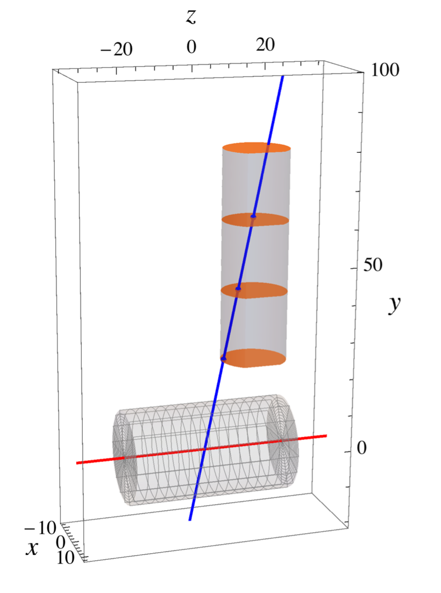
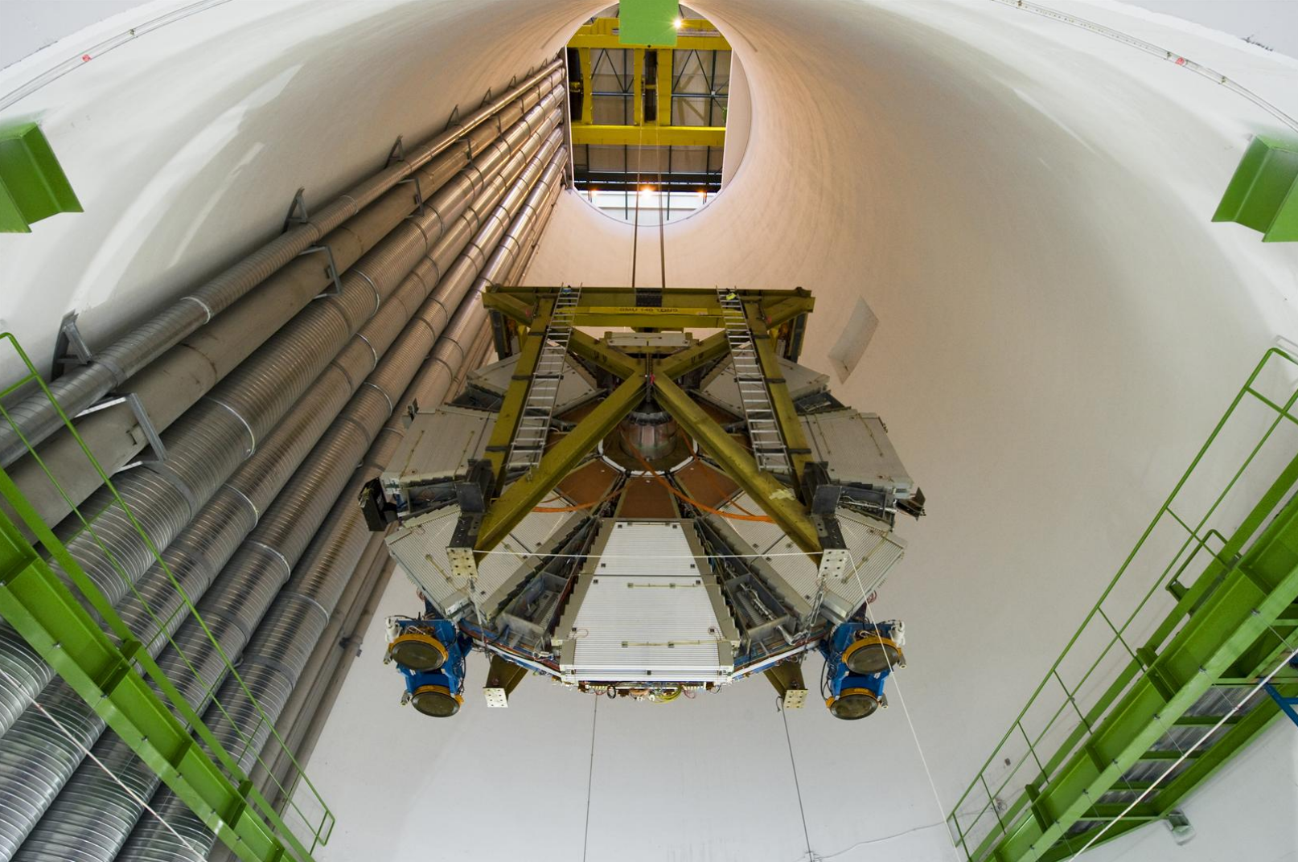

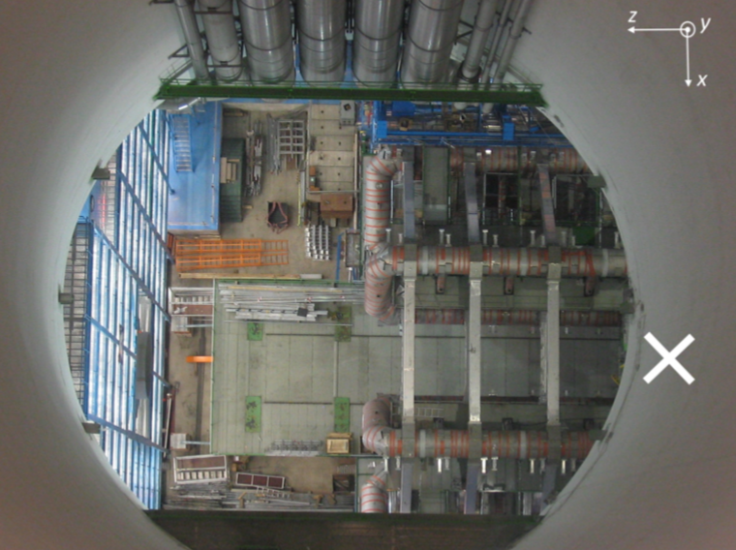
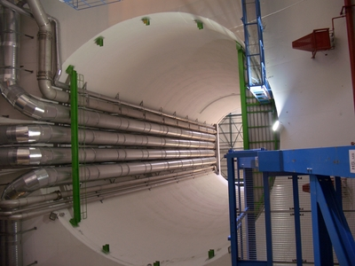

ANUBIS: idea
cranes can support up to 270 t
Existing geometry allows for minimal civil engineering costs
Projective decay volume optimises acceptance for different lifetimes
Can be conveniently combined with ATLAS
18 m
IP

Slide 4
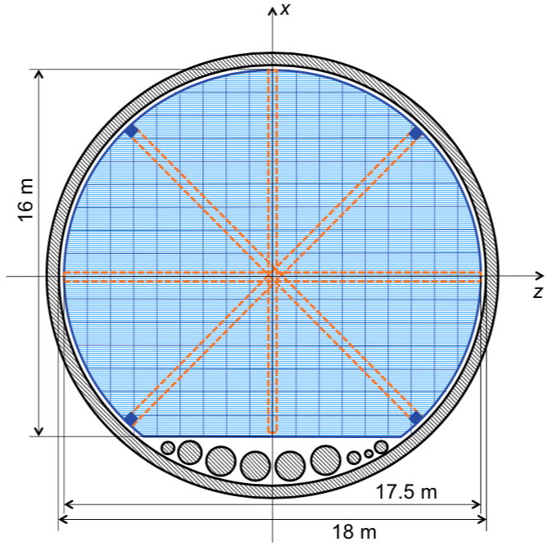
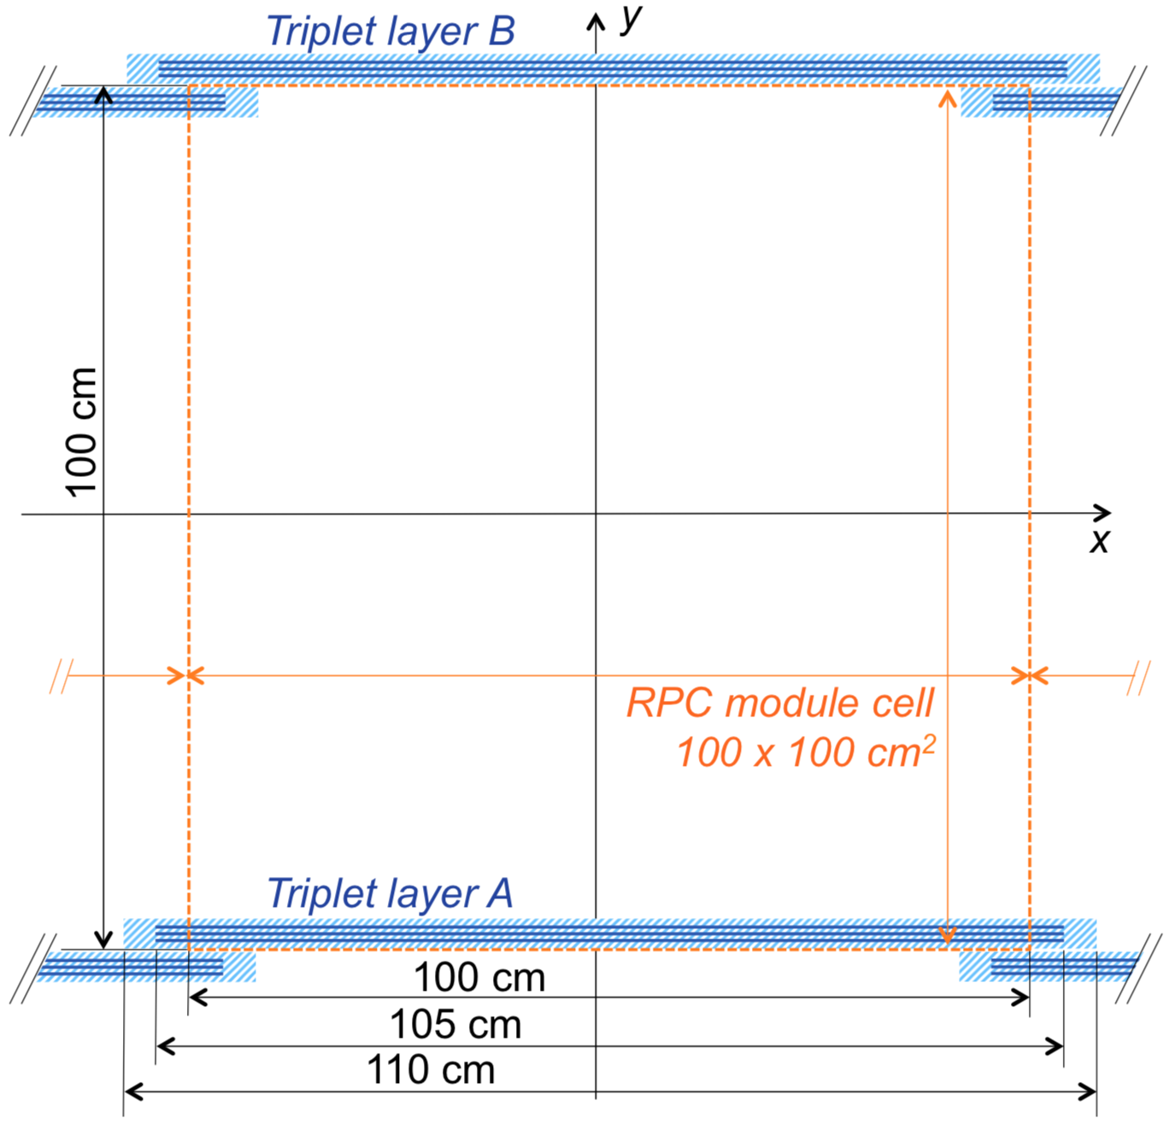
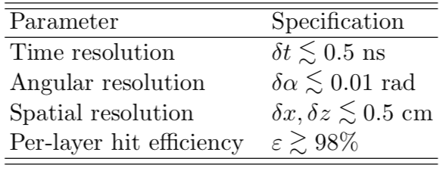
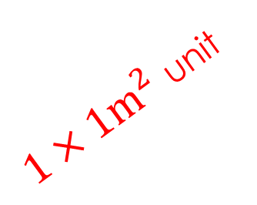
ANUBIS detector initial proposal
Proposed ATLAS Phase-2 upgrade RPCs as baseline technology
2D readout triplet chambers made of 3 independent singlets
2.3 k m² total instrumented area
Each tracking station weighs 230 m² x 51 kg/m² ~ 30 tons (OK)
IP
$1×1m^{2}$ unit
18 m

Slide 5
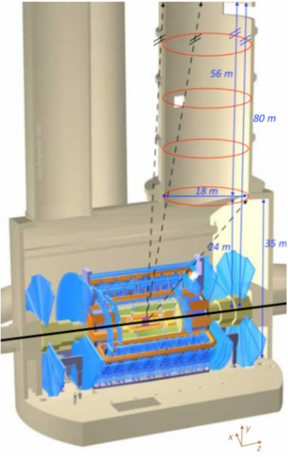
Possible implementations of ANUBIS concept
Standard (conservative) scenario
1 ring scenario
Extended scenario

Slide 6
PERFORMANCE OF the ATLAS muon system
new RPC layer in the Inner barrel
Same RPC technology baseline for ANUBIS
High efficiency projective to the access shaft
Can be improved with ID combined tracking
Time of flight performance
9 tracking layers
5 m independent lever arm
0.5% resolution on β

Slide 7
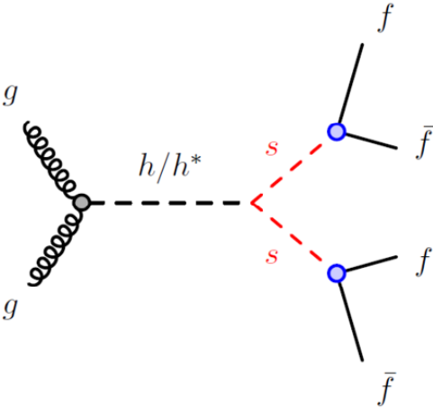
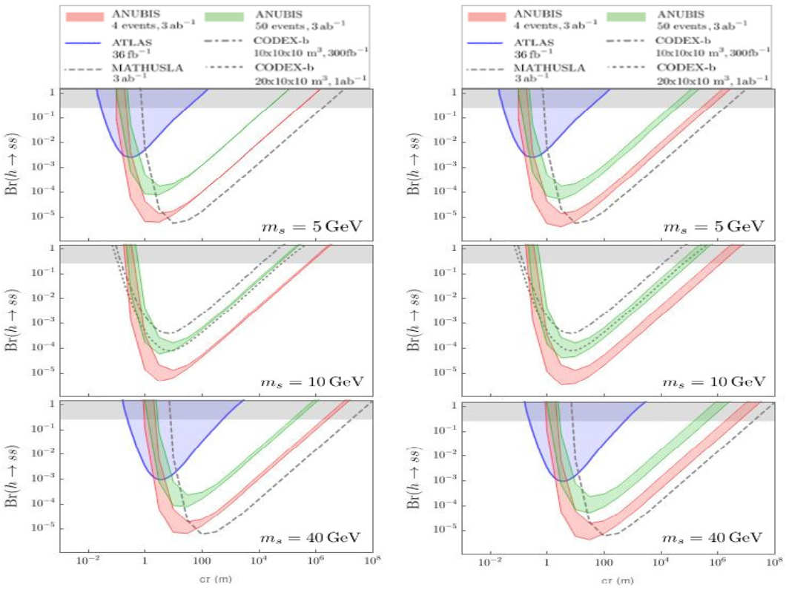
ANUBIS layout comparison
https://arxiv.org/pdf/1909.13022.pdf
1 ring vs. standard
extended vs. standard
For a given decay volume length
  More solid angle if closer to the IP
  Number of decays higher if closer to the IP (for shorter decay lengths)

Slide 8
detector requirements
Enclose large volumes → low cost per unit surface
Discriminate external SM particles → efficient, hermetic & time resolved
Tracking charged particles → good 2D tracking ability
resolving 2 (or more) tracks at small angle → multi-hit resolution
Measure particle β → Time of flight capability
Identify particles → pre-shower layers embedded
Veto→ active: close by experiments integrating DAQ with the host
Short time scale→ HL-LHC little residual time for design and construction
This applies also to CODEX-B which is preparing a large demonstrator using the same technology
(See Vladimir talk)
industrially produced on large scale → low unit cost
Thinner gas gap → higher time resolution
Built-in high sensitivity front end → high efficiency with thin gas gaps
50 ps embedded TDC and serializer→ high performance low cost, easy to readout
Stand-alone singlet structure → Can be combined in sandwich with high z layers for particle id
WHY ATLAS RPCs?
Turn key solution → new generation RPCs designed for HL-LHC and construction can start in time

Slide 9
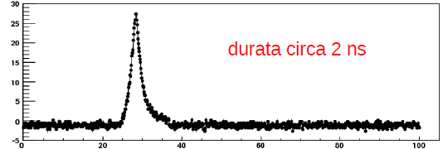
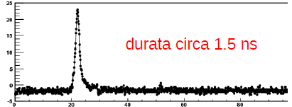
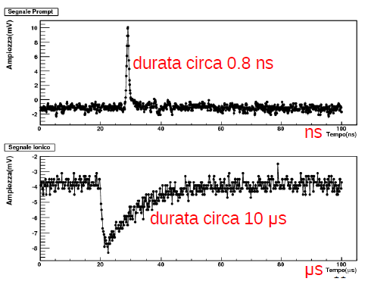
Gas gap vs. electronics
2mm
Duration about 3 ns
New design FE with Si-Ge transistor
Amplitude (mV)
Legacy RPC case
Time (ns)
BIS7 RPC case
1mm
Duration about 1.7 ns
Amplitude (mV)
Time (ns)
New design FE with Si transistor
ATLAS FE
R&D RPC case
0,5mm
Duration about 1.0 ns
Amplitude (mV)
Thinner gas gap
  → higher E field → higher charge density
  → same saturation with less charge
  → faster peaking time
Time (ns)
Higher electronics performance
  Can exploit thinner gas gap small & fast signals
  Can work at lower gas gain
  Compatible with eco-friendly gases

Slide 10
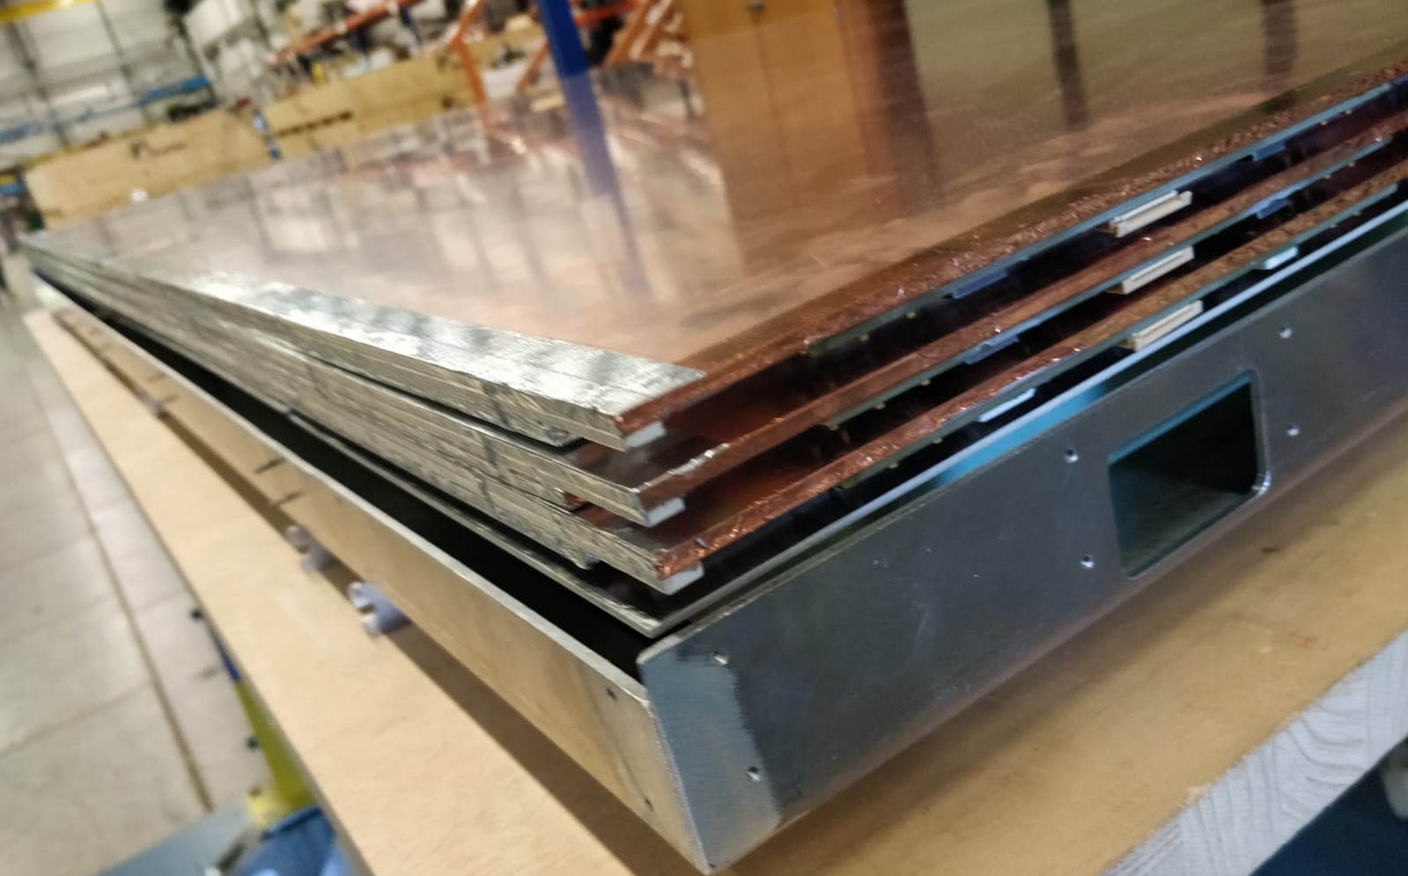
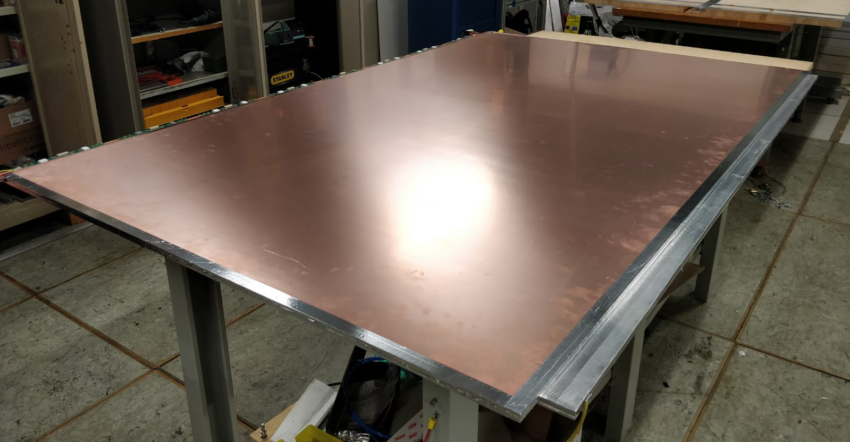
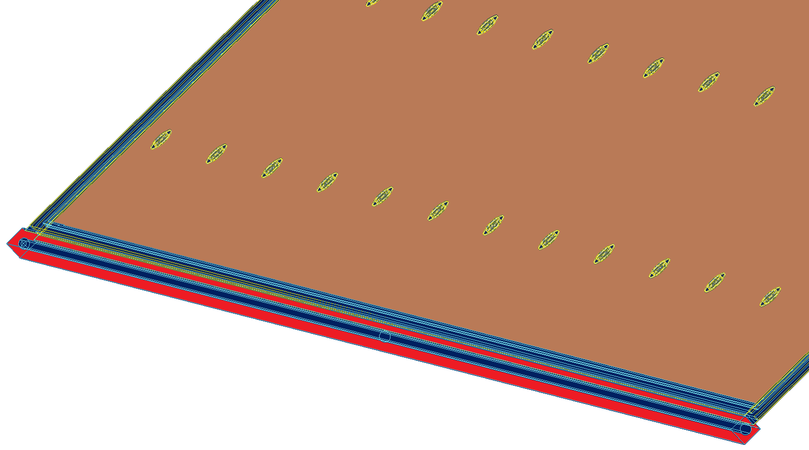
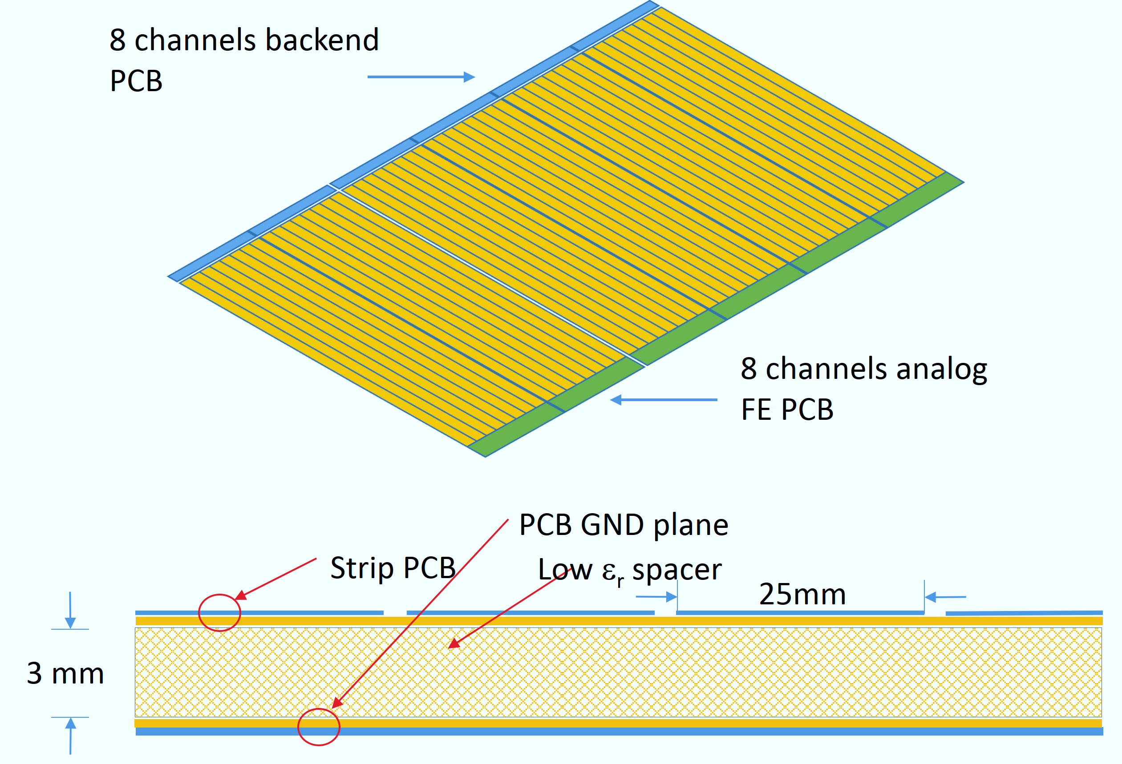
Singlet structure
A singlet is made of
a RPC gas gap
Two readout strip panels
  Strip PCB facing the gap
  Low ε_{r} dielectric filler
  Reference ground plane
  Front end electronics
  Matching resistors
Ground reference interconnections
A singlet is a independent faraday cage insensitive to the external world
A number of singlets can be boxed freely and interleaved with other materials

Slide 11
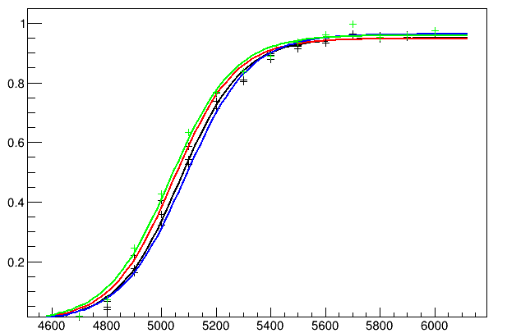
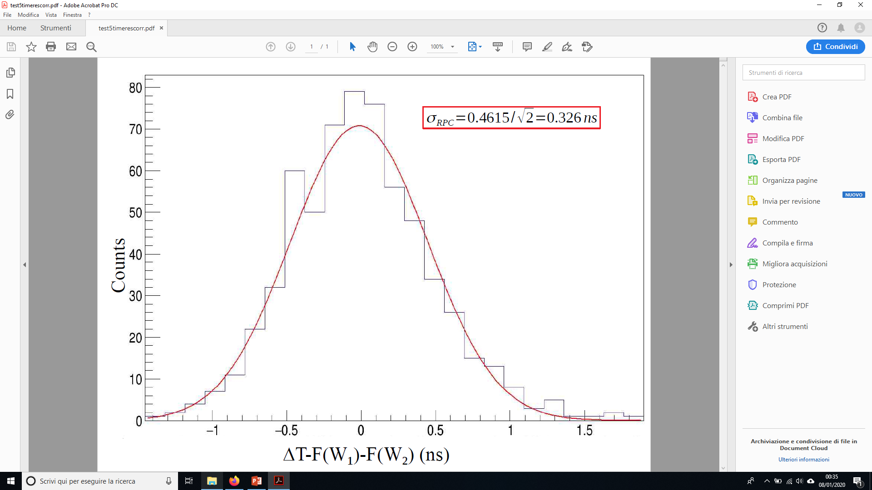
State of the art performance with 1 mm gas gap
Efficiency curve all over the singlet surface
Time resolution of a single 1mm gas gap measured through TOF between identical detectors
About 350 ps with time walk correction
About 200 ps for a triplet of gas gaps
η layer
Φ layer
AND η-Φ
OR η-Φ
Efficiency
HV applied (kV)
95% of efficiency at 5,6kV for each singlet
Measurement over all surface with CR → a few percent of missing acceptance
Inactive area 1% for the spacers

Slide 12
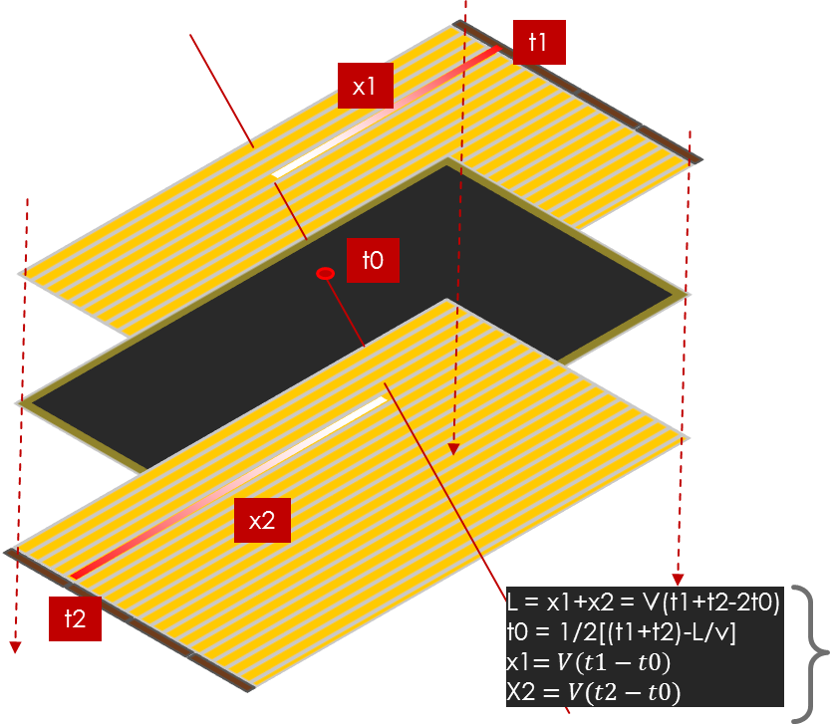
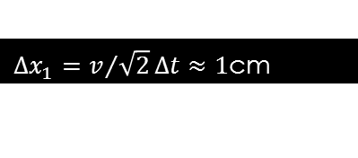
Cutting costs and simplify layout: digitization inside
An upgraded readout chip in preparation for the ATLAS RPC phase2 upgrade:
  Same as present amplifier
  Same as present fast discriminator
  70 ps low power TDC
  Data encoder with serializer
daisy chain option foreseen for the low rate experiment as ANUBIS
  greatly compress the readout cost
Standard 2D readout for squared chamber
1D readout convenient for rectangular formats
  Less channels and less dead area
  Second coordinate from time difference at strip ends
$∆x_{1}=v/{\sqrt{2}}∆t≈1$cm
See “5D tracking concept” in RPC2016

Slide 13
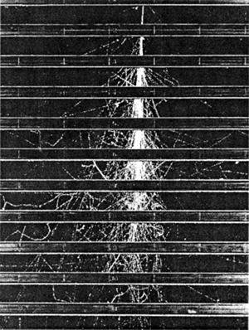
Initial detector design proposal
Station structure
Each station is a Multi singlet interleaved with high z material layers acting as pre-showers
2D readout with mean timer functions
Embedded 50 ps TDC
RPC singlet
High Z layer
High Z layer
μ
e
γ
RPC discharge cells are ~0.1x0.1mm^2 small
RPC elementary cells respond independently on each other till to very high particle density
Signal amplitude proportional to the number of tracks
Ideal after a pre-shower
Several stations can perform some calorimetry
Take home message:
gamma discrimination is possible!
Montecarlo studies needed

Slide 14
CONCLUSIONS
ANUBIS combined with ATLAS has a competitive LLP search potential
New generation RPCs is a promising technology to built the detector
A technical collaboration with ATLAS RPC upgrade started
Prototypes can be readily installed by cloning ATLAS phase-1 chambers
Base technology for the final detector can be taken from the ATLAS phase-2 chambers
specific layout for ANUBIS to be defined basing on final performance requirements
One of the main difficulties is to organize such a big production in time
other LLP search experiments are based on the same technology
CERN should create a local pool for RPC based detector construction

