Slide 1
BLM database changes at SPS
Eva Calvo (BE-BI-BL)
Special thanks to E. Effinger and C. Zamantzas
Machine Protection Panel Meeting (5th June 2020)

Slide 2
Motivation
To introduce all the SPS BLM detectors in the Layout Database so that all the stake holders can clearly know their location in the machine, their type and their characteristics.
Those detectors were installed some tens of years ago, but the installation was modified in successive shut down periods, leading little by little to a situation where it was not always fully clear the name and location of some detectors.
Prepare the path towards the future upgrade in LS3

Slide 3
Old naming scheme
Old names used in applications, logging and documentation were not compliant with the SPS naming convention
  So can not be kept in the Layout Database
  Ideally, use the same name in the layout database, logging database, applications, layout drawings, etc
3 types of SPS BLM sub-systems :
  Those of the Arcs : E.g. BLM.507
  Those of the LSS : E.g. BLM.21636.ZS1
  Those of the TL : E.g. BLMI.82904, BLMI.400316, SPS.BLM.211106 or TT20.BLM.210305.QTLD
Arcs used 3 digits, LSS 5 digits and TL are diverse

Slide 4
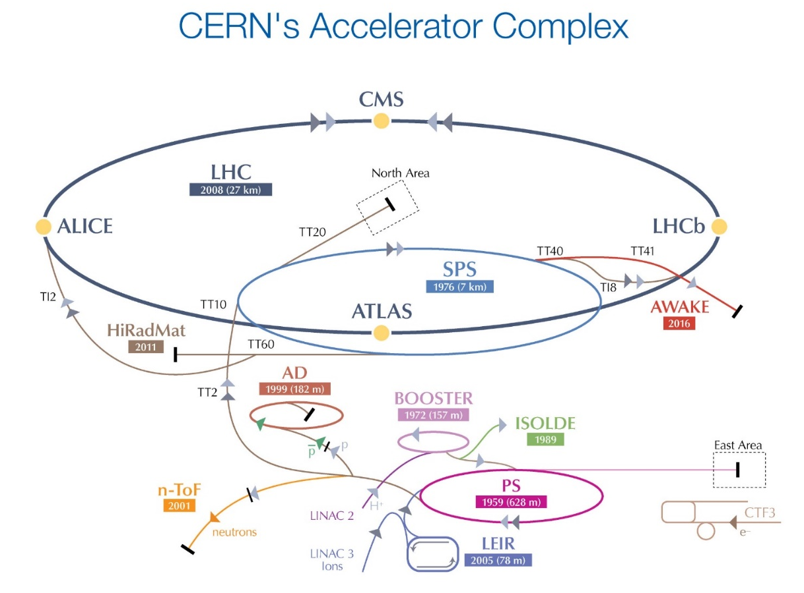
Naming scheme scopes
Unfortunately, there is a full ecosystem of heterogeneous naming conventions, not always fully compliant among them: SPS-C-QA-0001, PS-C-QA-0001, PS-C-QA-0002, CPS-PM-QA-0001, PSZ-C-QA-0001
They split the CERN accelerator complex by regions, that are not always common to how the acquisition systems are distributed
Geographical scope of the
SPS naming scheme applies :
▪ SPS ▪ TT40
▪ TT10 ▪ TT41
▪ TT20 ▪ TT60
Please note, that TI2 and TI8 BLMs detectors are acquired with SPS BLM system, but follow the LHC naming convention.
TT10 uses different acquisition system (injectors), but should follow the SPS naming scheme

Slide 5
SPS new naming convention
Equipment code
1 | 2 | 3 | 4 | 5 | 6 | 7 | 8 | 9 | 10
B | L | M | L | . | x | y | y | z | z
Position (@ SPS):
x : sextant [1..6]
yy : half-cell [00-99]
zz : slot [00-99] (not linear)
Layout component:
1 | 2 | 3 | 4 | 5 | 6 | 7 | 8 | 9 | 10 | 11
B | L | M | I | . | x | x | y | y | z | z
BLM Functionality:
L : LSS
R : Ring
I : Transfer lines
H : LHC ionization chambers
D : Diamond type
Position (@ TL):
xx : transfer line segment *
yy : half-cell [00-99]
zz : slot [00-99] (~linear)
Expert name:
 |  |  | 1 | 2 | 3 | 4 | 5 | 6 | 7 | 8 | 9 | 10 | 11 | 12 | 13 | 14 | 15 | 16 | 17 | 18 | 19 | 20 | 21 | 22 | 23 | 24
S | P | . | B | L | M | L | . | 1 | 0 | 1 | 0 | 8 | . | I | L | L | _ | M | S | E | 1 | _ | T | T | 2 | 0
Transverse position:
E : External
I : Internal
T : Top
B : Bottom
L : Left to beam direction
R : Right to beam direction
Optional fields
Transfer line name
Ring
Electronics type:
V : VFC-ADC
C : CFC
I : Transfer line kind
O : Oasis
D : BLEDP acq. elec.
S : SPS integrator
Observed elements:
Up to two elements (e.g. MSE, MKDV, etc)
Transfer
Lines
Monitor installation :
L : Longitudinal to the beam direction
T : Transversal to the beam direction

Slide 6
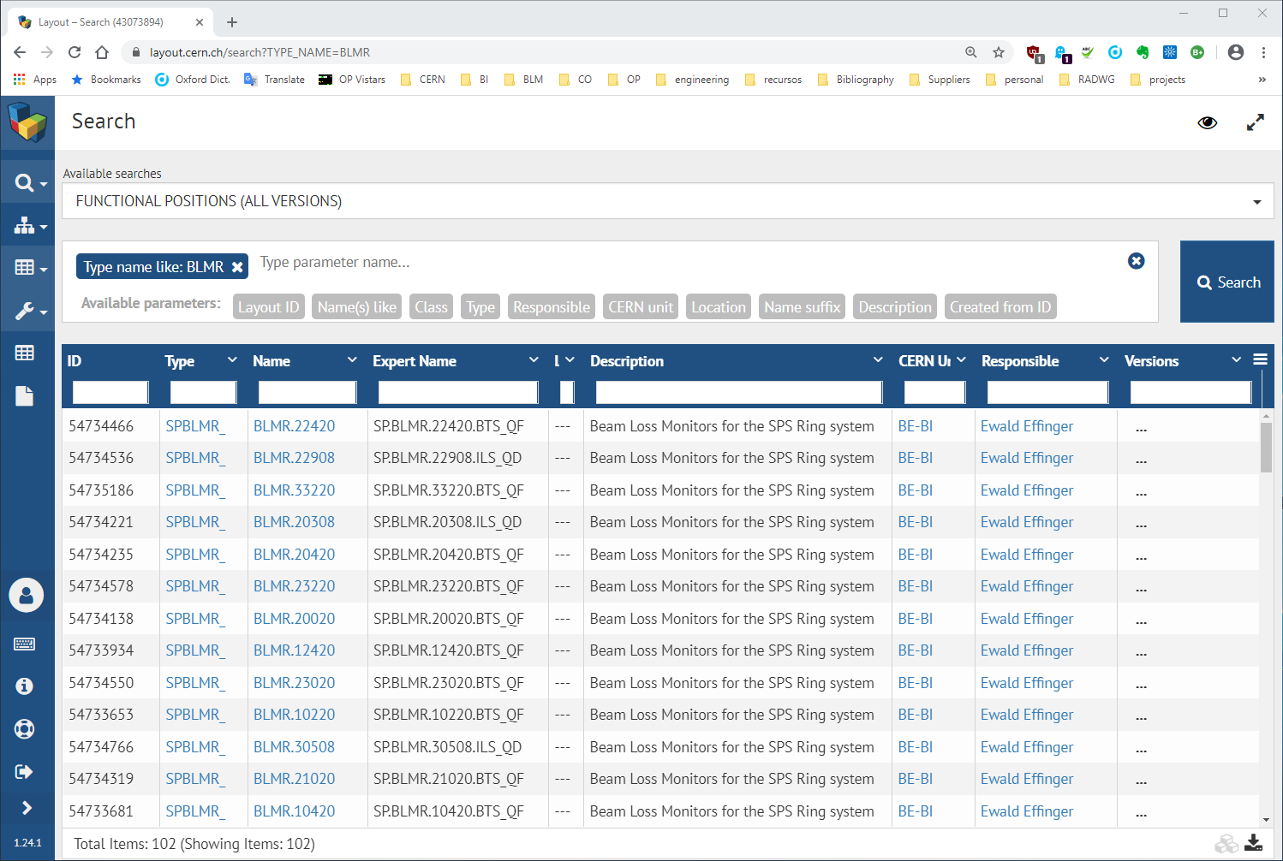
Status
The BLMR detectors of the first 3 sextants are already published in the LDB
And the rest will follow soon
Many thanks to S. Bartolome, for the amount of work carried out in order to make this possible.

Slide 7

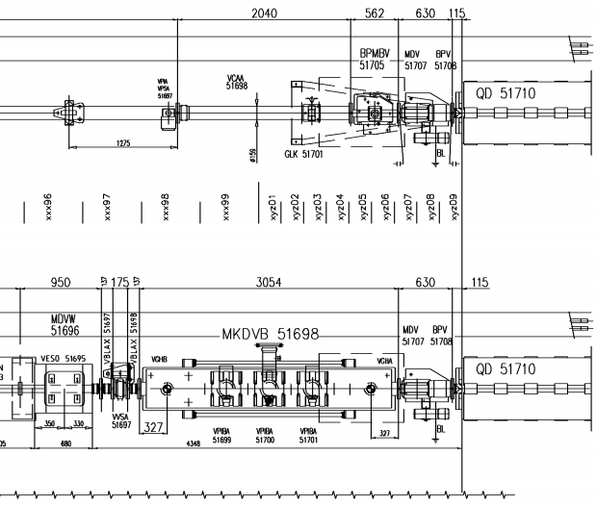
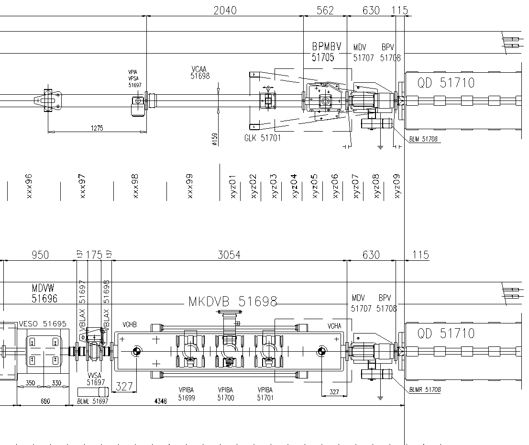

Layout drawings
Some layout drawings contained obsolete BLM locations or names.
We are now collaborating with EN-ACE-INT to keep updated all the layout drawings. E.g.
LSS1 : SPSLNINS0142-AD
LSS2 : SPSLNINS0146-AA
LSS3 : SPSLNINS0106-AF
LSS5 : SPSLNINS0143-AE
LSS6 : SPSLNINS0145-AA
LSS6 : SPSLNINS0154-AA
TI8 : LHCLSI__0034-AF
TI2 : LHCLSI__0035-AE
No names
Old name
Missing detectors
No names
New name
New detector

Slide 8
LS2 ECRs impacting SPS BLM system
The list of ECRs impacting the BLM layout is tracked at :
https://bl-ls2-activities.web.cern.ch/LS2-SPS.php
LSS1 :
  SPS-BLM-ES-0001 v.0.2
  SPS-BLM-EC-0003 v.0.1
  SPS-BLM-EC-0006 v.1.0
LSS2 :
  SPS-ZS-EC-0001 v.1.0
LSS5 :
  SPS-BLM-ES-0001 v.0.2
  SPS-LJ-EC-0003 v.3.0
  SPS-BLM-EC-0004 v.0.1
  SPS-XRP-EC-0001 v.0.2
LSS6 :
  SPS-TPSG6-EC-0001 v.1.0
TI2/TI8 :
  LHC-TCDI-EC-0002
Pending a new ECR describing the SPS BLM detectors renaming with an Annex with old and new names (SPS-BLM-EC-0008 v.0.1)

Slide 9
Any questions?

Slide 10
Thank you

