Slide 1
Welcome to the PERLE
Collaboration meeting
This is the first extended meeting of the PERLE Collaboration with the aim to review the status and the next steps towards the TDR and beyond.
Achille Stocchi

Slide 2
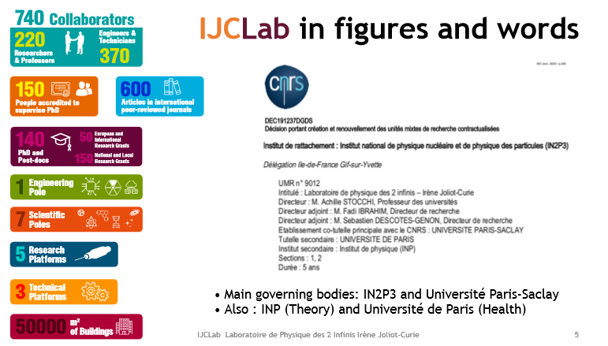
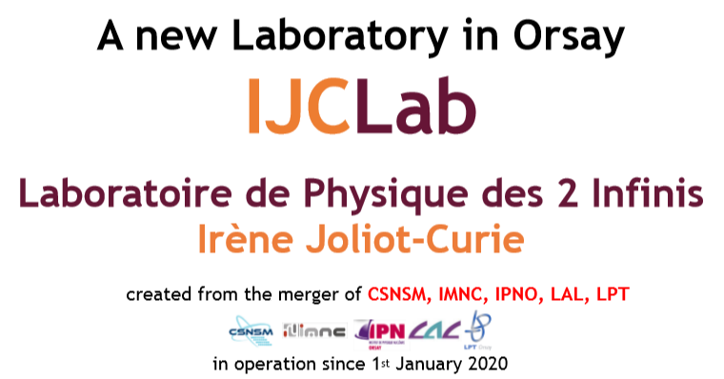
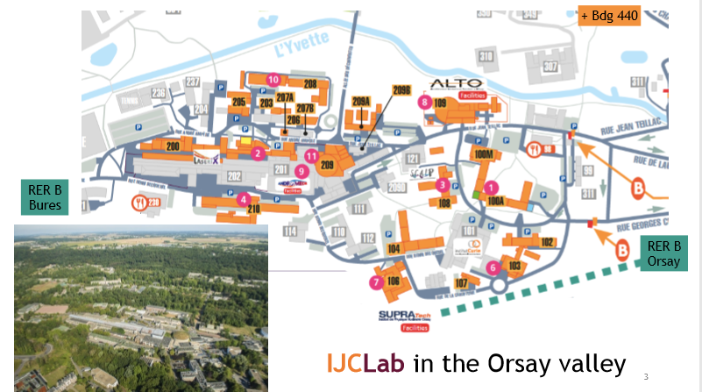

Two quick slides on IJCLab

Slide 3
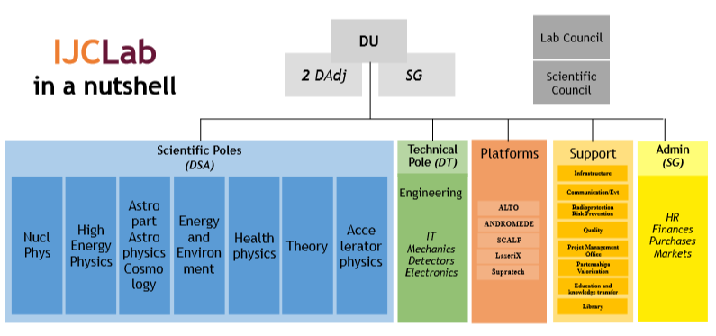
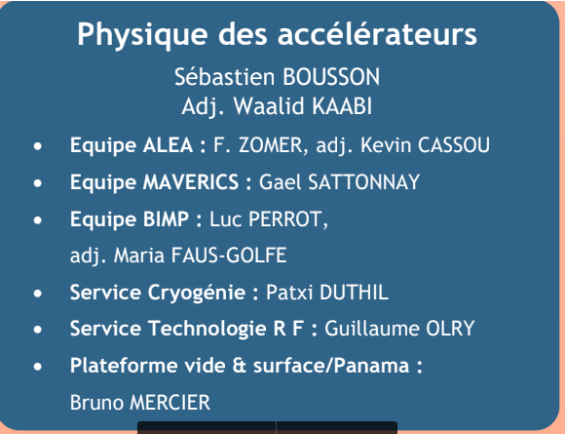
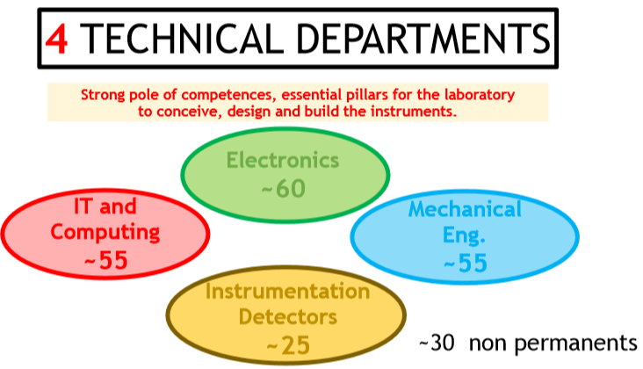
~10 people
~240 people
90 people (with 14 PHD)

Slide 4
For some time we have together been interested in PERLE and developed the plan for its realization : PERLE
PERLE is a collaborative effort of several institutes and we have offered to host it at Orsay : PERLE@ORsay
Locally an important step has been done with the creation of IJCLab
and encouraged by CNRS, to include PERLE into our firm plans
Globally the ESPP is taking place and the R&D on accelerator and ERL technology will receive a boost.
Quite a strong and increasing interest from the national/international nuclear community to consider Perle@Orsay as a first step for a future Nuclear Facility. Still large interest to use Perle@Orsay as a Facilty for Compton Backscattered photons
Hence :
We have to move now forward and firmly toward the realization of PERLE
In order to provide a framework for the PERLE Collaboration we have drafted a Collaboration Agreement.
Will be discussed at the Collaboration Board meeting on Friday, 5th June
and hopefully will be signed before summer.

Slide 5
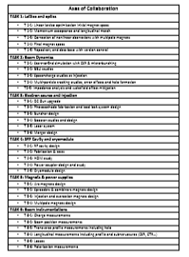
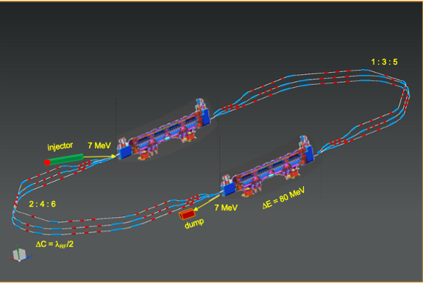
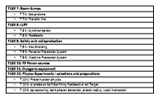
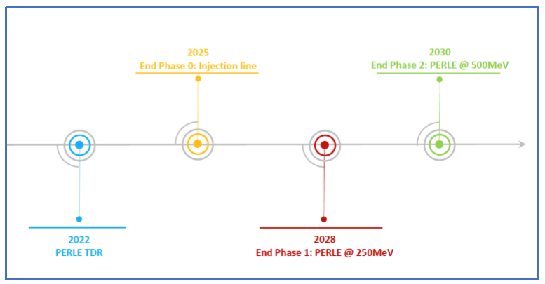
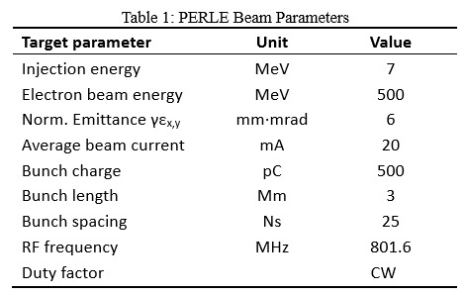
PERLE@ORsay
By signing the CA, a Party expresses its readiness to contribute with expert knowledge, in terms of knowledge, studies, expertise, equipment, materials, funds and/or other resources. This agreement with the collaboration is to be endorsed by the PERLE Collaboration Board and the host institution.
…
Material contributions to the PERLE facility will be regulated in an Addendum to be signed by the representatives of a Party and of CNRS as the Host Organization. These Addenda include, Each Party’s contribution, including, where applicable, the required resources, the duration of the activities and any deliverables, milestones, acceptance procedures and other key elements. shall be set out in an Addendum to this CA, which shall be signed by authorized representatives of CNRS as the Host Organization and the Party concerned.
…
INTEREST ALSO TO COLLABORATE TO
OTHER ERL NETWORK/FACILITIES

