Slide 1
CORONA MAGNIFICATION

Slide 2
Intensifier
Used Camera: Basler :
  5.86umx5.86um
  1920px x 1200px
  11.3mmx7.1mm
Intensifier Used Hamamstu
  17mm diameter
  Relay Lens 2(entrance):1(exit)
  60 lp/mm -> Res: 16 um
1444 camera pixels
722 macro-pixels
(binning 2x2)
Camera
Biggest square FOV in intensifier:
510 macro pixels
(12 mm at intensifier entrance)

Slide 3
85% advised usage from Hamamatsu for geometrical aberrations in relay lens
Intensifier
Used Camera: Basler :
  5.86umx5.86um
  1920px x 1200px
  11.3mmx7.1mm
Intensifier Used Hamamstu
  17mm diameter
  Relay Lens 2(entrance):1(exit)
  60 lp/mm -> Res: 16 um
1200 camera pixels
600 macro-pixels
(binning 2x2)
Camera
Biggest square FOV in intensifier:
436 macro pixels
(10.2 mm at intensifier entrance)

Slide 4
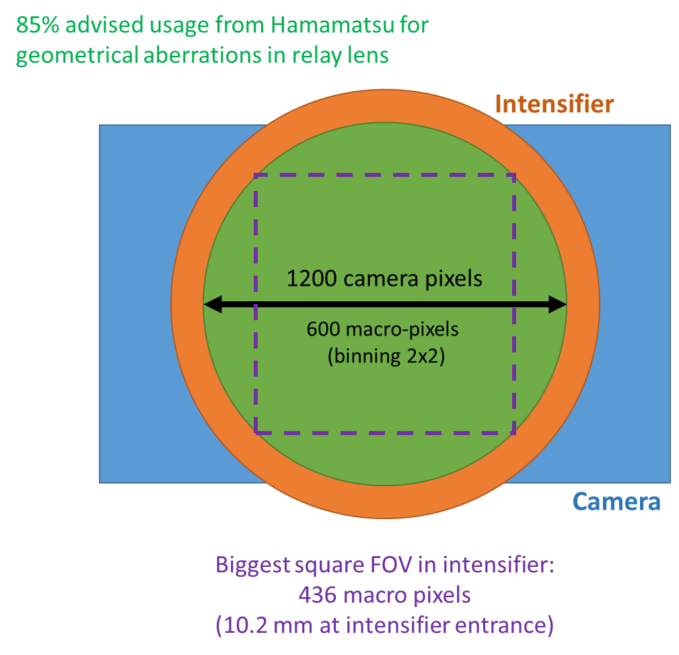
Coronagraph system:
  FOV ~ 17 sigma reference
  INJ:
  H: 1020 um in object plane (beta 200m)
  V: 1250 um in object plane (beta 300m)
  FT:
  H: 270 um in object plane (beta 200m)
  V: 330 um in object plane (beta 300m)
  21.25 mm in object plane INJ.
  5.61 mm in object plane FT.
Single Magnification
Two Magnifications
10.2/21.25 = 0.48
-> 20.9 px/sigmaH at Injection
-> 25.6 px/sigmaV at Injection
-> 5.5 px/sigmaH at FT
-> 6.75 px/sigmaV at FT
For Injection:
Mag 0.48
For FT:
Mag change by 3.7
to obtain same px/sigma
(ideally tot new mag 1.8)

Slide 5
In case separate magnifications to be implemented, if coronagraph provides Mag 0.48:
Eyepiece 20 mm
Corona
(OBJECTIVE + FIELD + RELAY)
Halo Magnified by 1
40 mm
40 mm
Corona extended by 80 mm
HALO IMAGE
Eyepiece 20 mm
Corona
(OBJECTIVE + FIELD + RELAY)
Halo Magnified by 3.7
25.4 mm
94 mm
Corona extended by 120 mm
HALO IMAGE
If eyepiece on 50mmTS and camera on 150 mm TS: 94-40 = 54

Slide 6
In case separate magnifications to be implemented, if coronagraph provides Mag 0.2:
Eyepiece 20 mm
Corona
(OBJECTIVE + FIELD + RELAY)
Halo Magnified by 2.4
28.3 mm
68 mm
Corona extended by 97 mm
HALO IMAGE
Eyepiece 20 mm
Corona
(OBJECTIVE + FIELD + RELAY)
Halo Magnified by 9
22.2 mm
201 mm
Corona extended by 224 mm
HALO IMAGE
If eyepiece on 50mmTS and camera on 150 mm TS: 201-68 = 133

Slide 7
In case separate magnifications to be implemented, if coronagraph provides Mag 0.1:
Eyepiece 20 mm
Corona
(OBJECTIVE + FIELD + RELAY)
Halo Magnified by 4.8
24.2 mm
115.2 mm
Corona extended by 140 mm
HALO IMAGE
Eyepiece 20 mm
Corona
(OBJECTIVE + FIELD + RELAY)
Halo Magnified by 18
21.1 mm
383 mm
Corona extended by 404 mm
HALO IMAGE
If eyepiece on 50mmTS and camera on 150 mm TS: 383-115= 268

Slide 8
Price in distance to pay with the relay group to increase mag from 0.1 design to 0.48 (at least) to not use eyepiece
F = 800
F = 800
Drift Core Mask → Field Lens 1 | 100
Focal Length Field Lens 1 | 800
Drift Field Lens 1 → Field Lens 2 | 956
Focal Length Field Lens 2 | -150
Drift Field Lens 2 → Lyot Stop | 1839
Full Square Lyot Stop | 50
Drift Lyot Stop → Relay Lens 1 | 100
Focal Length Relay Lens 1 | 800
Drift Relay Lens 1 - > Relay Lens 2 | 1206
Focal Length Relay Lens 2 | -150
Drift Relay Lens 2 → Image | 185
100
956
1839+100
1206
185
F = -150
F = -150

Slide 9
F = 800
F = 800
100
956
1839+100
1206
185
F = -150
F = -150
1070.285
2070.561
1303.714
-97.714
100
-114.285
-131.561
+280.325
F = 800
F = -150
F = 800
F = -150
M1 = 1.142
M2 = 0.12292
M3 = 0.6296
M4 = 2.868
M = 0.253

Slide 10
F = 800
F = 800
Thin vs Real Lenses?
100
956
1839+100
1206
185
F = -150
F = -150
1070.285
2070.561
1303.714
-97.714
100
-114.285
-131.561
+280.325
F = 800
F = -150
F = 800
F = -150
M1 = 1.142
M2 = 0.12292
M3 = 0.6296
M4 = 2.868
M = 0.253

Slide 11
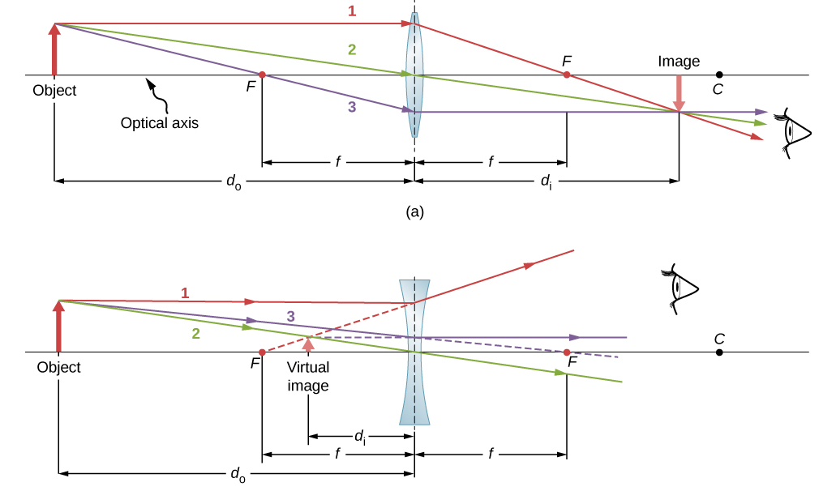

Slide 12
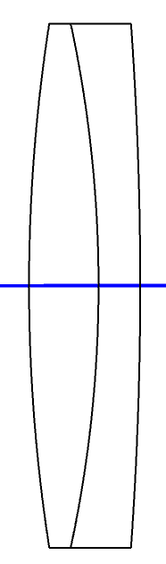
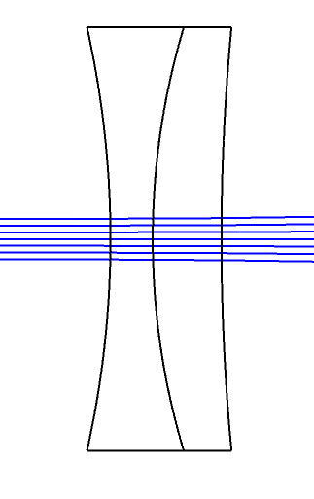
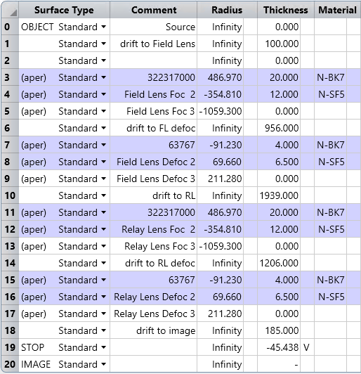
800 mm
https://www.youtube.com/watch?v=Hm3ZWI6I6pI
-150 mm
20 mm
4 mm
6.5 mm
12 mm

Slide 13
800 mm
https://www.youtube.com/watch?v=Hm3ZWI6I6pI
-150 mm
+2.218 mm (Obj)
-4.2 mm (Img)
+5.69 mm (Obj)
-14.774 mm (Img)
12 mm
4 mm
6.5 mm
20 mm
F = -149.978
F = 799.057

Slide 14
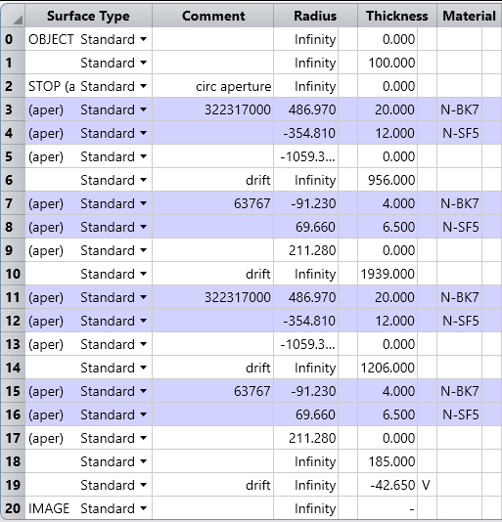
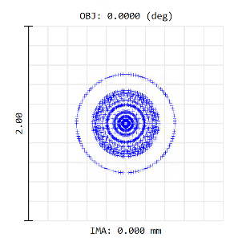
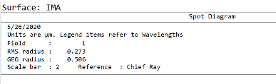
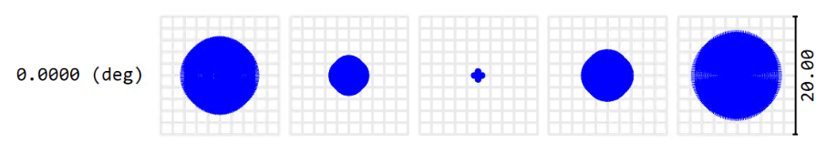
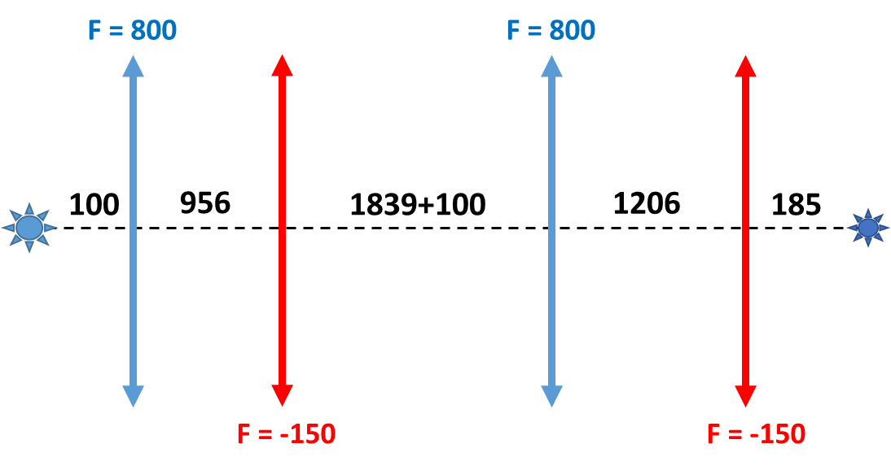
Price in distance to pay with the relay group to increase mag from 0.1 design to 0.48 (at least) to not use eyepiece
800 mm
-150 mm
800 mm
-150 mm
Correction?
-2 mm
-1 mm
0
+1 mm
+2 mm

Slide 15
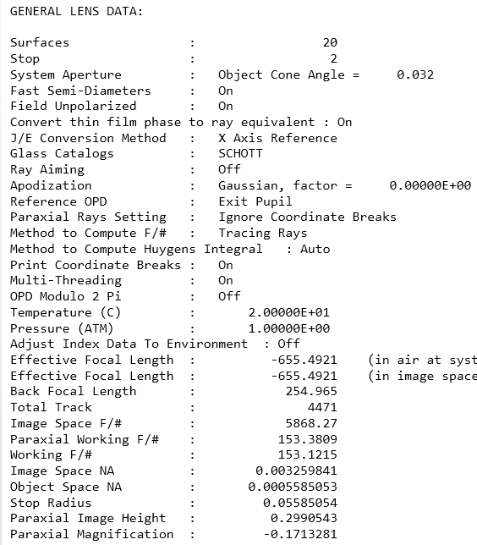
Price in distance to pay with the relay group to increase mag from 0.1 design to 0.48 (at least) to not use eyepiece
800 mm
-150 mm
800 mm
-150 mm
Correction?

Slide 16
32
10.5
32
10.5
100
956
1939
1206

Slide 17
105.69
MAG 1 = 1.152
121.8
1094.792
MAG 2 = 0.1204
131.907
2080.797
MAG 3 = 0.623
1297.201
74.208
MAG 4 = 1.979
IMG @ 142.69
From last surf
146.89
MAG =0.1713

Slide 18
Mag from Mask : 0.1713, knowing that mag objective is 0.48 -> Total Mag = 0.08
 | Present CASE | OPTION 1 | OPTION 2 | OPTION 3
Total MAG | 0.08 | 0.1 | 0.2 | 0.4
Mag of Last L-150 | 1.979 | 2.473 | 4.947 | 9.895
D: L800 -> L-150 [mm] | 1206 | 1190.86 (delta: -15.14) | 1160.526 (delta: -45.47) | 1145.364 (delta: -60.63)
D: L-150 -> IMG [mm] | 142.69 | 216.8 | 588.2 | 1331.6
Corona extended by [mm] |  | +58.86 | +400 | +1128

Slide 19
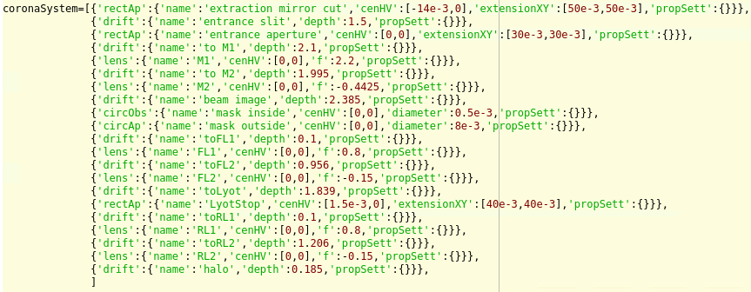
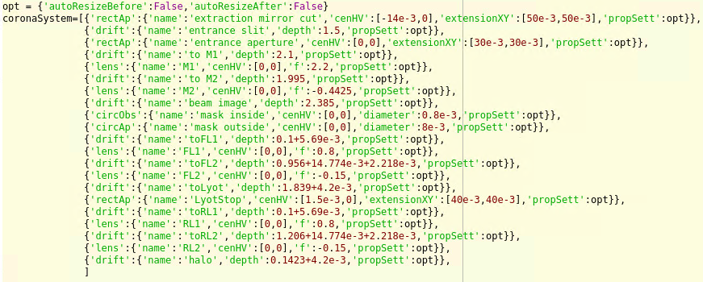

Slide 20
IMAGING MAG

Slide 21
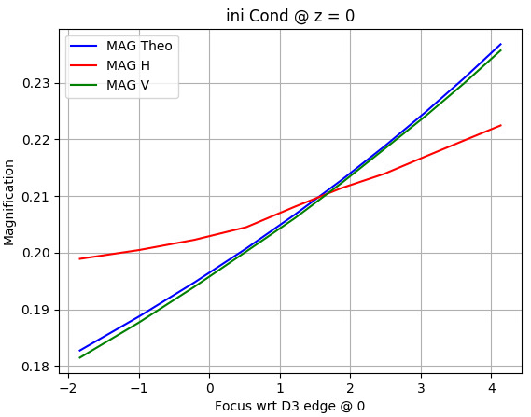
LHC SOURCE SIMPLE IMAGING ONE LENS
Extraction
Mirror
x
UND
D3
y
z
Detector
Lens f=5m
When scanning the lens
by +/-150 mm wrt to initial (focused on +1.5m inside D3)

Slide 22
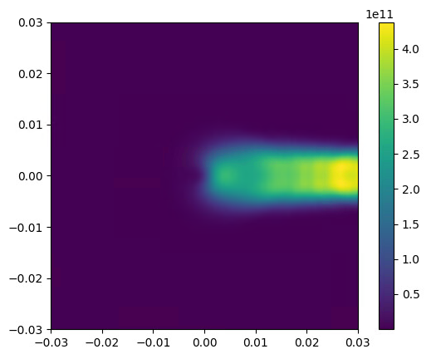
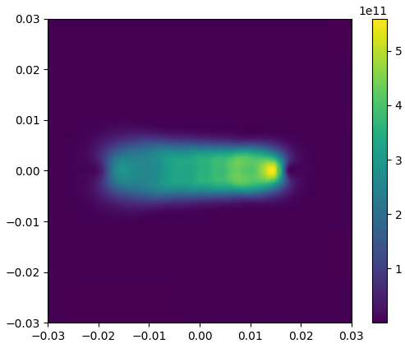
Effect of light xing the lens?
Beam initial conditions:
X=0,Y=0 @ z=0
Beam initial conditions:
X=0,Y=0 @ z=5
x
x
y
z
y
z

Slide 23
Effect of light xing the lens?
Lens
Lens
Extraction mirror
Extraction mirror
Beam initial conditions:
X=0,Y=0 @ z=0
Beam initial conditions:
X=0,Y=0 @ z=5
x
x
y
z
y
z

Slide 24
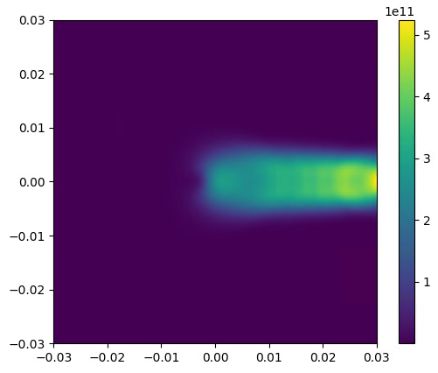
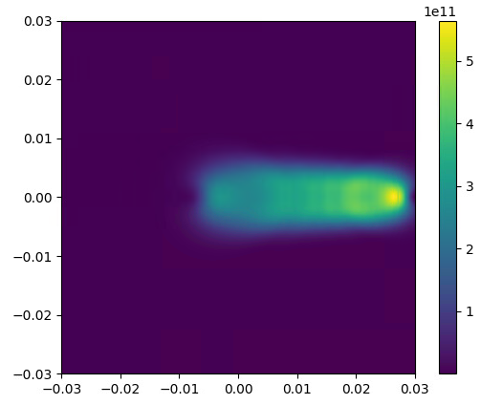
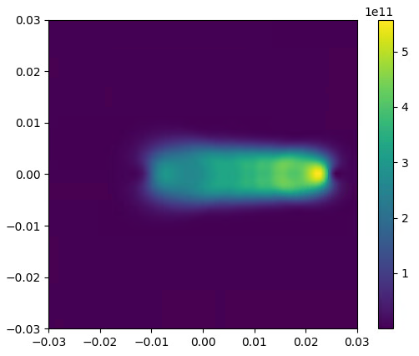
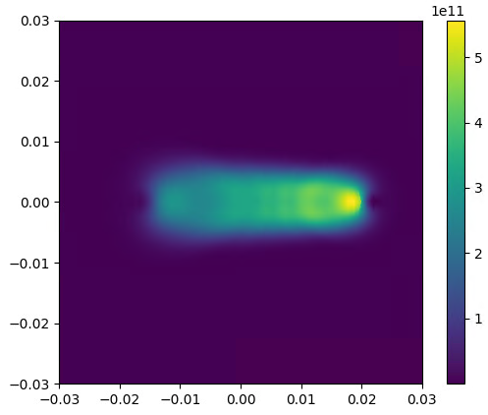
@ z=0
@ z=1
@ z=2
Varying beam initial conditions in the magnetic structure
@ z=3
@ z=4
@ z=5

Slide 25
