Slide 1
36GHz HOM MBK design status
2020/06/12
Jinchi Cai, Igor Syratchev, Graeme Burt

Slide 2
Outline
Beam-wave interaction analysis
Beam optics Design

Slide 3
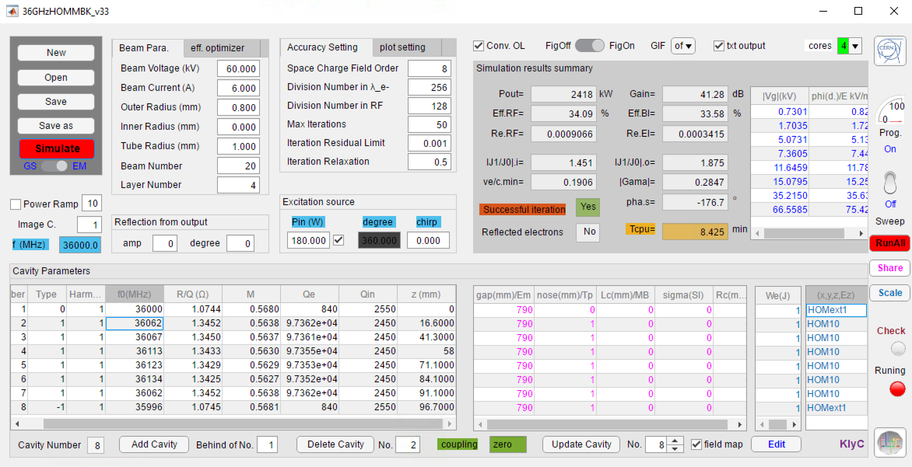
KlyC simulation results
The saturation output power is 2.4MW
The saturated efficiency is 33.6%
Gain=41dB
Emax=67kV/mm
-3dB bandwidth is [-22MHz, +28MHz]
Tube is compact as a whole and could be installed quite close to the linearizer as plug-in/ plug out module
Frequency tuning for each cavity will be a technical challenging
Bandwidth is little bit narrow, which leads to 80% linearizer performance comparing with infinite bandwidth;
More results will be available in coming weeks

Slide 4
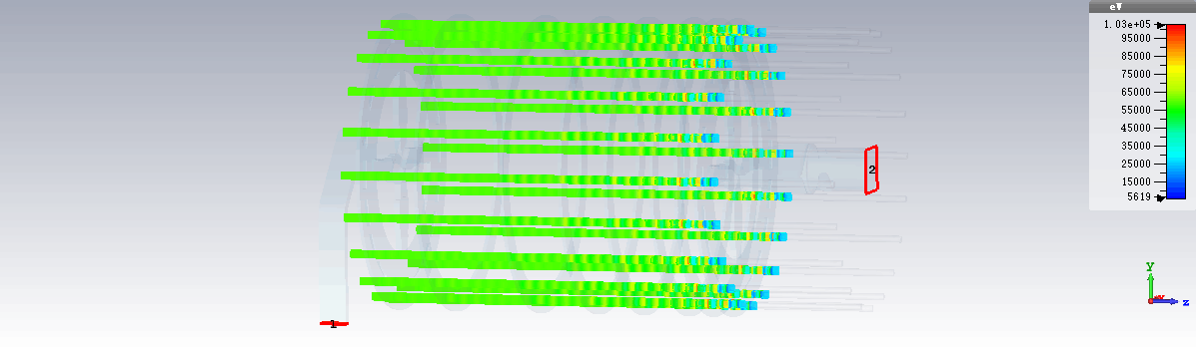
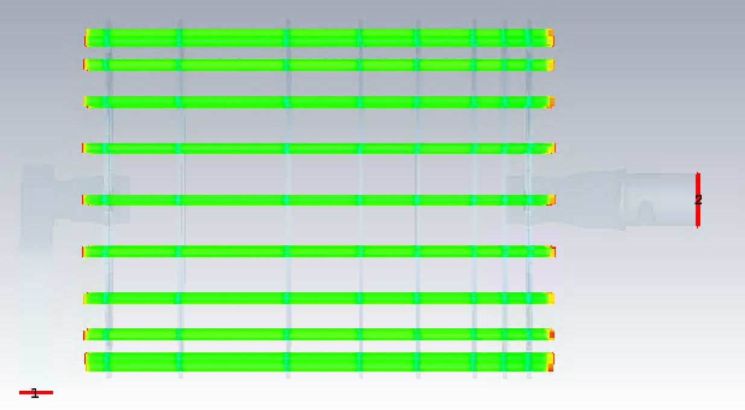
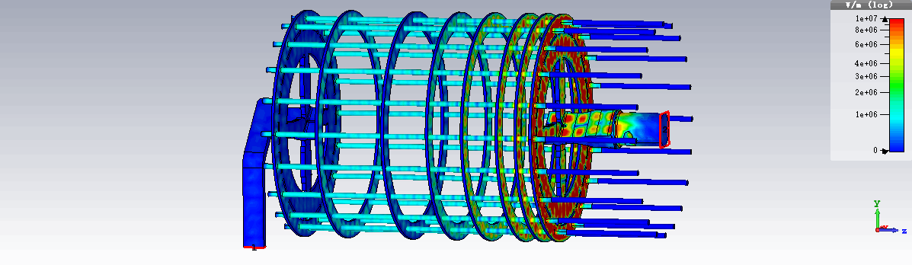
CST 3D simulations of entire 20 beams 36GHz MBK (KlyC benchmark, Bz=20T)
Bz=20T
V beam = 60kV
I beam = 6A
RF circuit was optimized in KlyC.
Input (output) coupler combiner topology provides efficient extraction of RF power into H_{O1} in the circular waveguide.
RF circuit length 11cm.
Pout=2.57MW
Eff. = 35.6%
Pin=200W
Emax~90kV/mm

Slide 5
Outline
Beam-wave interaction analysis
Beam optics Design

Slide 6
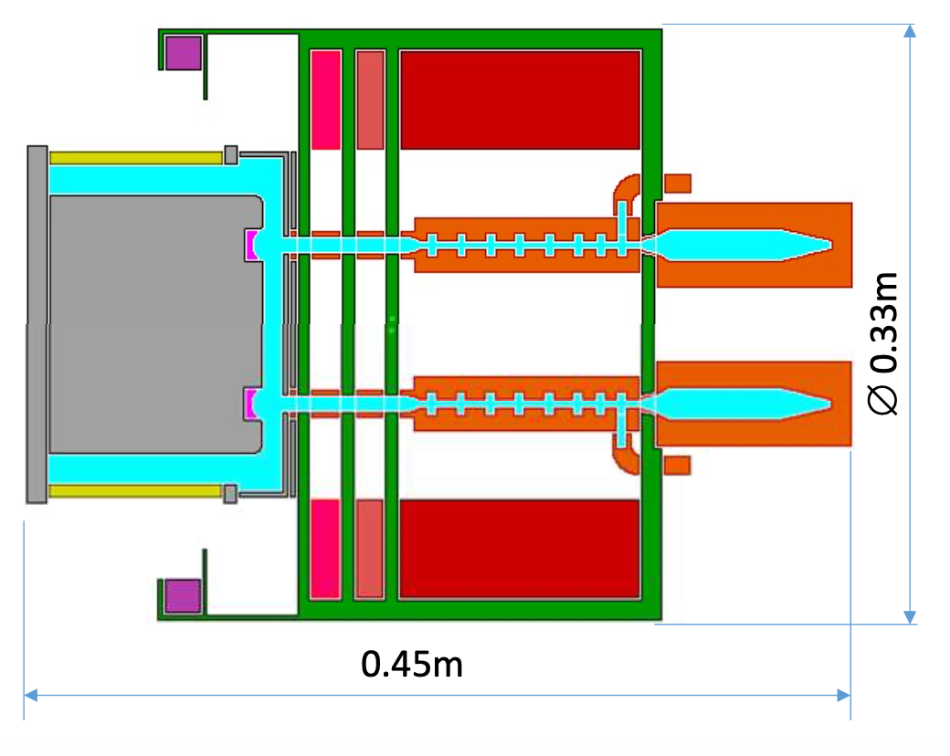
Basic Topology of the optics
Amend coils to further confine the beam
V=60kV, I=6A, r_{m}=0.8mm, r_{c}=1mm
20 beamlets on radial position of 38.4mm
The radial margin for each beamlets on the cathode is 6mm;
Limited control electrode makes double convergence necessary
Individual collectors are used for power dissipation
Design could be based on single beamlet if beam-beam interference and transverse magnetic field could be ignored
Compensate for B-field shield
Main coil to guide the beam
Small electron Gun for primary convergence
Individual collectors

Slide 7
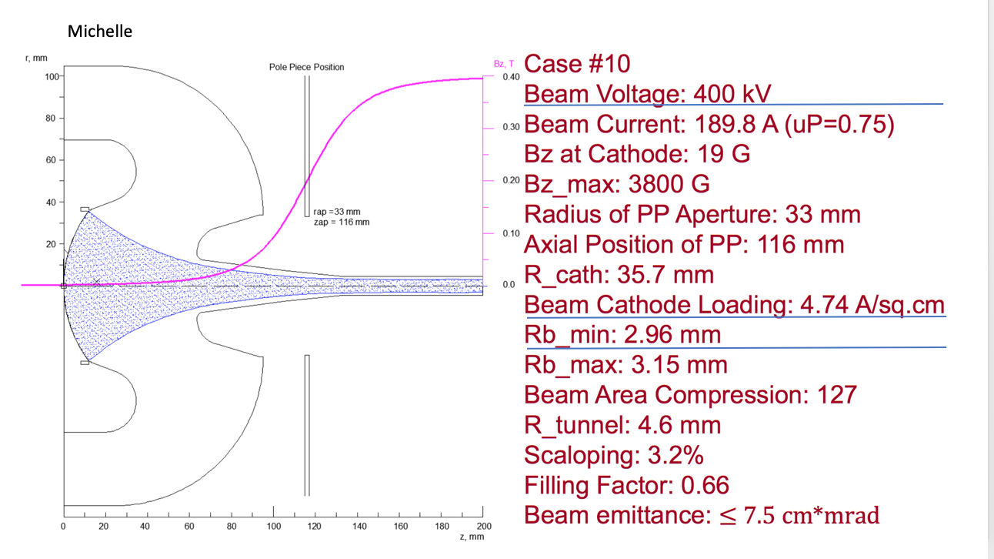
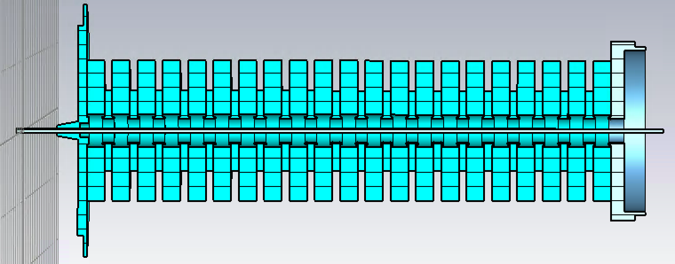
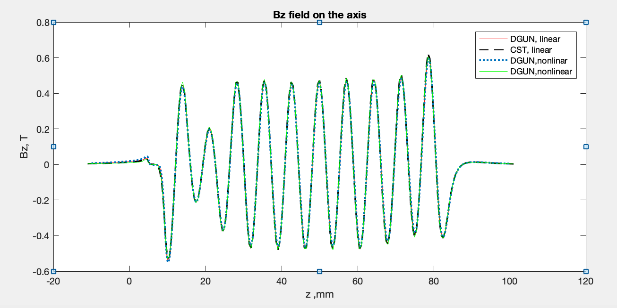
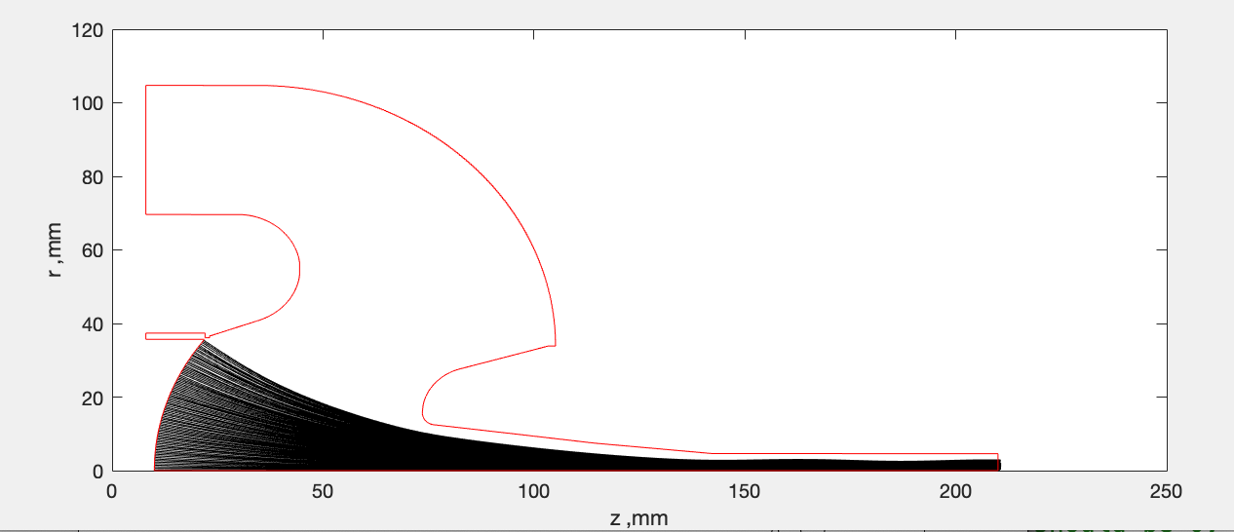
Simulation Tool
CGUN (home-made 2D code), benchmarked with CST TRK, DGUN, Michelle…
Magnetic module
Beam optics module
Some benchmark results for complicated cases
Example: GUN for SLACX
Example: PPM for 220GHz BWO
Michelle
400kV,190A
CGUN 400kV,186A

Slide 8
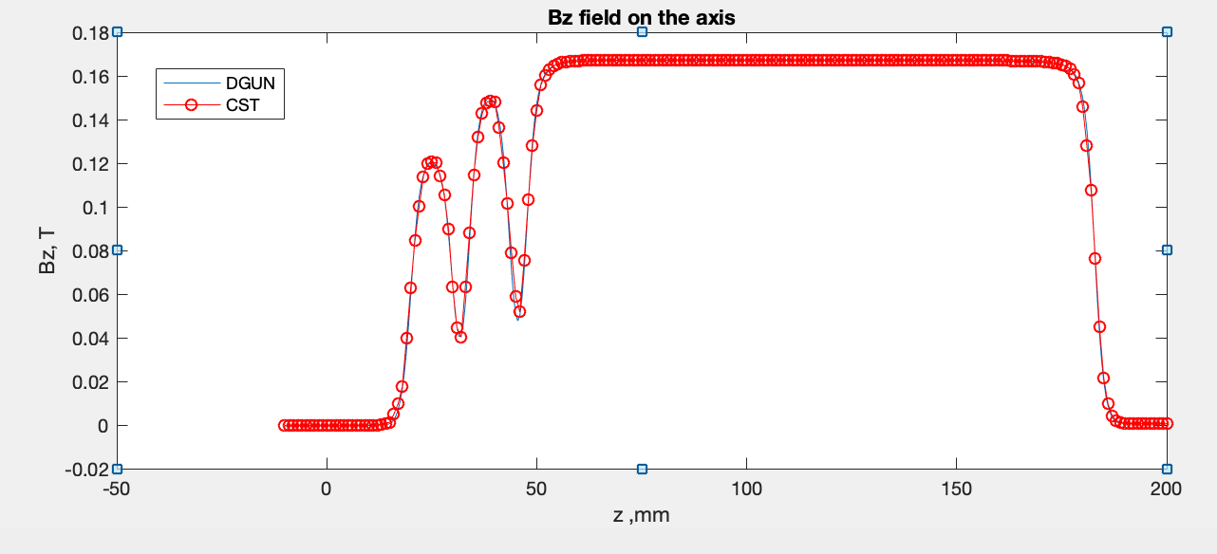
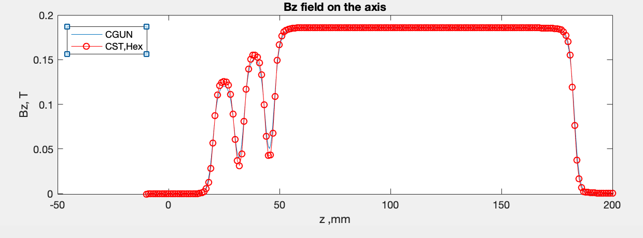
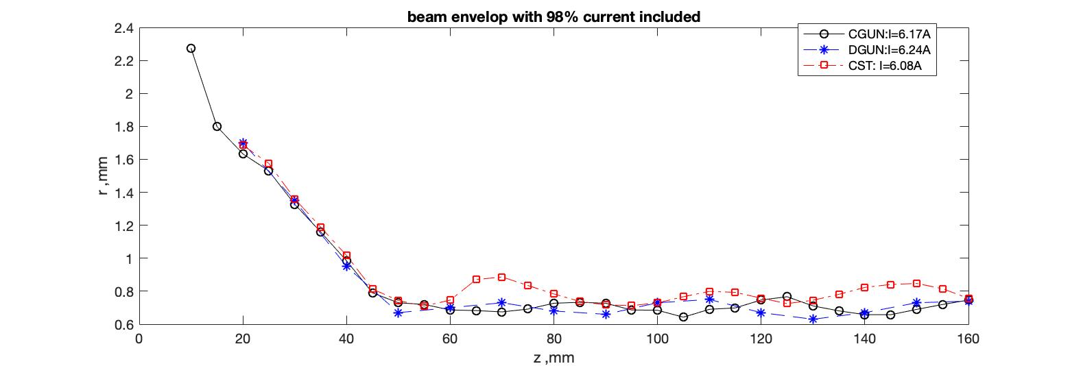
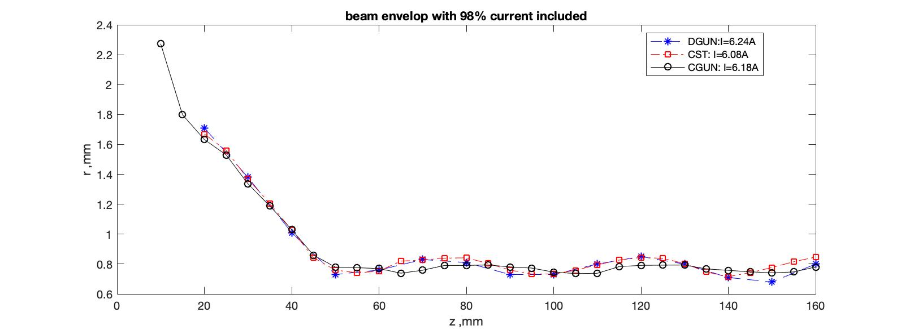
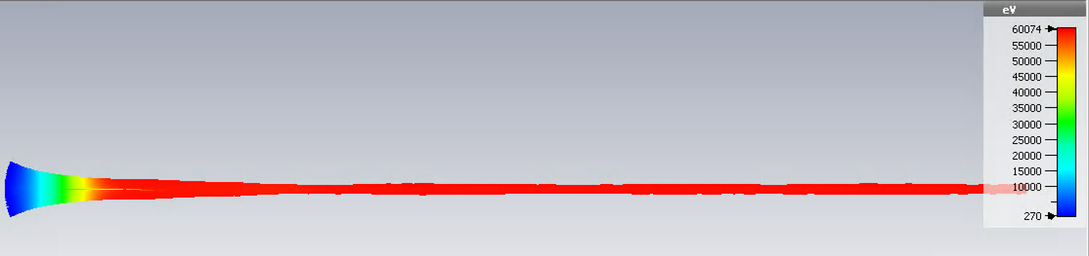
Optimization by CGUN – CERN home made tool (benchmarked with CST)
Bz field increased by 10%
Final design adopted
CST TRK shows larger beam radius
CGUN demonstrated very good agreement with other available codes.
Final optics tuning will be done in CST, that allows to include the MB effects.

Slide 9
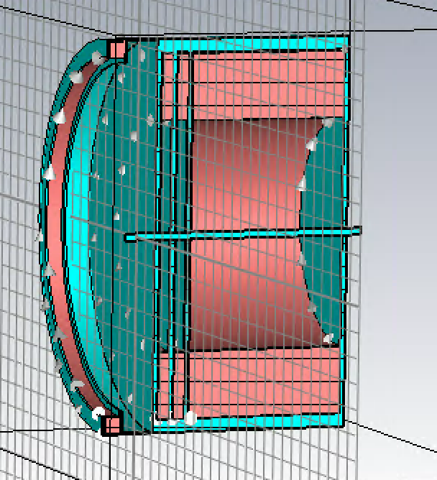
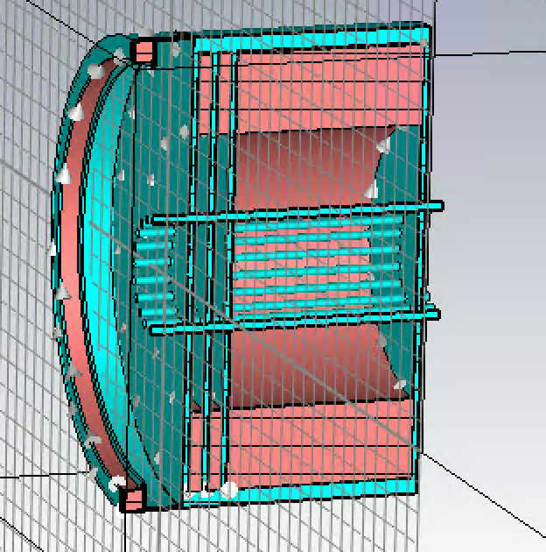
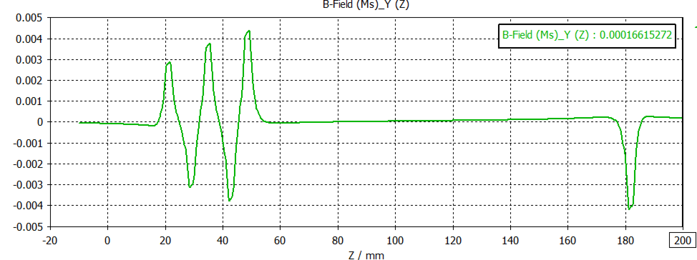
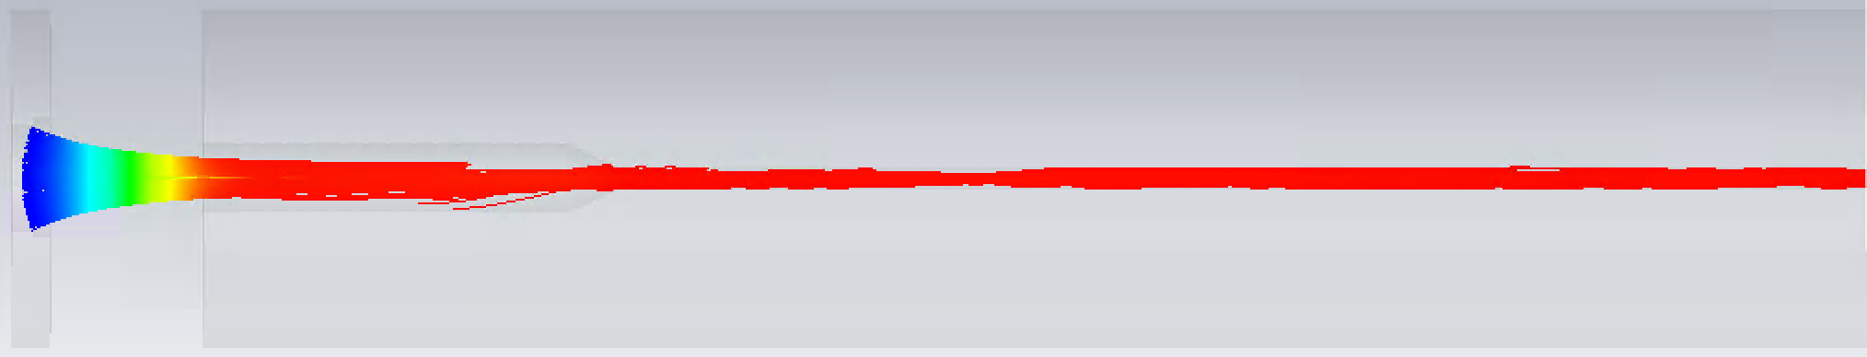
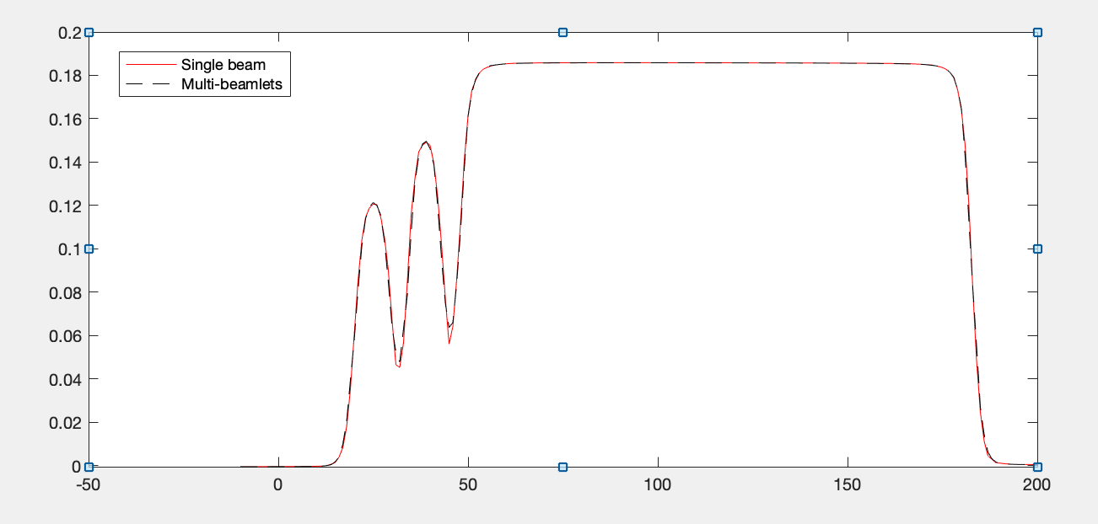
Transverse Magnetic field issues in MBK topology
Iron aperture
Max(Br)/Max(Bz)=0.02
2D design
3D design
25% beam interception
3D magnetic field map used for single beam simulation is done. Beam losses are heavy.
To reduce the transverse magnetic field, the inner/outer radii of the magnet, beam apertures in the iron shields have been adjusted.
Longitudinal magnetic field is almost identical

Slide 10
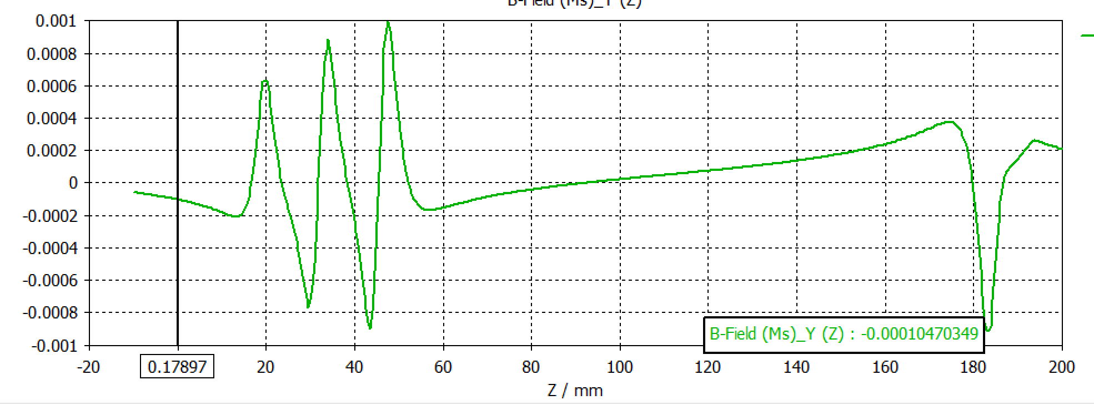
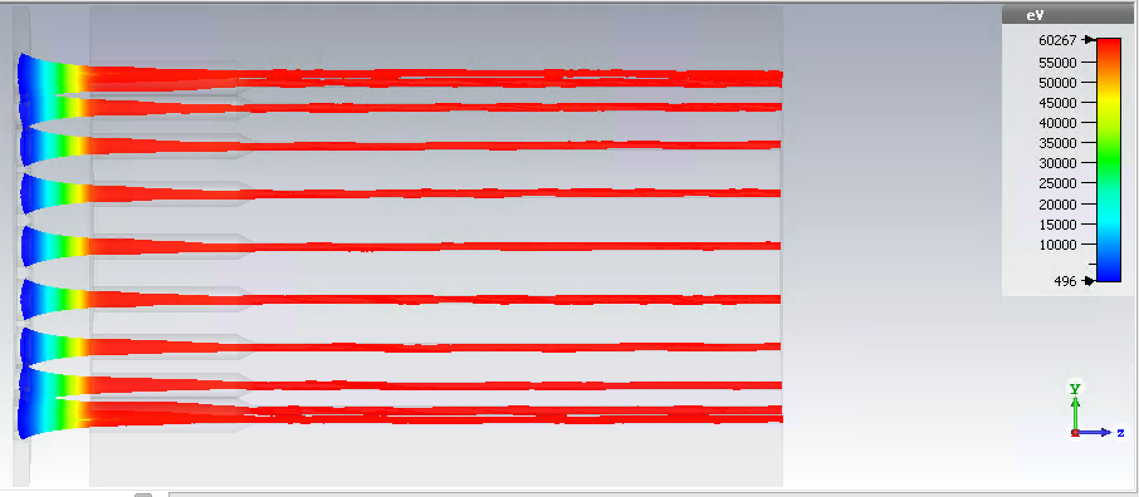
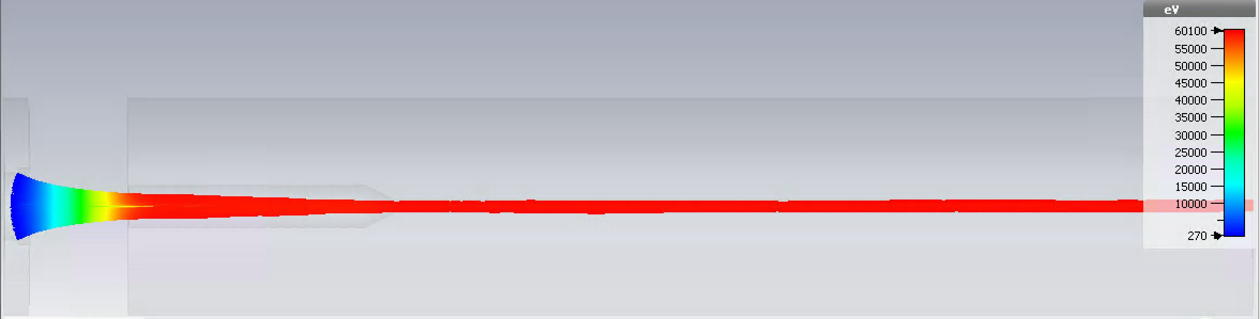
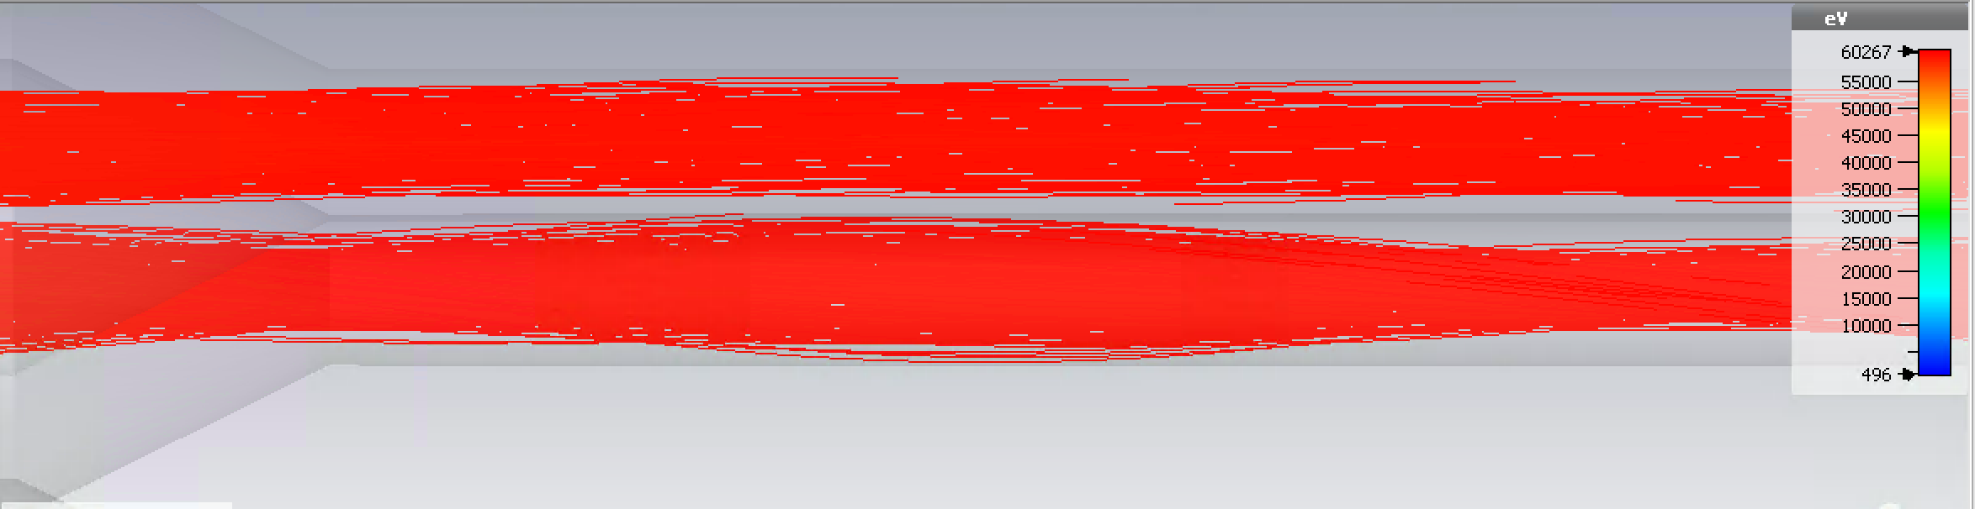

Efforts to Mitigate the transverse Magnetic field effect
Slightly enlarge iron aperture will suppress Br/Bz by factor of 4
Bz(z) is almost unvaried
Multi-beam check
Single beam check
Beam interception=5%
Because of beam-beam interference in GUN area, transverse shift of beamlets becomes more pronounced which leads to higher beam interception
Next, the radial position of iron apertures will be optimized in attempt to reduce transverse B field further.
Beam interception=0.2%

Slide 11
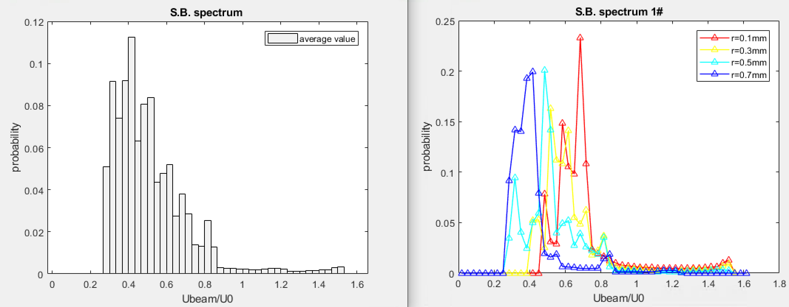
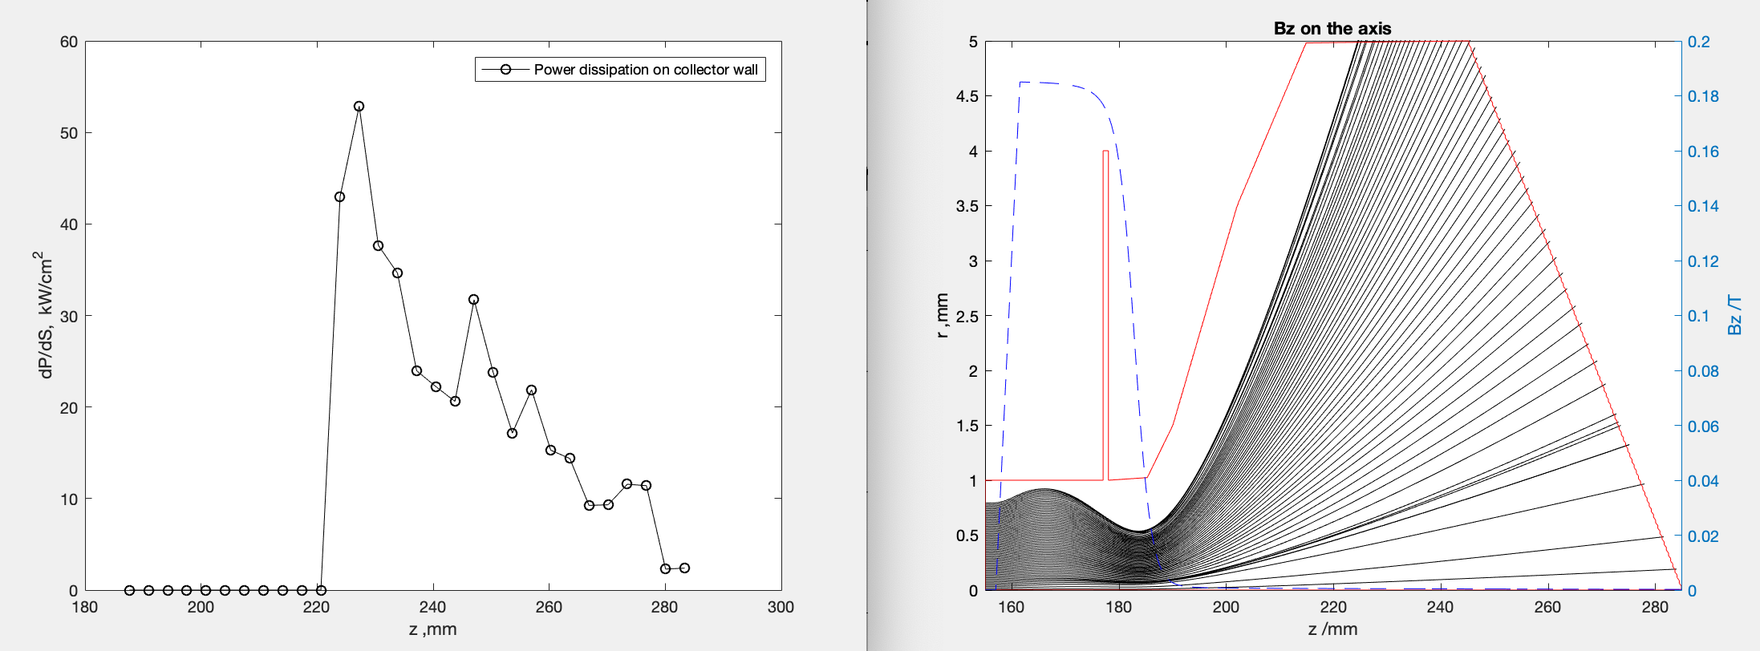
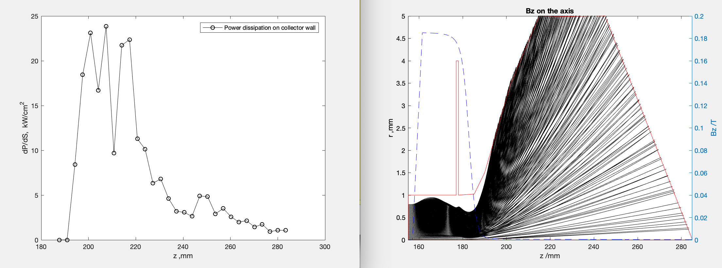
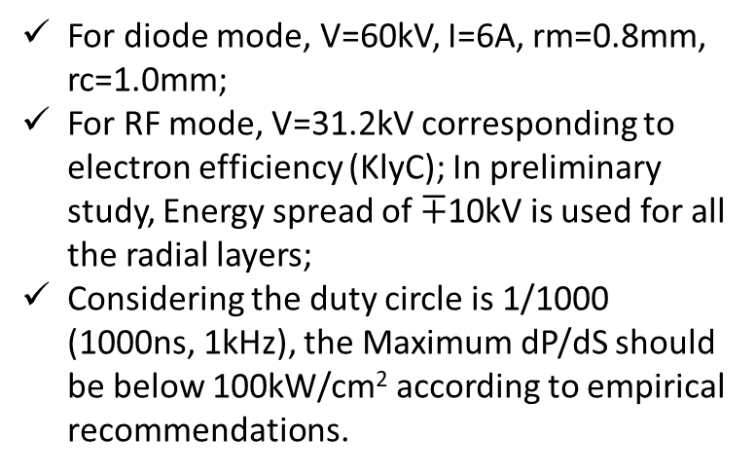
Preliminary design of the Individual Collector with KlyC/CGUN
For diode mode, V=60kV, I=6A, rm=0.8mm, rc=1.0mm;
For RF mode, V=31.2kV corresponding to electron efficiency (KlyC); In preliminary study, Energy spread of $∓$10kV is used for all the radial layers;
Considering the duty circle is 1/1000 (1000ns, 1kHz), the Maximum dP/dS should be below 100kW/cm² according to empirical recommendations.
Spent beam energy spectra from KlyC
For DC, V=60kV, I=6A, max(dP/ds)=55kW/cm².
For RF, V=31.2kV $∓$10kV, I=6A, max(dP/ds)=25kW/cm².

Slide 12
36 GHz, 2.5 MW MBK parameters
Voltage: 60 kV (no oil insulation needed)
N beams: 20
Current/beam: 6A
Current/total: 120 A
Power in saturation: 2.57MW
RF efficiency: 37.5%
Power gain: 41dB
Bandwidth -3dB (KlyC): 50MHz
Solenoidal field: ~0.2T
Tube length total: 0.45m
Max. Cathode current density: 9A/cm²
RF pulse length (tentative): 1000 ns
Max repetition rate (diode mode): <2kHz
Max repetition rate (RF mode): <4kHz

Slide 13
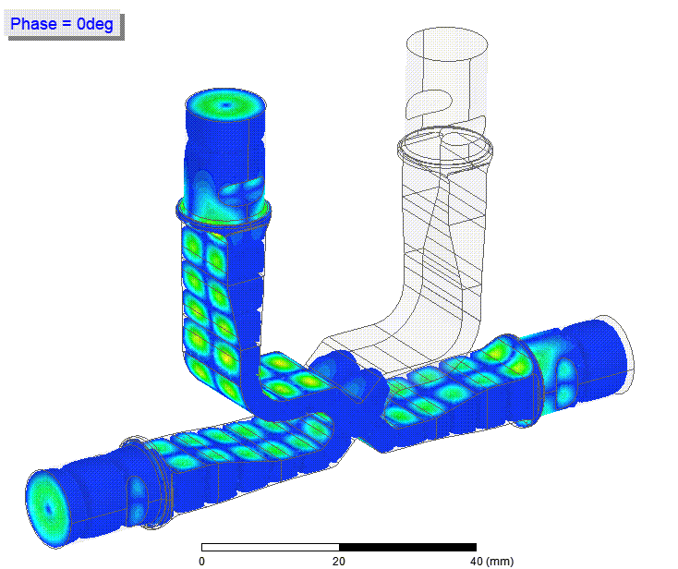
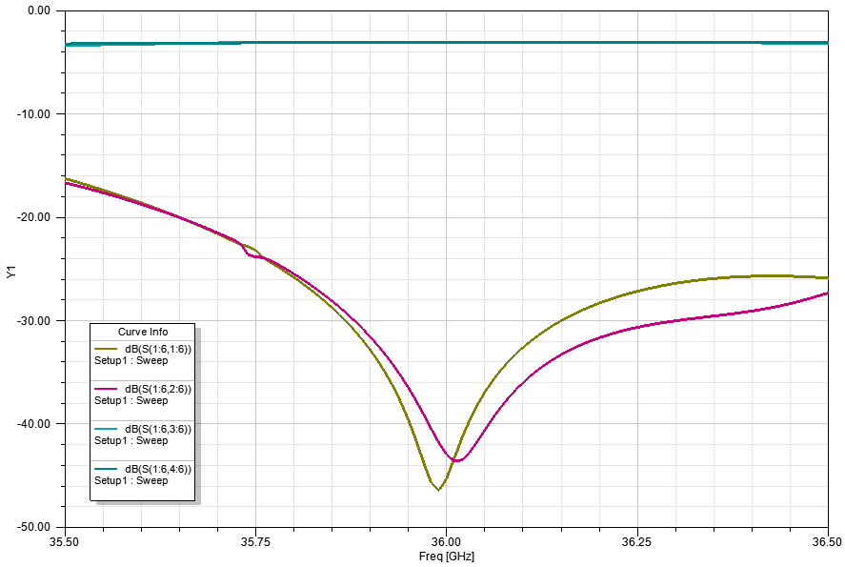
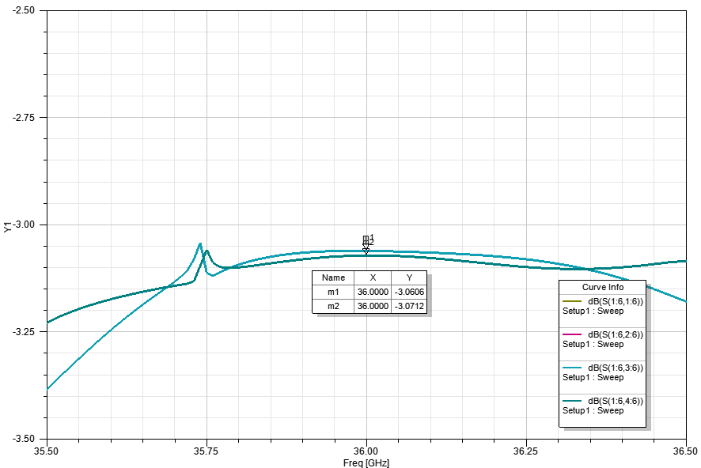
Designed by Igor
3dB E01_H20 hybrid. Power head for PC and/or klystrons combiner

Slide 14
Summary and outlook
CGUN code is self-developed and has been well benchmarked with other codes.
MBK GUN and Magnetic system design are almost finished. Further optimizations are ongoing to improve the beam transmission.
Preliminary design for Collector is done, to be checked with full tube simulation in CGUN/KlyC (required modification is almost finished).
PIC simulation with practical beam optics imported from TRK will be done as a final verification (Cathode-RF circuit-Collector).
Evaluation of the cooling circuit (feasibility analysis)

