Slide 1

ISOLDE Technical Report
64th Meeting of the INTC
24th of June 2020
Joachim Vollaire on behalf of the technical teams

Slide 2
Outline
Highlights of activities in the target area and “Class A” laboratories
  Frontends production and installation
  Nano-laboratory construction
  MEDICIS update
LS2 activities in the experimental hall:
  Tape Station
  REX TRAP&EBIS
  REX/HIE ISOLDE Linac
Master Schedule for 2020 and 2021
Some physics highlights

Slide 3




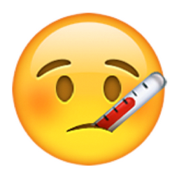
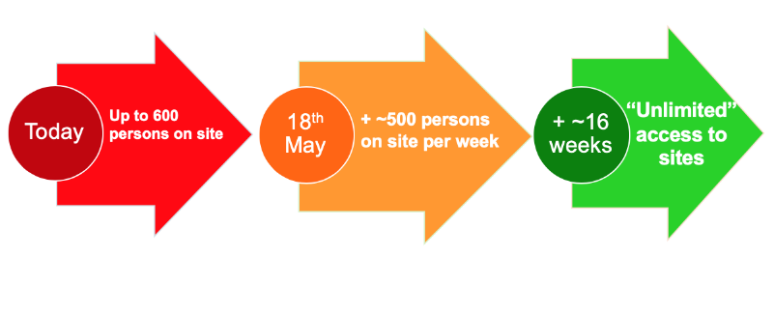
CERN since the last INTC
Phase 1
Phase 2
Endorsement by RB, IEFC and LS2C of HIE ISOLDE early startup in 2020
Mid-March
Safe-mode and other
urgent activities
Resume gradually, starting
with LS2, accelerator and
detector upgrades, urgent
site and building work
Ramp-up to “unlimited”
access may be completed
by mid-September

Slide 4
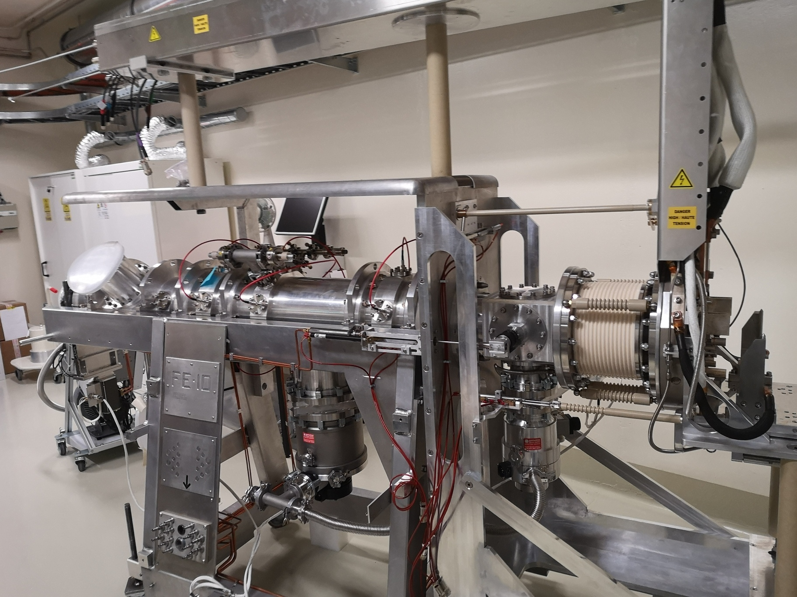
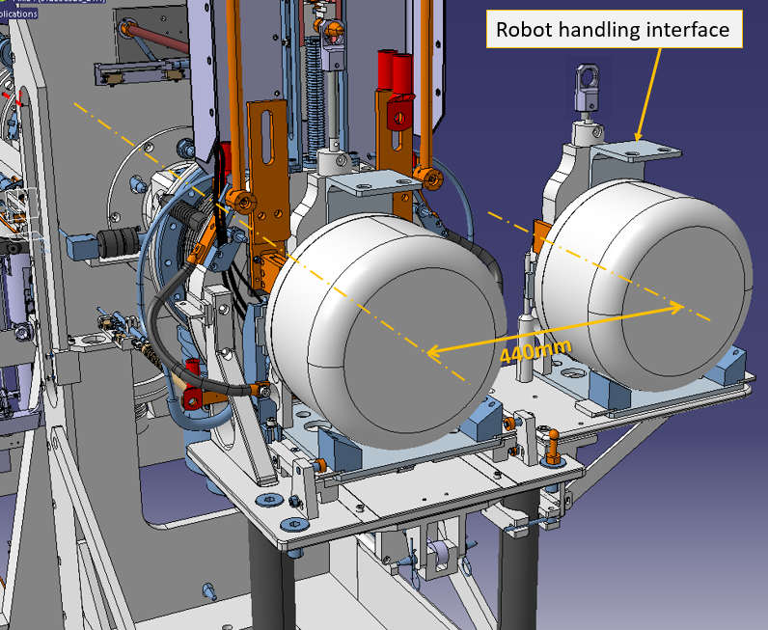
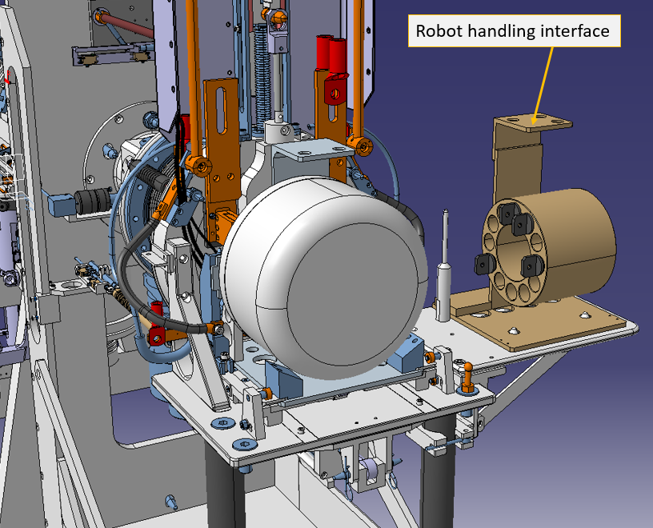
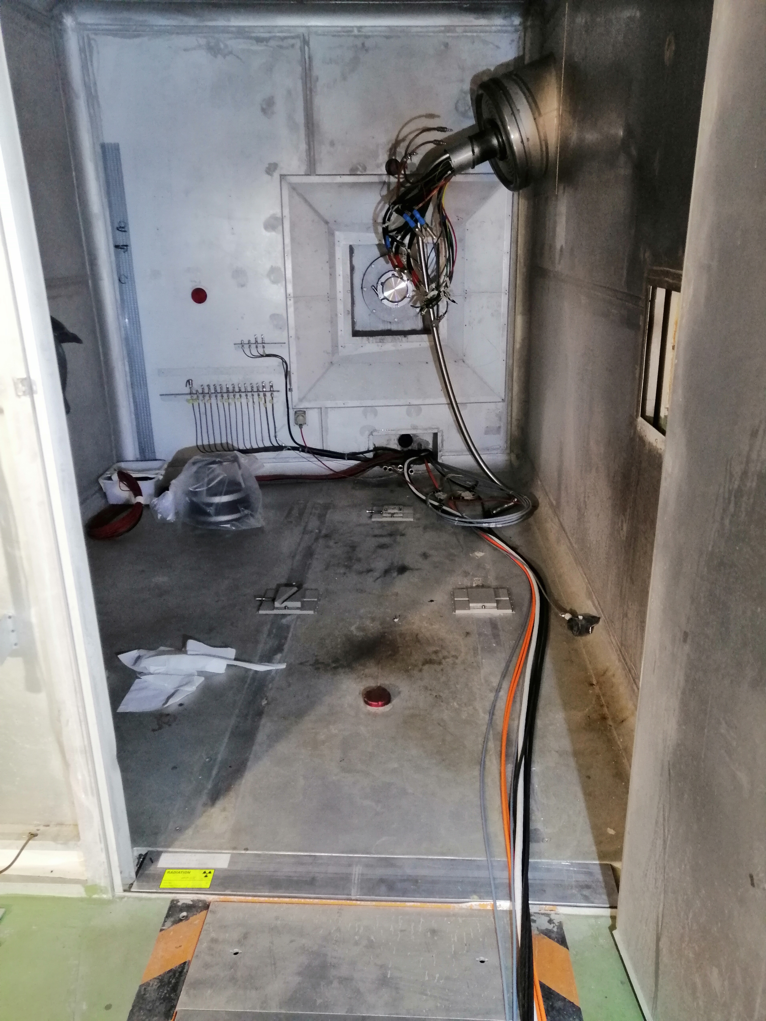
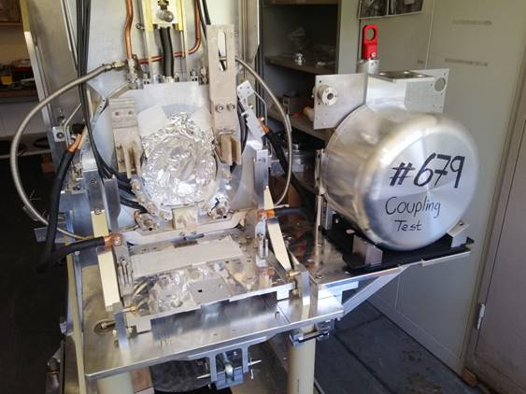
FE10 production status (installation on GPS)
Activity with the highest priority for the STI-RBS section when work on site resumed
FE10 (inside Building 179) successfully vacuum tested during the last weeks
Preparatory activities (alignment, cabling….) inside the GPS Faraday cage in view of the FE installation
Transfer to the target area end of July and first stable beams in September
New irradiation table
GPS Faraday Cage

Slide 5
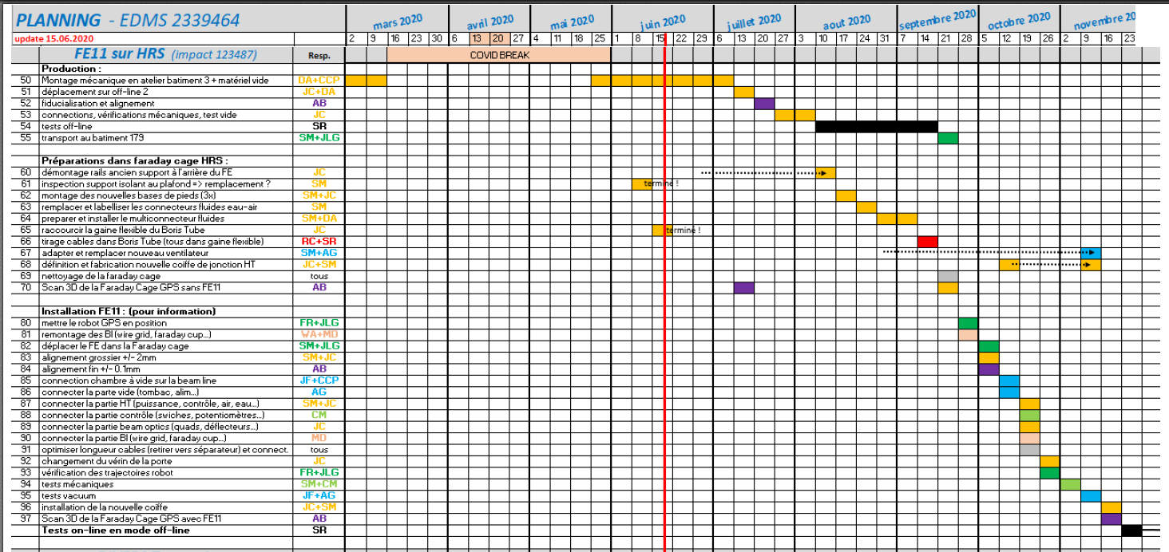
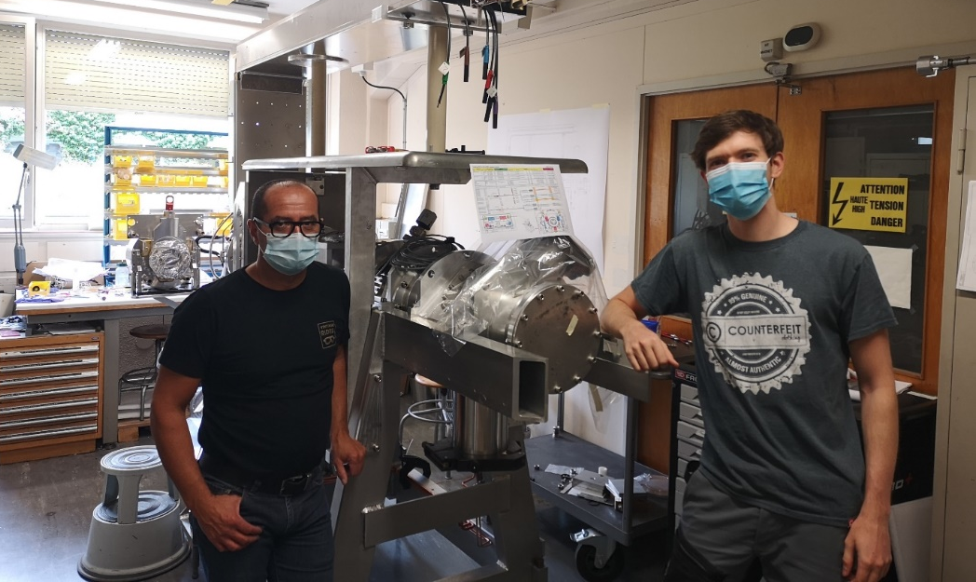
FE11 production status (installation on HRS)
Progress with mechanical assembly resumed end of may and excellent progress since (less difficulties encountered as compared to the FE10 production).
Stable beam testing period at offline2 starting in August. Transfer for installation in the target area in September. First stable beam tests at HRS expected in November.

Slide 6
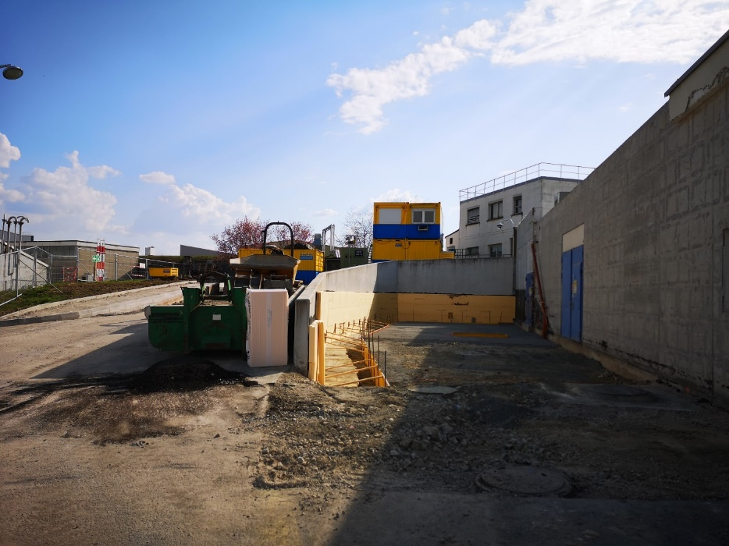
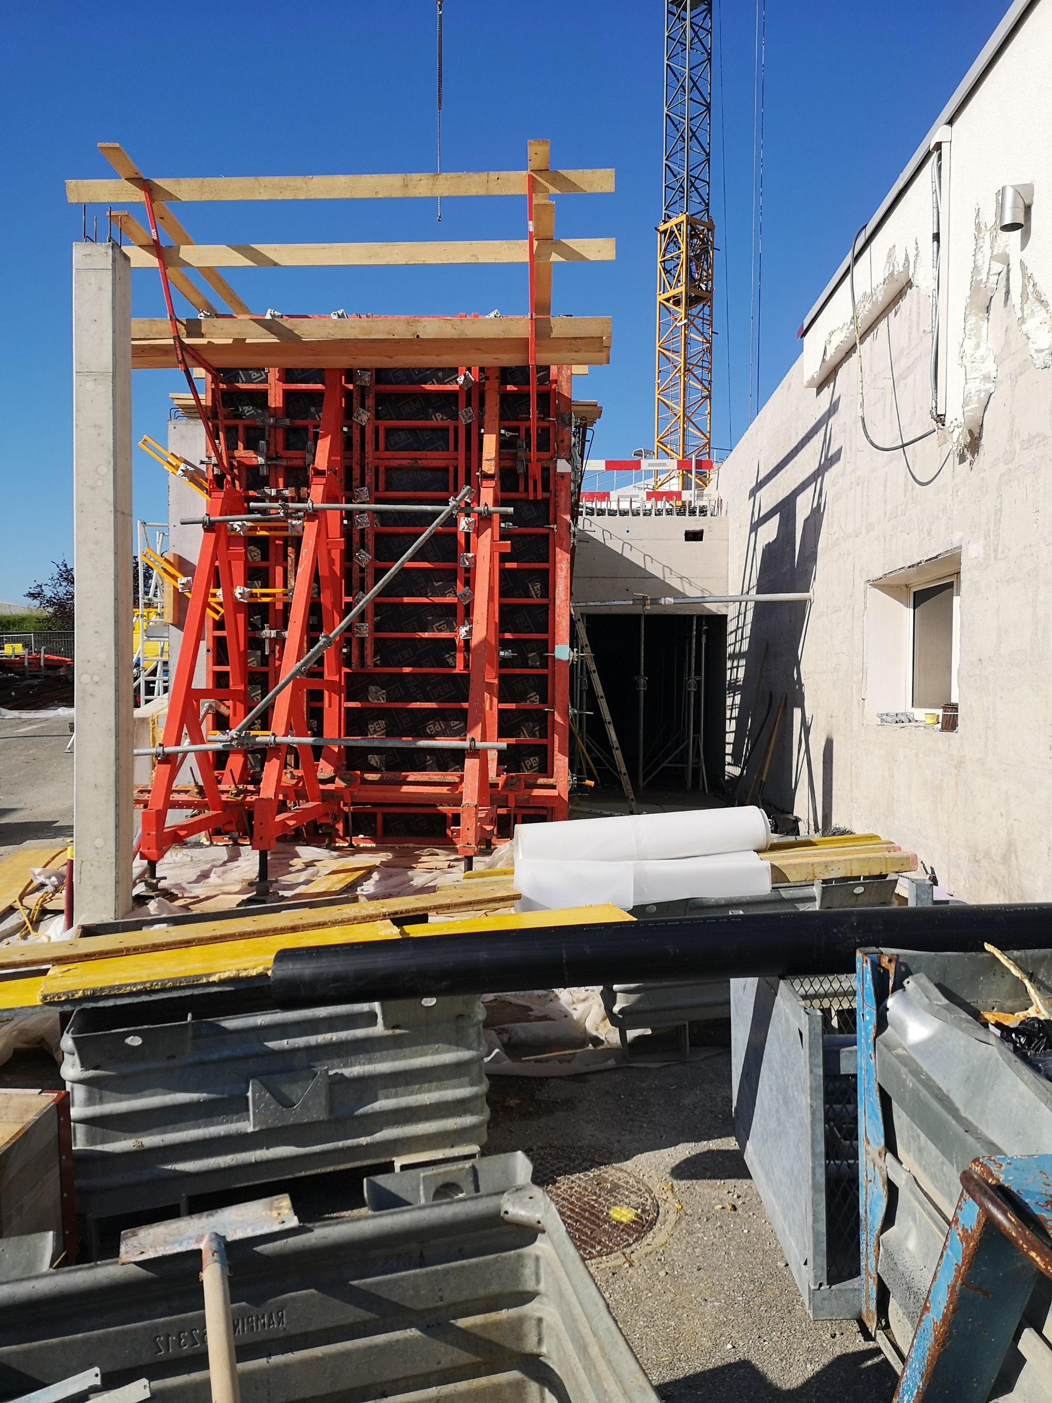
Nano-Laboratory Construction
Extension of Building 179 (ISOLDE and MEDICIS laboratories for radioactive material handling)
Situation mid March
Situation mid June
Part dedicated to radioactive material storage (heavy density concrete)
Work could resume earlier than other activities (according to host state guidelines)
Overall project planning remains unchanged (Building delivered end of May 2021 with service and laboratory equipment)
Building 179

Slide 7
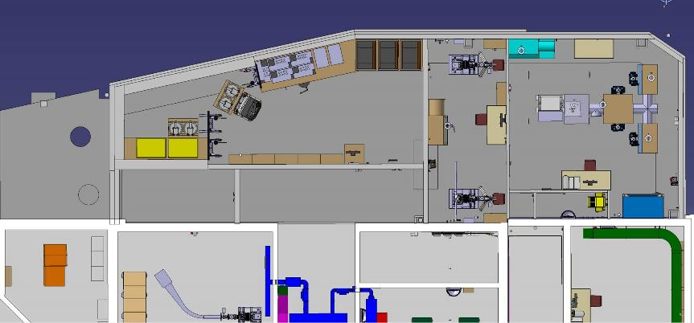
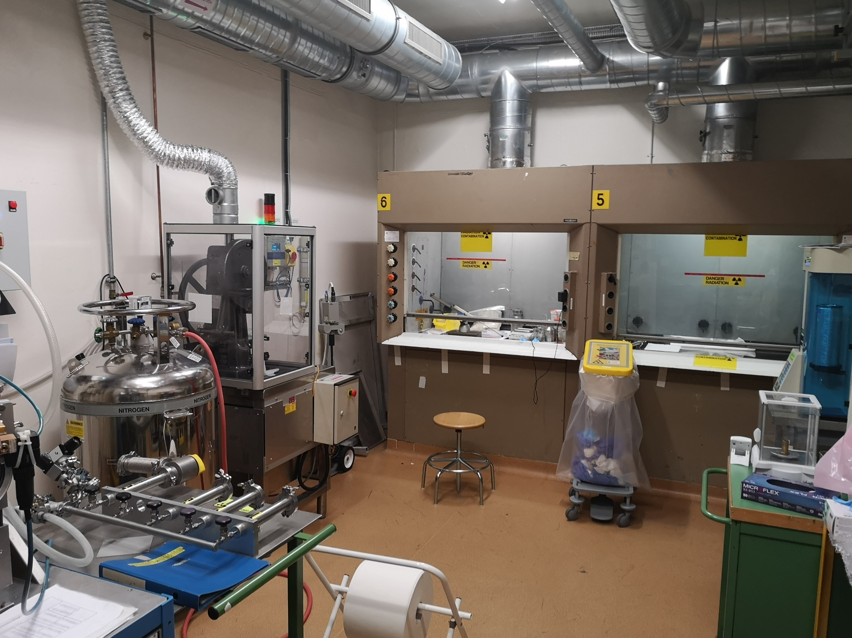
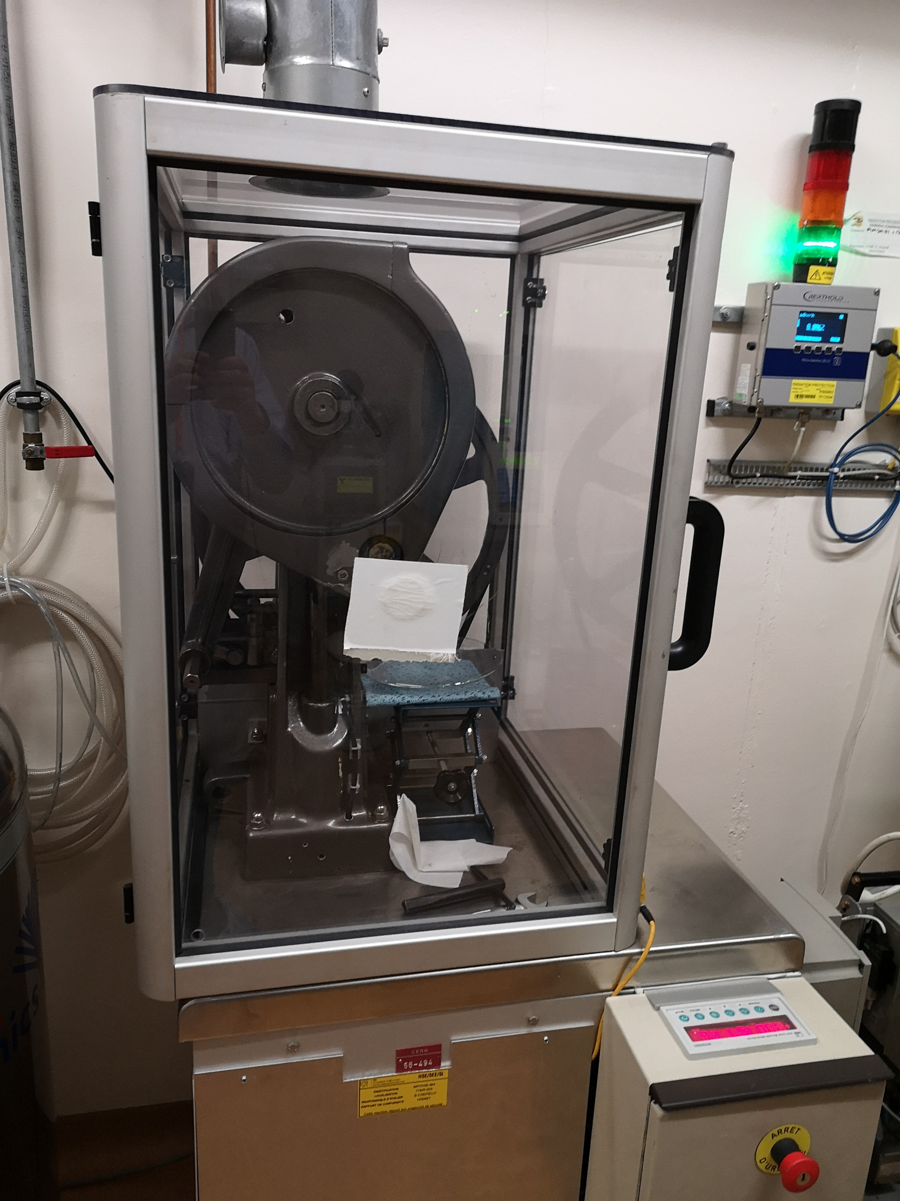
New nano-laboratory – operational constraints
Carburation and calibration Area
Laboratory for UCx production
(no nano-material handling allowed)
UCx pills production
Radioactive storage
Existing Building
New laboratory will offer more space and a modern infrastructure (fully enclosed process requiring less transfer of radioactive powder) for production of UCx pill (including pills from nano-material powders)
Storage area necessary for routine targets dismantling (ISOLDE hot cell)

Slide 8
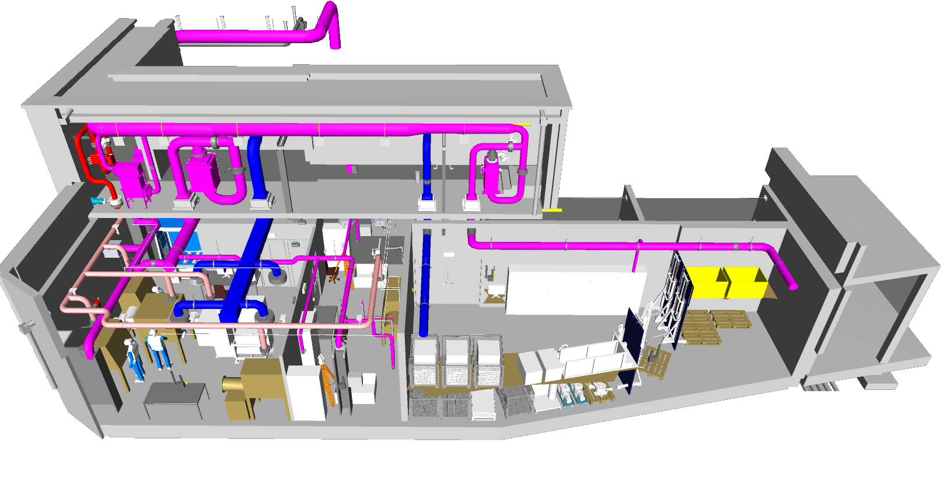
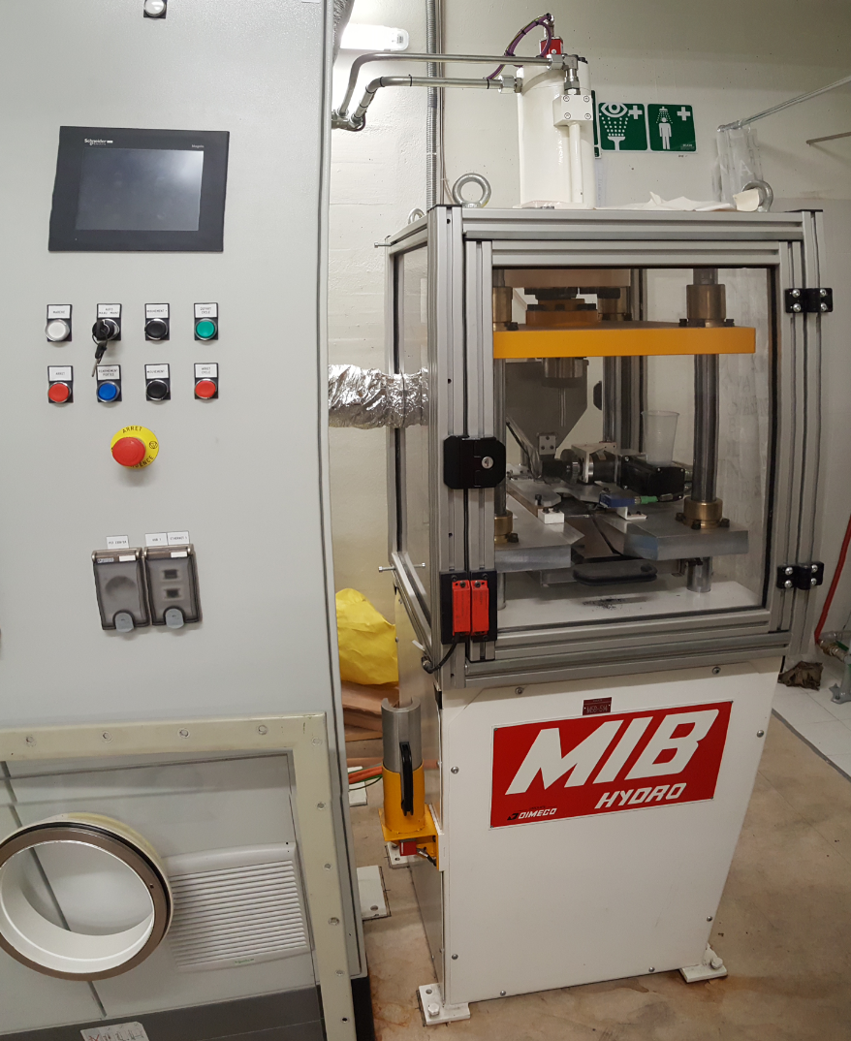
3D model of the nano-laboratory
Nuclear ventilation expanded to include the new laboratory (dynamic confinement) impact activitis in 2021
Fully enclosed process:
  4+1+1 glove boxes
  Enclosure of new pill-press
  Dedicated process ventilation
Nano-material handling considered in building specification (access SAS…)
Re-enforced shielding area
4 Glove boxes arrangement
(UO2+C pill production)
glove box
Inert atmosphere
Location for optional glove box
Radioactive material storage
Carburation and calibration stands
New pill press
Nano-Lab. 3D model integration EN-ACE / EN-CV

Slide 9
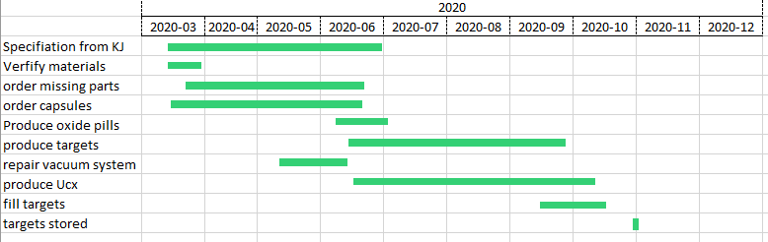
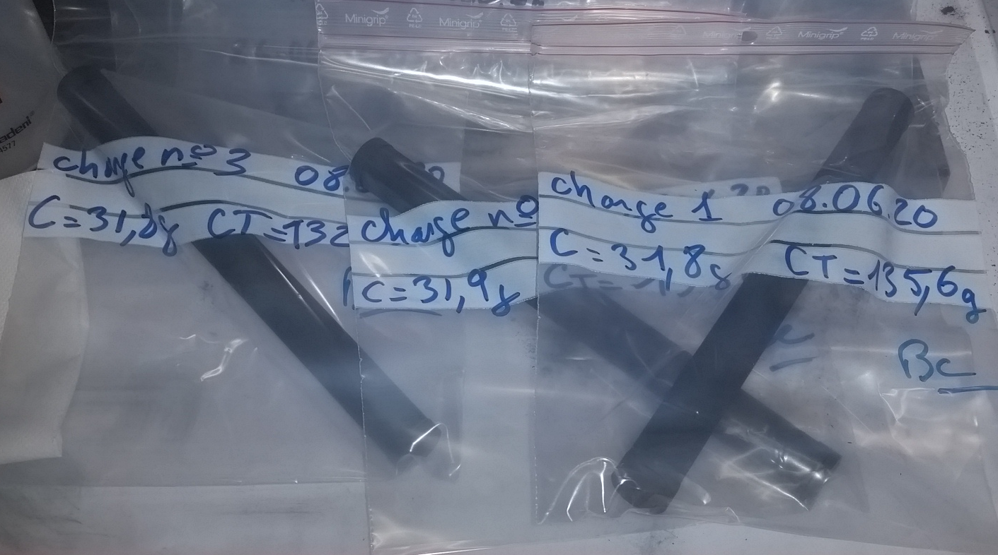
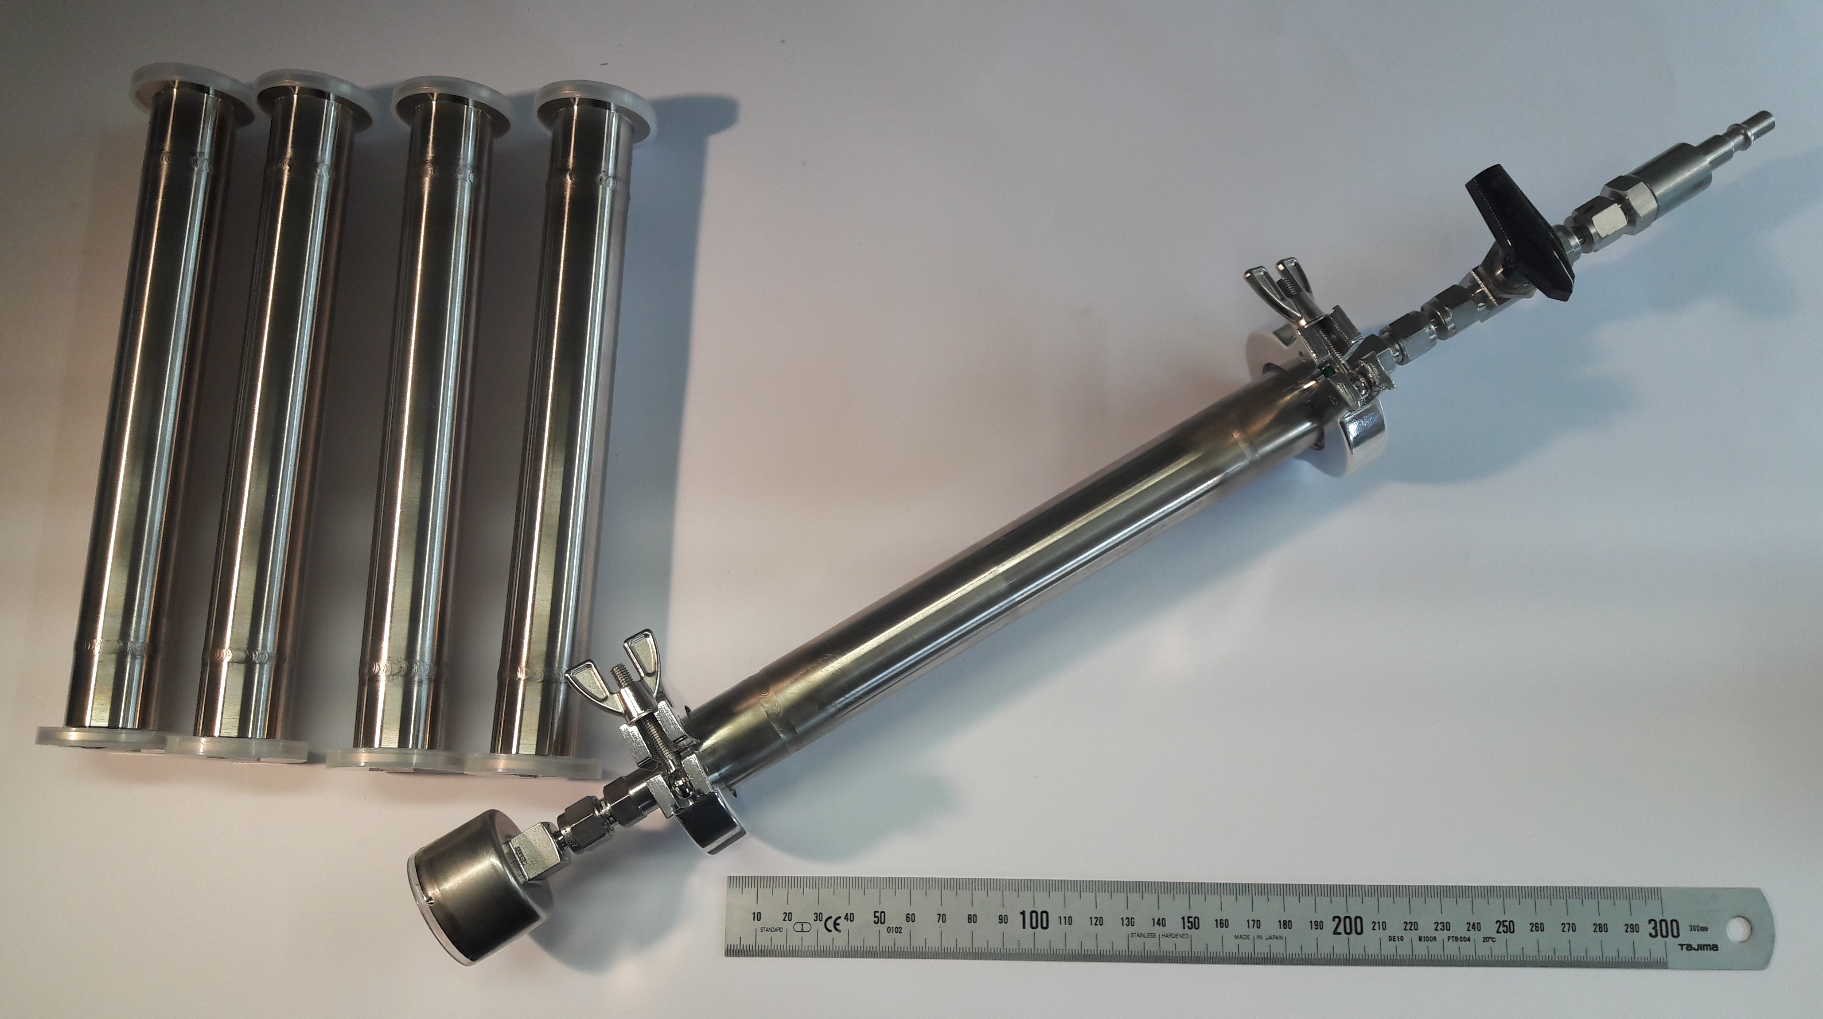
Targets for 2021 (anticipate in 2020)
UCx targets pre-production in view of nanolab ventilation cut Q1-Q2 2021
UO+C pills production ongoing
10 targets in queue
708-UC-MK1
709-UC-MK1
710-UC-MK1
711-UC-MK1
712-UC-MK1
713-UC-VD5
714-UC-VD7
715-UC-MK1
716-UC-MK1
717-UC-MK1
Production of storage container ongoing
Targets to be reused for 2021
#654-UC-MK1-W
#635-UC-MK1-Ta
#534-Sn-VD7
#619-Pb-VD
#653-UC-Ta-n
#641-UC-Ta
Also available: Targets from TISD tests
#638-UC-MK1-Re
#659-UC-VD7
#668M-UC-VD5
#637-UC-MK1-W
B. Crepieux, M. Owen, S. Rothe

Slide 10

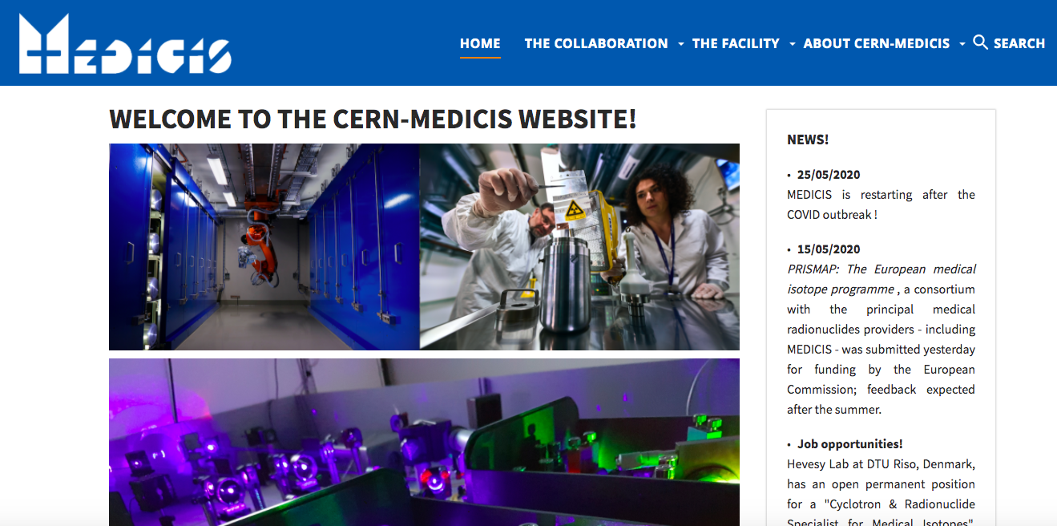
MEDICIS Status Report (02/20 to 06/20)
Technical stop completed (January and February 2020)
Successful stable beam commissioning (beginning of March)
Installation stopped and put in safe mode on 16th of March 2020 (Covid)
MEDICIS is back in operation with stable beam since 25th of May 2020
Laser alignment performed and first laser ionized beam of the year with MELISSA on 15th of June 2020!
First reception of an external radioactive source foresees for the 26th of June 2020 (Sm-153 for MED-025).
MEDICIS website is now available!
https://cern-medicis.web.cern.ch/
C. Duchemin on behalf of MEDICIS

Slide 11
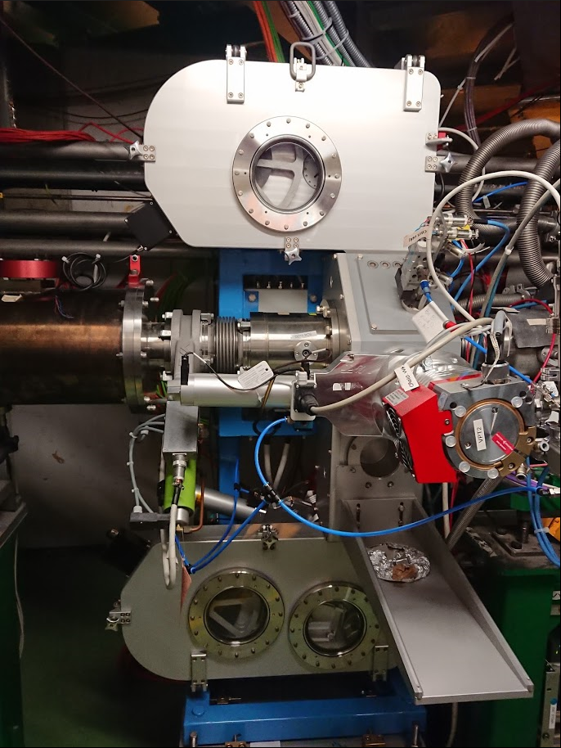
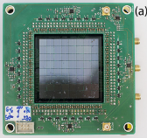
New Fast Tape Station
Low level controls to be tested/fixed EN/SMM (ongoing)
Basic high-level application / Beam instrumentation display by BE/OP (from Oct 2020)
Advanced yield measurement application via EN/STI (2021)
Detectors (4pi beta | (beta/)gamma | alpha) with strong support by EP/SME (2020|2021|2022)
Investigating SiPM electronics designed by IFIN (Bucharest, Romania)
Tapestation 2 at GLM on hold till TS1 advanced
https://doi.org/10.1016/j.nima.2019.163263
Courtesy S. Rothe et al.
Courtesy of S. Rothe

Slide 12
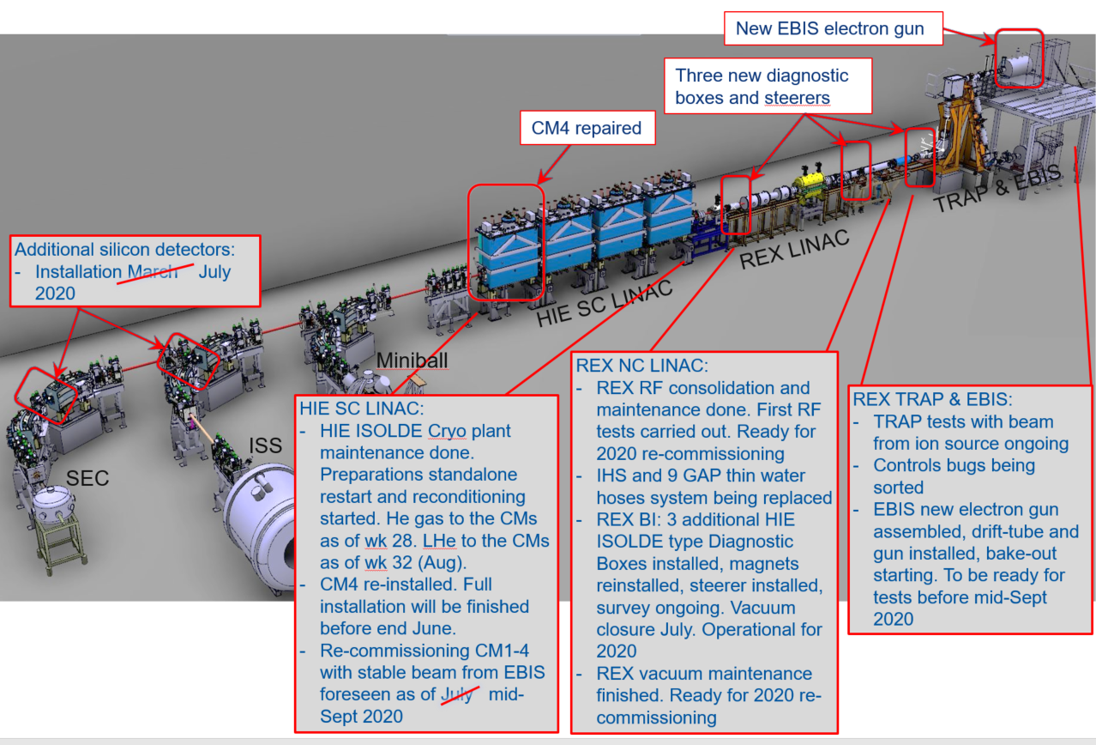
Status REX & HIE ISOLDE
May 2020:
Overall REX/HIE ISOLDE installation planning was reviewed in the frame of CERN wide prioritisation of activities and allocation of resources taking COVID-19 delay and measures for a progressive re-start as of 18th May in account
REX/HIE ISOLDE aim: Maintain for 2020: Crucial Hardware tests, EBIS new gun, HIE ISOLDE Cooldown, Cryo Module recommissioning and Beam (stable) Commissioning.
Abandoned for 2020: extensive Machine Studies
As of today, all REX / HIE ISOLDE LS2 tasks are on track with regard to the new COVID revised planning
E. Siesling slide ISCC

Slide 13
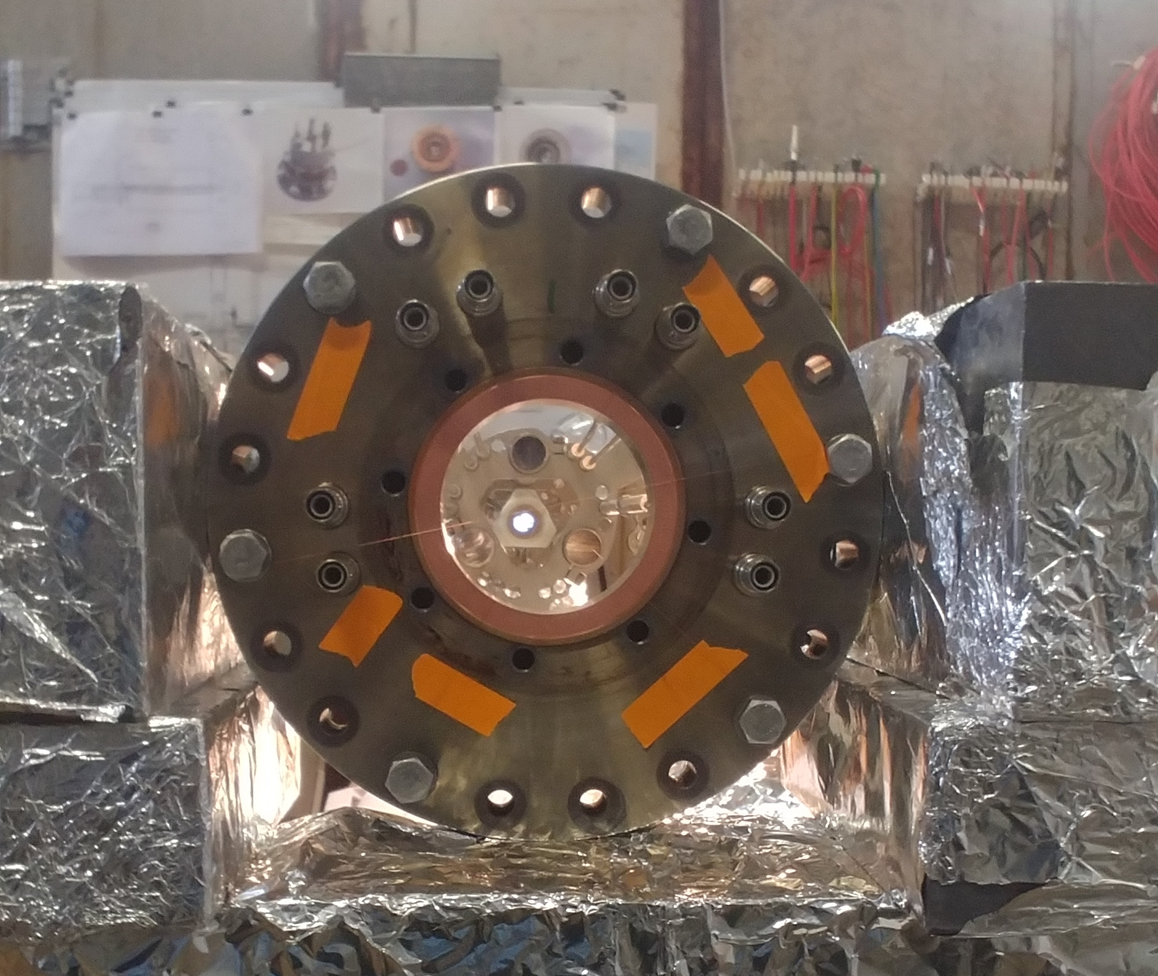
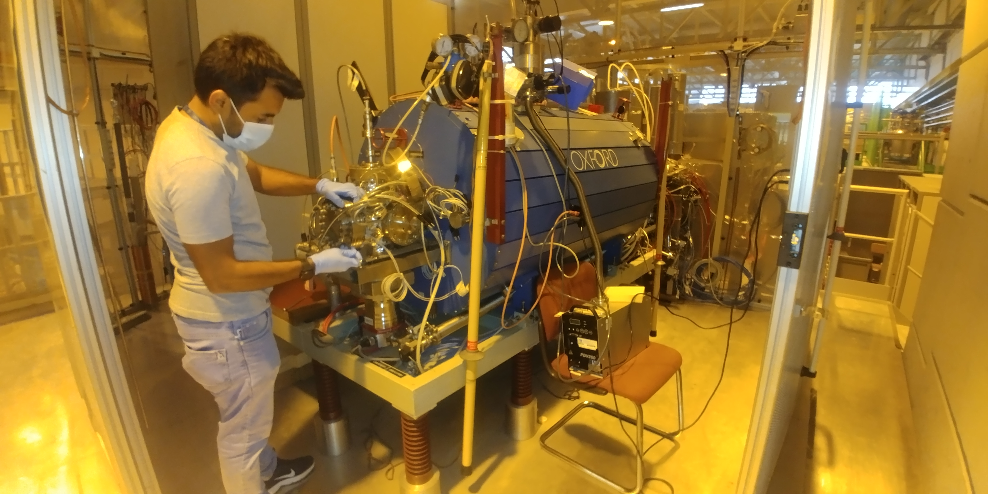
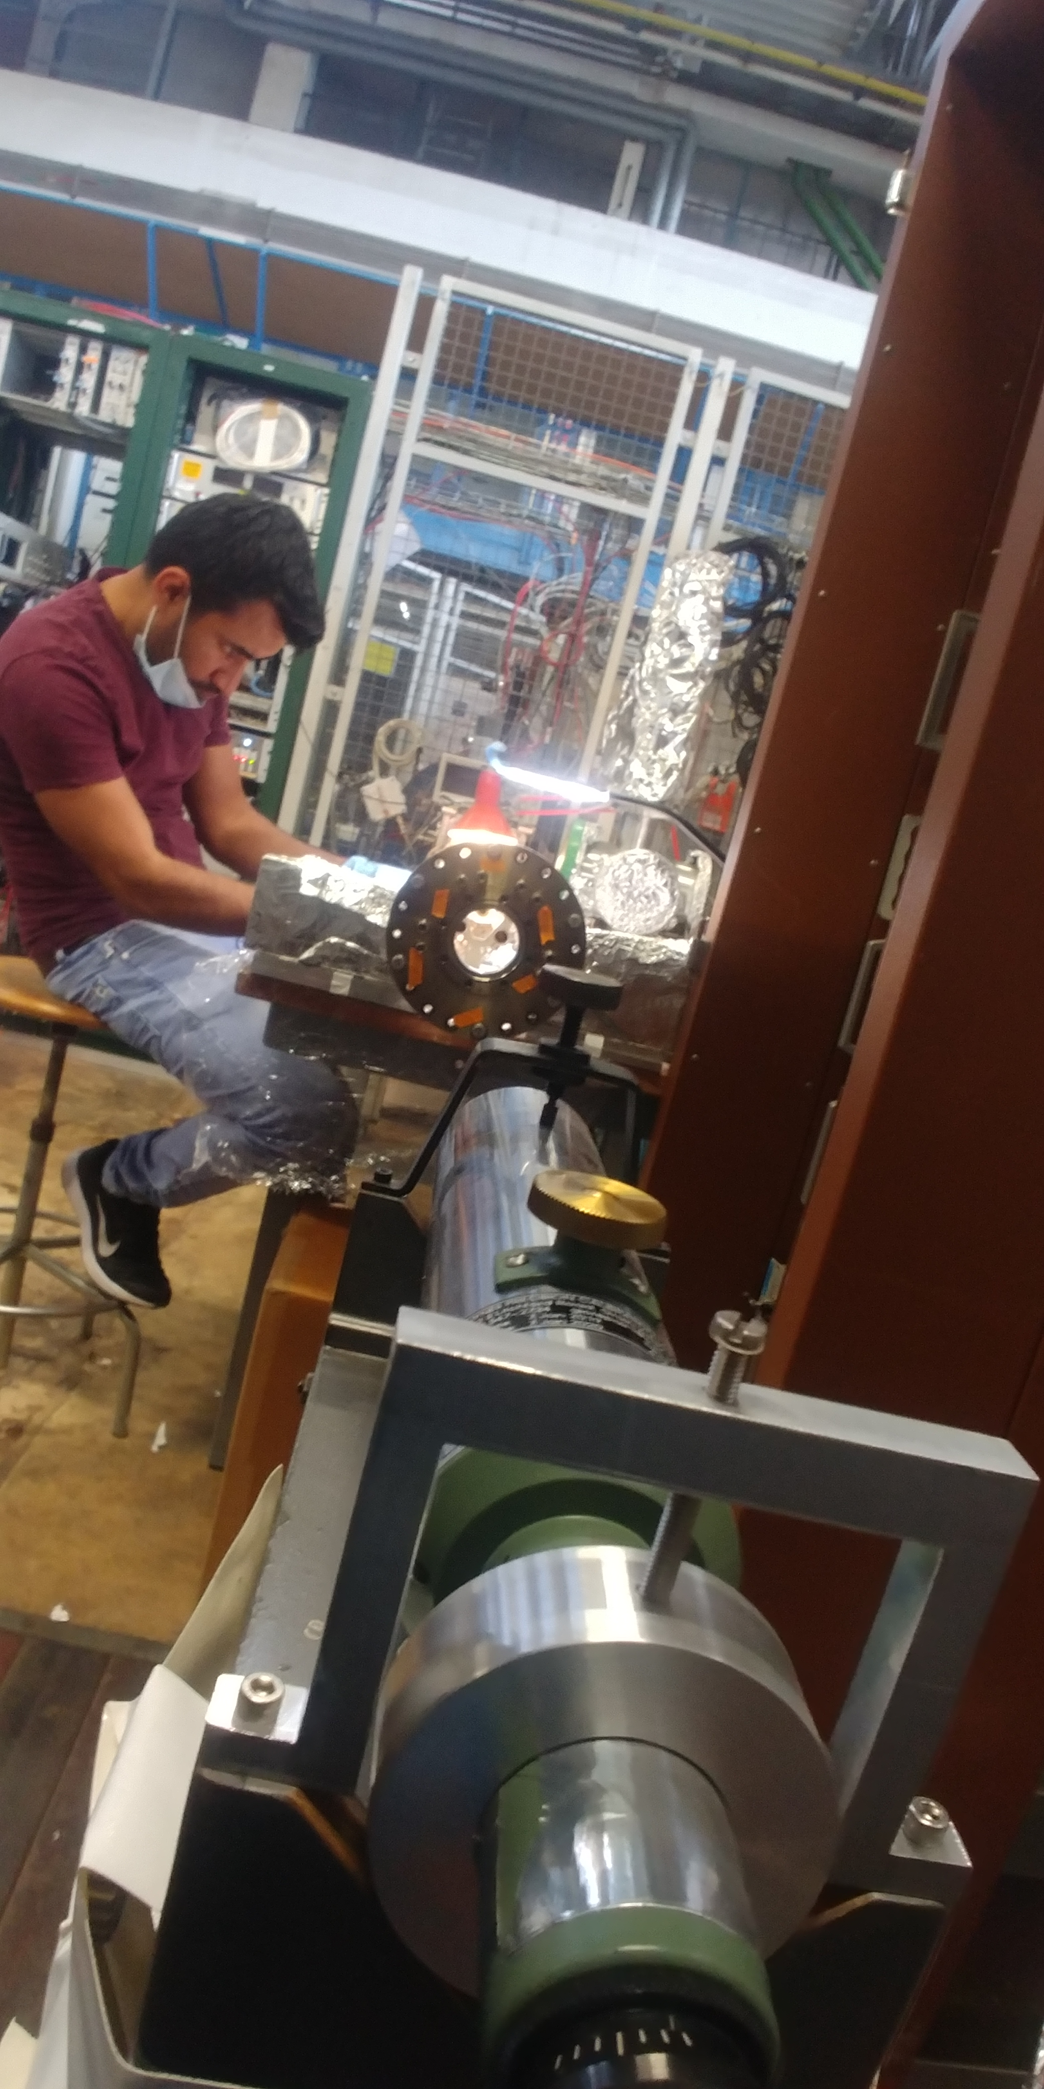
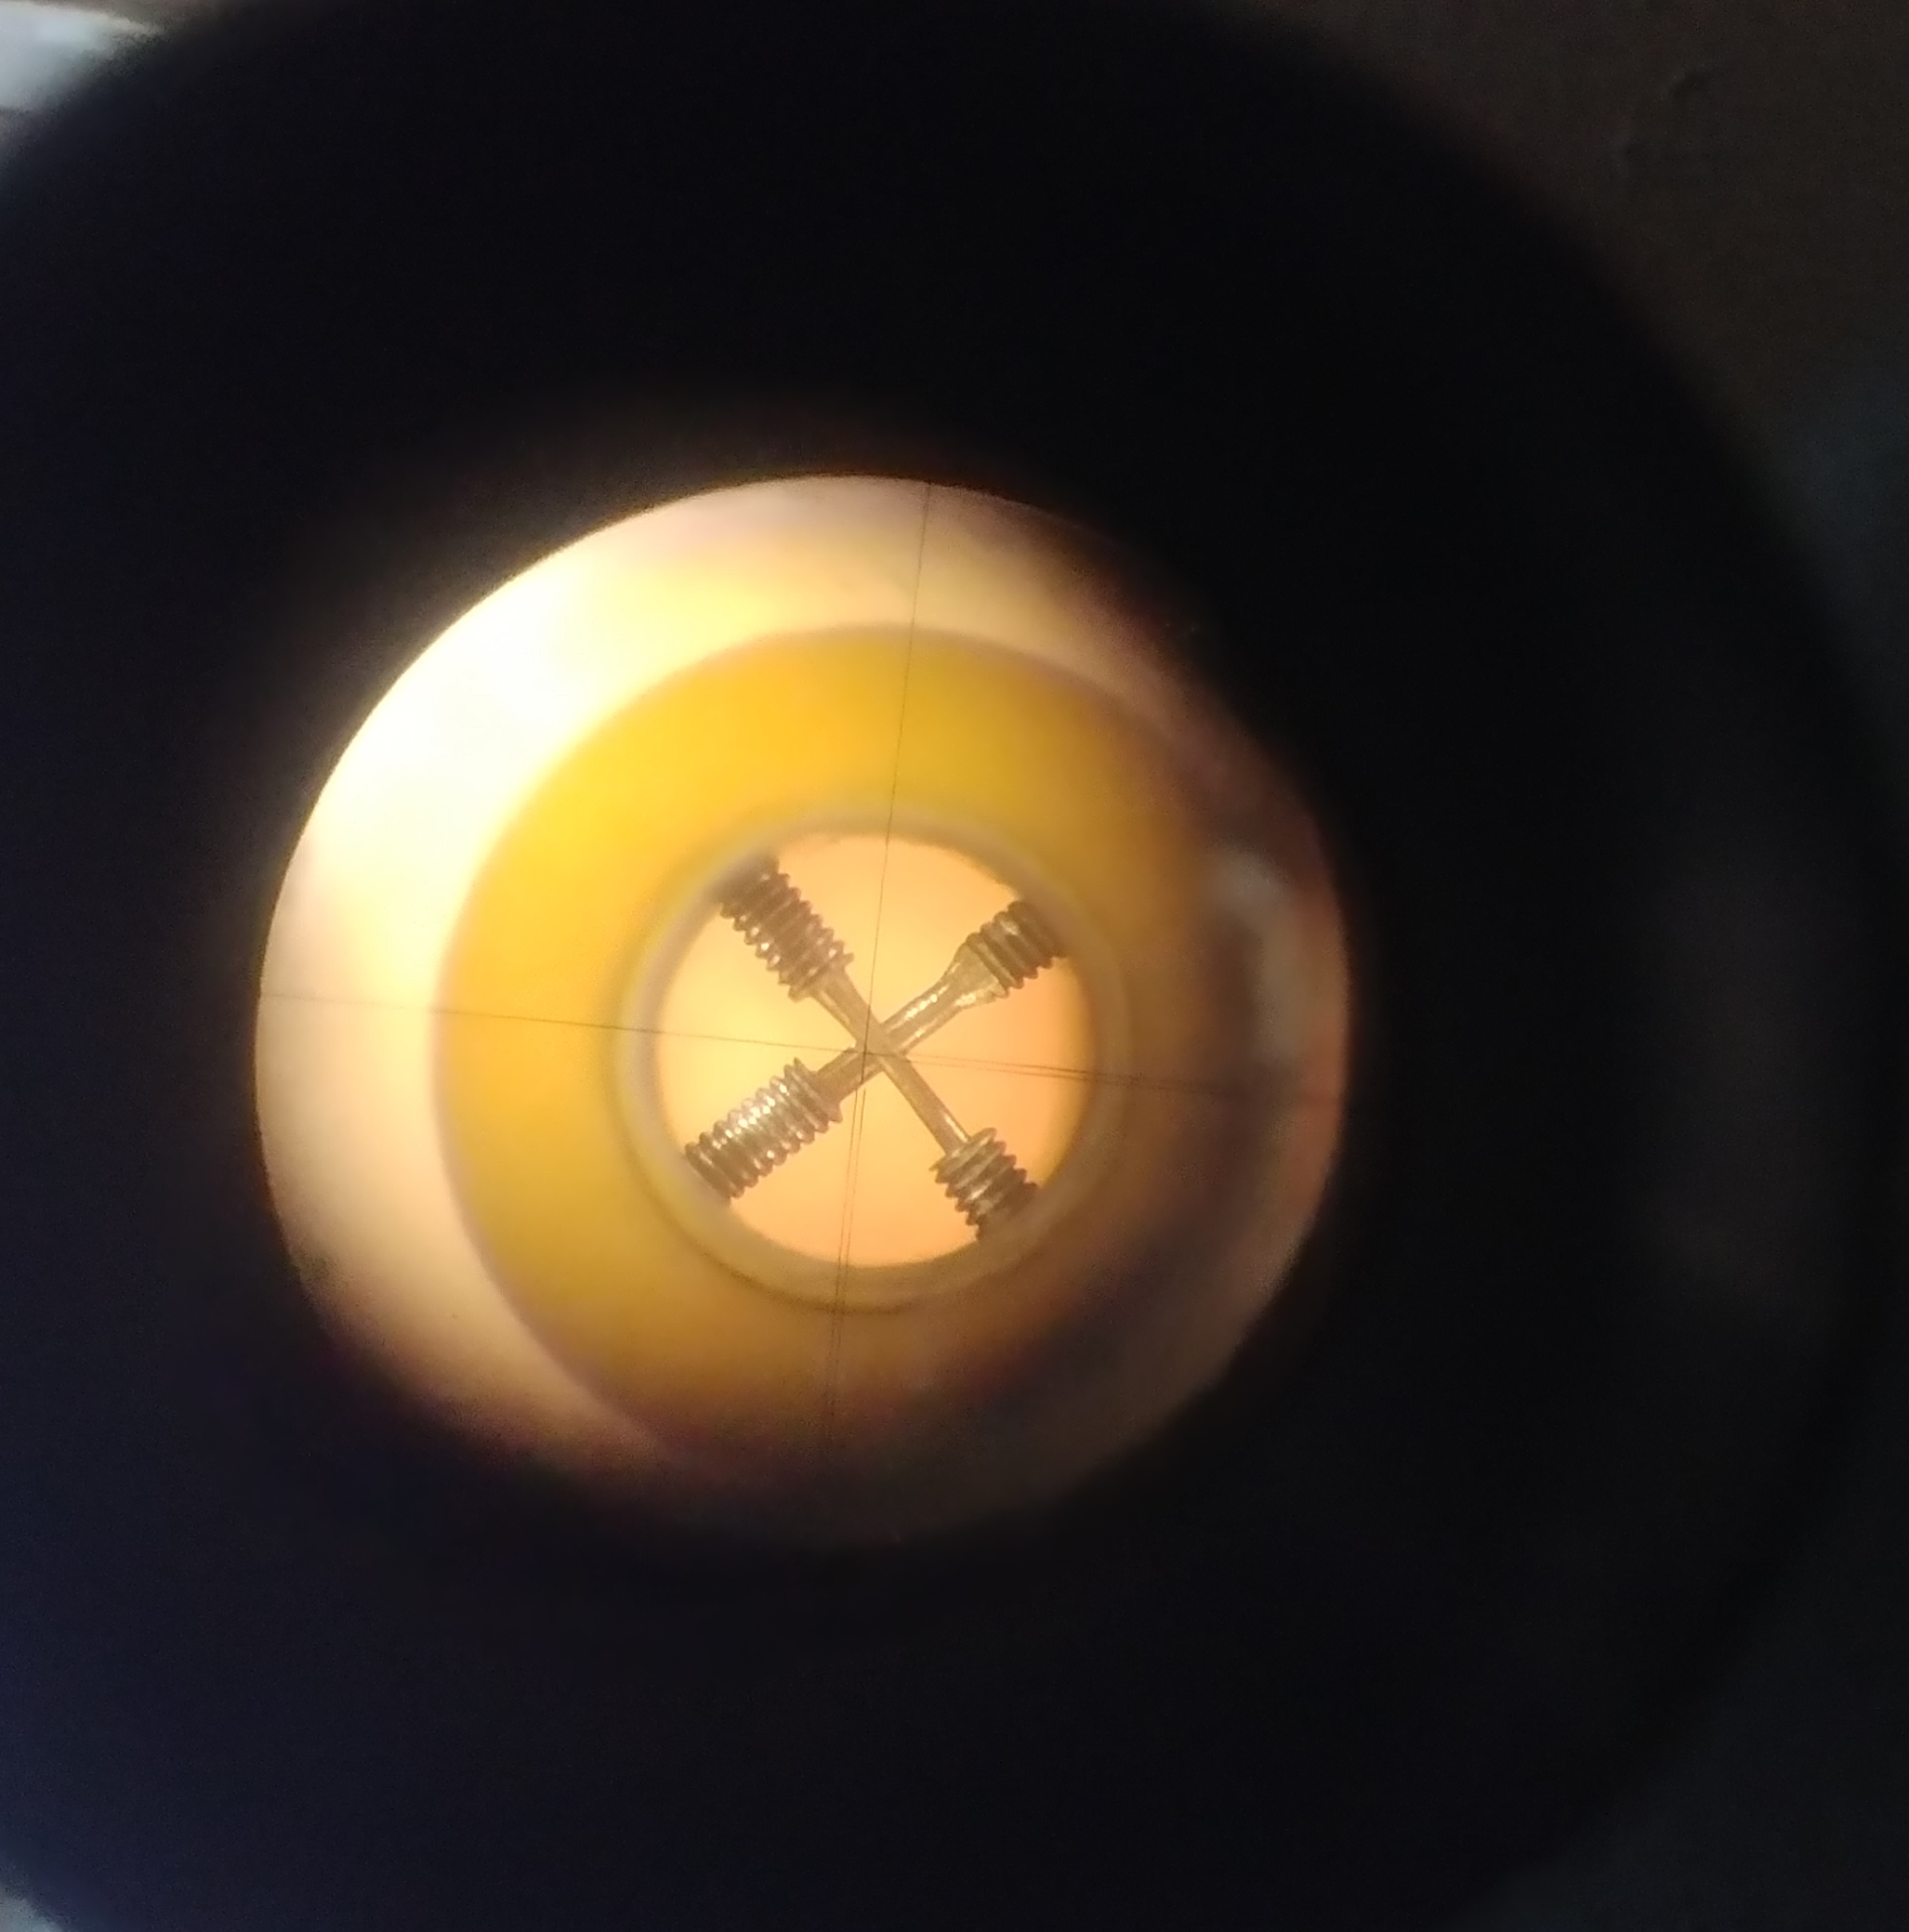
REX EBIS new immersed Electron gun and Drift Tube work
realign with +-0.1 mm transverse precision
Refurbished drift tube
Courtesy Fredrik Wenander, Gunn Khatri BE-ABP, Simon Mataguez BE-OP, et all.
E. Siesling slide ISCC

Slide 14
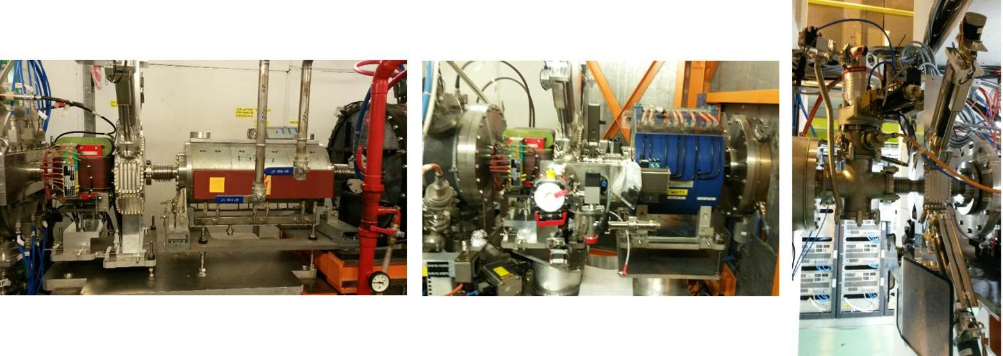
REX 3 new diagnostic boxes + additional steerer
Main progress:
All three boxes, the two magnets and the two steerers in place
All vacuum chambers and related equipment in place
Aim: To be ready second week of July for RF tests (tunnel closed and vacuum OK) and for HIE Cryo cooldown as of Aug (restricted tunnel access).
Courtesy Candy Capelli EN-MME, Nicolas Chritin EN-MME, Simon Mataguez BE-OP, William Andreazza, Enrico Bravin, Sergey Sadovich BE-BI, Jose Ferreira Somoza, Guillermo Merino Fernandez TE-VSC, Transport Team – E. Siesling slide ISCC

Slide 15
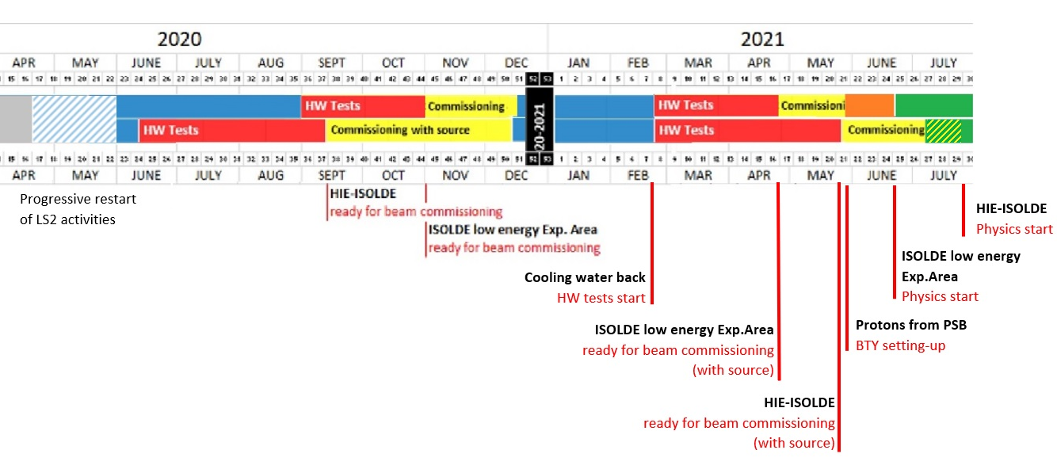
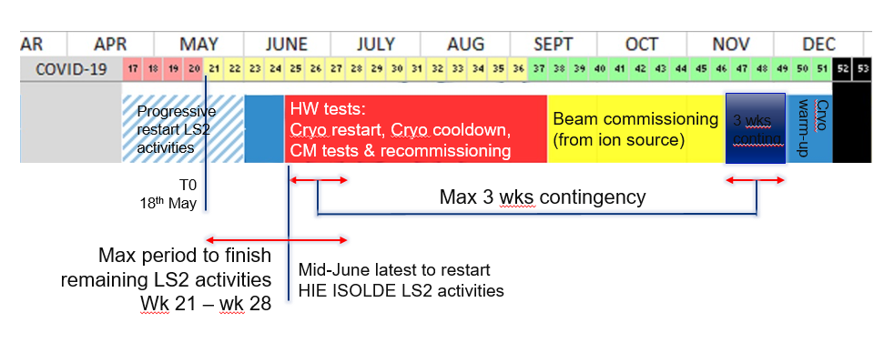
Revised LS2 Master Schedule for ISOLDE
REX / HIE ISOLDE LS2 activities
Physics 2021:
Low E Physics start end-June 2021 (was end-April)
HIE-ISOLDE Physics start end-July 2021 (was mid-May)
  E. Siesling LS2C 12 June 2020 / ISCC 23 June 2020

Slide 16
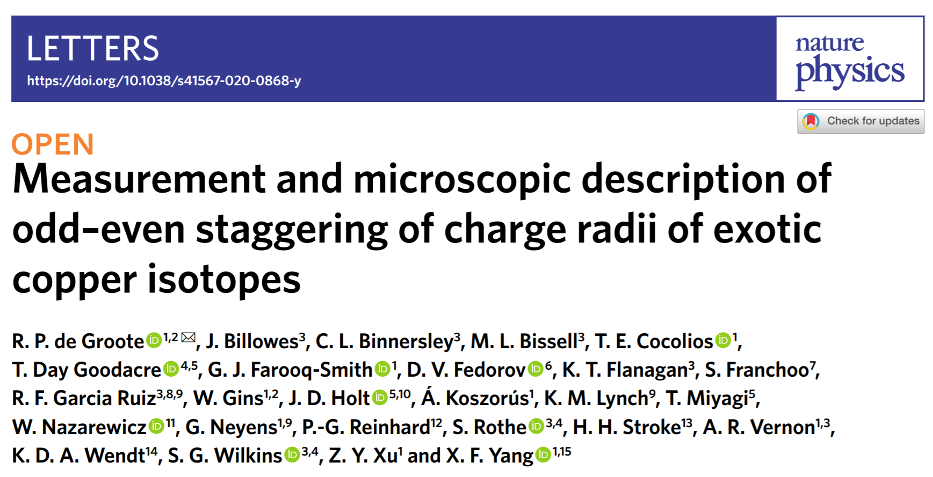
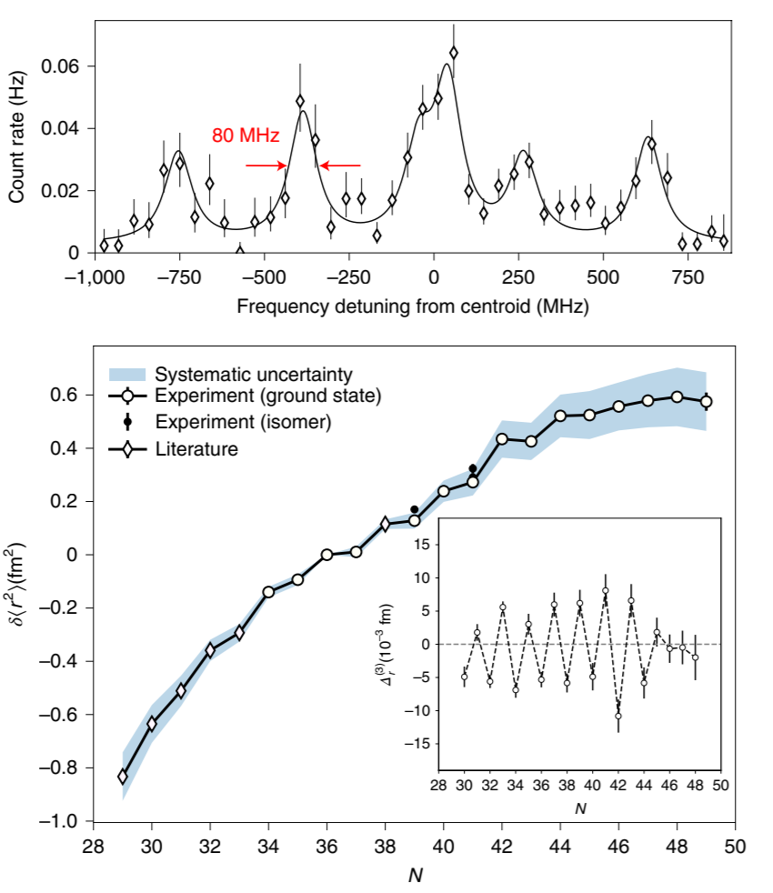
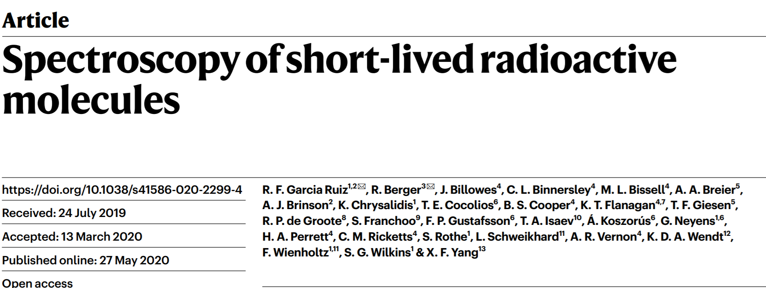
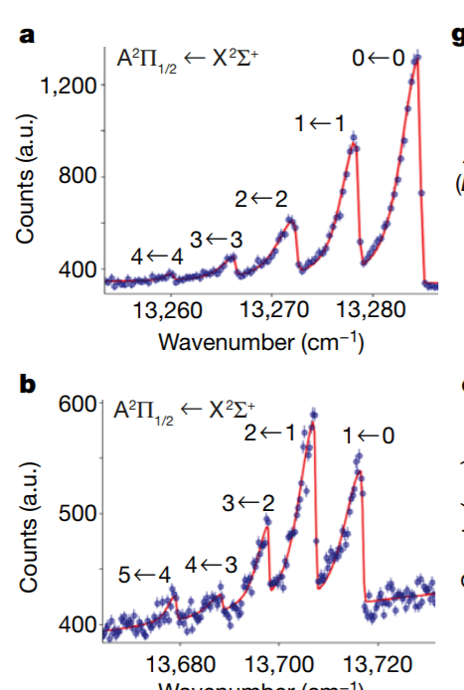

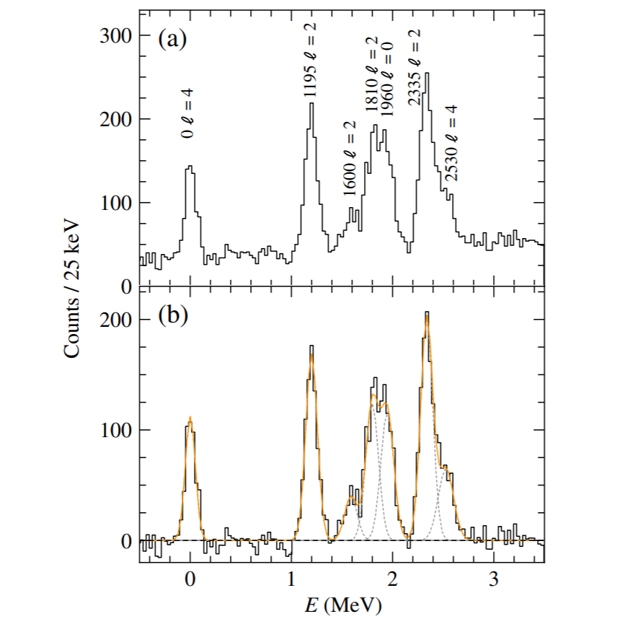
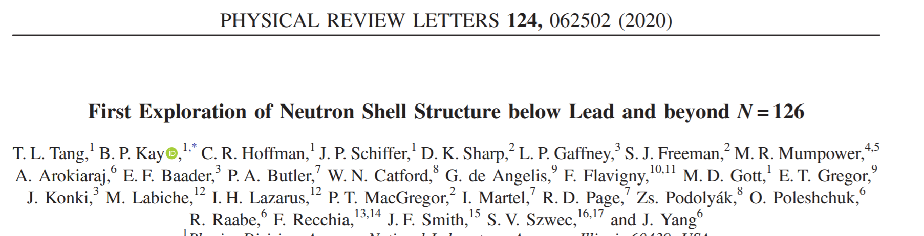
Some recent ISOLDE physics output
First measurements on radioactive molecules….
… proven to be the ideal probes to search for physics beyond Standard Model
Courtesy of K. Johnston and G. Neyens
First ISS paper.
First “high energy” HIE paper: 7.38MeV/u

Slide 17
Summary
LS2 activities have resumed since mid-May with increasing number of personnel allowed on site
COVID related safety measures included in work practices and organization
Activities planning were revised to include the duration of the closure and available resources
Very strong support and commitment from groups to finalize ISOLDE LS2 work to allow the full recommissioning of the machine in 2020 (new front ends, new tape station, new beam instrumentation, new REX/EBIS e⁻ gun, repaired CM4….)
Execution of the extensive machine study program foreseen in 2020 will however not be possible
Opportunities to recover part of the time for machine studies will be investigated in the coming months (keep the Cryo plant running over the winter closure ?)

Slide 18
Thank you for your attention!

