Slide 1
What we really do at n_TOF
Alberto Mengoni, on behalf of the n_TOF Collaboration
1. Nuclear astrophysics
2. Advanced nuclear technologies
3. Basic nuclear science & applications
INTC, 24 June 2020

Slide 2
What we really do at n_TOF
Alberto Mengoni, on behalf of the n_TOF Collaboration
1. Nuclear astrophysics
nucleosynthesis of the heavy (Z>26) elements
stellar evolution
primordial nucleosynthesis (BBN)

Slide 3
What we really do at n_TOF
Alberto Mengoni, on behalf of the n_TOF Collaboration
2. Advanced nuclear technologies
Fission reactors (ADS, Gen-IV)
Nuclear Data for Fusion applications
Transmutation of nuclear waste
Neutron capture therapy

Slide 4
What we really do at n_TOF
Alberto Mengoni, on behalf of the n_TOF Collaboration
3. Basic nuclear science & applications
nuclear interactions
nuclear structure effects in fission
high energy nuclear reactions

Slide 5
What we really do at n_TOF
Alberto Mengoni, on behalf of the n_TOF Collaboration
1. Nuclear astrophysics
2. Advanced nuclear technologies
3. Basic nuclear science & applications

Slide 6
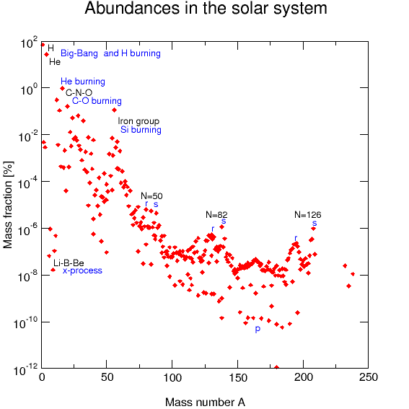
s-process
The lifetime of a nucleus against (n,γ) is:
For σ_{(n,γ)} ≈ 100 mb and kT ≈ 30 keV, it is:
neutrons
The canonical s-process
alberto.mengoni@cern.ch

Slide 7
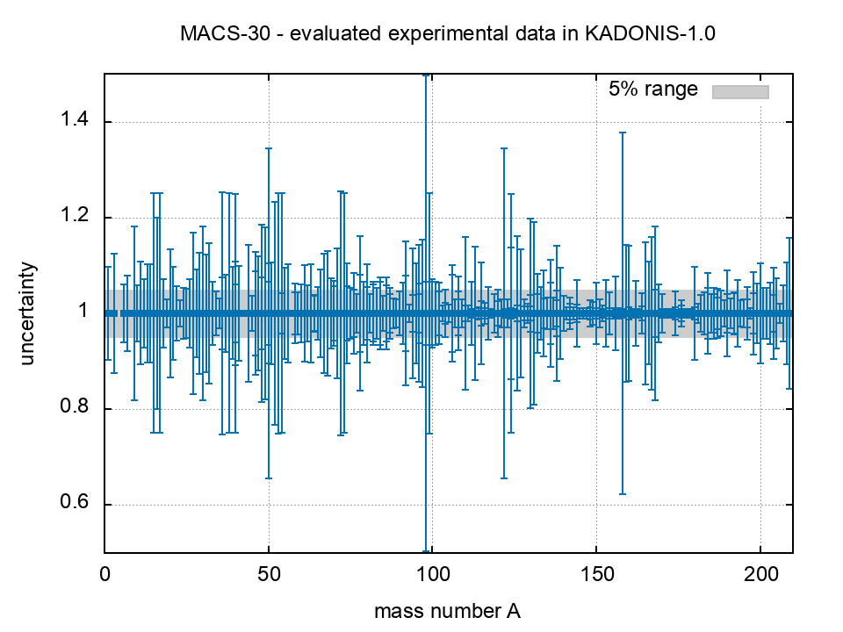
MACS-30
https://exp-astro.de/kadonis1.0/
276 nuclides
154 nuclides
with Δ𝜎 > 5%
69 nuclides
with Δ𝜎 > 10%
16 nuclides
with Δ𝜎 > 20%

Slide 8
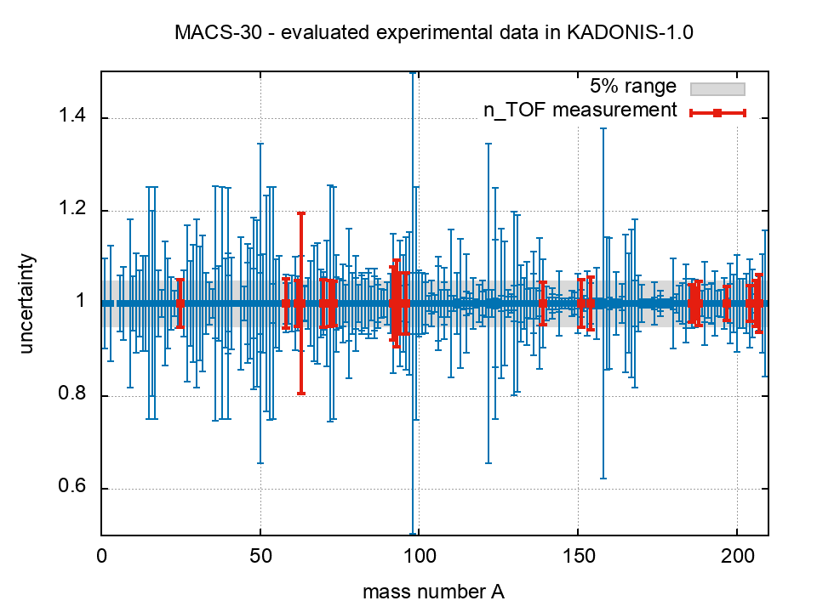
MACS-30
https://exp-astro.de/kadonis1.0/
Evaluated data files cannot solve the problem of the accuracy of neutron cross sections data
n_TOF can!
(*) exception: ⁶³Ni, t_{1/2} = 100 yr
first measurement at n_TOF
C Lederer-Woods et al., PRC 89 (2014)
Notes:
Exceptions are Ni-63 (first measurement, radioactive sample) and to a less extent some Zr isotopes

Slide 9
Better MACS-30 means more
Reducing the uncertainty in the MACS is not only a question of better nuclear data: higher accuracy in the reaction rates opens the possibility to investigate new astrophysical scenarios
[nuclear clocks, constrains on the BBN, AGB modeling, nucleosynthesis conditions in explosive scenarios, others]
Notes:
Exceptions are Ni-63 (first measurement, radioactive sample) and to a less extent some Zr isotopes

Slide 10
Accurate cross section data are key to:
1. Nuclear astrophysics
2. Advanced nuclear technologies
3. Basic nuclear science & applications

Slide 11
2. Advanced Nuclear Technologies
“Several parameters, particularly safety parameters of reactors and other nuclear facilities, need to be known with a precision well below 0.1% resulting in nuclear data precisions better than a few percent, some times better than 2%, and this is a serious challenge. In other cases the precision needed can range from 5 to 20% but the isotope or material to be measured is highly radioactive or very scarce raising a different but also important challenge.”
cit. “SUPPLYING ACCURATE NUCLEAR DATA FOR ENERGY AND NON-ENERGY APPLICATIONS – SANDA”, EU H2020 Nuclear Data Project, started in September 2019 (4 years duration)

Slide 12
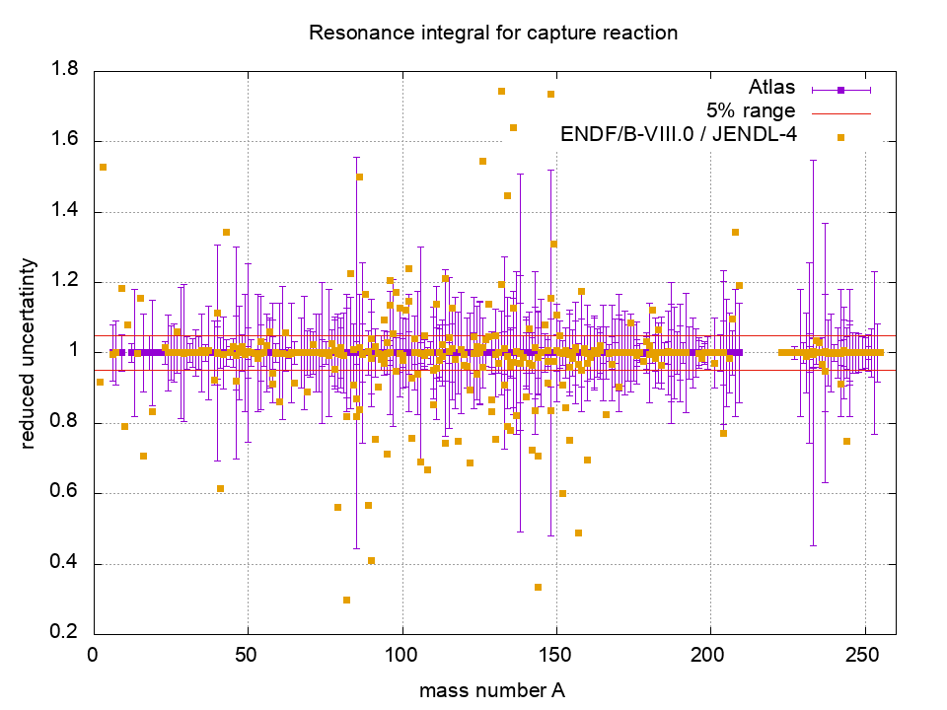
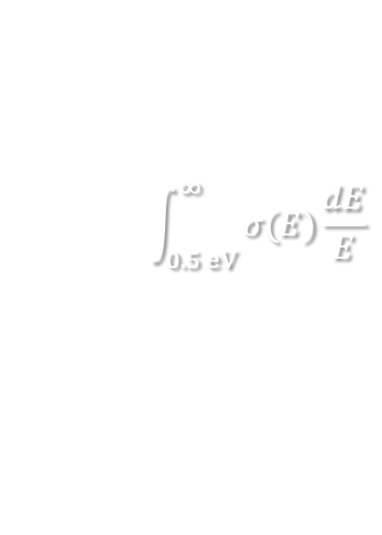
Resonance Integrals: capture
$$\int_{0.5 eV}^{∞}{σ(E)\frac{dE}{E}}$$
328 nuclides
231 nuclides
with Δ𝜎 > 5%
120 nuclides
with Δ𝜎 > 10%
21 nuclides
with Δ𝜎 > 20%
Data source: S Mughabghab, Atlas of Neutron Resonances (2006)

Slide 13
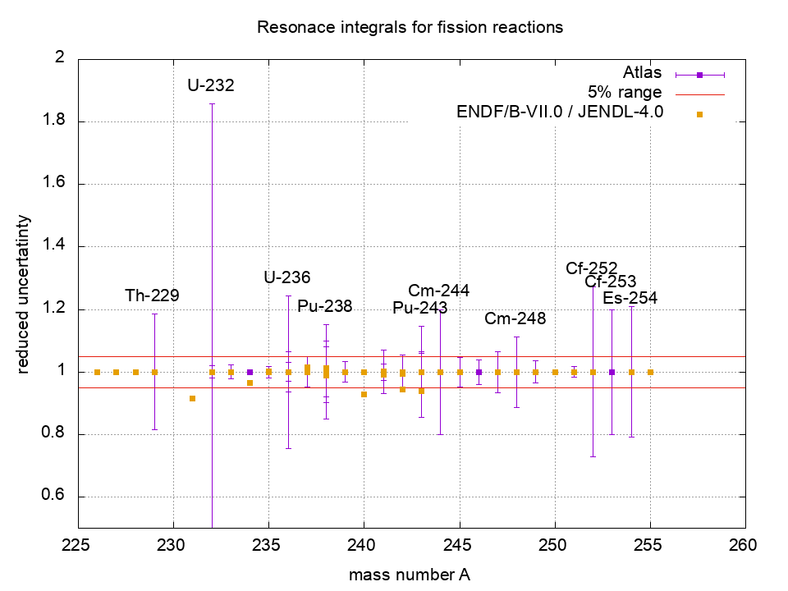
Resonance Integrals: fission
$$\int_{0.5 eV}^{∞}{σ(E)\frac{dE}{E}}$$
29 nuclides
18 nuclides
with Δ𝜎 > 5%
10 nuclides
with Δ𝜎 > 10%
4 nuclides
with Δ𝜎 > 20%
Data source: S Mughabghab, Atlas of Neutron Resonances (2006)

Slide 14
Conclusion-1
There is enough “raw material” for building up
a strong experimental program for the
n_TOF Phase-2021
Commissioning
New experimental proposals
Notes:
Today is not the right time to discuss in details the physics cases on which we will build the n_TOF Phase-2021. I have shown only very simple seeds information.

Slide 15
Phase-2021: Commissioning
Group | Task
EN-STI + groups from ATS and HSE | Coordination of the facility, target systems and technical components, collimators, R2E and R2M for NEAR
 | Extraction, optics, p-beam parameters, SEM, VISTAR
 | Alignment, DAQ
 | Radiation measurements in the target area (and in the EARs)
n_TOF Collaboration | n-flux, beam profile, background conditions, beam resolution, new detectors
A joint CERN groups + n_TOF Collaboration WG forming

Slide 16
Phase-2021: New proposals
reaction | field of interest | note
^{94,95,96}Mo(n,𝛾) | – s-process AGB stars, SiC grains – fp, fuel alloys | stable samples (*)
⁹⁴Nb(n,𝛾) | – anomalies in pre-solar grains – strong contributor to the long-term radiotoxicity among fp | radioactive sample t_{1/2} = 20 ka
⁷⁹Se(n,𝛾) | – s-process thermometer – strong contributor to the long-term radiotoxicity among fp | radioactive sample t_{1/2} = 300 ka
^{50,53}Cr(n,𝛾) | – criticality safety (major element in stainless steel) | stable samples
⁴⁰K(n,p) ⁴⁰K(n,𝛼) | – radiogenic heating in earth-like exoplanets (destruction vs production mechanisms) | stable samples
continue…
(*) part of a EU H2020 nuclear data project

Slide 17
Phase-2021: New proposals
reaction | field of interest | note
²³⁹Pu(n,𝛾) and 𝛼-ratio | – advanced nuclear technologies | radioactive sample t_{1/2} = 24.1 ka (*)
n + d → p + 2n | – nn scattering length | basic nuclear physics application
²⁴³Am(n,f) | – contributes to production of ²³⁹Pu (by 𝛼 + 𝛽⁻ decays) | radioactive sample t_{1/2} = 7364 a
(…) |  | under discussion
(*) part of a EU H2020 nuclear data project

Slide 18
Program for Phase-2021: NEAR
during the design studies
of the new shielding around
the target station...
the opportunity for a new
near-target experimental area
appeared (NEAR station)
p beam
neutrons to EAR1

Slide 19
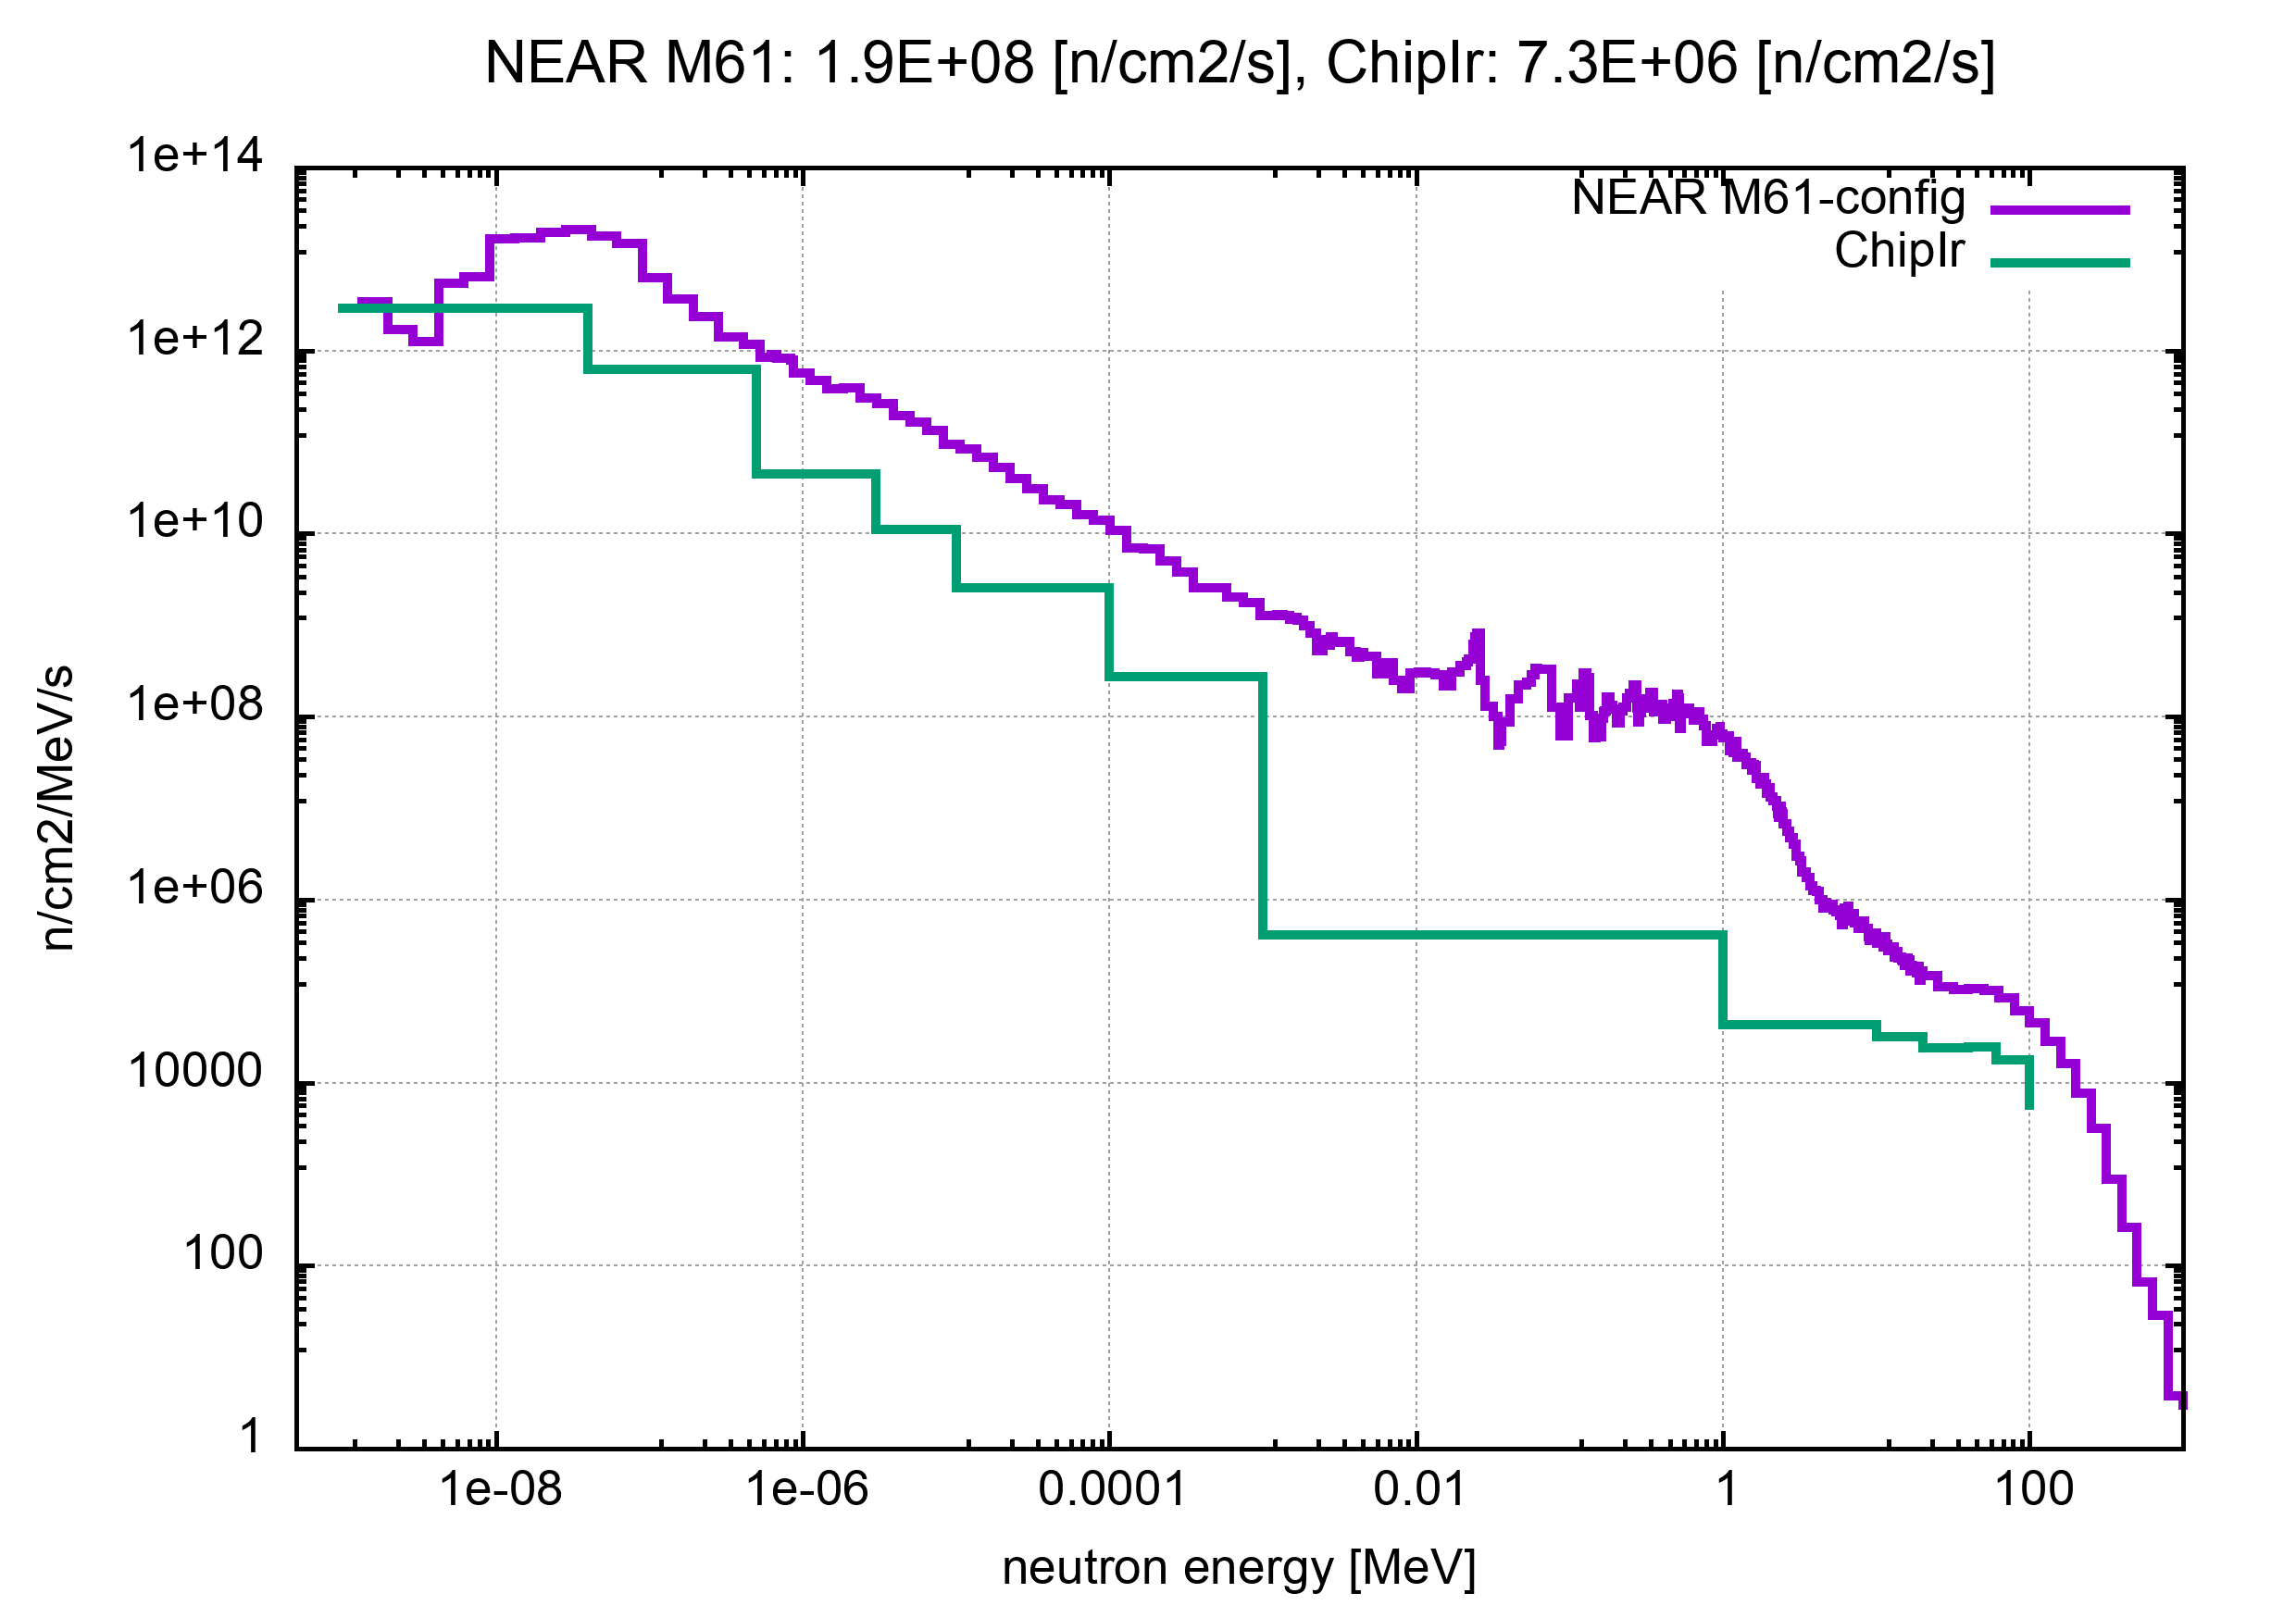
Program for Phase-2021: NEAR
WG on the NEAR station established
collect infos & ideas, provide technical specs for collimation
feasibility of activation measurements, others
example of simulations
of the neutron beam
in the NEAR area in
comparison to the new
ChipIr facility at ISIS(*)
(*)D Chiesa et al., NIMA 902 (2018) 14

Slide 20
Program for Phase-2021
Proposals to INTC
Commissioning: November 2020
New experiments: November 2020 & February 2021

Slide 21
The End
alberto.mengoni@cern.ch

Slide 23
Additional material

Slide 24
Phase-2021: Commissioning
purpose | detectors in EAR1 | detectors in EAR2
neutron flux small/large collimators | SiMON, MGAS, PTB chamber PPACs, MGAS | SiMON-2D, MGAS, PPACs MGAS, PPACs
beam profile small/large collimators | CR39, PPACS | SiMON-2D, XYMGAS, PPAC, CR39 PPAC, CR39, MGAS
beam resolution | C6D6 (L6D6, Bicron), TAC | C6D6 (Bicron, L6D6)
background conditions | C6D6, TAC, i-TED | CR39, C6D6, MGAS (³He, TLDs, ⁶Li-glass, Timepix BC501)
tests for new detectors | LaBr₃, NaI, CsI-Si, new-SiMON, HPGe | LaBr₃, LaCl₃, CeBr₃, NaI, CsI/Si arrays, new detectors

Slide 25
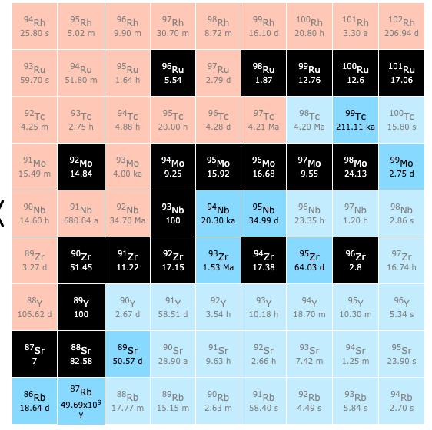
(n,𝛄) on Molybdenum
Applications in nuclear astrophysics include studies to interpret traces of s-process pollution in SiC grains and by providing strong constrains on the main s-process component in AGB stars (C-13 pocket).
Mo isotopes are currently found in nuclear reactors as fission products or in Mo-alloys in research or naval or space reactors. Moreover, in nuclear cycle Mo isotopes are taken into account in criticality safety studies for transport casks or irradiated fuel storage (use in burn-up credit) or in reprocessing plants (for example: UPu-MoZr deposits in reprocessing plant equipment).
additional:
⁹²Mo(n,p) in NEA/HPRL

Slide 26
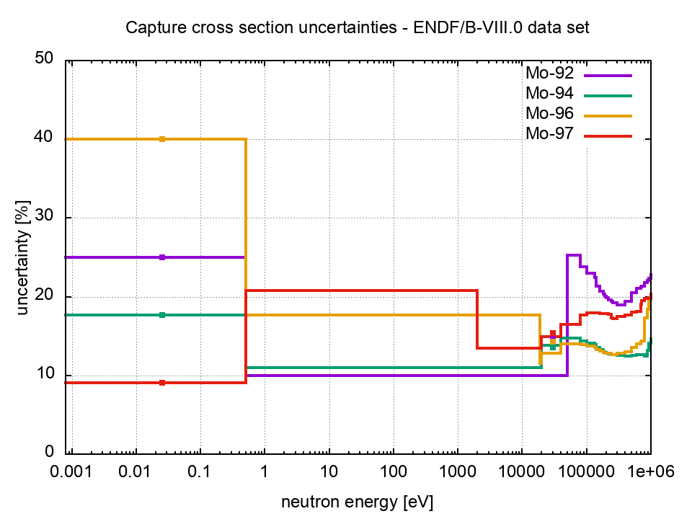
(n,𝛄) on Molybdenum

Slide 27
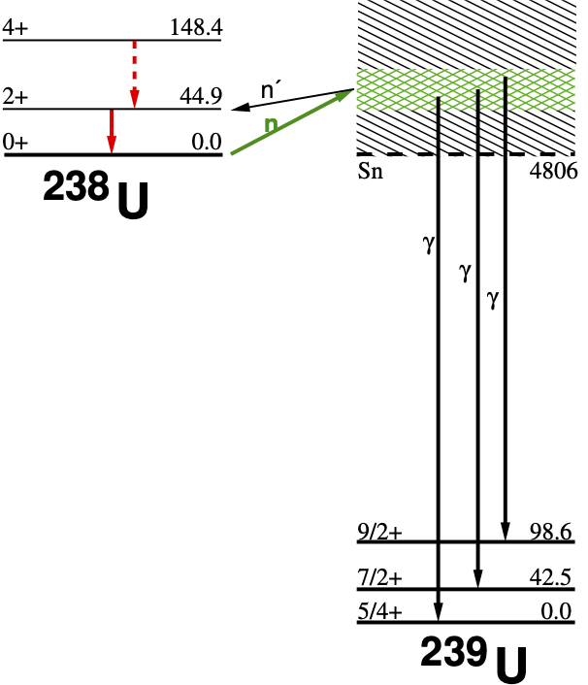
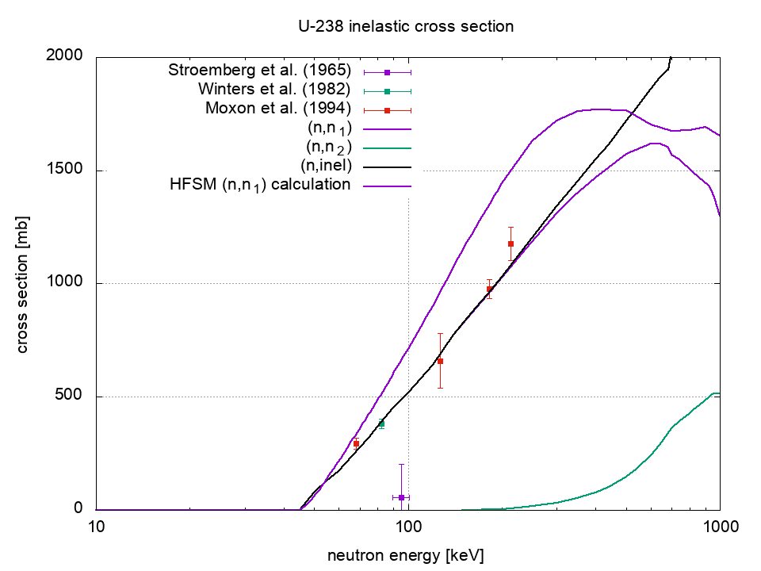
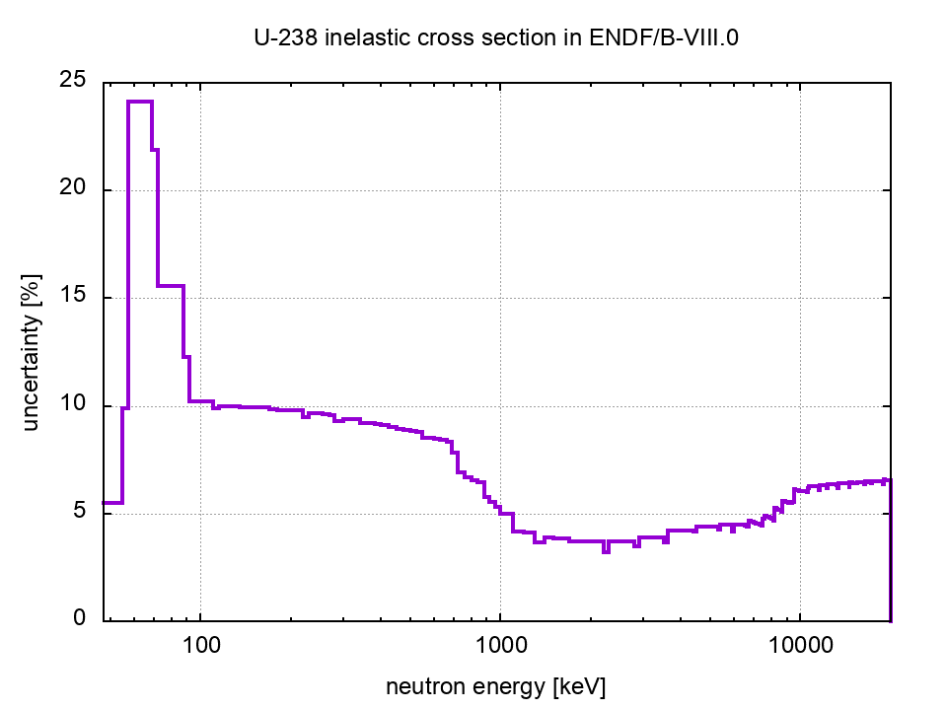
²³⁸U(n,n’)
Progress in Nuclear Energy 106 (2018) 372–386
high(est) priority
in the NEA/HPRL
feasible with
our new HPGe?

Slide 28
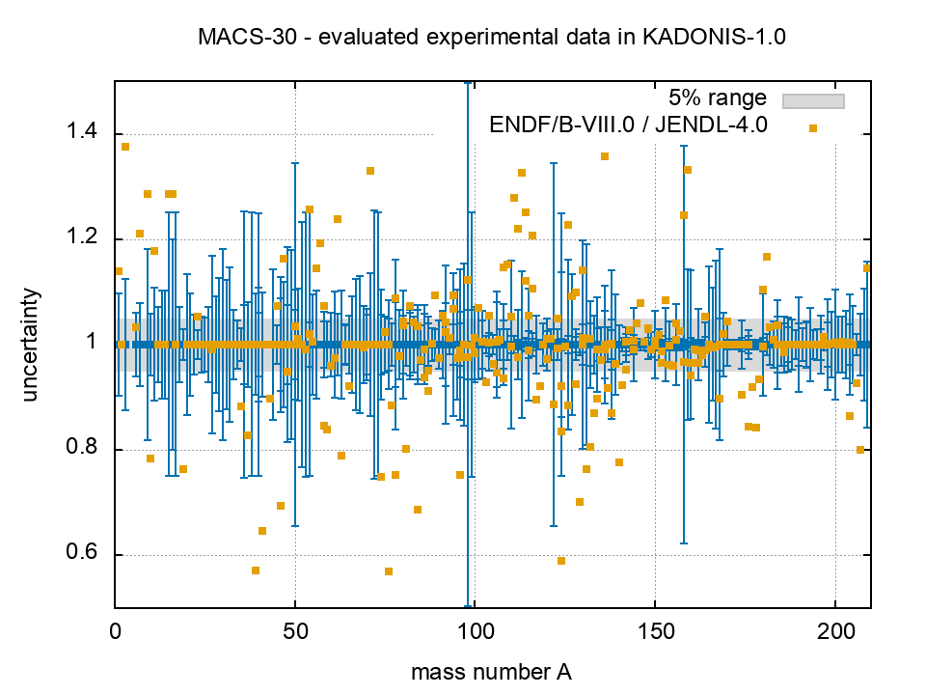
MACS-30
https://exp-astro.de/kadonis1.0/
276 nuclides
154 nuclides
with Δ𝜎 > 5%
69 nuclides
with Δ𝜎 > 10%
16 nuclides
with Δ𝜎 > 20%

Slide 29
Program for Phase-2021
abundances data from Anders & Grevesse (1989)

Slide 30
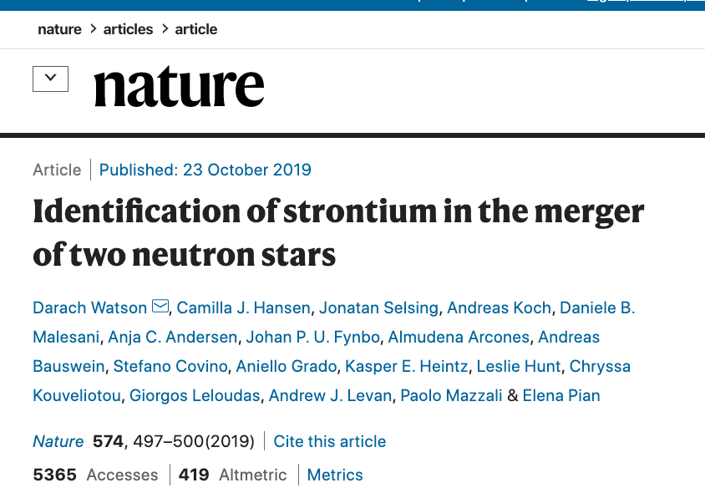
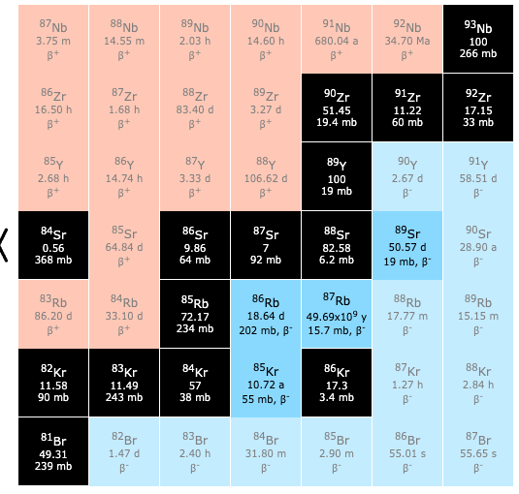
Better MACS-30 means more
Reducing the uncertainty in the MACS is not only a question of better nuclear data: higher accuracy in the reaction rates opens the possibility to investigate new astrophysical scenarios
[nuclear clocks, constrains on the BBN, AGB modeling, nucleosynthesis conditions in explosive scenarios, others]
s-only
nucleosynthesis
in neutron star mergers
r-process
Notes:
Exceptions are Ni-63 (first measurement, radioactive sample) and to a less extent some Zr isotopes

