Slide 1
n_TOF Report
at the 64th Meeting of the INTC
Alberto Mengoni, EP-UNT
Oliver Aberle, EN-STI-TCD

Slide 2
Outlook
Update for the main LS2 activities
  Horizontal beam line
  Target exchange
  New control room

Slide 3
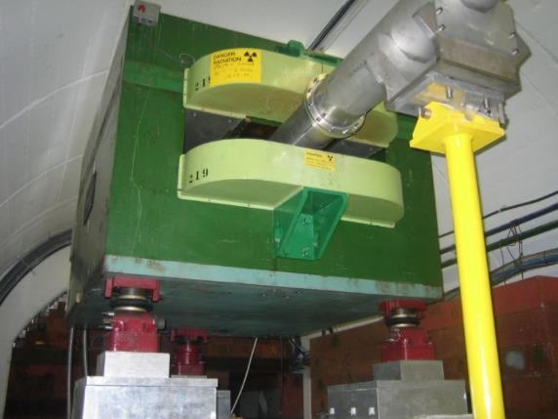
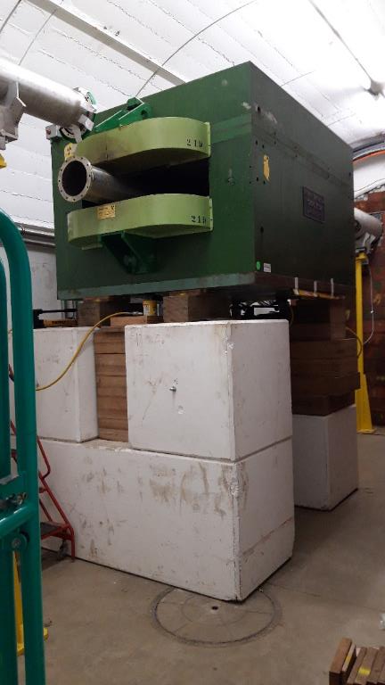
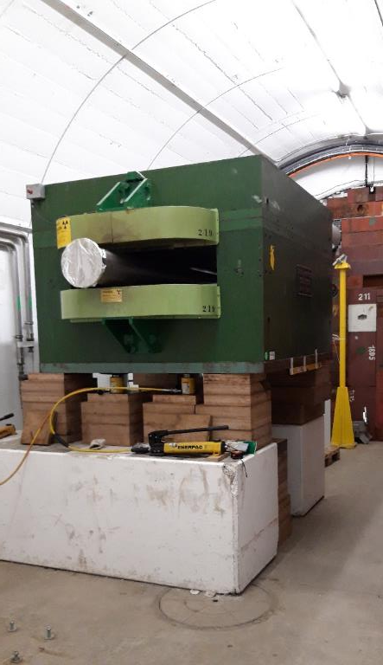
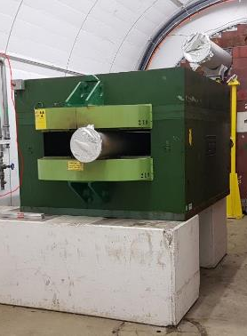
Main n_TOF LS2 activities - ongoing
Old sweeping magnet
Before lock-down in March,
now it is on the final position ready to receive the new magnet

Slide 4
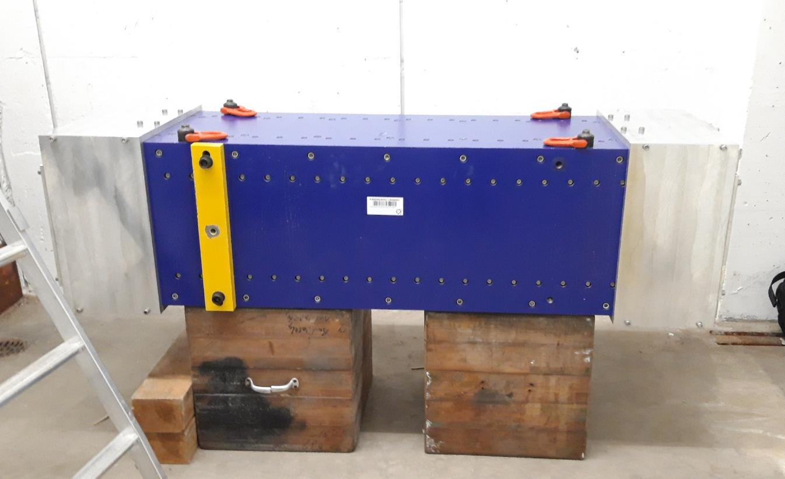
Main n_TOF LS2 activities - ongoing
New sweeping magnet
Cobalt-Samarium permanent magnet

Slide 5
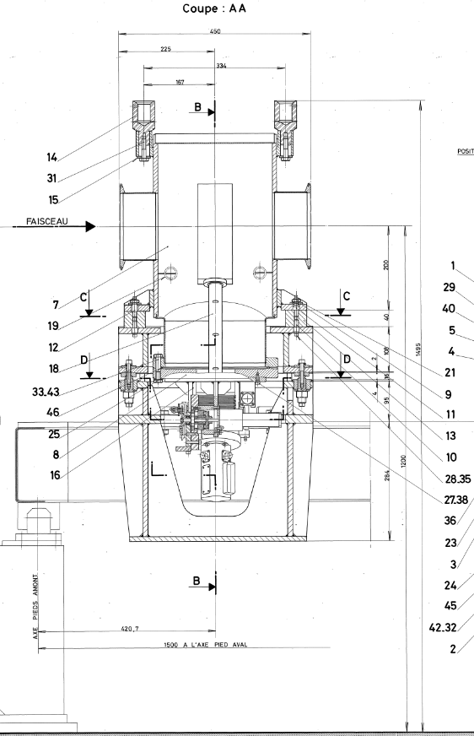
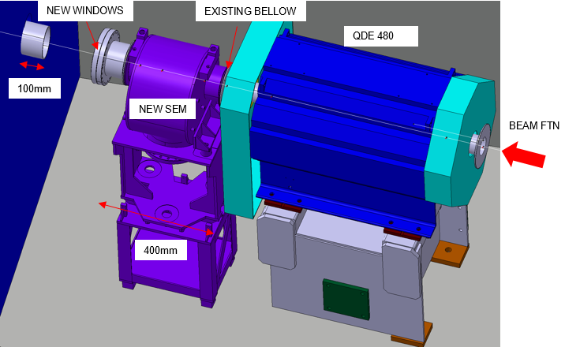
Main n_TOF LS2 activities - ongoing
New SEM grid
Chassis installed,
Cables in place in July/August
Tank installation in August, instrument in October

Slide 6
n_TOF spallation target #3
Project well in the target construction phase, having passed a series of reviews during 2018 and 2019
Going ahead with a sliced pure Pb target, cooled by N₂ flow at slightly above atmospheric pressure, ~800 m³/h
  Dedicated neutron moderation circuits, with borated water and demineralized (light) water
Matching the physics requirements of the n_TOF collaboration
On good track for target installation during November/December 2020

Slide 7
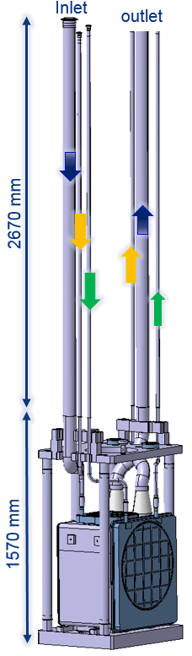
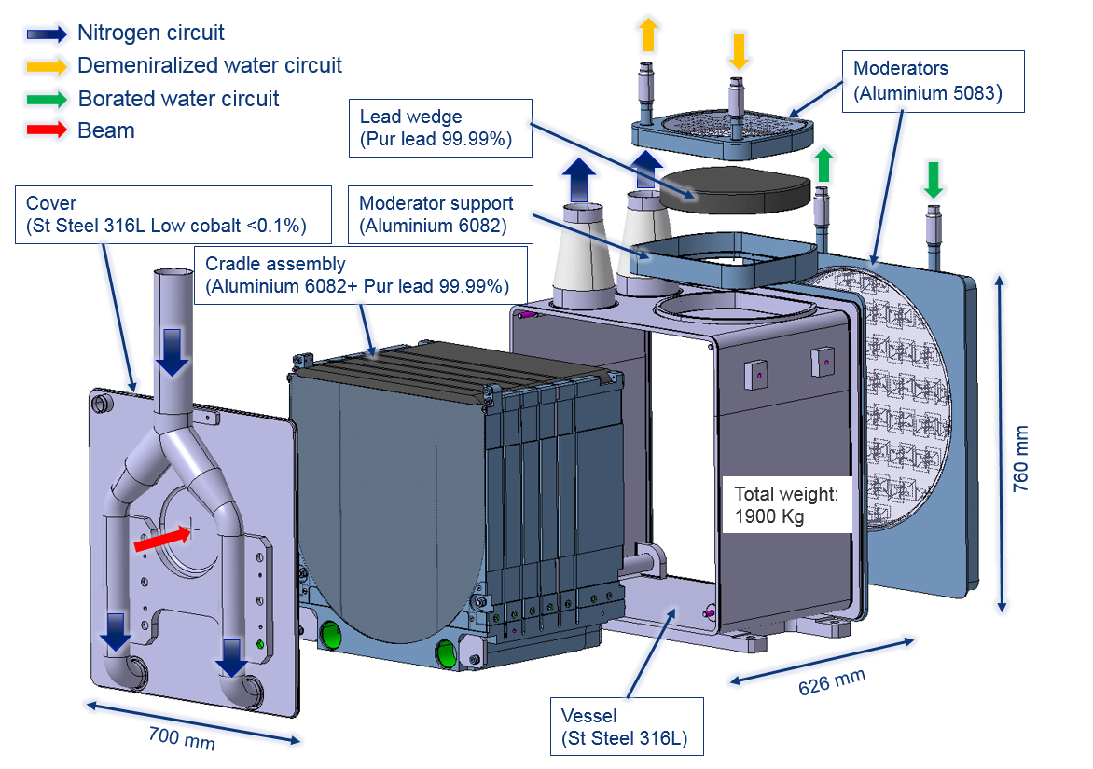
Mechanical design overview
n_TOF target #3
Production at full speed
M. Timmins & V. Maire n_TOF target #3 PRR 29-05-2019

Slide 8
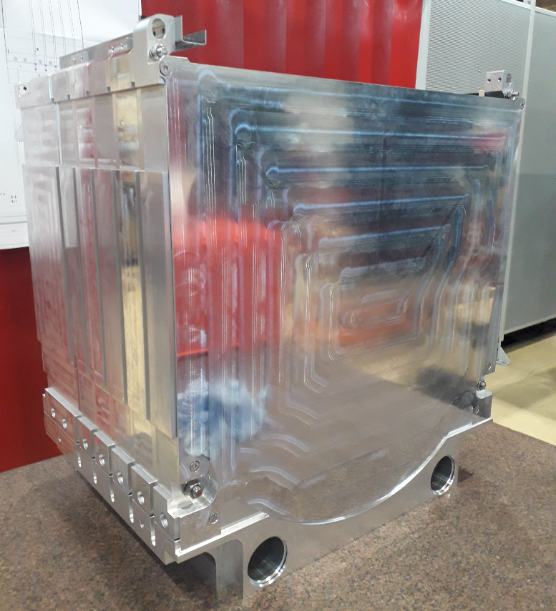
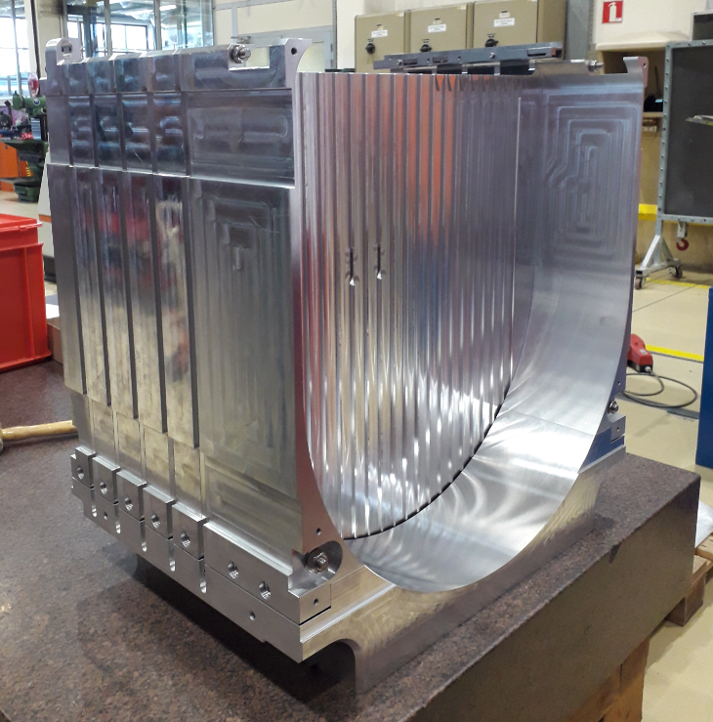
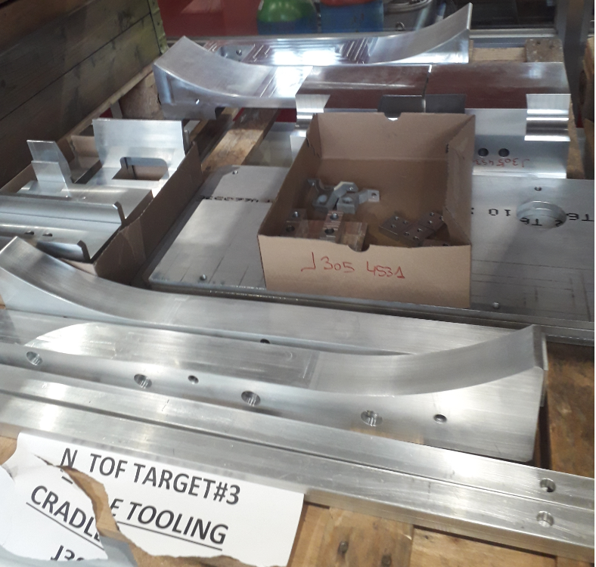
n_TOF target #3
Cradle assembly
Blank Assembly done
Metrology ongoing
Tooling for lifting & assembly finished
Courtesy T. Coiffet

Slide 9
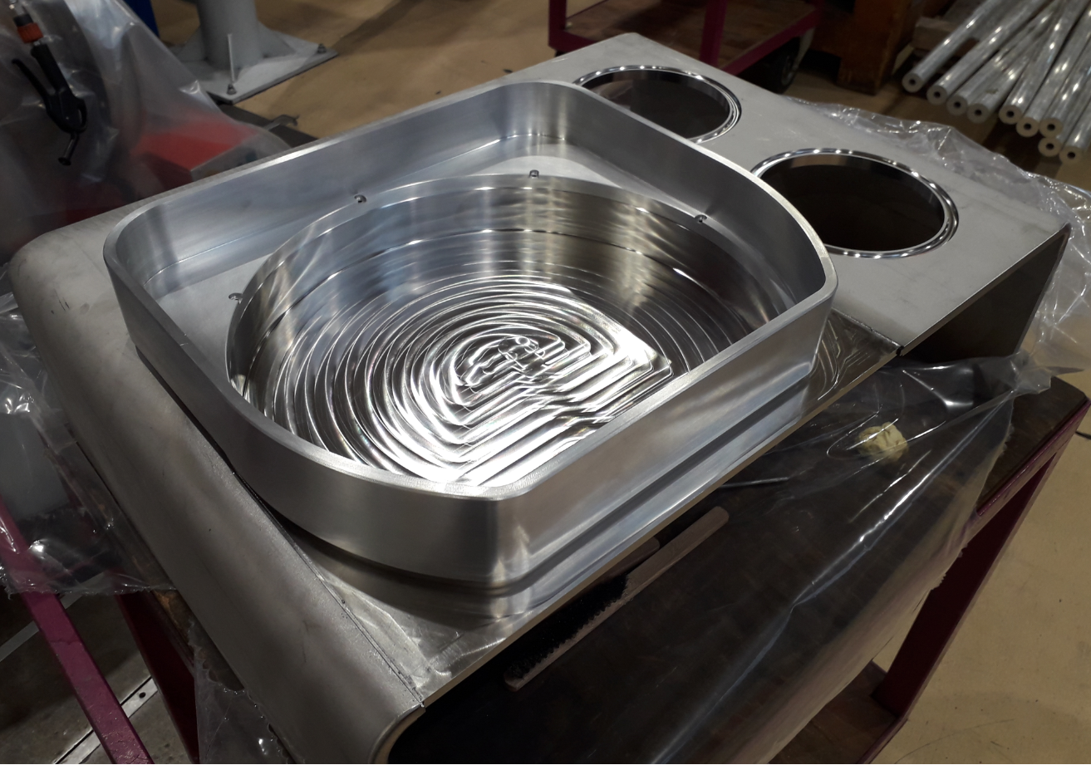
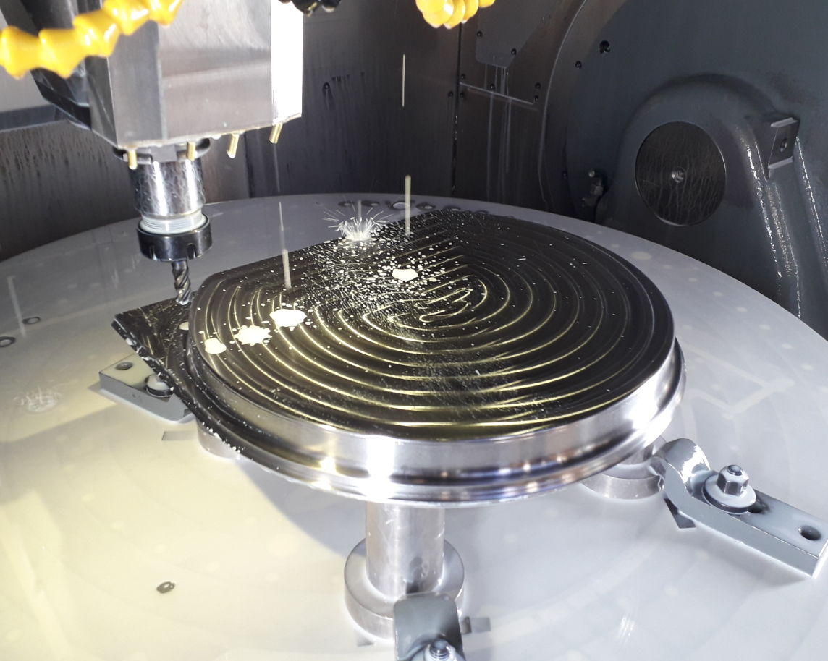
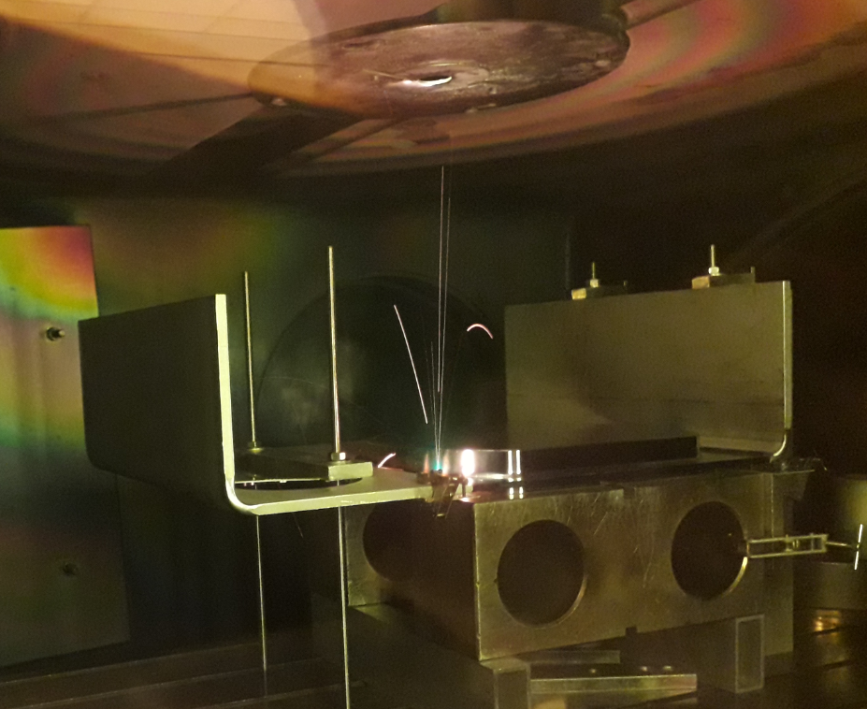
n_TOF target #3
Vessel
Upper part milling & EBW done
RT ongoing
Next Step: EBW lower part
Courtesy
T. Coiffet

Slide 10
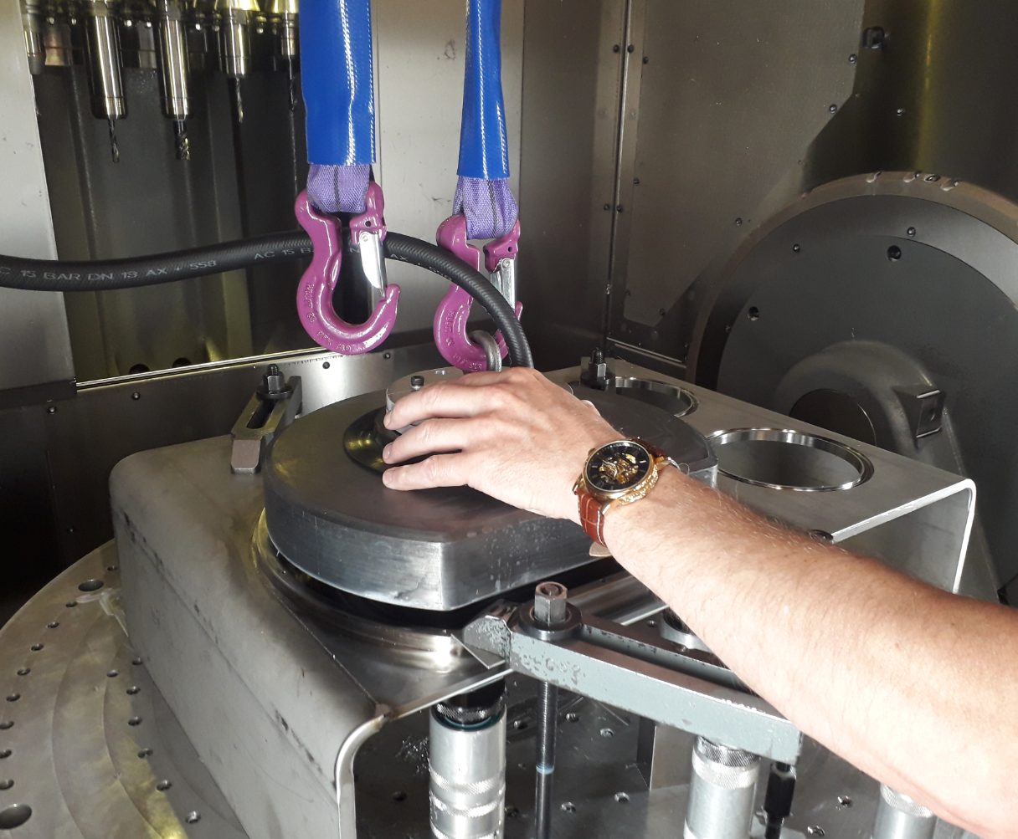
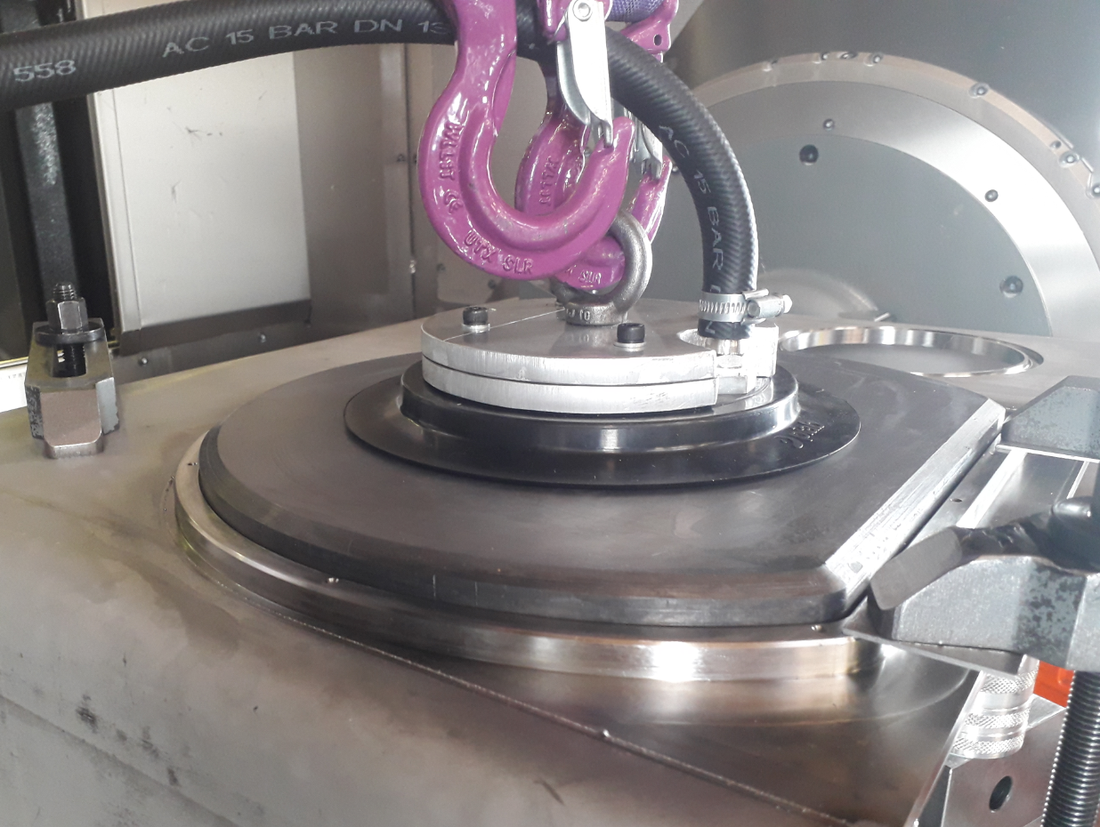
n_TOF target #3
Vessel
Lead insertion test ok
Milling the stainless-steel insert to adjust the gap
Courtesy T. Coiffet

Slide 11
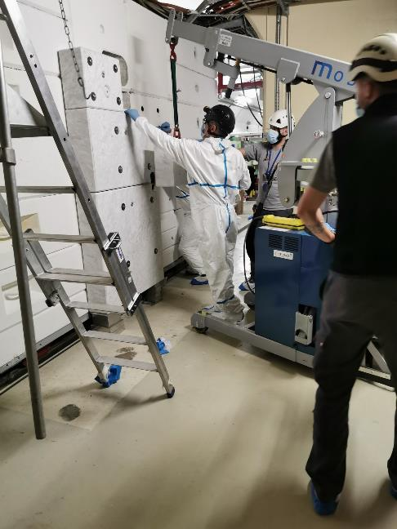
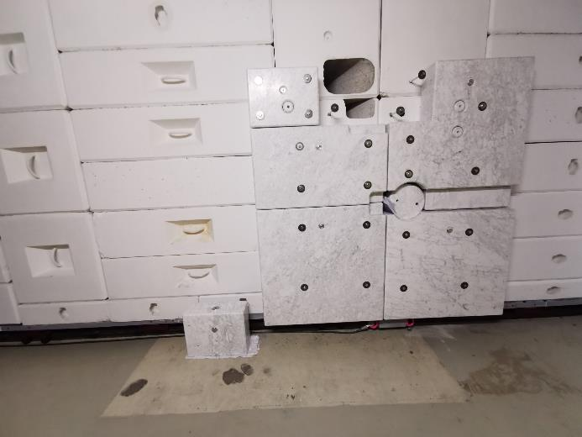
Modification of the target side shielding
Shieding wall status

Slide 12
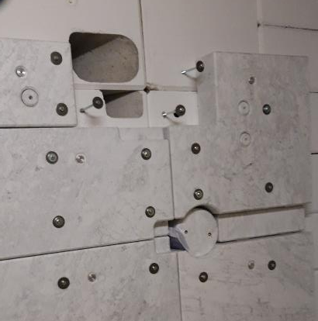
Modification of the target side shielding
Remaining actions
Installation of 2 tow bars bellow the shielding -> ½ day
Re-installation of pulley on the floor -> 1h
Change of end stop position -> 1h
Installation of drainage pipe -> 1h
Installation of shielding plates in big hole and round bars -> ½ day
Installation of remaining shielding bricks after target (~35) -> ½ day
Test of opening -> ½ day

Slide 13
n_TOF Experiment LS2 Coordination Meeting
Projects followed up until now:
  Experimental Areas Prepartion for the LS2 work. In particular,
    remove all radioactive samples and sources to be stored by RP
    Contamination control perfomed by RP confirms absence of contamination
  Cabling campaign in EAR1 (remove the old sweeping magnet cables, replace the detector cables in the rack/bunker area)
  Implementation of the ASN-OFSP safety recommandations in EAR2
  Consolidation of the gas system in EAR2, hardware installed
  Consolidation of the alignment system
  Upgrade of the n_TOF electronics laboratory and control room
  DAQ upgrade
  Consolidation and R&D program for detectors

Slide 14
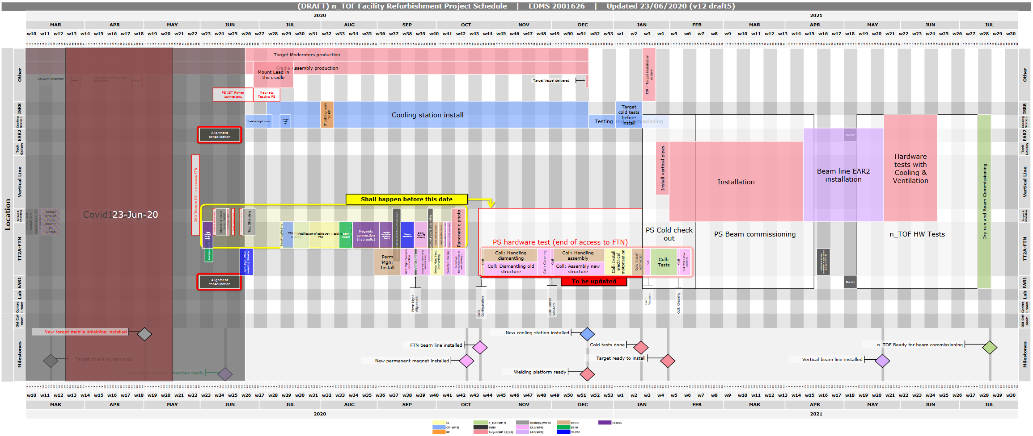
Schedule and coordination
n_TOF Facility Refurbishment Project Schedule: EDMS 2001626
Target manufacturing
Ready for beam
FTN line completion until October

Slide 15
Summary
Main activities for LS2 - Facility
  Horizontal beam line modifications ongoing
  Target production going well
  New target shielding close to completion
Restart after lock-down smooth and on track
Thank you Enrico!
Welcome Alberto

Slide 16
Thank you

