Slide 1
Nuclear moments of excited states in neutron rich Sn isotopes studied by on-line PAC
H. Haas^{1,2}, G. Georgiev³, J.G. Correia^{4,2}, A. Andreyev⁵, D.L. Balabanski⁶, J. Benito⁷, Y.Y. Cheng⁸, K. Chrysalidis², T.T. Dang⁹, A.S. Fenta¹, V. Fedosseev², L.M. Fraile⁷,
D. Galaviz¹⁰, T.J. Gray¹¹, Y. Ichikawa¹², K. Johnston², A. Kusoglu¹³, J. Ljungvall³,
D.C. Lupascu⁹, B.A. Marsh², T.J. Mertzimekis¹⁴, L.V. Rodriguez¹⁵, J. Röder^{1,2},
J. Schell^{9,2}, C. Sotty¹⁶, A.E. Stuchbery¹¹, A. Takamine¹⁷, H. Ueno¹⁷, S.G. Wilkins²,
D.T. Yordanov³
¹University of Aveiro, Portugal; ²CERN; ³IJC Lab, Orsay, France; ⁴C2TN, Universidade de Lisboa, Portugal; ⁵University of York, UK; ⁶ELI-NP, Bucharest, Romania; ⁷Complutense University, Madrid, Spain; ⁸Shanghai Jiao Tong University, Shanghai, China; ⁹CENIDE, Univ. Duisburg-Essen, Germany; ¹⁰LIP, Lisbon, Portugal; ¹¹The Australian National University, Canberra, Australia; ¹²Kyushu University, Japan; ¹³University of Istanbul, Turkey; ¹⁴Univ. of Athens, Greece; ¹⁵Max-Planck-Institut für Kernphysik, Heidelberg, Germany; ¹⁶Horia Hulubei National Institute, Bucharest, Romania; ¹⁷RIKEN Nishina Center, Japan
Spokespersons: Heinz Haas (heinz.haas@cern.ch), and Georgi Georgiev (georgi.georgiev@csnsm.in2p3.fr)
Local contact: Karl Johnston (karl.johnston@cern.ch)

Slide 2

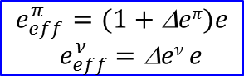





Nuclear moments – Why?
Magnetic dipole and electric quadrupole moments
  Sensitivity towards single-particle and collective properties of the nuclei
2 Q $=eπ\sum_{p=1}^{Z}{\left(3z2−r2\right)}+eν\sum_{n=1}^{N}{\left(3z2−r2\right)}$
Free-nucleon vs. effective g factors
Free-nucleon vs. effective charge
$$g_{s}^{π}= 5.58 g_{ℓ}^{π}=1$$
$$g_{s}^{ν}=−3.28 g_{ℓ}^{ν}=0$$
$$g_{s}^{π}=0.7∗g_{s}^{π} g_{ℓ}^{π}=1+\text{D}gπ$$
$$g_{s}^{ν} =0.7∗g_{s}^{ν} g_{ℓ}^{ν}=\text{D}gν$$
$$eπ=1e$$
$$eν= 0$$
$$e_{eff}^{π}=(1+\text{D}eπ)e$$
$${ e}_{eff}^{ν} =\text{D}eν e$$
Single-particle case
valence particle configuration;
core polarization (M1 excitations);
purity of the wave function
$$Q_{I}=\frac{2j+1−2n}{2j−1}Q_{j}$$
valence orbital occupation n;
collective properties;
nuclear deformation
additivity rule
$g= \frac{g_{1}+g_{2}}{2}$ + $\frac{g_{1}−g_{2}}{2}∗\frac{I_{1}\left(I_{1}+1\right)−I_{2}(I_{2}+1)}{I(I+1)}$
additivity: I₁xI₂ coupling,
simple addition if stretched

Slide 3
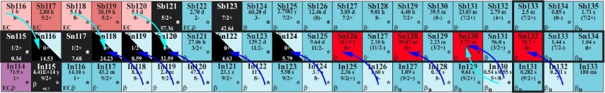
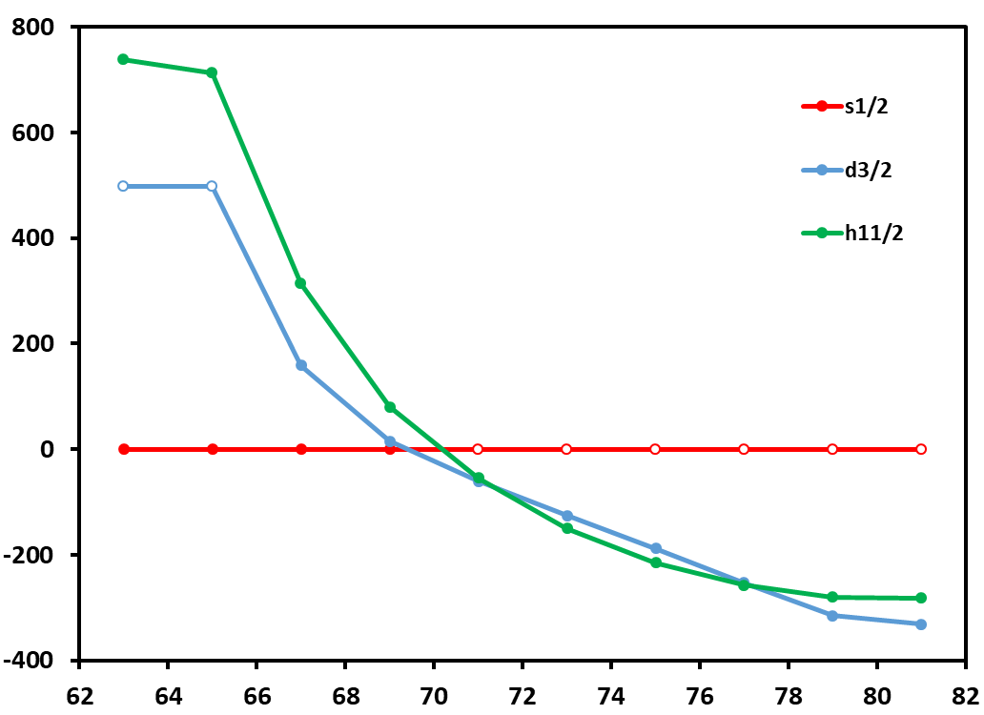
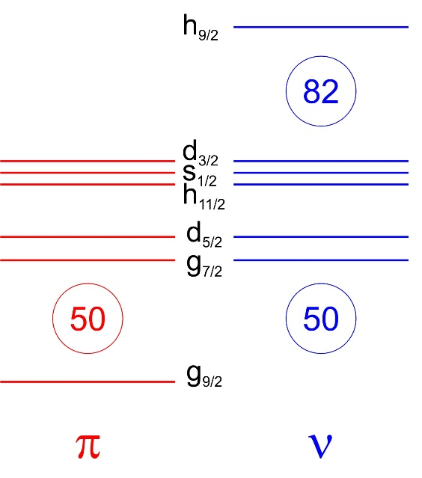
The area of the present proposal – neutron-rich Sn
Single-particle (hole) states in odd Sn
Most nuclear moments of the single-particle states have been determined, primarily by COLLAPS [D.T. Yordanov et al., Comm. Phys. 3, 107 (2020)]
μ for heavier s_{1/2} not measurable !

Slide 4
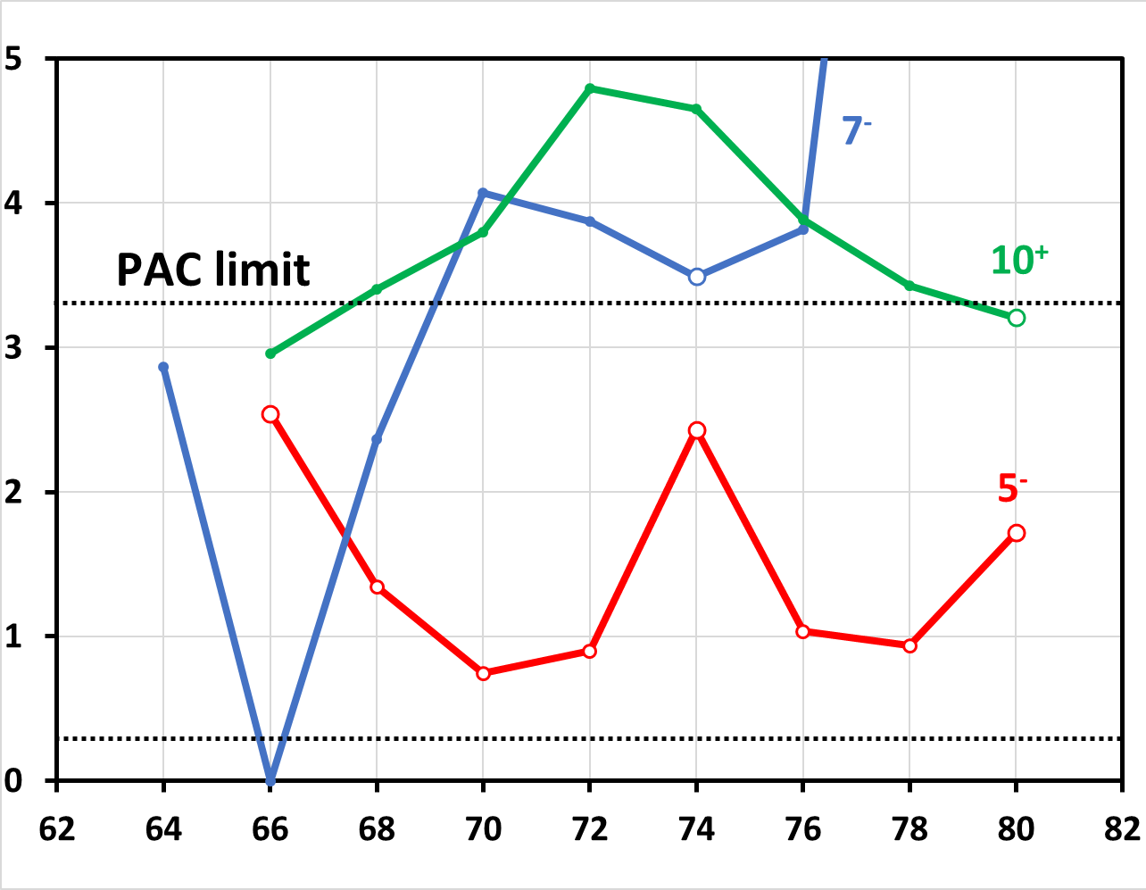
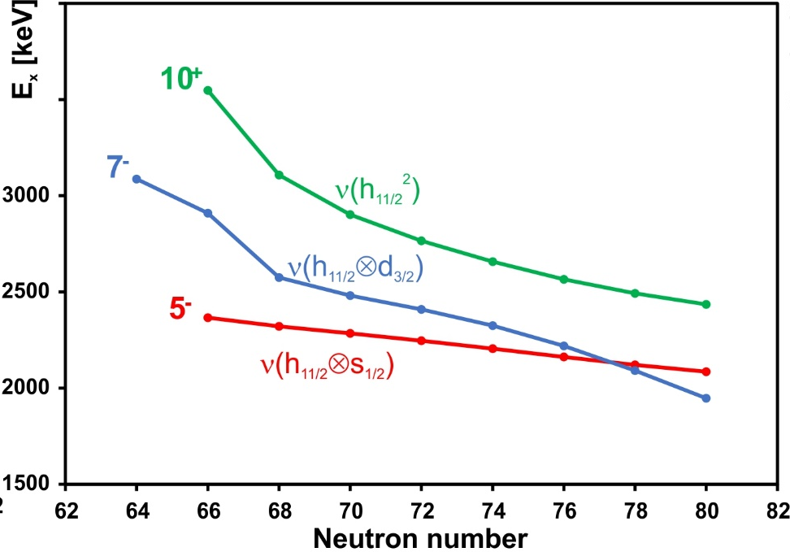
Subject of the present proposal: two-quasi-particle states
Probing the interaction between the neutron h_{11/2}, d_{3/2} and s_{1/2} orbitals at Z=50
Excitation energies
Half-lives
Our aim – test nuclear coupling concept (the additivity rule) for a chain of semi-magic (Sn) nuclei, a textbook case ?
The magnetic dipole and electric quadrupole moments of the 5⁻, 7⁻ and 10⁺ states in a chain of Sn isotopes would
provide a very stringent test of the nuclear models and demonstrate simple textbook concepts of nuclear physics
does the simple SM picture work or what could we learn?
indirect information on s_{1/2} moments through 5⁻ states !

Slide 5
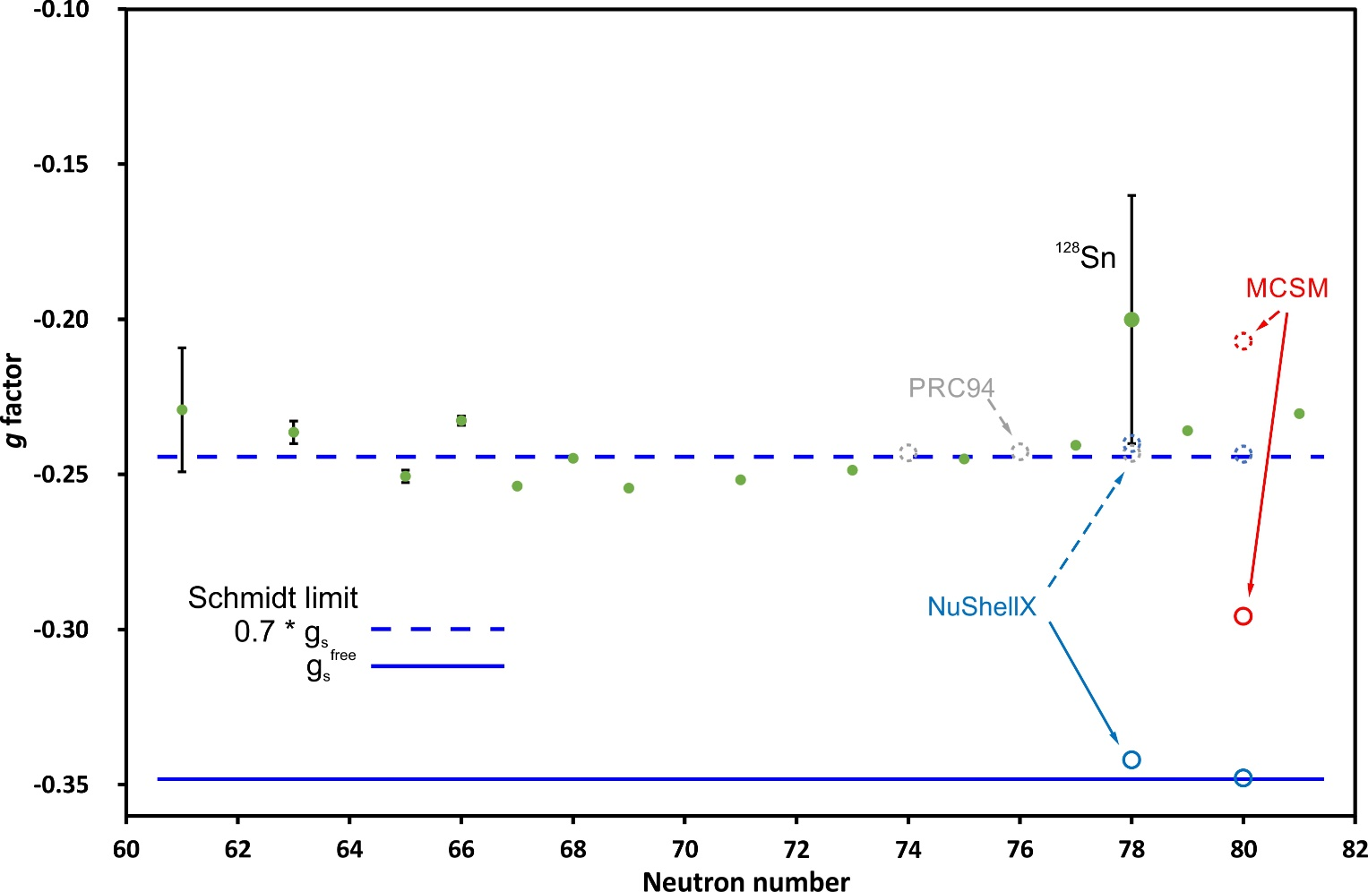
Unexpected results from RIKEN on ¹³⁰Sn 10⁺
Gyromagnetic factors of the 11/2⁻ states (also including
the 10⁺ in ¹¹⁶Sn) are quasi constant over the large range
of neutron numbers. The only exception 10⁺ in ¹²⁸Sn
(reported with a large error-bar). They are all very close
to the effective Schmidt line (g_{s} = 0.7*g_{s}^{free})
Different theoretical calculations reproduce those, using
effective g factors.
10⁺ state in ¹³⁰Sn should have the most pure configuration
(high spin; no possible mixing below the shell closure)

Slide 6
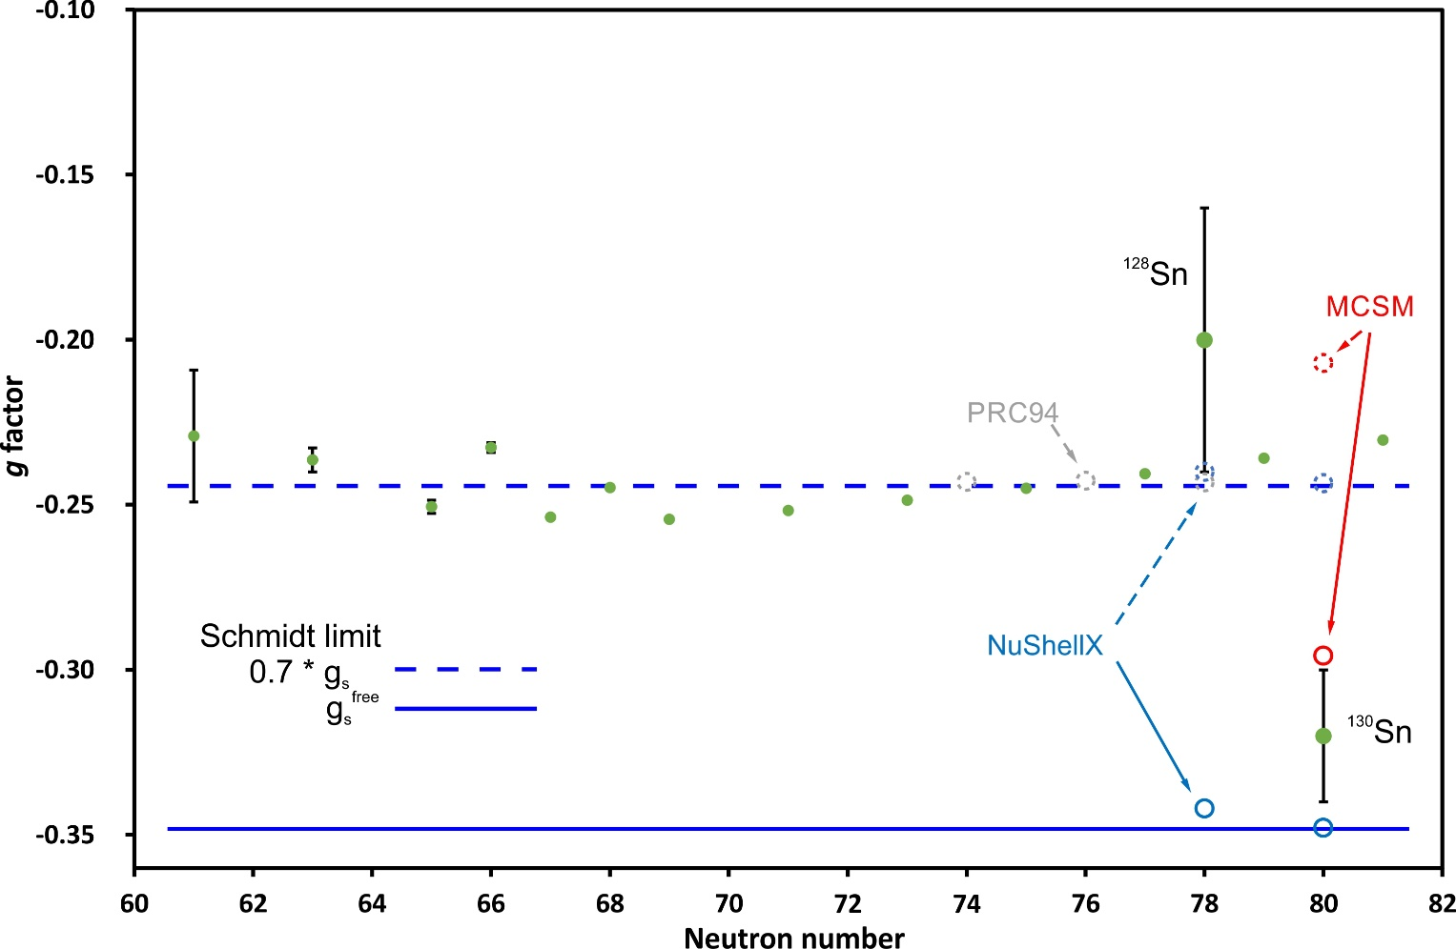
Unexpected results from RIKEN on ¹³⁰Sn 10⁺
Gyromagnetic factors of the 11/2⁻ states (also including
the 10⁺ in ¹¹⁶Sn) are quasi constant over the large range
of neutron numbers. The only exception 10⁺ in ¹²⁸Sn
(reported with a large error-bar). They are all very close
to the effective Schmidt line (g_{s} = 0.7*g_{s}^{free})
Different theoretical calculations reproduce those, using
effective g factors.
10⁺ state in ¹³⁰Sn should have the most pure configuration
(high spin; no possible mixing below the shell closure)
A recent study at RIBF, RIKEN of the 10⁺ isomer in ¹³⁰Sn indicates a g factor very close to the free Schmidt value. Is this
another example that the “effective values” are due to shortcomings in theory rather then having any robust physical
meaning? (see e.g. P. Gysbers et al., Nature Physics 15, 428 (2019))
The unexpected RIKEN result (done with very poor statistics) needs reconfirmation beyond any doubts!

Slide 7
The on-line PAC technique
From the experimental perturbation pattern one extracts
ν_{L} = μ/I * B / h
Magnetic field B from external
magnet or ferromagnetic solid
ν_{Q} = e Q * Vzz / h
Electric field gradient Vzz in non-cubic
solid (from theory!) or reference isotope

Slide 8
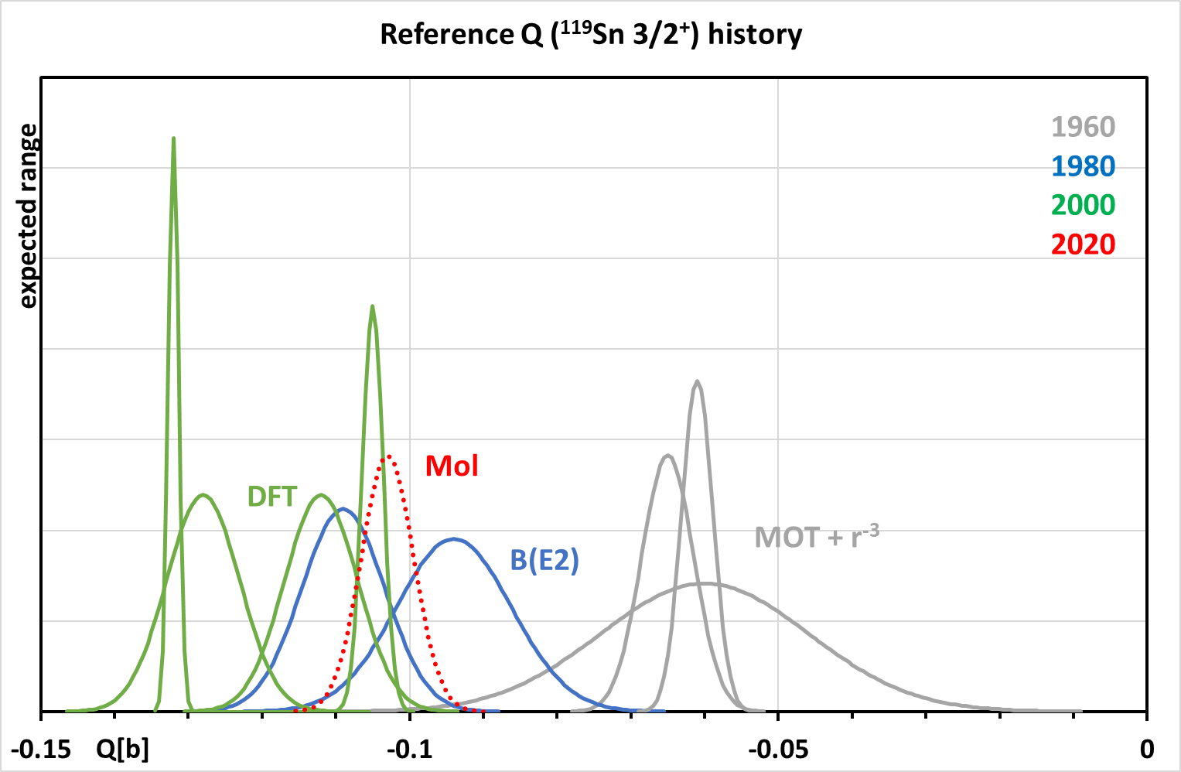
We shall clear up most of this mess !

Slide 9
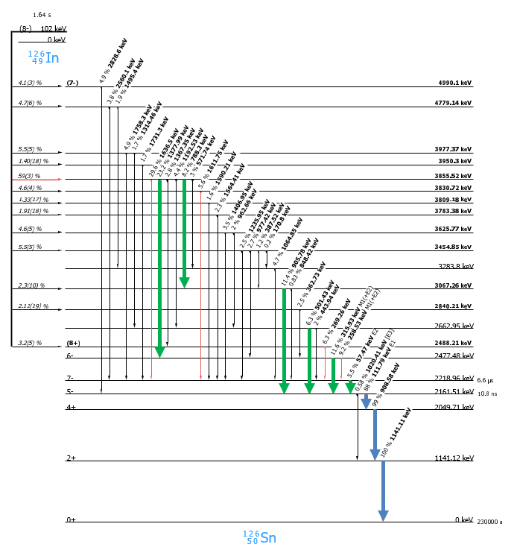
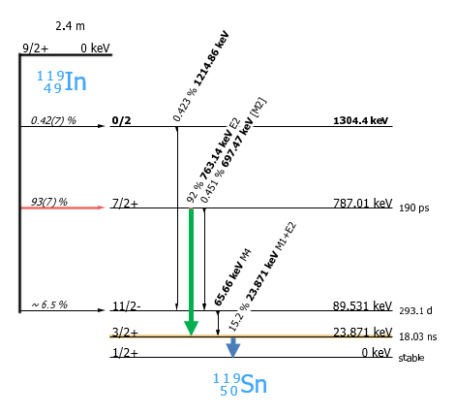
Complex decay scheme
requires multi-dimensional on-line
storage and off-line analysis
Simple decay scheme
for testing of target materials and effects of implantation damage

Slide 10
The test program using ¹¹⁹In ¹¹⁹Sn 3/2⁺
Experiment:
Test indium implantation into Zn single crystal,
study damage effect as function of temperature
Measure precision value for QI at one optimal T
Test indium implantation into graphite
or alternatives S, Se
Check effect of implantation damage in Fe at RT
Purpose:
Find optimal temperature for on-line
experiments with 5⁻ states
Find Q ratio to ¹¹⁶Sn 5⁻
Find optimal matrix for short-lived 5⁻
cases
Understand origin of spectral damping

Slide 11
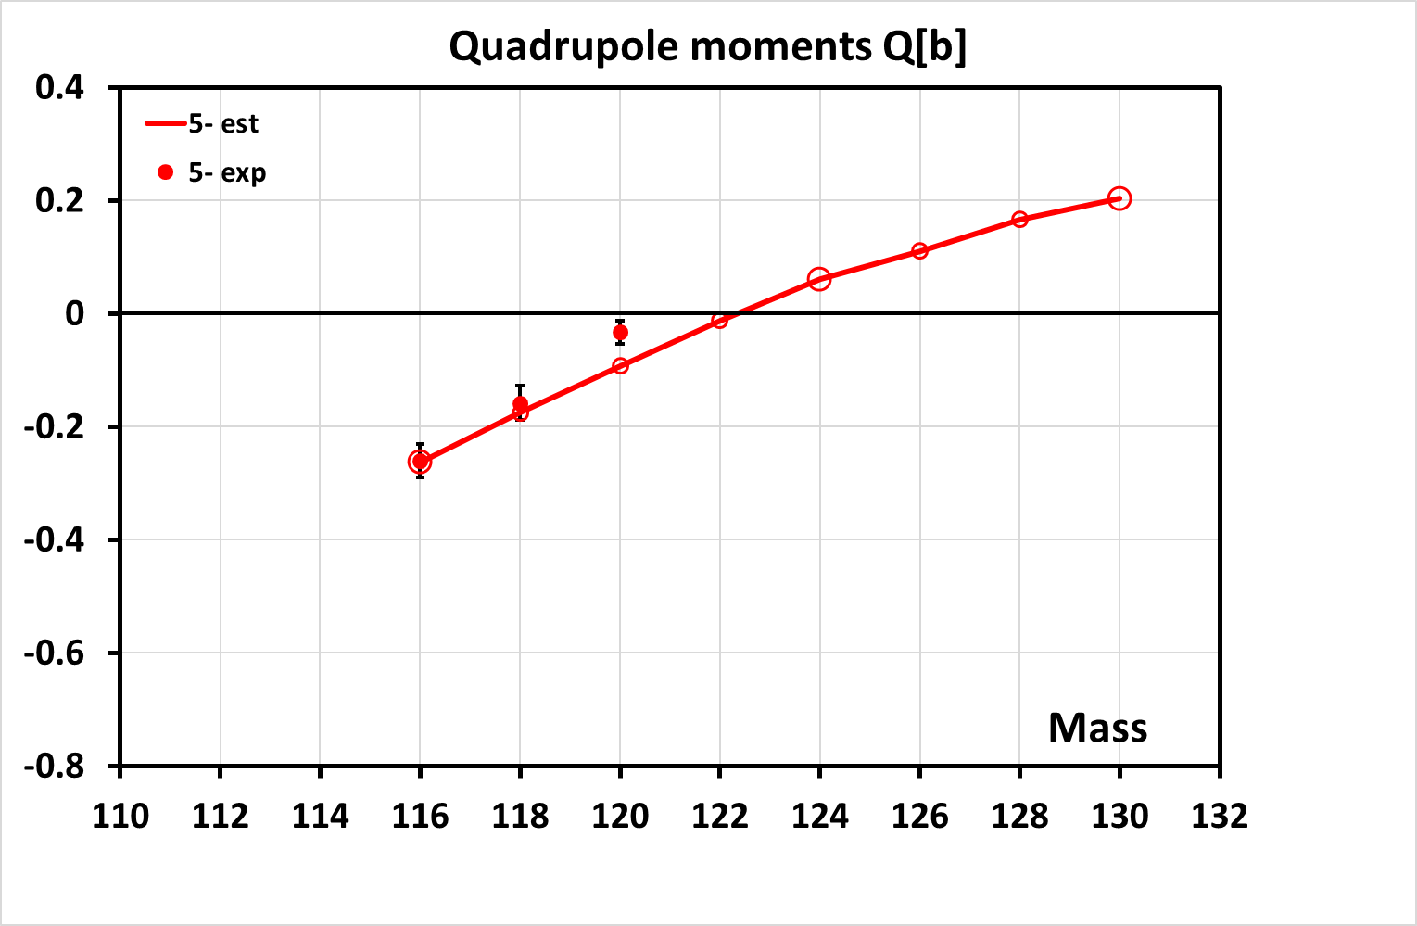
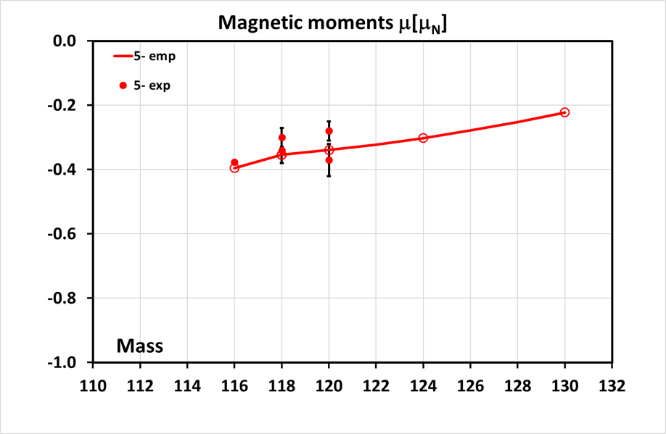
The 5⁻ states
Quadrupole moments expected
identical to 11/2⁻ state in ^{A+1}Sn
Magnetic moments as coupling of
μ(11/2⁻) and μ(1/2⁺) in ^{A+1}Sn

Slide 12
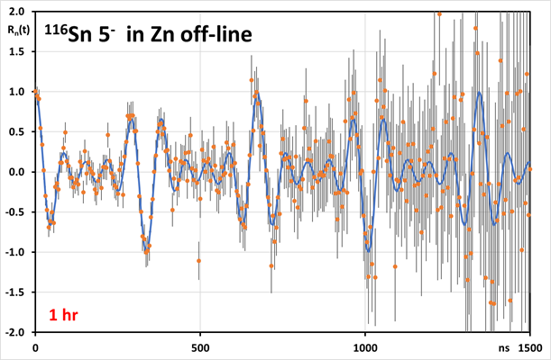
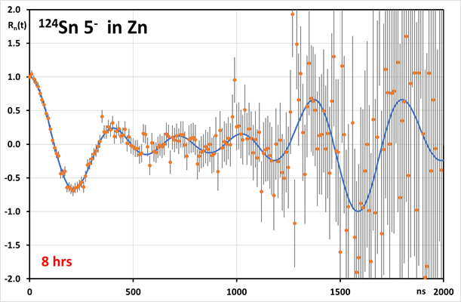
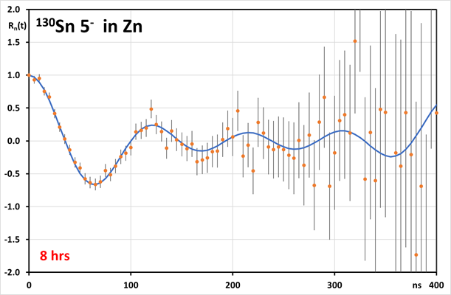
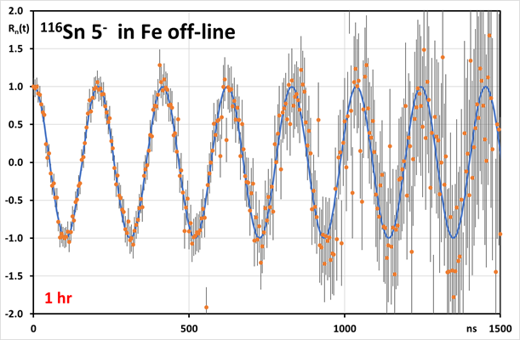
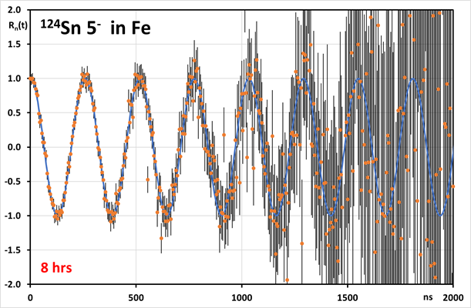
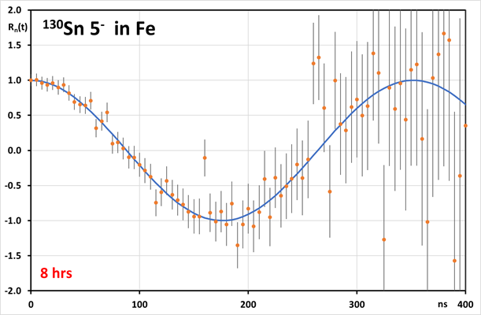
Simulated spectra for long-lived 5⁻ states
note different running times!

Slide 13
The off-line program for 5⁻ states with Sb sources
using 4-5 existing PAC spectrometers of solid-state collaboration
QI (temperature) for ¹¹⁶Sn in Zn after annealing (at least 2 points)
QI for ¹¹⁶Sn in In for precise Vzz
QI for ¹¹⁸Sn in Zn for precise Q
Test implantation of ¹¹⁸Sb into graphite
QI for ¹²⁰Sn in graphite to obtain Q
MI at RT for ¹¹⁶Sn in Fe after annealing for precise B_{hf}
MI for ¹¹⁶Sn in Ni at 200C
MI for ¹¹⁸Sn in Fe for precise μ
Test implantation of ¹¹⁸Sb into Gd
MI for ¹²⁰Sn in Gd to obtain μ

Slide 14
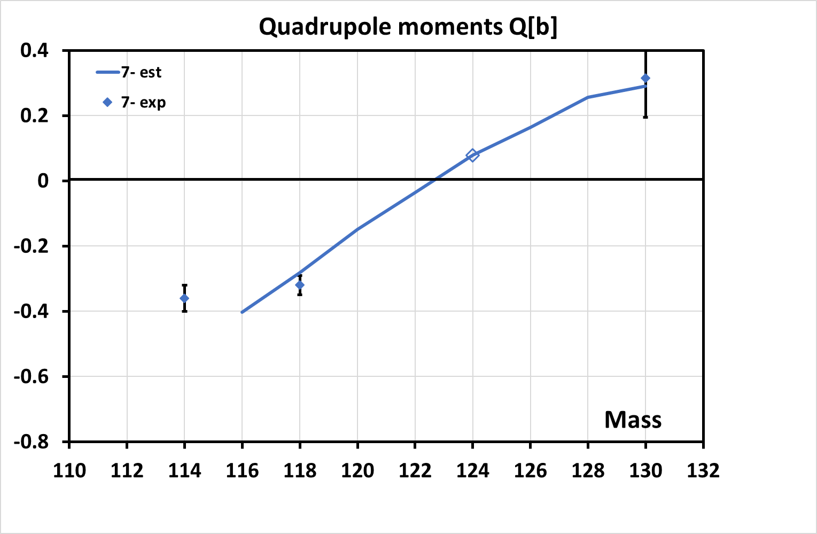
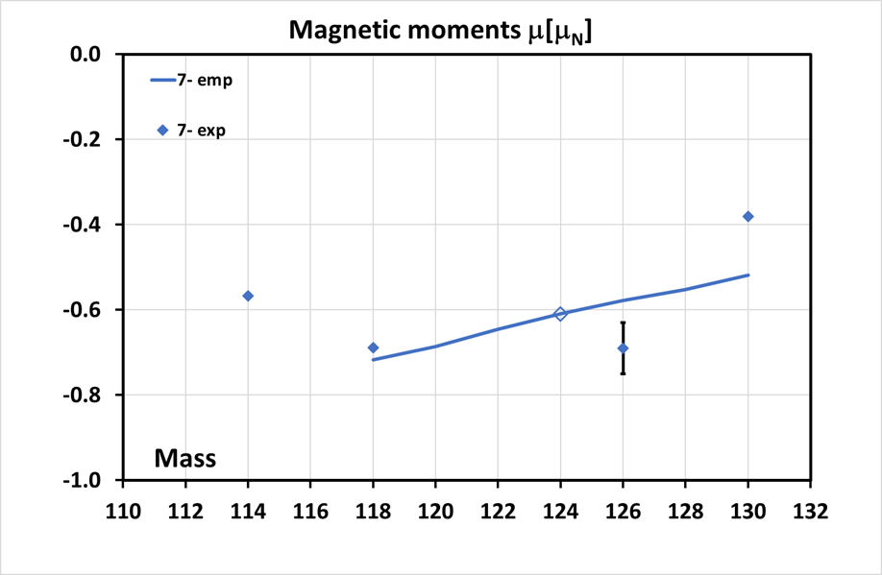
The 7⁻ states
Quadrupole moments as coupling of
Q(11/2⁻) and Q(3/2⁺) in ^{A+1}Sn
Magnetic moments as coupling of
μ(11/2⁻) and μ(3/2⁺) in ^{A+1}Sn

Slide 15
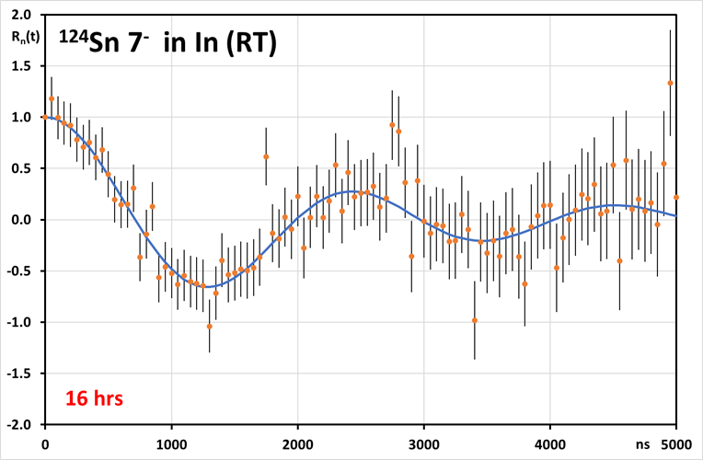
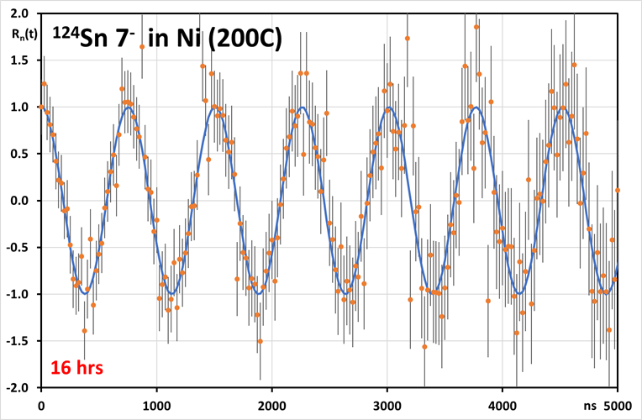
Simulated spectra for long-lived 7⁻ state in ¹²⁴Sn
A fortunate case: Due to small Q expected and favorable decay characteristics PAC feasible in spite of long t_{1/2} (3.1 μs)

Slide 16
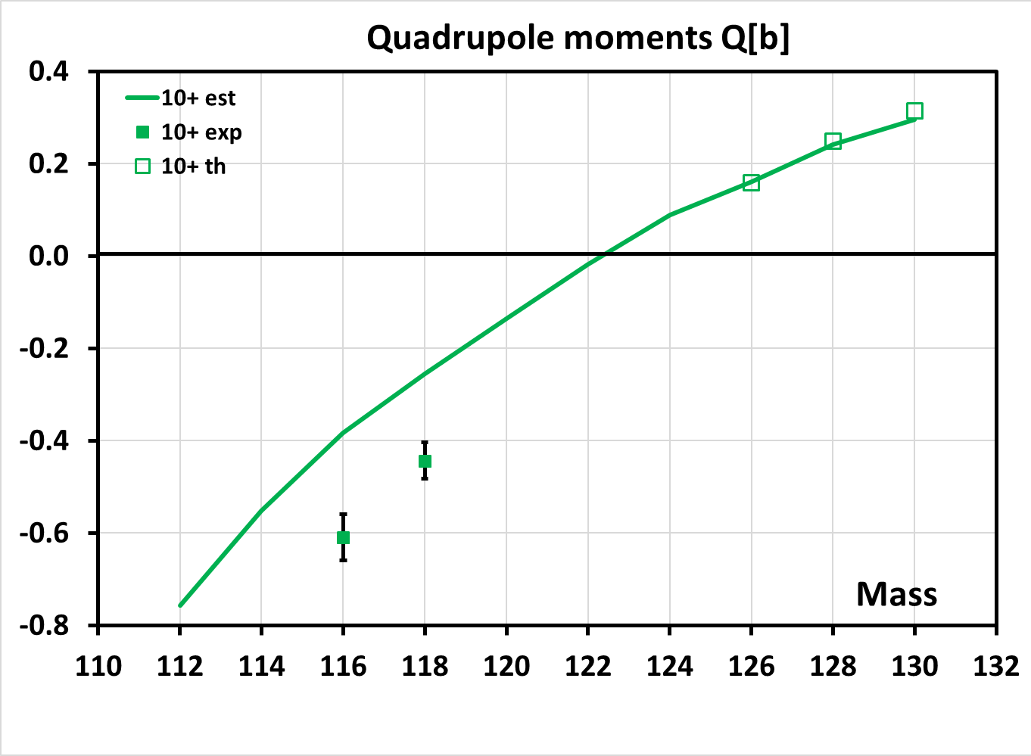
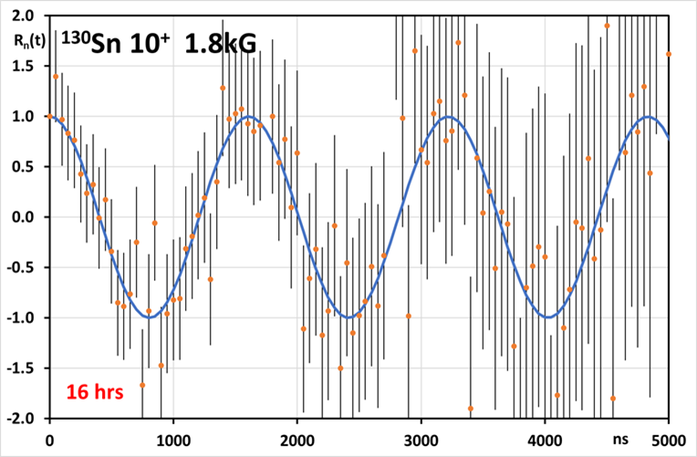
10⁺ state in ¹³⁰Sn
Should have a very pure h_{11/2}² configuration
Also 8⁺ state will be virtually pure h_{11/2}²
B(E2) will give the most precise value for Q
Thus: Measuring QI (in In) for new reference!
However: Difficult to estimate run time
Therefore: Postpone until after MI experiment!
Check of preliminary
RIKEN results for μ:
Simulated spectrum for
measurement in magnet
Acceptable accuracy reachable!

Slide 17
Required beamtimes
ISOLDE beam, UC/RILIS |  |  |  |  | State of interest |  |  | Experiment
 | Ip | t1/2 [s] | Approx. int. [at/µC] | Required int. [at/sec] |  | Ip | t1/2 [ns] | measure | host | shifts
¹¹⁹In | 9/2⁺ | 144 | 4x10⁷ | 2x10⁶ | ¹¹⁹Sn | 3/2⁺ | 18 | Q, μ | Zn,C,S,Fe | 3
^{118m}In | 8⁻ | 8.1 | 5x10⁷ | 1x10⁶ | ¹¹⁸Sn | 5- | 22 | Q | C | 1
^{120m}In | 8⁻ | 47.3 | 5x10⁷ | 1x10⁶ | ¹²⁰Sn | 5- | 5.5 | Q | C | 1
^{122m}In | 8- | 11 | 2x10⁸ | 1x10⁶ | ¹²²Sn | 5- | 7.9 | Q | C | 1
^{124m}In | 8⁻ | 3.7 | 4x10⁷ | 1x10⁶ | ¹²⁴Sn | 5⁻ | 270 | Q, μ | Zn,Fe | 2
^{126m}In | 8⁻ | 1.6 | 7x10⁶ | 1x10⁶ | ¹²⁶Sn | 5⁻ | 11 | Q | C | 1
^{128m}In | 8⁻ | 0.72 | 3x10⁶ | 1x10⁶ | ¹²⁸Sn | 5⁻ | 8.6 | Q | C | 1
^{130m}In | 5⁺ | 0.54 | 1x10⁵ | 2x10⁵ | ¹³⁰Sn | 5⁻ | 52 | Q, μ | Zn,Fe | 4
¹³²In | 7⁻ | 0.2 | 1x10⁴ | 4x10⁴ | ¹³²Sn | 6⁺ | 21.3 | μ | Fe | 2
^{124m}In | 8⁻ | 3.7 | 4x10⁷ | 5x10⁵ | ¹²⁴Sn | 7⁻ | 3100 | Q, μ | In,Ni | 4
^{130m}In | 10⁻ | 0.55 | 1x10⁵ | 2x10⁵ | ¹³⁰Sn | 10⁺ | 1610 | μ | Cu | 3
^{116m}Sb | 8⁻ | 1h | 5x10⁷ | 2x10^{10a)} | ¹¹⁶Sn | 5⁻ | 320 | Q, μ | Zn,In,Fe,Ni | 2
^{118m}Sb | 8⁻ | 5.1h | 1x10⁸ | 4x10^{10a)} | ¹¹⁸Sn | 5⁻ | 22 | Q, μ | Zn,C,Fe,Gd | 1
¹²⁰Sb | 8⁻ | 5.8d | 2x10⁸ | 2x10^{11a)} | ¹²⁰Sn | 5⁻ | 8 | Q | C,Gd | 1
On-line
23
Off-line
4

Slide 18
Slides for discussion

Slide 19
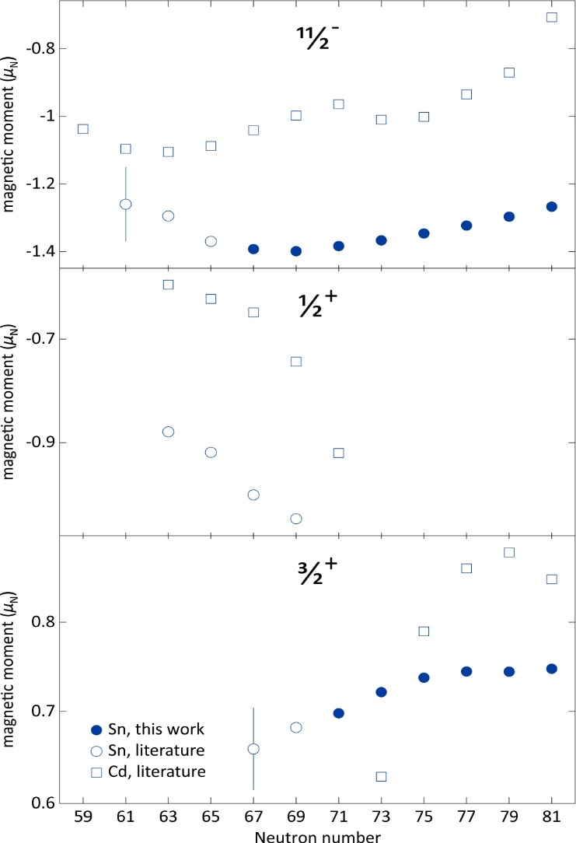
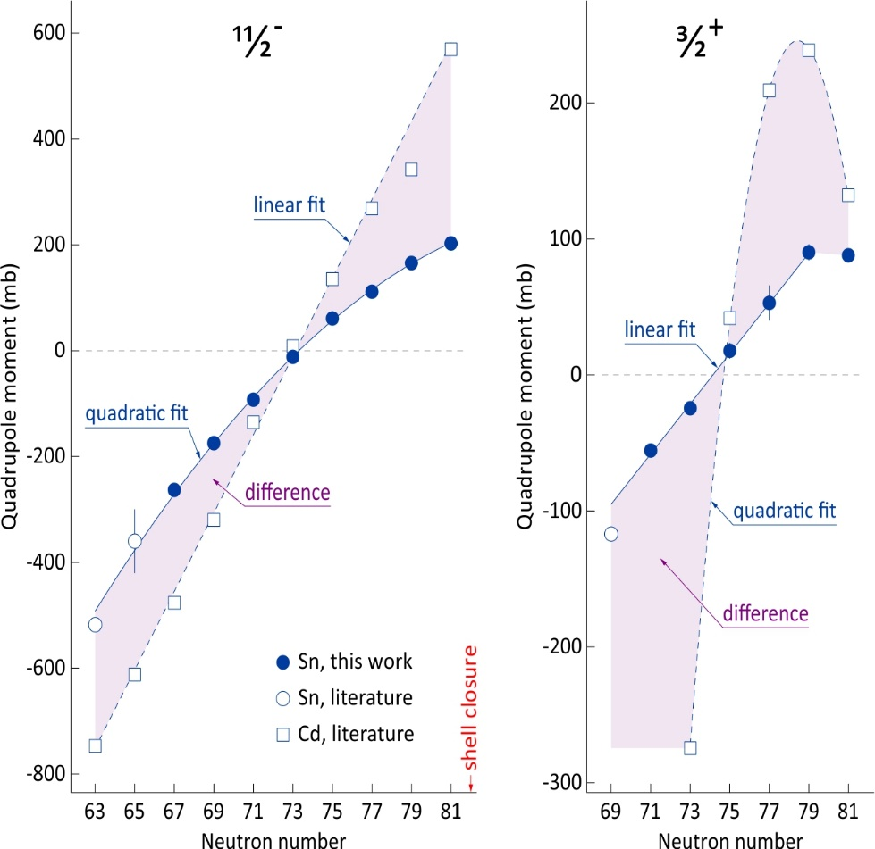
Sn results from COLLAPS
Recent results from laser spectroscopy of odd-mass Sn isotopes from COLLAPS: D.T. Yordanov et al., Comm. Phys. 3, 107 (2020) – magnetic and quadrupole moments and r.m.s. radii for odd-mass Sn isotopes
The magnetic and the quadrupole moments of the s.p. states have been determined!
Our aim – test the additivity rule for a chain of semi-magic (Sn) nuclei → does the simple SM picture work or what could it teach us?

Slide 20
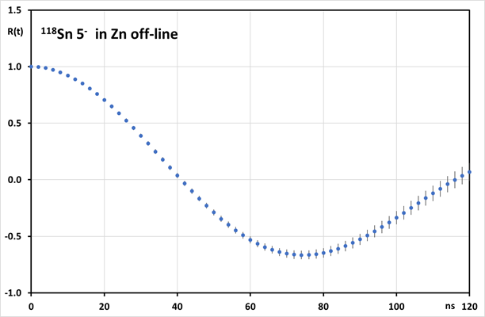
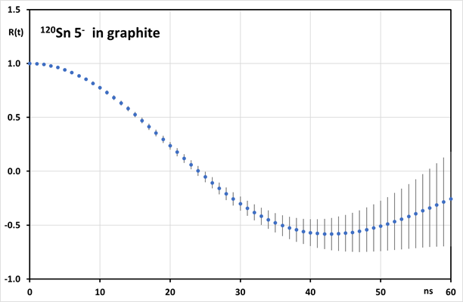
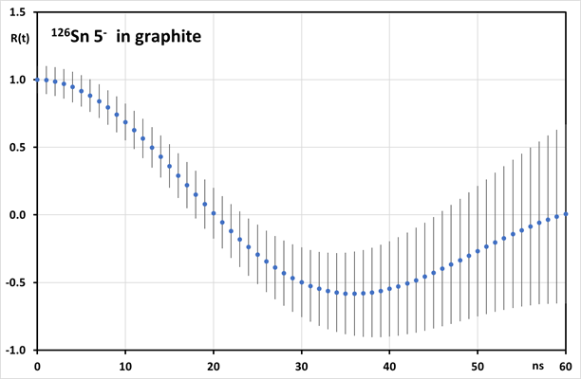
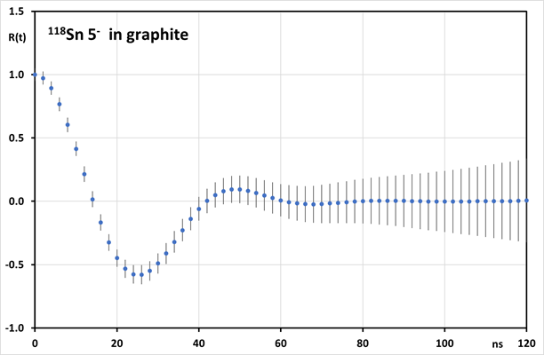
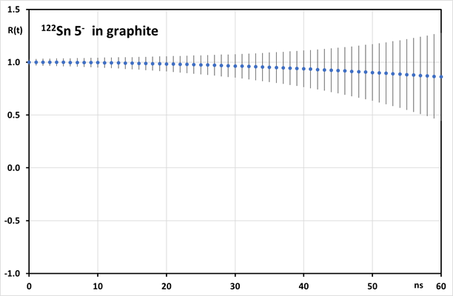
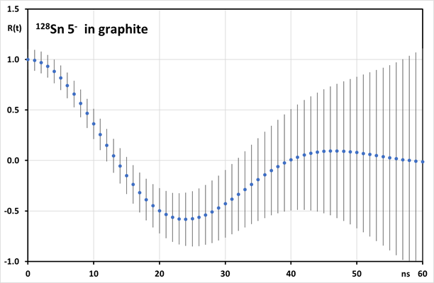
Expected spectra for short-lived 5⁻ states

Slide 21
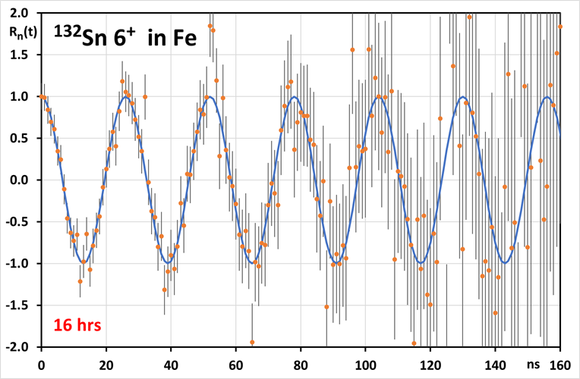
Simulated spectrum for 6⁺ state in ¹³²Sn

Slide 22
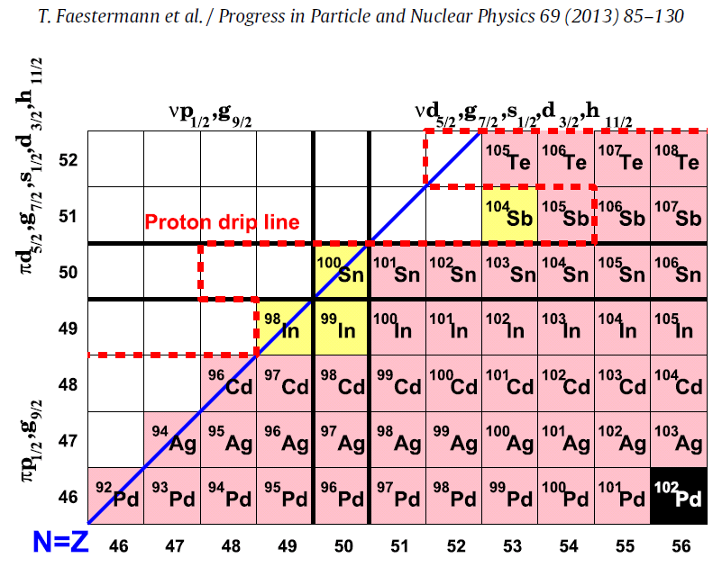
Gamow-Teller β decay of ¹⁰⁰Sn (Z,N=50)
(¹⁰³Sb)
⁹⁹Sn
⁹⁷In
⁹⁵Cd
⁹³Ag
D. Lubos et al., Phys Rev. Lett. 122, 222502 (2019)
P. Gysbers et al., Nature Physics 15, 428 (2019)

Slide 23
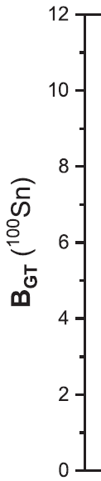
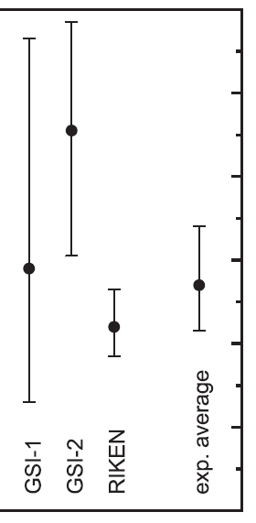

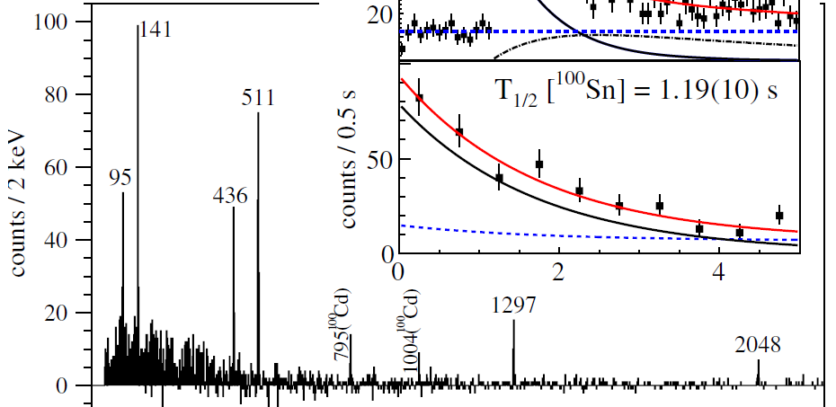
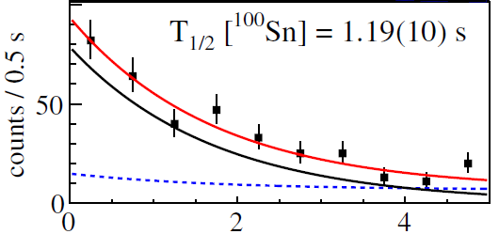


Gamow-Teller β decay of ¹⁰⁰Sn (Z,N=50)
D. Lubos et al., Phys Rev. Lett. 122, 222502 (2019)
P. Gysbers et al., Nature Physics 15, 428 (2019)

Slide 24
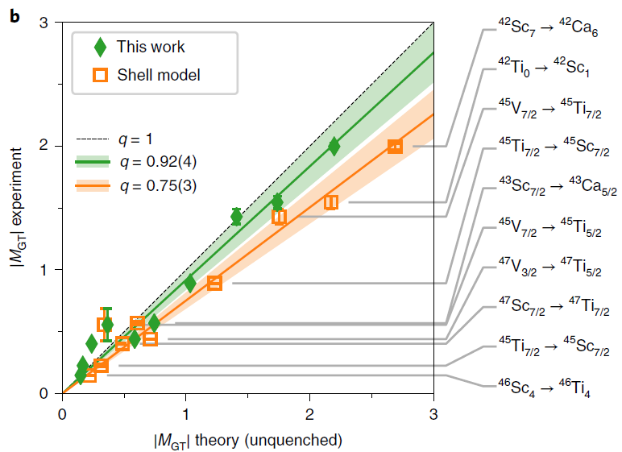
Gamow-Teller β decay of ¹⁰⁰Sn (Z,N=50)
Discrepancy between exp. and theoretical β decay rates, g_{A} (1,27) quenched ~ 0.75 (e.g. Towner “Quenching of spin matrix elements in nuclei” Phys. Rep. 155 (1987)), is without first-principle explanation
Combining EFT of the strong and the weak forces with quantum many-body techniques explains the discrepancy
P. Gysbers et al., Nature Physics 15, 428 (2019)

Slide 25
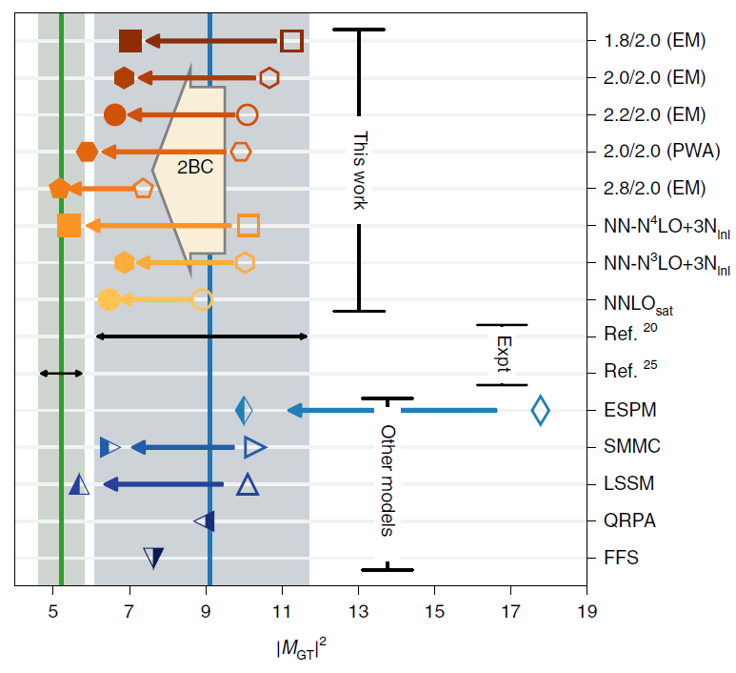
Gamow-Teller β decay of ¹⁰⁰Sn (Z,N=50)
Discrepancy between exp. and theoretical β decay rates, g_{A} (1,27) quenched ~ 0.75 (e.g. Towner “Quenching of spin matrix elements in nuclei” Phys. Rep. 155 (1987)), is without first-principle explanation
Combining EFT of the strong and the weak forces with quantum many-body techniques explains the discrepancy
¹⁰⁰Sn
P. Gysbers et al., Nature Physics 15, 428 (2019)

