Slide 1


Nuclear Structure of Odd-Au Isotopes
Martin Venhart
Department of Nuclear Physics, Institute of Physics, Slovak Academy of Sciences
John L. Wood
Georgia Institute of Technology, Atlanta, Georgia, USA
On behalf of
IS521 collaboration

Slide 2
How can we use odd-Au isotopes to understand the structure of Hg and Pt?
An odd particle acts as a probe of the core
  Information on independent particle states
  Information on deformation: axial and triaxial shapes
  Information on pairing from blocking
  Identification of intruder states free of mixing
  Information on rotational collectivity
Need of beta decay studies - non-yrast states
Need of in-beam studies - rotational bands
One way how to probe even-even cores
Martin Venhart: Structure of Odd-Au Isotopes
64th meeting of the INTC

Slide 3
Particle-core coupling: 0th order model to navigate the data
J. Meyer-ter-Vehn et al., Phys. Rev. Lett. 32, 1383 (1974).
Martin Venhart: Structure of Odd-Au Isotopes
64th meeting of the INTC

Slide 4
Particle-core coupling: 0th order model to navigate the data
Martin Venhart: Structure of Odd-Au Isotopes
64th meeting of the INTC

Slide 5
Broader picture of studies of odd-Au isotopes
Done at ISOLDE so-far: structure of ^{181,183}Au (4 publications, 1 PhD., 2 master and 3 bachelor theses)
In-beam gamma-ray studies performed at the University of Jyvaskyla and at iThemba Labs
Newly discovered K isomerism in light Au isotopes (unpublished) – new research program is starting
Lifetimes measurements are foreseen
These studies complement decay studies at ISOLDE
Our work has implications on understanding of even-even Hg isotopes
We closely follow the work of laser spectroscopy specialists
Martin Venhart: Structure of Odd-Au Isotopes
64th meeting of the INTC

Slide 6
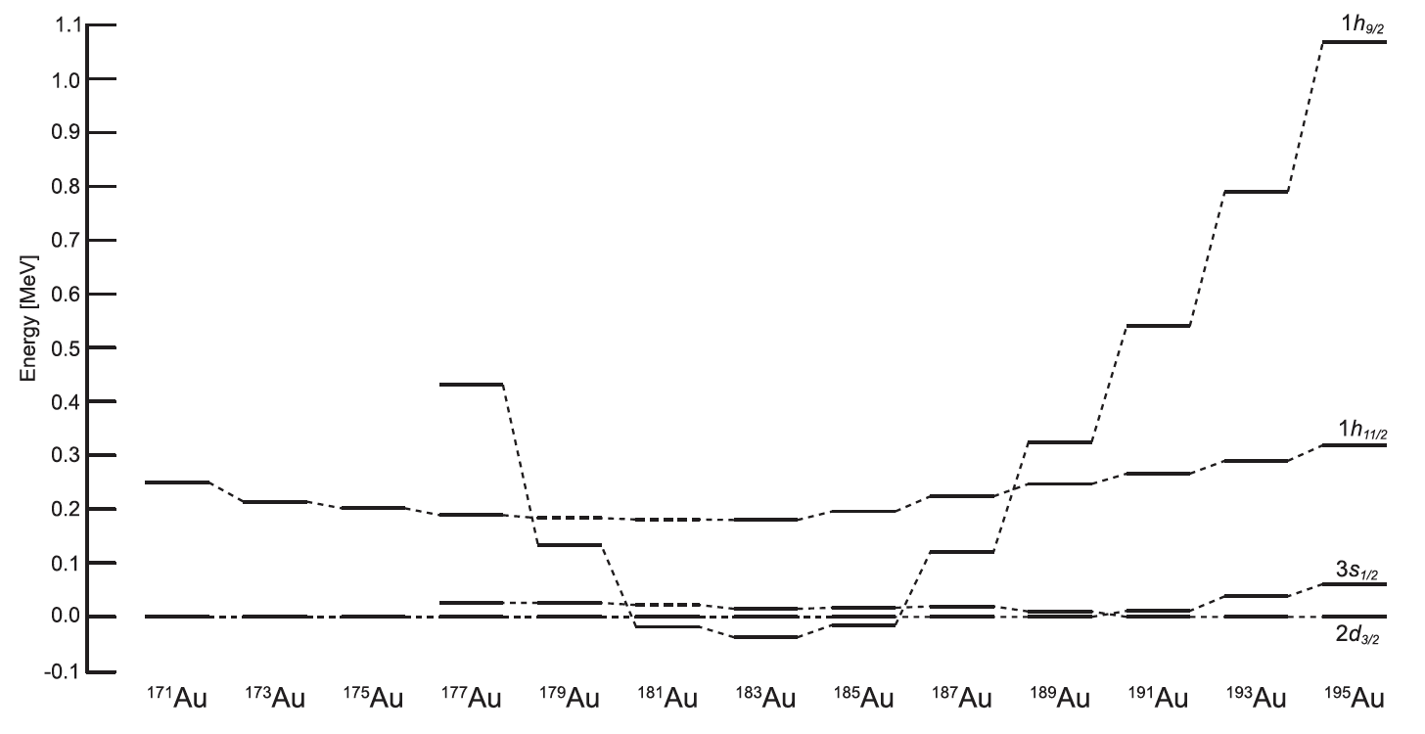
Choice of the isotope
Martin Venhart: Structure of Odd-Au Isotopes
64th meeting of the INTC

Slide 7
Choice of the isotope
Out in-beam work (JYFL):
Intruder configurations are different
M. Venhart et al., Phys. Rev. C 95, 061302(R) (2017).
M. Venhart et al., Phys. Lett. B 806, 135488 (2020).
Martin Venhart: Structure of Odd-Au Isotopes
64th meeting of the INTC

Slide 8
Choice of the isotope
To understand the difference:
Spectroscopic studies are needed
Out in-beam work (JYFL):
Intruder configurations are different
M. Venhart et al., Phys. Rev. C 95, 061302(R) (2017).
M. Venhart et al., Phys. Lett. B 806, 135488 (2020).
Martin Venhart: Structure of Odd-Au Isotopes
64th meeting of the INTC

Slide 9
Choice of the isotope
¹⁸⁵Hg decay
Martin Venhart: Structure of Odd-Au Isotopes
64th meeting of the INTC

Slide 10
Multiple shapes in odd-Au isotopes
C. D. Papanicolopoulos et al., Z. Phys. A 330, 371 (1988).
Martin Venhart: Structure of Odd-Au Isotopes
64th meeting of the INTC

Slide 11
Choice of the isotope: Complexity of the level scheme
Many configurations are expected to coexists in ¹⁸⁵Au
Only small fraction of the data that were measured at UNISOR was published
Large density of excited states (example: ¹⁸¹Au has first-excited state at 1.76 keV)
Resolution of the system is crucial
In ¹⁸⁷Au: 9 E0 transitions is known (connecting both positive and negative parity states)
In ¹⁸⁵Au: E0 transitions connecting positive-parity states are not known
Strongest gamma-ray is not placed into the level scheme
Martin Venhart: Structure of Odd-Au Isotopes
64th meeting of the INTC

Slide 12
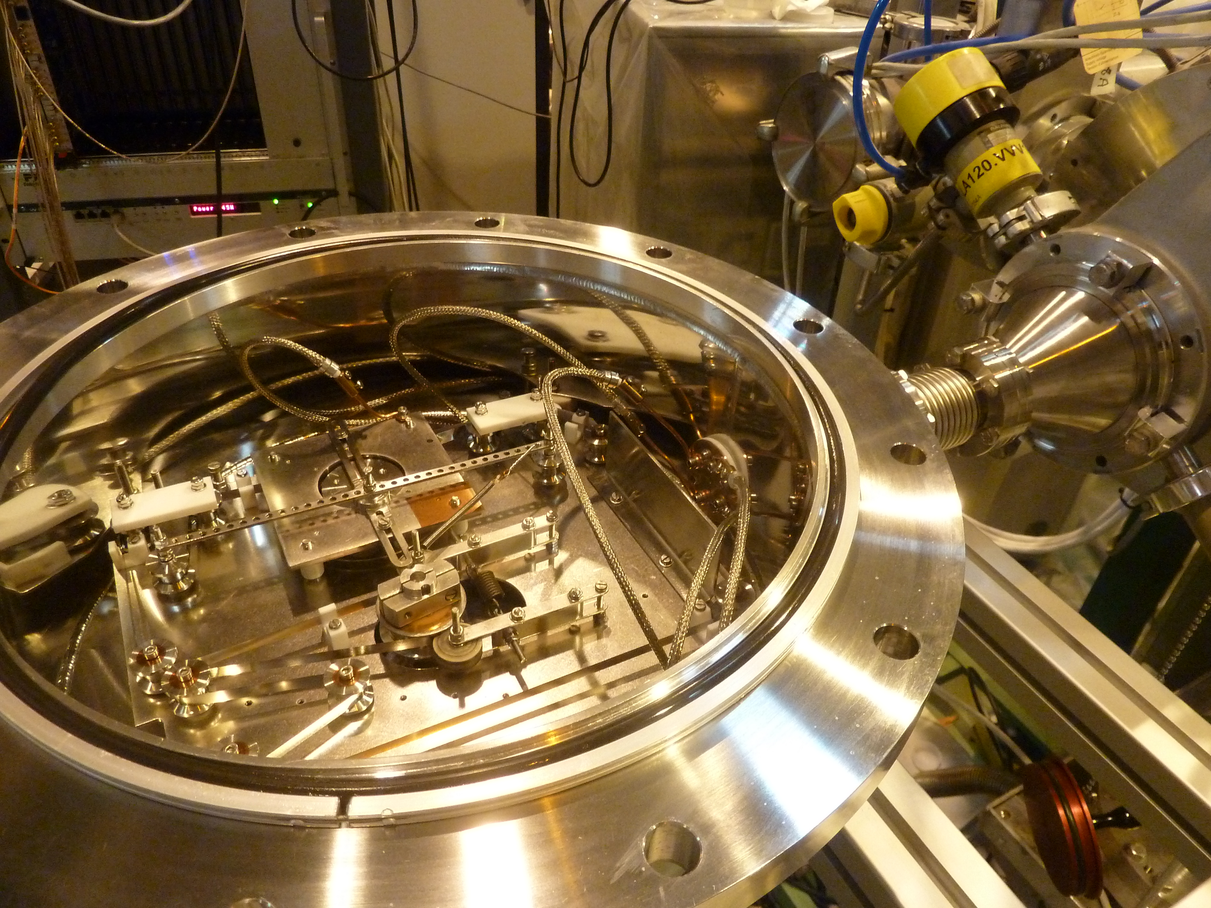
TATRA system: high-vacuum tape tranportation
TApe TRAnsportation system inspired by 8-track tapes
Rapidly quenched material: metallic glass is used to transport radioactive samples (deposition of ISOLDE beam)
Operated at 3 x 10⁻⁸ mbar
Windowless LN₂ cooled detector was used
Very good resolution for conversion electrons
V. Matoušek et al., Nucl. Instrum. And Meth A 812, 118 (2016).
Martin Venhart: Structure of Odd-Au Isotopes
64th meeting of the INTC

Slide 13
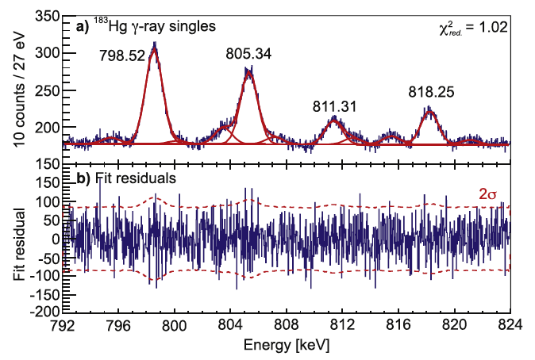
Broad Energy Germanium detotors
Apporximately 1 MeV range for the BEGe, i.e. 27 eV per channel
(Almost) ideal gaussian peak shape
(Almost) linear background
Rydberg-Ritz combination principle to 30 eV precision (in most cases down to 10 eV)
System is combined with “standard“ germanium detectors for coincidences
Sucessfully used to construct decay schemes of ^{181,183}Hg
Martin Venhart: Structure of Odd-Au Isotopes
64th meeting of the INTC

Slide 14
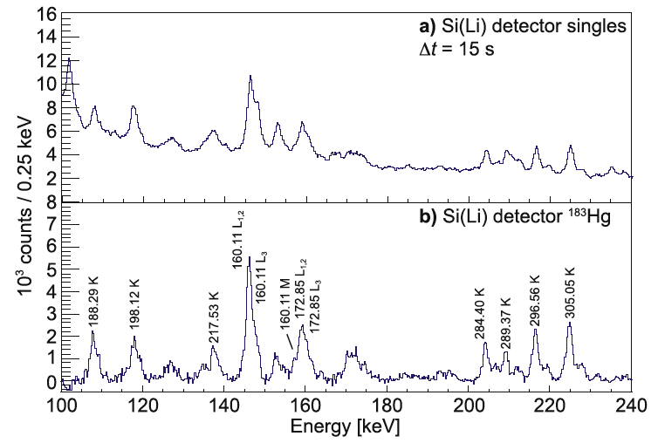
Conversion electrons
Resolution 1.6 keV for electrons above 100 keV
Worse resolution is not acceptable for these studies
Martin Venhart: Structure of Odd-Au Isotopes
64th meeting of the INTC

Slide 15
Beam time length justification
Goal of the experiment: Spectroscopy on the level of 1 % of strongest gamma ray
E0 transitions are expected to have 1 – 6 %
The yield is not a limitation, beam time estimation is based on our study of 183Hg decay (10 % of strongest gamma ray)
Increased gamma-gamma efficiency => factor of 3 increase
Optimised DAQ electronics => factor of 2 increase
Longer beam time compared with study of ¹⁸³Hg => factor of 2 increase
Within 4 days of beamtime we will reach the goal.
Therefore we request to add 7 shifts to remaining 5
Martin Venhart: Structure of Odd-Au Isotopes
64th meeting of the INTC

