Slide 1
Study of the Radiative Decay of the
Low-Energy Isomer in ²²⁹Th
S. Kraemer¹, K. Beeks², M. Block³, T. Cocolios¹, J.G. Correia⁴, S. Cottenier⁵, H. De Witte¹, K. Dockx¹,
R. Ferrer¹, S. Geldhof⁶, U. Köster⁷, M. Laatiaoui⁸, R. Lica⁴, P.-C. Lin⁹, V. Manea¹⁰, J. Moens⁹, I. Moore⁶,
L. M. C. Pereira⁹, S. Raeder³, M. Reponen⁶, S. Rothe⁴, T. Schumm², B. Seiferle¹¹, S.Sels¹, P.G. Thirolf¹¹,
P. Van Den Bergh¹, P. Van Duppen¹, A. Vantomme⁹, M. Verlinde¹, E. Verstraelen¹, U. Wahl¹²
Spokesperson: Piet Van Duppen
Local contact: Razvan Lica
1: Institute for Nuclear and Radiation Physics, KU Leuven, Belgium
2: Institute of Atomic and Subatomic Physics, Vienna University of Technology, Austria
3: GSI Helmholtzzentrum für Schwerionenforschung, Germany
4: ISOLDE-CERN, Switzerland
5: Center for Molecular Modelling, Ghent University, Belgium
6: Department of Physics, University of Jyväskylä, Finland
7: Institut Laue-Langevin Grenoble, France
8: Helmholtz-Institut Mainz, Germany
9: Quantum Solid State Physics, KU Leuven, Belgium
10: Institut de physique nucleaire d'Orsay, France
11: Ludwig-Maximilians-Universität München, Germany
12: Centro de Ciencias e Tecnologias Nucleares, Universidade de Lisboa, Portugal
64th INTC meeting
24/06/2020

Slide 2
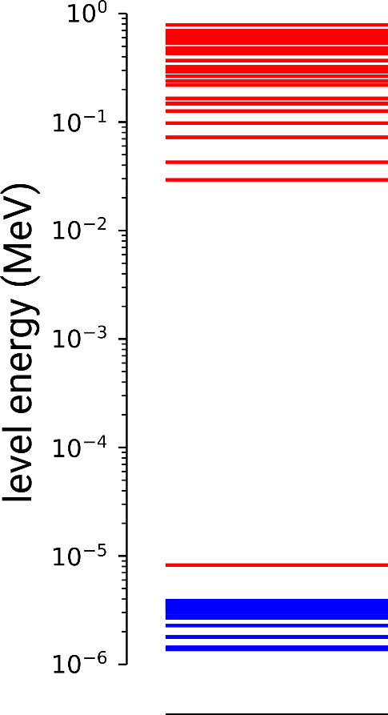
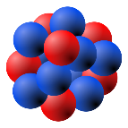
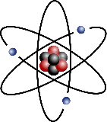
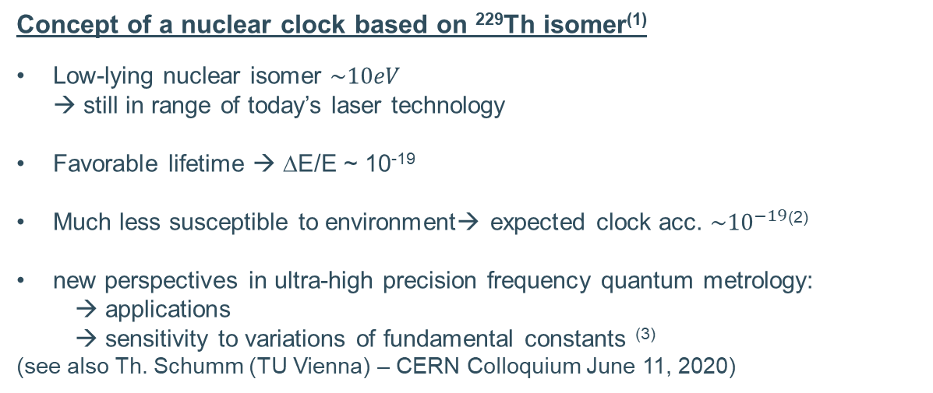

The Road towards a Nuclear Clock
Atomic clock based on electronic shell
Limitations:
Susceptible to the environment, i.e. Stark, Zeeman
Transition-intrinsic properties, i.e. $ν_{0}/Δν$
Concept of a nuclear clock based on ²²⁹Th isomer⁽¹⁾
Low-lying nuclear isomer $\sim 10eV$
→ still in range of today’s laser technology
Favorable lifetime → ΔE/E ~ 10⁻¹⁹
Much less susceptible to environment→ expected clock acc. $\sim {10}^{−19}$⁽²⁾
new perspectives in ultra-high precision frequency quantum metrology:
→ applications
→ sensitivity to variations of fundamental constants ⁽³⁾
(see also Th. Schumm (TU Vienna) – CERN Colloquium June 11, 2020)
^{229m}Th
Peik and Tamm 2014 J. Phys. Condens. Matter 26 10
Campbell et.al. 2012 PRL 108 12
Flambaum 2006 PRL 97 9

Slide 3
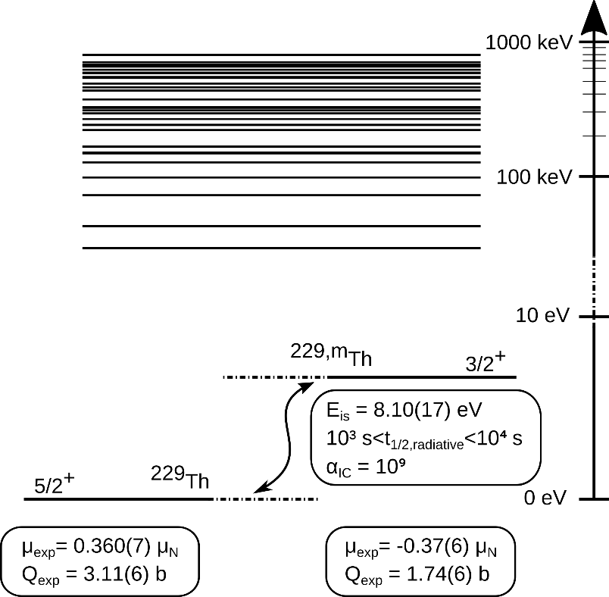
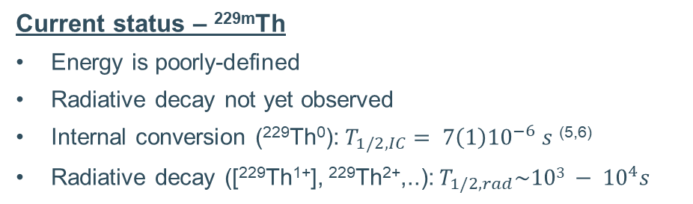
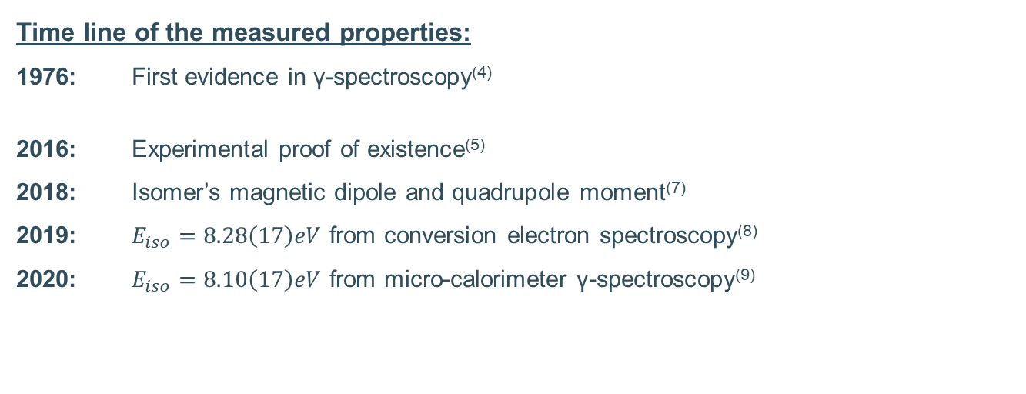
Nuclear Structure of the low-energy isomer ^{229m}Th
Time line of the measured properties:
1976: First evidence in γ-spectroscopy⁽⁴⁾
2016: Experimental proof of existence⁽⁵⁾
2018: Isomer’s magnetic dipole and quadrupole moment⁽⁷⁾
2019: $E_{iso}=8.28\left(17\right)eV$ from conversion electron spectroscopy⁽⁸⁾
2020: $E_{iso}=8.10\left(17\right)eV$ from micro-calorimeter γ-spectroscopy⁽⁹⁾
…
Current status – ^{229m}Th
Energy is poorly-defined
Radiative decay not yet observed
Internal conversion (²²⁹Th⁰): $T_{1/2,IC}= 7\left(1\right){10}^{−6} s$ ^{(5,6)}
Radiative decay ([²²⁹Th¹⁺], ²²⁹Th²⁺,..): $T_{1/2,rad}\sim {103 − 10}^{4}s$
(4) Kroger and Reich 1976 Nucl. Phys. A 259 1 (8) Seiferle et.al. 2019 Nature 573 7773
(5) Von der Wense et.al. 2016 Nature 533 7601 (9) Sikorsky et.al. Arxiv:2005.13340
(6) Seiferle et.al. 2017 PRL 118 4
(7) Thielking et.al. 2018 Nature 556 7701

Slide 4
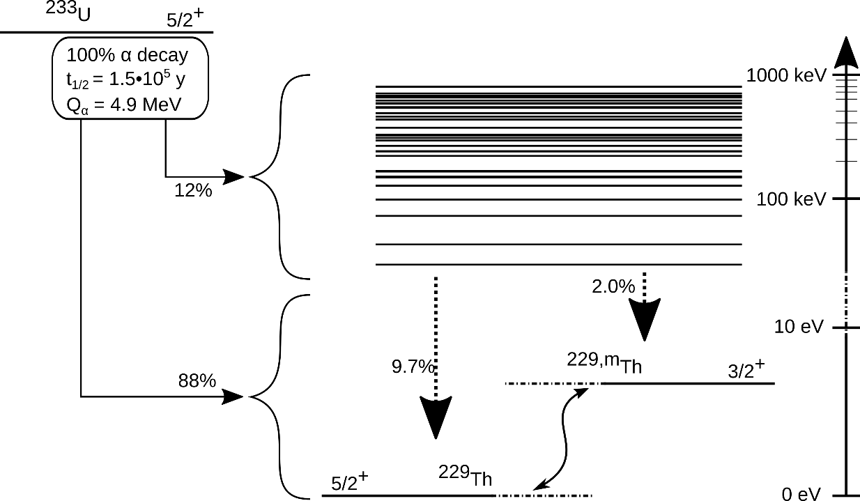
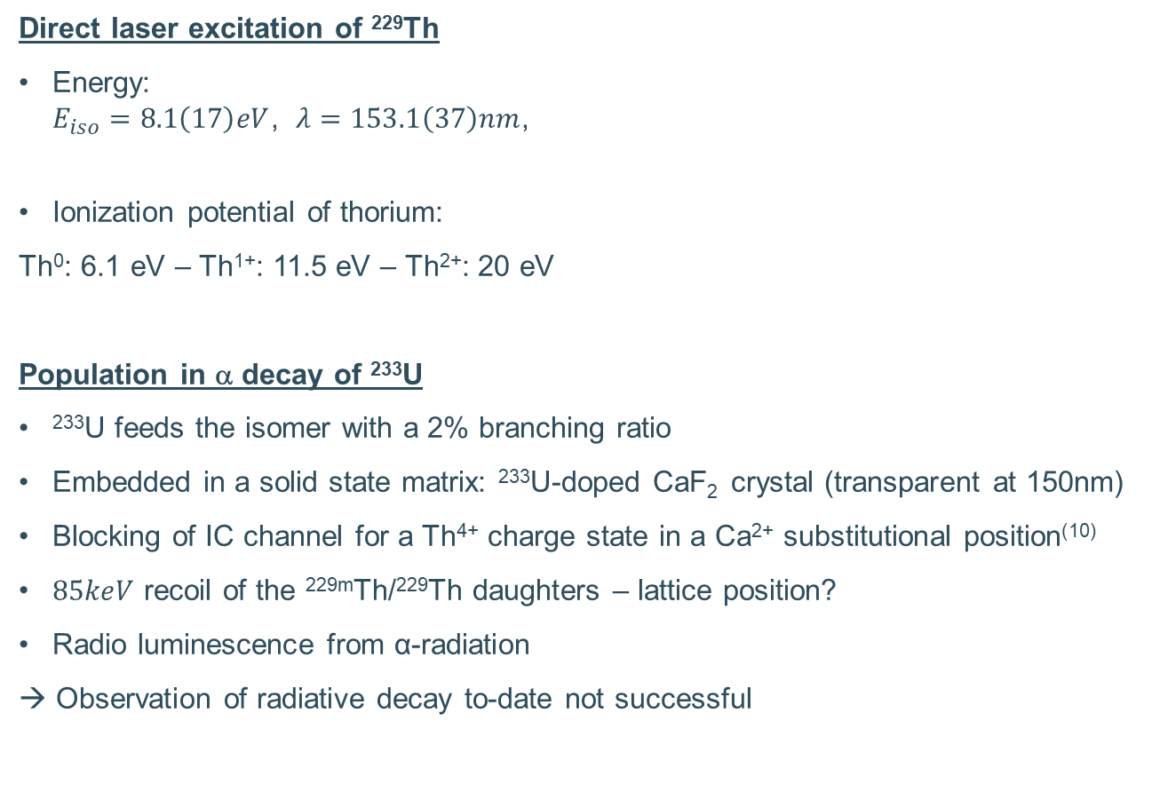
Population of the isomer
Direct laser excitation of ²²⁹Th
Energy:
$E_{iso}=8.1\left(17\right)eV$, $λ=153.1\left(37\right)nm$,
Ionization potential of thorium:
Th⁰: 6.1 eV – Th¹⁺: 11.5 eV – Th²⁺: 20 eV
Population in α decay of ²³³U
²³³U feeds the isomer with a 2% branching ratio
Embedded in a solid state matrix: ²³³U-doped CaF₂ crystal (transparent at 150nm)
Blocking of IC channel for a Th⁴⁺ charge state in a Ca²⁺ substitutional position⁽¹⁰⁾
$85keV$ recoil of the ^{229m}Th/²²⁹Th daughters – lattice position?
Radio luminescence from α-radiation
→ Observation of radiative decay to-date not successful
(10) Dessovic et al. 2014 J. Phys. Condens. Matter 26 10

Slide 5
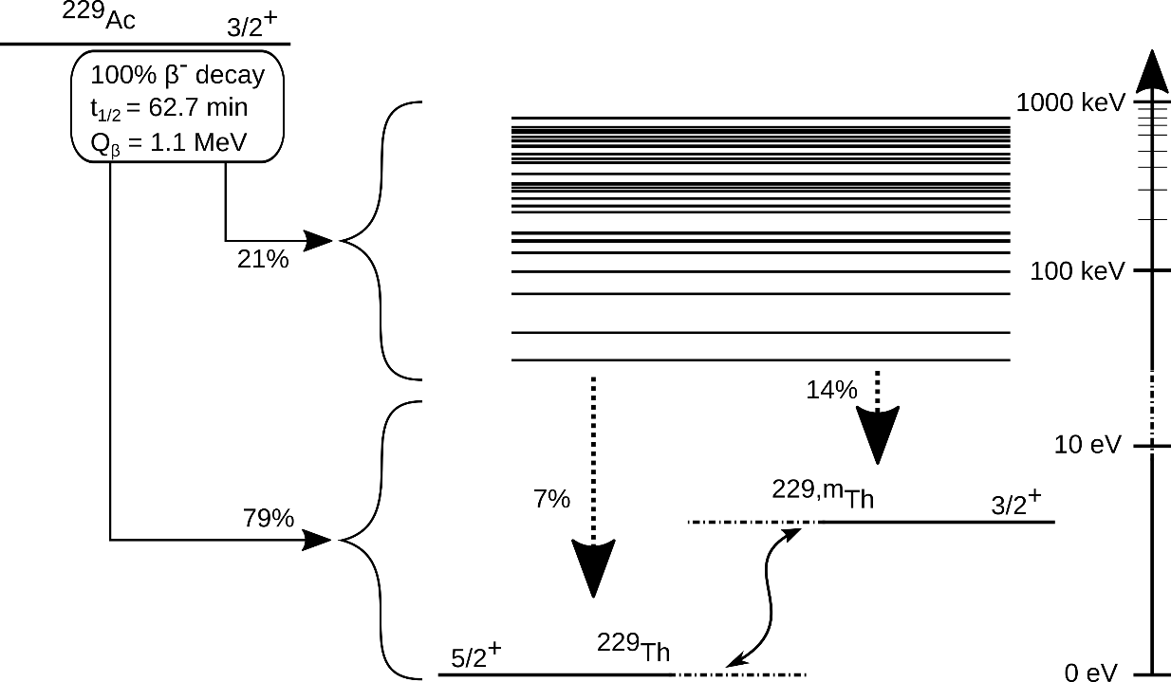
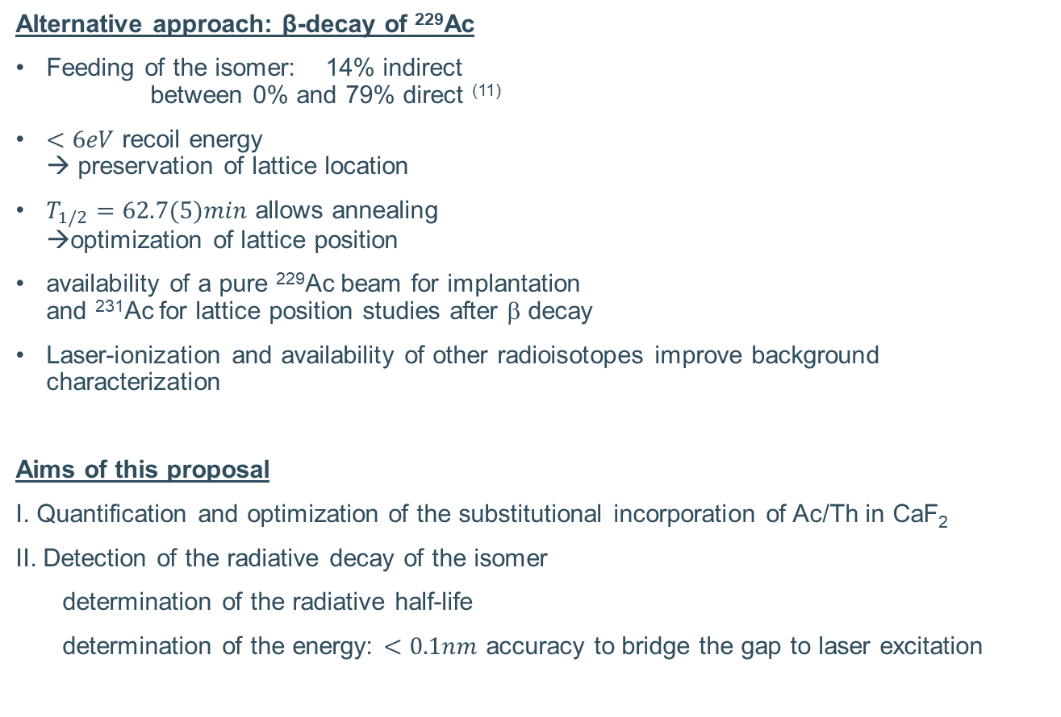
Population of the isomer in the β-decay of ²²⁹Ac
Alternative approach: β-decay of ²²⁹Ac
Feeding of the isomer: 14% indirect
between 0% and 79% direct ⁽¹¹⁾
$<6eV$ recoil energy
→ preservation of lattice location
$T_{1/2}=62.7(5)min$ allows annealing
→optimization of lattice position
availability of a pure ²²⁹Ac beam for implantation
and ²³¹Ac for lattice position studies after β decay
Laser-ionization and availability of other radioisotopes improve background characterization
Aims of this proposal
I. Quantification and optimization of the substitutional incorporation of Ac/Th in CaF₂
II. Detection of the radiative decay of the isomer
determination of the radiative half-life
determination of the energy: $<0.1nm$ accuracy to bridge the gap to laser excitation
(11) E. Ruchowska et al., Physical Review C 73, 044326 (2006).

Slide 6
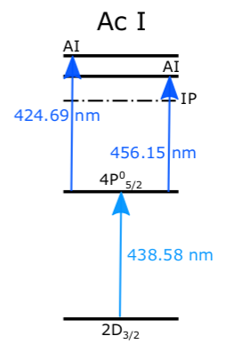
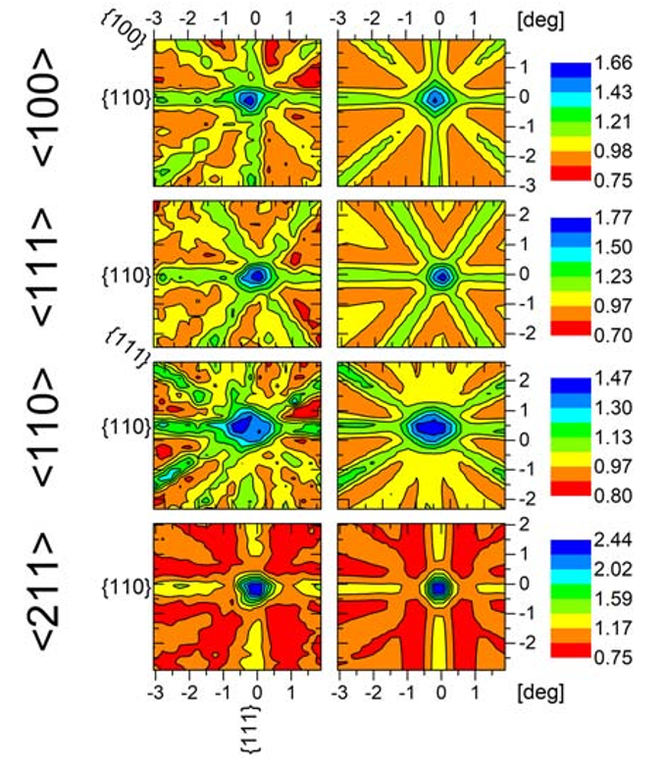
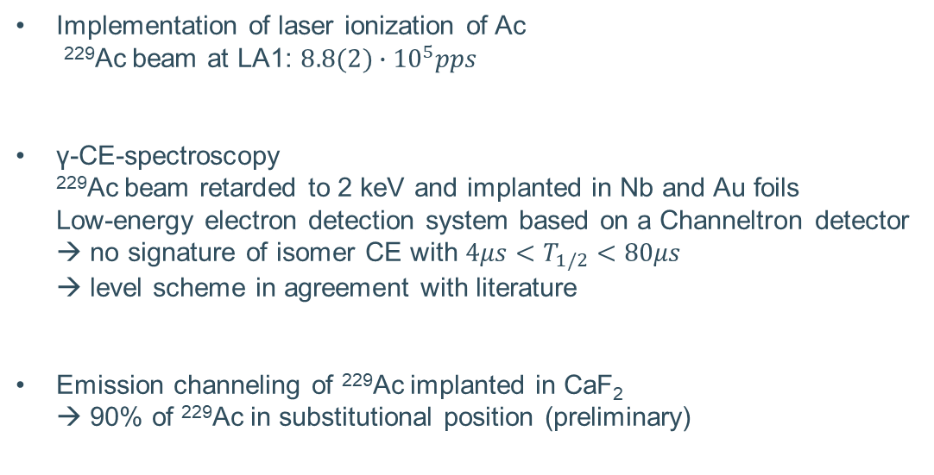
Preparatory study at ISOLDE: LoI198
Implementation of laser ionization of Ac
²²⁹Ac beam at LA1: $8.8(2)∙{10}^{5}pps$
γ-CE-spectroscopy
²²⁹Ac beam retarded to 2 keV and implanted in Nb and Au foils
Low-energy electron detection system based on a Channeltron detector
→ no signature of isomer CE with $4μs<T_{1/2}<80μs$
→ level scheme in agreement with literature
Emission channeling of ²²⁹Ac implanted in CaF₂
→ 90% of ²²⁹Ac in substitutional position (preliminary)
data
simulation

Slide 7
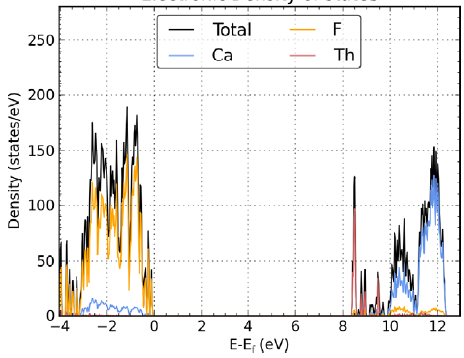
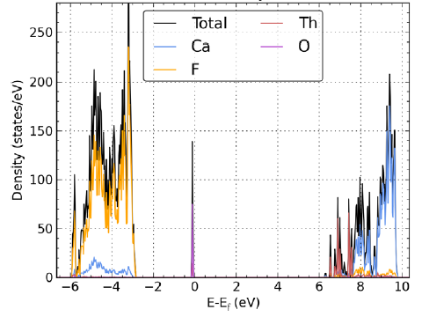
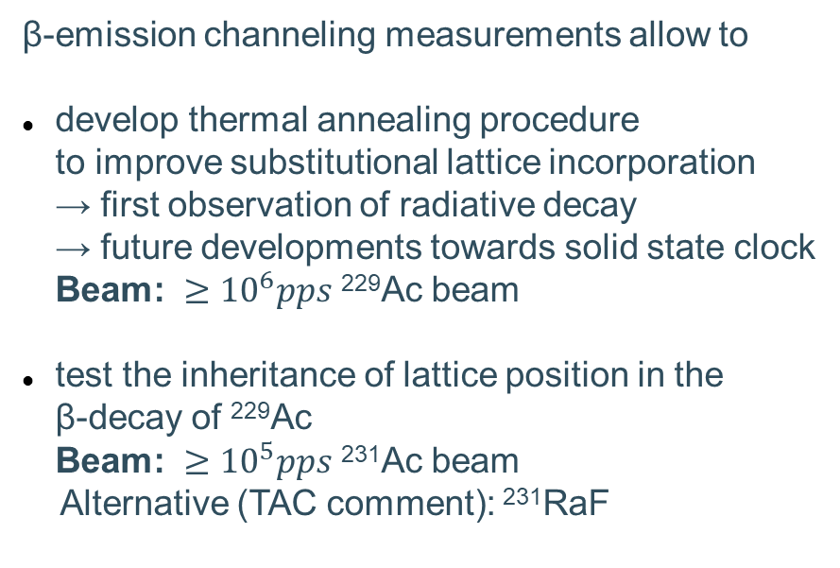
I. Characterisation of the Lattice Position
DFT calculation of Th:CaF₂ DOS
substitutional
β-emission channeling measurements allow to
develop thermal annealing procedure
to improve substitutional lattice incorporation
→ first observation of radiative decay
→ future developments towards solid state clock
Beam: $≥{10}^{6}pps$ ²²⁹Ac beam
test the inheritance of lattice position in the
β-decay of ²²⁹Ac
Beam: $≥{10}^{5}pps$ ²³¹Ac beam
Alternative (TAC comment): ²³¹RaF
interstitial
Taken from (10)
(10) Dessovic et al. 2014 J. Phys. Condens. Matter 26 10

Slide 8
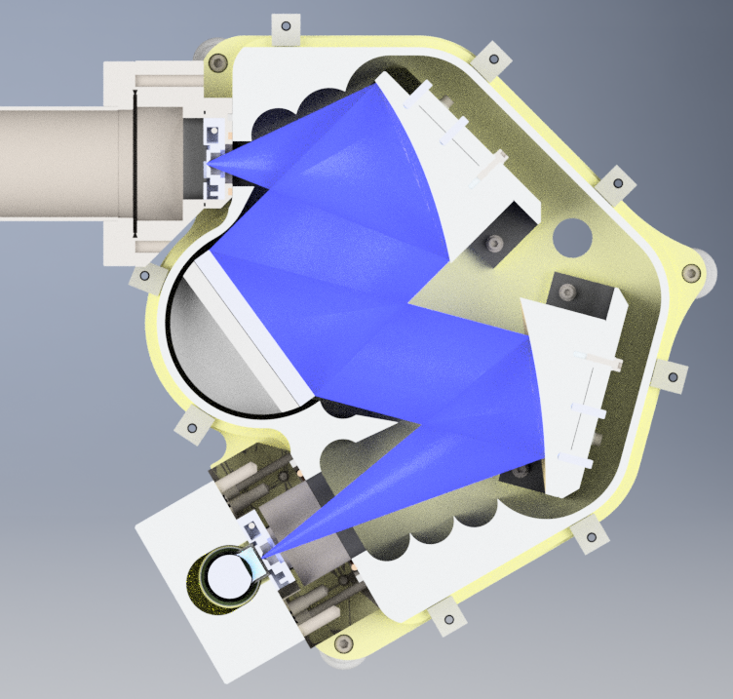
II. Spectroscopy of the Radiative Decay: Methodology
entrance slit
Focussing mirrors
Implantation into thin (50nm) CaF₂ crystal on Si backing (characterization at KU Leuven)
Implantation time: 2 half-lives
Transfer of crystal under vacuum to spectrometer
Crystal positioned close to entrance slit of VUV spectrometer (design based on Resonance Ltd customized VM180)
Activity monitoring using a Ge detector
Simulation of signal strength and worst-case background contributions (see next slide)
HPGe
CaF₂ crystal
exit slit
turnable grating
PMT detector

Slide 9
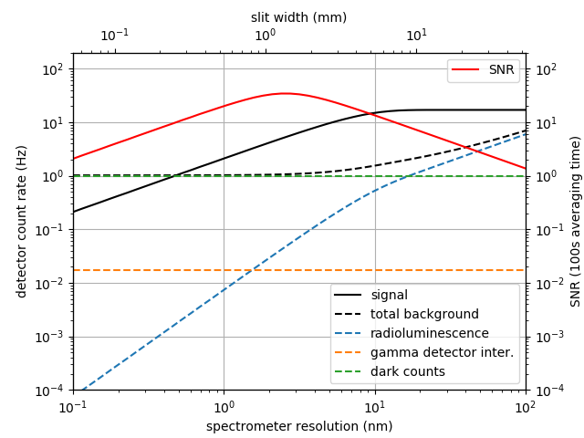
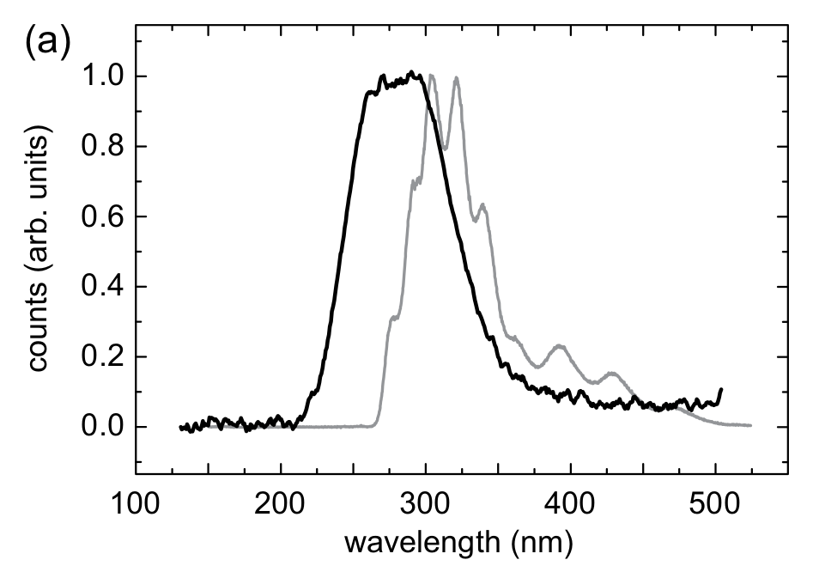

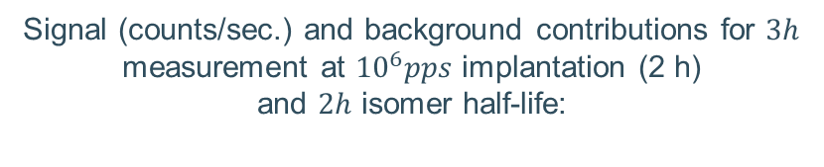
II. Spectroscopy of the Radiative Decay: Background
Implantation of a 4 mm FWHM ion beam
Scintillation properties in CaF₂
α,β: from literature $\sim 1\%$ conversion
γ: $100\%$ conversion
PMT sensitivity window
Conservative estimates of
- photon coll.+ det. efficiency: $>0.01\%$
- substitutional lattice position: $50\%$
- isomer feeding: $14\%$
Signal (counts/sec.) and background contributions for $3h$ measurement at ${10}^{6}pps$ implantation (2 h)
and $2h$ isomer half-life:
CaF₂ photoluminescence
PMT sensitivity window
CaF₂ radioluminescence
Taken from (11)
(11) Stellmer et al. 2015 Scient.Rep. 5 1

Slide 10
Summary
Study of the Radiative Decay of the Low-Energy Isomer in ²²⁹Th
Advantages compared to previous attempts:
> 14% feeding of the isomer in the β decay of ²²⁹Ac (versus 2% in α decay of ²³³U)
Implantation into a thin CaF₂ crystal - substitutional position: low recoil energy after β decay (< 6 eV)
T_{1/2}(²²⁹Ac) = 62.7 min: annealing and manipulation
Availability of a pure ²²⁹Ac beam: less crystal damage
Resonance ionization and availability of neighboring mass actinium: control of the background conditions
Study of ²³¹Ac – ²³¹Th: assess the stability of substitutional incorporation against low-recoil β-decay

Slide 11
Beamtime Request
Optimization of extraction of ²³¹Ac or ²³¹RaF
3 shifts
Emission channeling measurements
Quantification and optimization of the substitutional incorporation of Ac/Th in CaF₂Study of the lattice position inheritance in the low-recoil β-decay (²³¹Ac or ²³¹RaF – comment from the TAC)
2 shifts (multiple collections of 2h spread over several days)
VUV spectroscopy of the radiative decay
6 shifts (>20 collections of 2h spread over several days)

Slide 13
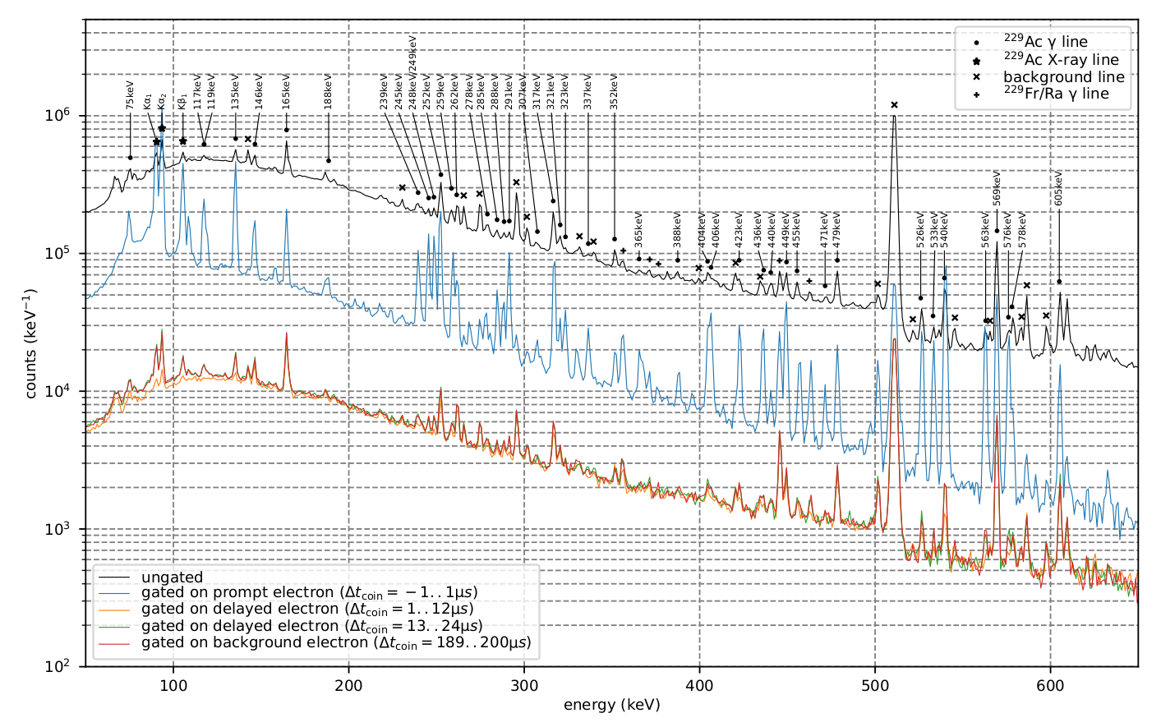
LoI198: γ-Spectra
[Implantation into Nb at 2keV]
13
Instituut voor Kern- en Stralingsfysica
Notes:
13

Slide 14
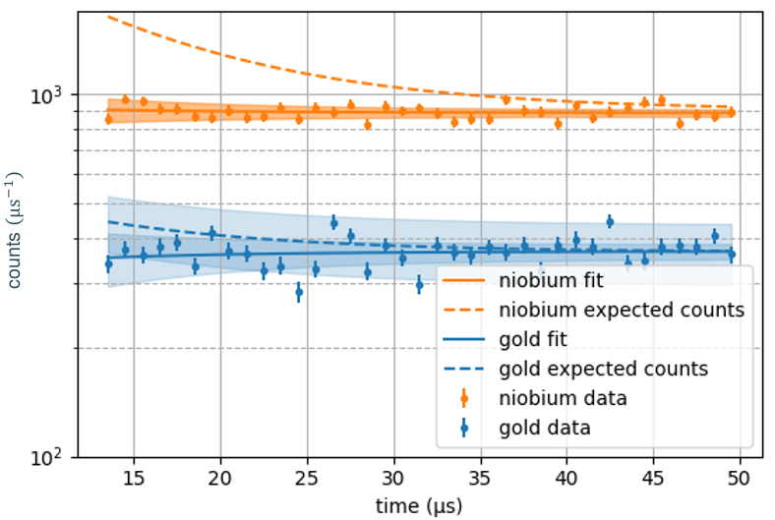
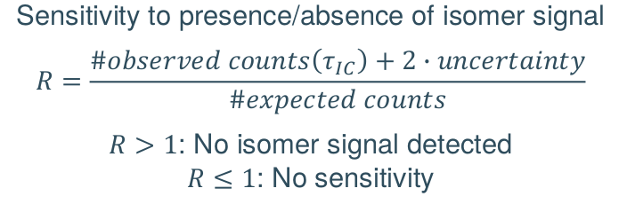
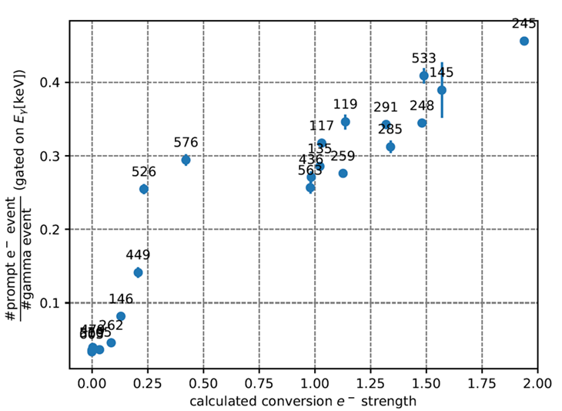
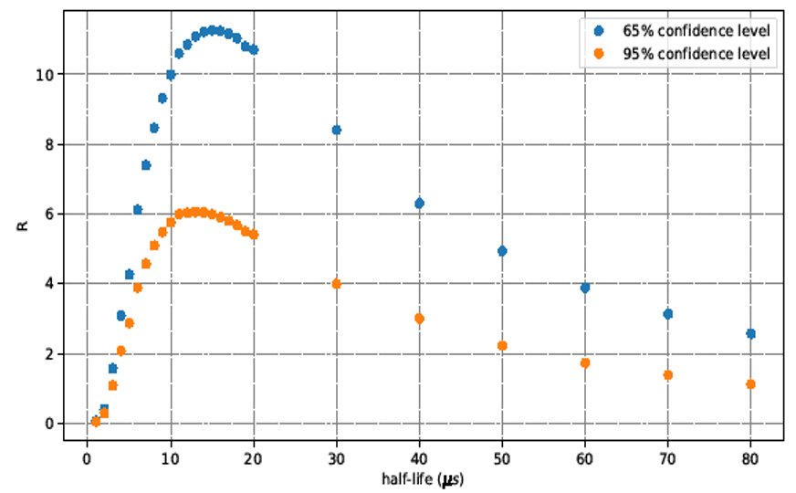
LoI198: Delayed γ-electron coincidences and CE strength
14
Instituut voor Kern- en Stralingsfysica
Notes:
14

Slide 15
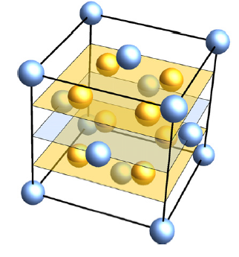
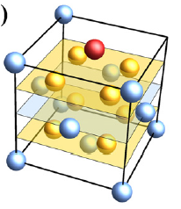
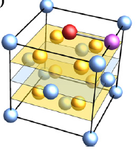
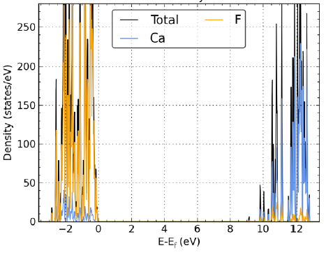
DFT calculation of Th:CaF₂
undoped
substitutional
Interstitial with O⁻
charge compensation
15
Figures taken from: Dessovic et al., JoP Cond. Mat. 2014; 26 (105402)
Instituut voor Kern- en Stralingsfysica
Notes:
15

Slide 16
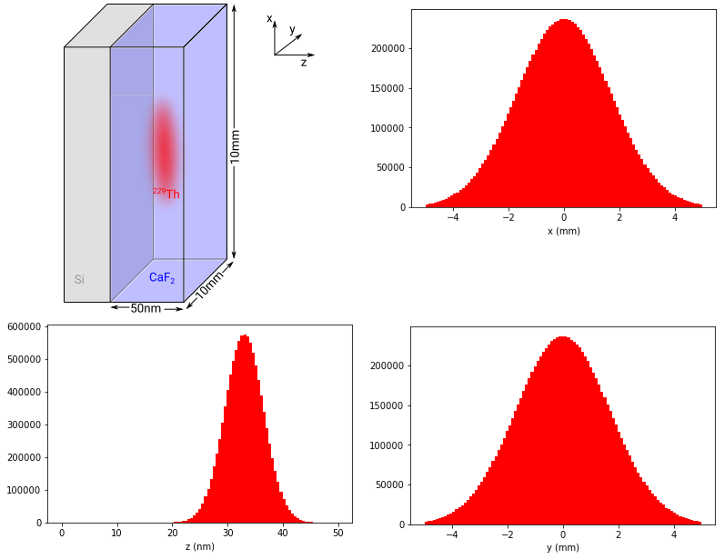
Implantation and Photon Source
16
Instituut voor Kern- en Stralingsfysica
Notes:
16

Slide 17
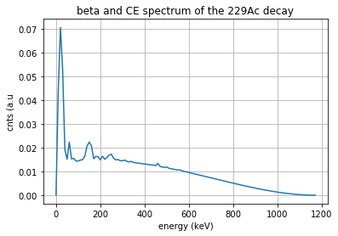
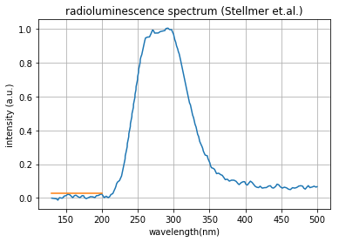

VUV spectroscopy background
Mean energy deposit in crystal based on
- stopping power/linear attenuation
- travelled path in crystal (for isotropic emission)
(from center of 50nm x 1cm x 1cm crystal)
Conversion deposited energy to photon:
α,β: $\sim 1\%$
γ: $100\%$
Spectral contribution around 150nm:
worst-case estimate from instrumental noise in
measurement performed at TU Vienna
Cherenkov
contribution | Energy deposit per β decay
γ | 0.25eV
Xray | 2.6eV
β | 137eV
CE | 71eV
α | 31keV (per α)
Worst case estimate
17
Instituut voor Kern- en Stralingsfysica
Notes:
17

Slide 18
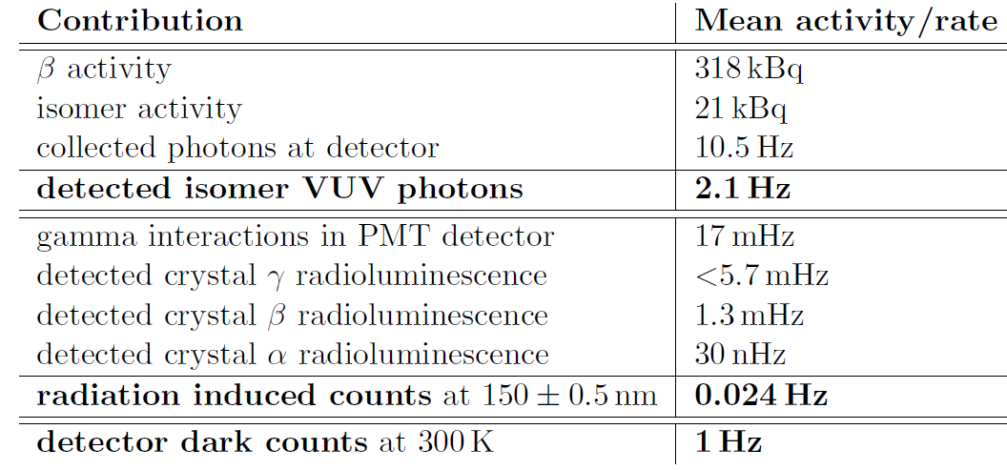
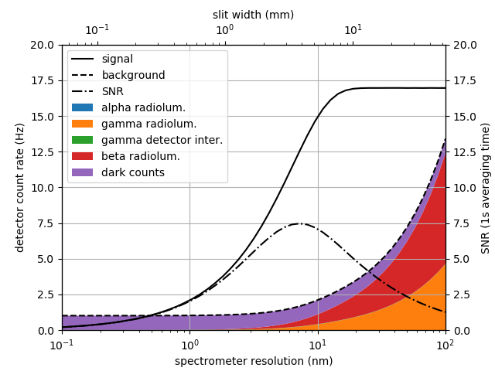
Background
10⁶ implantation rate (pps), 2 hrs isomer half-life, 3 h measurement

Slide 19
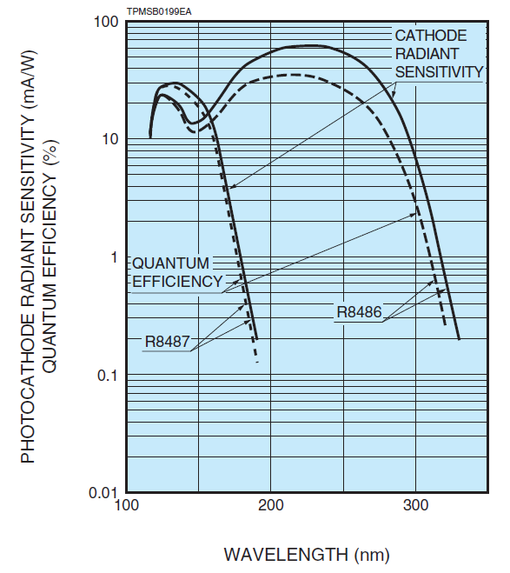
VUV spectrometer
contribution | note | Efficiency
Transmission through entrance slit | Beam: 4mm FWHM Gaussian | 12.3%
Solid angle spectrometer | Corresponding to F/1.2 | 3.85%
Reflectivity grating+mirrors | into 1st order | 38%
Quantum efficiency PMT detector | @ 150nm | 20%
Total: |  | 0.035%
Proposal: | (Conservative estimate) | 0.01%

Slide 20
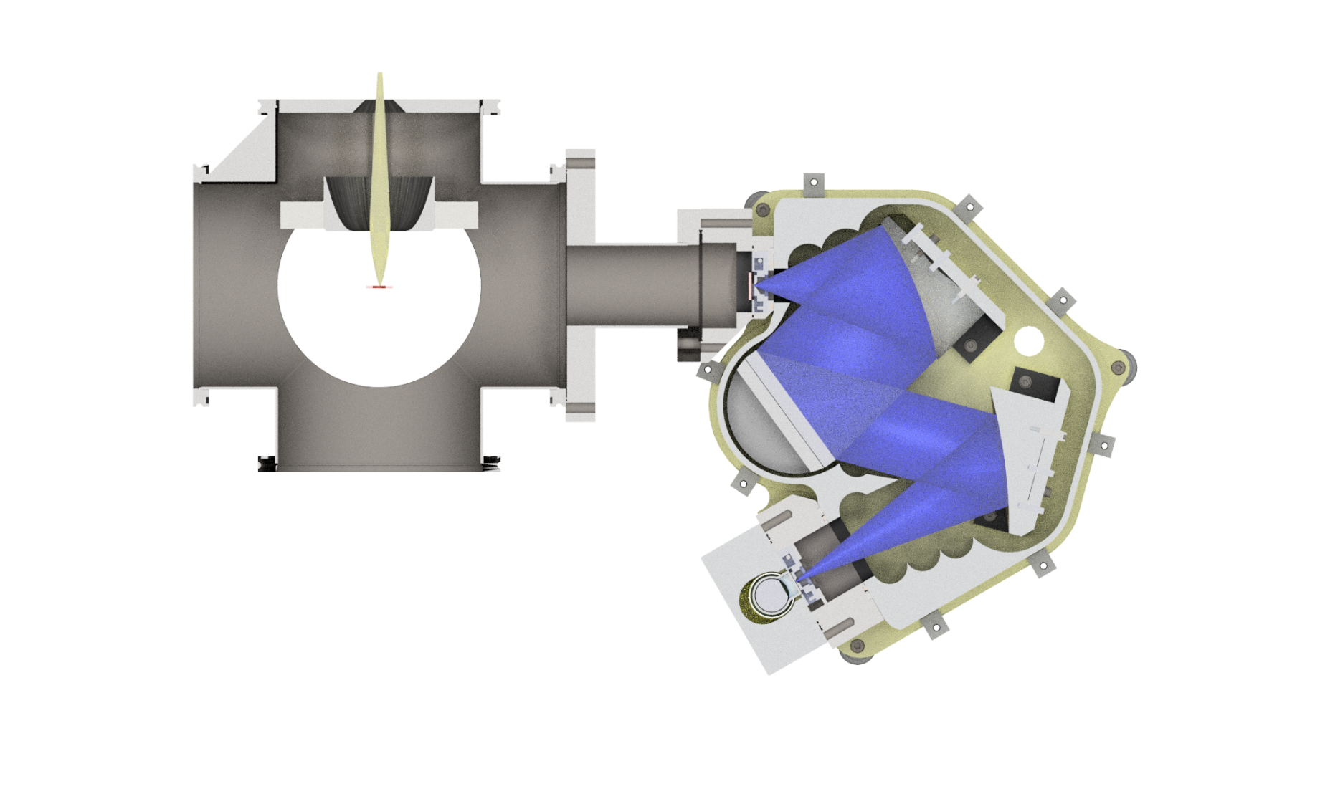

Spectroscopy of the Radiative Decay: Methodology
²²⁹Ac beam
HPGe
entrance slit
focussing mirrors
CaF₂ crystal
exit slit
turnable grating
PMT detector
Implantation
Implantation into thin (50nm) CaF₂ crystal on Si backing
Implantation time: 2 half-lifes
Transfer of crystal under vacuum to spectrometer
Crystal positioned close to entrance slit of spectrometer
Spectroscopy
(11) Stellmer et al. 2015 Scient.Rep. 5 1

Slide 21
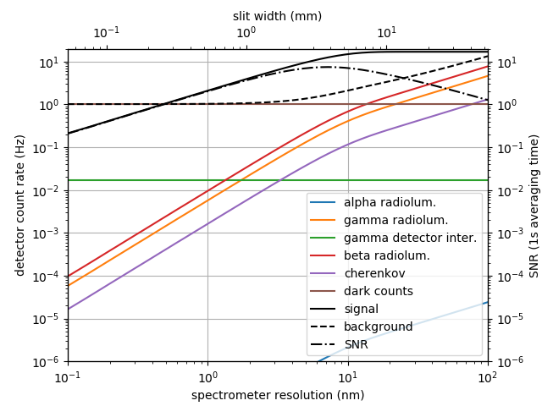
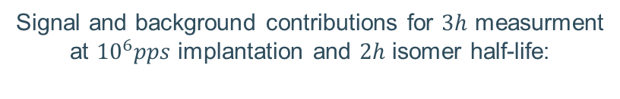
Signal and background contributions for $3h$ measurment
at ${10}^{6}pps$ implantation and $2h$ isomer half-life:

Slide 22
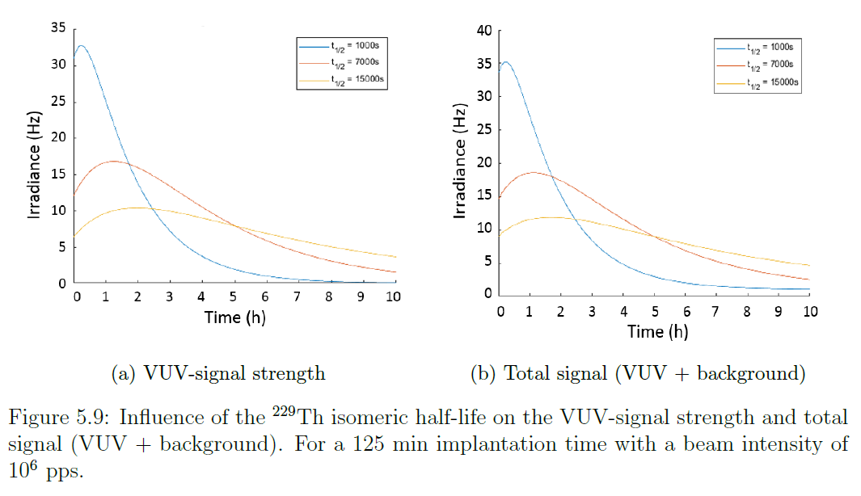
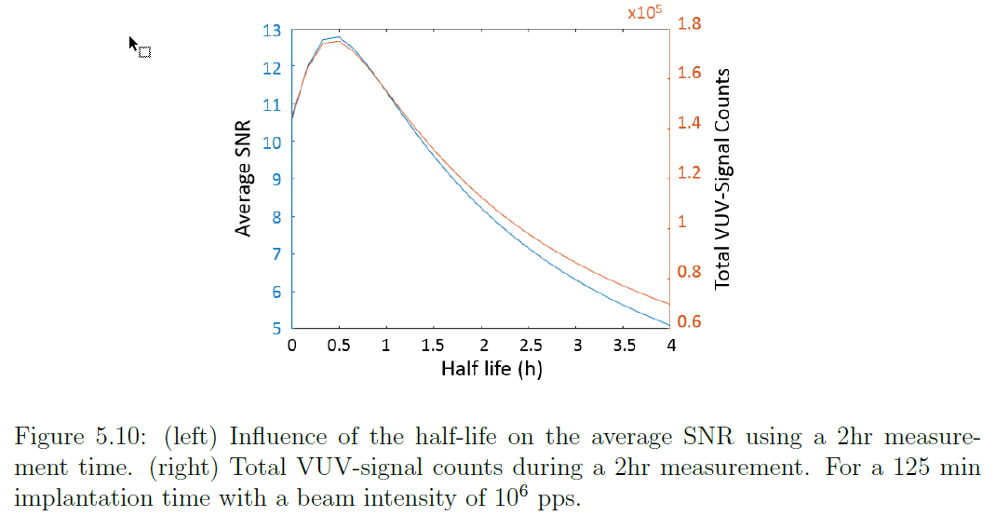
Dependance on the isomer’s half life

Slide 23
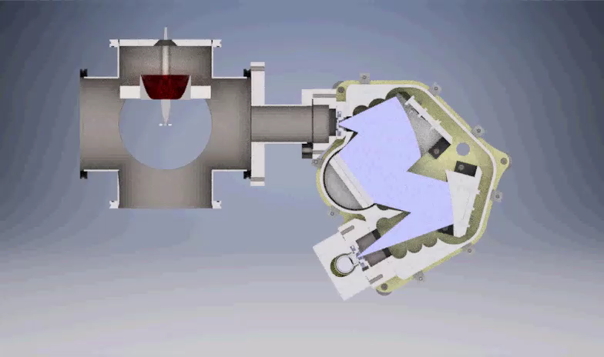
Spectroscopy of the Radiative Decay: Methodology
Implantation
Implantation into thin (50nm) CaF₂ crystal on Si backing
Implantation time: 2 half-lives
Transfer of crystal under vacuum to spectrometer
Crystal positioned close to entrance slit of spectrometer
Spectroscopy
(11) Stellmer et al. 2015 Scient.Rep. 5 1

Slide 24
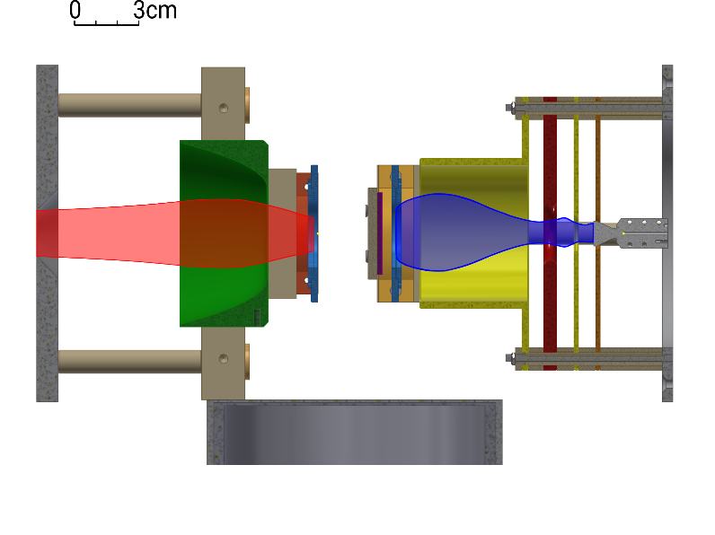
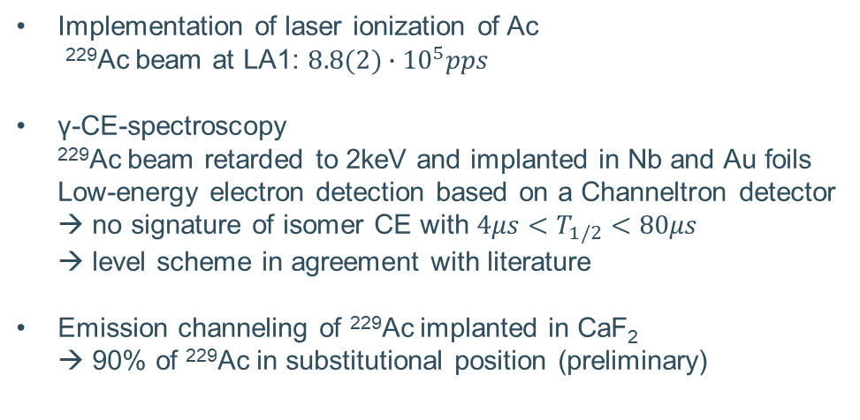
Preparatory study at ISOLDE: LoI198
Implementation of laser ionization of Ac
²²⁹Ac beam at LA1: $8.8(2)∙{10}^{5}pps$
γ-CE-spectroscopy
²²⁹Ac beam retarded to 2keV and implanted in Nb and Au foils
Low-energy electron detection based on a Channeltron detector
→ no signature of isomer CE with $4μs<T_{1/2}<80μs$
→ level scheme in agreement with literature
Emission channeling of ²²⁹Ac implanted in CaF₂
→ 90% of ²²⁹Ac in substitutional position (preliminary)
data
simulation
Channeltron detector
(low-energy electrons)
Retardation and focusing electrode
Implantation target
HPGe detector (γ)
Si-detector (β)

