Slide 1

Investigation of octupole deformation in neutron-rich actinium
using high-resolution in-source laser spectroscopy
Proposal to the ISOLDE and Neutron Time-of-Flight Committee
P-556
Reinhard Heinke
on behalf of the P-556 collaboration

Slide 2
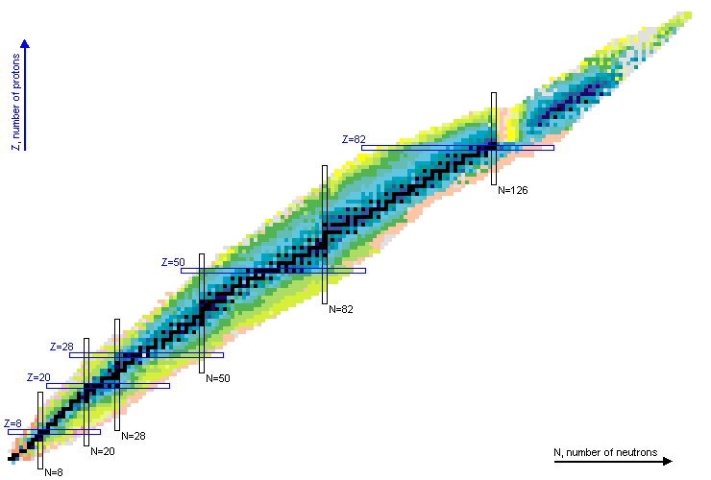
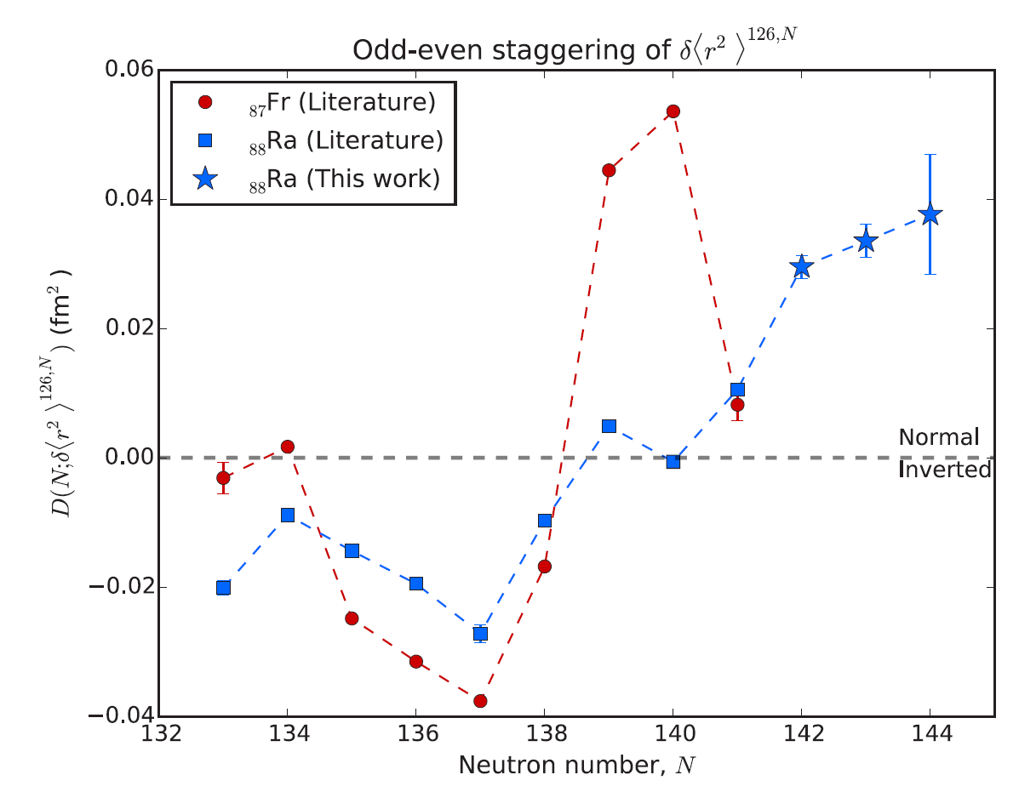
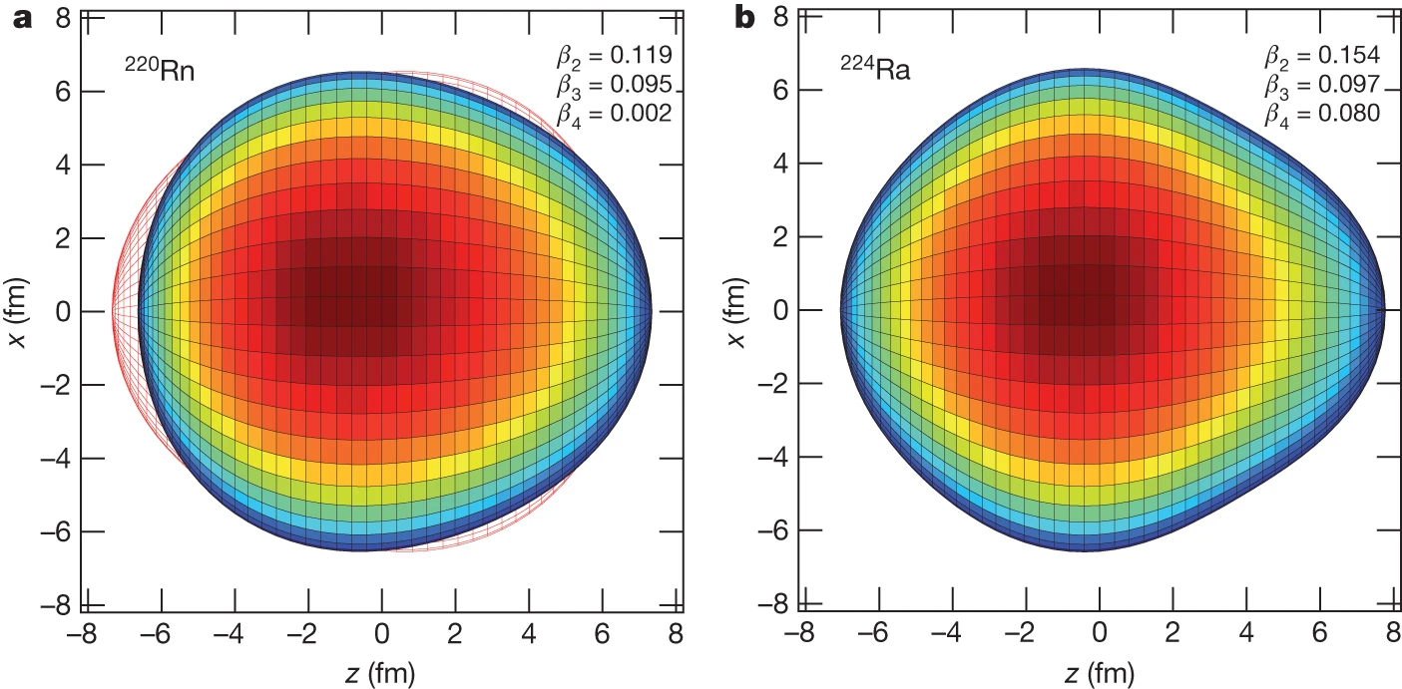
Octupole deformation in Ac region
Pear shaped intrinsic nuclear configurations
Resulting from opposite parity single nucleon states, differing in
3 units of orbital and total angular momentum
Breaking of reflection symmetry
Prominent around ²²²Ra (Z ≈ 88, N ≈ 134)
Manifestation in near-generate
parity doublets with same ang. momentum
Inverted odd-even staggering
of charge radii?
(Po, At, Fr,
Rn, Ra)
Lynch et al., Phys. Rev. C 97, 024309 (2018)
Gaffney et al., Nature 497, 199–204 (2013)
Notes:
Just to set the ground

Slide 3
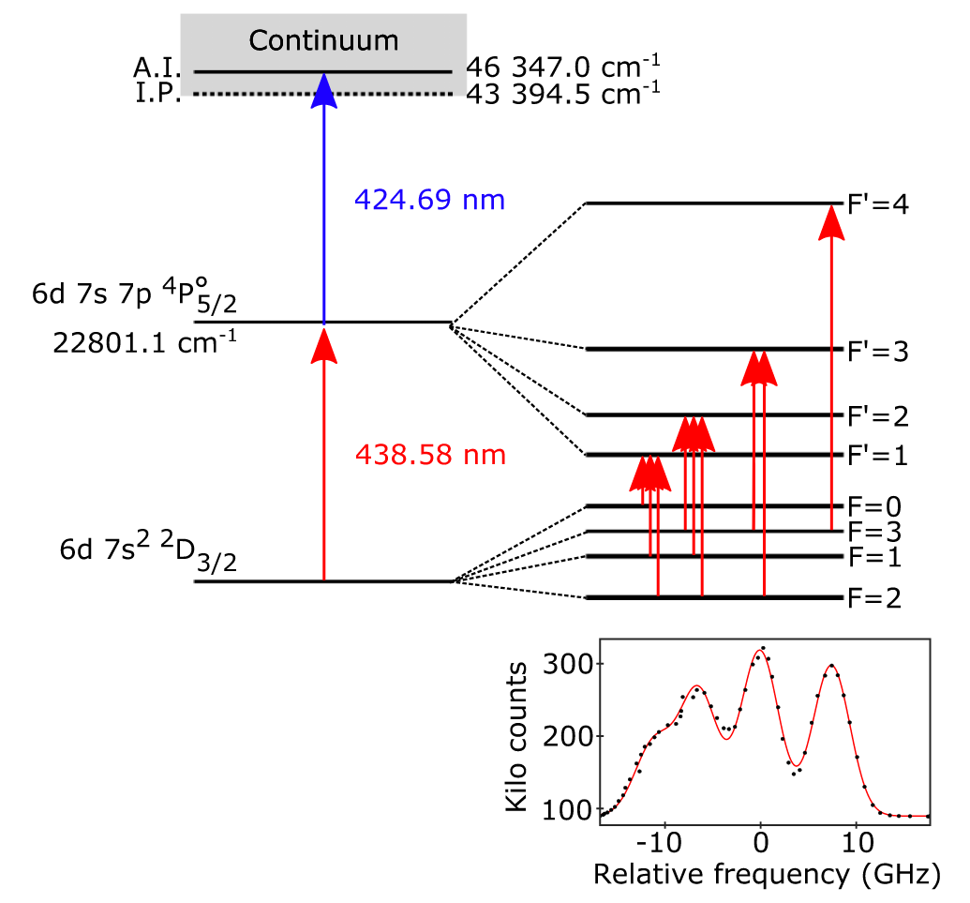
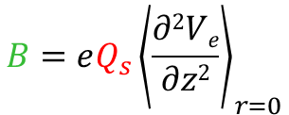

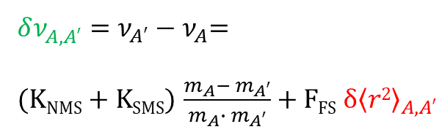
Nuclear shape investigations by laser spectroscopy
Ac laser ionization scheme
(used at LISOL, TRIUMF, ISOLDE, JGU, …)
Isotope shift:
Evolution of center frequency with changing N
Ion
$δν_{A,A′}^{}=ν_{A′}−ν_{A}$=
(K_{NMS} + K_{SMS}) $\frac{m_{A}−{ m}_{A′}}{m_{A}∙{ m}_{A′}}$ + F_{FS}${δ\left\langle r2\right\rangle }_{A,A′}$
Hyperfine structure:
Spin, magnetic dipole moment, electric quadrupole moment
Atom
$$A= \frac{μIBJ}{IJ}$$
$$B=eQ_{s}{\left.\left\langle \frac{∂2Ve}{∂z2}\right.\right\rangle }_{r=0}$$
Fig. from Verstraelen et al.,
Phys. Rev. C 100, 044321 (2019)
Notes:
Refer to presentations before > CRIS, MIRACLS

Slide 4
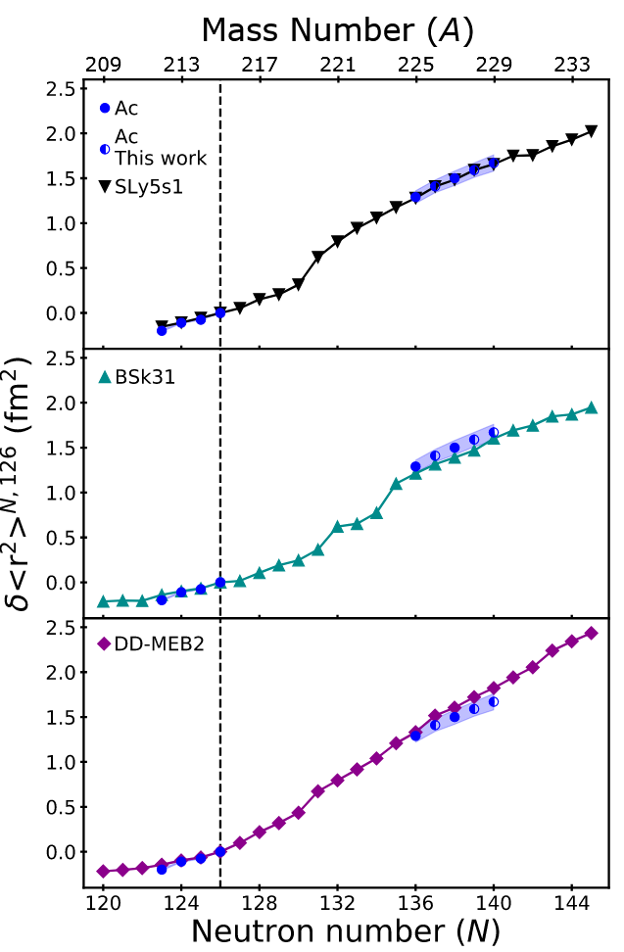
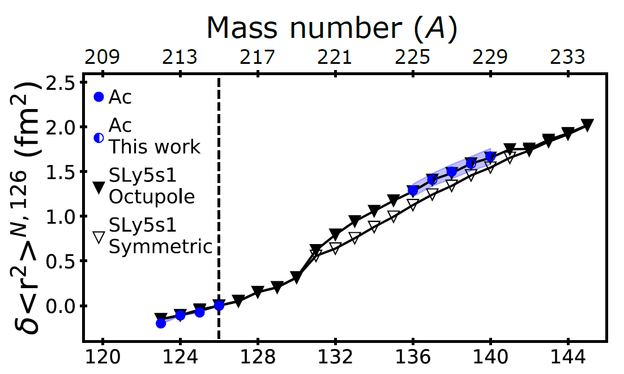
Changes in mean-square charge radii
State-of-the-art EDF calculations in comparison to laser spectroscopy data
Fig. from Verstraelen et al., Phys. Rev. C 100, 044321 (2019)
²³¹Ac
(²¹⁹Ac)
²³¹Ac
Measuement
range
Data below N = 126 described equally well
Neutron-rich data as benchmark cases
Incorporation of reflection-asymmetry
as key parameter
Measurement of δ<r²> to pin down behavior
Evaluation of odd-even staggering
Strong support from theory
²²³Ac
Notes:
Connected to inverted odd-even staggering: Odd-N N-rich Rn, Fr, Ra have larger radii than average even-n neighbours

Slide 5
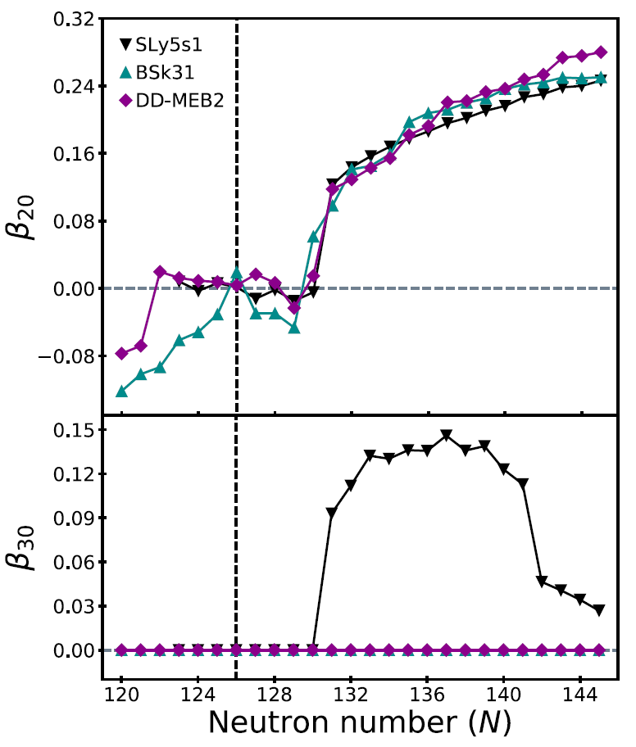
Electric multipole moments
δ<r²> a priori potentially arising from different multipole contributions
Larger β₂₀ values if no octupole deformation
Disentanglement by additional observables
  Β₂₀ as inferred from B(E2)
  in neighboring Th
  Observed parity doublets in Ac
  Measurements of spectroscopic quadrupole moment Q_{S}
Fig. from Verstraelen et al., Phys. Rev. C 100, 044321 (2019)
Measuement
range
Notes:
Measuring two more isotopes n-rich maybe possible

Slide 6
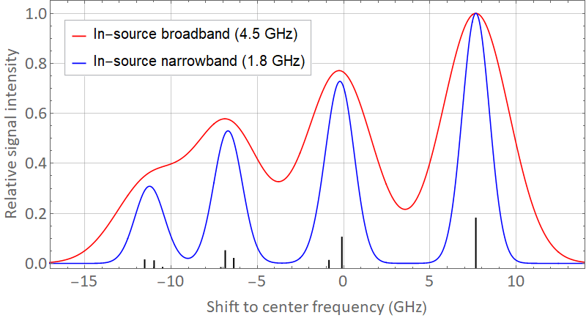
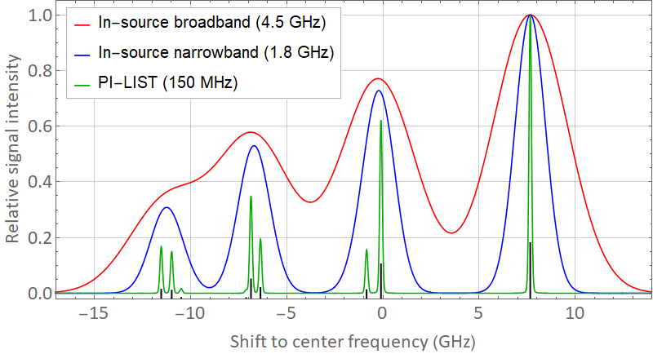
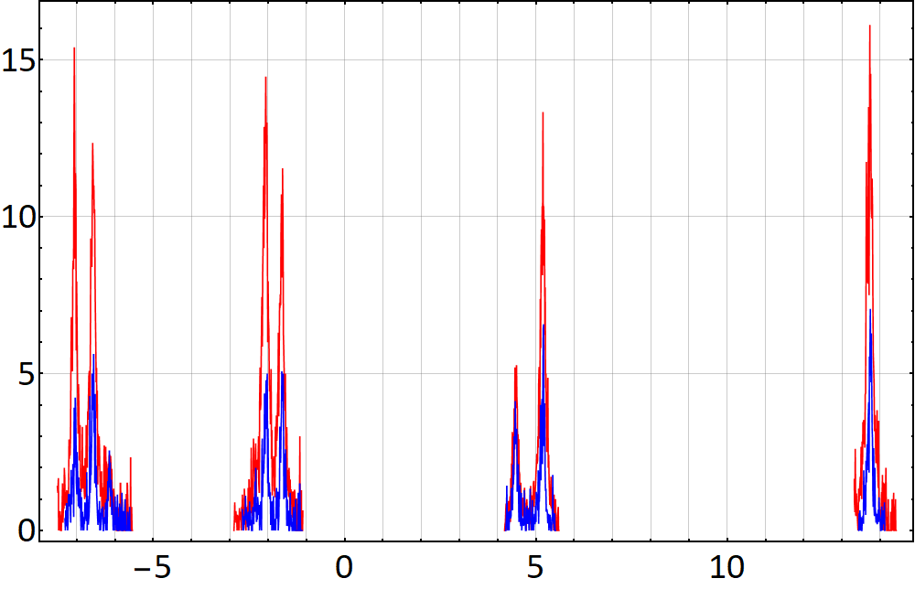
High resolution in-source spectroscopy
200 MHz
120 MHz
Off-line measurement
on 10⁹ atoms ²²⁵Ac
using PI-LIST at JGU
Ion signal (cps)
Extraction of Q_{S} prevented
by in-source Doppler broadening
➔ Sub-Doppler spectroscopy technique
Preliminary: S. Raeder at al., to be published
Frequency shift (GHz)
Notes:
Has been achieved with PI-LIST already

Slide 7
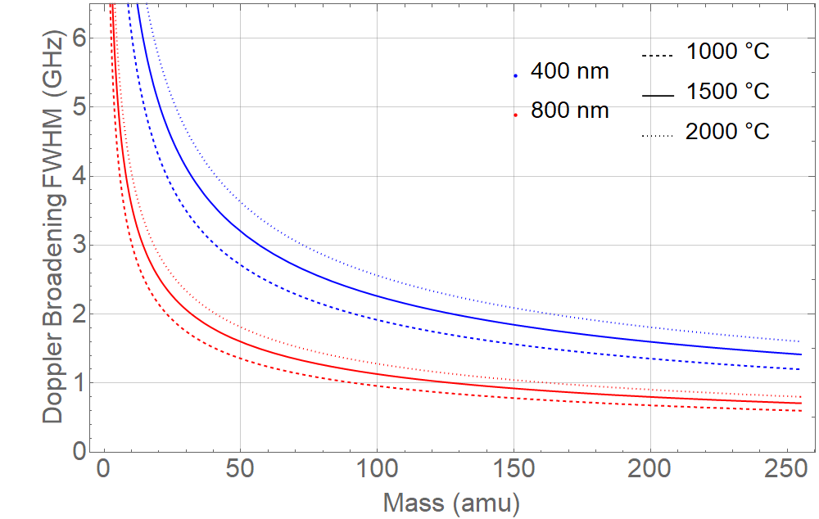

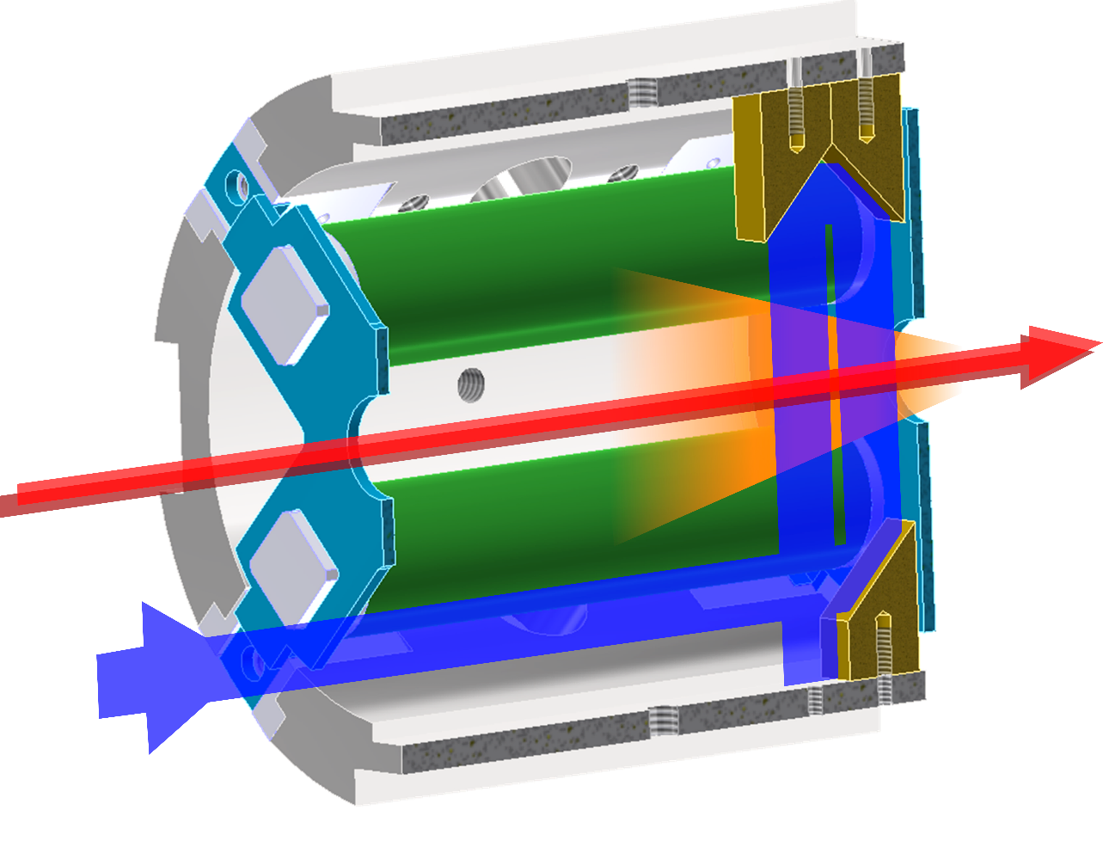

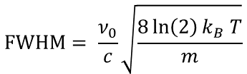

Sub-Doppler in-source spectroscopy: PI-LIST
ISOLDE’s LIST ion source
$$\text{FWHM}= \frac{ν_{0}}{c}\sqrt{\frac{8\ln\left(2\right)k_{B} T}{m}}$$
v_{thermal}
Atomic
beam cone
$ν_{0}$ ≙ 400 nm
$ν_{0}$ ≙ 800 nm
Narrow band spectroscopy laser
(Fiber link CRIS + RILIS,
used for 2-photon spectroscopy 2018)
Resolution enhancement
by order of magnitude (< 200 MHz)
at cost of factor 1000 in intensity
compared to standard RILIS
Operation mode change possible at any time

Slide 8
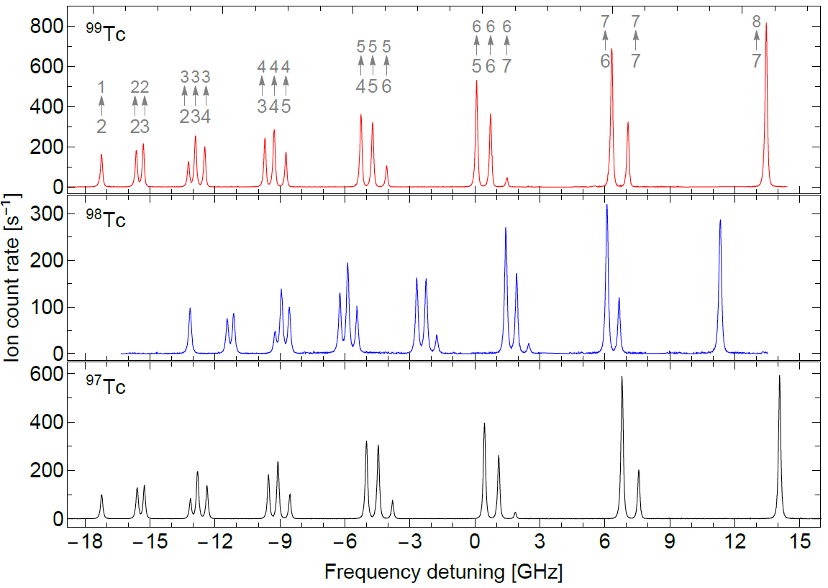
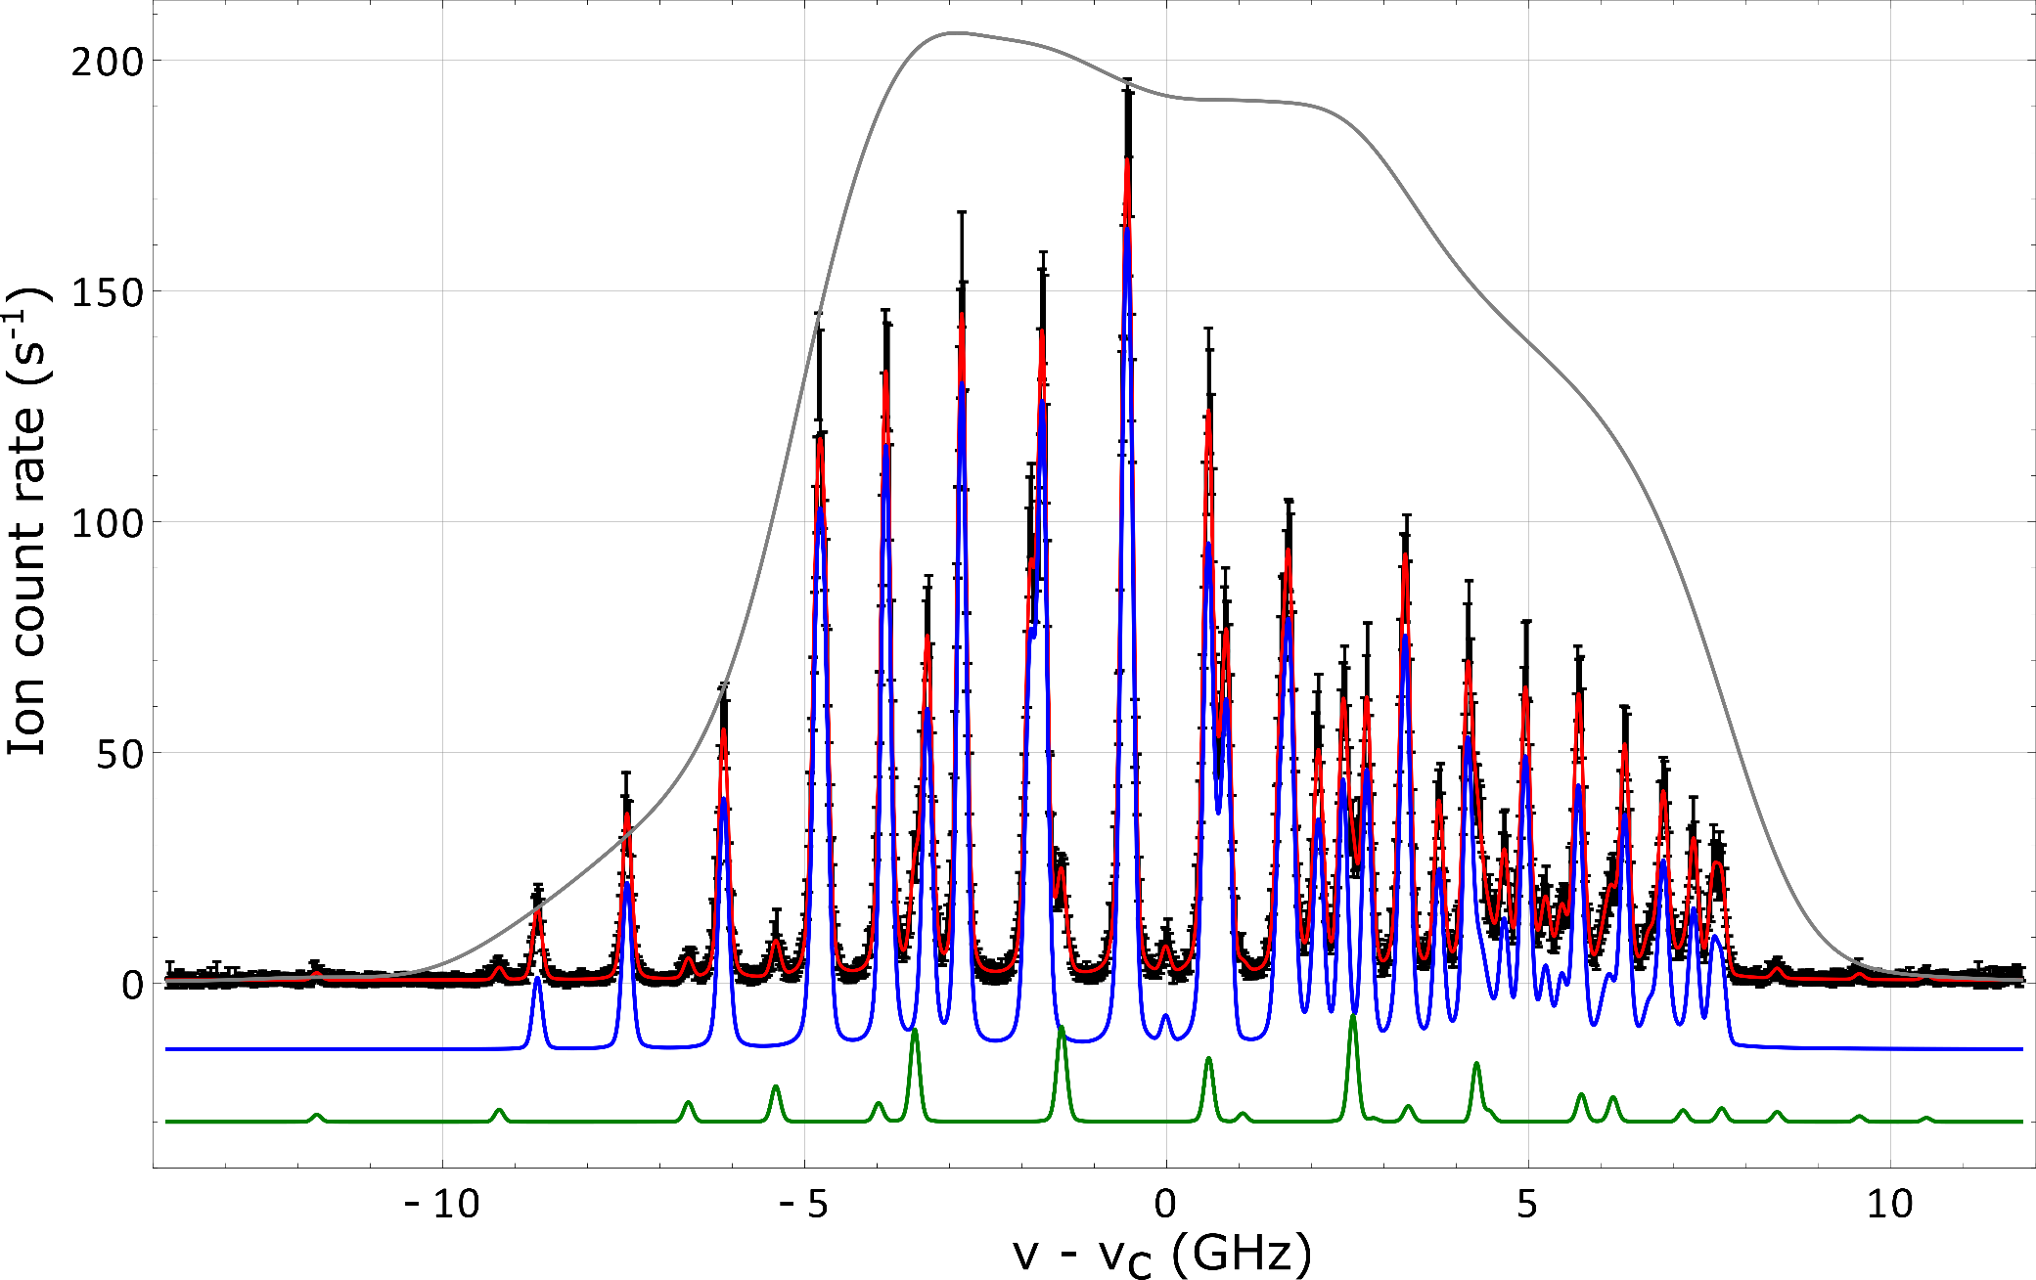
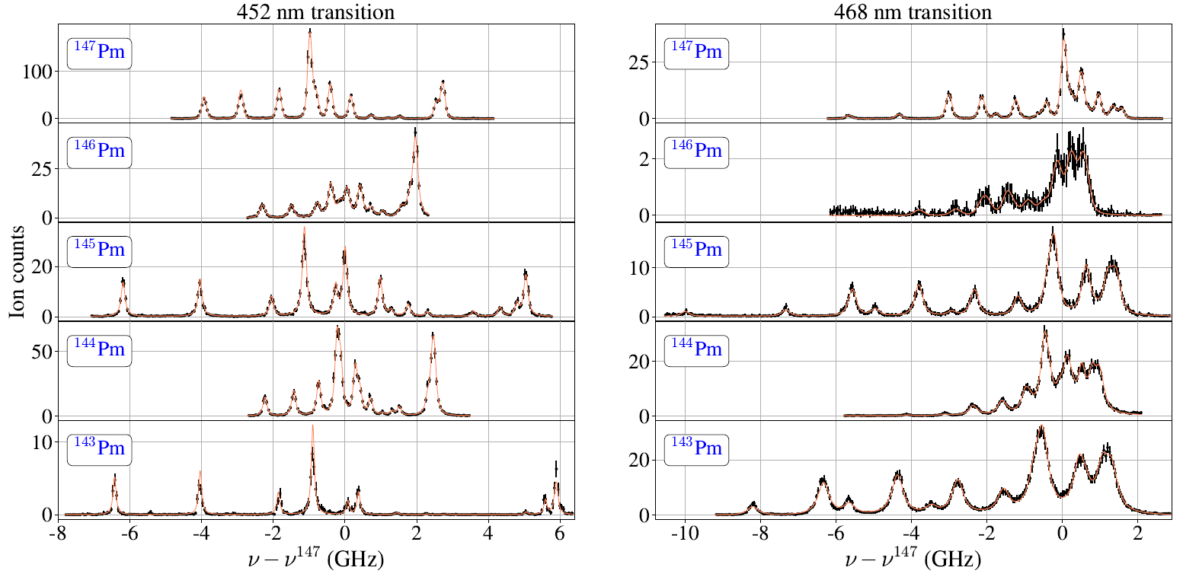
PI-LIST high-resolution spectroscopy at JGU
⁹⁷⁻⁹⁹Tc
accepted by PRC
100 – 120 MHz
^{163,165,166m}Ho
PhD R. Heinke
160 MHz
¹⁴³⁻¹⁴⁷Pm
Eur. Phys. J. A.
100 – 250 MHz
Resolution benchmark:
60 MHz @ U, Rb
Overall efficiency:
10⁻⁴ … 10⁻⁵
Notes:
To show capability/achievements of PI-LIST. Maybe leave out.

Slide 9
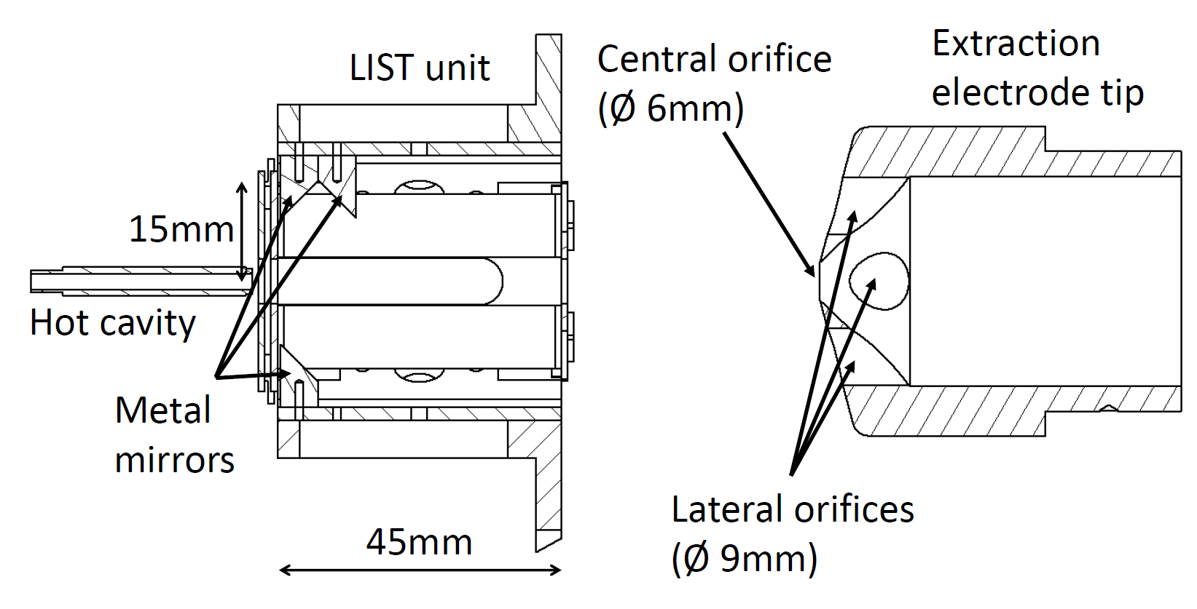

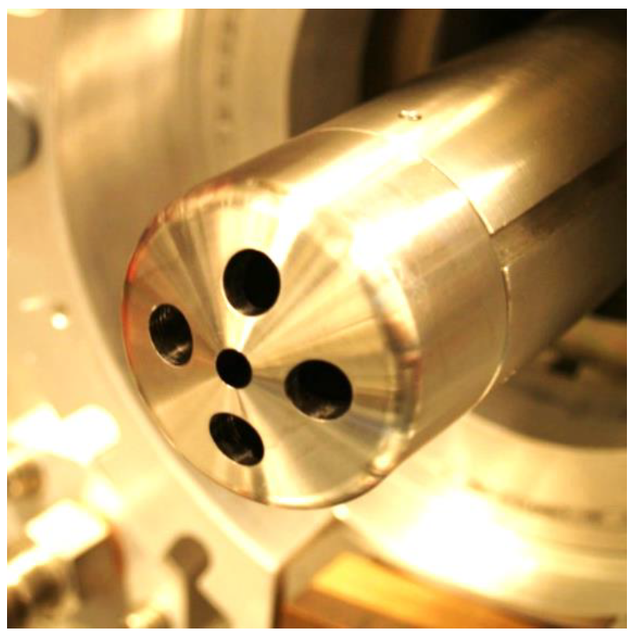
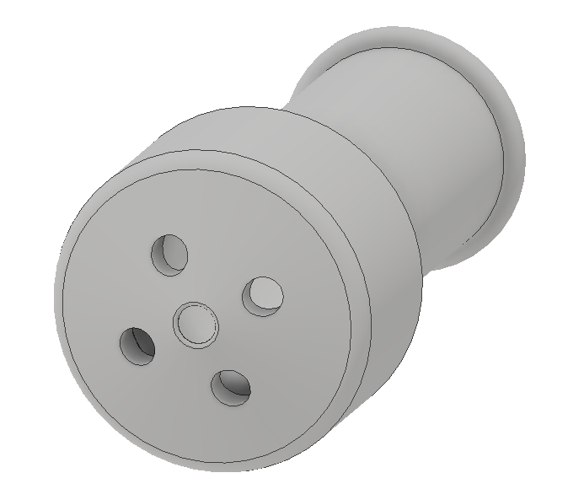


Implementation at ISOLDE: Adapted extractor
Extractor at JGU
Extensive simulation studies and off-line tests performed at JGU,
> 1 year of routine operation without problems
PI-LIST unit assembled at CERN
Adaption of ISOLDE-type extractor approved by RBS team
Test planned on Off-line 2 separator
Test planned at on-line frontend within LS2
➔ optimum moment for integration!
Activity within EU Marie Curie Network LISA
➔ dedicated manpower and support!
ISOLDE design
Notes:
Work ongoing, now is the best time!

Slide 10
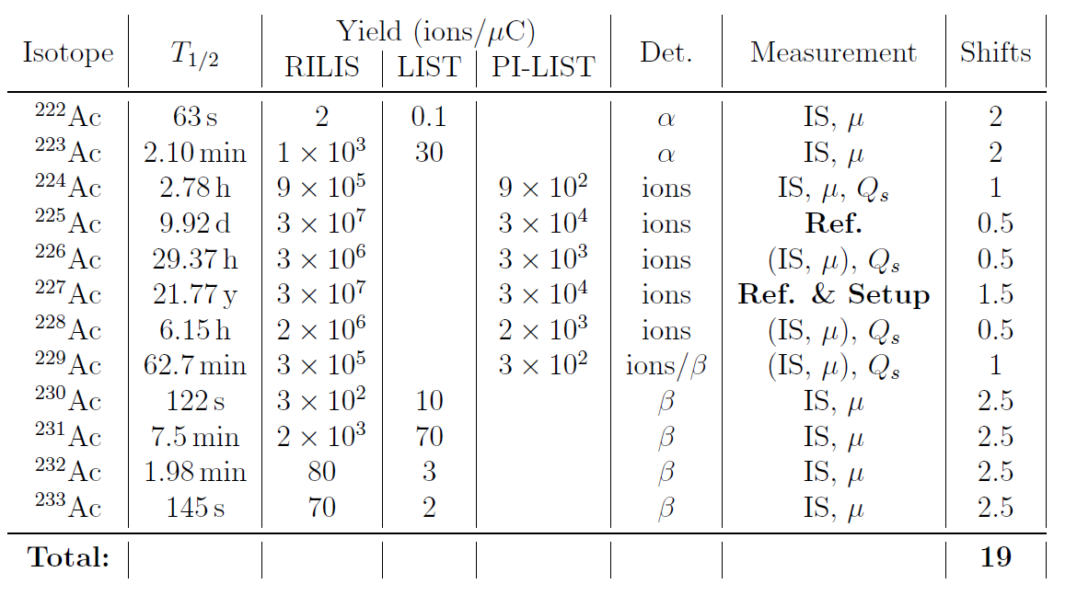

Shift planning and detection
Detection of produced ions vs. laser frequency adapted to yield and decay properties:
÷ 1000
÷ 30
Single ion counting with MagneToF
Lower resolution and
decay detection at
ISOLDE Decay Station
(annular Si detector + plastic scintillators)
TAC: Contamination of beam instrumentation (FC’s)?
➔ Only setup / cross checks in standard RILIS mode
Notes:
What is done where – maybe more details about IDS?

Slide 11
Summary
Measurement on ²²²⁻²³³Ac isotope chain
Extraction of δ<r²> , I, μ, Q_{S}
Pin down octupole behavior in Ac region
by probing state-of-the-art theoretical models
Achieve required resolution and selectivity
with PI-LIST and IDS
Notes:
Add some text

Slide 13
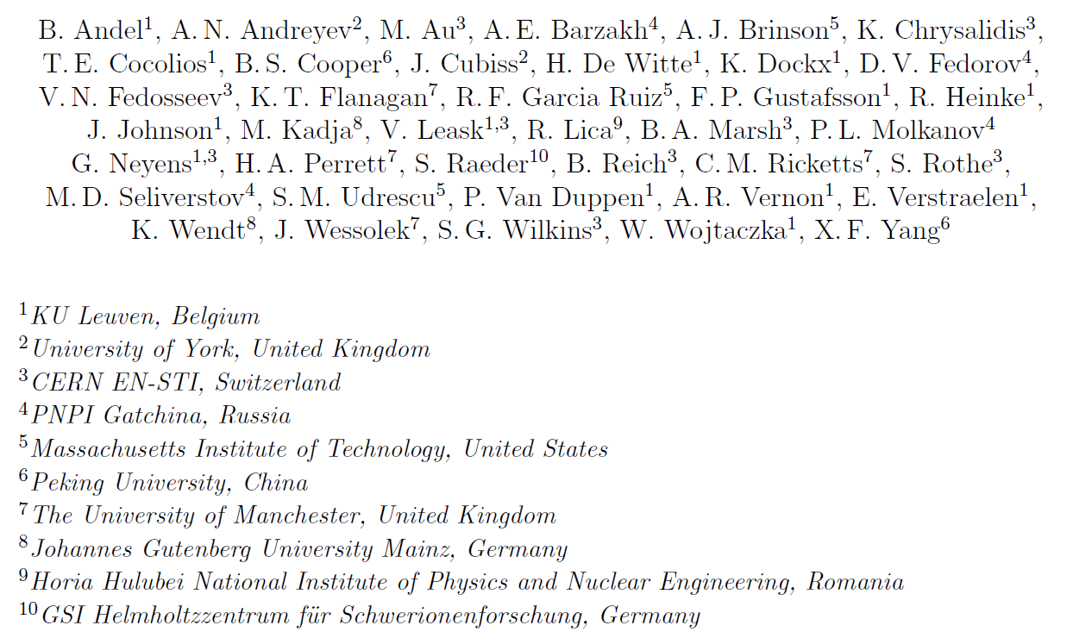
Collaboration

Slide 14
Backup slides

Slide 15
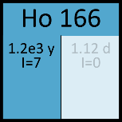
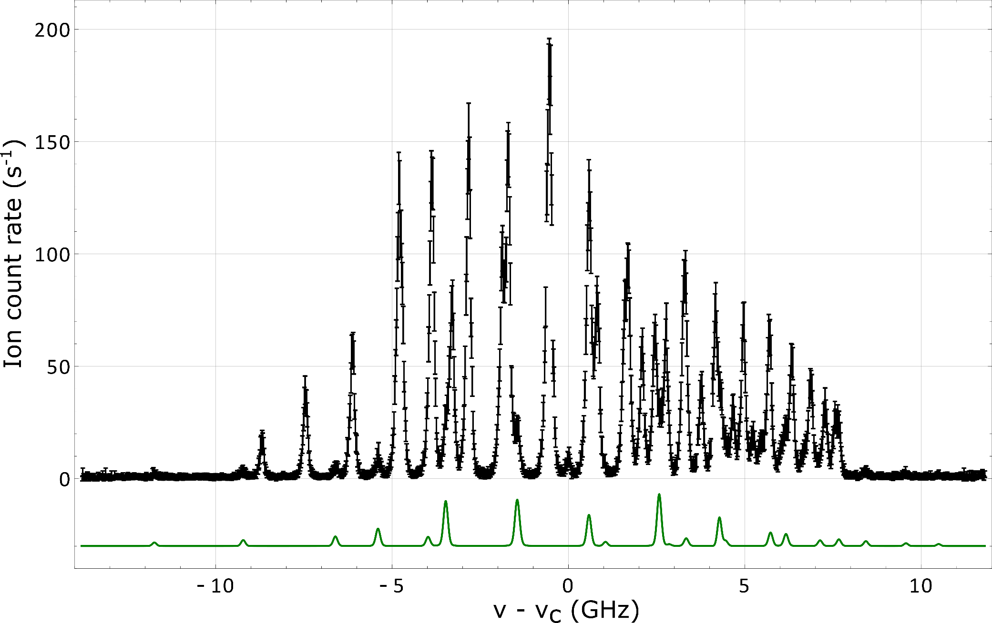
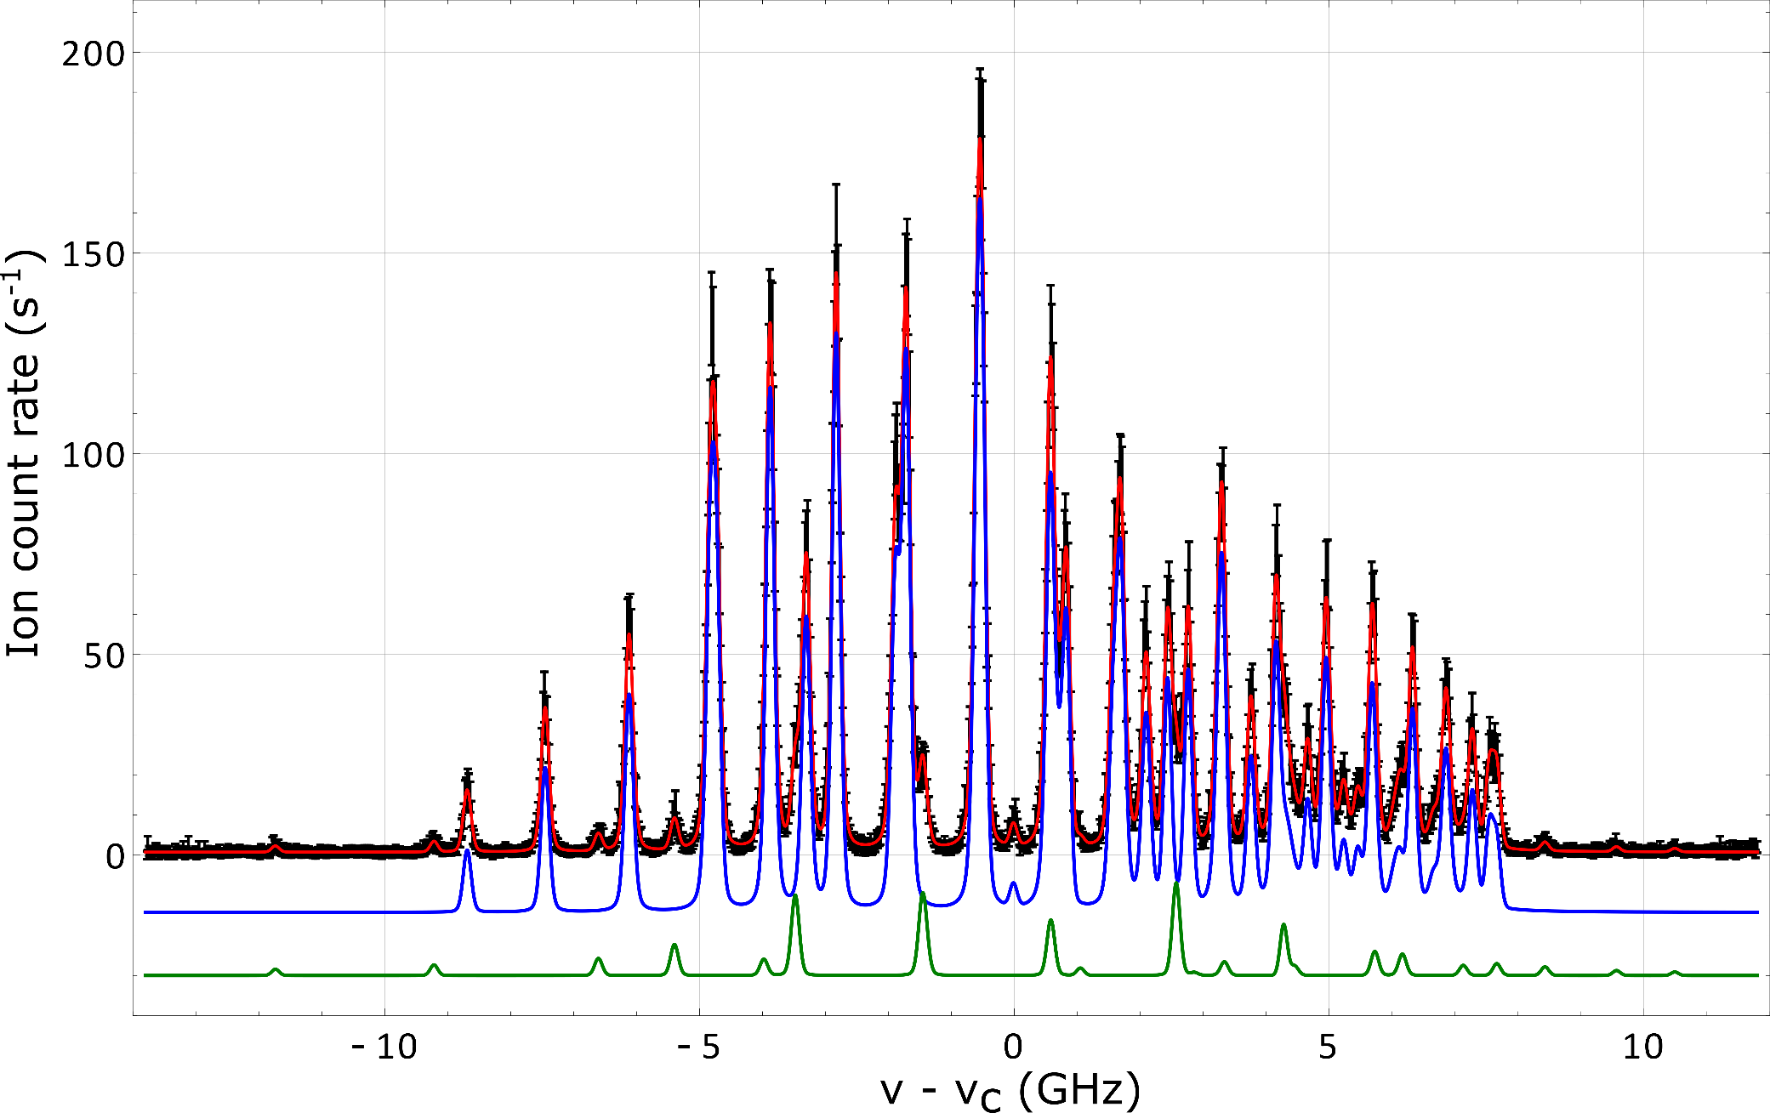
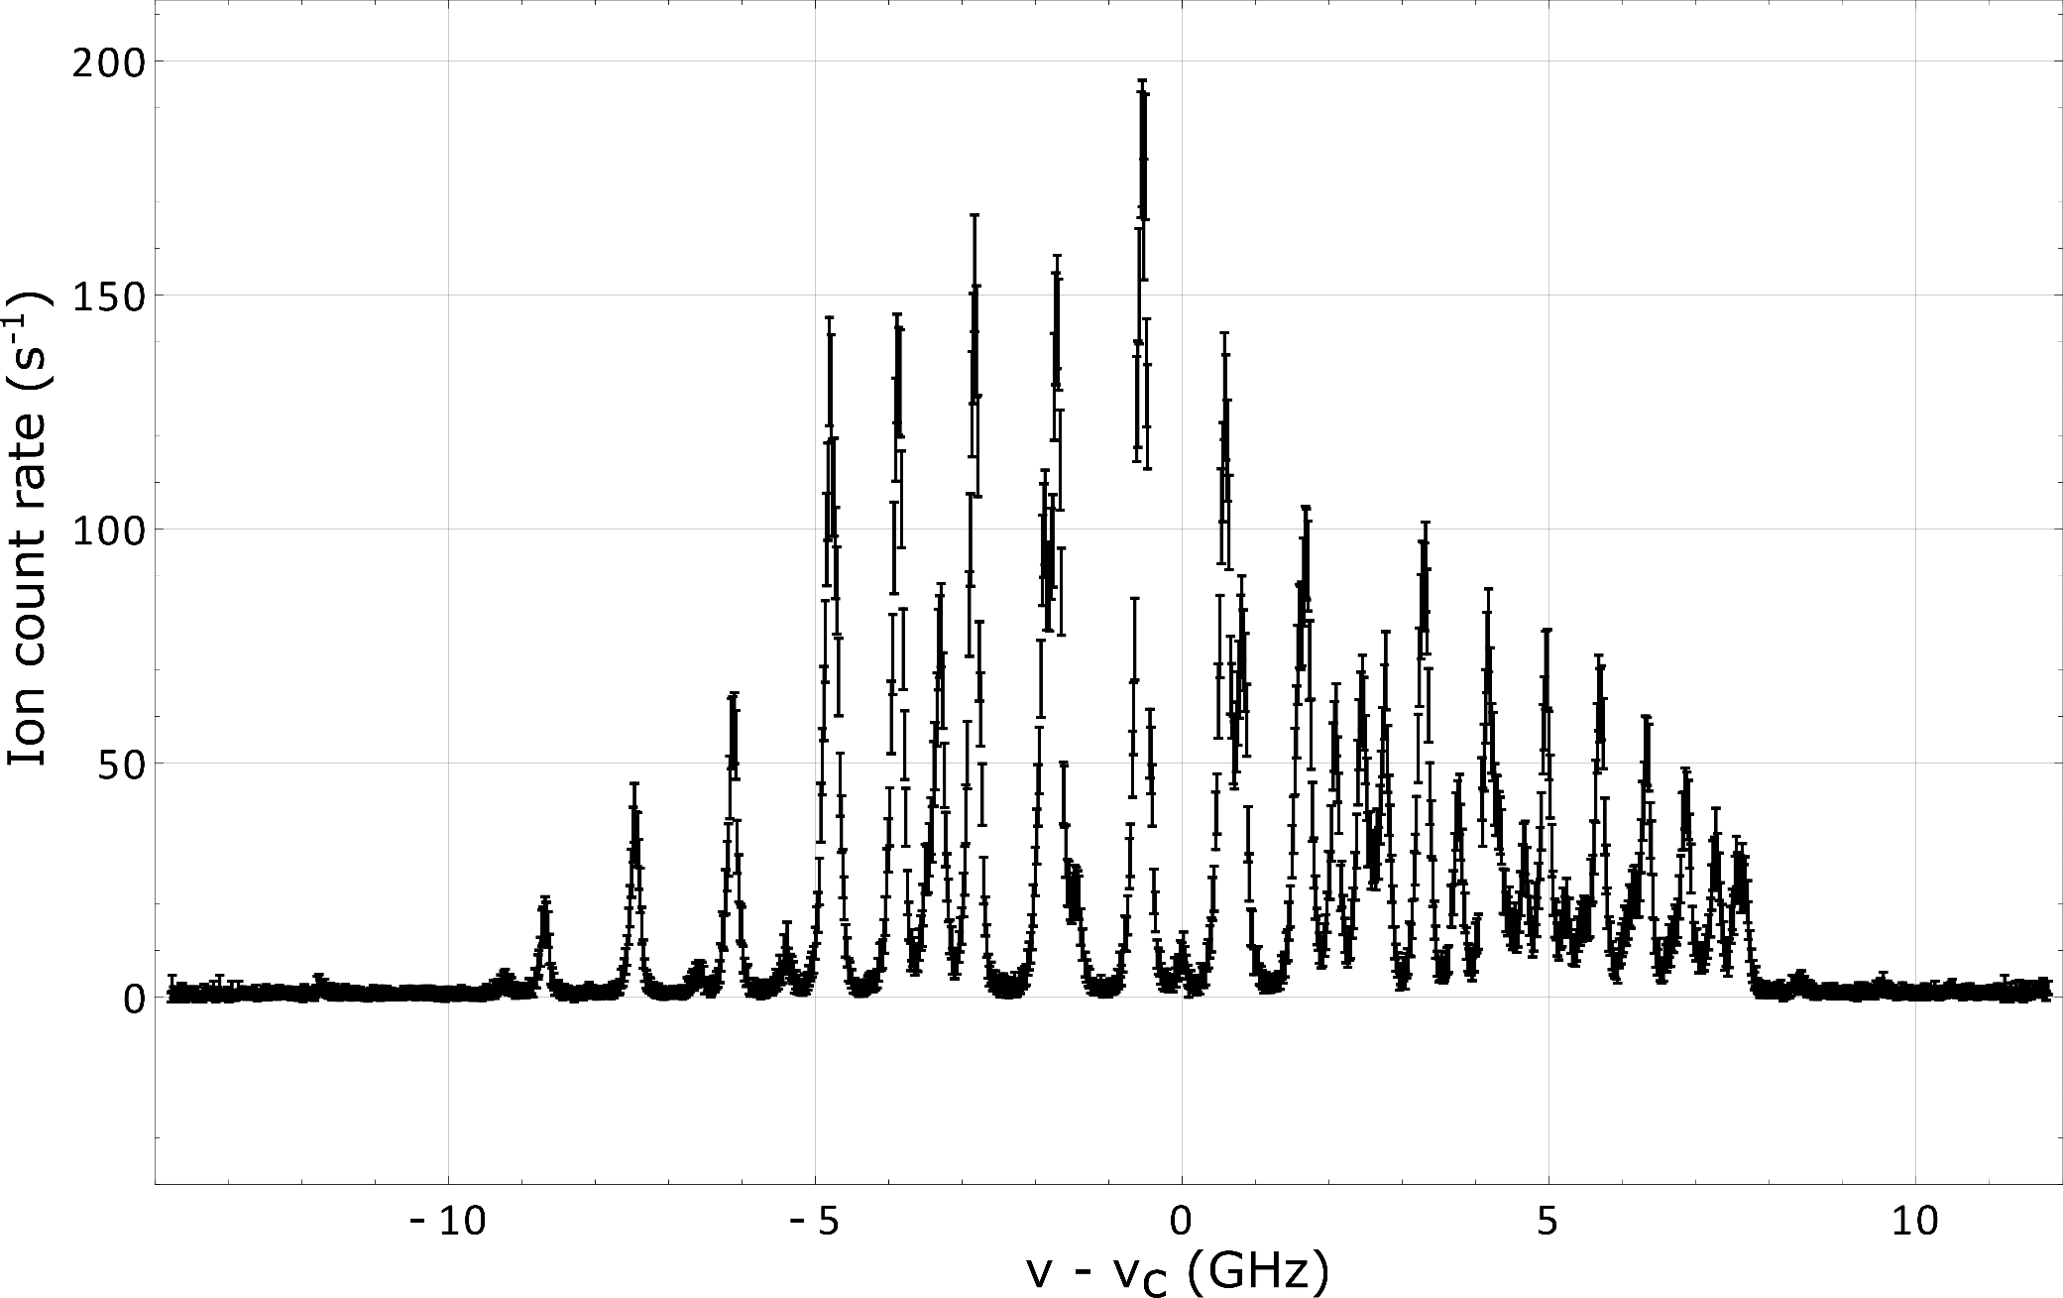
PI-LIST Spectroscopy on ^{166m}Hoc
Internal reflection
PI-LIST mode
¹⁶⁵Ho fit
^{166m}Ho fit
Standard
in-source
Cumulative fit
FWHM = 160 MHz

Slide 16
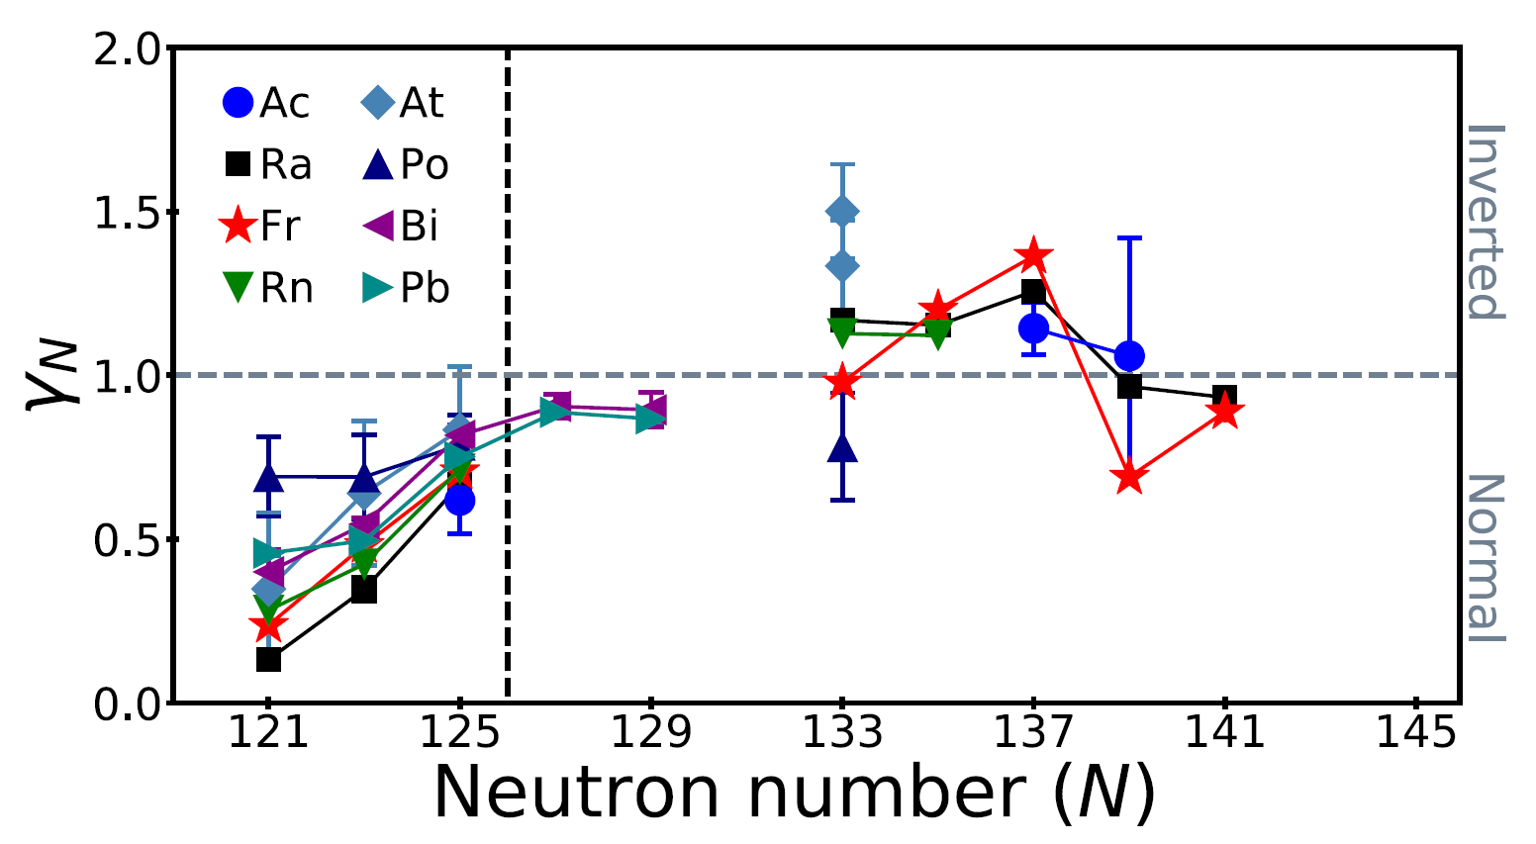
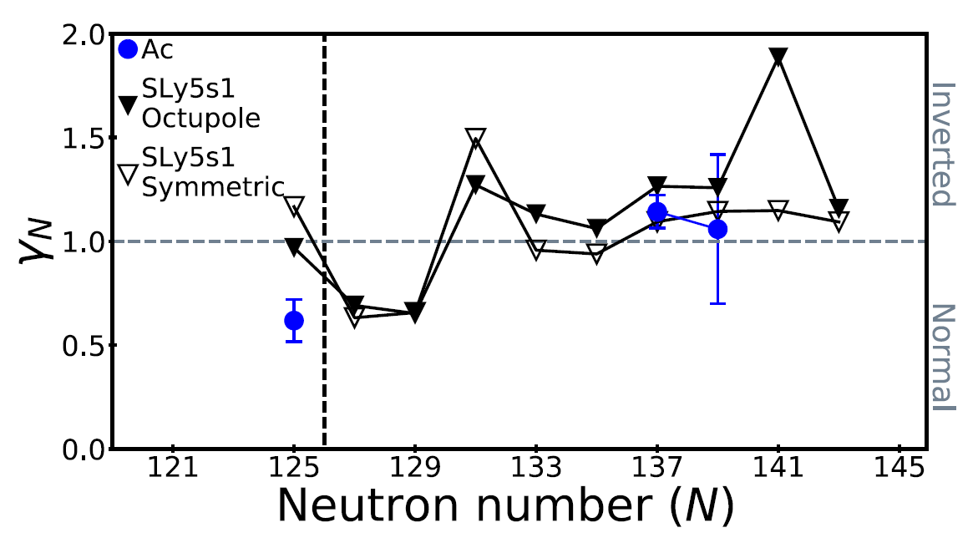
Inverse odd-even-staggering in actinium
Fig. from Verstraelen et al., Phys. Rev. C 100, 044321 (2019)
²²⁸Ac
²³²Ac

Slide 17
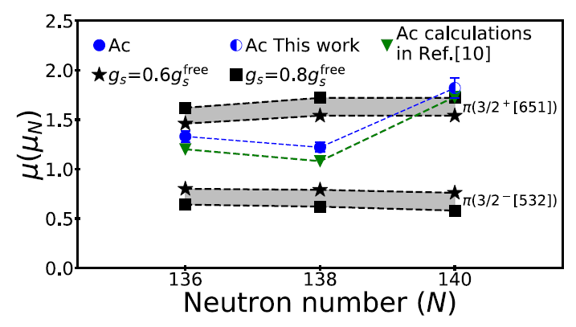
Nuclear moments in actinium
Fig. from Verstraelen et al., Phys. Rev. C 100, 044321 (2019)

Slide 18
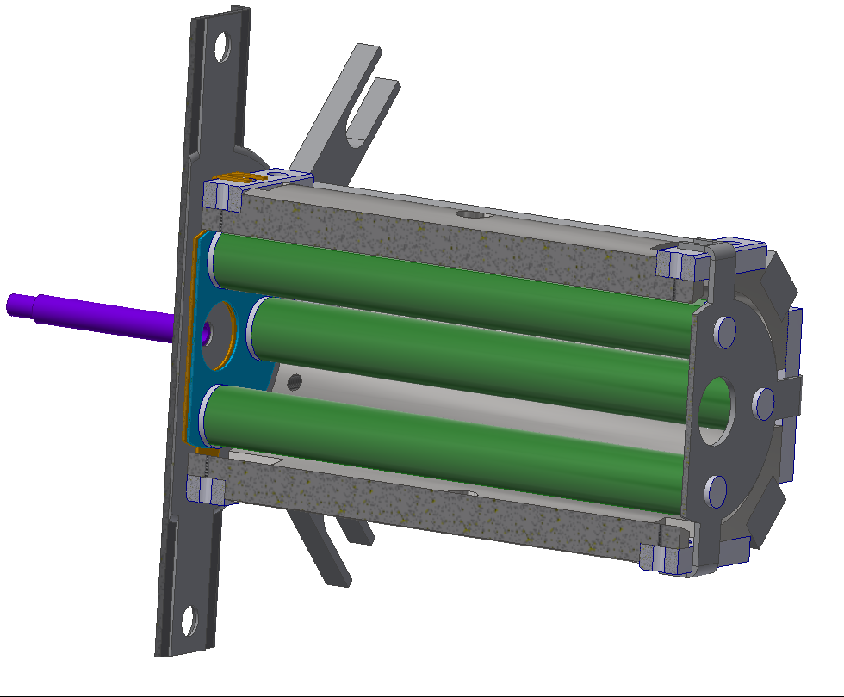
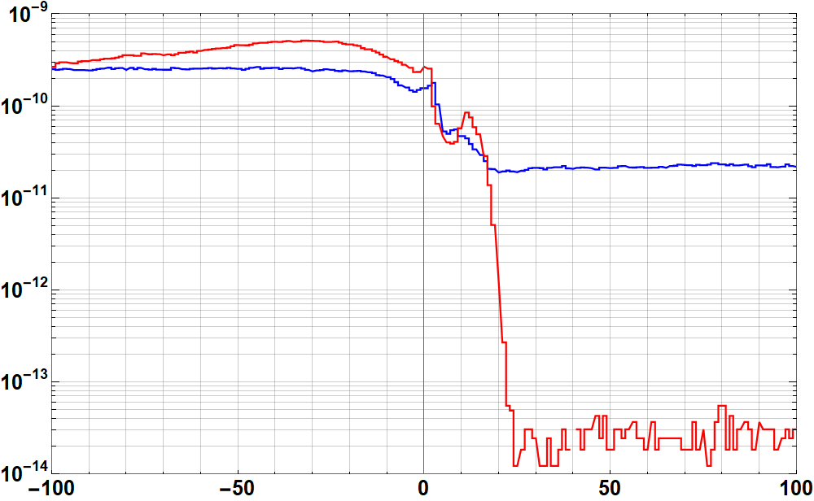
Standard LIST for IS614 (2018)
Loss Factor:
≈ 30
IonCurrent (A)
Suppression
Factor:
> 10⁴
Ion Guide mode
LIST mode
²⁴Mg Laser Ions
²³Na Surface Ions
Repeller Voltage (V)
Radioisotopes (β counting)
 | Before run | After run (4 days)
Loss Factor (²²Mg, T_{1/2} = 3.9s) | 28 | 26
Suppression Factor (²¹Na, T_{1/2} = 22.5s) | 1.0 · 10⁶ | 1.6 · 10⁶

Slide 19
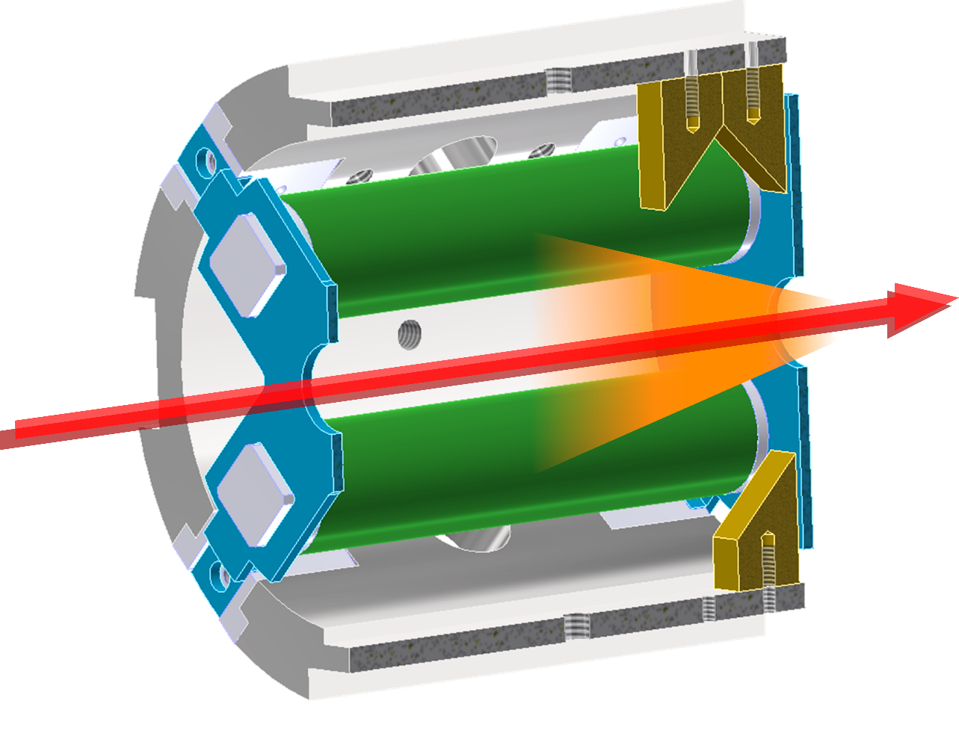
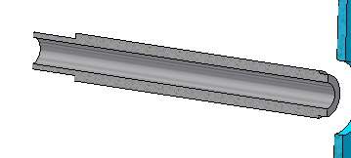
The Laser Ion Source and Trap LIST
45 mm
Metallic mirrors
Atomizer
Machined at
JGU mechanical workshop
Optional surface treatment
by pulsed laser deposition
Transversal reflection by robust metallic mirror surfaces
Off-axis guiding of spectroscopy laser through ion beam line

Slide 20
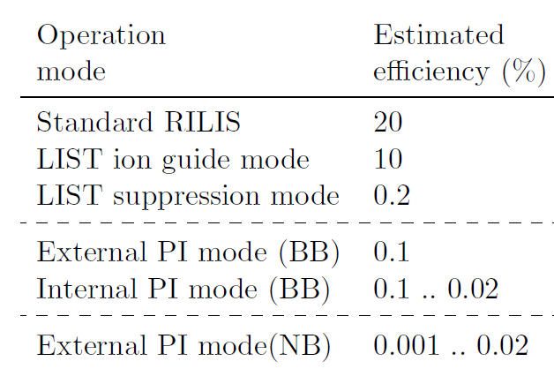
Efficiency considerations
Loss factors
RILIS → LIST
~ 30
LIST → PI-LIST
~ 4
PI-LIST opt.
~ 10
~ 1,000
➔ Overall efficiency 10⁻⁴ .. 10⁻⁵

