Slide 1
EUROPEAN ORGANIZATION FOR NUCLEAR RESEARCH
Proposal to the ISOLDE and Neutron Time-of-Flight Committee
Development of new rare-earth-free hard magnetic materials
D. Zyabkin¹, I. Unzueta², R. Mantovan³, H. P. Gunnlaugsson⁴, H. Masenda⁵, D. Naidoo⁶, K. Bharuth-Ram⁷, J. Schell^{7,8}, P. B. Krastev⁹, S. Ólafsson¹⁰, B.Qi¹⁰, T. T. Dang⁷, K. Johnston⁸, D. C. Lupascu⁷ P. Schaaf¹
¹Department of Materials for Electronics, Institute of Materials Science and Engineering, TU Ilmenau, 98693, Germany
²Department of Applied Mathematics, University of the Basque Country UPV/EHU, 48013, Spain
³Laboratorio MDM, IMM-CNR, Via Olivetti 2, 20864, Agrate Brianza (MB), Italy
⁴Science Institute, University of Iceland, Dunhaga 3, IS-107 Reykjavík, Iceland
⁵School of Physics, University of the Witwatersrand, WITS 2050, South Africa
⁶University of KwaZulu-Natal, Durban 4001, South Africa
⁷Institute for Materials Science and Center for Nanointegration Duisburg-Essen (CENIDE), University of Duisburg-Essen, 45141, Germany
⁸European Organization for Nuclear Research (CERN), CH-1211 Geneva, Switzerland
⁹Institute for Nuclear Research and Nuclear Energy, Bulgarian Academy of Sciences, Sofia, 1784, Bulgaria
¹⁰Science Institute, University of Iceland, 107, Iceland
1
INTC-P-564

Slide 2
New hard magnets?
Growing amount of autonomous vehicles, automatization
High demand of hard magnets
Depletion of rare-earth metals
(Nd, Dy, Tb etc)
Hard magnets without rare-earths?
Alternatives?
MnX (X= Al, Bi & Ga)
2
INTC-P-564

Slide 3
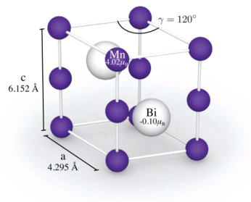
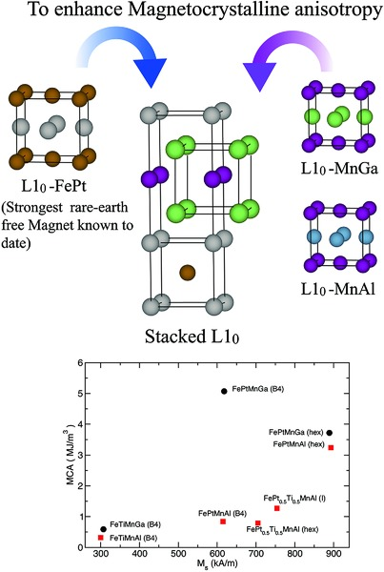
Candidates
Not a single phase
Segregation of Mn?
Doping theoretically may lead to high magnetization
hex.- MnBi
Metastable
Where is surplus of Mn? Which site?
Doping? Deteriorates magnetic properties!
Fe-doped is stable, what about dilute concentrations?
L1₀- MnAl
3
INTC-P-564

Slide 4
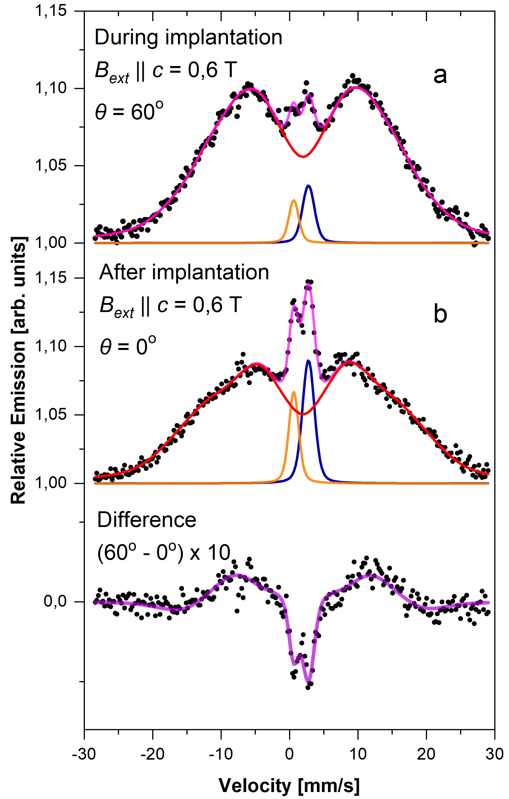
Candidates
Reveal the interplay between structure/strain and magnetism
Origin of the unexpected large hyperfine field at Ga sites
L1₀- MnGa
Expected:
negligible hyperfine fields with In at Ga sites
Observed:
huge hyperfine fields with ¹¹⁹In
LS2 did not allow to finalize the studies
In/Sn measured at angles of 60 and 0 under 0.6T during (a) and after (b) implantation.
4
INTC-P-564

Slide 5
Feasibility
WHAT?
HOW?
As a function of
Sample stoichiometry
  Mn_{x}Al [x=49-60]
  Mn_{x}Bi [x=49-60]
  Mn_{x}Ga [x=0.7-1.9]
Annealing and measuring temperature
Magnetic field
MnAl, MnBi & MnGa by electron beam and magnetron sputtering
[TU Ilmenau]
Implantation depth [TRIM est. at 40 keV]:
19/13 nm [⁵⁷Mn/ ¹¹⁹In] into MnAl
22/16 nm [⁵⁷Mn/ ¹¹⁹In] into MnBi
15/10 nm [⁵⁷Mn/ ¹¹⁹In] into MnGa
[ISOLDE/CERN]
5
INTC-P-564

Slide 6
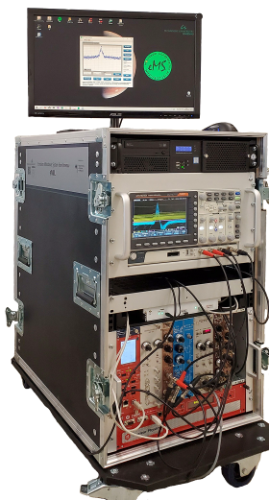
Feasibility
Emission Mössbauer spectroscopy
Probe-host & probe-defect interaction
  Valence, site symmetry, magnetic interactions, diffusion, spin relaxation, binding properties
Dilute concentration (~10⁻⁴ at.%)
Short spectra collection time
6
INTC-P-564

Slide 7
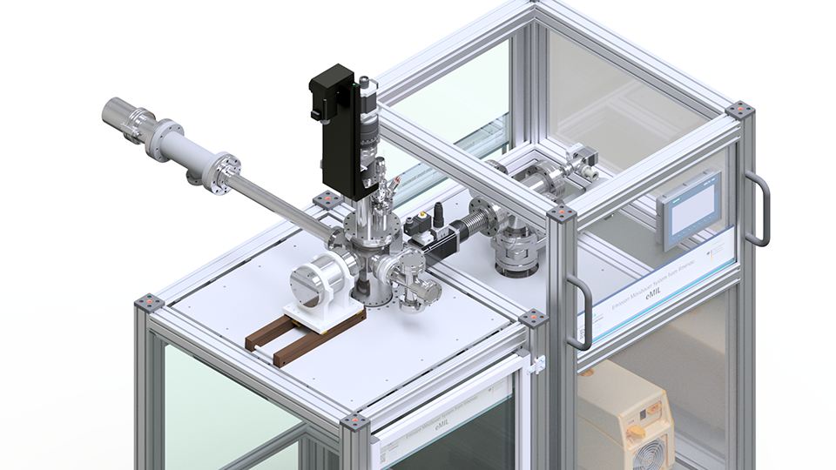
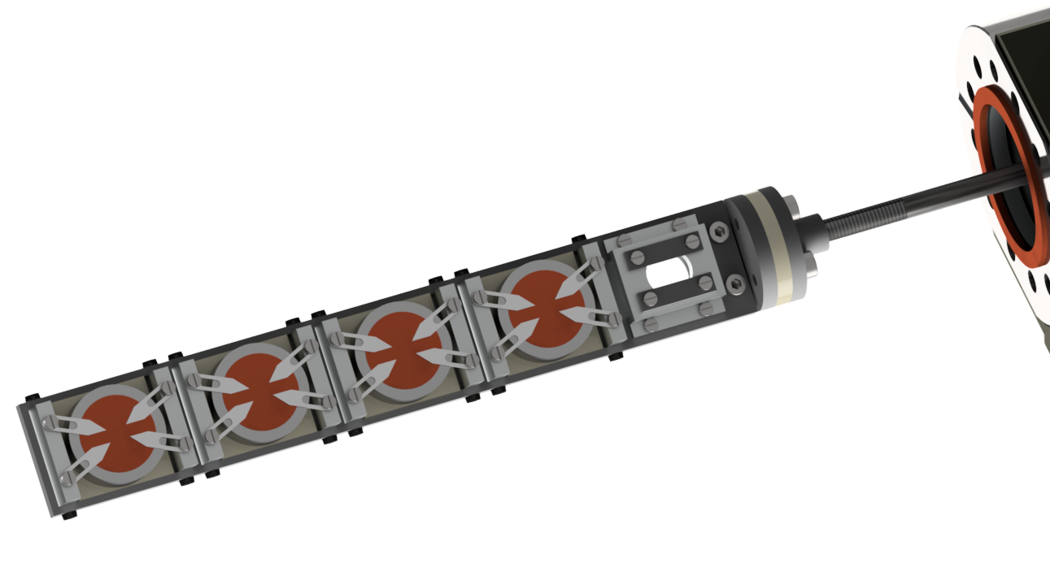
eMIL
Annealing up to 1100 K
Time-delayed measurements
Angular dependence
Solid Base for future modifications
Cryogenic measurements
Zyabkin et al. Nucl. Instrum. Methods Phys. Res A.968 (2020)
7
INTC-P-564

Slide 8
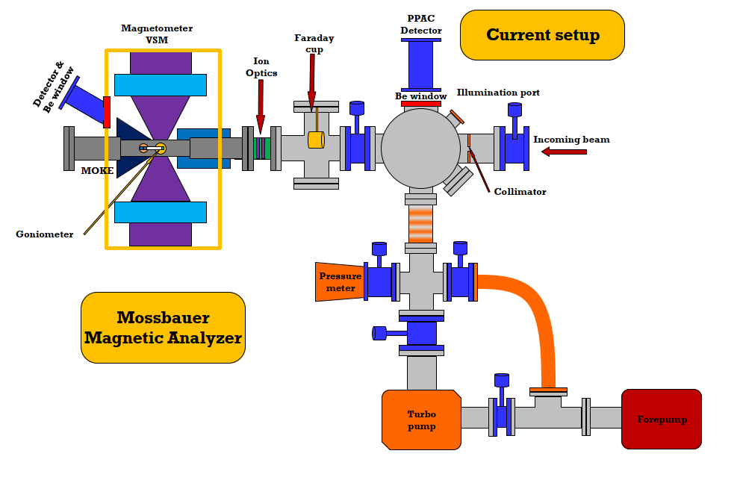
eMIL + eMMA
Magnetic field up 2.2 T
Off/On-line usage
Heating & possible cooling
Promising platform for investigation of magnetic materials
8
INTC-P-564

Slide 9
BEAM TIME REQUEST
Isotope | Minimum intensity | Beam energy | Shifts | Target | Ion source
⁵⁷Mn (1.5min) | (1-3) x 10⁸ | ≥ 40 keV | 10 | UC_{x} | Mn RILIS
¹¹⁹In (2.1min) | (2-3) x 10⁸ | ≥ 40 keV | 5 | UC_{x} | In RILIS
9
INTC-P-564

Slide 10

FUNDING INVOLVED
BMBF
Bundesministerium für Bildung und Forschung
Erforschung kondensierter Materie mit Großgeräten
Ausbau und Unterhalt der Einrichtungen an ISOLDE/CERN
Germany, contract: 5K19SI1
10
INTC-P-564

Slide 11
Thank you for your attention!
11
INTC-P-564

Slide 12
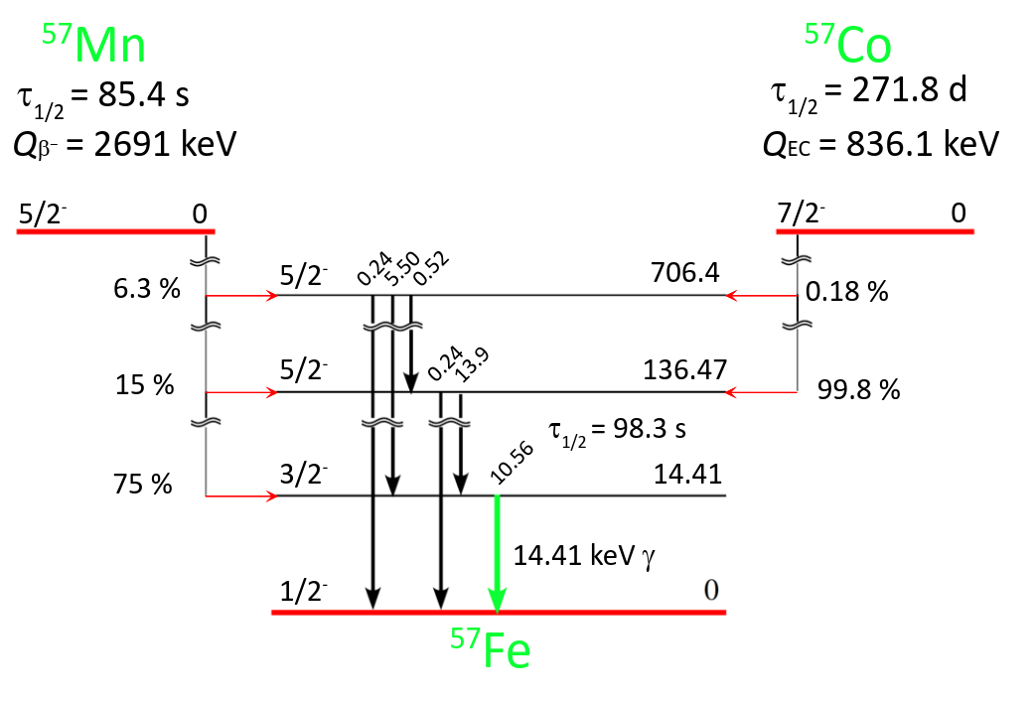
Additional information eMS
⁵⁷Mn/⁵⁷Fe
12
INTC-P-564

