Slide 1
Impact & Sustainability
(Work package 4 )
Silvia Vignetti (CSIL)
Monday, 9 November 2020, 14:30-15:00
This project has received funding from the European Union's Horizon 2020 research and innovation programme under grant No 951754

Slide 2
WP 4 rationale
FCC: a project designed for sustainability.
eDevelop a project scenario for the implementation of the new research infrastructure that delivers long-term service for a worldwide science community.
SO5 Demonstrate the role and impact of the research infrastructure in the innovation chain focusing on responsible resource use and managing environmental impacts

Slide 3
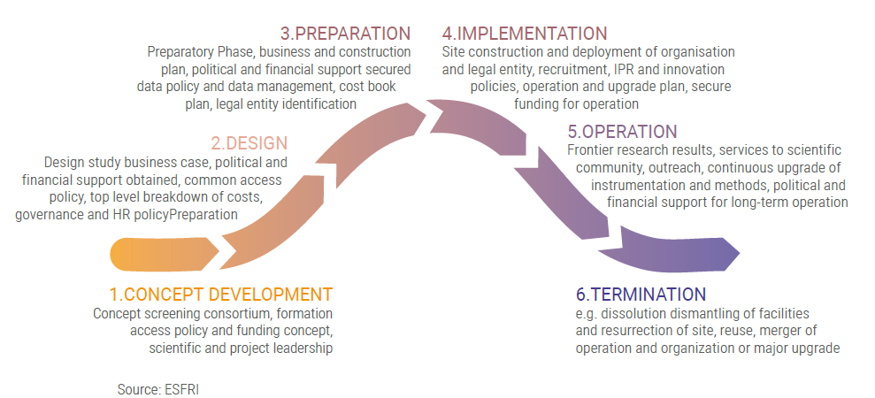
A LIFECYCLE APPROACH TO IMPACT ASSESSMENT
Lifecycle of a Research infrastructure

Slide 4
WHY SUSTAINABILITY IS IMPORTANT
A condition for feasibility and responsibility
A condition for acceptance

Slide 5
HOW CAN WE ENSURE SUSTAINABILITY?
Financial and environmental sustainability
  cost effectiveness and resource-responsibility
Socio-economic impacts
  User community engagement and capacity building
Economic perspective

Slide 6
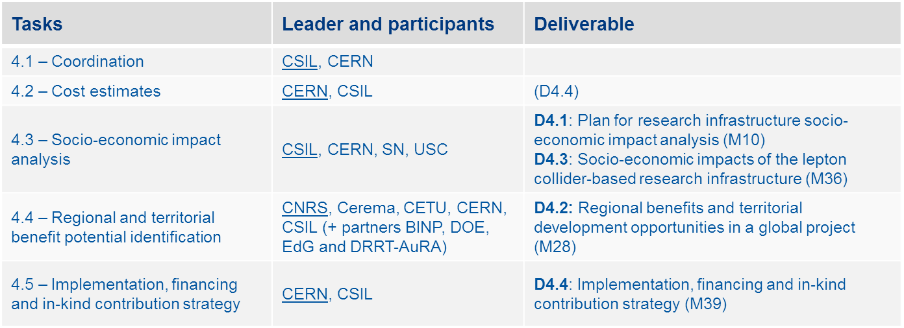
WP4 IN A NUTSHELL
Objectives:
  Develop the financial roadmap of the project
  Estimates of ranges and likelihoods of different impact
  Formulate recommendations for cost-effective and sustainable infrastructure

Slide 7
SOCIO-ECONOMIC IMPACT PATHWAYS
Science
Products
Public
Good
Value
Education
and
Training
IMPACT
Cultural
Effects
Industrial
Spillovers
ICT and Data
Spillovers

Slide 8
IMPACT PATHWAY LOGIC

Slide 9
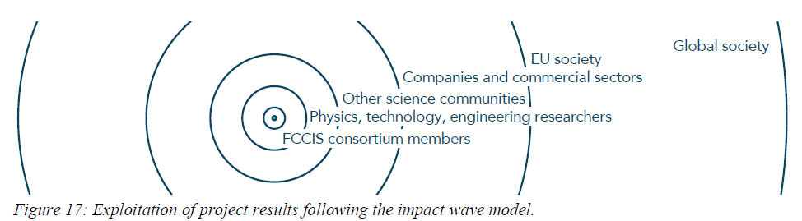
ENGAGING USERS COMMUNITIES

Slide 10
Maximising VALUE for society
Cultural benefits
Communication strategy
Non-use value

Slide 11
“To recognize that the public sector creates value we must first find ways to assess that value including the spill-overs.”
(M. Mazzucato)
THANK YOU
Silvia Vignetti
vignetti@csilmilano.com

