Slide 1



Grant agreement No 951754
Collider requirements and constraints
Volker Mertens
FCC November Week
10.11.2020
FCC
LHC
PS
SPS
Die Lösung ist immer einfach, man muss sie nur finden. A. Solschenizyn
Photo: J. Wenninger

Slide 2
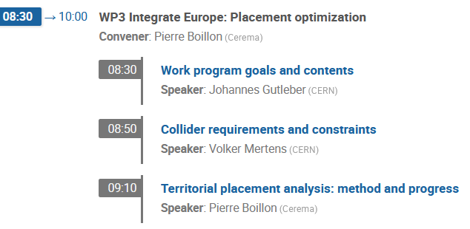
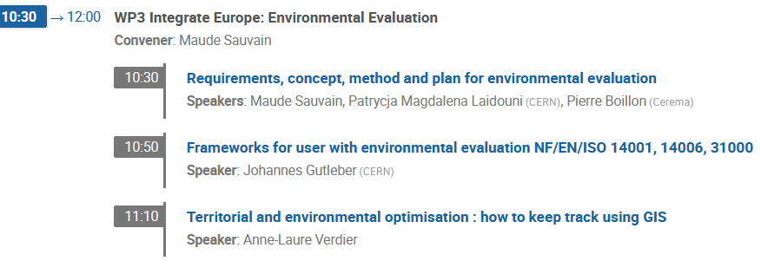
Scope, related presentations, acknowledgements
Many aspects are linked to such a monumental endeavour as the FCC, each with its own requirements and constraints:
physics, collider design, technologies, ... (the „machine“)
geology, topology, infrastructure, urbanistic, environment, ... (the „environment“ in which to implant the machine)
In this presentation I‘ll discuss some of the blue aspects.
Urbanistic, environmental ... aspects
... and other WP3 talks
Tuesday
Tuesday
Many thanks to W. Bartmann et al., Cerema team (P. Boillon et al.), H. Gerwig, J. Gutleber, M. Jones, J. Osborne,
I. Rühl, D. Schulte, A. A. Tudora, A.-L. Verdier, F. Zimmermann for material, discussions, great collaboration.

Slide 3
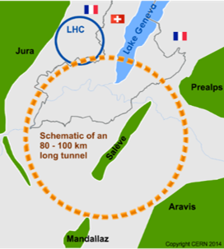
Major design considerations
Physics goals
energy, precision, run time (years of functioning), number of experiments
FCC-ee: synchrotron radiation (gets emitted, when relativistic charged particles get deflected);
for high beam current (many particles) and high energy, that energy loss gets substantial.
FCC-hh: until which force, precision, size of beam hole (aperture) can bending magnets
be produced (and operated) at an affordable cost.
Technological limitations
Proximity of exist. research
infrastructure
pre-accelerators (delivering the pre-accelerated beam (through connection tunnels)), competent people
aspects of complementarity/extension of existing facilities
other service infrastructure (electricity, ...)
Topological
(+ geological) constraints
civil engineering challenges should remain „reasonable“ (construction time, risk of delay/cost increase, tunnel instabilities (operational difficulties, high maintenance cost)), manageable shaft depths
Proposal of approximate placement inside Geneva basin
(in proximity of existing laboratory and pre-accelerators;
within boundaries from limestone formations and Pre-Alps)

Slide 4
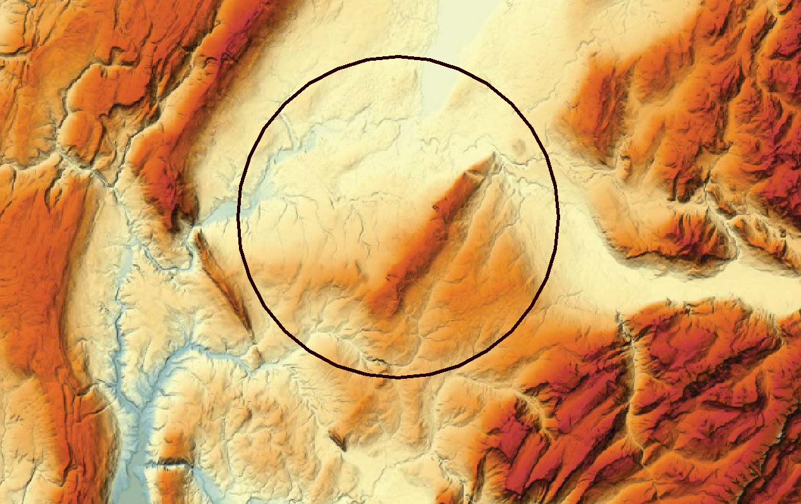

A multitude of constraints to respect …
(other than those from the collider itself)
Non-exhaustive ...
Lac Léman
300 – 372 m/mer
Urbanistic (constructed zones, developing zones,
existing and required infrastructure (access roads, ...))
Synergies also possible (and sought after)
Environmental (natural or agricultural zones, aquifers,
various impact on the surroundings, ...)
lake depth
Plaine du genevois
350 – 550 m/mer
karst
Various human-made objects (geothermal boreholes, gas pipelines, ...)
Vallée du Rhône
∼330 m/mer
Mont Salève
550 - 1380
karst, faults
Valée de l’Arve
400 – 600 m/mer
Plateau du Mont Sion
550 – 860 m/mer
Mont Vuache
550 - 1100
Plateau des Bornes
600 – 850 m/mer
shaft depths, overburden
„Operational needs“ (position of points with important infrastructure requirements and high flow of personnel, electricity and water needs, length and geometry
of beam transfer lines, ...)
Mandallaz
Topography (terrain profile, Lake Geneva, rivers, gorges, ...)
Geology (layers, boundaries/ceilings, fault lines, ...)
Civil engineering (vertical shafts, inclined access tunnels,
tilt of the collider plane to reduce depth of underground structures, ...)

Slide 5
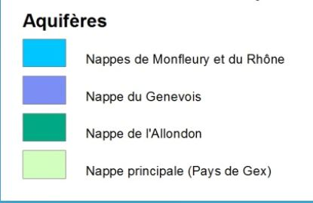
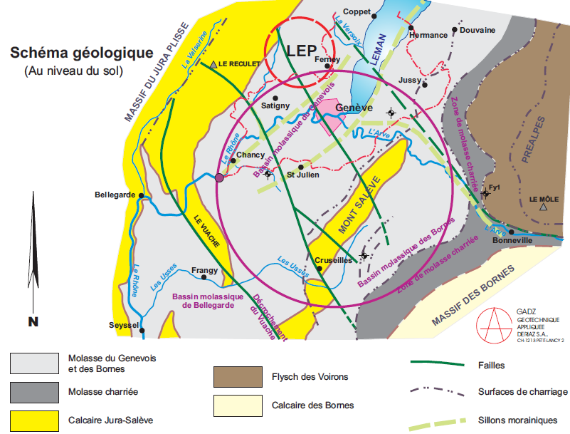
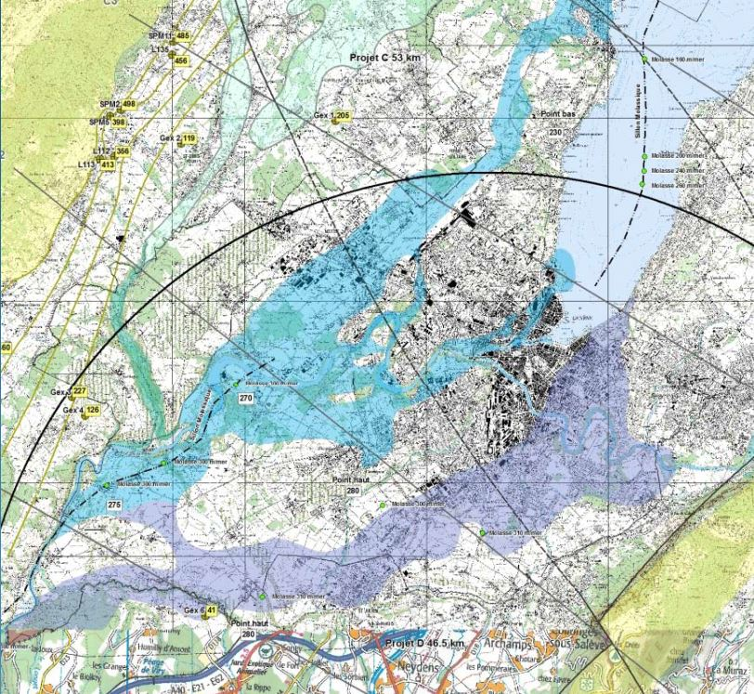
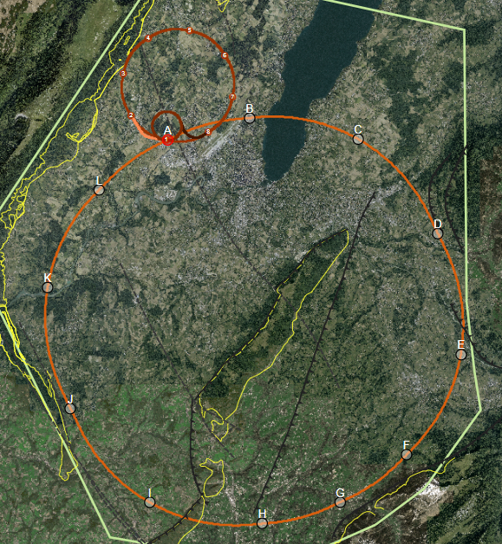
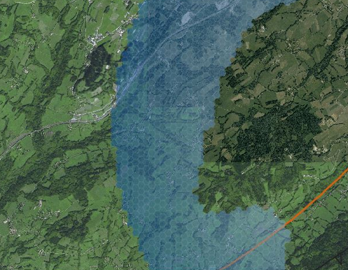
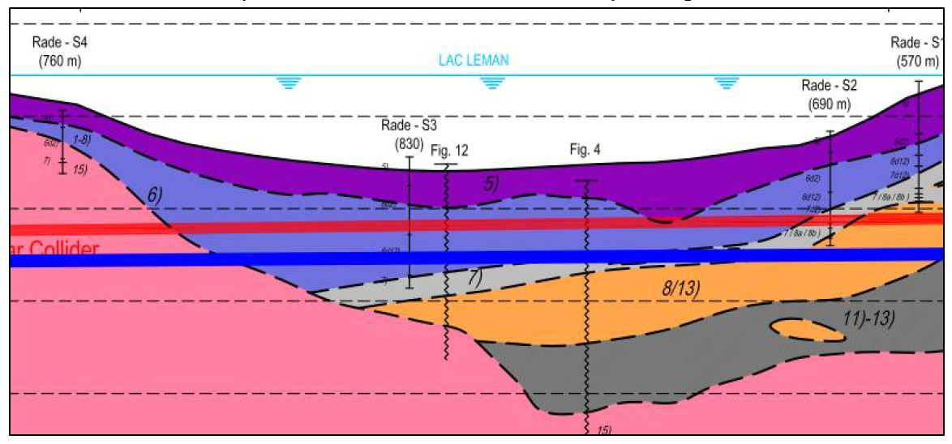
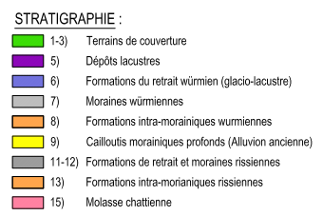
Examples of civil engineering input + study output
GESDEC
Some seismic
and borehole information for lake crossing exist from proposed road tunnel, but layered nature of lake bed leads to uncertainty.
A
B
GADZ
C
L
Criticality / uncertainty of tunnel stretches for CDR baseline scenario
D
K
E
Moraine/molasse interface not certain, cavern close to interface.
Lack of deep boreholes in area.
Hydrogeological database of the Canton of Geneva: Hydrological maps of the main aquifers, protected water sources.
J
Geology and main fault lines
F
I
H
G
TOT tool (ARUP)
Tunnel alignment under Lake Geneva
Investigation into areas from where an inclined tunnel with maximum slope of 15 % could lead to point F (avoiding deep shaft; example for illustration)
GADZ
J. Osborne. A. A. Tudora

Slide 6
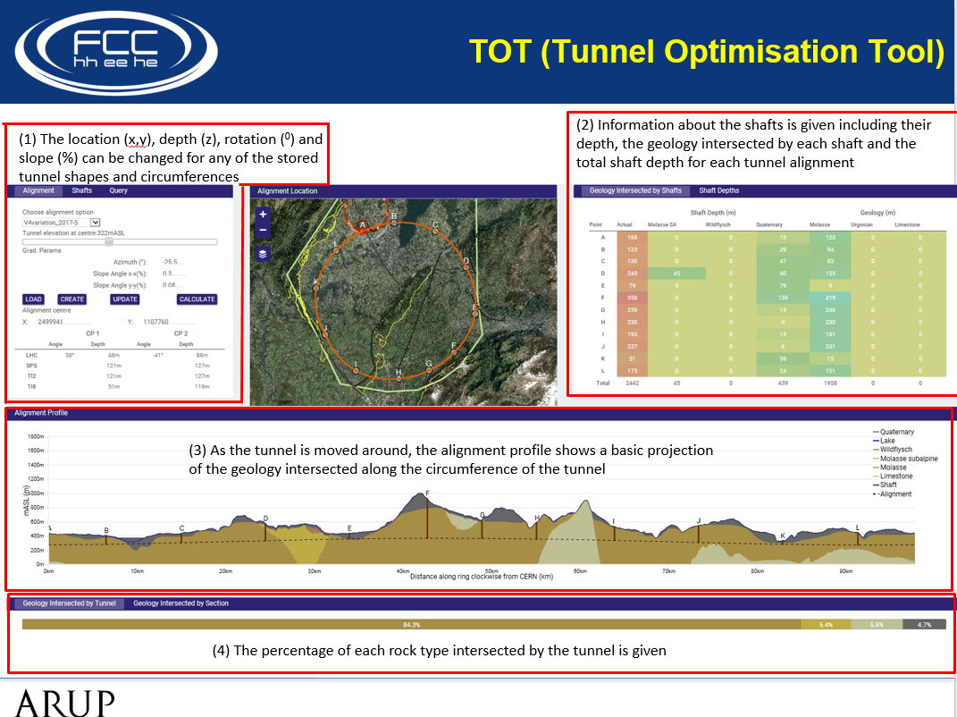
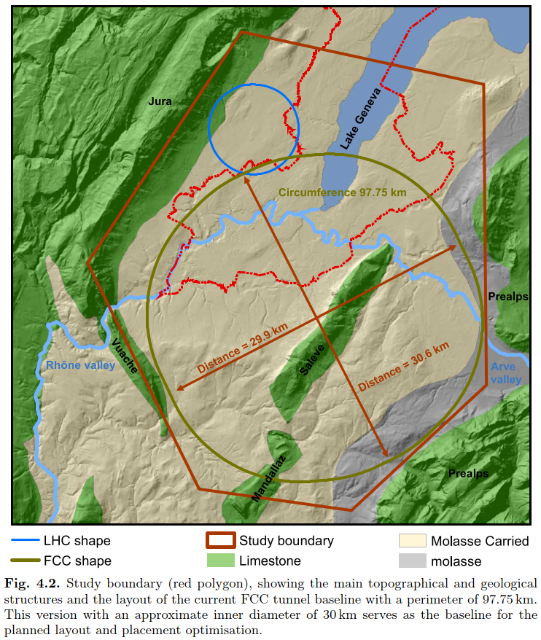
Pre-CDR exploration
First optimisation, mainly from civil engineering considerations, done in FCC study phase I (2014-2018).
NB: many alternative scenarios were also evaluated
(47 km „lakeside“, FCC intersecting LHC vs tangential, racetrack, under Jura, „trans-Jura“, ...).
„Baseline version“
(97.75 km, 12 access points)
published in CDR early 2019,
submitted to EPPSU process
J. Osborne, A. A. Tudora
For given ring shapes and lengths vary ...
LON/LAT
azimuth
depth
tilt
→ shaft depths
→ percentage of various geological formations traversed
Obvious surface obstacles (constructed areas, rivers, ...)
were of course avoided.

Slide 7
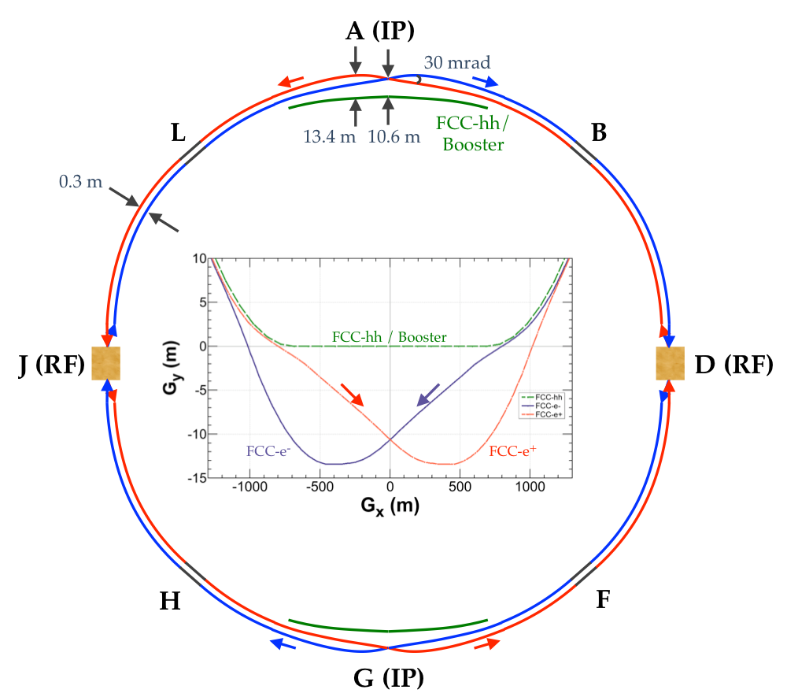
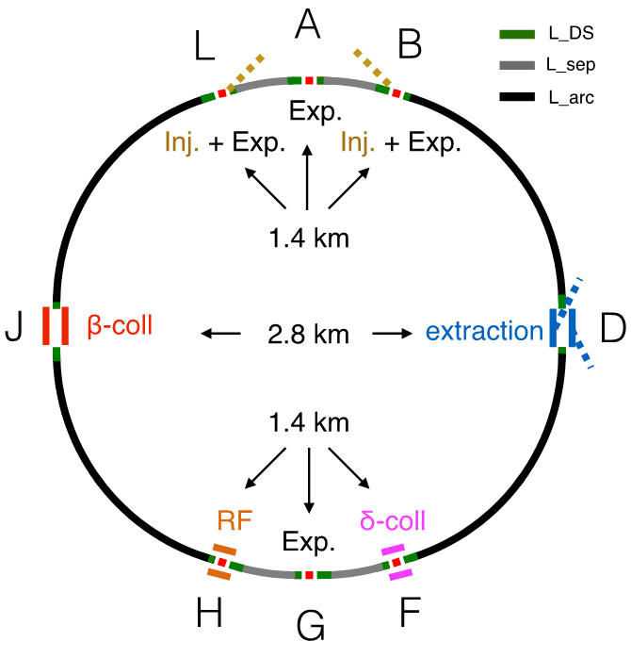
Two phases of FCC
first FCC-ee
then FCC-hh
Same tunnel
Some points change their purpose between FCC-ee and FCC-hh
Experimental zones
2 4
Requirements for both phases need to be taken into account from the outset
(compatibility with geological, territorial etc. constraints, space reservations)

Slide 8
Collider design and constraints (1)
FCC-hh
The ring is not a perfect circle. It is made from curved and from straight parts.
The experiments (the detectors) are installed in the centre of „long straight sections“ (LSS) of 1.4 km each, over which the beams are prepared for the collisions. Auxiliary systems occupy further LSS of 1.4 or 2.8 km, respectively.
The LSS can more easily be lengthened than shortened (to make the FCC fit other constraints). But attention: their lengthening (at constant total circumference) comes at the expense of shortening the arcs. This entails a smaller beam energy (thus reduced discovery potential) or more difficult (thus more expensive) magnets (or a combination of both).
Two beam transfer (injection) lines are needed, bringing beam from the pre-accelerateur (the SPS or the LHC). Two beam extraction lines are also needed, leading to two external beam absorbers.
For best collider performance/beam stability symmetries must be respected, e.g. relative position of experiments, length and distribution of LSS, ...

Slide 9
Collider design and constraints (2)
FCC-hh
The „rest“ of the ring is made from arcs, either „SHORT_ARCs“, here grey, or „LONG_ARCs“, black. The SHORT_ARCs should not be shorter than 1.5 km to limit the cross-talk between experiments.
Due to technical limitations (e.g. helium supply to superconducting magnets), but also for other reasons, the LONG-ARCs cannot reasonably exceed 10-11 km.
This entails the need for 4 additional „MID-ARC“ points. The total number of access points (and surface sites) thus becomes 12.
The arcs are made from „optical cells“ (repetitive sequences of bending and focusing magnets and other beam line elements).
In FCC-hh these cells have a length of 213 m. A priori one can only add or remove complete cells. Taking into account the symmetry requirements, one must repeat that same action in each SHORT_ARC (or LONG_ARC). If the circumference shall not change, one must swap cells between the SHORT_ARCs and the LONG_ARCs.
K
C
I
E

Slide 10
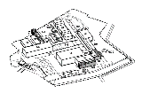
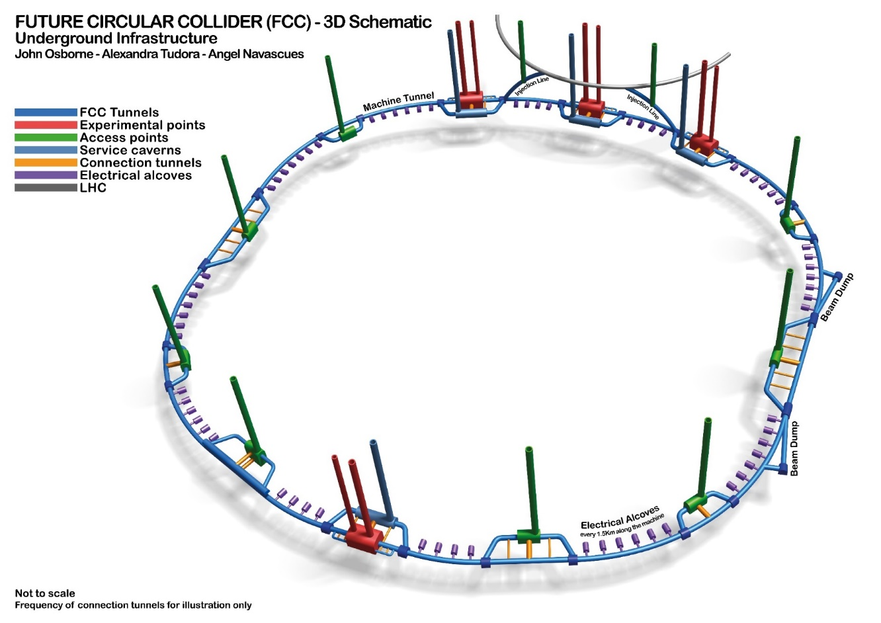

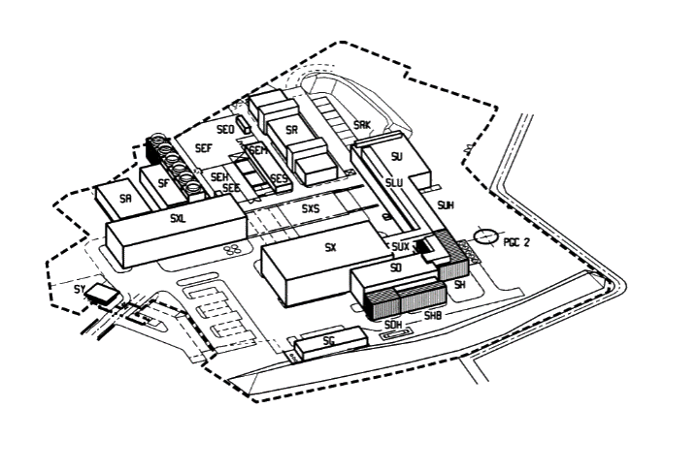
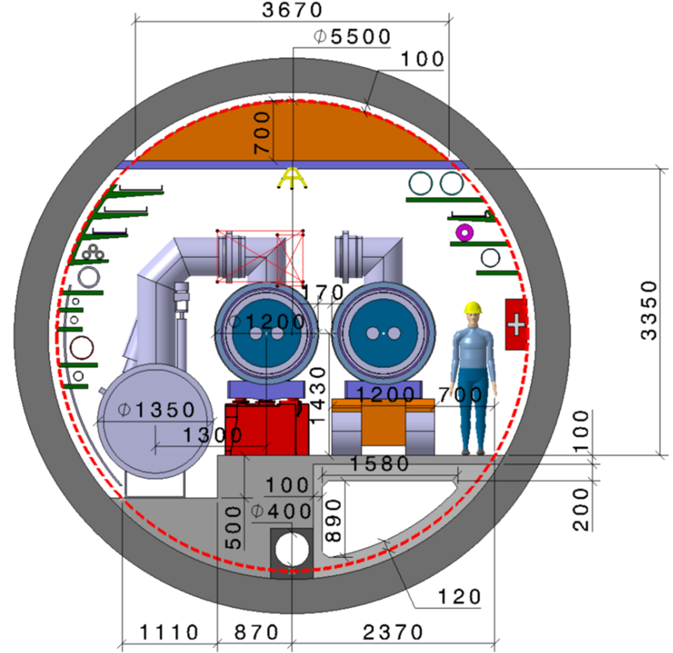
Underground and surface structures
At each of the 12 points around the collider are underground structures (caverns, galleries) and surface structures (halls, service buildings, electrical sub-stations, ...).
The underground and surface structures at each points are linked by one or more shafts of the required diameter, typically 12 to 18 m.
The size of the structures, their layout and the number of shafts depend on the type of point (larger for an experimental site, relatively small for a MID-ARC point). Detailed requirements are being compiled.
Also the position of the shafts and structures relative to the machine depends on the point use. Experiment shafts must a priori be located exactly over the beam trace (at about ± 20 m from the nominal point position). For other systems, e.g. at the MID-ARC points, a certain flexibility is possible (getting back to this on slide 14). This deviation from the normal case demands specific technical solutions, and causes usually extra cost. Such cases must be individually studied and their feasibility confirmed.
FCC-hh
97.75 km
200-400 m
schematic
not to scale
5.5 m Ø
few ha

Slide 11
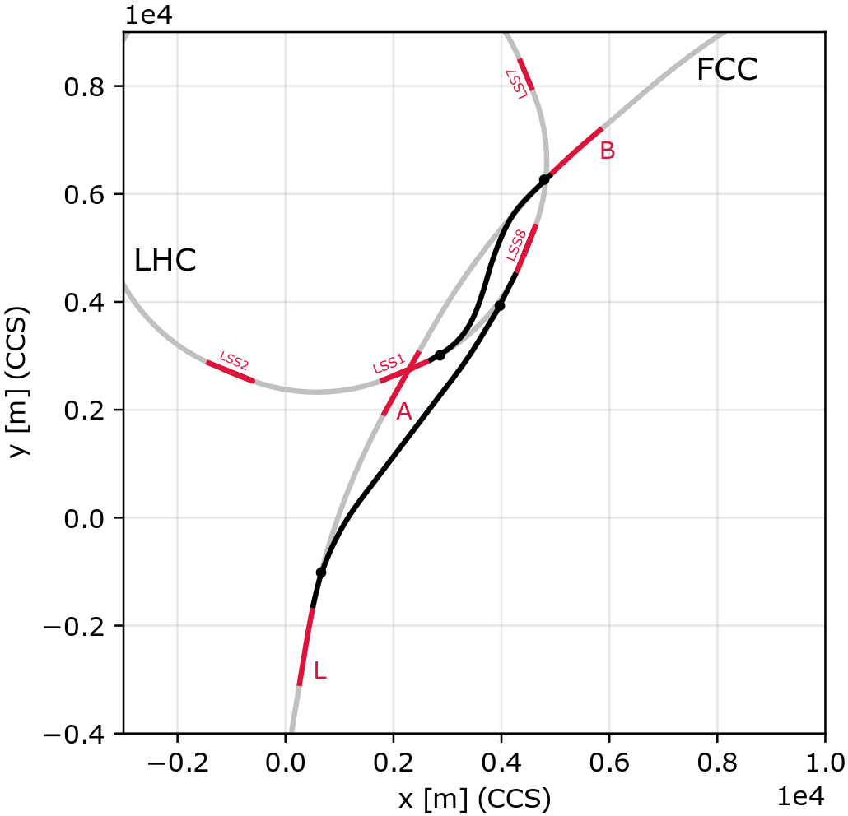
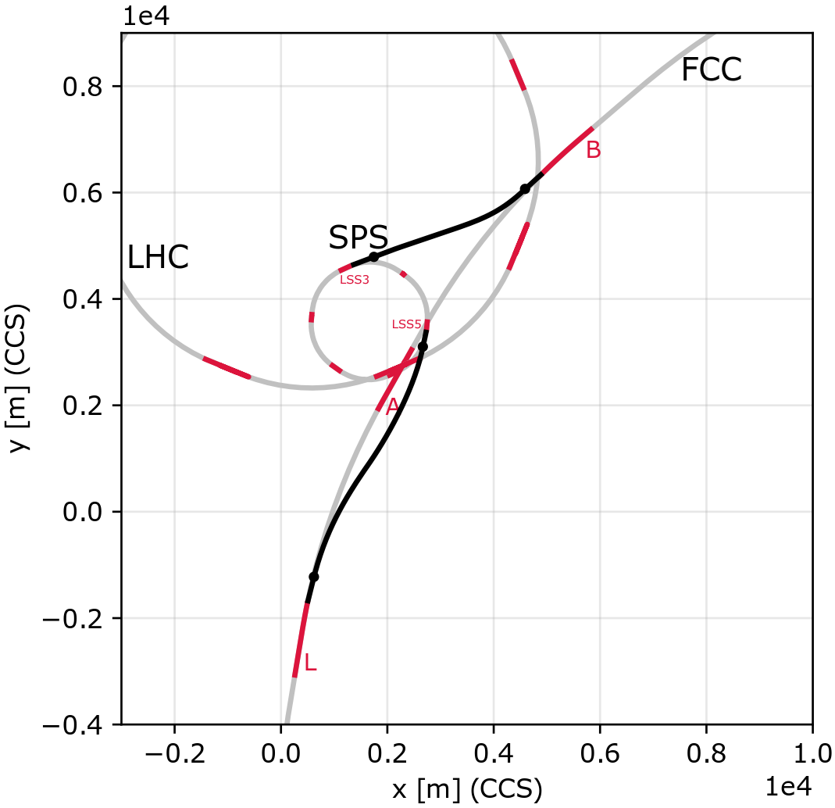
Beam transfer
(values for FCC-hh baseline scenario)
LHC to FCC
scSPS to FCC
Length given from extraction to injection.
Alternative: LHC_2 → FCC_B,
5 T dipoles, line factor 2 longer.
sc
Beam transfer (all in [km]) | SC part (7.2 T) | NC part (1.8 T) | Straights | Total length
LHC_1 → FCC_B | 3.9 | - | 0.3 | 4.2
LHC_8 → FCC_L | 1.5 | - | 5.9 | 7.4
scSPS_3 → FCC_B | - | 1.9 | 2.5 | 4.4
scSPS_5 → FCC_L | - | 4.4 | 1.3 | 5.7
W. Bartmann, B. Goddard, E. Renner

Slide 12
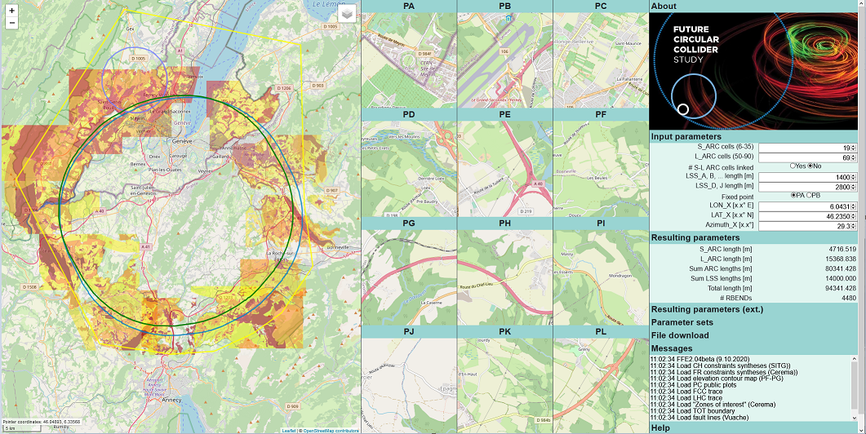
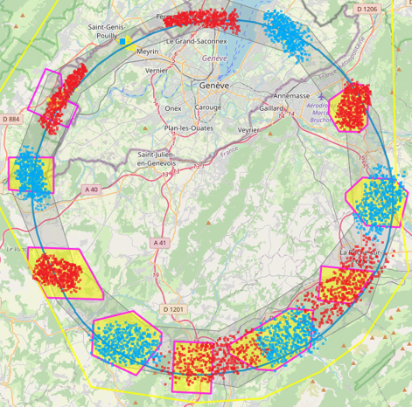
Post-CDR exploration (first step)
During 2019 and 2020, gathered much more input on territorial constraints → needed an efficient tool which allows to
vary machine and geographical ring parameters and update the resulting positions of access points in real time;
use various base maps and superimpose additional layers (e.g. constraints maps/“sensibility grids”).
New Web App „FCC Footprint Explorer“ (1500 lines of JavaScript) allows to scan parameter space much more rapidly.
While using it, underground and transfer line criteria are borne in mind. Following that first exploratory step, results are output for further processing (transfer to ArcGIS data base, production of detailed site description/analysis, “micro-optimisation”, …).
select base map and overlays
vary machine and geographical parameters
constraints maps
for chosen parameters,
the new trace and all point positions are updated in real time
„Assisted pre-search“ (additional SW module varies machine parameters automatically within chosen limits
and outputs candidate scenarios
with enough hits in „target zones“
for manual post-optimisation).
all data shown here are randomised (for illustration only)
12

Slide 13

“Invariants” and flexibility (1)
FCC-hh
Even with this efficient and versatile tool the „perfect“ alignment – fulfilling all criteria in an optimal fashion – wasn‘t found (yet).
Many territorial constraints exist in this densely populated area, and we must cope with „invariants“ (locations which „must“ be used).
The more such „invariants“ one has to respect, the more constrained becomes the search.
Everything is interconnected: trying to reach a „good“ spot in point X can degrade a good match in points Y, Z, ... (NB: 213 m steps !).
For sure: the FCC trace cannot zig-zag around, or change the arc radius, to connect „only ideal“ spots .
Current search follows the paper J. Gutleber/M. Benedikt: „Layout and placement optimization priorities on [F/CH] territory”, providing guidelines on primordial parameters and those where more flexibility is admitted (e.g. position of A, total length, …).
K
C
I
E
Need for flexibility can arise for different causes – the most prominent are land plot (or other territorial) constraints and shaft depth (or other topological aspects like important slope).

Slide 14
“Invariants” and flexibility (2)
Looked with machine designers which symmetries must be preserved and where flexibility exists to move systems.
Looked with (most) systems engineers which flexibility exists to displace systems or to displace access shafts.
„regular“ location of surface site w access shaft
K
C
displaced along the ring
„split“ site
displaced sideways
displaced sideways
(asymmetrically)
inside ring
I
E
Discussion on
mirror symmetry vs 2-superperiodicity ...
So far no showstoppers signalled.
Connecting the “supply” at the nominal point is usually preferred over an asymmetric situation. Expect higher cost and somewhat increased operational complexity.
Some impact on performance and operability may be expected (not yet assessed to detail, awaiting a more firm alignment).
In the end, to arrive at an „all-acceptable“ alignment, once must use such flexibilities to some degree plus „micro-optimise“.

Slide 15
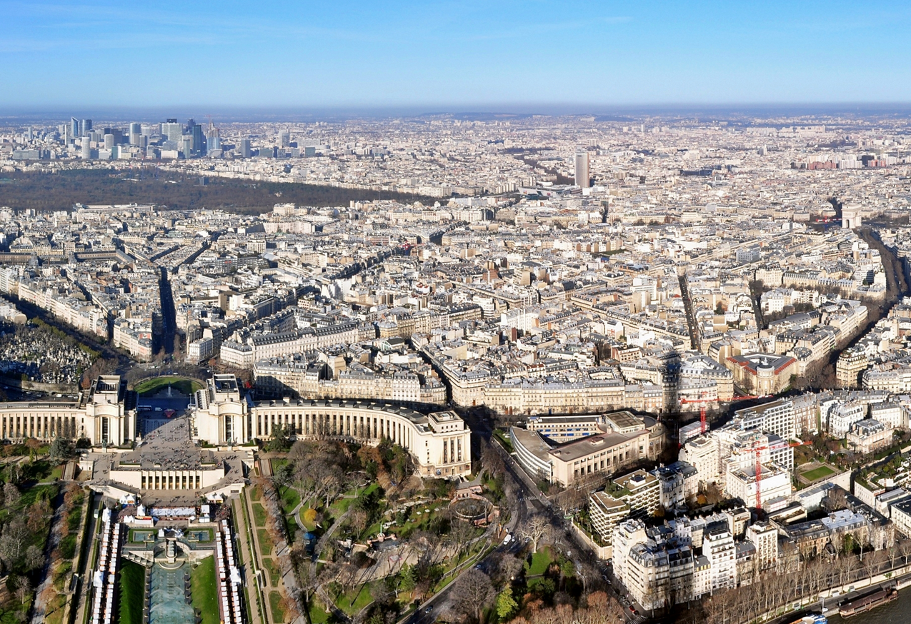
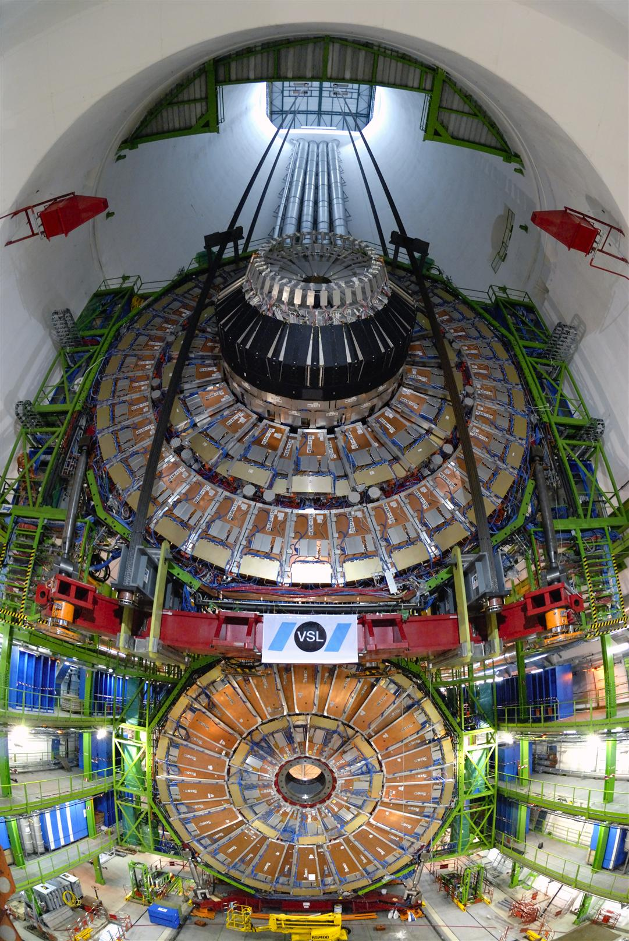

Shaft depth
Although technically a lot is feasible in terms of lifting gear, elevators etc. (conceptually confirmed) much emphasis is currently put on doing away with „excessively“ deep shafts (450 ... 500 ... 550 m), in particular for experiment site G.
Deep shafts (= high elevation) have also other drawbacks: water pressure, pipe/cable lengths, road accessibility, „remoteness“, ...
FCC shaft depth 550 m ?
view from here (276 m)
I. Rühl
Plot should also be sufficiently large and rather flat
(avoid too strong slopes; somewhat rare in Pre-Alps).
Lowering CMS detector part (1450 t); shaft depth 100 m

Slide 16
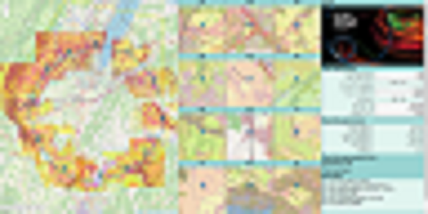
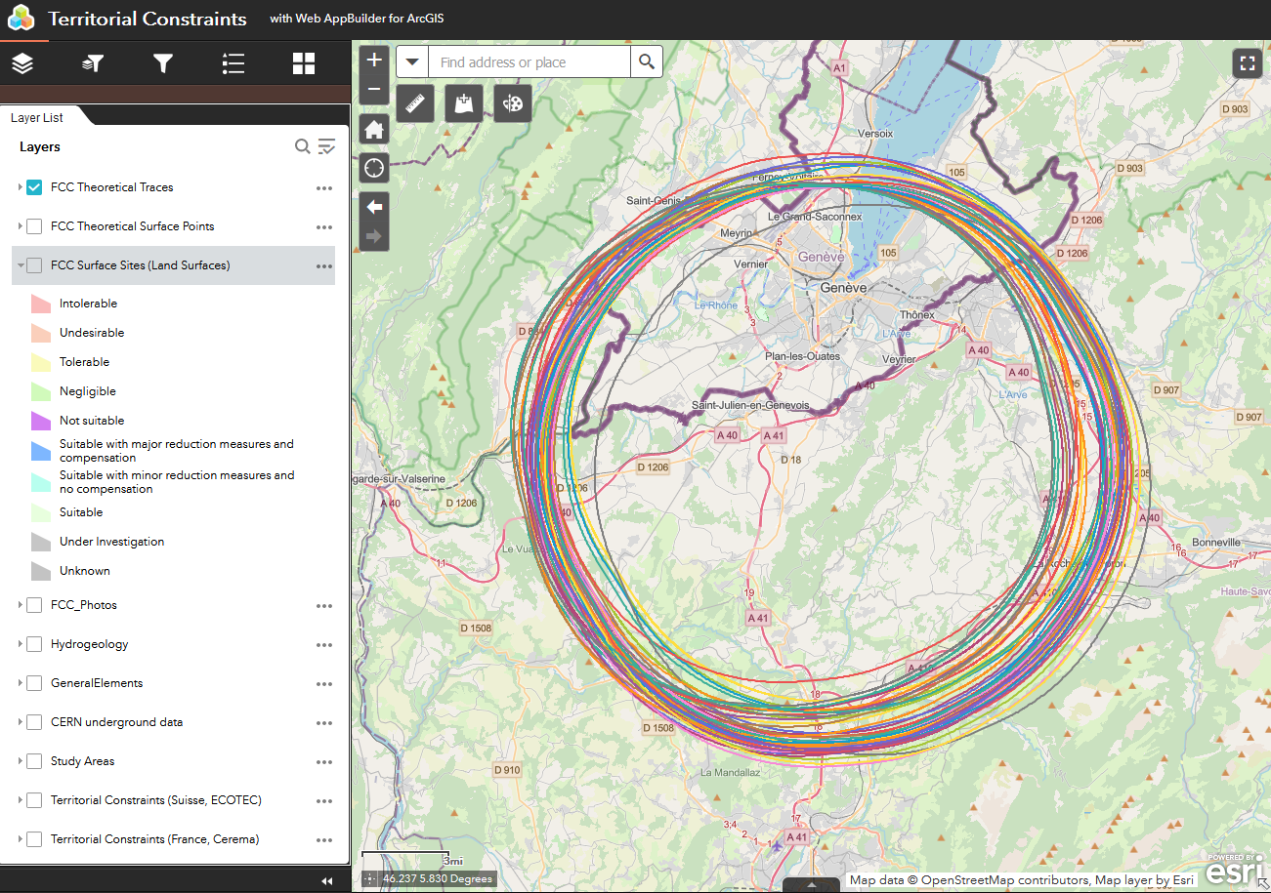



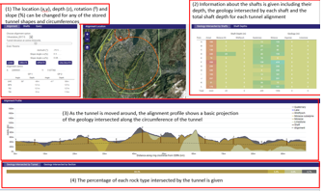
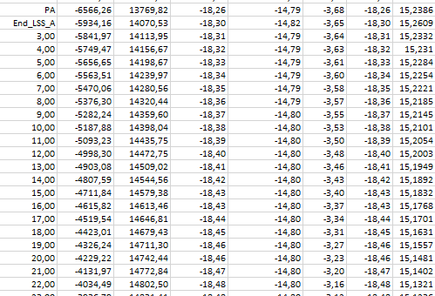
Current tool use, data flow/organisation
Surface point exploration
Viewing/assessment
Footprint Explorer Web App
Central, unique
data repository
FCC-GIS Web App
J. Gutleber, V. Mertens
A.-L. Verdier et al.
I/O with Host State bodies and companies
Underground check/optimisation
(geological layers, depth, tilt)
Survey
high precision calculations
TOT
Transfer line calculations
J. Osborne, A. A. Tudora
M. Jones
W. Bartmann et al.

Slide 17
Concluding remarks
Collider requirements and constraints are strong and important points in the layout and placement of the FCC,
but only part of a multitude of considerations to take into account.
By now we have gained much more insight into many of these other parameters
(process ongoing for: surface site refinement, environmental evaluation, geological modelling).
Identifying an „all-ideal“ placement (underground conditions, surface site and other constraints) is not straightforward.
„Invariants“ and strong criteria for specific points limit the choice.
Fully automatic search would be „nice to have“, but parametrisation probably pretty complex and ambiguous.
Have several efficient tools at hand for exploration and data organisation.
Established multi-criteria analysis helps for objective pre-selection of scenarios.
Very intensive post-CDR exploration and preparation phase, strongly supported by Host State bodies.
Despite many boundary conditions, it is meanwhile „looking good“ for several scenario „classes“.
Aim is to come up with more than one optimised scenario.
Work will continue to refine and pre-select them as basis for further evaluation with Host States and preparation for
high-risk site investigations (important next step for CE to better understand the geology
and further optimise the placement, to minimise CE cost and risk and indeed confirm the feasibility).

Slide 18

THANK YOU FOR YOUR ATTENTION !

