Slide 1


Emittance tuning simulations and next steps
Tessa Charles^{1,2} and the FCC-ee optics team
1. University of Liverpool,
2. Cockcroft Institute
FCC Week 10.11.2020
The Future Circular Collider Innovation Study (FCCIS) project has received funding from the European Union's Horizon 2020 research and innovation programme under grant No 951754.

Slide 2
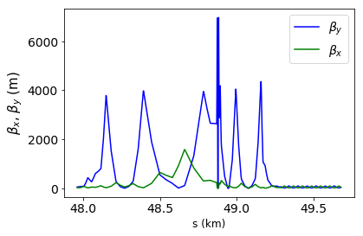
FCC-ee Emittance Tuning: Challenges & Constraints
Challenges:
Large beta function values makes us sensitive to field and misalignment errors
Small beta* means strong FF magnets, which in turn requires strong sextupoles for local chromaticity correction.
Small emittance ratio makes us sensitive to any coupling between the horizontal and vertical motion.
IP
Tessa Charles - FCC week 2020
2
Notes:
FCC-ee presents some unique challenges when it comes to emittance tuning. The v large beta max makes us sensitive to field and misalignment errors. The v small beta* mean strong FF magnets and requires strong sextupoles for chromaticity correction. And finally, there large emittance ratio makes us sensitive to any coupling between the horizontal and vertical motion.

Slide 3
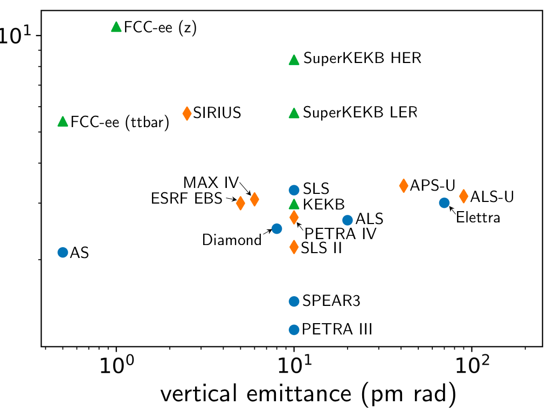


Natural chromaticities for a range of low emittance storage rings
(during collisions)
(during collisions)
Many thanks to:
Rohan Dowd (AS), Masamitsu Aiba (PSI), Katsunobu Oide (KEK), Thorsten Hellert (ALS), Ilya Agapov (DESY), Pedro Fernandes Tavares (MAX IV), Kent Wooton (APS), Bastian Härer (KEK), Liu Lin (LNLS), Simone Di Mitri (Elettra), Jeff Corbett (SLAC), Bernhard Holzer (CERN)
Many thanks to:
Rohan Dowd (AS), Masamitsu Aiba (PSI), Katsunobu Oide (KEK), Thorsten Hellert (ALS), Ilya Agapov (DESY), Pedro Fernandes Tavares (MAX IV), Kent Wooton (APS), Bastian Härer (KEK), Liu Lin (LNLS), Simone Di Mitri (Elettra), Jeff Corbett (SLAC), Bernhard Holzer (CERN), Ian Martin (Diamond)
3

Slide 4

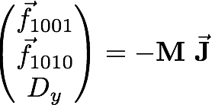
Correction tools
Orbit correction:
  MICADO & SVD from MAD-X
    Hor. corrector at each QF, Vert. corrector at each QD
  1598 vertical correctors / 1590 horizontal correctors
    BPM at each quadrupole
  1598 BPMs vertical / 1590 BPMs horizontal
Vertical dispersion and orbit:
  Orbit Dispersion Free Steering (DFS)
Linear coupling:
  Coupling resonant driving terms (RDT)
    1 skew at each sextupole + skews correctors at the IP
Beta beating correction & Horizontal dispersion via Response Matrix:
  Rematching of the phase advance at the BPMs
    1 trim quadrupole at each sextupole
Tessa Charles - FCC week 2020
4

Slide 5
Assigning misalignments
  - Misalignment randomly distributed via a Gaussian, truncated at 2.5 sigma.
  - 2 independent DX and DY misalignments for each end of the girder, and which are used to calculate DTHETA and DPHI.
Tessa Charles - FCC week 2020
5

Slide 6
Assigning girder misalignments
Arc quadrupoles and sextupoles are misaligned relative to a girder misalignment, incorporating misalignment due to ∆y_{girder} and ∆𝛳.
sextupoles/ quadrupoles
girder
girder
dipole
dipole
(not to scale)
Tessa Charles - FCC week 2020
6
Notes:
We add these various misalignments together to hopefully get a more realistic idea of how a machine may look in terms of misalignments,
and also we use this to determined tolerances of magnet alignments.

Slide 7
Assigning misalignments
Possibly still too tight
7
Notes:
These values have been gradually increasing over the past years, as we further develop the correction strategies to handle greater misalignments.
\begin{table}[htb!]
\centering
\begin{tabular}{lccccc}
\hline
Type & $\Delta$X ($\mu$m) & $\Delta$Y ($\mu$m) & $\Delta$PSI ($\mu$rad) & $\Delta$S ($\mu$m) & Field Errors \vspace{.1cm} \\
\hline
Arc quadrupole* & 50 & 50 & 200 & 50 & $\Delta k/k = 2\times 10^{-4}$ \\
Arc sextupoles* & 50 & 50 & 200 & 50 & $\Delta k/k = 2\times 10^{-4}$ \\
Girders & 100 & 100 & - & 500 & - \\
\hline
Dipoles & 100 & 100 & 200 & 500 & $\Delta$B/B $= 1\times 10^{-4}$ \\
\hline
IR quadrupole & 75 & 75 & 100 & 75 & $\Delta k/k = 2\times 10^{-4}$ \\
IR sextupoles & 75 & 75 & 100 & 75 & $\Delta k/k = 2\times 10^{-4}$ \\
\hline
BPM** & 40 & 40 & 100 & - & - \\
\hline
\end{tabular}
\end{table}
\vspace{-.45cm}
* \ misalignments relative to girder placement
** misalignments relative to quadruple placement

Slide 8
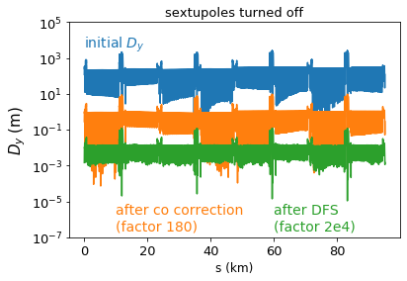
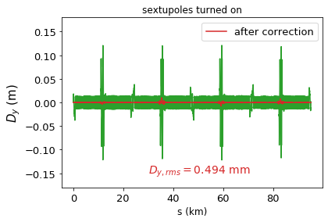
The starting situation....
Orbit correction
+DFS (sextupoles off)
Dispersion and coupling correction (sextupoles on)
Switch on
sextupoles
Tessa Charles - FCC week 2020
8

Slide 9
Correction Strategy (1/2)
Sextupoles strengths set to zero.
  Gradient errors applied
    Weighted beta-beat correction was performed and tune re-matched.
    Sextupole and dipole field errors introduced.
    Weighted beta-beat correction was performed and tune re-matched.
  Misalignments applied to all magnets and girders.
    Tune re-matched to the nominal tune, and orbit correction performed.
    Beta-beat correction applied, and if needed orbit corrected and tune rematched.
    Coupling correction, followed by beta-beat correction and coupling correction.
Sextupoles set to 10% of their design strength
(details on next slide)
Final correction (at 100% sextupole strength)
(details on next slide)
Tessa Charles - FCC week 2020
9

Slide 10
Correction Strategy (2/2)
Sextupoles strengths set to 0
  Closed-orbit correction
  Rematch the tune
  Beat-beat correction
  1 step Dispersion Free Steering w/o sextupole
  +
  1 step coupling correction
  CHECK of tunes, orbit, β_{y, max}
  1 step Dispersion Free Steering w/o sextupole
  +
  1 step coupling correction
  CHECK of tunes, orbit, β_{y, max}
  Save x,x’,y,y’ at the beginning of the machine
Set sextupoles strength to 10% of their design current
(details on next slide)
Final correction
(details on next slide)
Sextupoles strengths set to zero.
  (details on previous slide)
Sextupoles set to 10% of their design strength
  Orbit correction
  Combined coupling and dispersion correction
  Beta-beating correction applied.
  Sextupole strengths increased by 10%
Final correction (at 100% sextupole strength)
  Additional coupling, dispersion and beta-beating correction was applied.
  Step through corrections until beta beating threshold is reached (trade-off between beta beating and vertical emittance can be varied).
  Vary SV cut off values
Constant checking of the tunes and orbit avoids running into resonances, or failure to find the closed orbit.
These two steps repeated ~12 times.
Tessa Charles - FCC week 2020
10

Slide 11
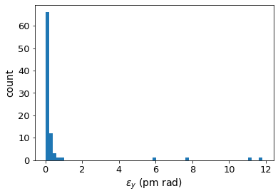
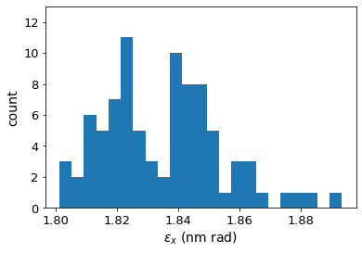
FCC-ee emittance tuning results
ttbar (182.5 GeV) 4IP lattice,
after correction strategy:
RMS misalignment and field errors tolerances:
Tessa Charles - FCC week 2020
11
Notes:
These are the main results
%$\epsilon_{x, \textrm{rms}} = 1.685$ nm rad \\
%$\epsilon_{y, \textrm{rms}} = 0.871$ pm rad \\
$\frac{\epsilon_{y}}{\epsilon_{x}} = 0.0789$ $\%$ \\
\begin{table}[htb!]
\centering
\begin{tabular}{p{3cm}cccc}
\hline
Type & $\Delta$X & $\Delta$Y & $\Delta$PSI & $\Delta$S \\
& ($\mu$m) & ($\mu$m) & ($\mu$rad) & ($\mu$m)
\vspace{.1cm} \\
\hline
Arc quadrupole* & 50 & 50 & 200 & 50 \\
Arc sextupoles* & 50 & 50 & 200 & 50 \\
\hline
Dipoles & 100 & 100 & 200 & 500 \\
\hline
Girders & 100 & 100 & - & 500 \\
\hline
IR quadrupole & 75 & 75 & 100 & 75 \\
IR sextupoles & 75 & 75 & 100 & 75 \\
\hline
BPM** & 40 & 40 & 100 & - \\
\hline
\end{tabular}
\end{table}

Slide 12
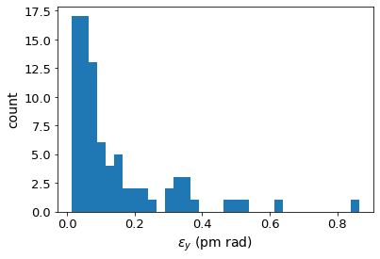
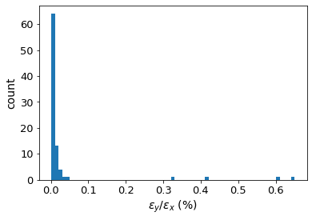
FCC-ee emittance tuning results
ttbar (182.5 GeV) 4IP lattice,
after correction strategy:
Removing 4 seeds with 𝜀_{y} > 5 pm rad
Tessa Charles - FCC week 2020
12
Notes:
These are the main results
%$\epsilon_{x, \textrm{rms}} = 1.685$ nm rad \\
%$\epsilon_{y, \textrm{rms}} = 0.871$ pm rad \\
$\frac{\epsilon_{y}}{\epsilon_{x}} = 0.0789$ $\%$ \\
\begin{table}[htb!]
\centering
\begin{tabular}{p{3cm}cccc}
\hline
Type & $\Delta$X & $\Delta$Y & $\Delta$PSI & $\Delta$S \\
& ($\mu$m) & ($\mu$m) & ($\mu$rad) & ($\mu$m)
\vspace{.1cm} \\
\hline
Arc quadrupole* & 50 & 50 & 200 & 50 \\
Arc sextupoles* & 50 & 50 & 200 & 50 \\
\hline
Dipoles & 100 & 100 & 200 & 500 \\
\hline
Girders & 100 & 100 & - & 500 \\
\hline
IR quadrupole & 75 & 75 & 100 & 75 \\
IR sextupoles & 75 & 75 & 100 & 75 \\
\hline
BPM** & 40 & 40 & 100 & - \\
\hline
\end{tabular}
\end{table}

Slide 13
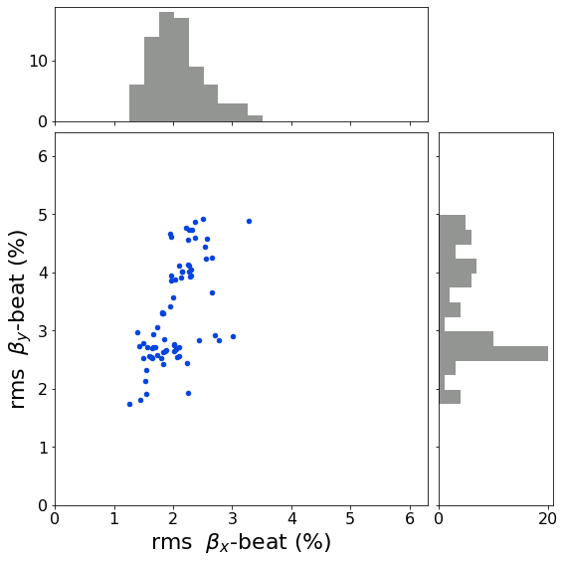
FCC-ee emittance tuning results
ttbar (182.5 GeV) 4IP lattice, after correction strategy:
RMS misalignment and field errors tolerances:
Tessa Charles - FCC week 2020
13
Notes:
3.5561651829486616
2.0491715154065955

Slide 14
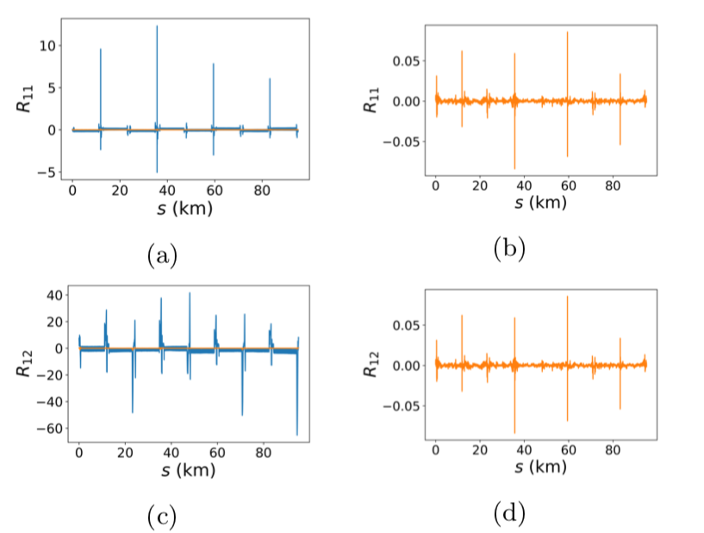
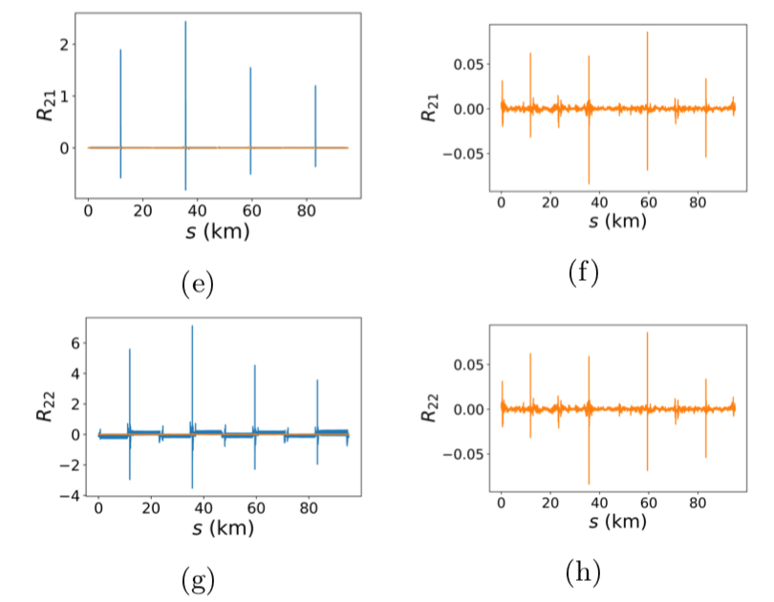
Coupling matrix elements
Before correction
(without sextupoles)
After correction
(with sextupoles)
Before correction
(without sextupoles)
After correction
(with sextupoles)
Tessa Charles - FCC week 2020
14

Slide 15
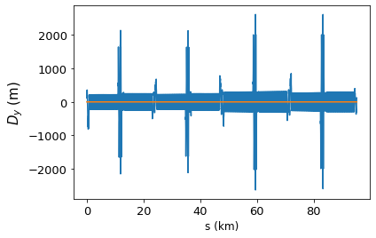
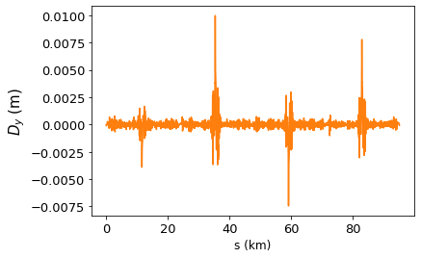
Vertical dispersion
Before correction
(without sextupoles)
After correction
(with sextupoles)
D_{y, rms} = 0.495 mm
Tessa Charles - FCC week 2020
15

Slide 16
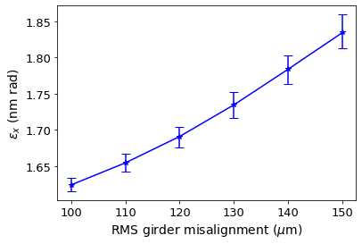
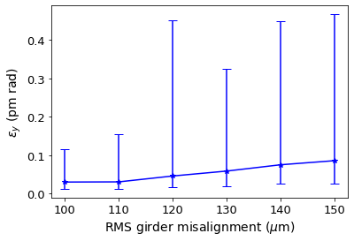
Girder misalignment
The girder misalignment has the strongest influence on horizontal emittance of all the parameters listed in the previous table.
error bars = 90% confidence interval
All other misalignments are as defined previously (slide 15).
Tessa Charles - FCC week 2020
16

Slide 17
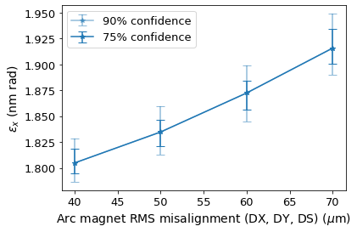
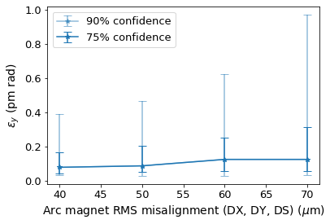
Arc magnet misalignments
All other misalignments are as defined previously (i.e. girder DX and DY = 150 𝜇m).
Tessa Charles - FCC week 2020
17

Slide 18
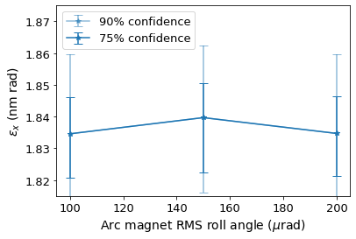
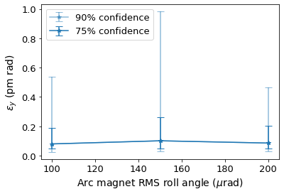
Arc magnet roll angles
Arc magnet roll angles of up 200 𝜇rad can be handled by the correction strategy. This could be extended beyond 200 𝜇rad if necessary.
All other misalignments are as defined previously.
Tessa Charles - FCC week 2020
18

Slide 19
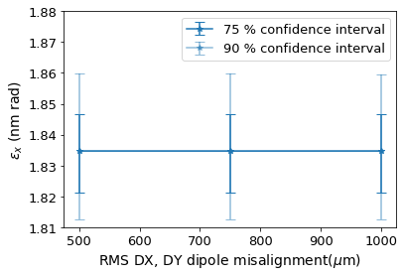
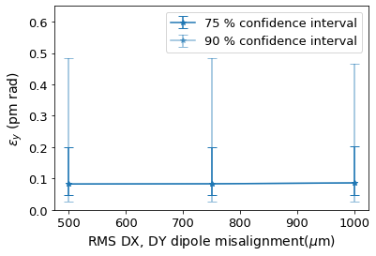
Dipole misalignments
Transverse dipole misalignments have little influence on final emittances achievable.
All other misalignments are as defined previously.
Tessa Charles - FCC week 2020
19

Slide 20
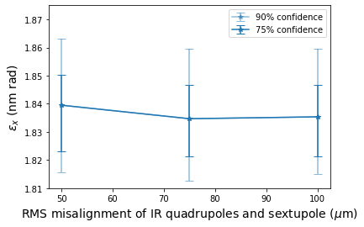
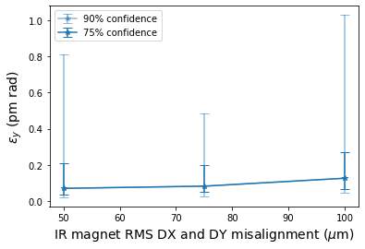
IR magnets alignment - transverse misalignments (𝛥X and 𝛥Y)
IR magnet misalignments as indicated in table, and all other misalignments are as defined previously (slide 11).
Tessa Charles - FCC week 2020
20

Slide 21
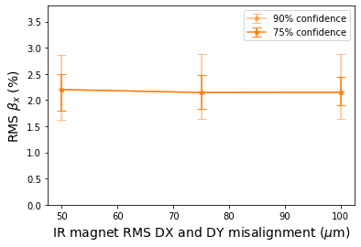
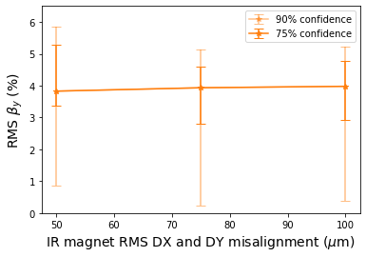
IR magnets alignment - transverse misalignments (𝛥X and 𝛥Y)
IR magnet misalignments as indicated in table, and all other misalignments are as defined previously (slide 11).
Tessa Charles - FCC week 2020
21

Slide 22
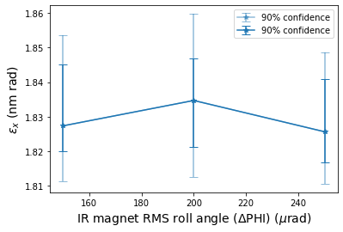
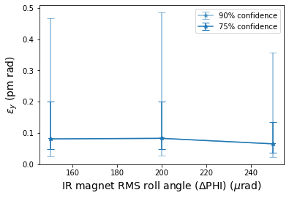
IR magnets alignment – roll angle (𝛥PHI)
IR magnet misalignments as indicated in table, and all other misalignments are as defined previously (slide 11).
Tessa Charles - FCC week 2020
22

Slide 23
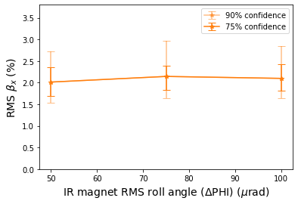
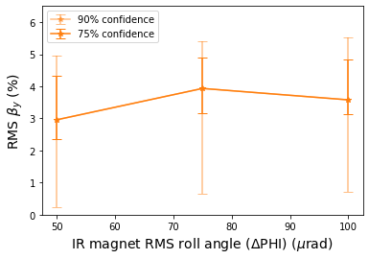
IR magnets alignment – roll angle (𝛥PHI)
IR magnet misalignments as indicated in table, and all other misalignments are as defined previously (slide 11).
Tessa Charles - FCC week 2020
23

Slide 24
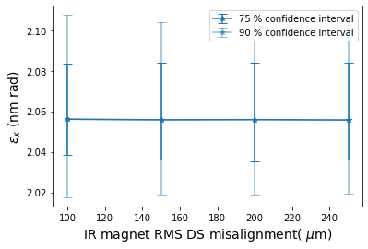
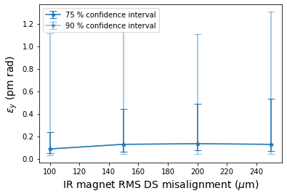
IR magnets - longitudinal alignment (𝛥S)
IR magnets and girders misalignments as indicated in tables, with all other misalignments are as defined on slide 11.
This data was taken from older simulation results, with different girder misalignment. Nevertheless, these results can be used to investigate the trends.
24

Slide 25
Next steps
Include solenoid misalignment into simulations
Establish the most realistic modelling for BPM errors (e.g. non-linear responses, calibration measures for rotated BPMs, non-Gaussian BPM offset distributions)
Investigate the few seeds that results in vertical emittances > 2 pm rad
Apply correction technique to low energy, Z lattice
Local corrections for vertical dispersion at the IP
Determine how to apply corrections quickly
  LOCO is too slow on such a large machine
  AC dipole method may run into problems due to strong damping
Possible simulation of commissioning
Tessa Charles - FCC week 2020
25

Slide 26
Summary
In a simulation campaign, we systematically studied a wide combination of magnet tolerances for field errors, alignment of individual magnets as well as girders and the settings of the BPMs.
The correction algorithms developed in this context represent a powerful correction tools and lead to successful convergence for a large majority of the applied errors seeds. And, most importantly, the lead to values of coupling and emittances that lie within the requirements of the machine design. For a standard set of misalignments, the final median vertical emittance achieved is 0.086 pm rad and horizontal emittance of 1.835 nm rad (see slide 12 and 14).
Thank you

