Slide 1




Updates on the impact of fringe fields on corrector strength
Thomas Pugnat, Barbara Dalena
A. Simona, L. Bonaventura
R. De Maria, V. K. Berglyd Olsen, R. Tomás, E. H. Maclean, O. Napoly, C. Lorin, S. Izquierdo Bermudez, E. Todesco

Slide 2


Outlook
Recap 166th HL-LHC WP2 meeting presentation
HL-LHC:
  Update of impact of fringe fields on b₆ correction for optics v1.4 and new b₆ value
LHC:
  Update impact of fringe fields on b₄ correction in LHC
  Impact of fringe fields on b₆ correction in LHC
Summary and open questions

Slide 3
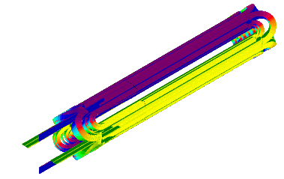
What we want to evaluate
3D Nb3Sn Quadrupole
Simulated with ROXIE
Courtesy of CERN magnets group
Part of systematic non linear field is concentrated in the magnet extremities
Accurate and efficient modeling of the magnet field extremities required to see their effects on the beam
In the High Luminosity IRs the variation of the beta function along a single magnet is not small, the longitudinal distribution of field errors may impact beam based quantities
Aim: improve our capability to correct non-linear effects hence the stability of future accelerators

Slide 4
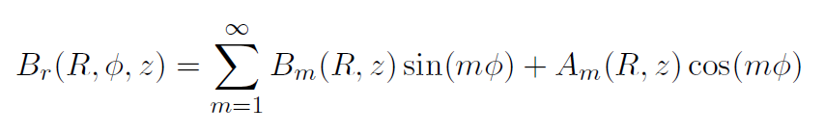

3D Field representation
Field Harmonics
Generalized Gradient for normal multipole
3D Vector Potential for normal multipole
$$A_{x}^{m}= \frac{x}{m}ℜ\left[{ \left(x+iy\right)}^{m}\right]\sum_{l=0}^{∞}{\frac{{\left(−1\right)}^{l}m! }{2^{2l}l!\left(l+m\right)!}{ C}_{m}^{\left[2l+1\right]}\left(z\right){\left(x^{2}+y^{2}\right)}^{l}}$$
$$A_{y}^{m}= \frac{y}{m}ℜ\left[{ \left(x+iy\right)}^{m}\right]\sum_{l=0}^{∞}{\frac{{\left(−1\right)}^{l}m! }{2^{2l}l!\left(l+m\right)!}{ C}_{m}^{\left[2l+1\right]}\left(z\right){\left(x^{2}+y^{2}\right)}^{l}}$$
HE approximation for normal multipole
$$A_{z}^{m}=−\frac{1}{m}ℜ\left[{ \left(x+iy\right)}^{m}\right]\sum_{l=0}^{∞}{\frac{{\left(−1\right)}^{l}m!\left(2l+m\right)}{2^{2l}l!\left(l+m\right)!}C_{m}^{\left[2l\right]}\left(z\right){\left(x^{2}+y^{2}\right)}^{l}}$$
$$A_{z}^{m}=\frac{1}{m}B_{m}ℜ[{ (x+iy)}^{m}]$$

Slide 5
Non-linear maps
HE (Hard Edge): 16 Drifts and Kicks of equal multipolar integrated strength.
HE+Heads: Similar to HE but with a part of the total integrated strength in additional Kicks in the two extremities, respecting the connector (CS) and non connector (NC) side
Lie2: Non-linear transfer map from Lie algebra. The extremities are modeled by computing the 3D vector potential with step of 2cm:
ND0: Only pure harmonics in the
Quadrupole.
ND6: with up to the 6th derivatives of
the generalized gradients.
Lie2 model has been developed at CEA and integrated in SixTrack
For details of Lie2 non-linear transfer map see T. Pugnat @ 122nd HL-LHC WP2 meeting

Slide 6
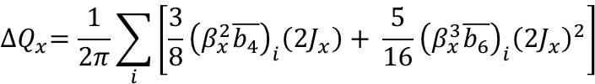
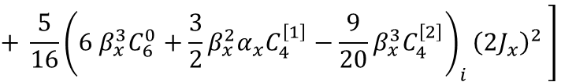
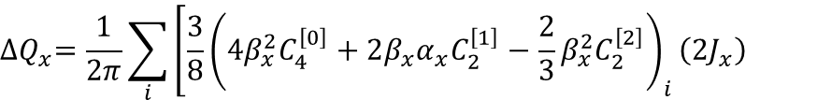
Direct amplitude detuning
HLLHC v1.0 optics
IT errors tables v5
Seed 1
Thomas Pugnat @ 166th HL-LHC WP2 meeting
$${∆Q}_{x}=\frac{1}{2π}\sum_{i}{\left[\frac{3}{8}{\left(β_{x}^{2}\overline{b_{4}}\right)}_{i}\left(2J_{x}\right)+ \frac{5}{16}{\left(β_{x}^{3}\overline{b_{6}}\right)}_{i}{\left(2J_{x}\right)}^{2}\right] }$$
$${∆Q}_{x}=\frac{1}{2π}\sum_{i}{\left[\frac{3}{8}{\left(4β_{x}^{2}C_{4}^{\left[0\right]}+2β_{x}α_{x}C_{2}^{\left[1\right]}−\frac{2}{3}β_{x}^{2}C_{2}^{\left[2\right]}\right)}_{i}\left(2J_{x}\right)\right. }$$
$$\left.+ \frac{5}{16}{\left(6 β_{x}^{3}C_{6}^{0}+\frac{3}{2}β_{x}^{2}α_{x}C_{4}^{\left[1\right]}−\frac{9}{20}β_{x}^{3}C_{4}^{\left[2\right]}\right)}_{i}{\left(2J_{x}\right)}^{2} \right]$$
In the plot: amplitude detuning with b₂ and b₆ harmonics only:
1st and 2nd order detuning well reproduced by analytic computation
HE+heads is a good approximation of Lie2 map, but do not account for effects due to gradients derivatives

Slide 7
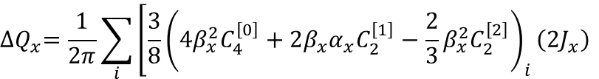
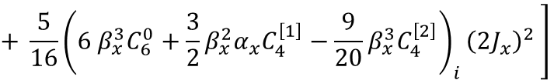
Octupole correctors strength
HLLHC v1.0 optics
IT errors tables v5
Thomas Pugnat @ 166th HL-LHC WP2 meeting
$${∆Q}_{x}=\frac{1}{2π}\sum_{i}{\left[\frac{3}{8}{\left(4β_{x}^{2}C_{4}^{\left[0\right]}+2β_{x}α_{x}C_{2}^{\left[1\right]}−\frac{2}{3}β_{x}^{2}C_{2}^{\left[2\right]}\right)}_{i}\left(2J_{x}\right)\right. }$$
$$\left.+ \frac{5}{16}{\left(6 β_{x}^{3}C_{6}^{0}+\frac{3}{2}β_{x}^{2}α_{x}C_{4}^{\left[1\right]}−\frac{9}{20}β_{x}^{3}C_{4}^{\left[2\right]}\right)}_{i}{\left(2J_{x}\right)}^{2} \right]$$
First and second derivative of the main quadrupole field provide a systematic shift in the integrated octupole corrector strength (K3L)
The shift is ~4% with respect to octupole correctors specification (IPAC13 WEPEA048)

Slide 8
Dodecapole correctors strength (1/2)
Thomas Pugnat @ 166th HL-LHC WP2 meeting
HLLHC v1.0 optics
IT errors tables v5
$${∆Q}_{x}=\frac{1}{2π}\sum_{i}{\left[\frac{3}{8}{\left(β_{x}^{2}\overline{b_{4}}\right)}_{i}\left(2J_{x}\right)+ \frac{5}{16}{\left(β_{x}^{3}\overline{b_{6}}\right)}_{i}{\left(2J_{x}\right)}^{2}\right] }$$
$${∆Q}_{x}=\frac{1}{2π}\sum_{i}{\left[\frac{3}{8}{\left(4β_{x}^{2}C_{4}^{\left[0\right]}+2β_{x}α_{x}C_{2}^{\left[1\right]}−\frac{2}{3}β_{x}^{2}C_{2}^{\left[2\right]}\right)}_{i}\left(2J_{x}\right)\right. }$$
$$\left.+ \frac{5}{16}{\left(6 β_{x}^{3}C_{6}^{0}+\frac{3}{2}β_{x}^{2}α_{x}C_{4}^{\left[1\right]}−\frac{9}{20}β_{x}^{3}C_{4}^{\left[2\right]}\right)}_{i}{\left(2J_{x}\right)}^{2} \right]$$
b6 longitudinal distribution along the inner triplet quadrupoles provides a systematic shift in the integrated dodecapole corrector strength (K5L)
The shift is ~13% with respect to correctors’ specification (IPAC13 WEPEA048)
HE+heads is a good approximation of the more accurate Lie2 calculation (…gradient derivatives more than 2nd have negligible impact… )

Slide 9
Dodecapole correctors strength (2/2)
HLLHC v1.0 optics
IT errors tables v5
HLLHC v1.4 optics
IT new b6 values
The shift with respect to correctors’ specification changes from ~13% to ~11%
The shift with respect to correctors’ specification due to the optic version is ~ 1%

Slide 10
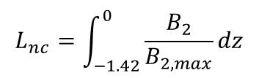
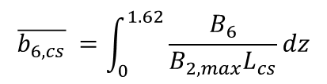
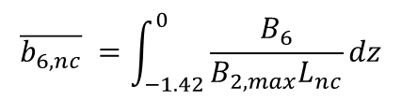
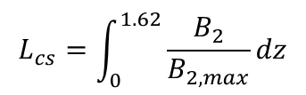
HE+Heads Lie2
HL-LHC MQXF prototype
Longer magnets has same Heads of prototype with longer body
$$L_{nc}=\int_{−1.42}^{0}{\frac{B_{2}}{B_{2,max}}dz}$$
$$L_{cs}=\int_{0}^{1.62}{\frac{B_{2}}{B_{2,max}}dz}$$
Heads: Non Connector
Connector Side
$$\overline{b_{6,nc}} =\int_{−1.42}^{0}{\frac{B_{6}}{B_{2,max}L_{nc}}dz}$$
$$\overline{b_{6,cs}} =\int_{0}^{1.62}{\frac{B_{6}}{B_{2,max}L_{cs}}dz}$$
$L_{mqxf}\overline{b_{6,mqxf}}= L_{body}\overline{b_{6,body}}+L_{cs}\overline{b_{6,cs}}$+$L_{nc}\overline{b_{6,nc}}$

Slide 11
HE+Heads vs HE+Heads Lie2
b6 | NC (0.581 m) [units] | CS (0.62 m) [units]
HE+Heads Lie2 | -1.0303 | 4.8663
b6 | NC (0.341 m) [units] | CS (0.4 m) [units]
HE+Heads | -0.0250 | 8.943
HE+Heads converges to HE calculation of the correctors strength (<1% difference from HE)
HE+Heads Lie2 converges to the calculation of the correctors strength done with 2 cm sampled harmonics in the heads (~ 11% difference from HE)
⇒ How the magnet is divided into Heads + Body change correctors strength evaluation

Slide 12
What About LHC ?

Slide 13

Magnetic MEASUREMENTS: LHC
NbTi quadrupole (MQXA)
2 cm step for the longitudinal harmonics measurements of one head
Systematic b₄ presents in both ROXIE model and measurements (for us, it would be better to measure until the field harmonics are zero on the axis)
No similar data or model available for the NbTi MQXB type of magnet
Courtesy of Tatsu Nakamoto
For difference between MQXA and MQXB design see Ezio talk WP2 172th meeting, 7th April 2020

Slide 14
Recap impact of Fringe Field on b₄ correction in LHC
Thomas Pugnat @ 166th HL-LHC WP2 meeting
Measured Integrated b₄ [units]
K3L Right [m⁻³]
IR5
Q1/Q3 (MQXA)
b4 | NC (0.62 m) [units] | CS (0.34 m) [units]
HE+Heads | 2.07 (0.14) | 1.17 (0.14)
IR1
K3L Left [m⁻³]
Beam-based values courtesy of E. Maclean
Data from https://lhc-div-mms.web.cern.ch/lhc-div-mms/tests/MAG/Fidel/
Beam Screen (BS) contribution missing (see Ezio talk @ 172nd HL-LHC WP2 meeting)!

Slide 15
Update impact of MQXA Heads on b₄ correction LHC
WISE values for the total integrated b₄ (MQXA & MQXB), which include BS contribution
The BS contribution of MQXA is approximately assumed to go entirely in the body
IR5
IR1
Reduction of the discrepancy with beam based values for IR5
Slight increase in the discrepancy with beam based values for IR1
⇒ It doesn’t help to solve the puzzle of b₄

Slide 16
Impact of MQXA Heads on b₆ correction in LHC
WISE values for the total integrated b₆ (MQXA & MQXB)
Q1/Q3 (MQXA)
b₆ | NC (0.62 m) [units] | CS (0.34 m) [units]
HE+Heads | 2.59 (0.10) | -0.54 (0.10)
IR5
IR1
https://lhc-div-mms.web.cern.ch/lhc-div-mms/tests/MAG/Fidel/
Big impact of longitudinal distribution of b₆ in MQXA on correctors strength calculation
⇒ difficult to predict a precise value

Slide 17
Summary and Open questions
3D representation of the main field and errors of the inner triplet impacts the non linear correctors strength computation
HL-LHC:
  main field derivatives have small impact on b₄ correction (~4%)
  The impact of the longitudinal distribution of b₆ can be well approximated by splitting the magnet in 2 Heads + Body and it results in a shift of ~ 11% for HL-LHC optic 1.4 and b_{6,body} =-4 units (but depends on the definition of the Body and Heads)
  Accurate measurements of the longitudinal harmonics are important when comparing accelerators models with beam based values, in particular of the not allowed ones (b₃,b₄,b₅, etc for quad), for which no ROXIE model is available.
LHC:
  MQXA b₄ longitudinal distribution produces a small shift with respect to WISE integrated value which increases the puzzle of octupole correction in LHC
  MQXA b₆ longitudinal distribution has a big impact on the dodecapole correctors strength, hard to predict a precise value (how much it can change with another definition of Body and Heads?)
  Are the derivatives of the systematic b₄ in MQXA also playing a role in the second order amplitude detuning ?
  Longitudinal profile of MQXB b₄ and b₆ are not available, any guess on them is difficult due to the strong difference between MQXA and MQXB type of magnets

