Slide 1
FastCaloGAN: a fast simulation for the ATLAS calorimeter system using GANs
Michele Faucci Giannelli,
On behalf of the ATLAS collaboration
30/11/2020

Slide 2
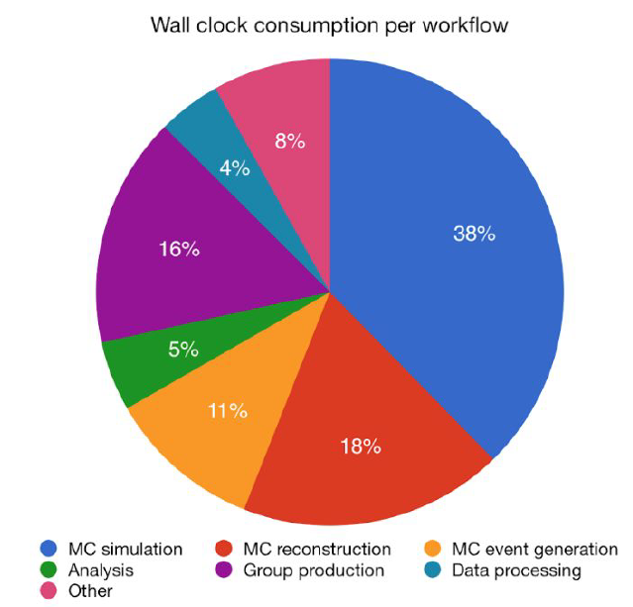
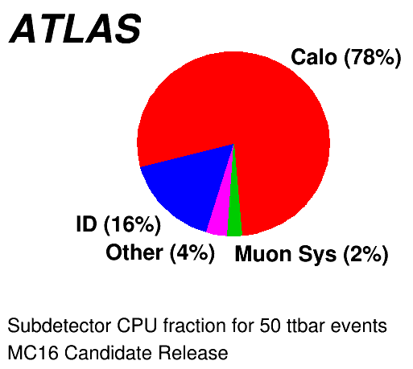
Motivation and strategy
Simulation has the largest CPU consumption
→ this will only increase in time
Calorimeters require the most CPU
→ we need a fast calo simulation
FastCaloGAN provides a full system calorimeter fast simulation using 300 Generative Adversarial Networks: ATL-SOFT-PUB-2020-006
The detector is segmented in 100 slices in η (0.05 wide)
  In each slice 15 energy points are used to train a GAN
  Three GANs are trained for electrons, photons and pions in each slice
The trained generators are used to simulate HITS in the ATLAS Athena software framework

Slide 3
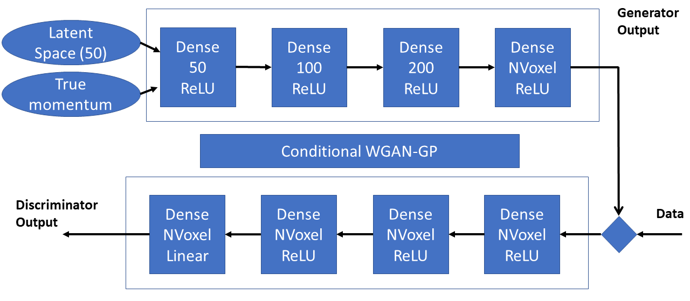
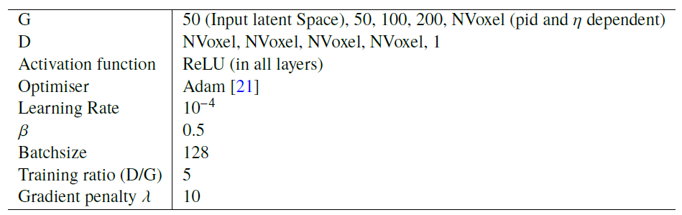
The GAN
Train the GANs on voxelised hits
NVoxel depends on PID and η

Slide 4
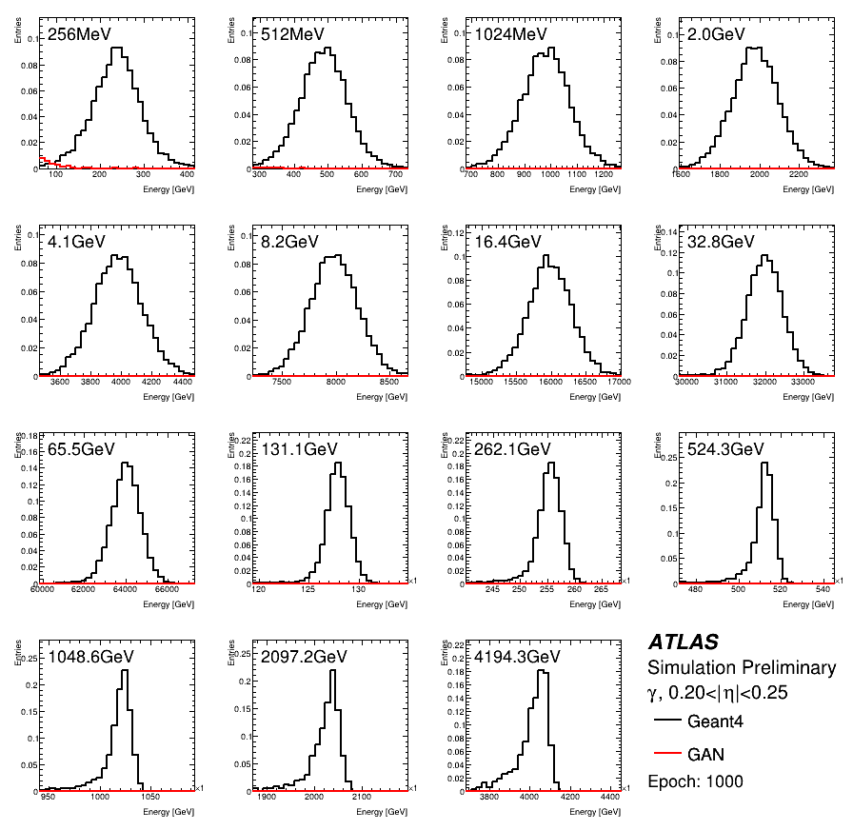
Training

Slide 5
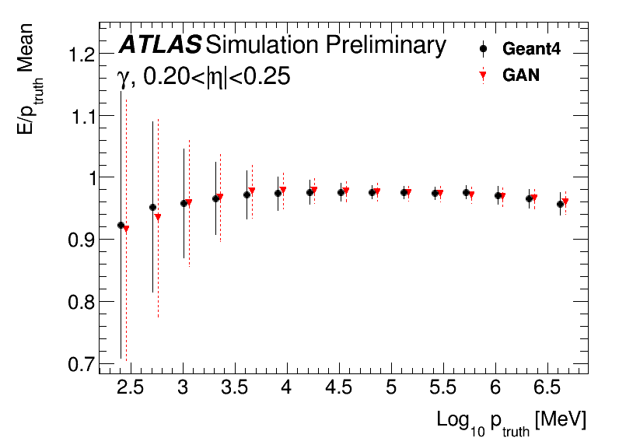
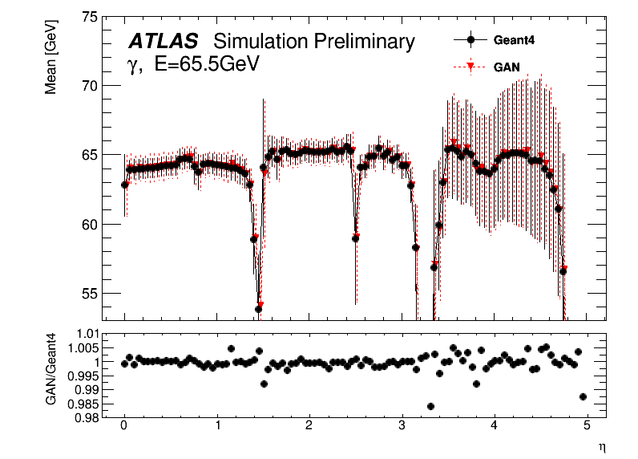
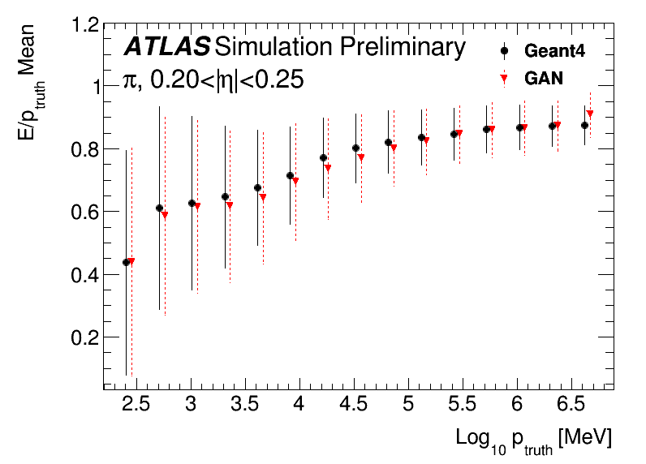
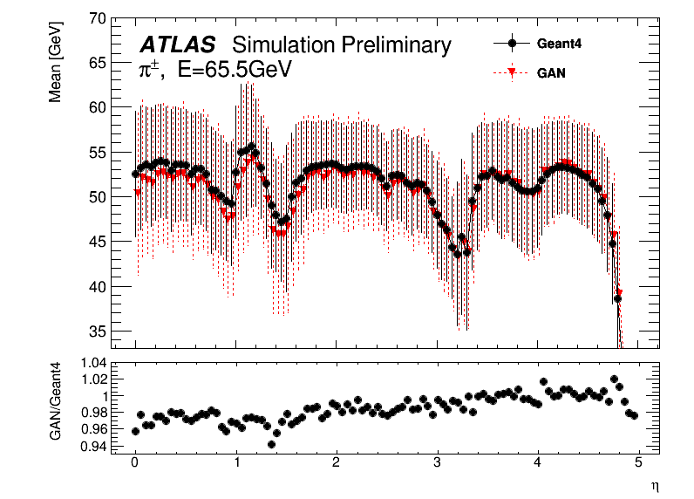
Performance of the GANs
Differences within a few %

Slide 6
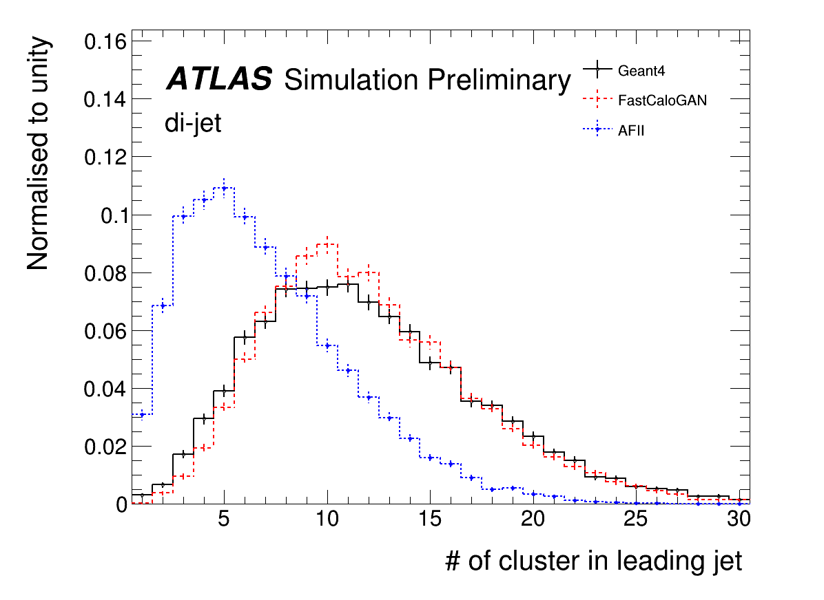
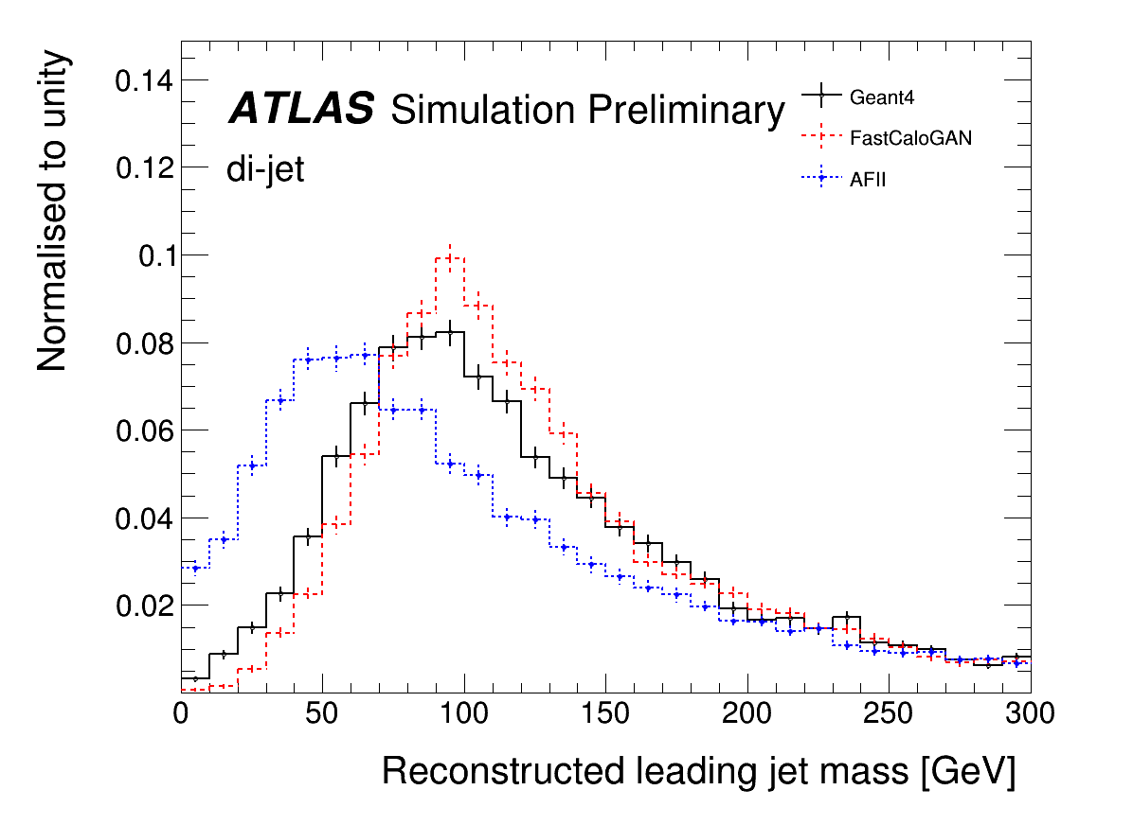
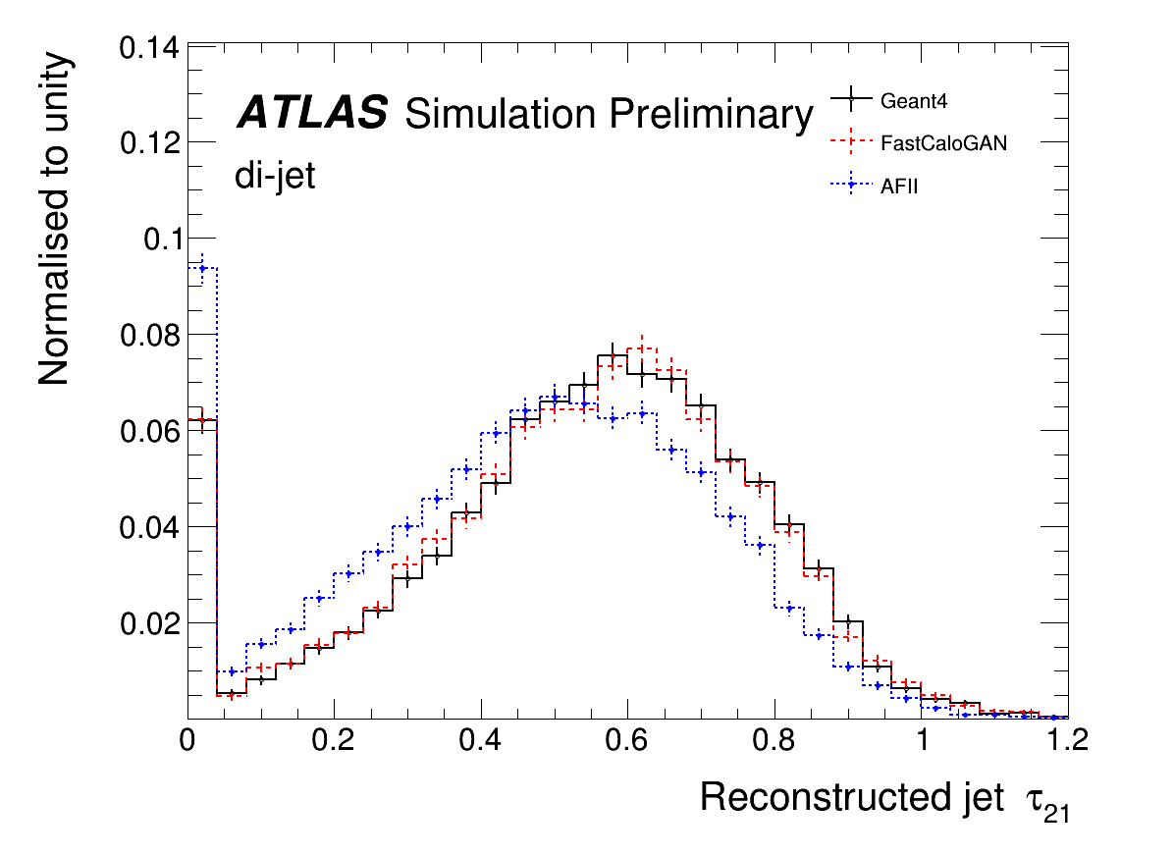
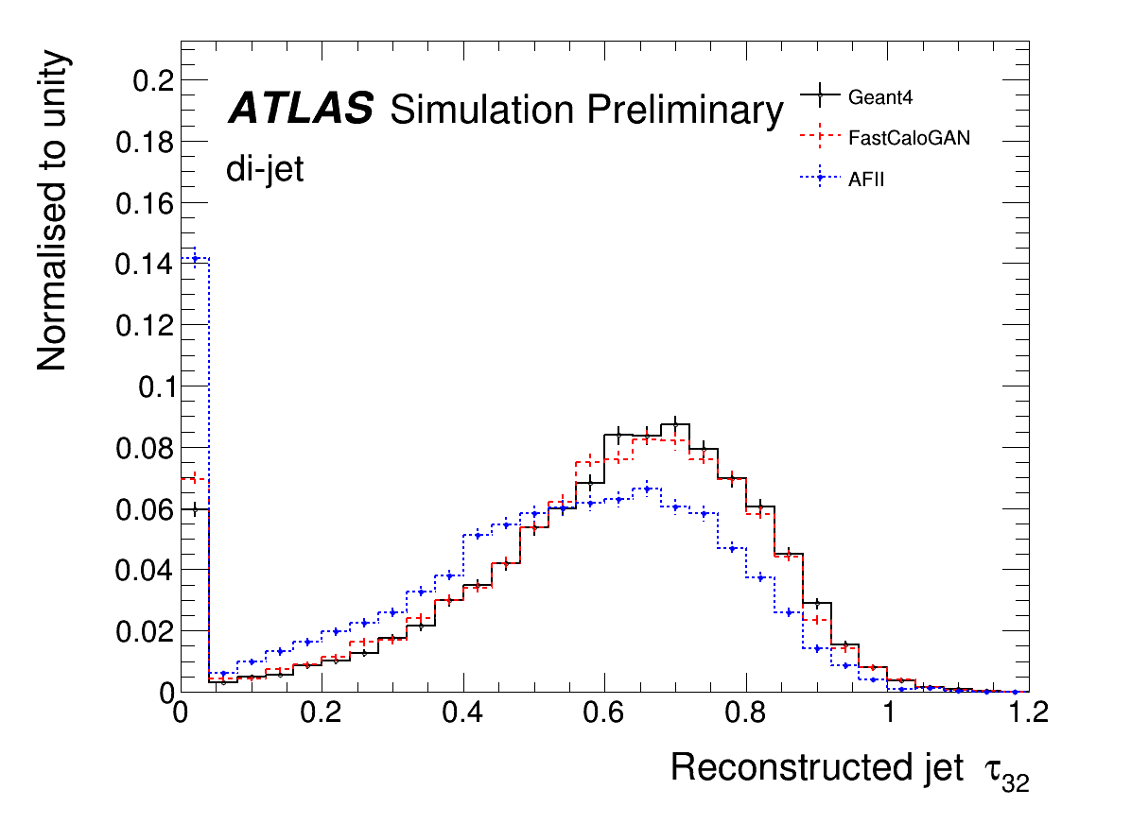
Performance on di-jets events
AFII is the current ATLAS fast simulation, used for producing ~50% of MC samples

Slide 7
Conclusion
FastCaloGAN use 300 GANs to simulate the interaction of photon, electrons and pions in the ATLAS calorimeter system
The GANs can reproduce the G4 distribution within a few %
FastCaloGAN outperform the current fast simulation (AFII) in the boosted regime
FastCaloGAN is being considered as one component of the next generation fast calorimeter simulation in ATLAS

Slide 8
Backup

Slide 9
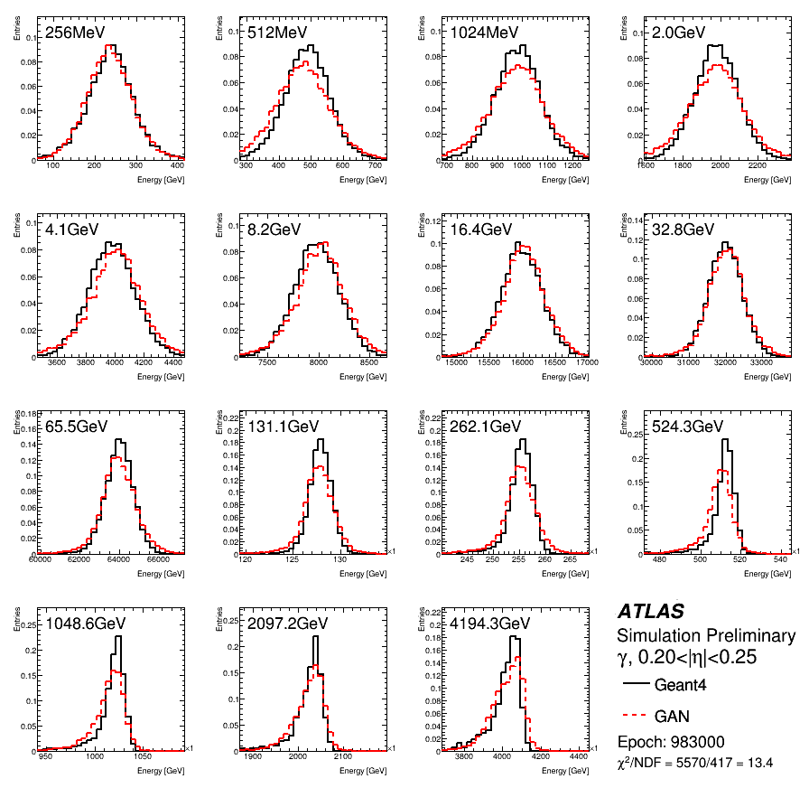
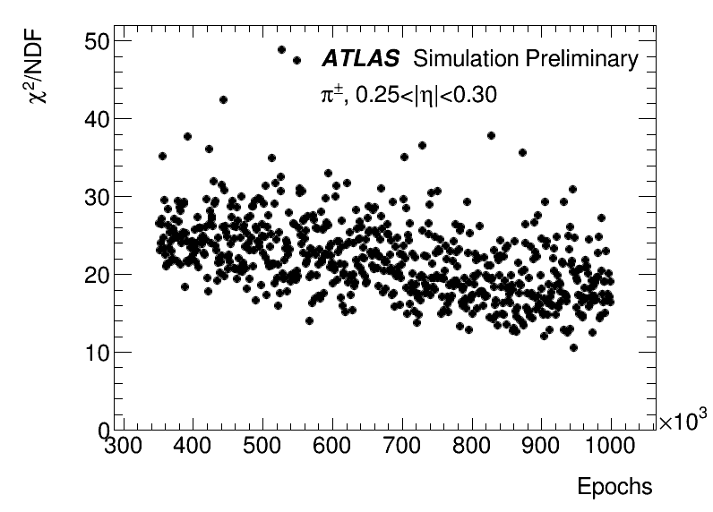
Result of the training
Best epoch selected as the minimum χ2 calculated from the comparison between G4 and the generated events from all energies
Best epoch

Slide 10
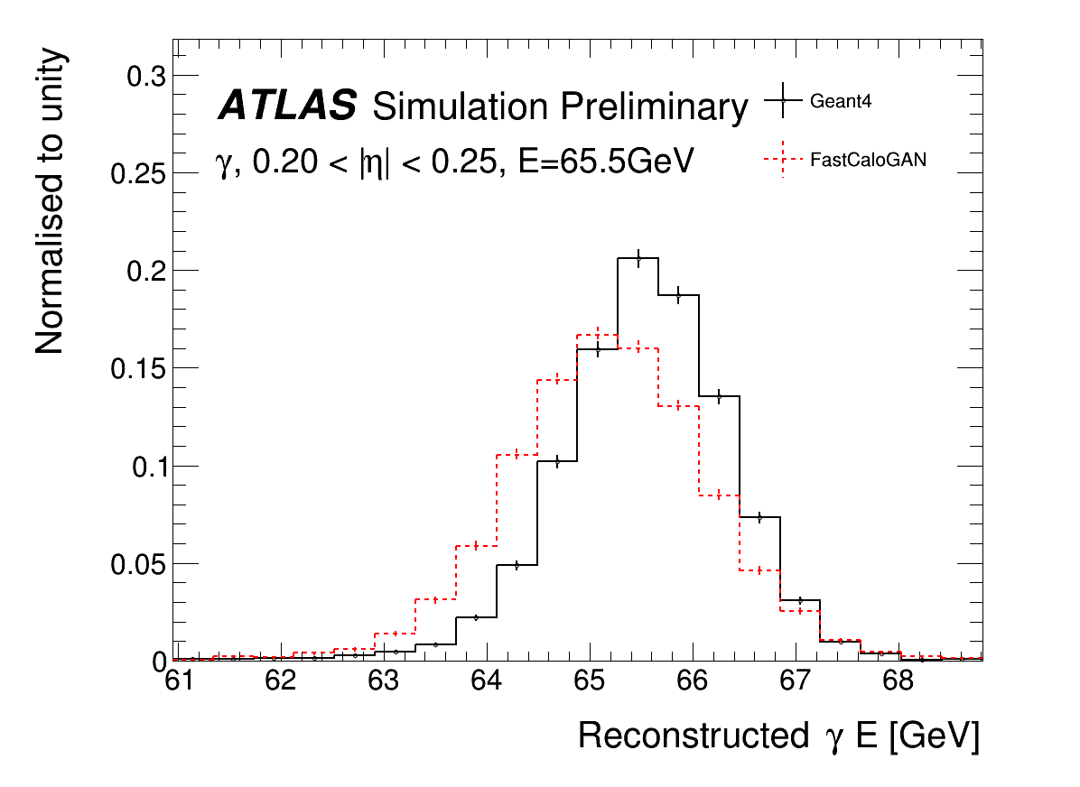
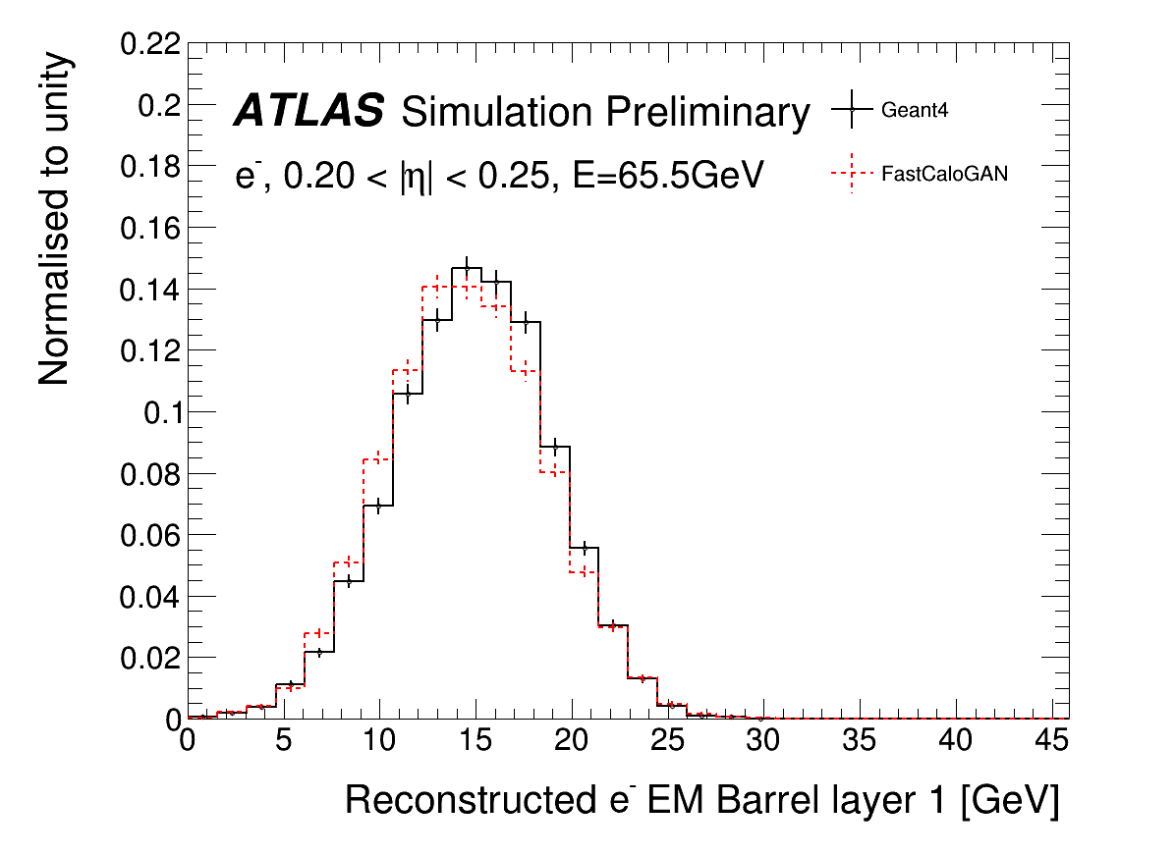
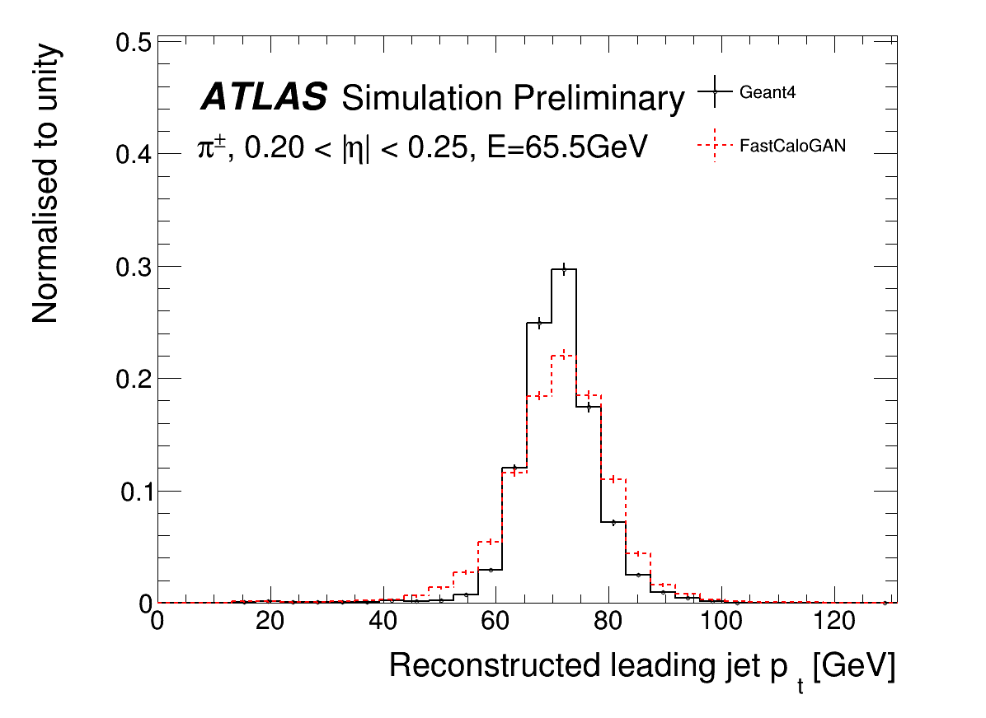
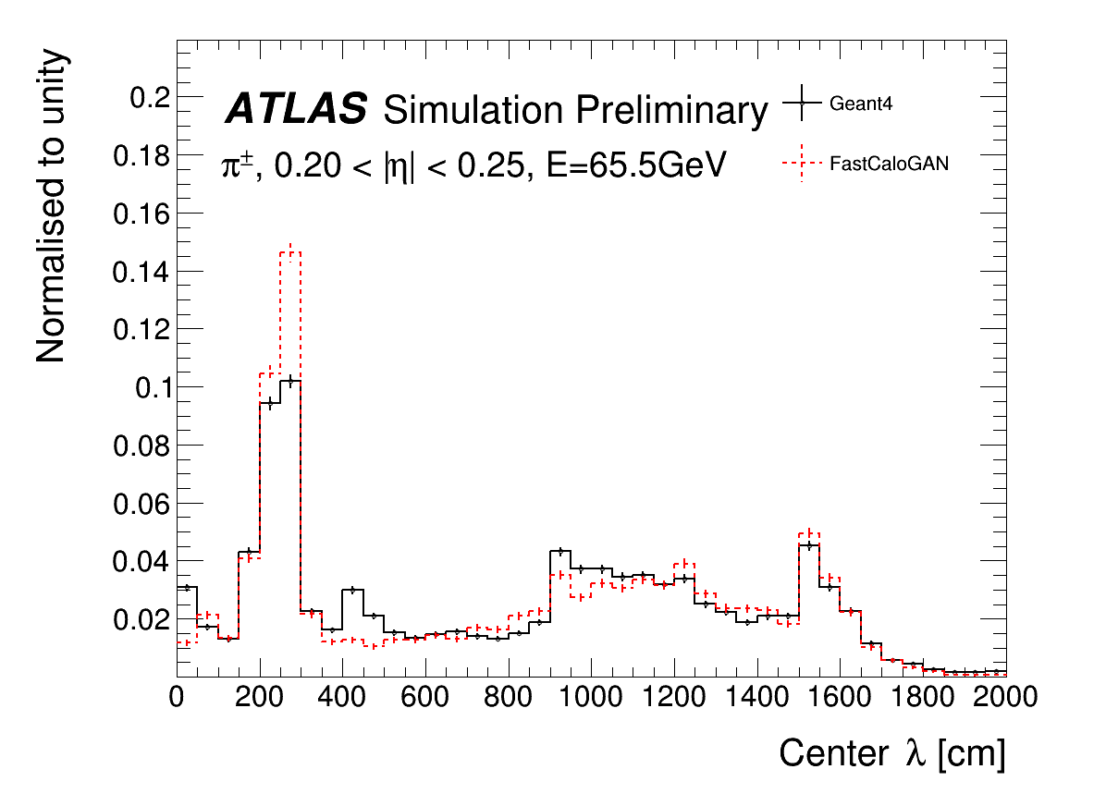
Simulation of single particles

