Slide 1

Physics Meeting
brief news 2 July 2020

Slide 2


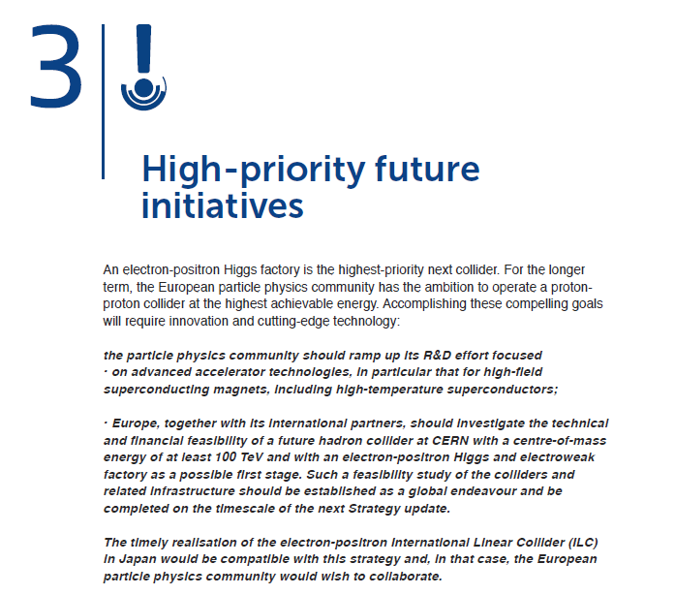
HOT NEWS
Preamble

Slide 3

The ESPP is out and unanimously approved by the member states
clearly a difficult process, many compromises were needed to get unanimous approval
``it is the best that was possible, while many other outcomes were possible, I dont think you can imagine how much we worked!”
Main points:
-- Higgs Factory is highest priority
-- way towards high energies with FCC-hh is the preferred long term plan
and this is materialized by recommandation of strong R&D on High Field magnets
-- clear recommendation for the Technical and Financial Feasibility Study of FCCs
Europe, together with its international partners, should investigate the technical and financial feasibility of a future hadron collider at CERN with a centre-of-mass energy of at least 100 TeV and with an electron-positron Higgs and electroweak factory as a possible first stage. Such a feasibility study of the colliders and related infrastructure should be established as a global endeavour and be completed on the timescale of the next Strategy update.
-- this is considered robust w.r.t. a ‘timely’ ‘would be’ realization of the ILC or rather vice versa;

Slide 4
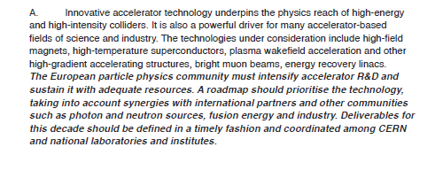
Clearly there is general concern that CERN must have more than one string to its bow.
FCC-ep (PERLE, etc…) can feel comforted by this. Muon collider folks
are already organizing meetings… (before deliverables have been defined).

Slide 5
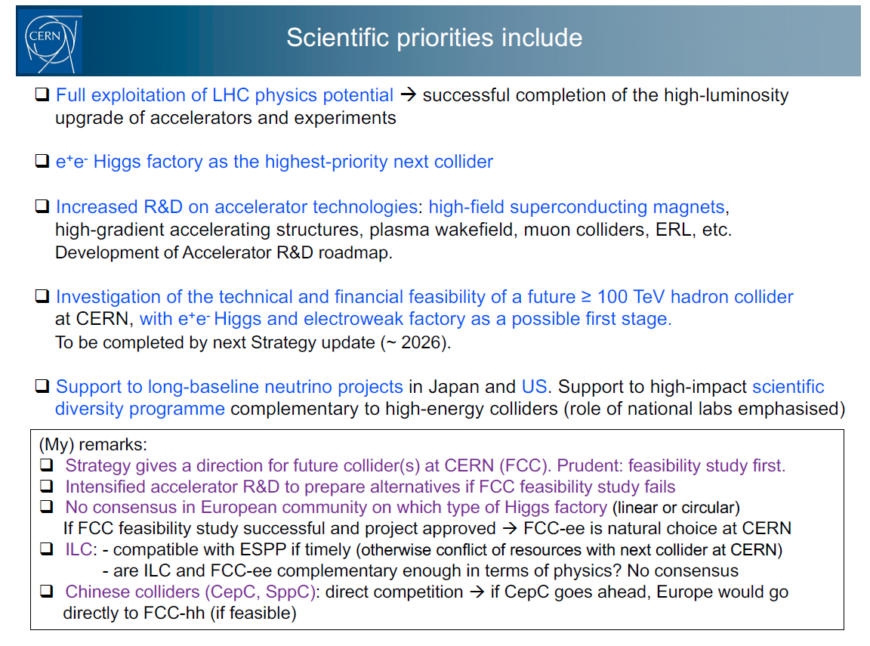
CERN DG F. Gianotti presented the strategy to CERN members & associates Monday 29 June
(Fabiola’s)
Underlying Difficulties:
AB: Present lack of consensus explains «reserved» tone wrt FCC-ee (many enthusiasts, though)
CERN apparently must find funding for – explicitely -- the tunnel part of the project.
The time scale for the FCC-ee is after HL-LHC with *operation* asap after 2038.

Slide 6
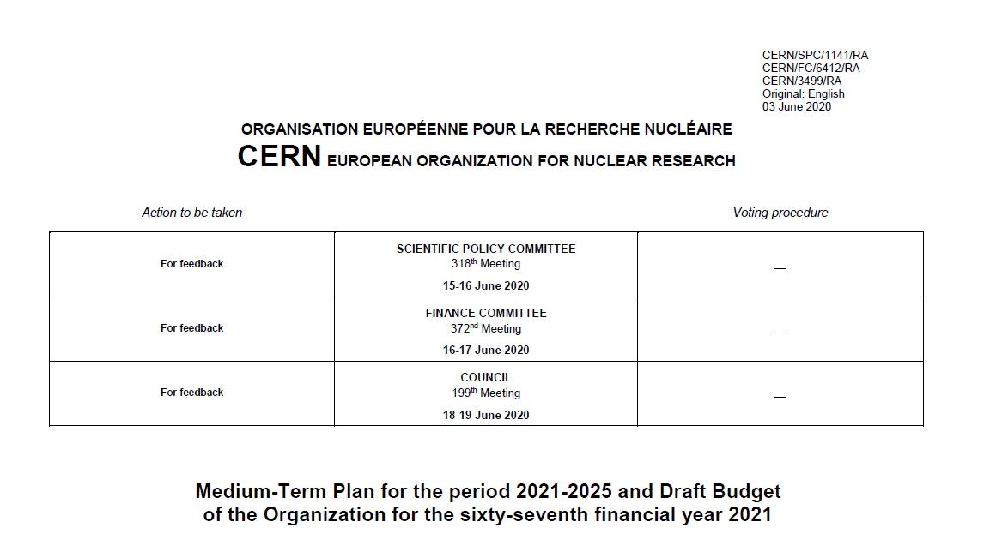
Implementation at CERN
The Medium Term Plan (MTP) and DRAFT budget was discussed by SPC and council
and got excellent feedback (everyone involved knew the strategy)
Final version will be presented for approval in September 2020.

Slide 7
The DRAFT MTP proposes a significant increase of FCC funding both on
FCC study itself (20MCHF per year)
High Field magnet R&D (16->20CHF/yr in addition)
CLIC accelerator technology development funded to ensure ‘plan B’ if FCC feasibility fails
(but detector development group will not continue)
MTP also includes more R&D for future options (including seed money for Muon collider
to establish if/which demonstrator is needed)
The detector R&D roadmap will be studied under the aegis of ECFA
so that CERN-EP detector R&D will be re-assessed.
Conclusion for us: FCC (ee included) is highest priority for CERN long future projects
-- intensify our efforts to enlarge and welcome/support the experimental community
FCC-France FCC-Italy must be followed by FCC-UK, PL, … etc… This works!
-- physics studies (benchmark case studies towards detector requirements)
-- development of detector concepts matching the requirements
-- intensify theoretical developments, esp. precision calculations

Slide 8
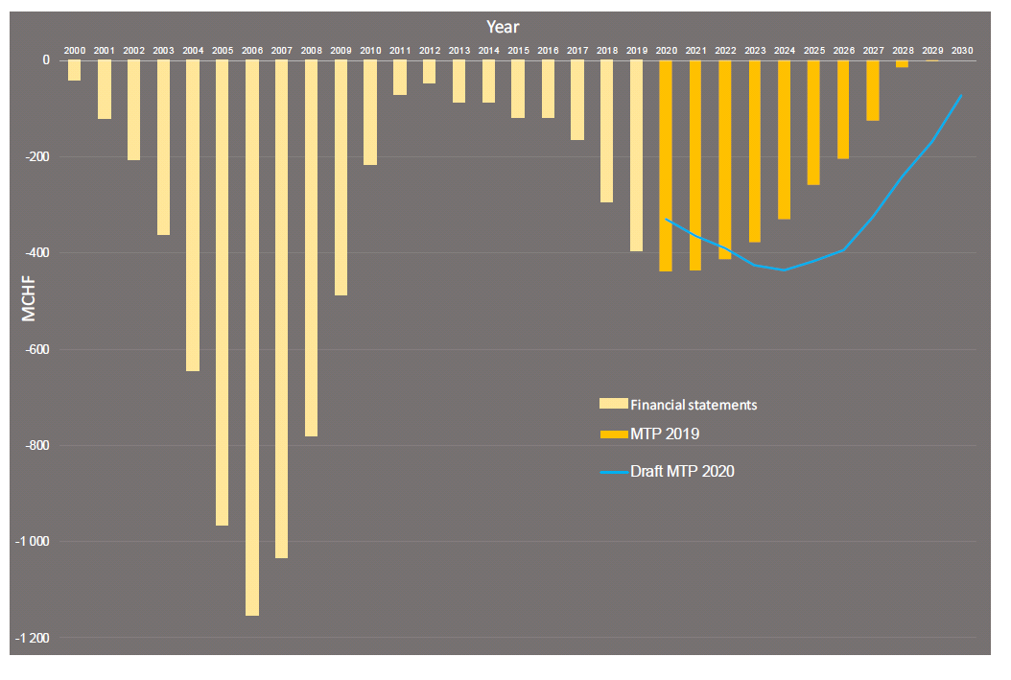
Humility, tenacity…. and patience are in order.

Slide 9
Physics Performance group & conveners
The first thing that was asked from us after the start of national group (FCC-France) was
-- is there a document with the detector requirements?
. this definitely will be needed in a short time ( a few years) scale to help detector design
. TeraZ opportunity makes detector requirements much more stringent (wrt e.g. ILC, CLIC)
ref. slides shown at March physics meeting
. this is a large amount of work requiring tools and organization.
The FCC-ee PE&D SG approved last week a proposal for a Physics Performance group
in short:
1. Physics working groups (conveners) establish list of BENCHMARK MEASUREMENTS
2. Case study teams establish DETECTOR REQUIREMENTS for optimizing measurement,
and in particular matching exp. systematics with the expected statistical precision.
3. This requires simulations of detector setup (fast sim or full sim as appropriate)
with help/guidance from detector experts

Slide 10
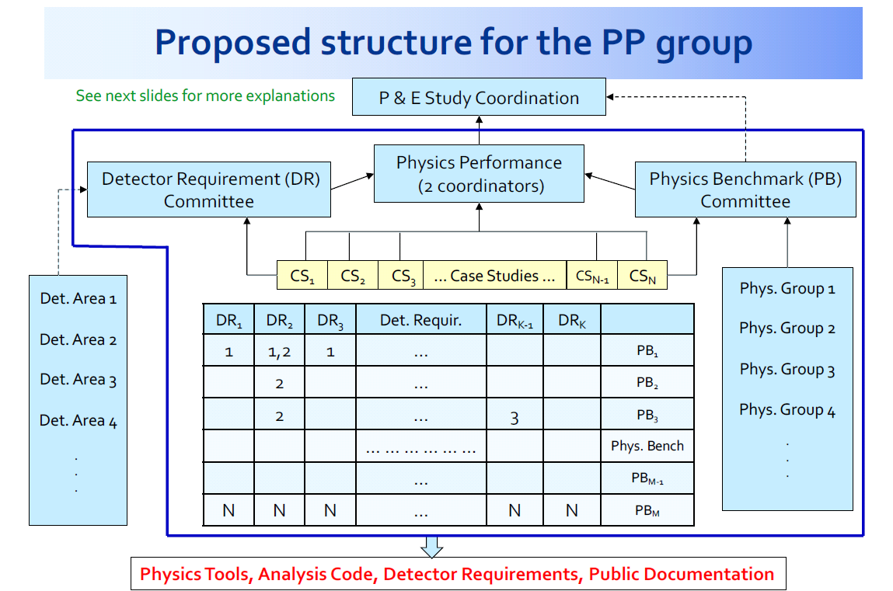
Now receiving nominations for Physics performance coordinators…
+ one case study already started (b/c/g&q tagging for Higgs BRs and cross-section)

Slide 11
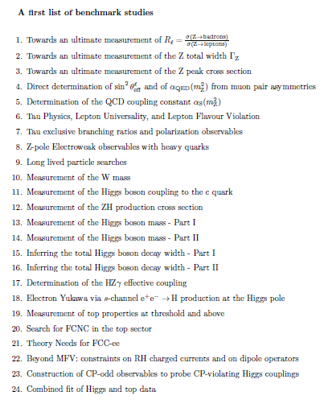
A first selection of Benchmark studies (mostly experimental, some theory)
has already been prepared.
A list of abstracts is here:
https://www.overleaf.com/read/dyjpdszrqxhz
it will be regularly updated
➔Alain Blondel Patrick Janot Markus Klute
+Christophe Grojean and Matthew Mc Cullow
for theory
This was also submitted to the SNOWMASS
process. https://snowmass21.org/
If you are interested in contributing this is a
great way to start.
More soon.
tera Z
WW
H fact
ee→H
top
theory

Slide 12
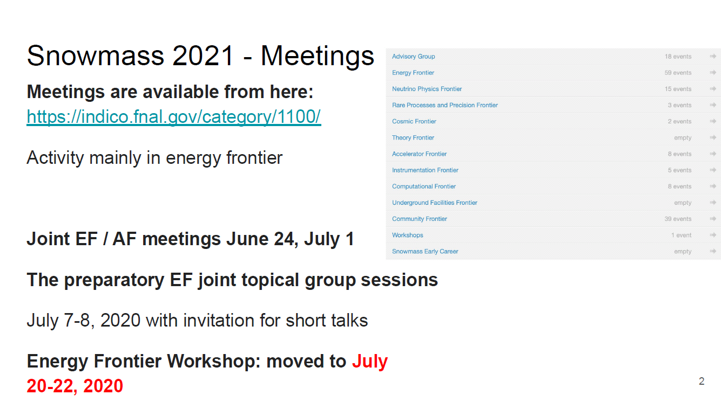
More news:
This is important to us
please feel encouraged to participate!
There will be an FCC-ee presentation
at this meeting
←

Slide 13
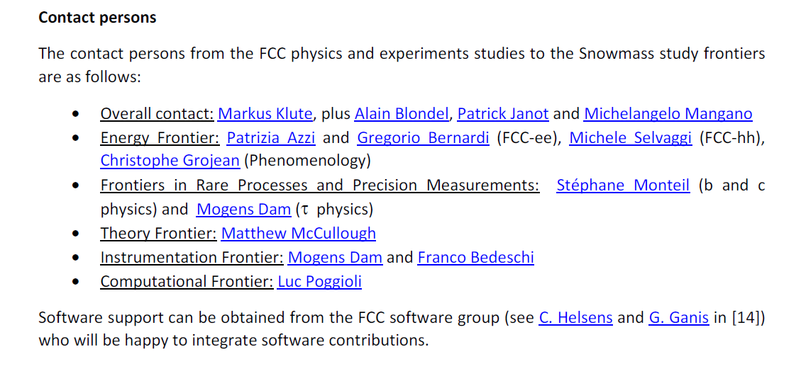
see memo in the snowmass thread:
SNOWMASS21-EF-RF-TF-IF-CompF-TOPIC0-003.pdf

Slide 14
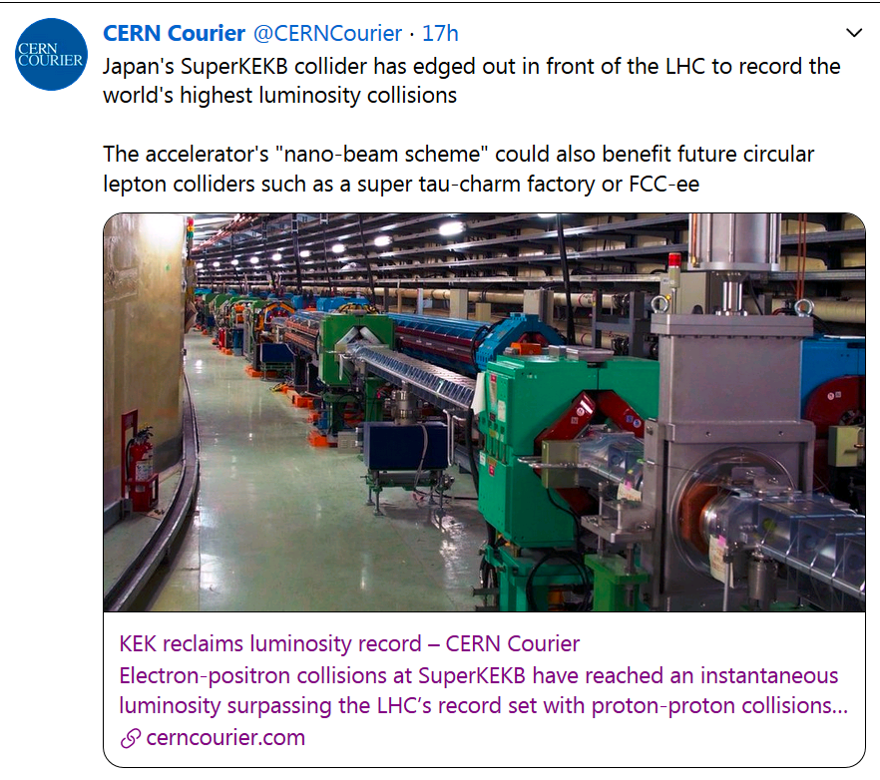
https://cerncourier.com/a/kek-reclaims-luminosity-record/
competition ☺ …
low beta* works
Increase of lumi/MW !
proof of principle for FCC-ee

Slide 15
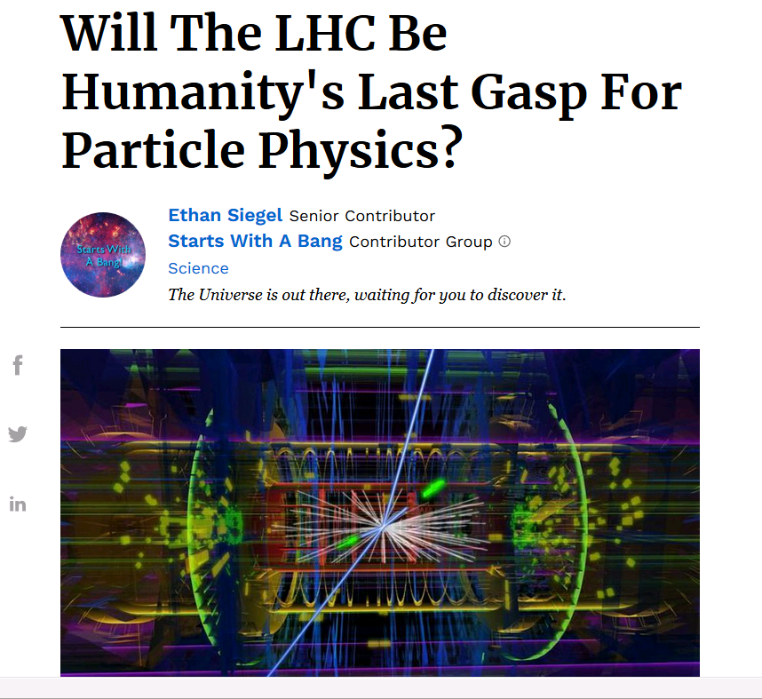
https://www.forbes.com/sites/startswithabang/2020/06/23/will-the-lhc-be-humanitys-last-gasp-for-particle-physics/#4a32e2cf4165
A nice article (in spite of the
apocalyptic title)

Slide 16
Conclusions
We are now at the start of a new process with a clear mission from the Strategy:
a financial and technical fesasibility study of the FCC-ee and FCC-hh.
We can see that it will be a challenge – we are used to this!
Not all instructions have been given and the major partners still need to become
involved (CERN, ECFA, etc..)
Meanwhile we have some very clear tasks in front of us,
-- national FCC groups
-- Benchmark studies and detector requirements
-- also finding detector solutions!
-- theory calculations and BSM ideas
➔ do contact us if you wish to get (more) involved
➔ Please make sure to mark your calendars for the FCC-IS kick-off meeting 9-13 November!

