Slide 1
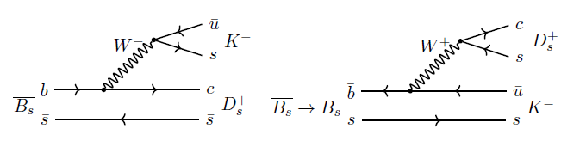
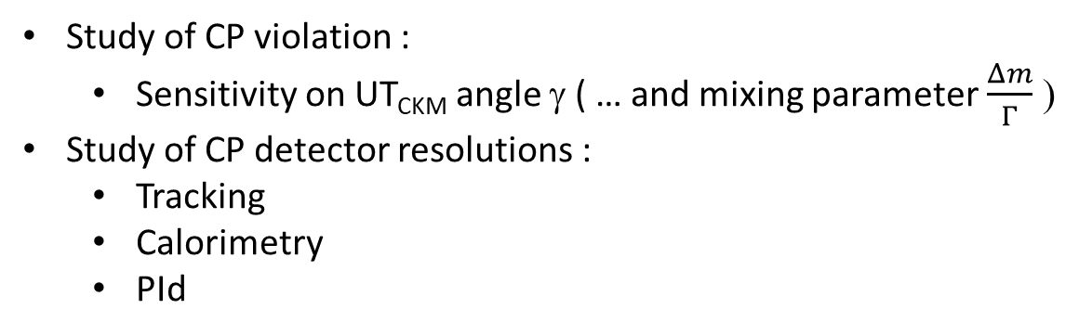
Study of B_{s} -> D_{s} K at FCC-ee
R. Aleksan
21/5/2020
Motivations
Study of CP violation :
  Sensitivity on UT_{CKM} angle γ ( … and mixing parameter $\frac{Δm}{Γ}$ )
Study of CP detector resolutions :
  Tracking
  Calorimetry
  PId

Slide 2
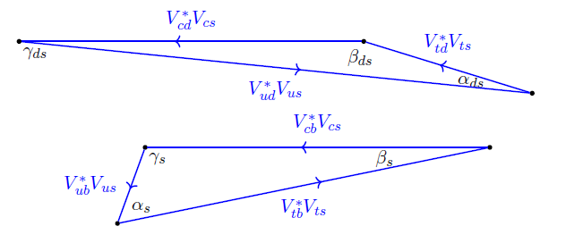
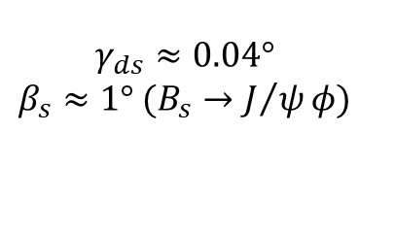
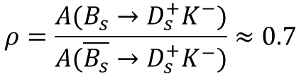
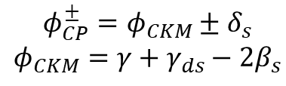



R.A. , I. Dunietz, B. Kayser Z. Phys. C54, 653 (1992)
Time dependent B_{s} decay
https://doi.org/10.1007/BF01559494
$$ρ=\frac{A(B_{s}→D_{s}^{+}K^{−})}{A(\overline{B_{s}}→D_{s}^{+}K^{−})}≈0.7$$
$$ρ\left(D_{s}^{+}π^{−}\right)=0$$
$$ω=wrong tagging$$
$$φ_{CP}^{±}=φ_{CKM}±δ_{s}$$
$$φ_{CKM}=γ+γ_{ds}−2β_{s}$$
$$γ_{ds}≈0.04°$$
$$β_{s}≈1° (B_{s}→J/ψφ)$$
$ΔΓ_{s}$ neglected
2-fold ambiguity

Slide 3
Expected number of events
(To be x 2 for B_{s})

Slide 4
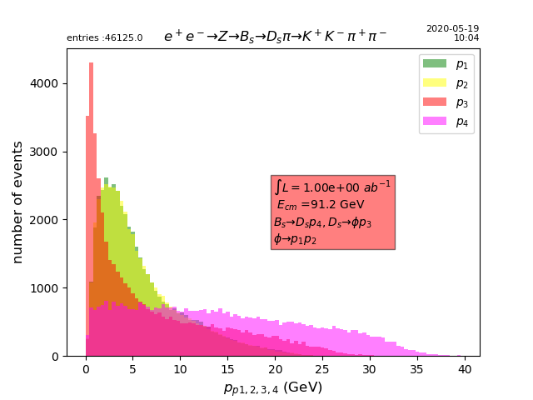
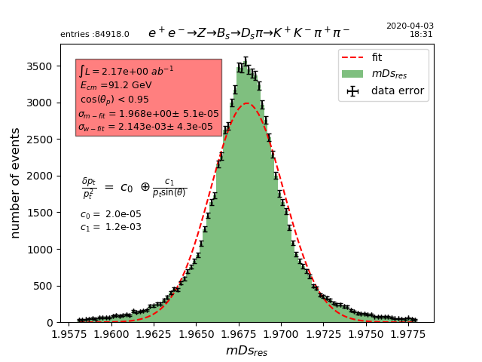
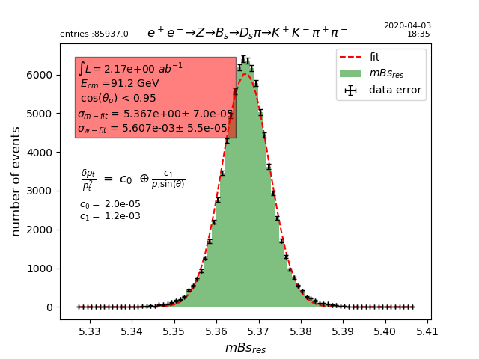

Detector response is parametrized
Kaons from φ
Pid up to ~35 GeV!
(Bachelor π/K)
To be compared to
$${σ(mB_{s})}_{LHCb}≈17 MeV$$

Slide 5
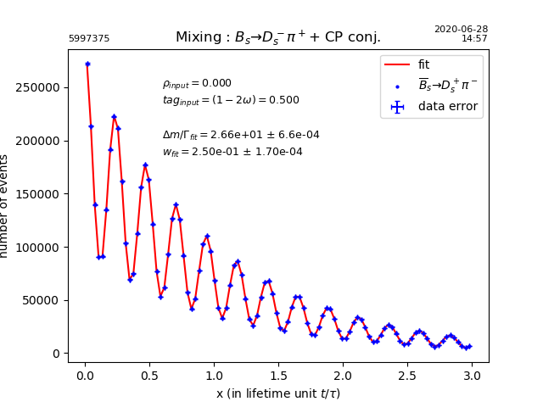
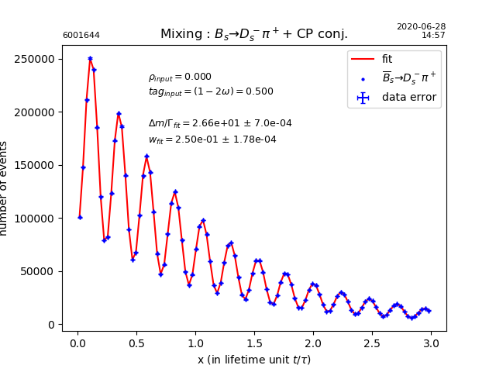
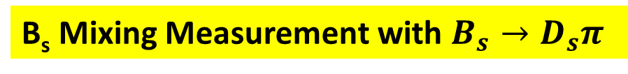
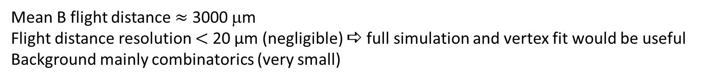

B_{s} Mixing Measurement with $B_{s}→D_{s}π$
Mean B flight distance $≈$ 3000 μm
Flight distance resolution $<$ 20 µm (negligible) a full simulation and vertex fit would be useful
Background mainly combinatorics (very small)
$$δ(Δm_{Bs})_{stat}≈\left(5×{10}^{−4}\right) {10}^{12}ℏs^{−1 } [PDG:\left(2.1×{10}^{−2}\right) {10}^{12}ℏs^{−1 }]$$
$$δ(ω)_{stat}=1.4×{10}^{−4}$$

Slide 6
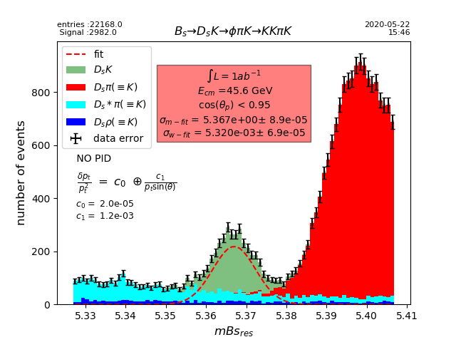
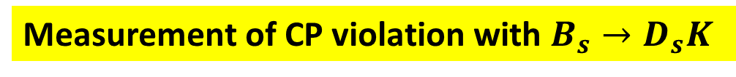
Measurement of CP violation with $B_{s}→D_{s}K$
Tracking resolution crucial to reduce background
Combinatoric background to be added (expected to be relatively small)
A modest PId (ToF + dE/dx) enough (see later)

Slide 7
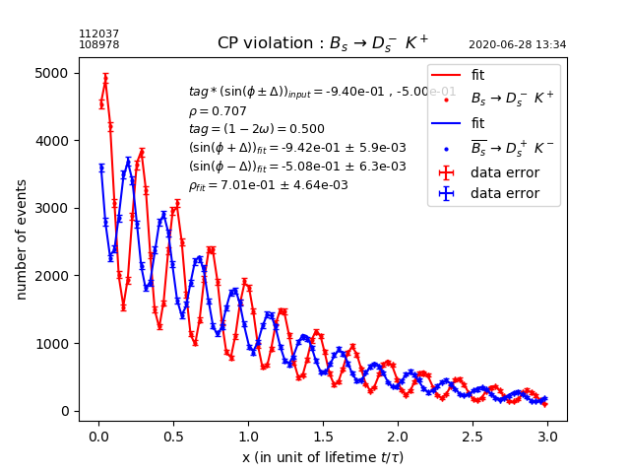
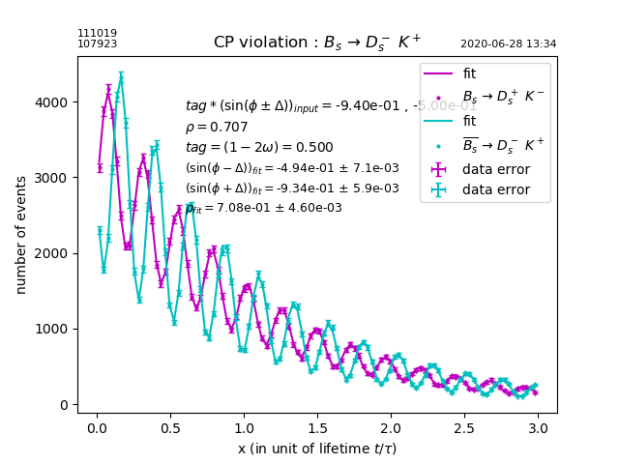
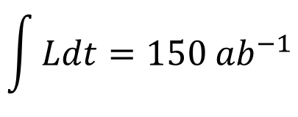
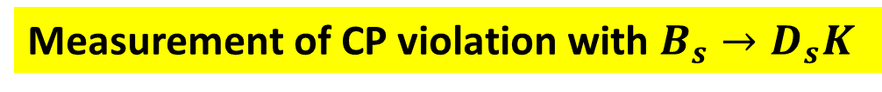


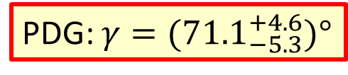
Measurement of CP violation with $B_{s}→D_{s}K$
$$\int{Ldt=150 {ab}^{−1}}$$
PDG: $γ={(71.1}_{−5.3}^{+4.6})°$
$$δ\left(ρ\right)≈3.2×{10}^{−3}(stat.)$$
$$δ\left(\sin^{2}φ_{CKM}\right)≈δ\left(\sin^{2}γ\right)≈5×{10}^{−3}(stat.)$$
$$≅δ\left(γ\right)≈0.4° (stat.)$$
Potential to increase statistics by factor 4-5 with $D_{s}^{±}→ K^{∗0}K^{±}, φρ^{±}, …$ but background needs to be studied

Slide 8
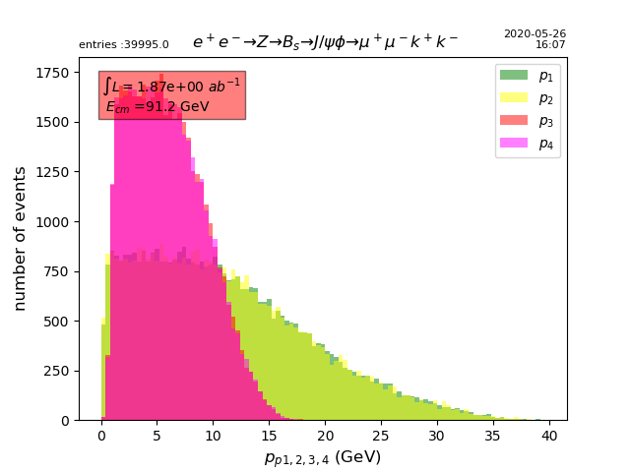
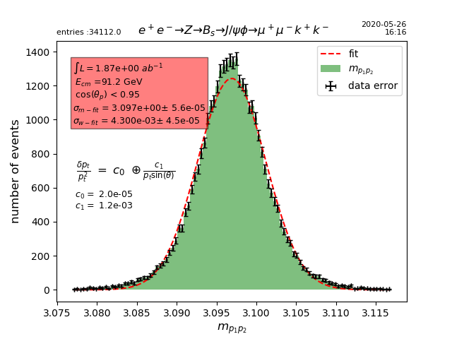


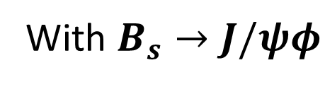
Measurement of CP violation with $B_{s}→J/ψφ→μ^{+}μ^{−}K^{+}K^{−}$
With $B_{s}→D_{s}K :δ\left(φ_{CKM}\right)=δ(γ+γ_{ds}−2β_{s})≲0.4° (stat.)$
To take advantage of the full sensitivity , β_{s} needed
With $B_{s}→J/ψφ$
$$φ_{CKM}={2β}_{s}≈2°$$
Kaons from φ
$$σ\left(m_{ψ}\right)=4.3 MeV$$
muons from J/ψ

Slide 9
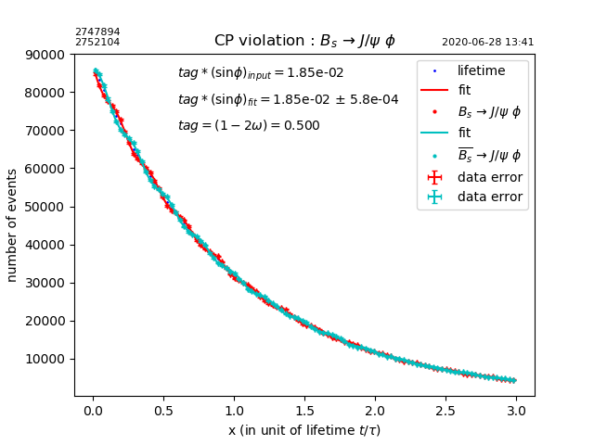

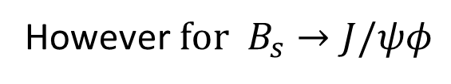
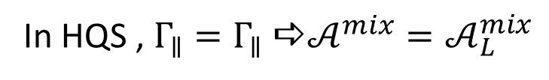
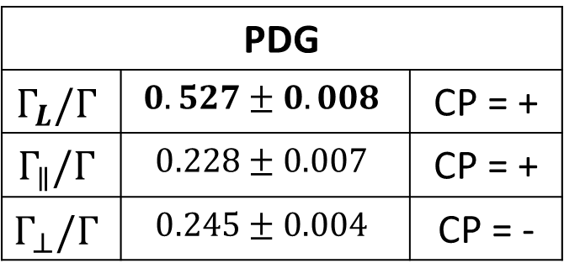
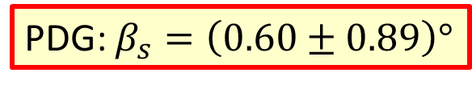
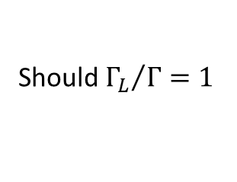

Measurement of CP violation with $B_{s}→J/ψφ→μ^{+}μ^{−}K^{+}K^{−}$
$CKM: β_{s}≈1°$
PDG: $β_{s}=\left(0.60±0.89\right)°$
Should ${Γ_{L}}/Γ=1$
However$for{ B}_{s}→J/ψφ$
PDG
$$Γ_{L}/Γ$$ | $$0.527±0.008$$ | CP = +
$$Γ_{∥}/Γ$$ | $$0.228±0.007$$ | CP = +
$$Γ_{⊥}/Γ$$ | $$0.245±0.004$$ | CP = -
$$\int{Ldt=150 {ab}^{−1}}$$
In HQS , $Γ_{∥}=Γ_{∥}$a$𝒜^{mix}=𝒜_{L}^{mix}$
Angular analysis required (tbd)
Otherwise additional dilution factor ~0.5
Slightly reduced sensitivity
$$δ\left(sinφ_{CKM}\right)=δ\left(sin{2β}_{s}\right)≈1.2 ×{10}^{−3} ≅δ\left(β_{s}\right)≈3.4°×{10}^{−2}(stat.)$$

Slide 10
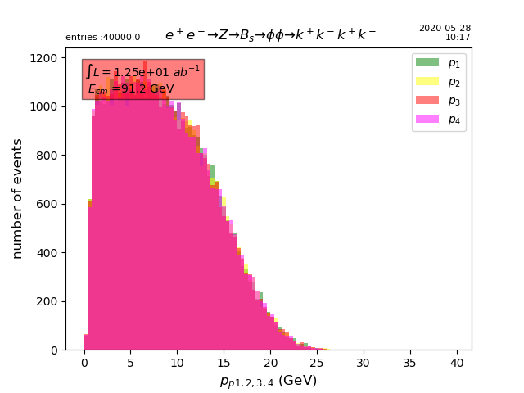
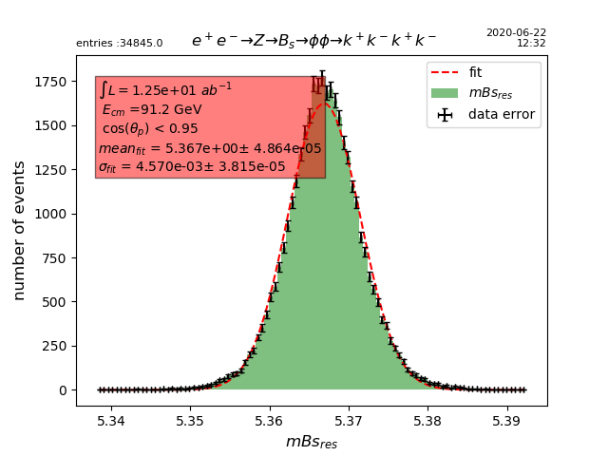
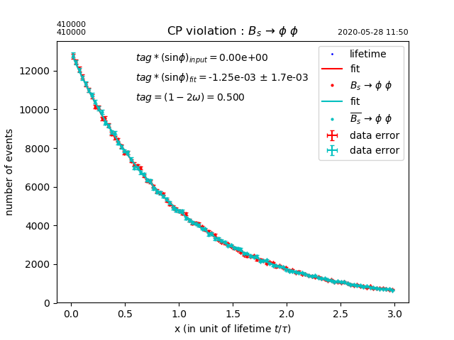
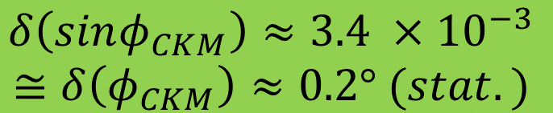
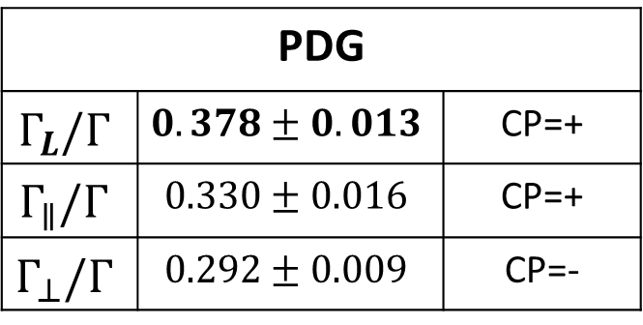
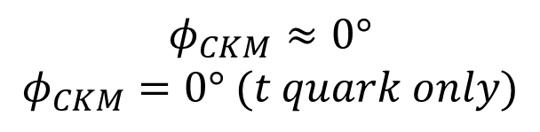
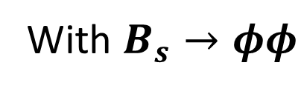

Study of CP violation with $B_{s}→φφ→K^{+}K^{−}K^{+}K^{−}$
$$φ_{CKM}≈0°$$
$$φ_{CKM}=0° (t quark only)$$
With $B_{s}→φφ$
a Very good for probing BSM
Kaons from φ
$$σ\left(m_{B_{s}}\right)=4.6 MeV$$
PDG
$$Γ_{L}/Γ$$ | $$0.378±0.013$$ | CP=+
$$Γ_{∥}/Γ$$ | $$0.330±0.016$$ | CP=+
$$Γ_{⊥}/Γ$$ | $$0.292±0.009$$ | CP=-
Angular analysis required (tbd)
Otherwise additional dilution factor ~0.4
$$δ\left(sinφ_{CKM}\right)≈3.4 ×{10}^{−3}$$
$$≅δ\left(φ_{CKM}\right)≈0.2° (stat.)$$

Slide 11
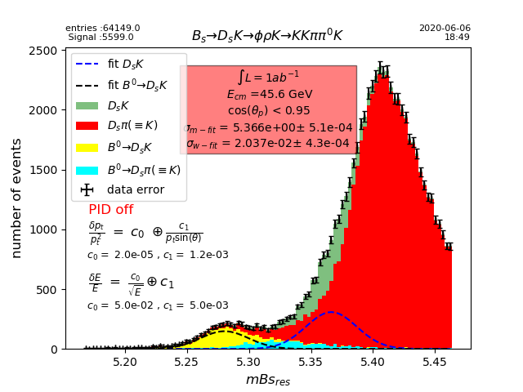
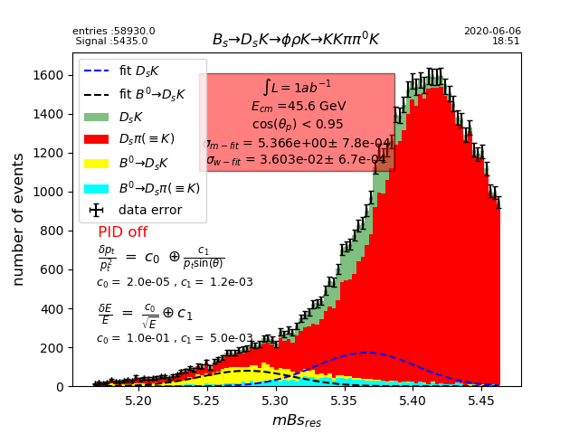
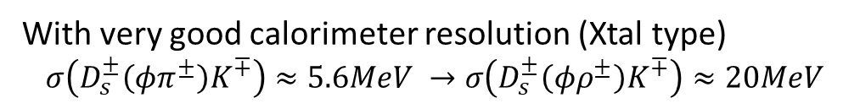


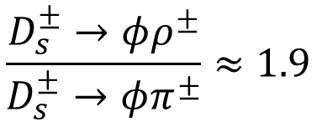

NO PId
Inclusion of neutrals for $B_{s}→D_{s}K$ reconstruction
$$\frac{D_{s}^{±}→φρ^{±}}{D_{s}^{±}→φπ^{±}}≈1.9$$
e.g. could potentially increase statistics (x 3) by adding
$$D_{s}^{±}→φρ^{±}$$
More generally many physics topics (such as flavor physics) would benefit by using neutrals
a Big advantage compared to LHCb a constraint on calorimeter and PId
With very good calorimeter resolution (Xtal type)
$$σ\left(D_{s}^{±}\left(φπ^{±}\right)K^{∓}\right)≈5.6MeV →σ\left(D_{s}^{±}\left(φρ^{±}\right)K^{∓}\right)≈20MeV$$
a Background $D_{s}^{±}\left(φρ^{±}\right)π^{∓}$ huge
a PId mandatory
Much worse with
LAr type Cal.
$$σ\left(D_{s}^{±}\left(φρ^{±}\right)K^{∓}\right)≈36.MeV$$

Slide 12
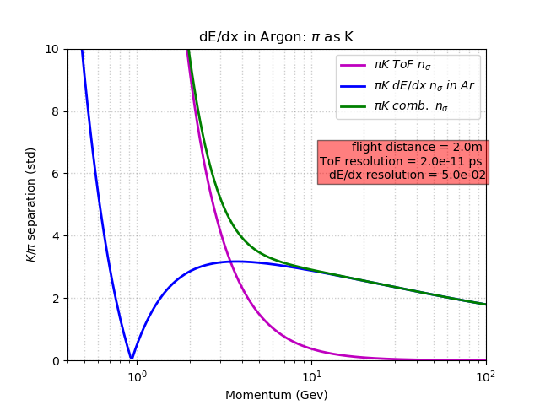
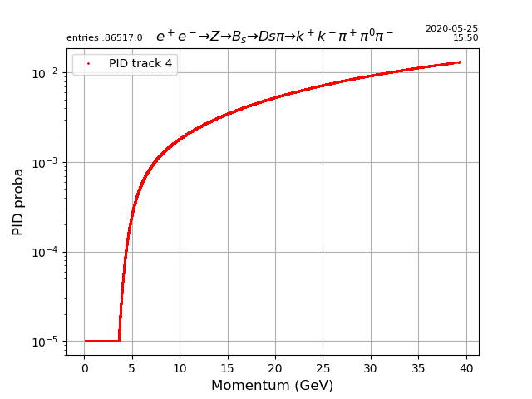
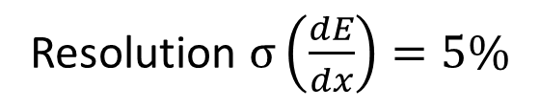
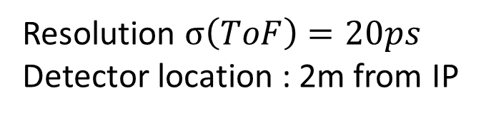
Inclusion of dE/dx and ToF
Resolution $σ\left(\frac{dE}{dx}\right)=5\%$
π Rejection factor with ε(K)=50%
Resolution $σ\left(ToF\right)=20ps$
Detector location : 2m from IP

Slide 13
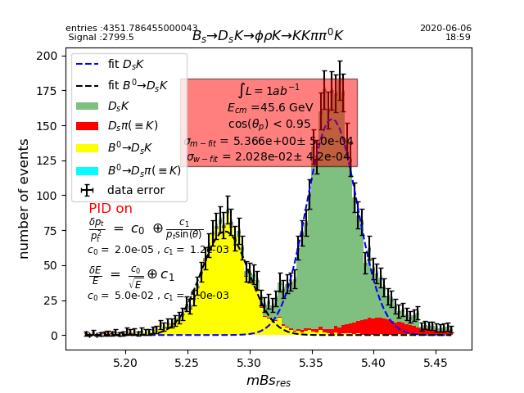
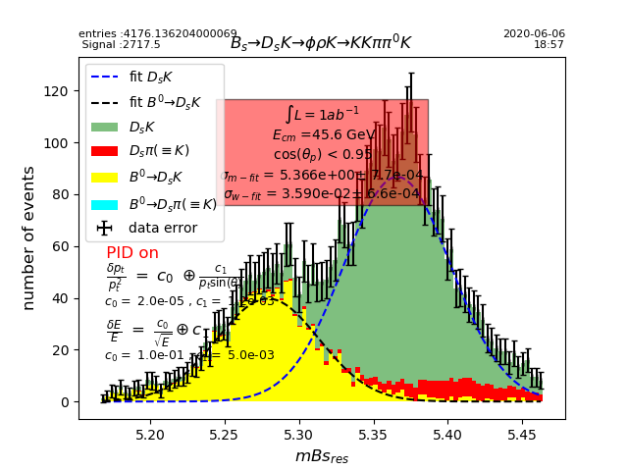
Effect of dE/dx and ToF
Other backgrounds have to be added
dE/dx + simple ToF probably not enough unless
beyond state-of-the-art is achieved for dE/dx and ToF
or addition of a dedicated PId system

Slide 14
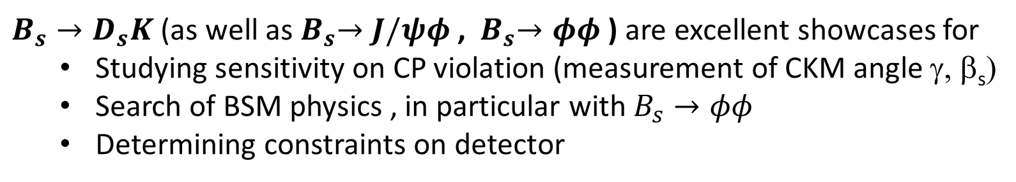
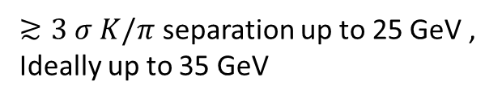
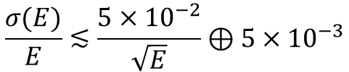

Conclusions
$B_{s}→D_{s}K$ (as well as${ B}_{s}→J/ψφ$ , ${ B}_{s}→φφ$ ) are excellent showcases for
  Studying sensitivity on CP violation (measurement of CKM angle γ, β_{s})
  Search of BSM physics , in particular with $B_{s}→φφ$
  Determining constraints on detector
$δ\left(γ\right)≲0.4° (stat.) δ\left(β_{s}\right)≲3.4°×{10}^{−2}(stat.)$ achievable
More that 1 order of magnitude improvement compared to present PDG errors
However this requires
Excellent tracking and vertexing resolution ,
$$\frac{σ(p_{T})}{p_{T}^{2}}≤2. ×{10}^{−5}⊕\frac{1.2×{10}^{−3}}{p_{T}sinΘ}$$
Excellent calorimetry resolution, ideally
$$\frac{σ(E)}{E}≲\frac{5×{10}^{−2}}{\sqrt{E}}⊕5×{10}^{−3}$$
AND Excellent PId resolution
$≳3 σ K/π$ separation up to 25 GeV ,
Ideally up to 35 GeV
A full simulation would be useful to refine further analysis, in particular for vertexing

Slide 15
Backup Slides

Slide 16


Detector resolutions
ILD type detector (6 vertex Si layers + 2 Inner Si layers + TPC + 1 outer Si layer)

Slide 17



Slide 18




Energy spectrum of γ from $D_{s}^{−}→φρ^{−}→(K^{+}K^{−})_{φ}(π^{−}π^{0})_{ρ}$
X-tal like cal.
LAr like cal.

Slide 19









Study of CP violation with $B_{s}→φγ$
Same as $B_{s}→φφ$
$$φ_{CKM}≈0°$$
$$Br\left(B_{s}→φγ\right)=3.4×{10}^{−5}$$
a Very good for probing BSM
$$≅1.7×{10}^{6} events with 150 ab^{−1}$$
2 main issues requiring dedicated study
  Study of background as mass resolution is poor
    $σ\left(m_{Bs}\right)≈39 MeV$with Xtal like calo.
    $σ\left(m_{Bs}\right)≈70 MeV$ with Lar like calo.
  Study of vertex resolution as φ is strongly boosted ($σ>400μm!)$
Kaons from φ
γ

Slide 20


$$σ\left(D_{s}K\right)≈17 MeV$$

