Slide 1
Status of GE1/1 services
Zoltan SZILLASI
11. June 2020

Slide 2
outline
gas status
cooling status
HV/LV cabling status
RO fibers status
Temperature measurement fibers (FBG) status
where we are? what is missing? how many working days of work? how many working days available?
who will executed the work? when? WP exist?

Slide 3
Gas

Slide 4
GE1/1 gas installation
GE1/1 gas system readiness :
  Gas system for GE-1/1 fully tested and running since Nov 2019. ✔
  Few lines had to be inspected in situ to tighten some components and reduce some potential leaks.
  GE-1/1 12 lines are already monitored in the GCS (gas WinCC control system). Running as of today in pure CO2.
  Gas system in GE+1/1: still two lines (4 pipes) to install between periphery and detector position. Should be finished at the end of June by the ZEC team.
  Once the first bunch of 6 consecutive GE+1/1 will be installed, we will begin to use the gas system in positive endcap with pure CO2 again
Daniel Teyssier

Slide 5
Cooling

Slide 6
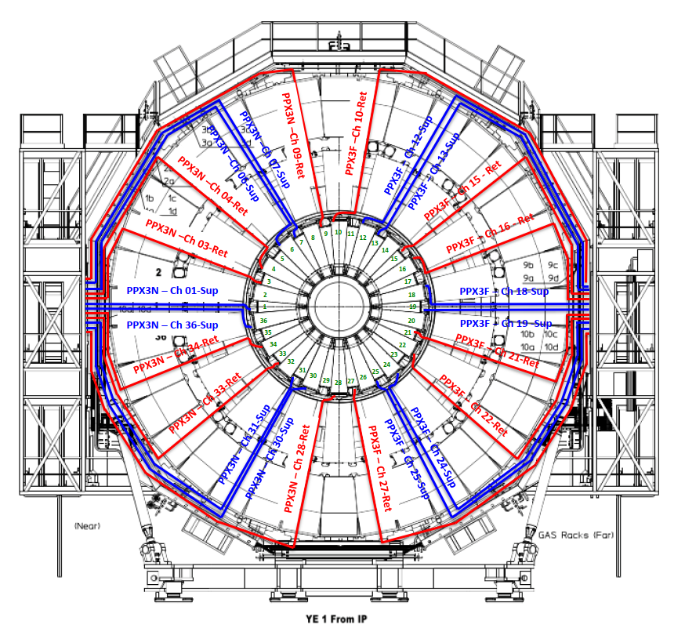
Cooling status
Cooling system completed and running in GE-1/1. No leaks detected and allowed the first pre-commissioning. ✔
Cooling system installation completed in GE+1/1 (see next slide), not yet running as no detectors are installed. The system was by the way gas leak tested by the ZEC team already. ✔
Daniel Teyssier

Slide 7
High voltage / Low voltage

Slide 8
HV / LV system
  High Voltage and Low Voltage system installation – ON STANDBY!
  the HV and LV mainframes are already installed in 2019
  the LV boards already in place; 15 HV boards currently used in the QC6/QC8 stand and 6 HV boards had to be delivered in February from CAEN group company;
  however, delivery postponed for the SARS COV-2 crisis in June 2020

Slide 9
LV Power System Overview & Status
-ve EndCap
X5
V33
USC
UXC
2 PATCH PANELS (PP)
In X4 balcony
the –ve near side
Cables from PP to X2/X5 in Negative Endcap are connected.
GE1/1
S4F03
X2
V33
Rack X4N19
ME0
Cables from mainframe to Patch panels are routed for both –ve & +ve EndCaps.
GE2/1
Busy
Rack X4N55
Mainframe SY4527
GE1/1
X5
J33
ME0
Branch Controller BC
A1676A
Cables from PP to X2/X5 in Positive Endcap should be during April/May 2020. (postponed due to COVID19 Crisis).
GE2/1
X2
J33
Each BC control one rack in UXC through the 2 Patch Panels
+ve EndCap
Shimaa AbuZeid

Slide 10
GE1/1 UXC Racks (48 V Service & Power)
Service
48 V service from Patch Panel (PP)
Fiber P.Panal
MAO 1
MAO 2
48 V Service Dist.
A3016 HP | A3016 HP | A3016 HP | A3016 HP | A3016 HP
Cupper Rod
A3016 HP
Cupper Rod
MAO 3
A3009 HP | A3009 HP | A3009 HP | A3009 HP | A3009 HP
Cupper Rod
Power
The second output channel of MAO2 is used to provide the service to the other modules, through a distribution unit
4 kW
Crate 1
All modules of LV power system in Racks (X5J33, X2J33) in –ve EndCap are connected controlled by DCS.
2 kW
Crate 2
4 modules of LV power system should be installed (after testing in 904 lab) in Racks (X5V33, X2V33) in +ve EndCap.
Only DAQ cables are there. Other cables should be connected soon to complete these Racks
Still embty to be filled by LV power system of GE2/1
Shimaa AbuZeid

Slide 11
LV power system
Setup the system in 904 lab and test 4 LV boards then install them in racks in UXC will take (2-3) days.
For each rack in UXC, routing the cables to the modules will depend on the technician availability but it should take 1-2 full days.
The responsible person for testing and installing modules is Shimaa
The work should be resume by the end of June or beginning of July.
Shimaa AbuZeid

Slide 12
high voltage / low voltage cabling status
negative endcap cabling is ready (GE-1/1, GE-2/1) ✔
USC/UXC cables installed ✔
positive endcap (GE+1/1, GE+2/1):
HV cabling is ongoing. Cabling started on 2. June on positive disk. Will be finished at the end of June (probably on 26. June)
LV cabling will come later
Connectorization of HV cables are ongoing in USC (Svetlana/Igor)
After that connectorization on rack side will needed.
Need Naples technicians to install the radial connectors (cables to patch board) - need 3 weeks full time work

Slide 13
Readout fibers

Slide 14
Readout Fibers/Fibers for link to CSC
GE-1/1: everything is installed ✔
GE+1/1: need to connect the fibers to the patch panels in UXC, and also need some CTP7s at P5
  Readout Optical Fibers routing/connectorization – ONGOING!
  the readout fibers routing/connectoritazion had been scheduled from March 2020;
  however, installation postponed for the SARS COV-2 crisis in June 2020
  Readout Fibers/Readout Back-End system installation - ON STANDBY!
  the µTCA crate is already installed in 2019
  the CTP7s currently used in the QC7/QC8 stand and R&D activities
The fiber connection is not a complicated task, just requires manual labor. Would be good to get a student to do it (of course Evaldas would train the person for the job)
Support of getting the DAQ operational: Evaldas could dedicate a week or more of his time explicitly for this, but do it remotely. As long as Laurent is on-site.

Slide 15
Readout Fibers/Fibers for link to CSC
Evaldas Juska

Slide 16
Radmon

Slide 17
GE1/1 RADMON tasks for INRNE-Sofia
1. GE1/1(-) commissioning
- Controller-Raspberry connectivity
- Raspberry data parsing and event preparation
- DCS raw data archiving
- DCS data processing & visualization
2. GE1/1(+)
- UXC wheel 6 cables installation – SC-Splitter
- UXC-USC 2 cables installation – Splitter - controller
- Cable connectorization (soldering) & test
- Controller installation
- Commissioning - the same as for GE1/1(-)
Possibly the GE1/1(-) commissioning could be made from Sofia
Bulgarian engineer at CERN for connectorization/test
Plamen Stoianov Iaydjiev

Slide 18
Temperature sensor fibers

Slide 19
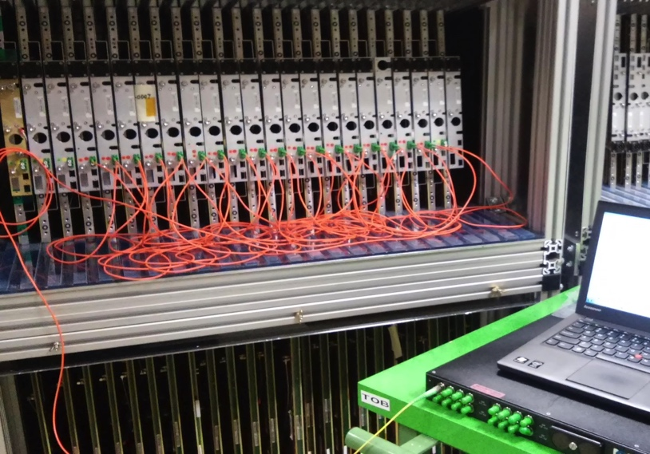
Fibers for Temperature Sensors
GE1/1:
1 FBG per short chamber
GE-1/1: optical fibers routing/connectorization is done ✔
GE+1/1: optical fibers routing/connectoritazion had been scheduled from March 2020; however, installation postponed for the SARS COV-2 crisis

Slide 20
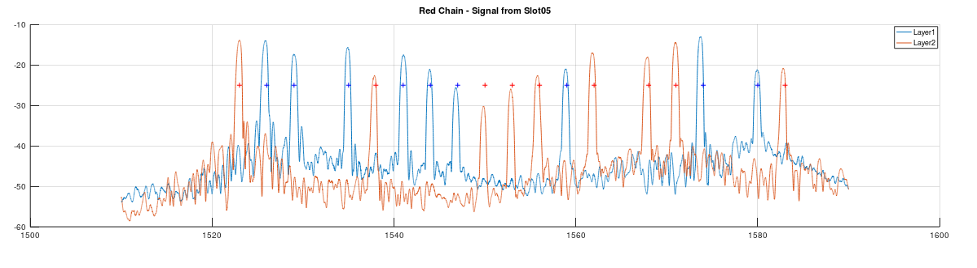
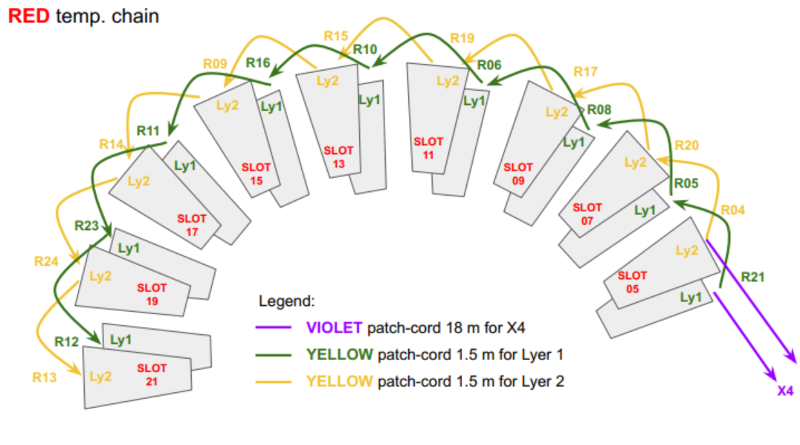
RED temp chain is OK
Because of high attenuations, the full chain shall be split in two chains.
- ‘Layer1 chain’
- ‘Layer2 chain’
Michele Caponero

Slide 21
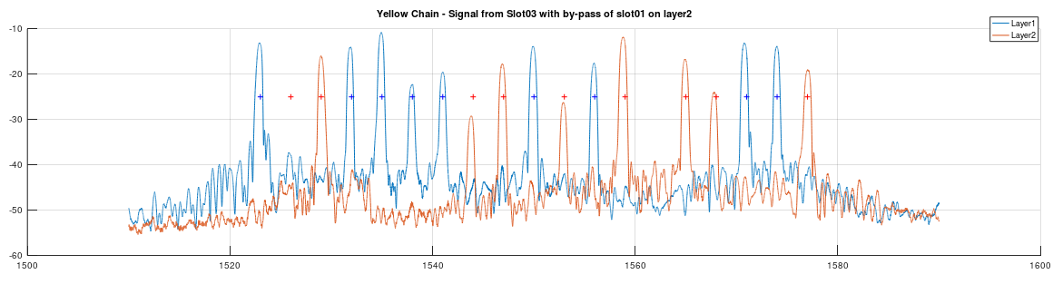
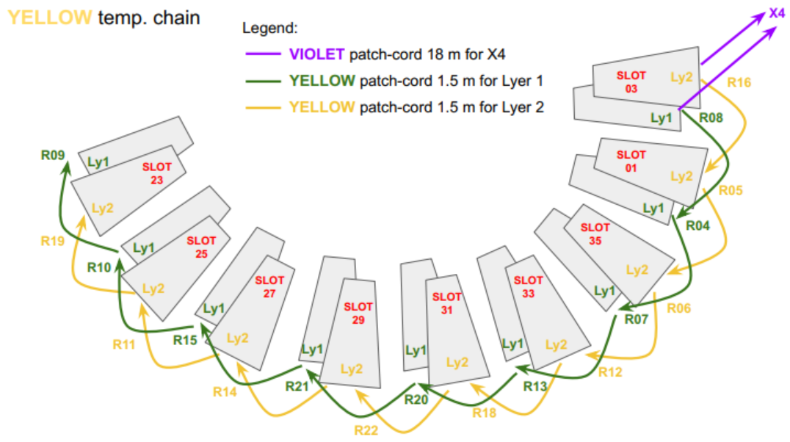
slot1/layer2 missing
Because of the bypass
Yellow temp chain has a problem in the chamber @slot1/layer2
chamber @slot1/layer2
shall be bypassed
Because of high attenuations, the full chain shall be split in two chains.
- ‘Layer1 chain’
- ‘Layer2 chain’
Michele Caponero

Slide 22
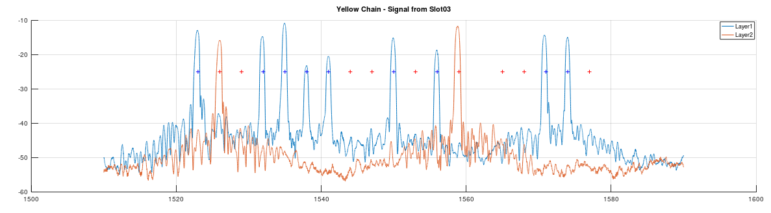
slot1/layer2
slot3/layer2
Yellow temp chain has a problem in the chamber @slot1/layer2
From slot3, only the chamber @slot3 and the chamber @slot1 can be seen
Michele Caponero

Slide 24
backup

Slide 25
GE2/1
1 FBG per module
4 FBGs per chamber
The 4 FBGs are chained inside the chamber (ChamberChain)
FBG sensor
Temperature sensing (0.2°C)
FBGs can be chained and interrogated in Wavelength Division Multiplexing
each sensor shall operate in a unique wavelength band
ME0
1 FBG per module
6 FBG per stack
The 6 FBGs are chained outside the modules (StackChain)
CMS GEM Upgrade Workshop 20.05.2020 – Temp Monitor System for Phase 2 GEM Projects – M. Caponero
25

Slide 26
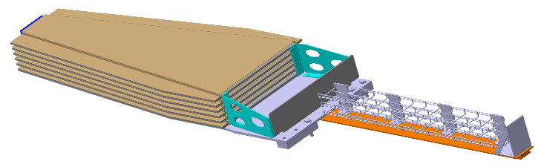
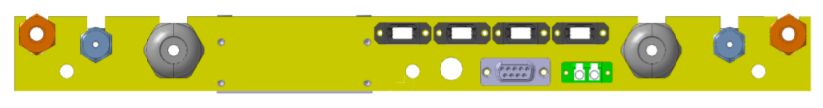
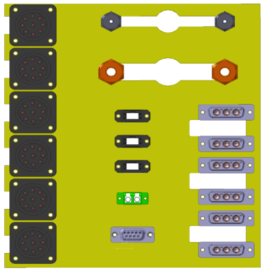
ME0 Temp Monitor System
The FBG of each module shall have a unique wavelength (WL)
There are 6 different WLs
The position of the WLs along the chain can be modified
All stacks have the same Wls
(stacks can be interchanged)
WL1
WL2
WL3
From ME0_R&D_Status_Plan
by Michele Bianco
WL4
WL5
WL6
6pcs
FGB on 'bare' f.o., d=0.25 mm
2pcs
1xf.o. patchcord, d=3 mm
5pcs
1xf.o. patchcord, d=3 mm
1pcs
zip cable 2xf.o., d<5mm,
LC/APC connector this end
FC/APC connector other end
6pcs
duplex LC adapter
1pcs
duplex LC adapter
CMS GEM Upgrade Workshop 20.05.2020 – Temp Monitor System for Phase 2 GEM Projects – M. Caponero
26

Slide 27
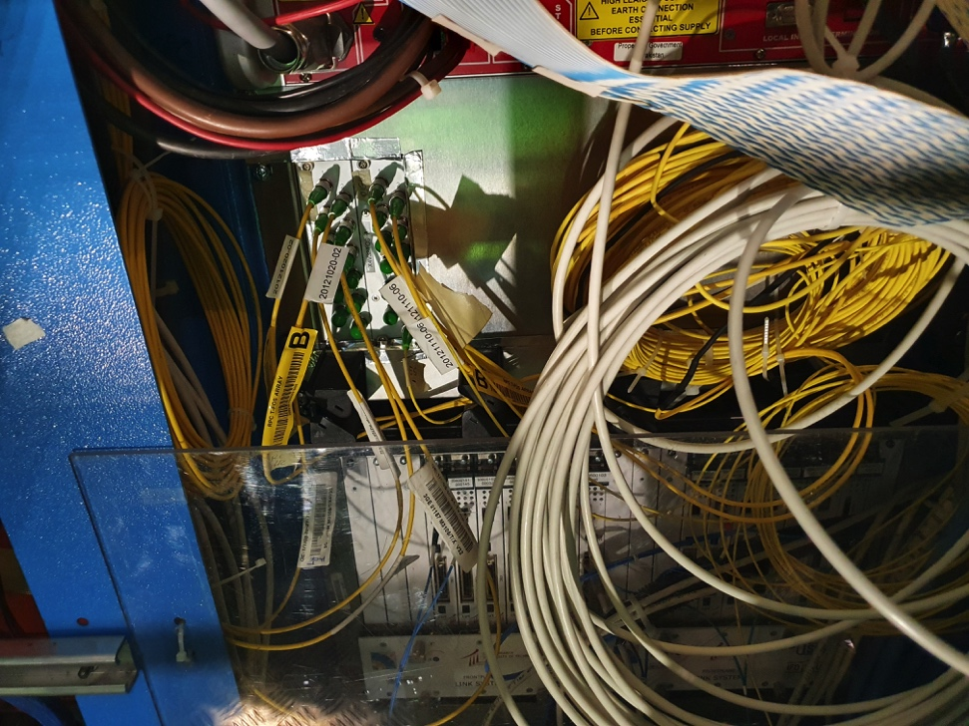
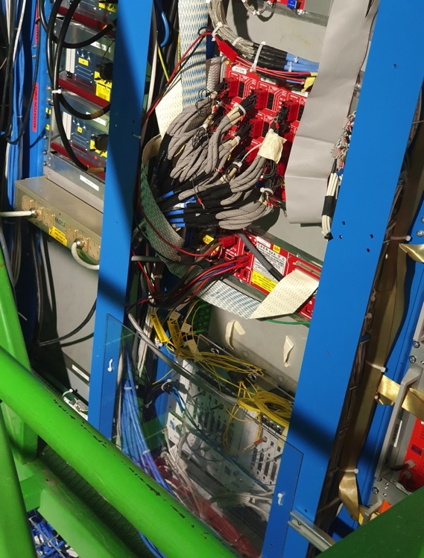
No much space at X4
Space is necessary for the fibre optic transceiver/patch-panel
Space is necessary to park the extra-length of patchcords
There is a free ‘1U’ below the FOS patch panel in both X4J32 and X4V32
The width of the FOS patch panel is not ‘full rack-size’
X4J32
X4V32

Slide 28
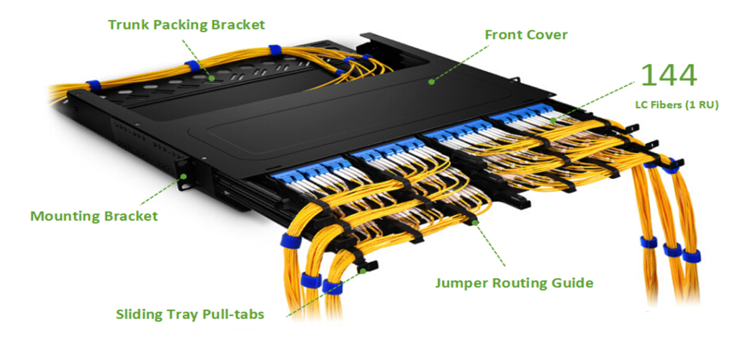
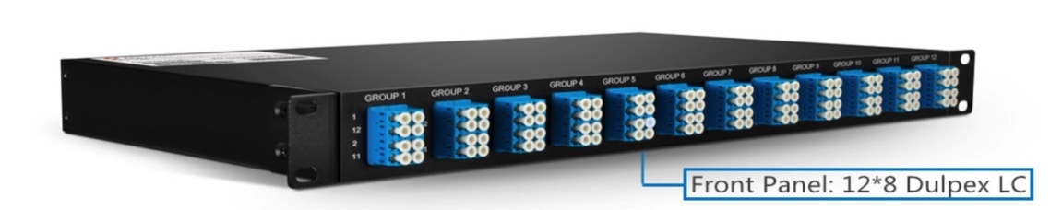
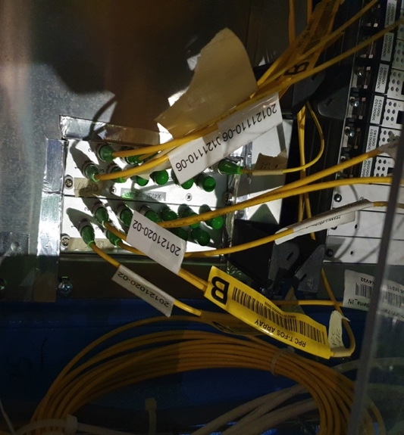
Commercial small form-factor solutions exist; 144 LC adapters can stray in ‘1U’ space
Smart custom small form-factor solution exist as well
Zoltan’s design with ‘NIM module’ form-factor already in use at X4
Full crate width and full rack depth not used yet
Dense cabling of fibre optic cables relies on nice and clean routing !!!
Space is necessary for parking fibre extra-length ...
… or precise fibre length in necessary!!!

Slide 29
ME0 Temp Monitor System (ME0: 216 modules in total; 18 stacks of 6 modules per yoke)
6 FBG per stack, 1 FBG per module
The 6 FBGs are chained at the patch panel of the stack (StackChain)
SCHEMA ‘A’: Both ends of all StackChain are routed to USC
In USC Stackhains are time-multiplexed and routed to the FBG Interrogation System
1 zip cable 2xf.o. from each stack 18 zip cables to X4J32(?), 18 zip cables to X4V32(?)
1 cable 36xf.o. from X4J32(?) to the FOS Rack (UXC Ground Level)
1 cable 36xf.o. from X4V32(?) to the FOS Rack
1 cable 72xf.o. from FOS rack to USC (SC218?)
1
1
FOS multiplexer and FBG Interrogator
18
36
USC
UXC
X4 (@YE+1)
X4 (@YE-1)
72xfo
2xfo
36xfo
FOS Rack
(Ground level)
CMS GEM Upgrade Workshop 20.05.2020 – Temp Monitor System for Phase 2 GEM Projects – M. Caponero
29

Slide 30
ME0 Temp Monitor System (ME0: 216 modules in total; 18 stacks of 6 modules per yoke)
6 FBG per stack, 1 FBG per module
The 6 FBGs are chained at the patch panel of the stack (StackChain)
SCHEMA ‘B’: One end of all StackChain is routed to USC, the other end stays spare at X4(YE+/-1)
In USC Stackhains are time-multiplexed and routed to the FBG Interrogation System
1 zip cable 2xf.o. from each stack 18 zip cables to X4J32, 18 zip cables to X4V32
1 cable 18xf.o. from X4J32 to the FOS Rack (UXC Ground Level)
1 cable 18xf.o. from X4V32 to the FOS Rack
1 cable 36xf.o. from FOS rack to USC (S2C18)
1
1
FOS multiplexer and FBG Interrogator
18
18
USC
UXC
X4 (@YE+1)
X4 (@YE-1)
36xfo
2xfo
18xfo
FOS Rack
(Ground level)
CMS GEM Upgrade Workshop 20.05.2020 – Temp Monitor System for Phase 2 GEM Projects – M. Caponero
30

Slide 31
GE2/1 Temp Monitor System (72 chambers in total; 2 layers of 18 chambers per yoke)
4 FBGs per chamber: 1 FBG per module
The 4 FBGs are chained inside the chamber (ChamberChain)
SCHEMA ‘A’ Both ends of each ChamberChain are routed to USC
In USC ChamberChains are chained/time-multiplexed and routed to the FBG Interrogation System
1 zip cable 2xf.o. from each chamber 36 zip cables to X4J32, 36 zip cables to X4V32
1 cable 72xf.o. from X4J32 to the FOS Rack (UXC Ground Level)
1 cable 72xf.o. from X4V32 to the FOS Rack
1 cable 144xf.o. from FOS rack to USC (S2C18)
1
1
18
1
FOS multiplexer and FBG Interrogator
18
72
USC
UXC
144xfo
72xfo
FOS rack
(Ground level)
2xfo
X4 (YE+1)
X4 (YE-1)
CMS GEM Upgrade Workshop 20.05.2020 – Temp Monitor System for Phase 2 GEM Projects – M. Caponero
31

Slide 32
GE2/1 Temp Monitor System (72 chambers in total; 2 layers of 18 chambers per yoke)
4 FBGs per chamber: 1 FBG per module
The 4 FBGs are chained inside the chamber (ChamberChain)
SCHEMA ‘B’ Both ends of each ChamberChain are routed to X4(YE+/-1)
The ChamberChains of the same layer&yoke are chained in a LayerChain (18x4 = 72 FBGs)
In USC LayerChains are time-multiplexed and routed to the FBG Interrogation System
1 zip cable 2xf.o. from each chamber 36 zip cables to X4(YE-1), 36 zip cables to X4(YE+1)
1 cable 4xf.o. from X4 (YE-1) to the FOS Rack (UXC Ground)
1 cable 4xf.o. from X4 (YE+1) to the FOS Rack
1 cable 8xf.o. from FOS rack to USC (S2C18)
1
18
1
1
FOS multiplexer and FBG Interrogator
4
18
USC
Layer 1
UXC
8xfo
4xfo
FOS rack
(Ground level)
2xfo
Layer 2
X4 (YE+1)
X4 (YE-1)
CMS GEM Upgrade Workshop 20.05.2020 – Temp Monitor System for Phase 2 GEM Projects – M. Caponero
32

Slide 33
Connection at the GEM chambers
- LC/APC duplex adapter on the patch panel (ME0 Module and Stack; GE2/1)
Routing schema shall be defined
Space at X4 for both transceiver/patch-panel and fibre parking
- Containing extra-length of zip patchcords (chamber <---> X4)
Number of available fibres for routing X4 <---> FOS Crate in UXC <---> USC
- Existing spare fibres and blowing-in conduits
Expansion of channel numbers of the FOS Interrogation System
Solution for Time-Division Multiplexing is on the way (Zoltan is working on it)
Budget constrains: severe (approaching ‘critical’)
Custom solutions are necessary for the transceiver/patch-panel (commercial solutions
are cost-effective if the highest concern is for frequent plug/unplug operations)

