Slide 1
GE11 SC Production Status
Jeremie A. MERLIN
GEM GE1/1 Workshop
June 10, 2020

Slide 2
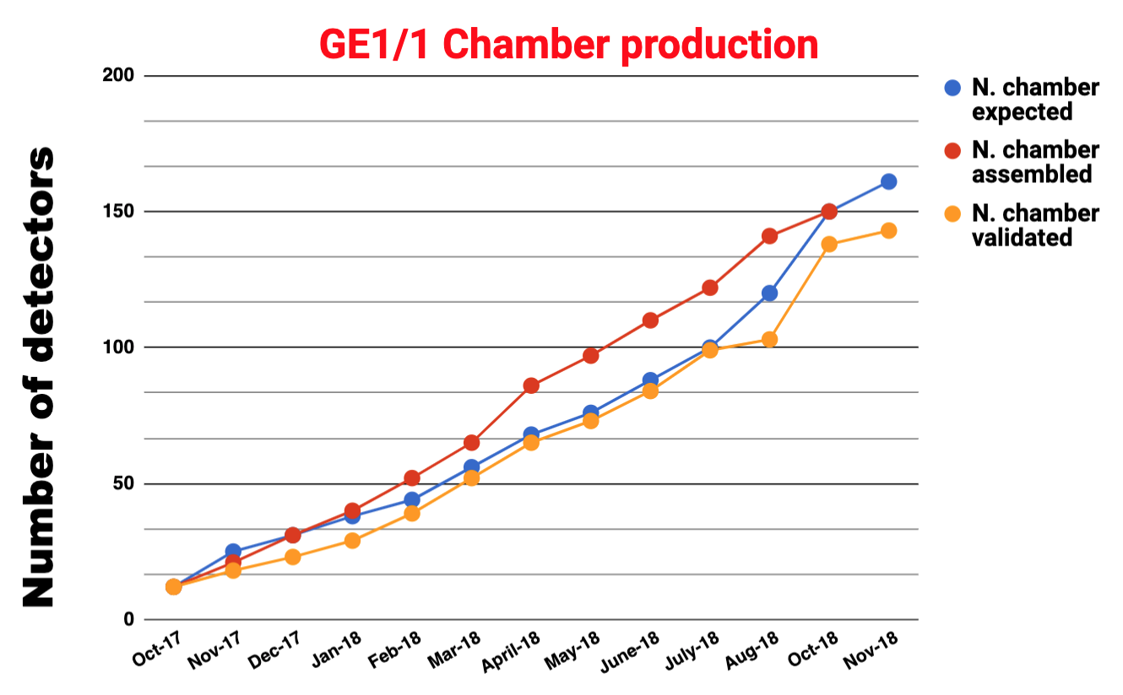
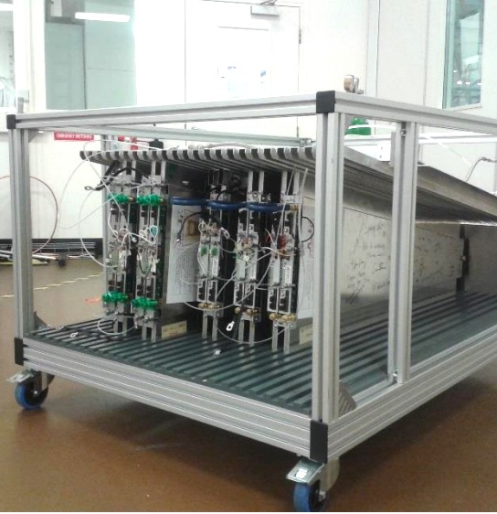
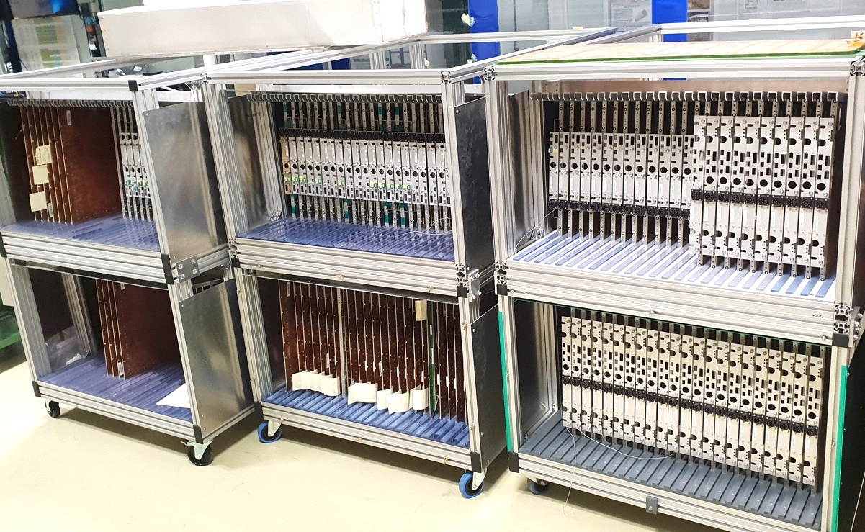
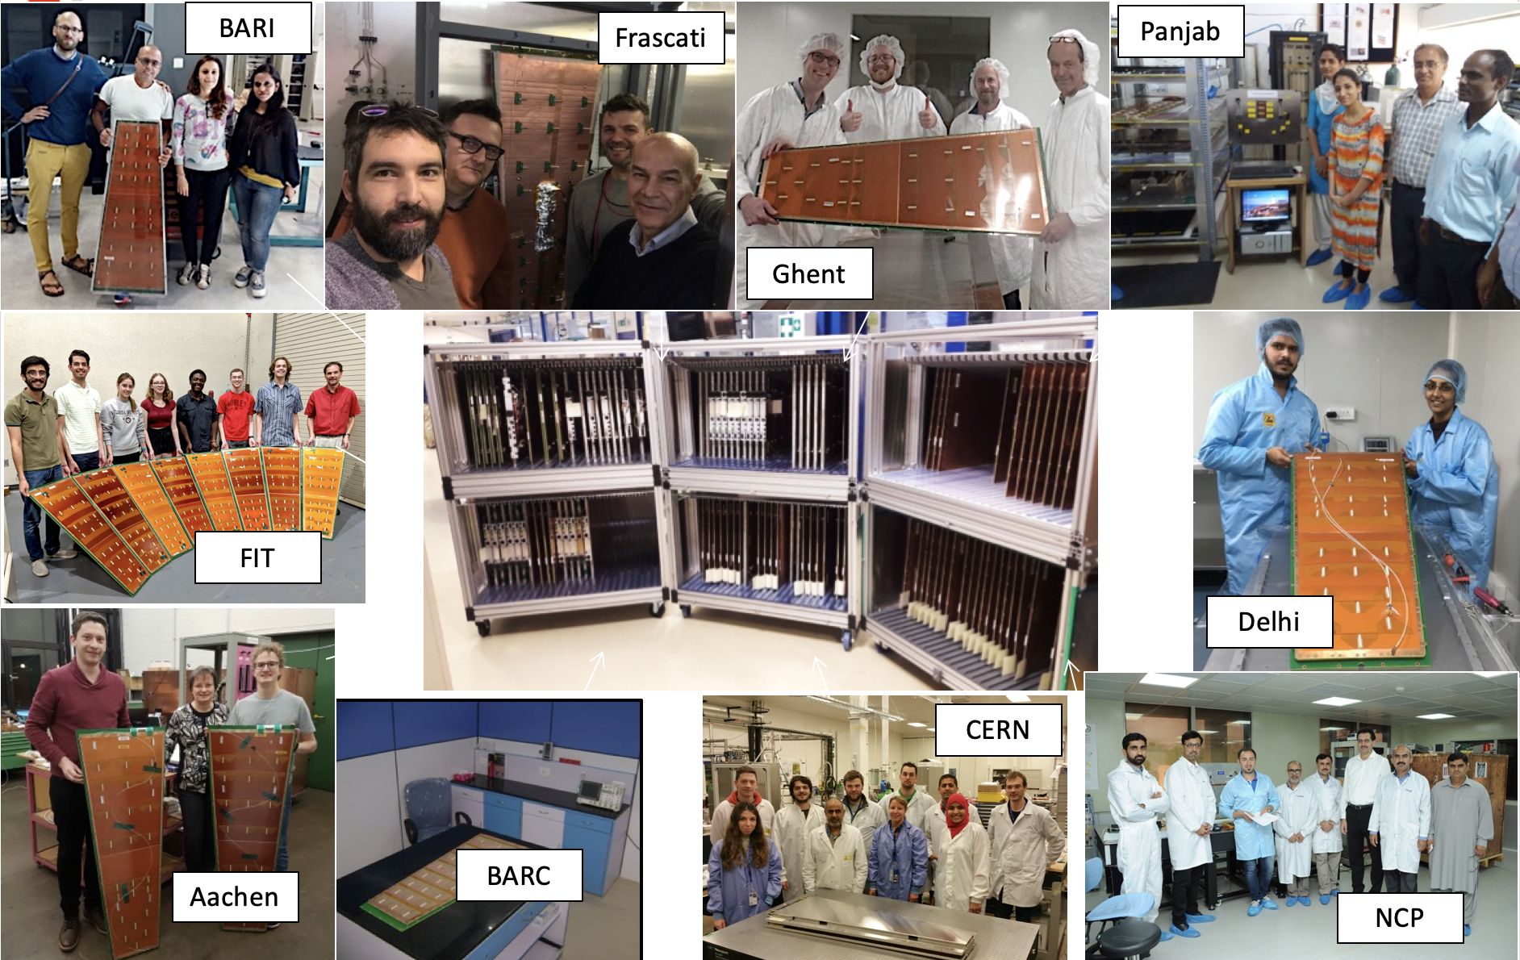
Chamber Production Summary
GE1/1 Production Summary:
Successful and on-time production of both endcaps from Sep 2017 to Dec 2018
161 GE1/1 Detectors:
  2 QC pending
  4 requires in-depth investigations
  155 Fully validated up to QC5
  (yield > 96%)
GE1/1 Slice Test Production (2015-2016)
GE1/1 Mass Production (2017-2018)

Slide 3
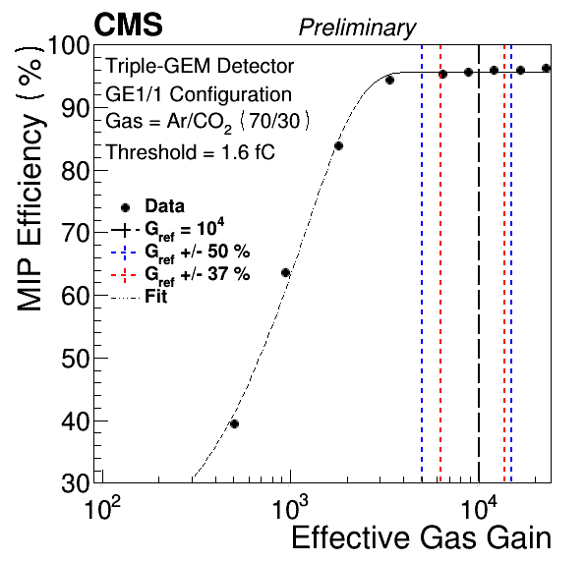
Chamber Production Summary
Analysis work done by the production community and validated during dedicated workshops/meetings
At this point the chambers are back to CERN and centrally stored
Chamber assembly and QC done at production sites
QC5-1
passed
Effective gain
This is where the SC adventure actually starts
Detector X
Assembly
+
QC2
QC3
QC4
Combined analysis
Average gain
passed
passed
passed
failed
failed
failed
Uniformity map
QC5-2
passed
Best match
Selection for SC
Optimum HV point
Performance check
QC5-1
passed
Effective gain
Detector Y
Assembly
+
QC2
QC3
QC4
Combined analysis
Average gain
passed
passed
passed
failed
Uniformity map
failed
failed
QC5-2
passed

Slide 4
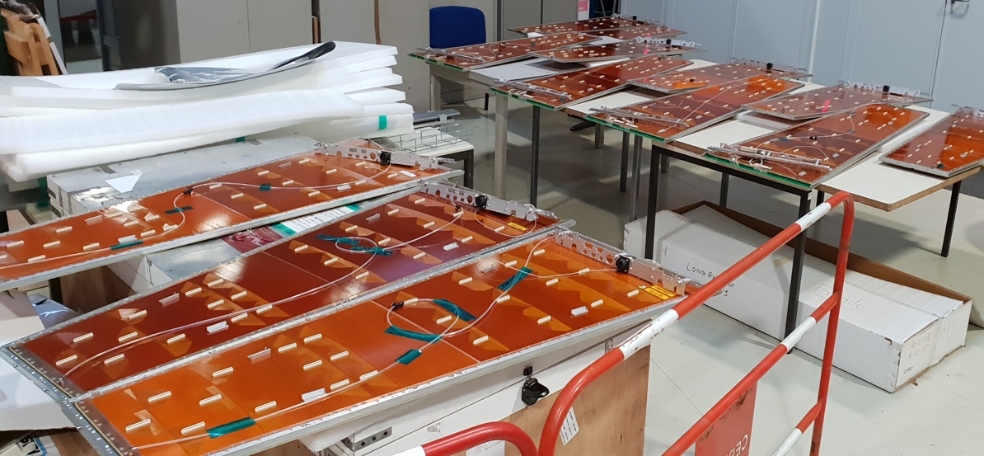
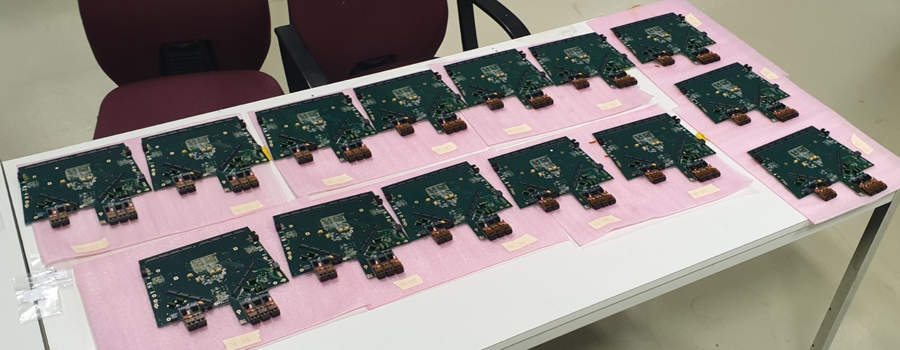
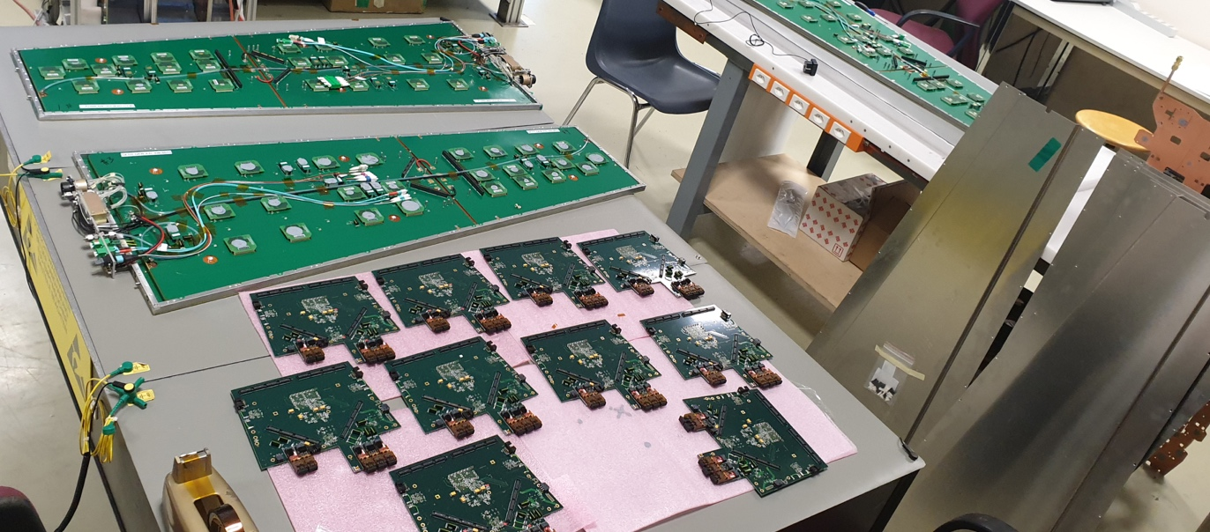
Super-Chamber Production
All SC production steps are done in 904
Mechanics
QC6
Electronics
QC7
Coupling
failed
failed
QC8
failed
Construction and assembly steps for SC were optimized over time to fulfill technical requirement and address all issues faced during production
Each step is performed on a dedicated setup by trained people
SC components preparation

Slide 5
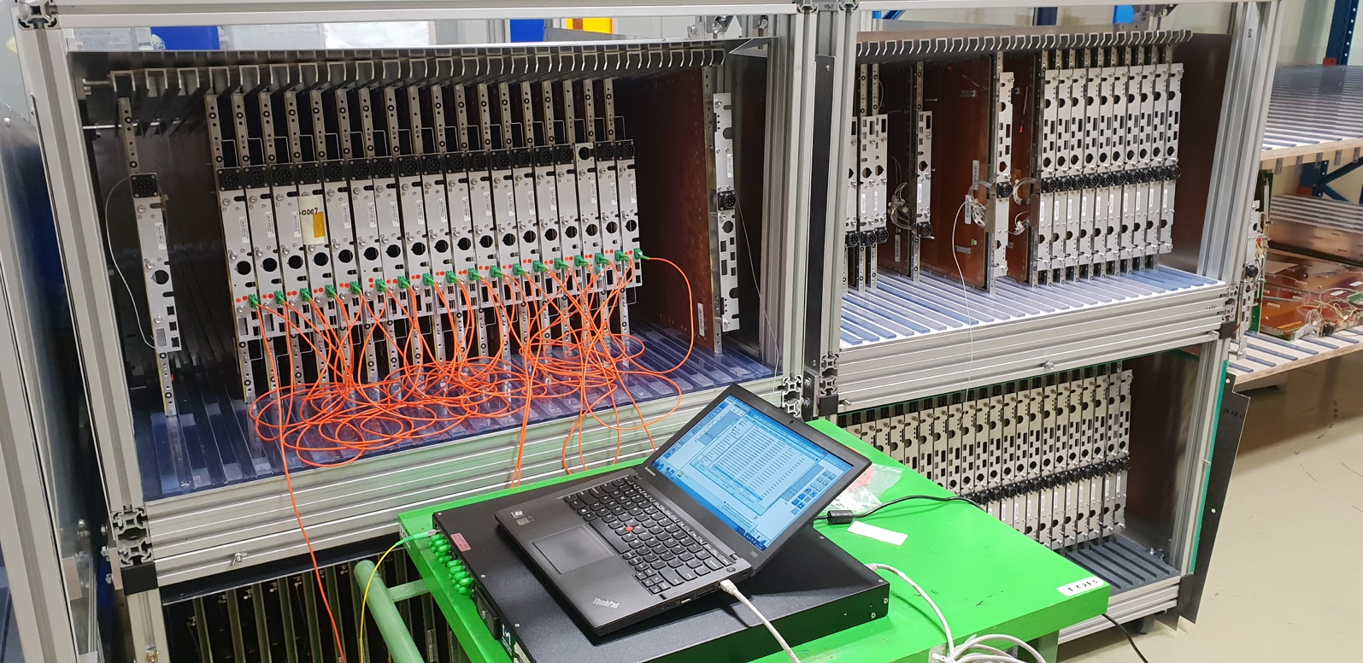
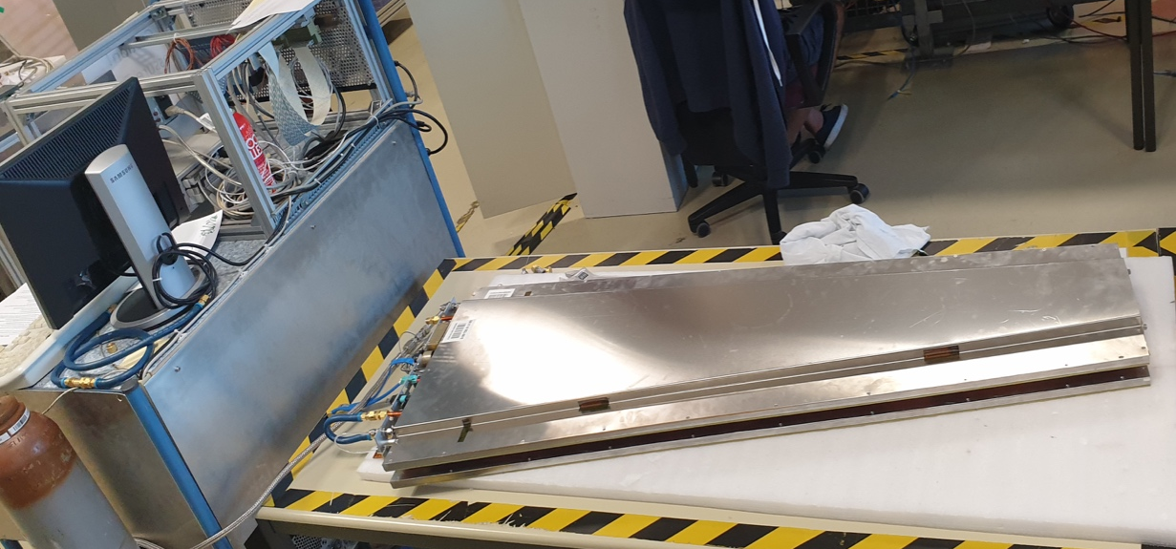
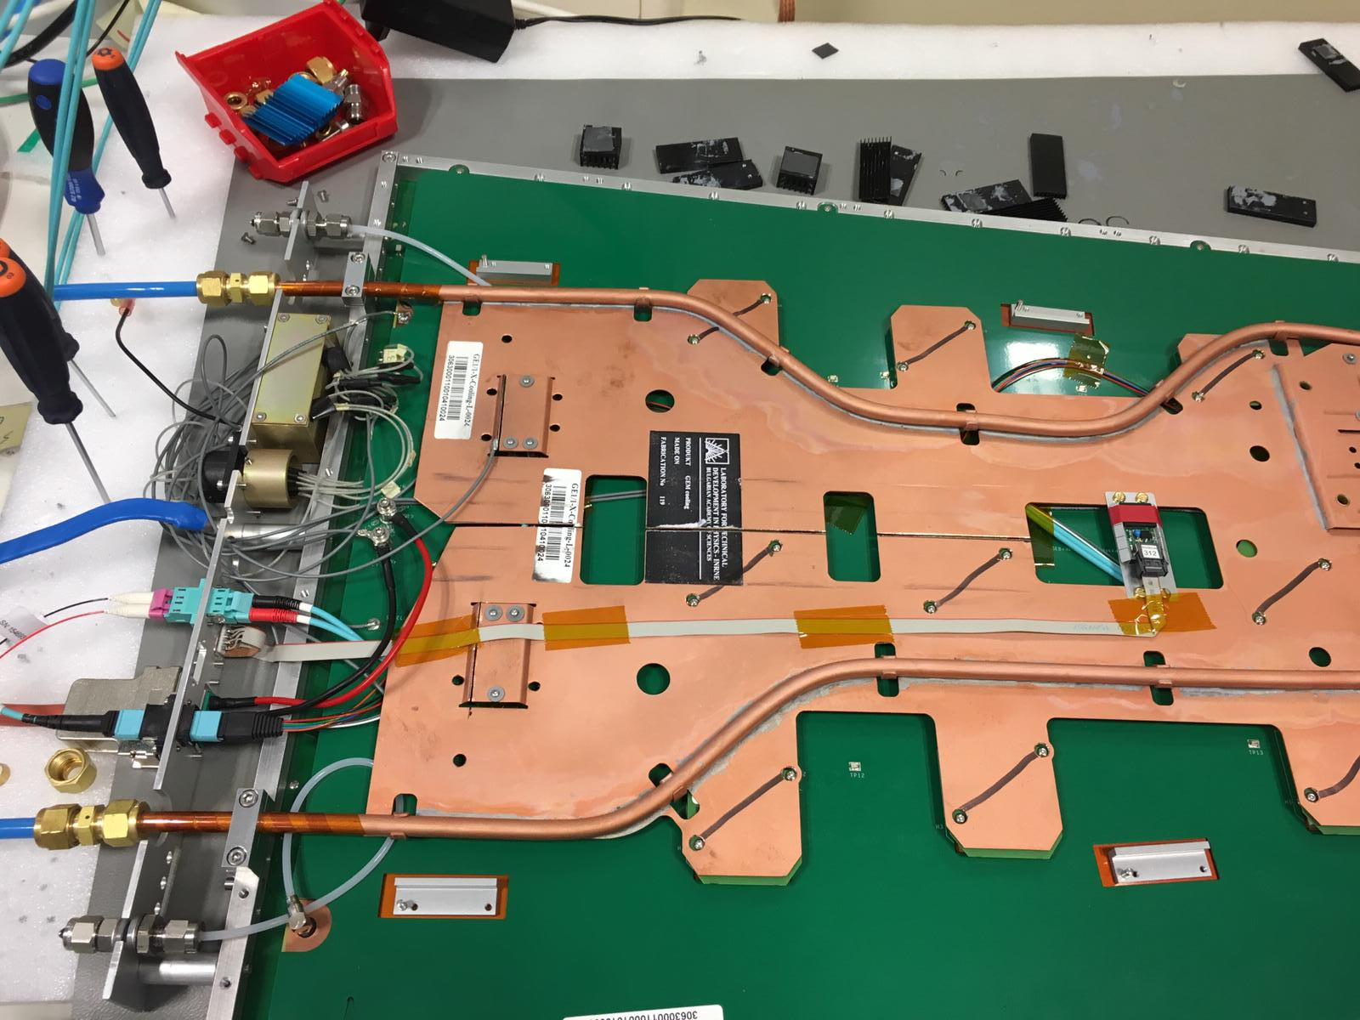
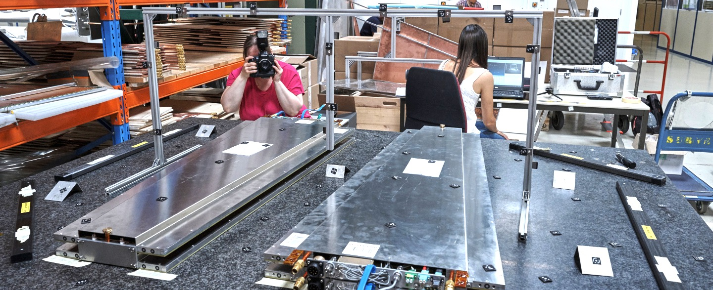
Super-Chamber Production
Not approved yet – for internal use only
All SC production steps are done in 904
Mechanics
QC6
Electronics
QC7
Coupling
Testing of temperature sensors
failed
failed
Photogrammetry I
Temperature fiber installation
QC8
RADMON sensor installation
failed
Cooling test
Photogrammetry II
Cooling test
RADMON sensor installation
Chamber/Super-Chamber Photogrammetry

Slide 6
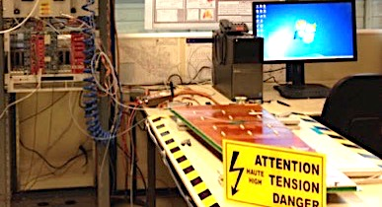
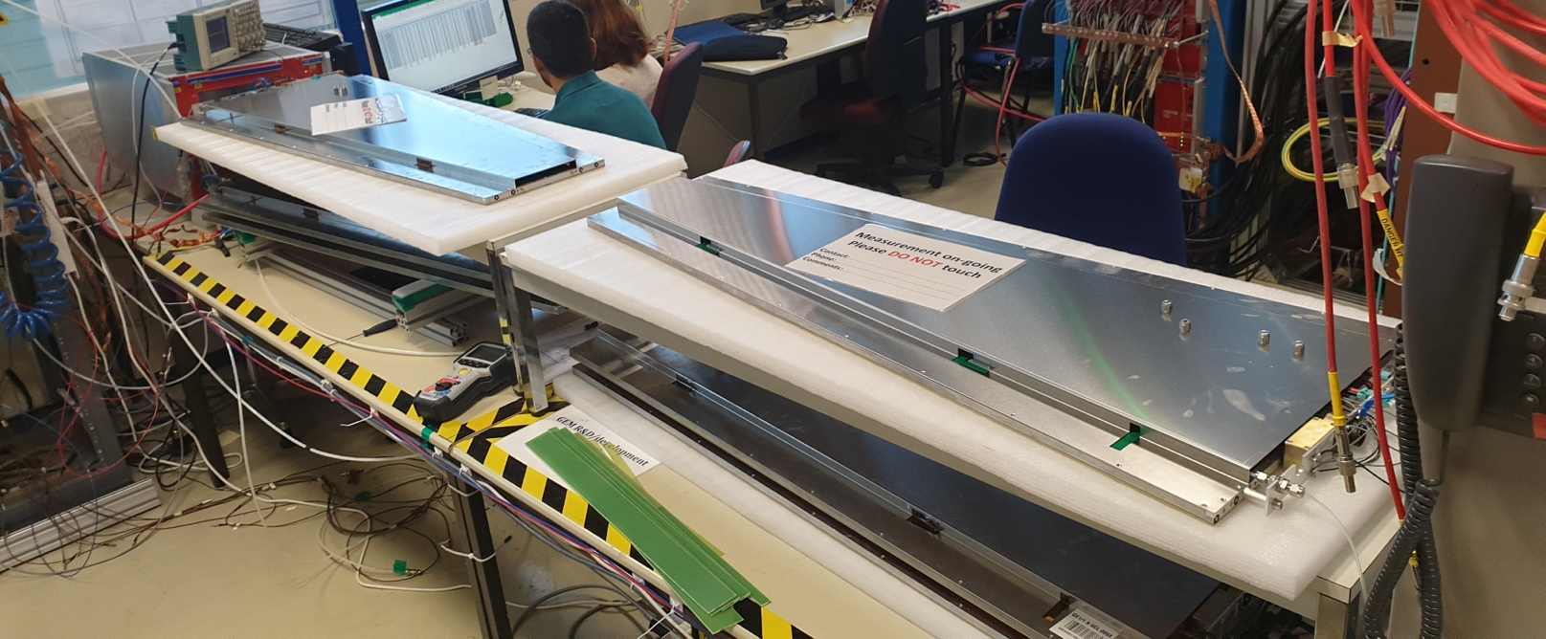
QC6
Goals: Ensure the proper connectorization of the HV filters and confirm the HV stability of the GEM foils
Initial version
Updated version
2 chambers/day
4 chambers/day
Stress test at 550V per foil
HV scan (IV measurement)
Short-term stability (4 hours)
Stress test at 550V per foil
Continuity test
Stress test up to 1000 V per foil
HV scan #1 (IV measurement)
long-term stability (> 12 hours)
HV scan #2 (IV measurement)
However some chambers showed non optimal behavior after (very) long-term storage → need for additional cleaning steps in the procedure
Similar procedure adopted in P5 before starting the operation in Ar/CO2

Slide 7
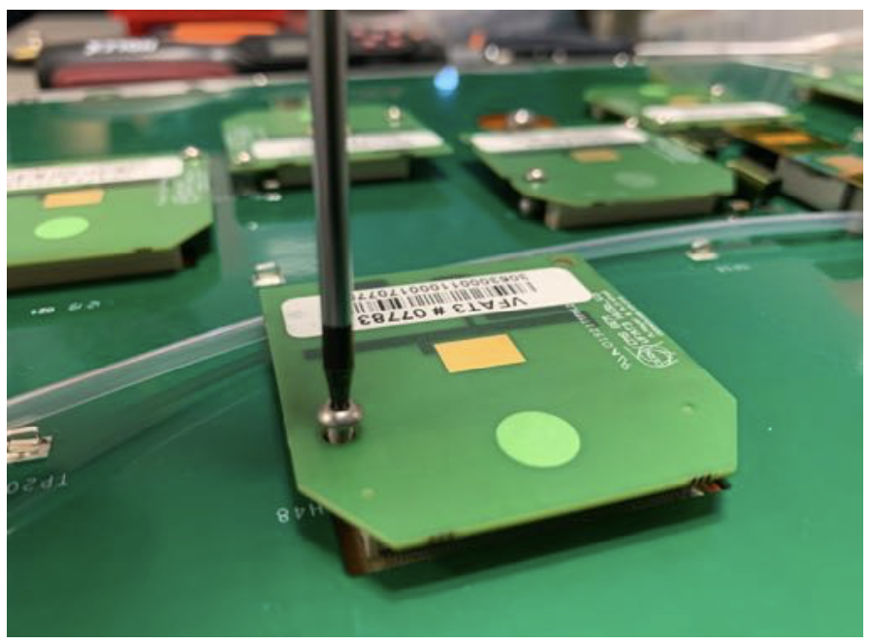
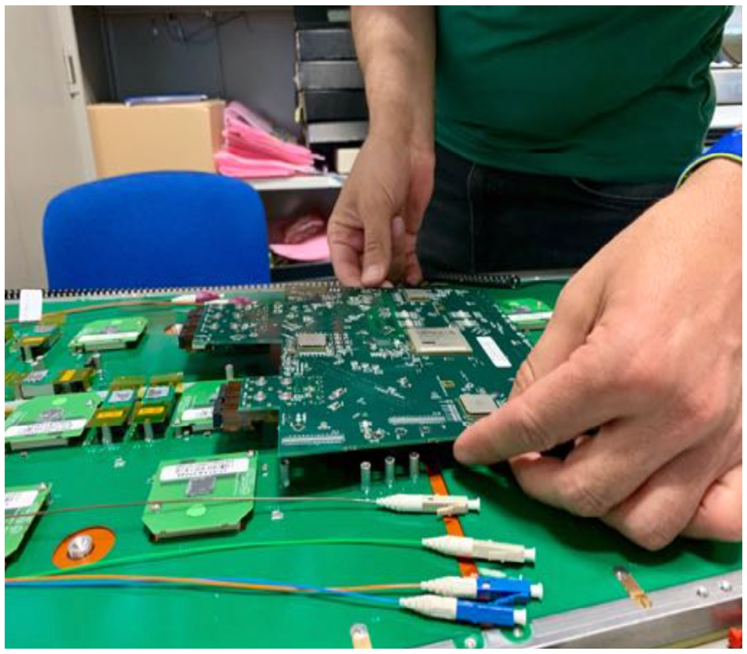
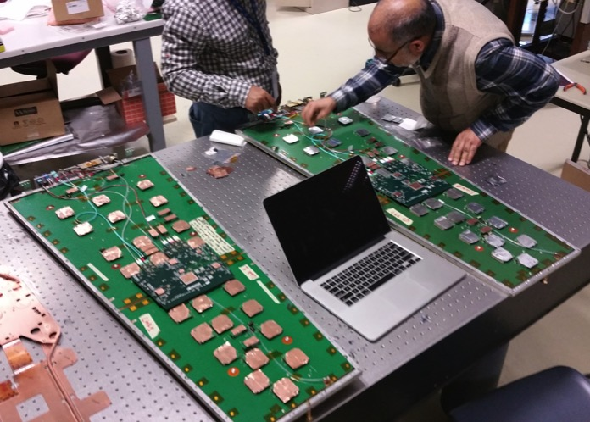
Mounting of the electronics
Mounting of the VFATs
Mounting of the OH and fibers
Final verification
Mounting of the GEB and on-chamber services (LV, gas, grounding)
Mounting of the OH and fibers
Mechanical fixation of all components
Verification of the voltages at the OH and FEAST levels
The cooling installation is not anymore part of the “assembly” step since it is required to access all electronics components during QC7
  → The mounting and the fixation of the cooling board is now done at the last stage of the electronics test

Slide 8
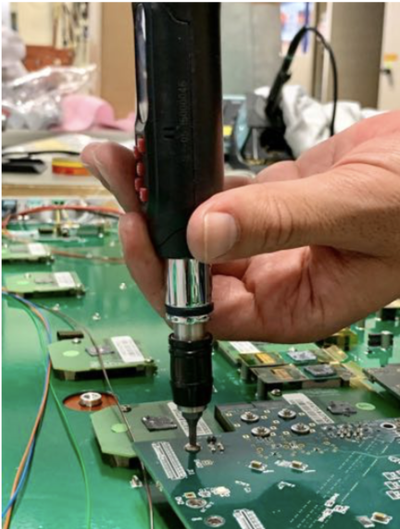
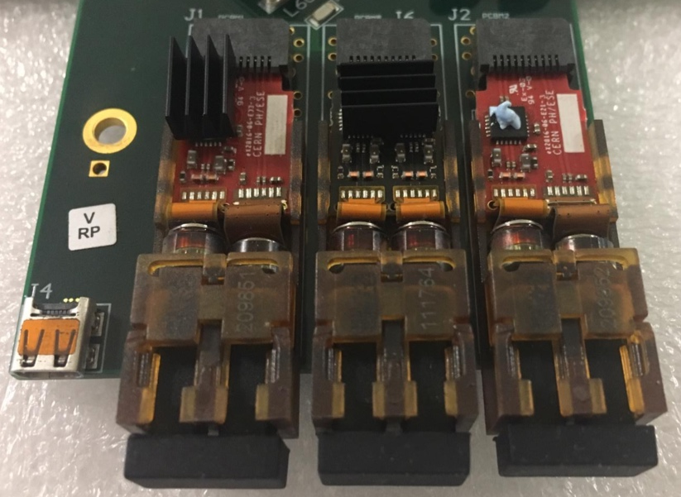
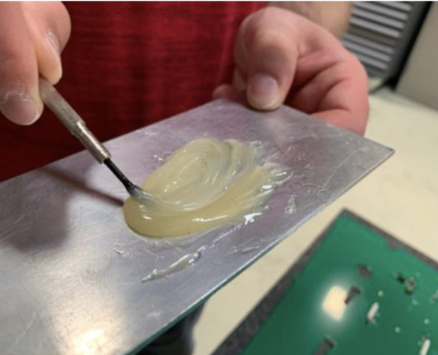
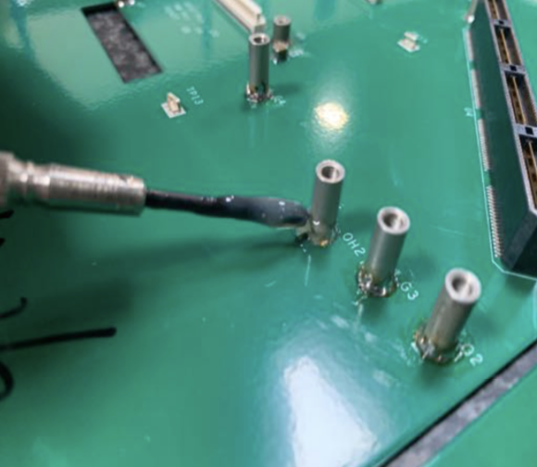
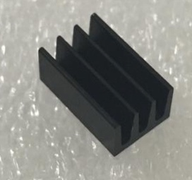
Mounting of the electronics
Update of the assembly procedure to ensure mechanical long-term stability
Torque control of the critical screws
Use of locking washers for critical screws
Gluing of the electronics standoffs
Improvement of the mechanical flexibility of the cooling plates
Gluing of heat sink on the optical transceivers
Fixation of the OH
This experience is very valuable for the design/optimization of GE21 and ME0 components
Heat sink for the VTTx
Gluing of the OH standoffs

Slide 9
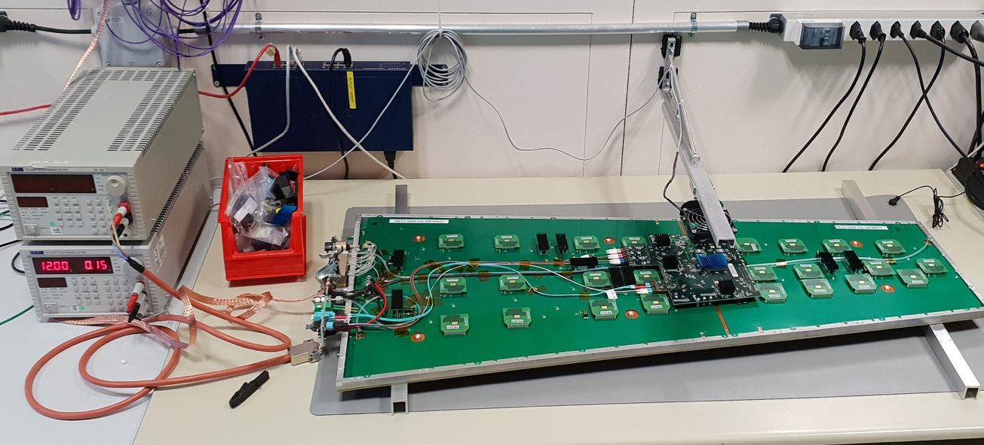
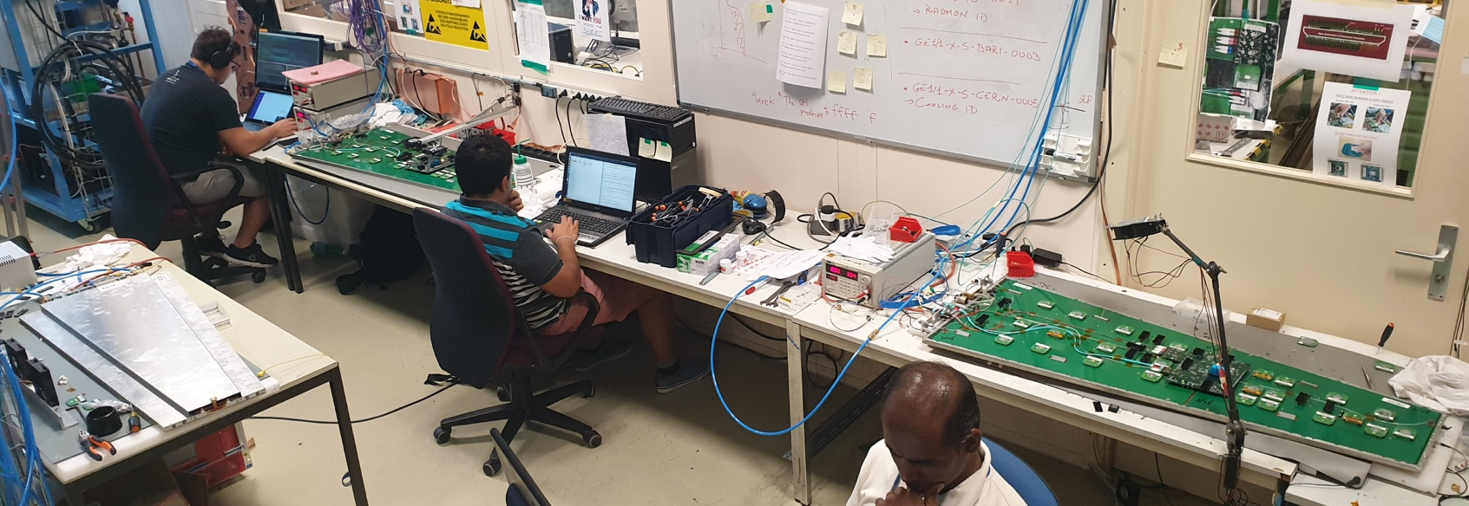
QC7
Goals: Test the connectivity of the electronics components, monitor the communication stability, check noise level and output signals
Initial version
Updated version
1 chambers/day
3 chambers/day
Connectivity
Calibration
Identification of dead/hot channels
Connectivity
Calibration
Identification of dead/hot channels
Global threshold scans (SBIT line) per VFAT
ENC measurement (S-curves)
Local threshold scans (SBIT line) per channel (to identify disconnected channels)
However in some cases this procedure was not sufficient to identify noise issues (ground loops or faulty component) and disconnected channels
The entire procedure is repeated after mounting the cooling plate and the chimney

Slide 10
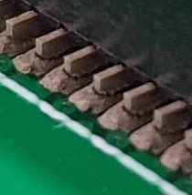
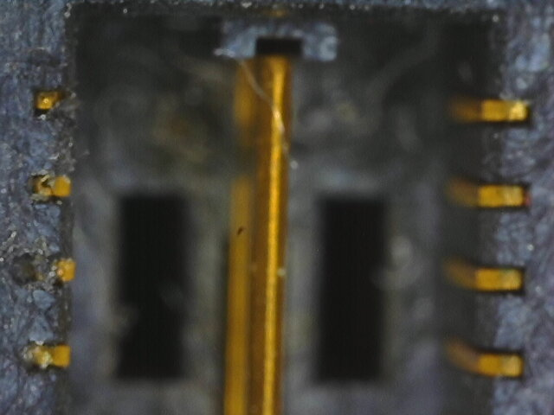
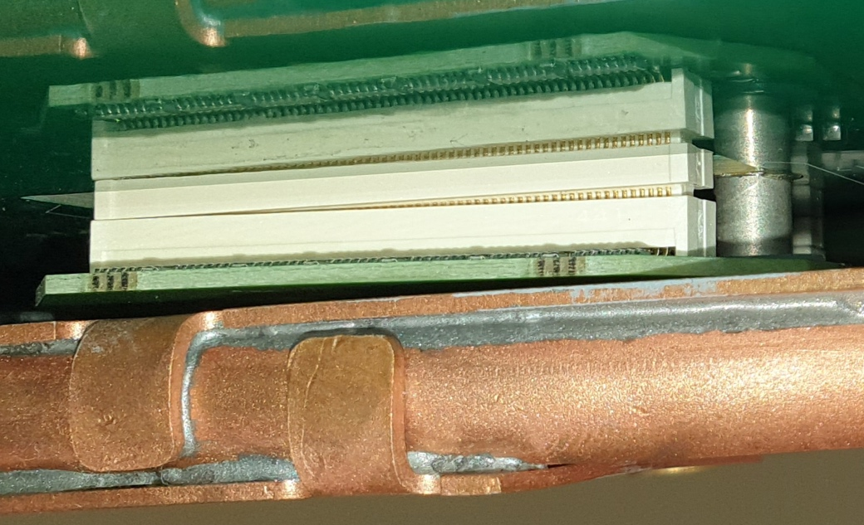
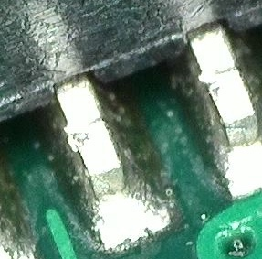
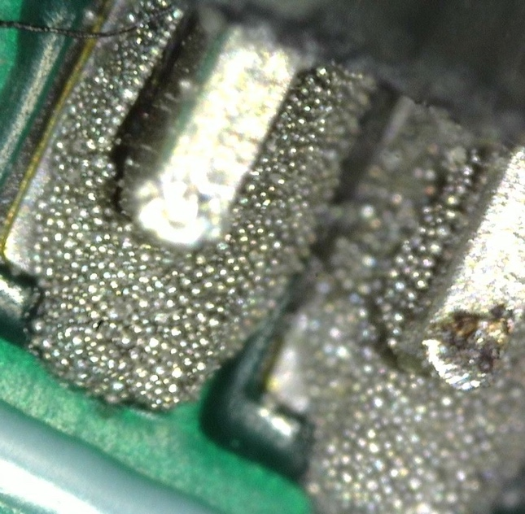
Issues and Problems
Typical problems found at QC7:
Faulty FEASTs (non-working, unstable or inducing noise)
Defects on the GEBs and/or on the SAMTEC connectors
Dirty PANASONIC connectors
Unplugged/damage/problematic VFATs
Ground loops (especially bad cooling plate fixation)
Missing grounding/shielding connections
Test procedure and “table of solutions” are
systematically updated according to new observations
Damaged connection
Good
Bad
Faulty SAMTEC connector
Unplugged VFAT hybrid
Bad soldering of the SAMTEC pins

Slide 11
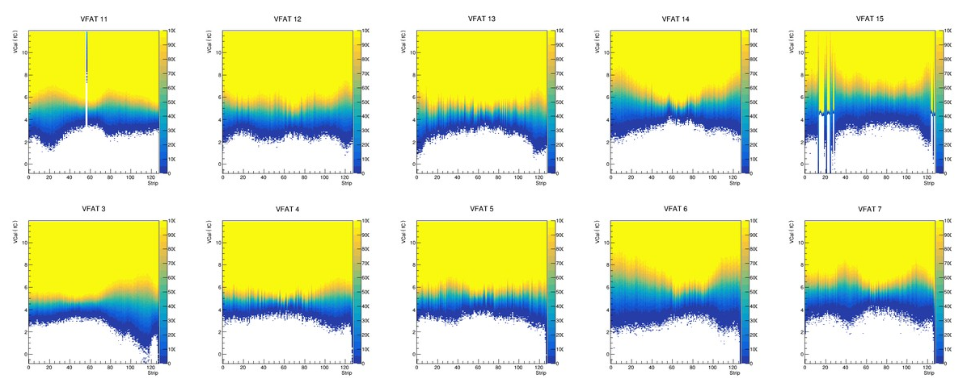
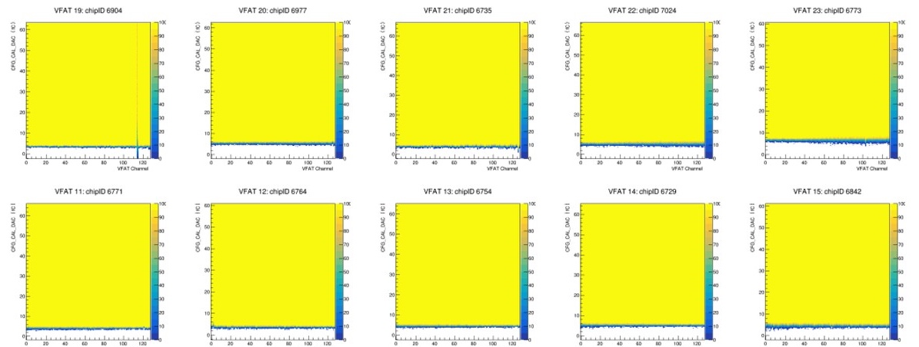
Issues and Problems
Summary of the noise study held in May/June 2019:
Noise measurements and electronics characterization was performed immediately after the reception of the final VFAT hybrids
All chambers showed large ENC (4-7 fC),
Corresponding thresholds were incompatible with the expected charge per strip for MIPs (~12-15 fC @ gain = 10 000)
Investigations conducted by detector,
electronics and DAQ experts lead to
the identification of several ground
loops (mostly caused by the cooling
board
Typical behavior in April/May 2019
Investigations of the VFAT settings also helped to improve the sampling of the signals (i.e. signal to noise ratio)
Typical behavior in July/Aug 2019
S-curves measurements (VFAT3 Hybrid V3 + GE1/1 detector)

Slide 12
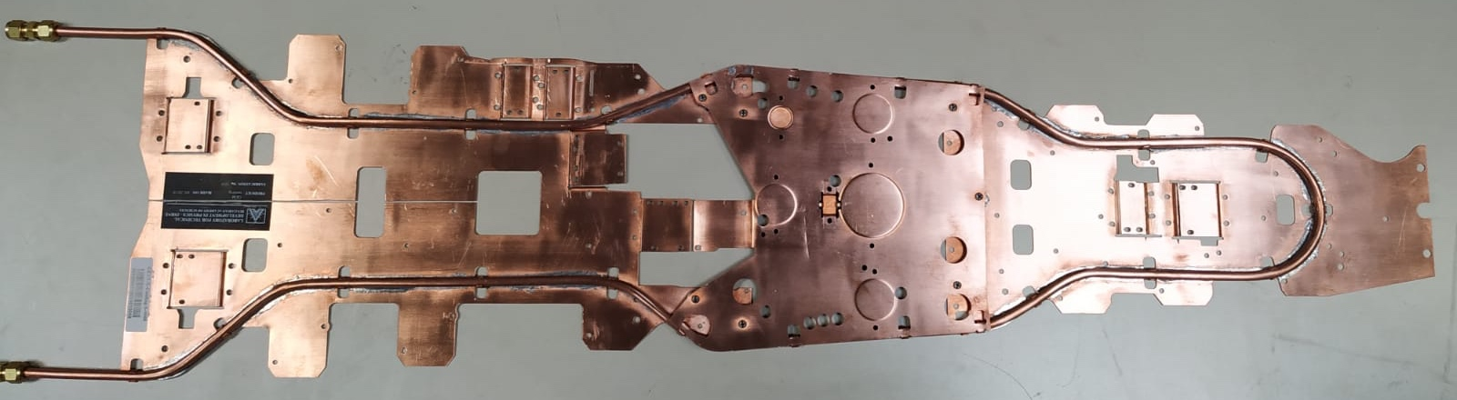
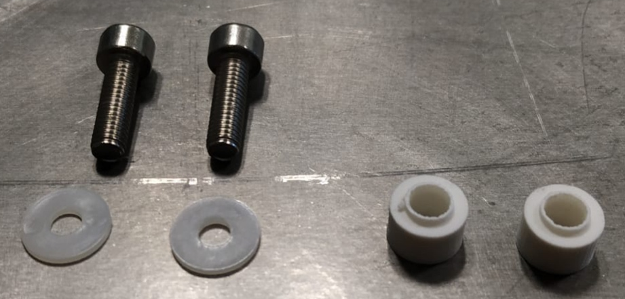
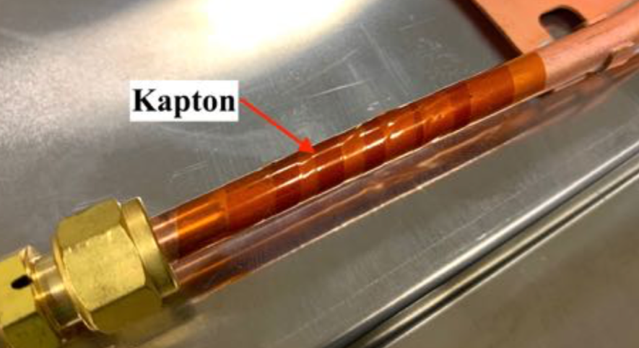
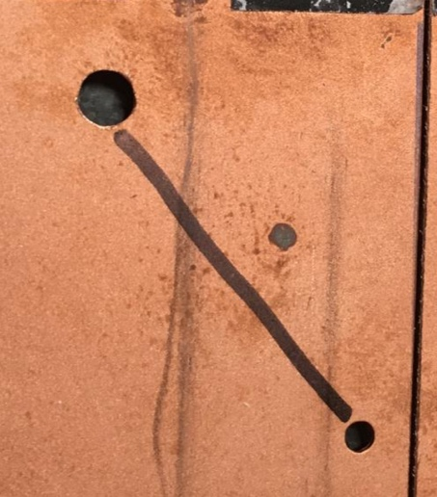
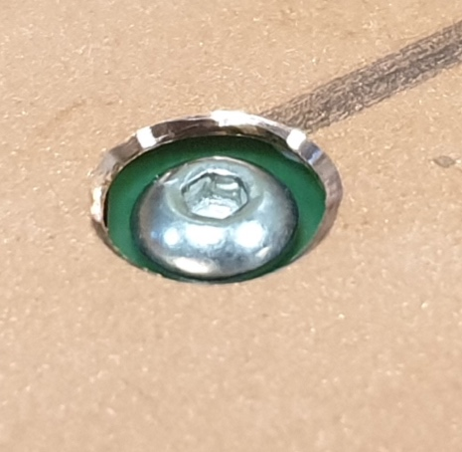
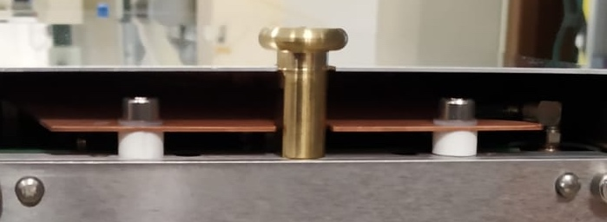
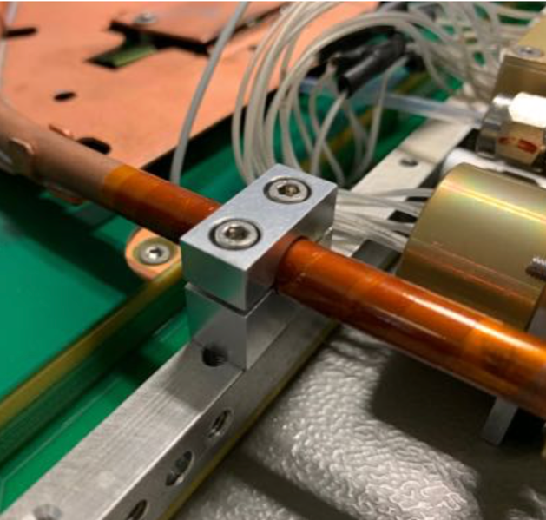
Issues and Problems
Isolation of the cooling board I:
Adding plastic washers and plastic tubes to isolate from the chassis at the narrow base
Wrapping of the cooling pipe to isolate from the chassis at the wide base
BEFORE
After
Enlarging the VFAT screw holes to prevent unexpected connections with the GEB
The tip of the cooling plate was also reduced (few mm) to prevent unfortunate contact with the SC closing plate

Slide 13
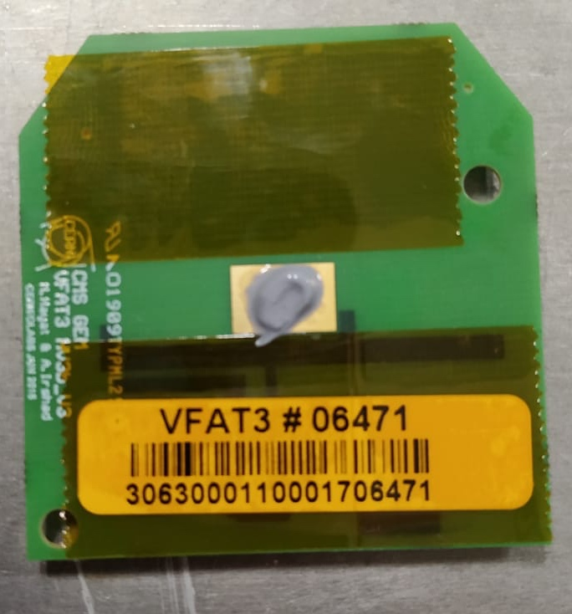
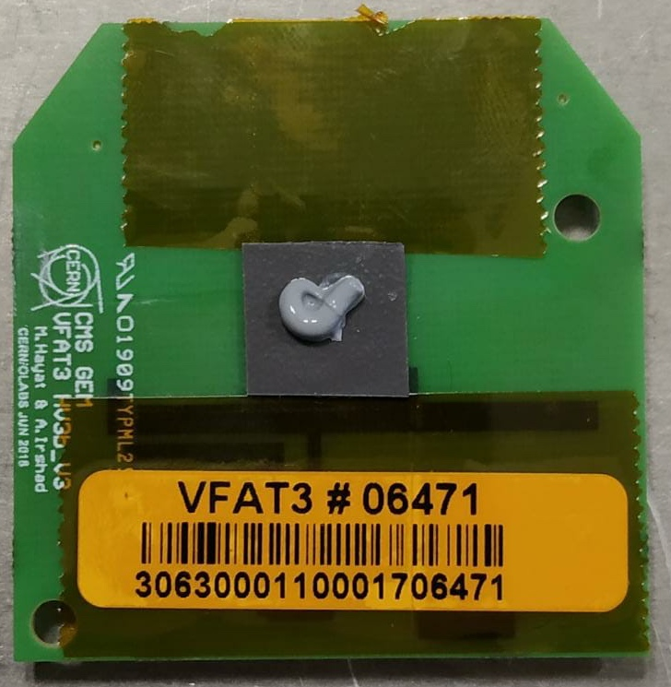
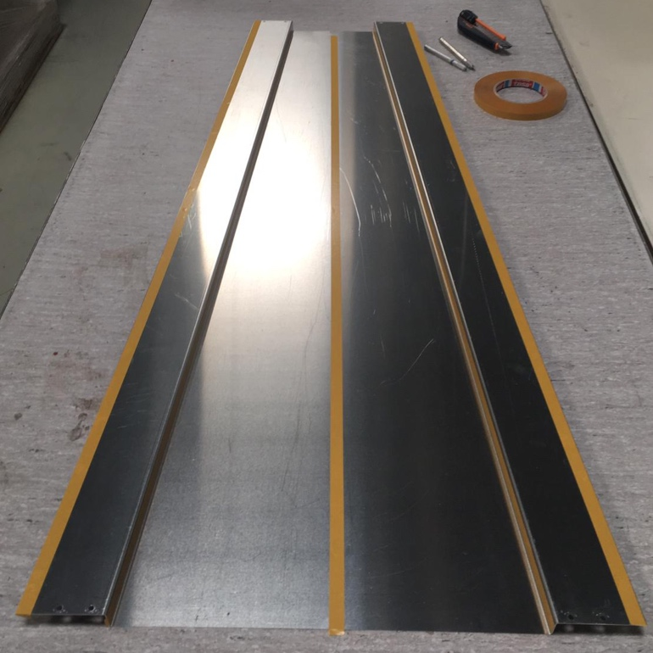
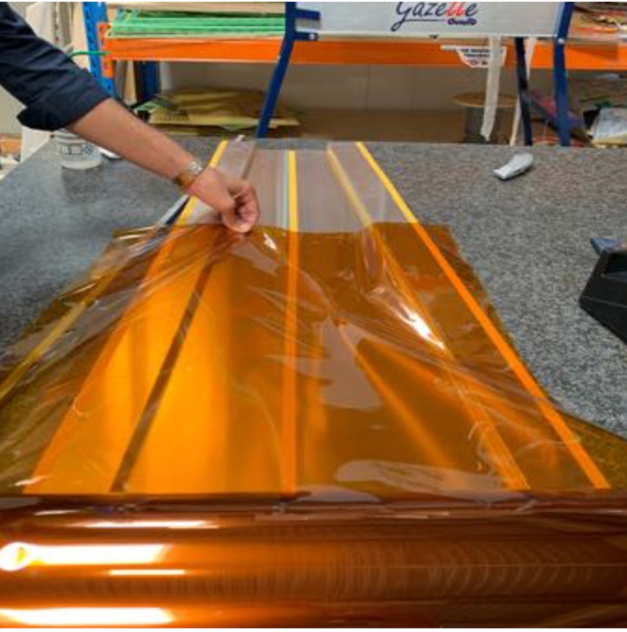
Issues and Problems
Isolation of the cooling board II:
BEFORE
AFTER
The use of thermal grease ensures a good heat dissipation but does not prevent mechanical contact between the cooling board and the heat pads of the VFAT. It was necessary to add a “solid” thermal pad in between
Possible contacts between the cooling board and the chimney was creating ground loops. Chimneys are now covered internally with Kapton foil
BEFORE
AFTER

Slide 14
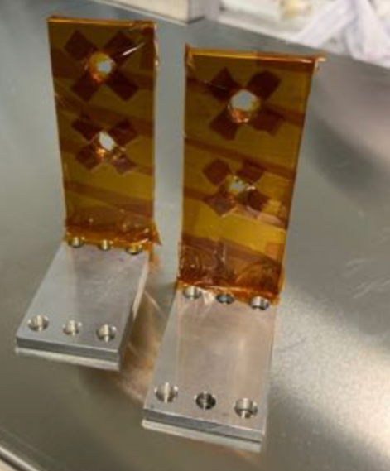
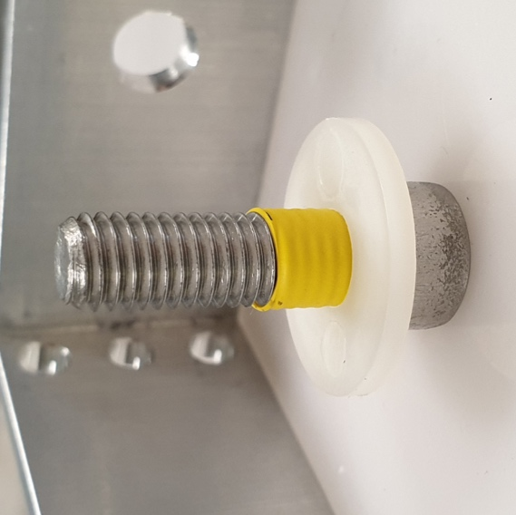
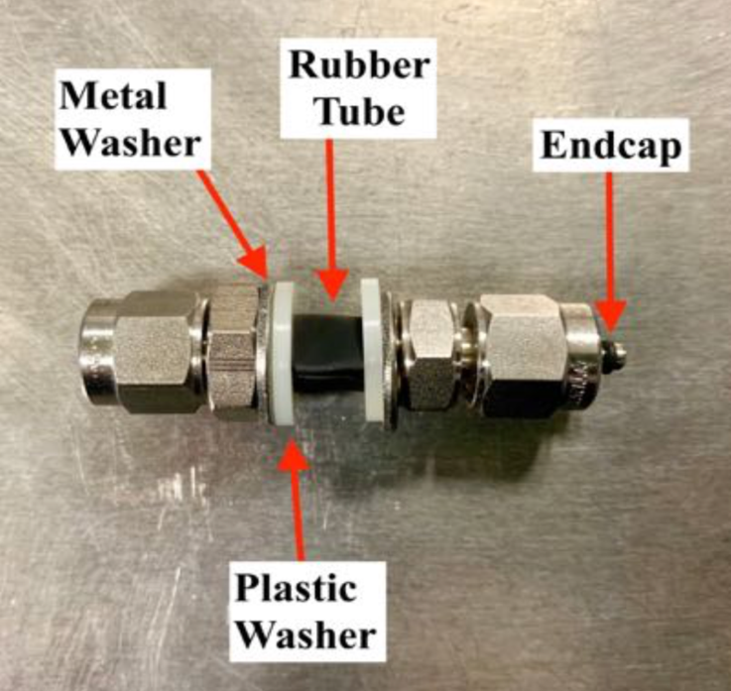
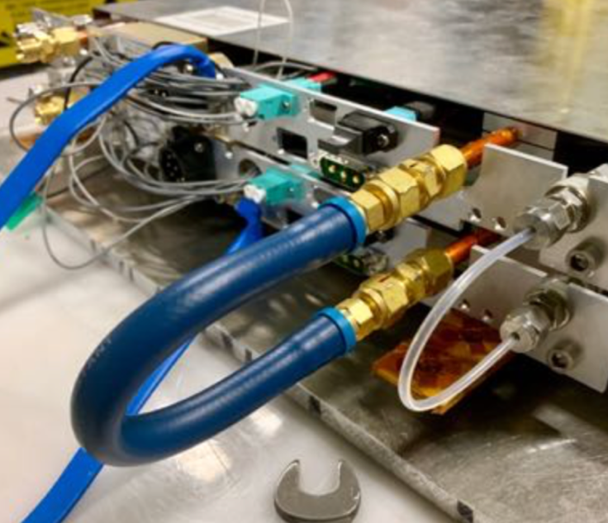
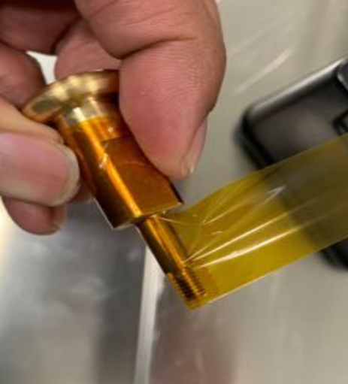
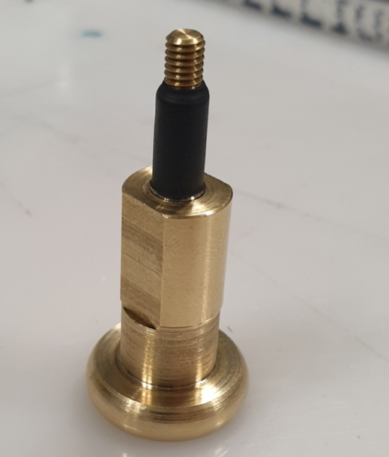
Issues and Problems
Optimization of the chamber star-point
AFTER
Using shrinkable tubes and plastic washers to insulate the chassis from the CMS gas pipes
BEFORE
Isolation of the brackets, initially done with Kapton, is now achieved thanks to shrinkable tube
Replacing the copper cooling U tube with a flexible rubber tube to de-couple the SC cooling circuits and prevent antenna effects
Similar technique to be used for the pivots

Slide 15
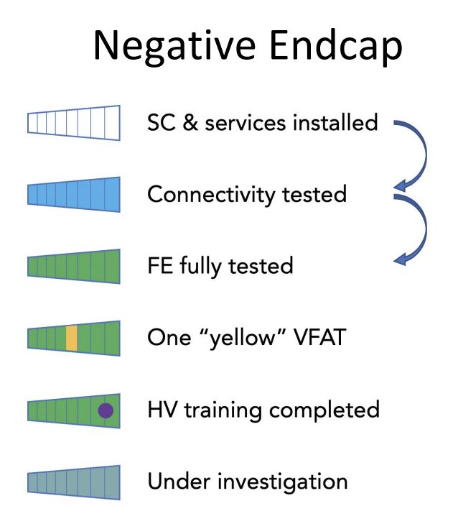
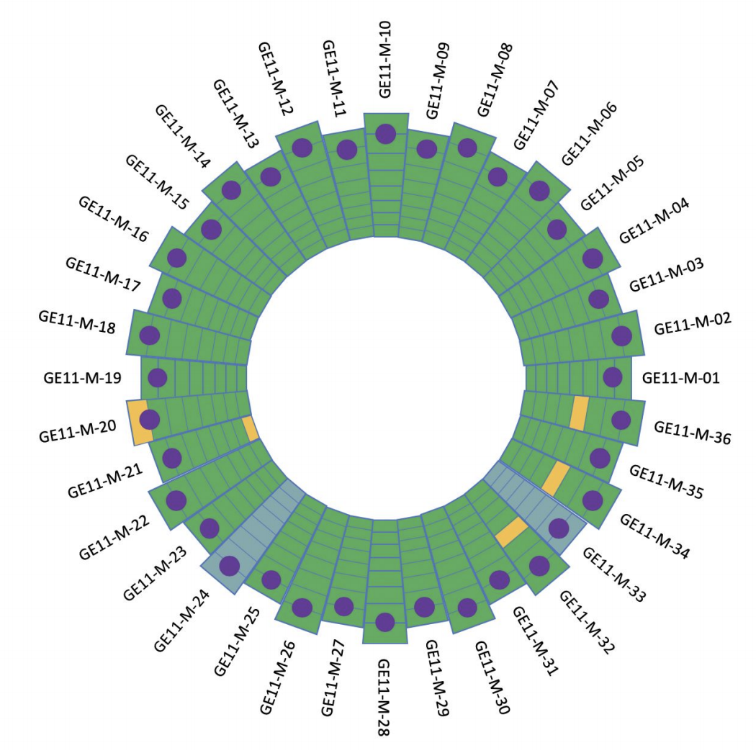



Summary: negative end-cap
Production step | Mechanics | Photogrammetry I | QC6 | Electronics | QC7 | Coupling | QC8 | Photogrammetry II | Storage
chambers | 72/72 | 72/72 | 72/72 | 72/72 | 72/72 | 36/36 | 36/36 | 36/36 | 36/36
% | 100 | 100 | 100 | 100 | 100 | 100 | 100 | 100 | 100
First end-cap already installed in the negative nose
Multiple installation windows from July 2019 to October 2019
Commissioning is on-going (see the GE11 RC workshop for more details: https://indico.cern.ch/event/923564/
Nice pictures and movies of this story available at:
http://cds.cern.ch/record/2684028
http://cds.cern.ch/record/2683694
https://www.youtube.com/watch?v=fU0ujGWbeQ0&feature=youtu.be
https://www.youtube.com/watch?v=PXjr0VlFOzw&feature=youtu.be

Slide 16
Summary: positive end-cap
Production step | Mechanics | Photogrammetry I | QC6 | Electronics | QC7 | Coupling | QC8 | Photogrammetry II | Storage
chambers | 72/72 | 71/72 | 65/72 | 62/72 | 58/72 | 29/36 | 21/36 | 0/36 | 21/36
% | 100 | 99 | 90 | 86 | 81 | 81 | 58 | 0 | 58
Discussing with alignment experts to organize the photogrammetry (next session on Monday 15th)
Work is on-going (dedicated presentation in this workshop)
Work is on-going (dedicated presentation in this workshop)
Work is on-going (dedicated presentation in this workshop)

Slide 17


Work in progress
Production step | Mechanics | Photogrammetry I | QC6 | Electronics | QC7 | Coupling | QC8 | Photogrammetry II | Storage
chambers | 72/72 | 71/72 | 65/72 | 62/72 | 58/72 | 29/36 | 21/36 | 0/36 | 21/36
% | 100 | 99 | 90 | 86 | 81 | 81 | 58 | 0 | 58
Short SC:
Last two short SC are in place in the cosmic stand and ready to be tested (more news in Giovanni’s presentation)
Long SC:
Four SC in the cosmic stand and ready to be tested
”basin effect” : nine chambers show an efficiency drop near the wide base of the trapezoid → most probably induced by a strong bending of the RO PCBs. Two chambers already re-opened to re-shape the RO board and reduce the bending (now under-going QC6 before going to gain uniformity measurement and cosmic test)
→ Battle plan for validating the last SC long is being finalized (requires the presence of experts in 904 and remotely – to be coordinated with the COVID strategy)

