Slide 1
Issues related to software, instrumentation, data acquisition, observed by MP3 during previous HWC campaigns
Zinur Charifoulline, Arjan Verweij, 10 June 2020
Arjan Verweij, 10/6/2020

Slide 2
Intro
Issues with hardware have triggered our continuous wish to improve the possibilities for post-mortem analysis (higher sampling rate, better resolution, more channels, etc).
The long time-span of the LHC, the long period between HWC campaigns, and rather small number of issues during operation, also calls for a coherent approach for analysis.
The following slides show a mix of issues linked to data acquisition, instrumentation, software and communication that were discussed by the MP3 in the last 10 years, that hopefully can be resolved in the future, possibly as part of future IST campaigns.
For sure, all systems work close to perfect but, due to our progressive insight in the LHC (especially for interplay between systems) and due to changes in systems, we still see some room for improvement.
Arjan Verweij, 10/6/2020

Slide 3
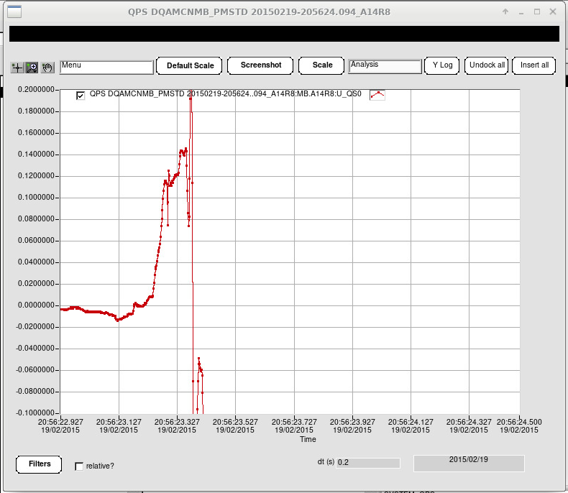
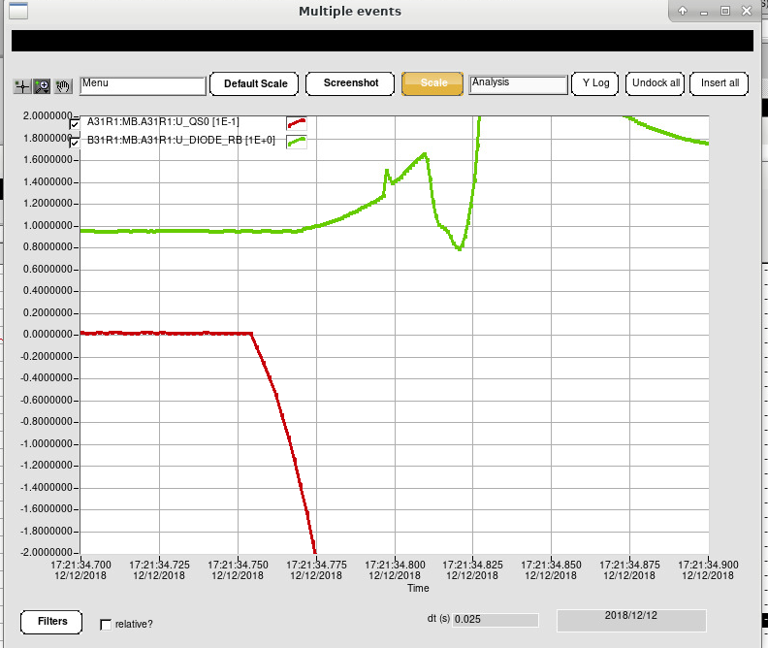
Timing errors
PM analysis requires timing accuracy of 1 ms between PC, QDS, EE, QHs, PIC and BLMs (in case of beam-related events). We observed many timing issues, with errors up to O(1 sec).
iQPS: PM timestamp and PM timescale are sometimes shifted
iQPS PM with respect to nQPS PM
600 A circuits: QDS signals with respect to FGC signals
Beam induced quenches: QDS with respect to BLM
iQPS voltages with respect to QHs
A14R8:U_QS0
A31R1:U_DIODE_RB (nQPS)
~800ms
A31R1:U_QS0 (iQPS)
Arjan Verweij, 10/6/2020

Slide 4
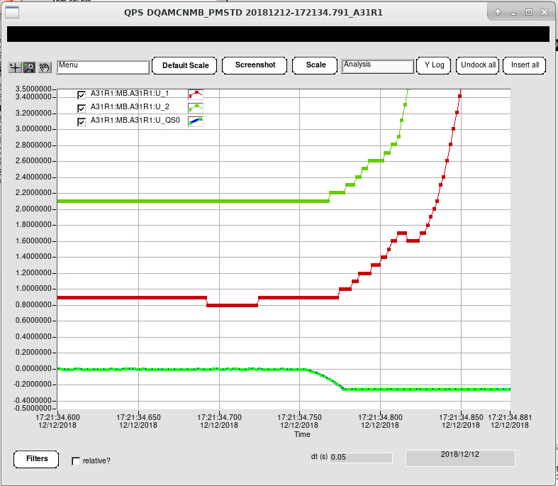
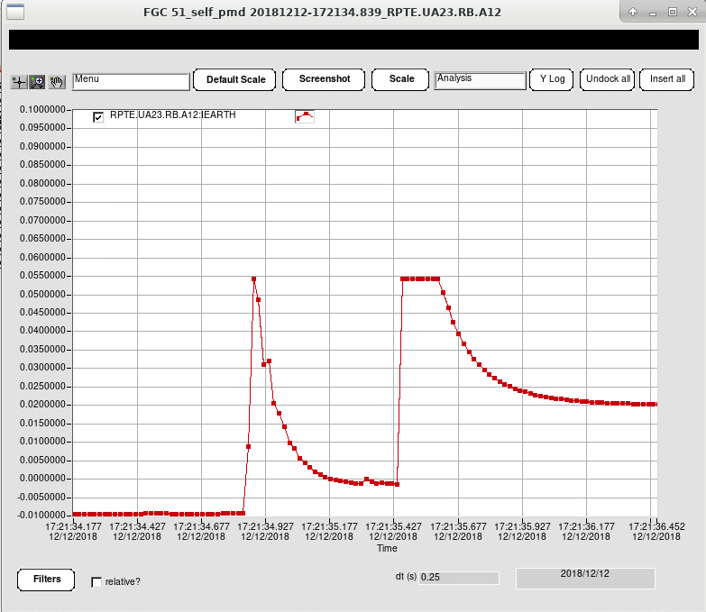
Signal saturation & resolution
Especially in non-standard cases (earth fault, QH problem, …) signals could be saturated. A good balance between signal resolution and maximum input should be discussed.
iQPS: U_1, U_2 (high range, limited resolution), U_QS0 (limited range, high resolution )
nQPS: U_EARTH (voltage feelers)
FGC: I_EARTH (I_sat=54 mA, fuse blows at 1-3 A, FPA in RB gives I_earth > 54 mA)
A12.RB:IEARTH
A31R1:U_2
A31R1:U_1
A31R1:U_QS0
Arjan Verweij, 10/6/2020

Slide 5
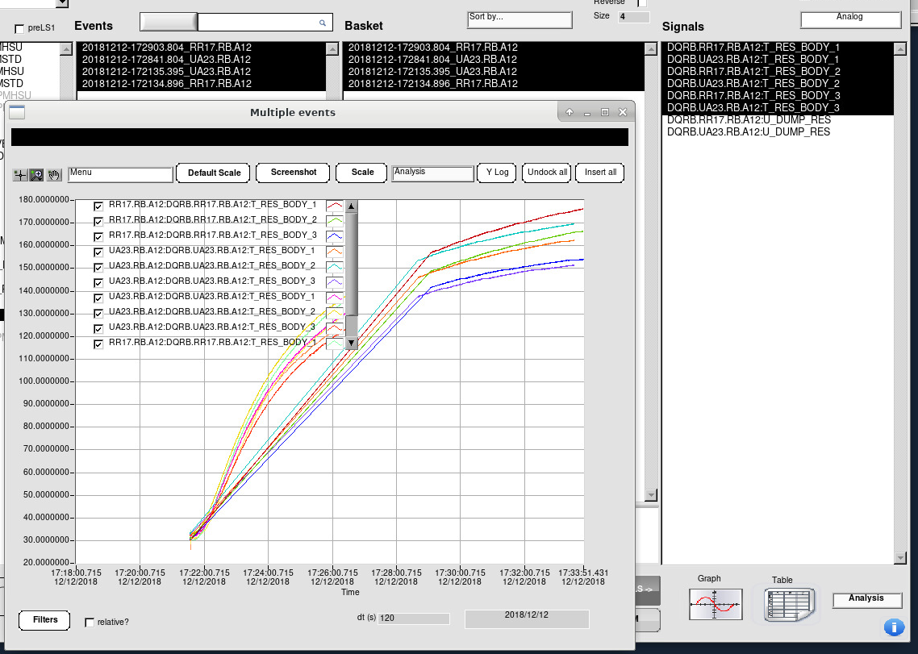
PM duration
High sampling PM data have limited duration, and trigger point is not always correct.
Arjan Verweij, 10/6/2020

Slide 6
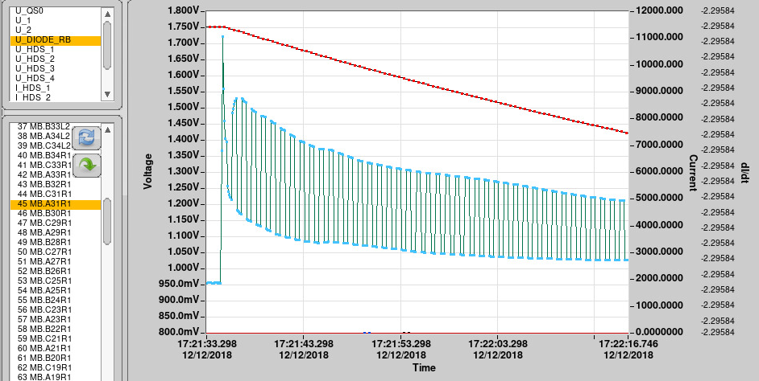
‘Toggling’
Toggling was implemented in the Logging DB to store the signals from board A and B for all QDS units. (Important for the nQPS to deduce the resistance of the diode leads during a quench)
Solution: Logging DB should contain both signals from boards A and B. The signals names should reflect the board, e.g.: U_xxx_A and U_xxx_B
Arjan Verweij, 10/6/2020

Slide 7
B1 vs B2 swap
QPS voltage signals of the 2 apertures of many IPQ magnets were swapped with respect to FGC signals.
Solution: Check with tiny current (<100 A) during IST (or eventually a check can be added during PIC2 test).
Arjan Verweij, 10/6/2020

Slide 8
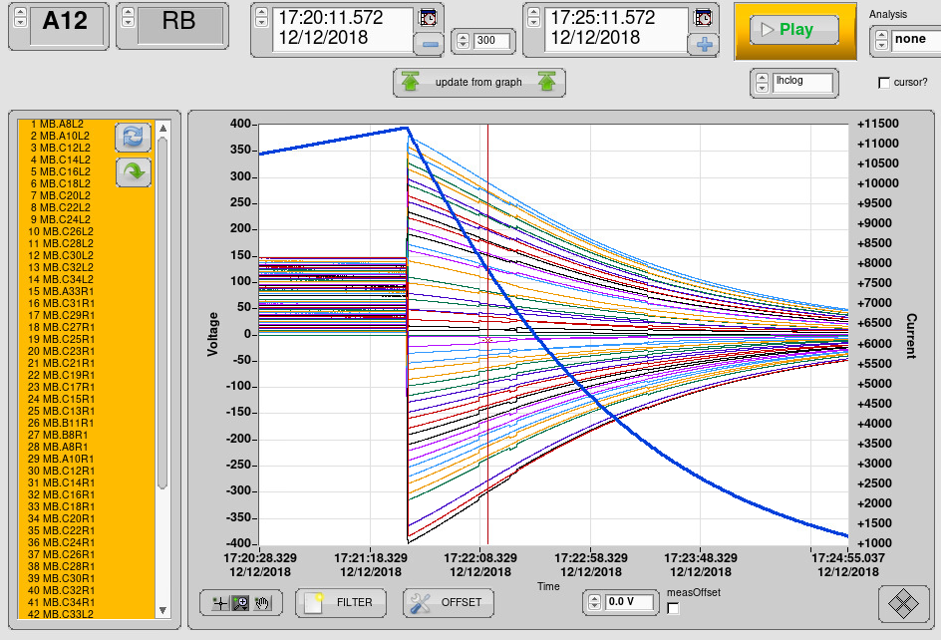
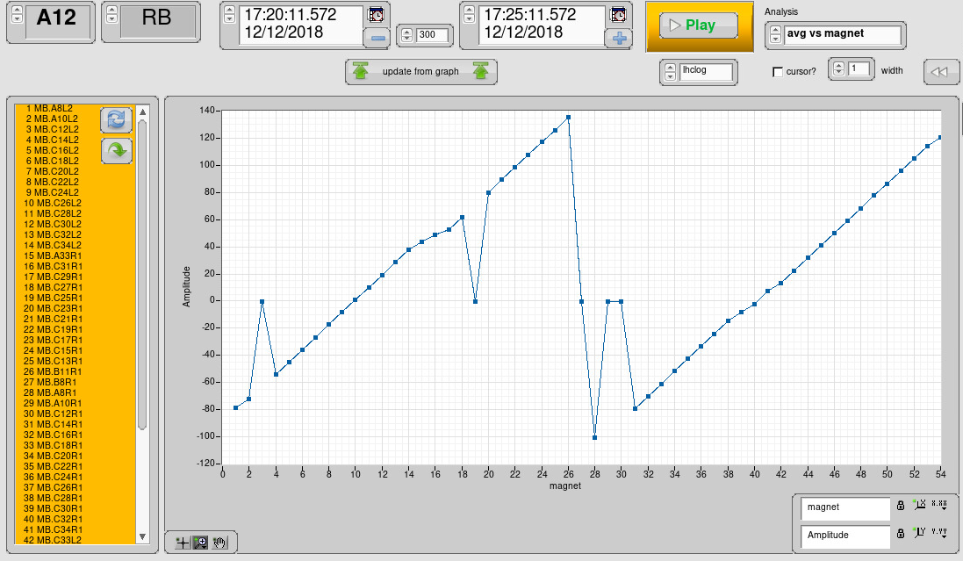
Voltage feelers
Very frequently one or more of the voltage feelers in an RB circuit show zero voltage.
Arjan Verweij, 10/6/2020

Slide 9
Thresholds for analysis
Not always clear if thresholds for analysis coming from the system experts are ‘warning’ levels or ‘alarm’ levels.
Examples:
600 A: circuit resistances
DFB temperatures and valve opening
nQPS: bus bar resistances
Current differences / drift (QDS and FGC in 600 A)
EE analysis
Number of expected quench files (not always clear)
Solution: Re-iterate with system experts, and have ‘warning’ and ‘alarm’ for some signals.
Arjan Verweij, 10/6/2020

Slide 10
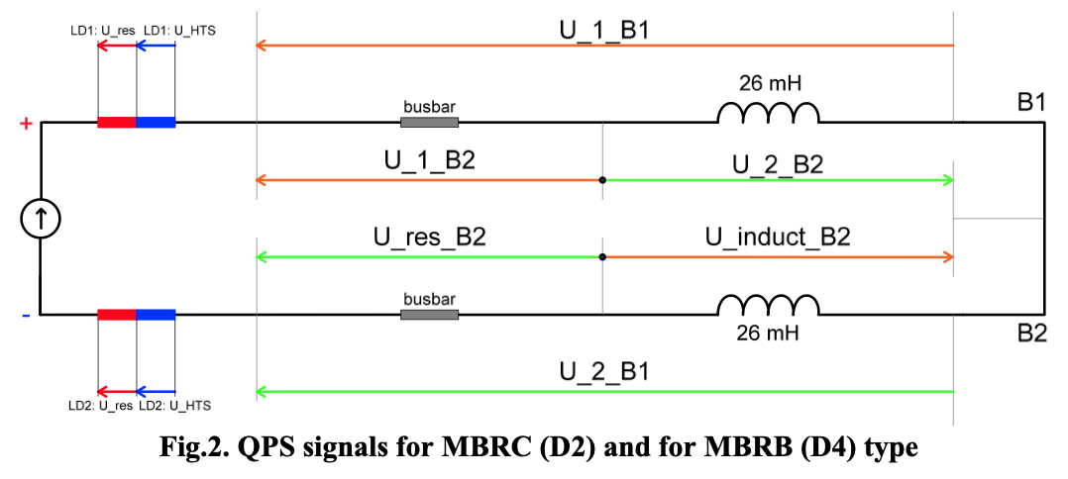
Signal names
Signal names are not always intuitive.
Signal names of boards A and B are the same.
Confusion between nQPS crate name and iQPS magnet name
IPD: strange naming for some circuits
Busbar segment naming
IPD and IPQ: B1 and B2 are not linked to beam 1 and beam 2
RQD/F versus int/ext versus B1/B2
Arjan Verweij, 10/6/2020

Slide 11
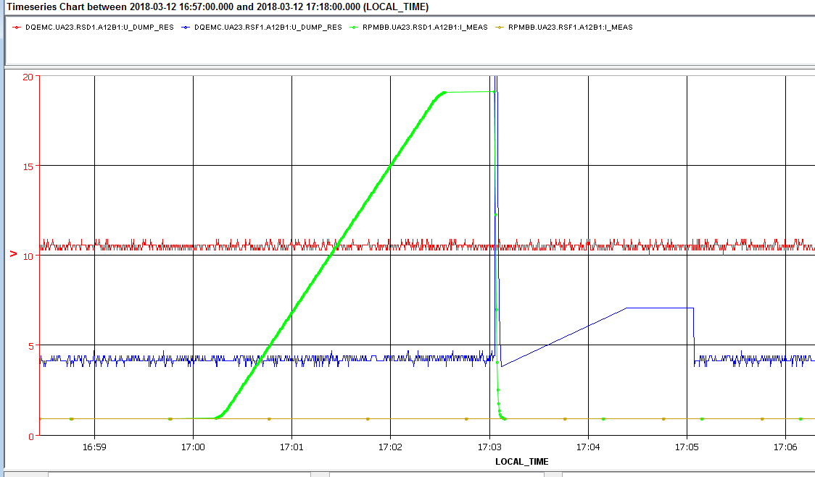
Signal names consistency
Signal names (or correspondence?) have to be the same for Front End, PM and Logging DB.
The list of the 600AEE-circuits, where the EE logging data are swapped:
DQEMC.UA23.RSD1.A12B1 <-> DQEMC.UA23.RSF1.A12B1
DQEMC.UA23.RSD1.A12B2 <-> DQEMC.UA23.RSF1.A12B2
DQEMC.UA23.RSD2.A12B1 <-> DQEMC.UA23.RSF2.A12B1
DQEMC.UA23.RSD2.A12B2 <-> DQEMC.UA23.RSF2.A12B2
While the PM-data for QDS (DQAMGNA) and for EE (DQAMSN600) are correct.
PLI3.b1: RSD1.A12B1
RSD1.A12B1:I_MEAS
RSD1.A12B1:U_DUMP_RES
RSF1.A12B1:U_DUMP_RES
Arjan Verweij, 10/6/2020

Slide 12
Different tools
We work with analysis tools written by many people and which are not coherent (different access, loading, saving, buttons, graphs, colors, formats, …)
Labview tools from several people from Adriaan’s/Odd’s section
Labview tools from Zinur
Tools for analysis of EE (Arek -> MS section) and PIC (LV for mains, eDSL for 600 A)
eDSL (MS section)
Solution: We are heading for analysis tools (notebooks, Python-based) that came as spin-off from the ‘Signal Monitoring Project’.
Arjan Verweij, 10/6/2020

Slide 13
Parallel execution of powering tests
Analysis of HWC tests / quenches / trips is often complicated due to the execution of powering tests of circuits that have known mutual coupling.
QDS of four 600 A circuits on the same crate -> trip
Opening EE -> trip
Firing QHs -> trip
Quench in MB in cells 8-10 can trip IPQ
Mutual coupling between busbars
Coupling in the DFB
Arjan Verweij, 10/6/2020

Slide 14
Test signatures
Tests to be signed in AccTesting, PMEA, and/or LabView tools, and in the future also Swan notebooks.
Not always clear where to sign and if signatures are communicated between PMEA and AccTesting.
Arjan Verweij, 10/6/2020

Slide 15
Long duration for data transfer
Transfer of PM files of the RB and RQ circuits takes very long, especially for snapshots.
No bottleneck for timely quench analysis (in shadow of re-cool-down of the sector), just a bit annoying.
MTF
We are still writing lots of results to MTF, although I think nobody ever tried to extract something.
Is this useful? It might be much easier and more correct to re-analyse data from the past with one well defined tool.
Arjan Verweij, 10/6/2020

