Slide 2
Individual System Tests of the Current Lead Heating System located in UAs, UJs and USC55.
Giorgio D’Angelo TE-MPE-EE
10-May-2020

Slide 3
Outline
Introduction to Current Lead Heating system
Preventive maintenance during LS2
IST – Goal? How?
IST Procedure – Test reports
Conditions, Infrastructure, Safety
Resources and material
Conclusions

Slide 4
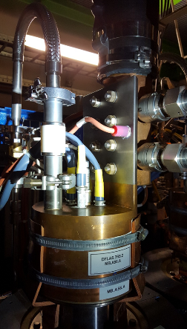
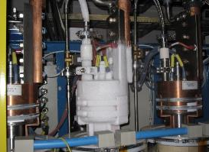
Introduction
The HTS current leads present in the LHC are important elements of the superconducting circuits. They are mounted inside the liquid helium vessel and operating at cryogenic temperatures.
Heater cartridges are incorporated inside the top part of each current lead to avoid heavy water condensation or ice formation. These heaters guarantee that the temperature at the top of the current lead stays above the dew point.
Cartridges and transformers are located by the DFBs while heater control units are situated in the UAs, ULs or RRs.

Slide 5
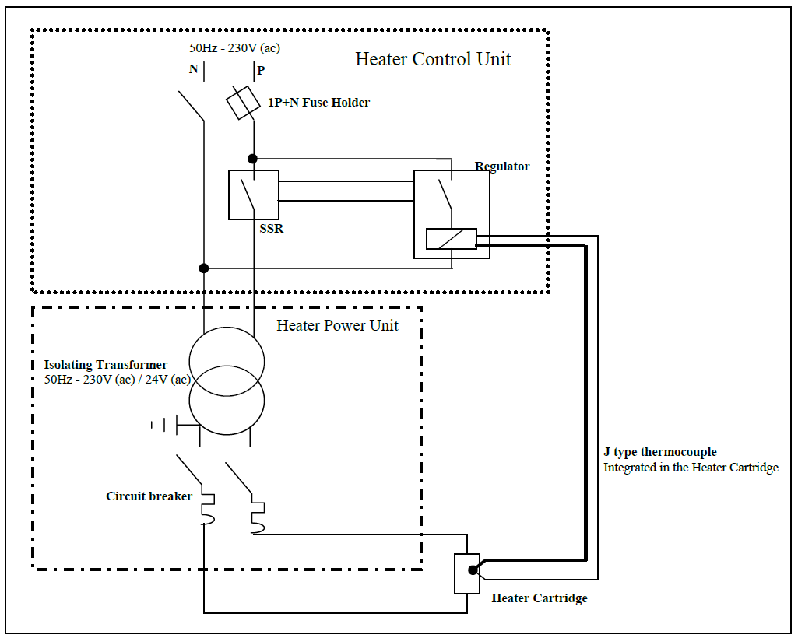
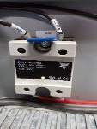
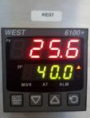
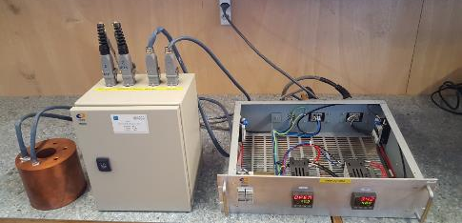

Each Current Lead Heating System is composed of a Heater Control Unit, a Heater Power Unit and Heater Cartridges with a thermocouple as shown here below.
Electrical schematic:
Hardware components
Varistor
Static Relay
Temperature Regulator
Heater Cartridges
Transformer Input 230V AC Output 24V AC

Slide 6
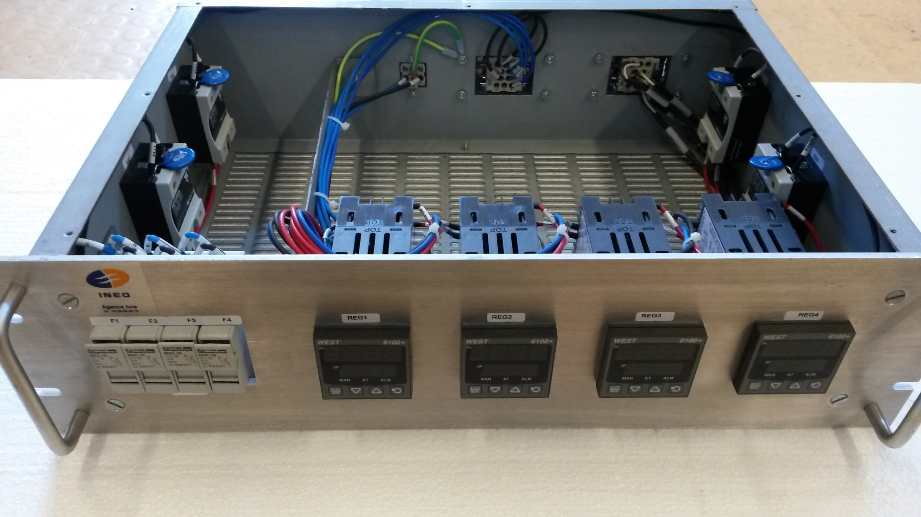
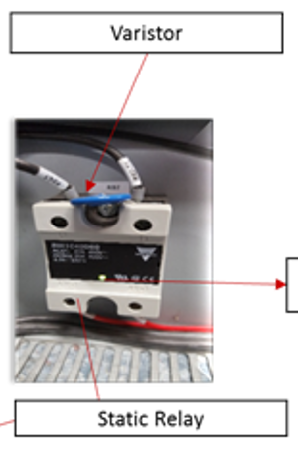
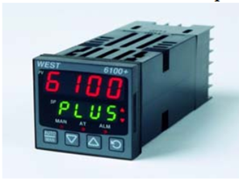
Preventive maintenance during LS2
It has been decided to perform preventive maintenance, during LS2, on the heater controlled units, called crates, located in UAs, UJs and USC55. The remaining heater controlled units located in RRs will undergo through a major upgrade.
The maintenance on the crate consist of:
  Replacement of the “WEST 6100+” regulator.
  Replacement of Solid State Relay (SSR) and its Varistor.
  Verification of internal cabling.
  Functional and quality control of the crate (report).

Slide 7
The total number of heater control unit called “crates” and sub-components treated are shown below:
All of them went through quality and functional tests after maintenance. A test report was produced for traceability.
Then, the crates were transported and reinstalled to their original location in the LHC tunnel.
Total number of crates |  | Total numbers of regulators | Total numbers of Solid-state relays | Total number of Varistors
Point 1 (US15) | 14 | 56 | 56 | 56
Point 2 (UA23/27) | 60 | 228 | 228 | 228
Point 3 (UJ33) | 25 | 100 | 100 | 100
Point 4 (UA43/47) | 46 | 172 | 172 | 172
Point 5 (USC55) | 14 | 56 | 56 | 56
Point 6 (UJ63/67) | 42 | 156 | 156 | 156
Point 8 (UA83/87) | 60 | 228 | 228 | 228
Total from the tunnel | 261 | 996 | 996 | 996
Spare crates (Piquet) | 29 | 102 | 102 | 102
Total (tunnel + spares) | 290 | 1098 | 1098 | 1098

Slide 8
Individual System Test objectives
The objectives of the Individual System Test (IST), performed at warm, while the machine is locked-out, is to ensure a proper functioning of the heating control system when the cool-down of current leads will start, sequentially with the cooling of the sectors, in the second part of LS2.
Once the cool down starts, the system will be operating continuously.
In order to perform the IST the following actions were performed:

Slide 9
IST actions:
Verification (visual inspection) that proper cables were connected to dedicated connectors in each crate. Locking-out of the cable to the connector.
Verification of the power-on of each crate (fuse status, unlock-out of the main electrical source).
Verification of the regulator’s assignment:
  One person is in front of the regulators while a second person is next to the assigned current lead on the electrical Distribution Feed Box (DFB) side.
  The regulator is turned ON by the person standing on the controller side while the other person by the DFB verifies that the heater cartridge start to heat.
Verification of the full operating cycle. To perform this test, the set point of the temperature is adjusted and the entire thermal cycle is verified:
  heating until the set point temperature is reached, then
  stopping of heating and then cool down naturally until lower limit is reached, then
  restarting of the heating
At the end of the IST test, the current lead heating system is turned off and locked out of the crate is maintained until the restart of the sector’s cool down.

Slide 10
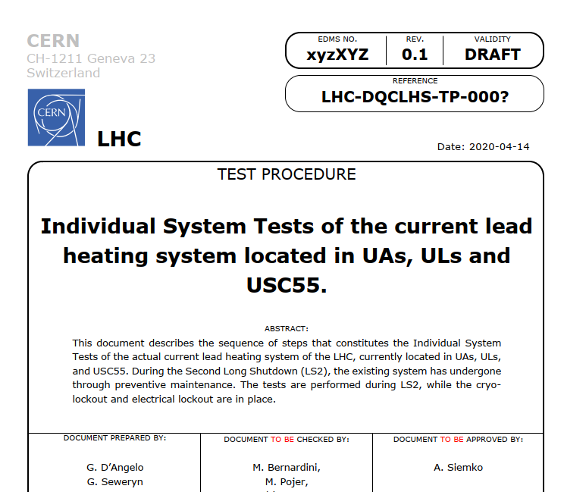
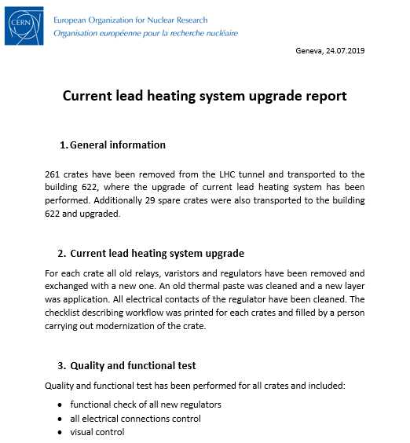
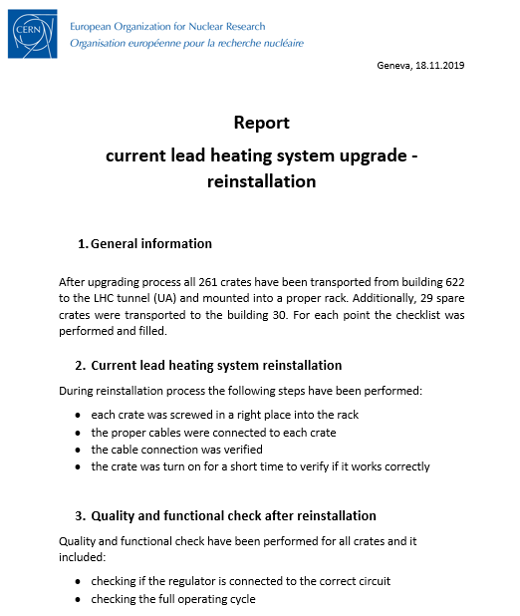
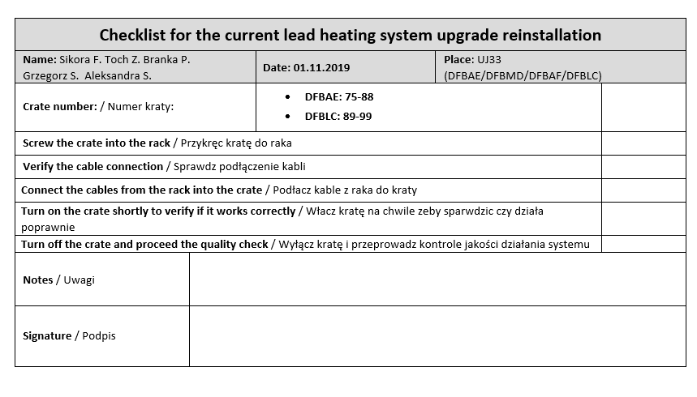
IST Procedure
For the purpose of the LS2 maintenance, dedicated documents have been prepared:
  Check list during maintenance in the lab.
  Test report after maintenance in the lab.
  Test report after re-installation in the LHC underground.
  IST description
A summary report has been prepared.

Slide 11
Conditions, infrastructure, safety
All current lead heating systems have been locked out during LS2, once the sectors reached ambient temperature.
The maintenance on the crates has been performed while all superconducting circuits were locked out.
The re-installation of the crates in the tunnel could be done without generating any constraint to the other users.
For the IST test, the access to the DFB is necessary. This has been scheduled around the LHC according to general planning, taking in account other activities constraints.
The work on site has been performed by a team of 2 persons minimum, following safety aspects.

Slide 12
Resources and materials
The material was ordered well in advance and was available on time at CERN.
Building 622 was used for the maintenance and quality checks of the crates in the surface.
The work was performed by:
  Project Associates colleagues (AGH), in total 40 man * week, distributed among 4 persons.
  CERN support: 2 staff
The total cost for the hardware is about 163 kCHF:
Total number of crates |  | WEST 6100+ | Solid State Relays | Varistors | Thermal paste tube
Total (tunnel + spares) | 290 | 1098 | 1098 | 1098 | 40
Price per unit (EUR) |  | 109.8 | 26.6 | 0.382 | 10
Total cost (EUR) | 150587 | 120560 | 29207 | 419 | 400

Slide 13
Conclusions
The maintenance of the current lead heating system in UAs, ULs and USC55 was planned well in advance, and the hardware was ordered and received on time.
261 heater control unit (crates) have been removed from the tunnel for their maintenance. 29 additional spare crates have been treated. Summary report is available.
After the re-installation of the crates in the tunnel, Individual System Test was performed it. Summary report available.
We profit form the IST to replace the thermal paste also on the current lead itself (where the heater cartridges are inserted).
The re-installation of the crates and IST have been completed everywhere around the machine except IP2-Right where the access was not possible due to water cooled cable maintenance.
The maintenance in RRs has not been performed since a major upgrade is ongoing (together with EP section) for radiation tolerance purpose. Dedicated IST will be applied to these upgraded systems.

Slide 14
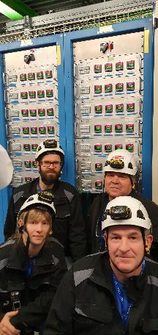
Special Thanks to:
Grzegorz Seweryn
Aleksandra Stuglik
Franciszek Sikora
Paweł Branka and
Zbigniew Toch
who performed most of the job on site.
Thank you for your attention !

