Slide 1
Estimating Emittance Growth due to Misalignments:
a comparison between theory and simulation
Léon Van Riesen-Haupt and Tessa Charles

Slide 2
Goals
This presentation:
Evaluate the effect alignment errors have on the vertical emittance, specifically:
Roll errors of quadrupoles
Vertical misalignments of sextupoles
Compare emittance evaluated from:
Simulations
Analytical expression
Possible long term:
Understand scope and limitations of analytical estimates
Quantify the impact misalignments of specific elements have on emittance
Expand scope of analytical estimates

Slide 3
Comparison Studies
MADX Simulations
Tessa Charles
Calculated using EMIT module
Evaluated for 100 seeds
Compute average and standard deviation
Analytical Expression
Leon van Riesen-Haupt
Expression given in [1]
Computed in python from Twiss
[1] K. Panagiotidis, A. Wolski – THPMN075, PAC07

Slide 4
Lattice
Four IP
ttbar lattice
FCCee_t_301_nosol_53a.seq
Applied errors to arcs and IRs separately

Slide 5
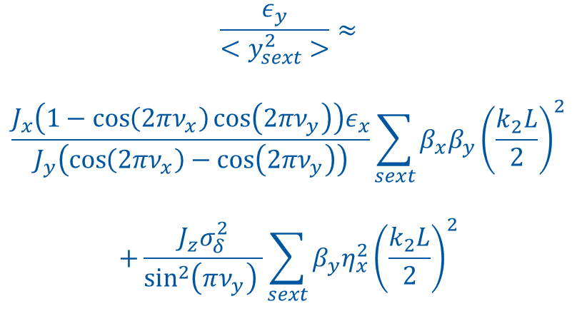
Analytical Formula for Sextupoles
$$\frac{ε_{y}}{<y_{sext}^{2}>}≈$$
$$\frac{J_{x}\left(1−\cos\left(2πν_{x}\right)\cos\left(2πν_{y}\right)\right)ε_{x}}{J_{y}\left(\cos\left(2πν_{x}\right)−\cos\left(2πν_{y}\right)\right)}\sum_{sext}{β_{x}β_{y}{\left(\frac{k_{2}L}{2}\right)}^{2}}$$
$$+\frac{J_{z}σ_{δ}^{2}}{\sin^{2}\left(πν_{y}\right) }\sum_{sext}{β_{y}η_{x}^{2}{\left(\frac{k_{2}L}{2}\right)}^{2}}$$
Coupling contribution
Dispersion contribution

Slide 6
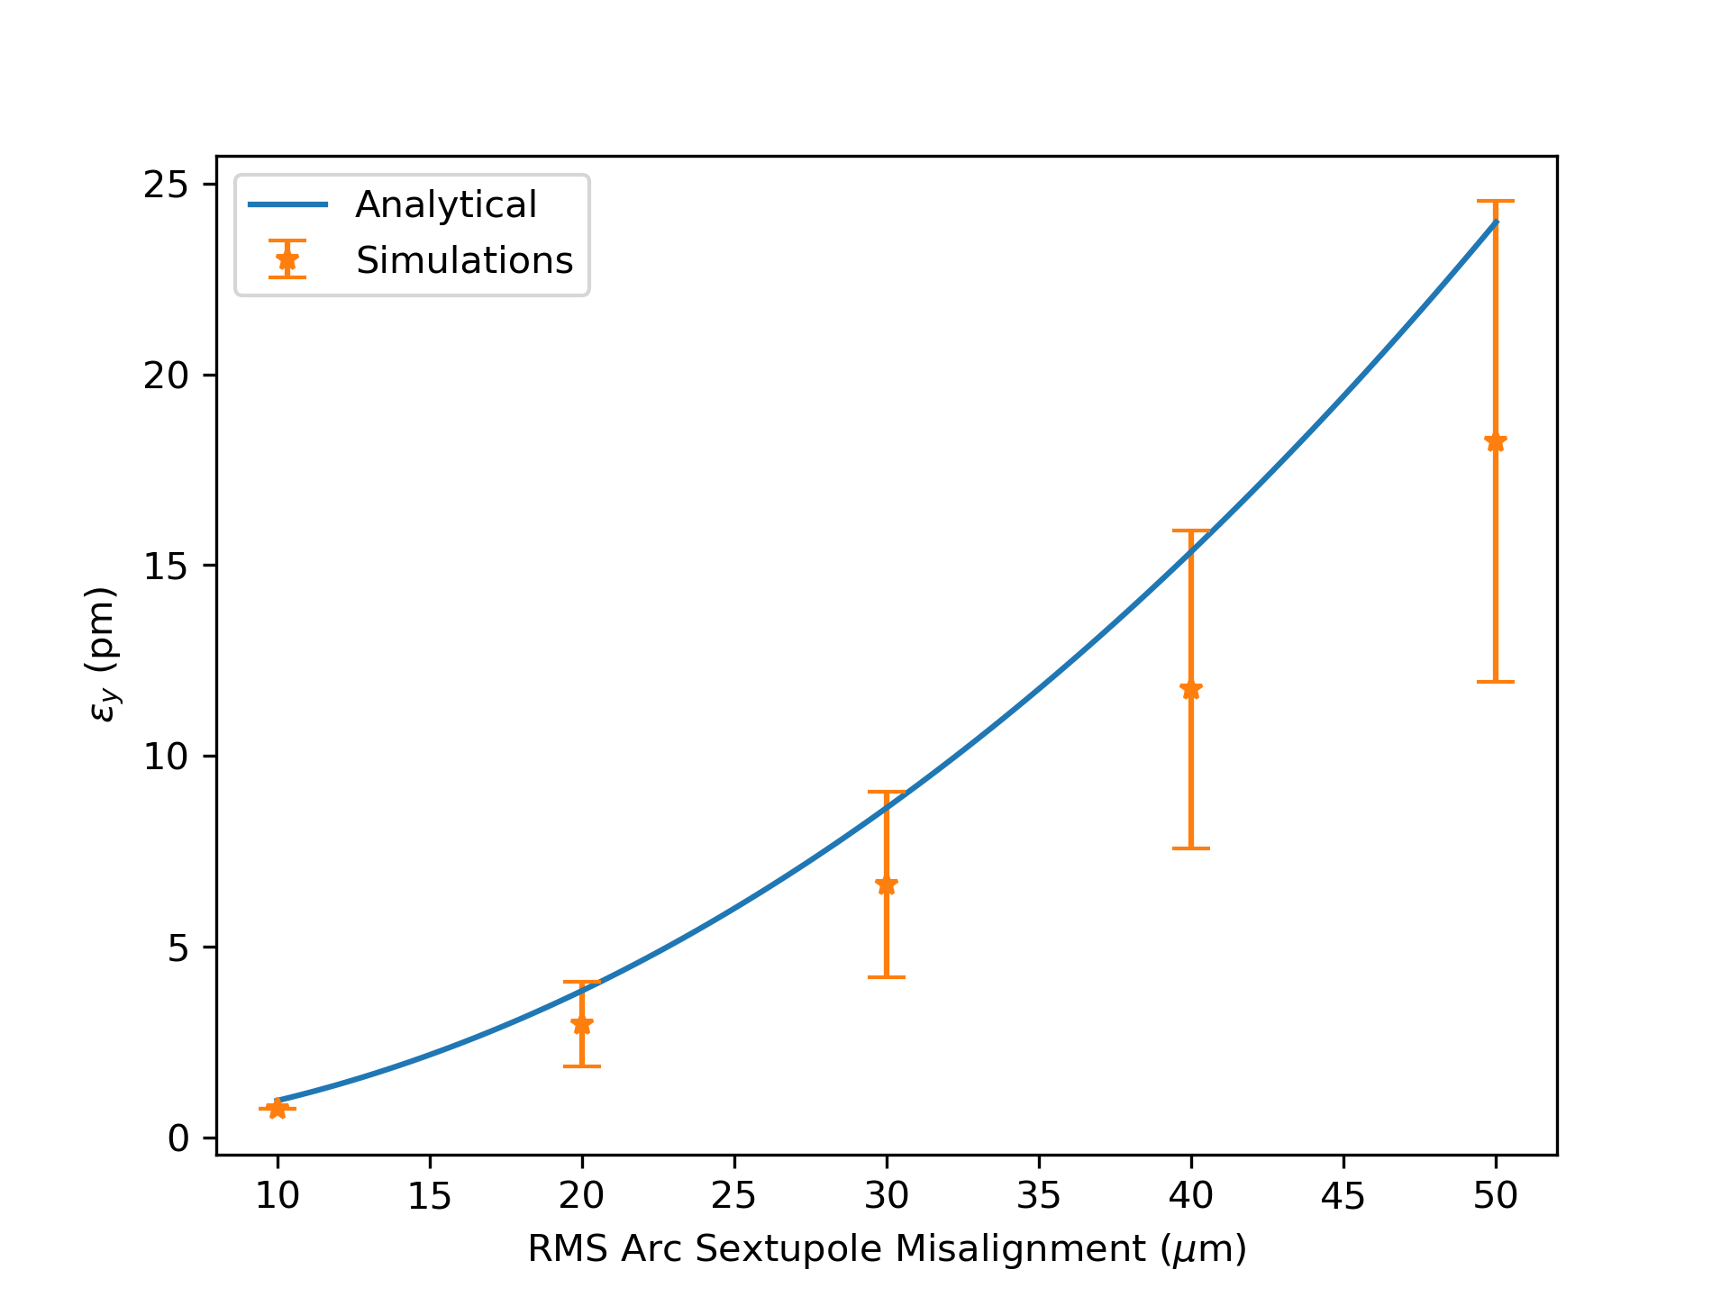
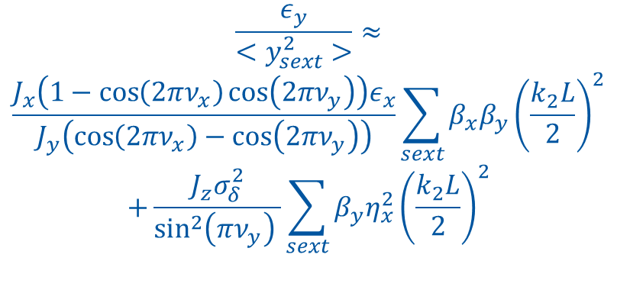
Vertical Misalignment of Arc Sextupoles
$$\frac{ε_{y}}{<y_{sext}^{2}>}≈$$
$$\frac{J_{x}\left(1−\cos\left(2πν_{x}\right)\cos\left(2πν_{y}\right)\right)ε_{x}}{J_{y}\left(\cos\left(2πν_{x}\right)−\cos\left(2πν_{y}\right)\right)}\sum_{sext}{β_{x}β_{y}{\left(\frac{k_{2}L}{2}\right)}^{2}}$$
$$+\frac{J_{z}σ_{δ}^{2}}{\sin^{2}\left(πν_{y}\right) }\sum_{sext}{β_{y}η_{x}^{2}{\left(\frac{k_{2}L}{2}\right)}^{2}}$$

Slide 7
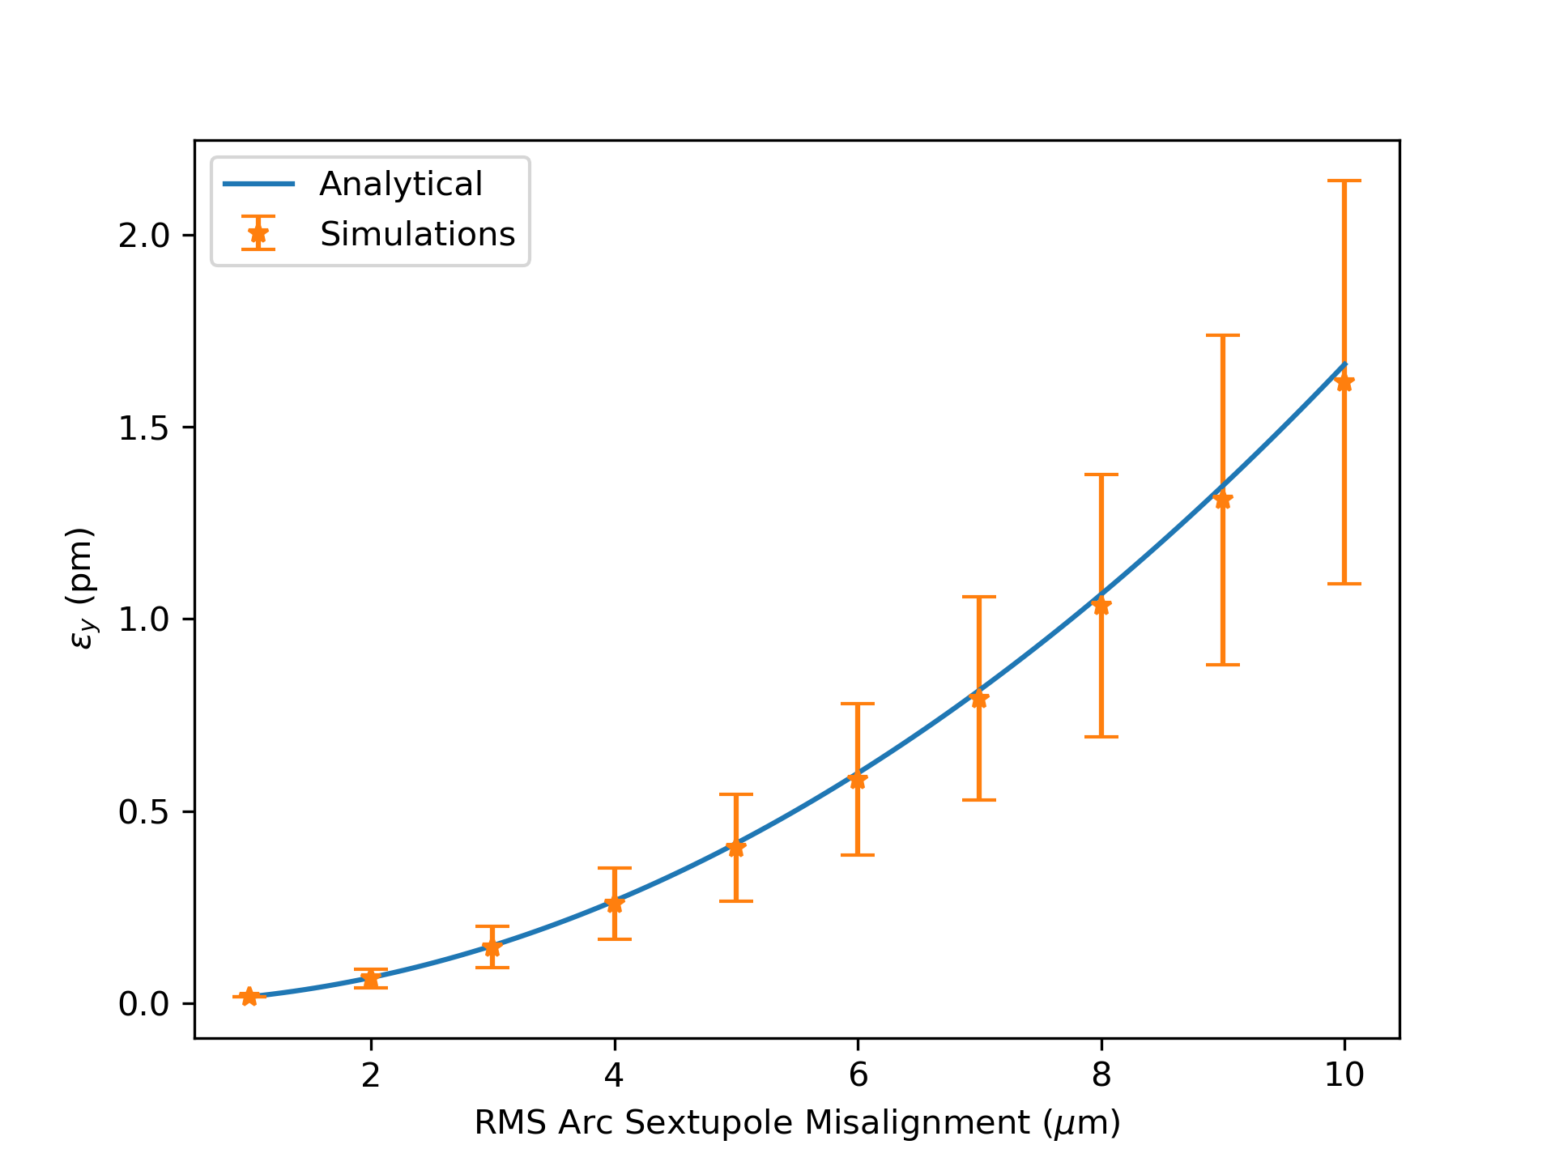
Vertical Misalignment of IR Sextupoles
$$\frac{ε_{y}}{<y_{sext}^{2}>}≈$$
$$\frac{J_{x}\left(1−\cos\left(2πν_{x}\right)\cos\left(2πν_{y}\right)\right)ε_{x}}{J_{y}\left(\cos\left(2πν_{x}\right)−\cos\left(2πν_{y}\right)\right)}\sum_{sext}{β_{x}β_{y}{\left(\frac{k_{2}L}{2}\right)}^{2}}$$
$$+\frac{J_{z}σ_{δ}^{2}}{\sin^{2}\left(πν_{y}\right) }\sum_{sext}{β_{y}η_{x}^{2}{\left(\frac{k_{2}L}{2}\right)}^{2}}$$
RMS IP

Slide 8
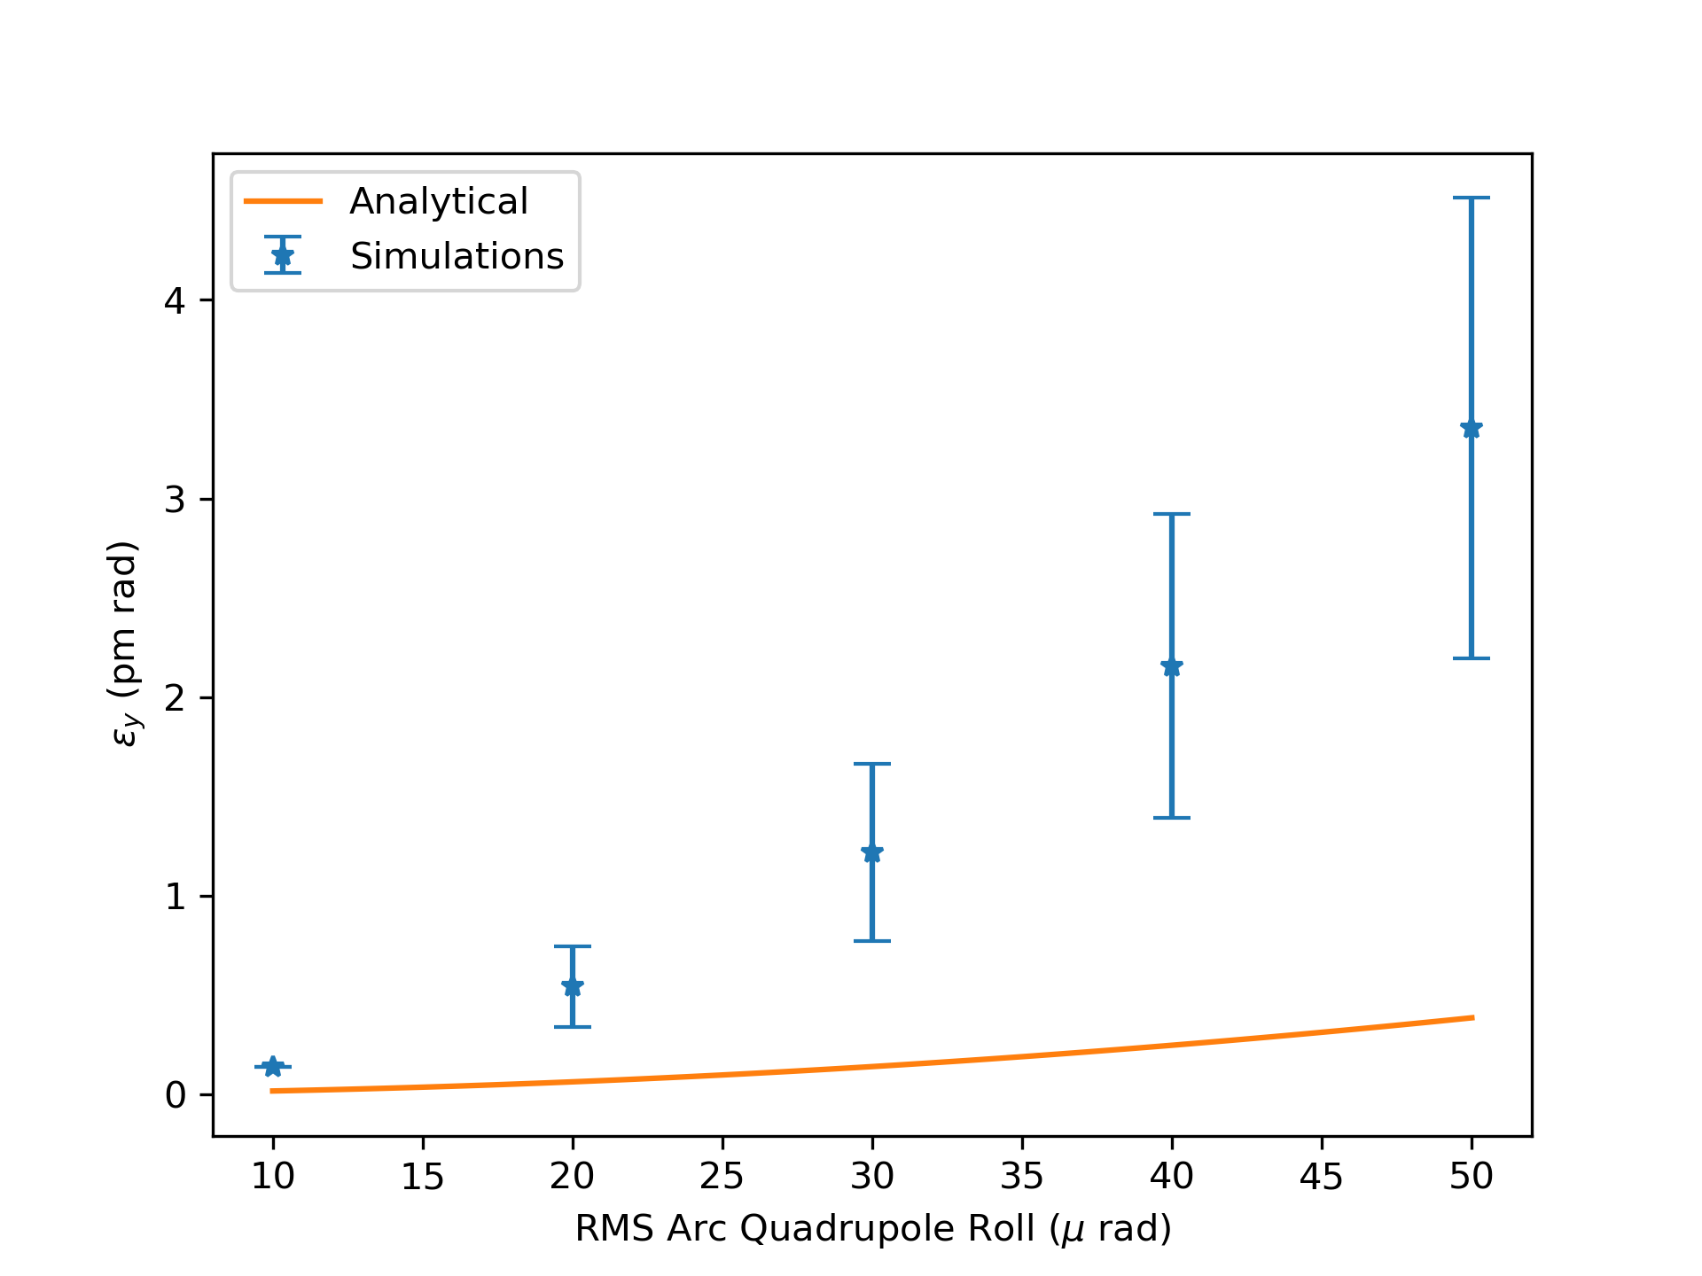
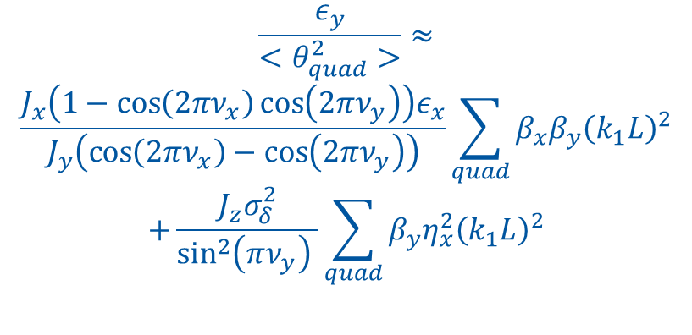
Arc Quadrupoles Roll
$$\frac{ε_{y}}{<θ_{quad}^{2}>}≈$$
$$\frac{J_{x}\left(1−\cos\left(2πν_{x}\right)\cos\left(2πν_{y}\right)\right)ε_{x}}{J_{y}\left(\cos\left(2πν_{x}\right)−\cos\left(2πν_{y}\right)\right)}\sum_{quad}{β_{x}β_{y}{\left(k_{1}L\right)}^{2}}$$
$$+\frac{J_{z}σ_{δ}^{2}}{\sin^{2}\left(πν_{y}\right) }\sum_{quad}{β_{y}η_{x}^{2}{\left(k_{1}L\right)}^{2}}$$

Slide 9
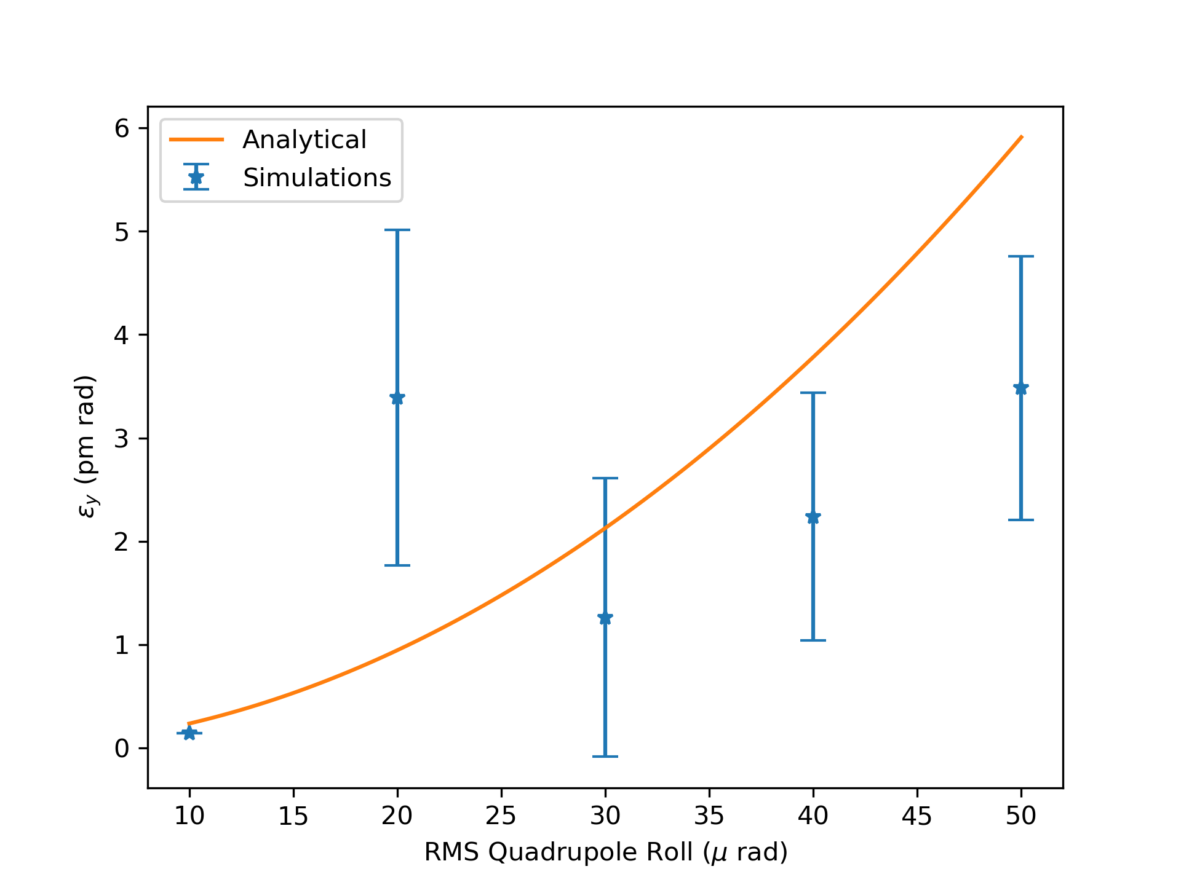
Roll angle of all Quadrupoles
$$\frac{ε_{y}}{<θ_{quad}^{2}>}≈$$
$$\frac{J_{x}\left(1−\cos\left(2πν_{x}\right)\cos\left(2πν_{y}\right)\right)ε_{x}}{J_{y}\left(\cos\left(2πν_{x}\right)−\cos\left(2πν_{y}\right)\right)}\sum_{quad}{β_{x}β_{y}{\left(k_{1}L\right)}^{2}}$$
$$+\frac{J_{z}σ_{δ}^{2}}{\sin^{2}\left(πν_{y}\right) }\sum_{quad}{β_{y}η_{x}^{2}{\left(k_{1}L\right)}^{2}}$$

Slide 10
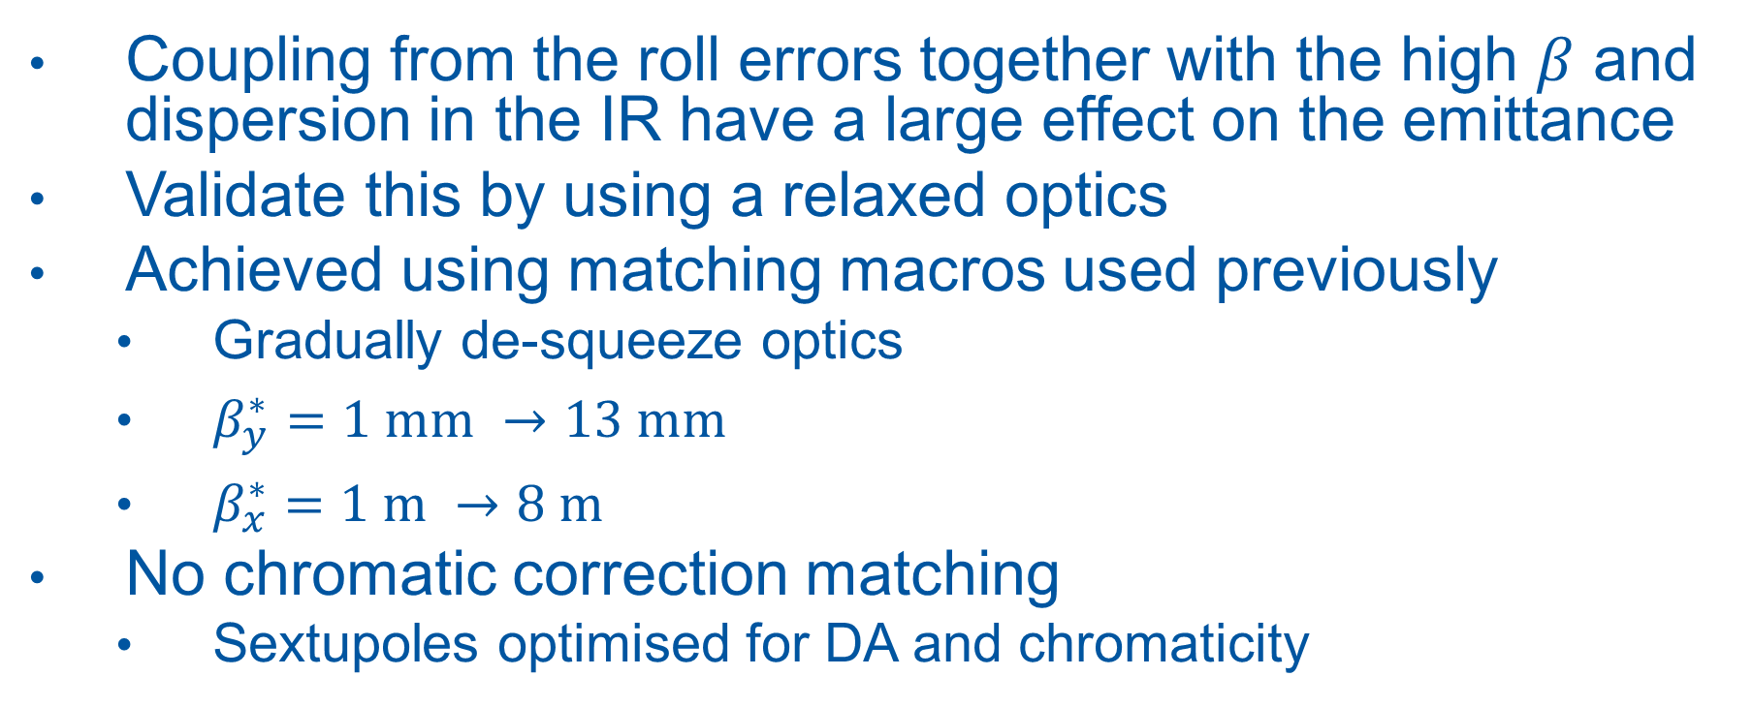
Relaxed Optics
Coupling from the roll errors together with the high $β$ and dispersion in the IR have a large effect on the emittance
Validate this by using a relaxed optics
Achieved using matching macros used previously
Gradually de-squeeze optics
$β_{y}^{∗}=1 mm →13 mm$
$β_{x}^{∗}=1 m →8 m$
No chromatic correction matching
Sextupoles optimised for DA and chromaticity

Slide 11
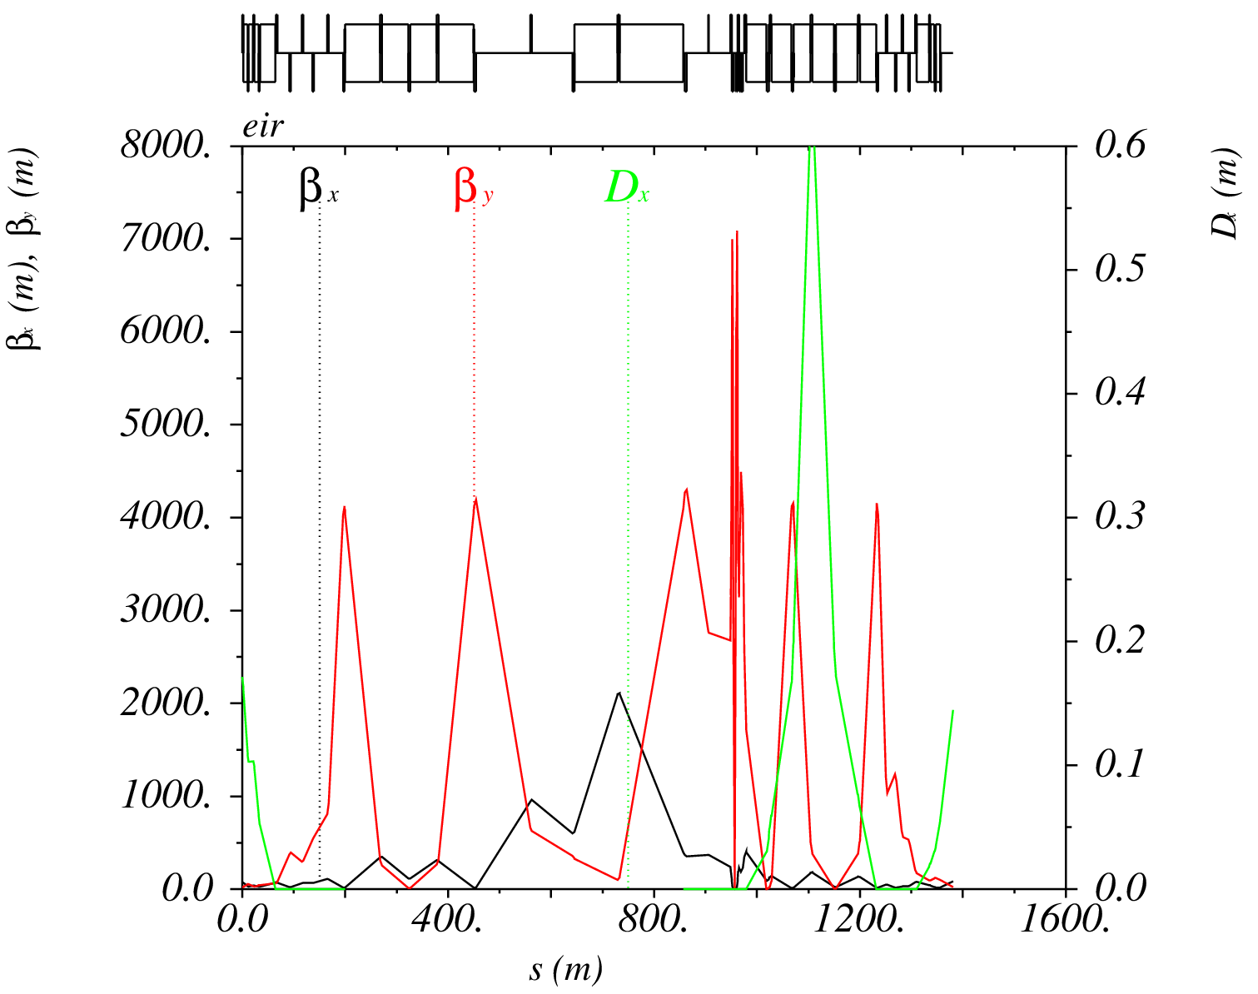
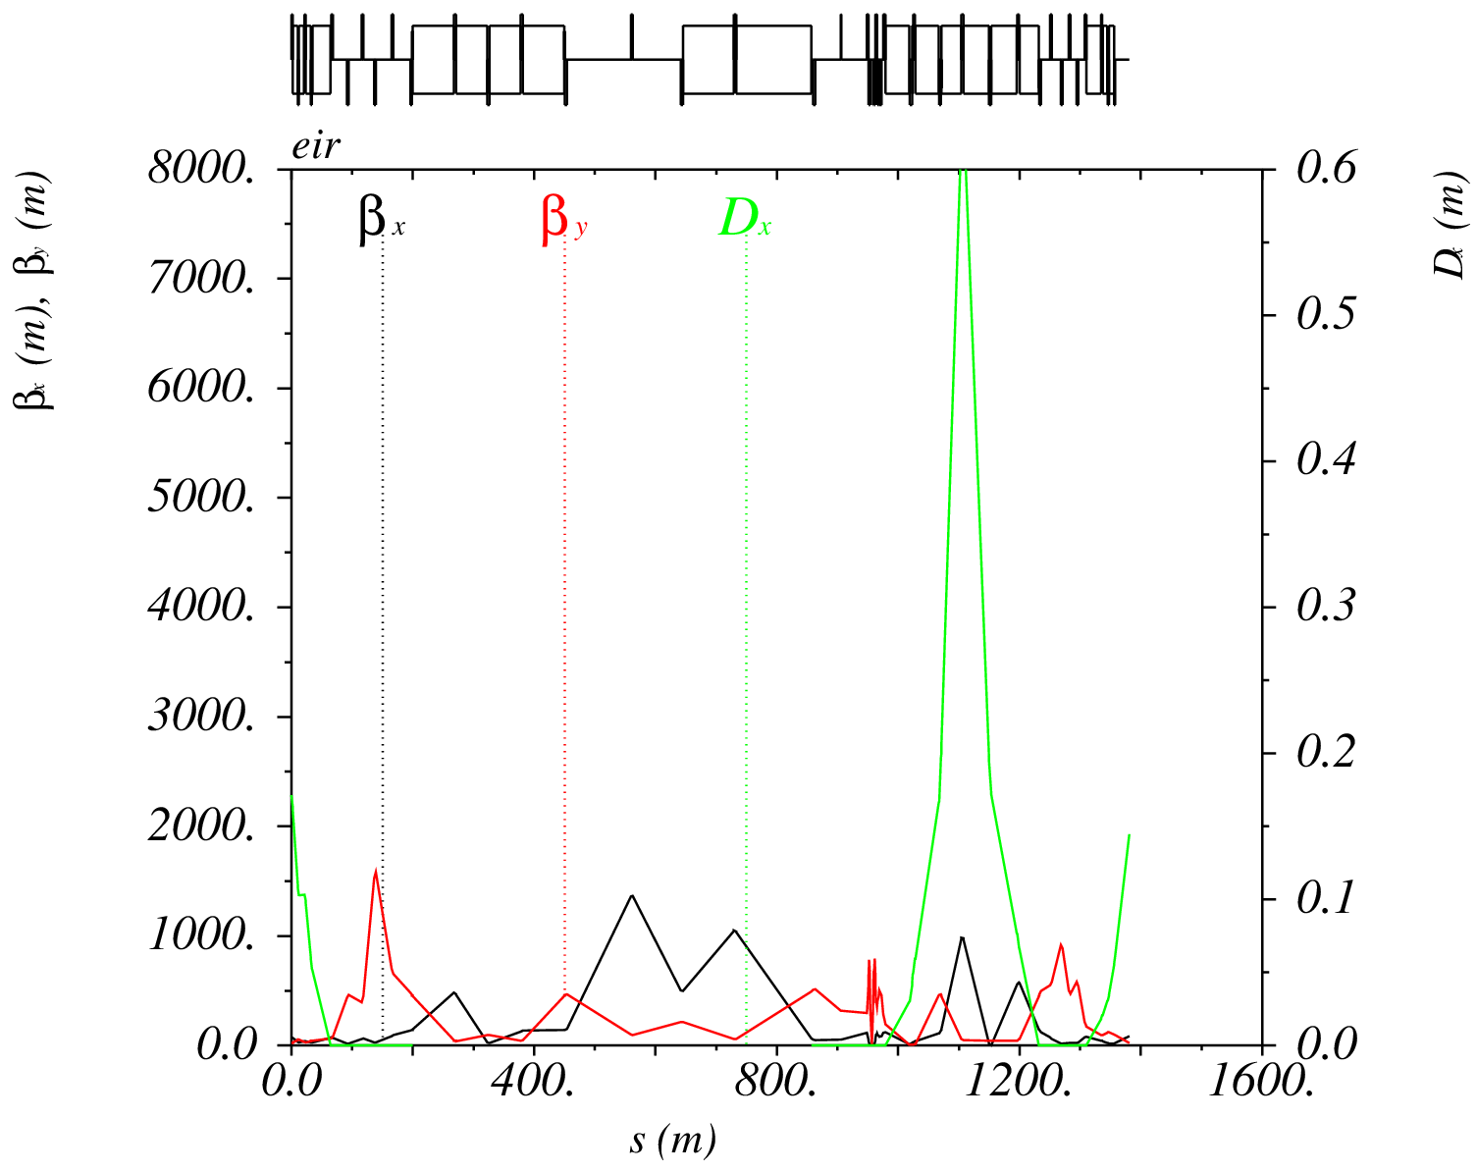
Relaxed Optics

Slide 12
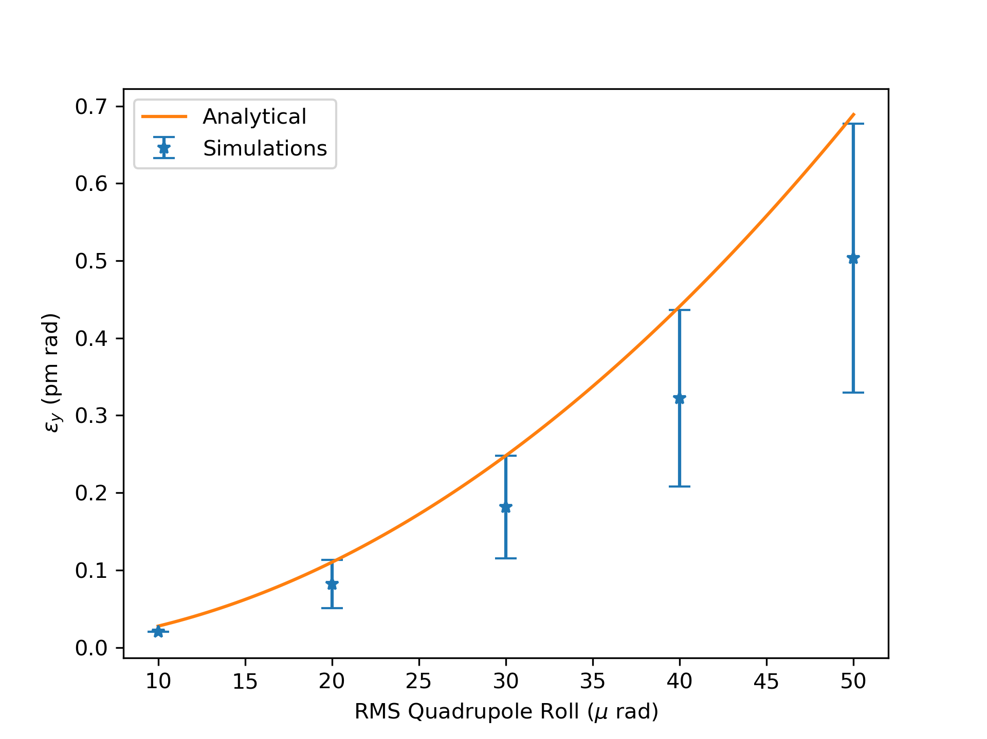
Roll Angle all Quadrupoles with Relaxed Optics
Squeezed
Relaxed

Slide 13
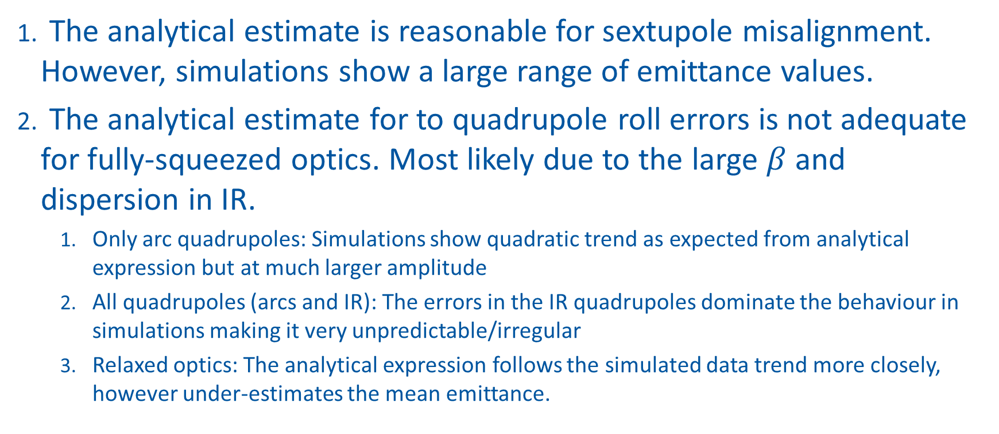
Take-a-ways
The analytical estimate is reasonable for sextupole misalignment. However, simulations show a large range of emittance values.
The analytical estimate for to quadrupole roll errors is not adequate for fully-squeezed optics. Most likely due to the large $β$ and dispersion in IR.
Only arc quadrupoles: Simulations show quadratic trend as expected from analytical expression but at much larger amplitude
All quadrupoles (arcs and IR): The errors in the IR quadrupoles dominate the behaviour in simulations making it very unpredictable/irregular
Relaxed optics: The analytical expression follows the simulated data trend more closely, however under-estimates the mean emittance.
Notes:
The analytical expression gives a reasonable estimate for vertical emittance due to sextupole misalignment. However it’s worth noting that from the simulations we see that a large range of emittance values could be expected from the different random seeds.
The analytical estimate for vertical emittance due to quadrupole roll errors is not adequate for fully-squeezed optics. This is most likely due to the large beta functions in the IR where the horizontal dispersion is also large and is strongly coupled to the vertical plane, resulting in increase vertical emittance.
When we considered only the arc quadrupoles, the analytical expression follows the simulated data trend more closely.
When we consider all quadrupoles (arcs and IR), the errors in the IR quadrupoles dominate the behaviour making it very unpredictable/irregular.
When we use relaxed optics whilst looking at the effect of quad rolls, the analytical expression follows the simulated data trend more closely, however under-estimates the mean emittance.
The vertical emittance is most susceptible to vertical sextupole misalignments.

Slide 14
Open Questions
What causes the difference between the behaviour for quadrupoles and sextupoles?
At what amplitude do quadrupole roll errors start behaving irregular?
Dispersion vs. coupling contribution in both cases?
Could phase advance to elements have an impact?
How to quantify vertical quadrupole alignment effects:
Known to have a big impact from simulations but for similar misalignments as in this study, it requires correction as MADX cannot find stable orbit for EMIT for most seeds
There is no first order analytical formula (directly affects closed orbit which then affects emittance)
How can information from these studies best be used to help choose alignment strategies?

Slide 15
Backup slides

Slide 16
Vertical Misalignment of IR Quads

Slide 17
Vertical Misalignment of arc Quads

