Slide 1
LpGBT and Versatile Link ⁺
TWEPP2020 User Group Meeting
Francois Vasey

Slide 2
Link⁺ Project
LpGBT
Versatile Link⁺
LpGBT-FPGA
Front-end
Back-end
TRX
FPGA
SERDES
SERDES
SERDES
LpGBT
VTRx+
Passives
CERN-B
Firefly
VLDemoBoard ⁺

Slide 3
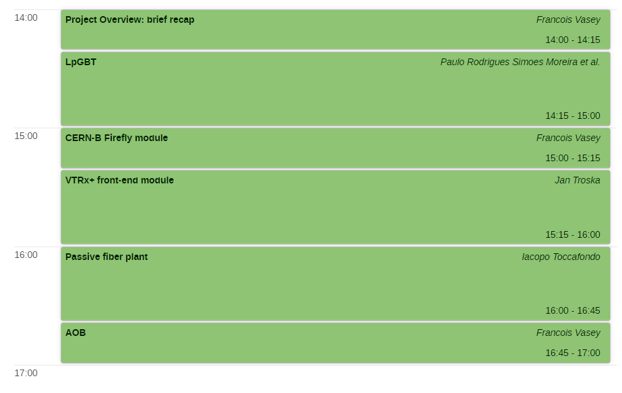
Agenda
LpGBT
Versatile Link⁺
LpGBT-FPGA
Front-end
Back-end
TRX
FPGA
SERDES
SERDES
SERDES
LpGBT
VTRx+
Passives
CERN-B
Firefly
VLDemoBoard ⁺

Slide 4
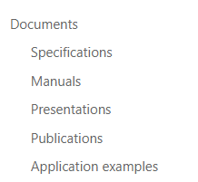

LpGBT References
LpGBT Sharepoint site
https://espace.cern.ch/GBT-Project/LpGBT/default.aspx
ACES 2020
https://indico.cern.ch/event/863071/contributions/3738814/

Slide 5
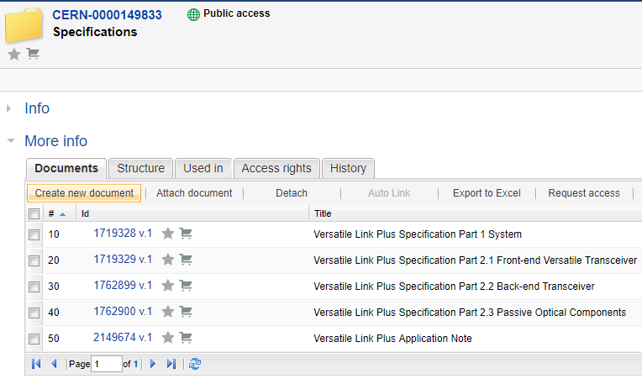
VL⁺ References
VL⁺ specifications in EDMS
  https://edms.cern.ch/ui/#!master/navigator/project?P:1930058715:1767090345:subDocs
  Including Samtec product brief and VL+ application note
VL⁺ Sharepoint site
  https://espace.cern.ch/project-Versatile-Link-Plus/SitePages/Home.aspx

Slide 6

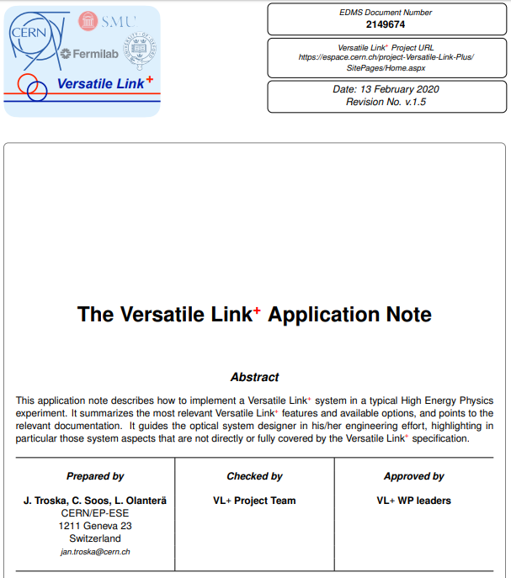
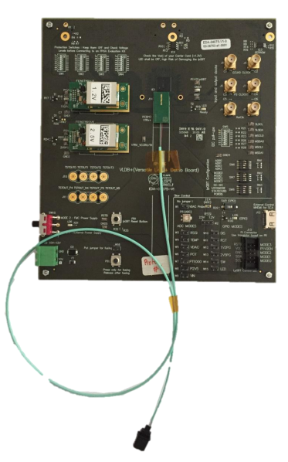
VL⁺ Implementation Details
1. ACES 2020
2. Application Note
https://indico.cern.ch/event/863071/contributions/3738815/
3. VLDB ⁺
https://vldbplus.web.cern.ch/

Slide 7
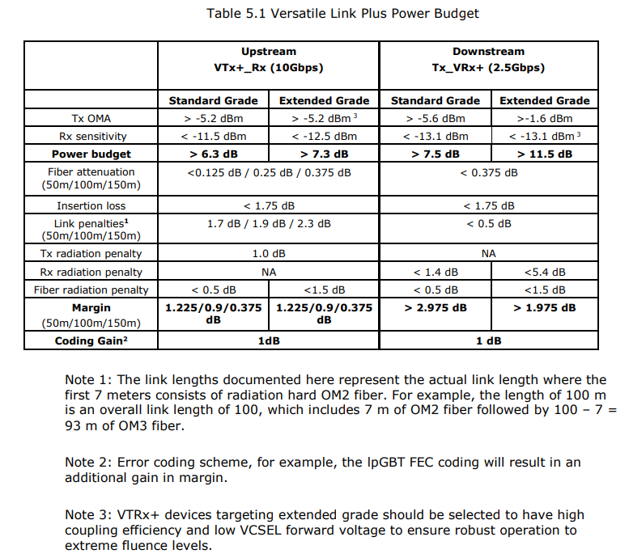
Power Budget
Upstream Power Budget is tight. Depending on link length and radiation environment, extended grade components must be used.
Best margin achieved for short links with few breakpoints

Slide 8
Standard or Extended Grade ?
Consider VTRx+ environment
If fluences at VTRx+ position are:
  above standard grade levels > select Extended Grade
  at/ or below standard grade levels: move to step 2
    Consider Fibre environment
    calculate Radiation Induced Attenuation (RIA) in fibre (choice of standard and rad hard fibre types)
      If RIA is below 0.5dB > select Standard Grade
      If RIA is above 0.5dB > select Extended Grade
Tolerance level | Dose and fluence (1Mev neutron equivalent)
Standard Grade | 1 MGy 1.7 x 10¹⁴ neutrons/cm² 1 x 10¹⁴ hadrons/cm²
Extended Grade | 1 MGy 1 x 10¹⁵ neutrons/cm² 1 x 10¹⁵ hadrons/cm²
If unsure, contact VL+ team with:
      detector ionising radiation map
      fibre route and patch panel locations
      Position of Cold / Warm transition (if applicable)
  To determine fibre type(s), calculate total RIA, and select VL+ grade

