Slide 1
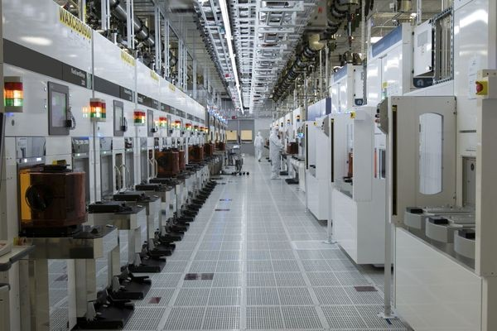
Microelectronics
User Group Meeting
TWEPP 2020 – Virtual Session
22, September 2020
WELCOME!

Slide 2

MUG meeting Agenda
“Welcome”
by Dr. Kostas Kloukinas (CERN) (10’)
“ASIC support News & Radiation Tolerant device models for 65nm technology”
  by Dr. Alessandro Caratelli (CERN) (20’)
“CHIPS: CERN-HEP IC design Platform and Services”
  by Dr. Xavier Llopart (CERN) (20’)
“EP R&D WP: CMOS Technologies for Future Experiments”
  by Dr. Kostas Kloukinas (CERN) (20’)
“28nm CMOS Mixed Signal Design Kit”
  by Alessandra Fioriti (CERN) (15’)
Coffee Break (15’)
“Europractice EDA tools for the HEP community”
  by Europractice STFC, UK) (30’)
“Semiconductor process selection from ESD perspective: FinFET, SOI or CMOS?”
by Benjamin Van Camp, CTO SOFICS (30’)
“Open Discussion” (20’)

Slide 3



MUG meeting on Zoom
Keep in “Mute”
if you are not speaking
Questions & Comments at the end of the presentations
Use “Zoom raise hand”
to talk
Thank You

