Slide 1
Power supplies for phase 2
–
Procurement progress

Slide 2
Outline
Market survey context and results
Procurement process and schedule
Power supply procurement status
Targeted procurement framework

Slide 3
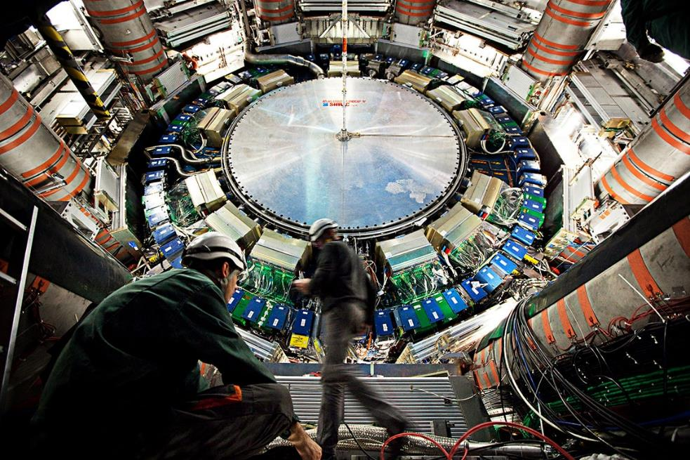
Market survey context
Large variety of power supply types (and layouts)
Each detector has different constraints …
  Powering needs
  Locations (related environmental constraints)
  Physical/space limitations
  Cooling requirements/constraints
  Control granularity
  Etc.
… and different system choices
  Dedicated radiation tolerant POL DC-DC converter
  Own-custom developed AC-DC and/or bulk DC-DC
  Dedicated shunt LDO chip for serial powering
  Etc.

Slide 4
Market survey context
Goal of the market survey
Broad spectrum
  Covering different needs
  Experiments are large international collaborations
  Lots of different detectors each with different powering needs
Selection of candidate manufacturers before development, prototyping and call for tender
  Prepare purchasing process for the users (detectors)
  Make the development, prototyping and call for tender processes easier and faster for the users
Include the long term availability and maintenance requirements
  Purchase order to be accepted 15 years after completion of series production
  On-site support and maintenance on-call or at regular interval for a period of 15 years after completion of series production
  Corrective maintenance during the warranty period on the CERN site if so requested
  Immediate technical support from within Europe during normal office hours during the entire lifetime of the equipment

Slide 5
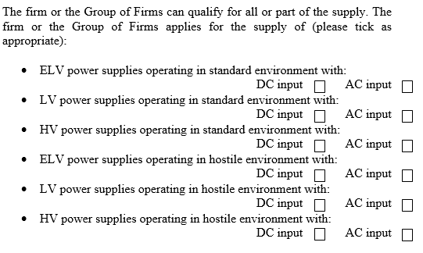
A framework MS for multiple needs
Group of firms are welcome!
Subcontracting allowed except design, development, final assembly and testing.

Slide 6

Procurement process of MS-4492/EP
Award based on: Lowest compliant bid
/!\ Alignment rule not applicable
MS – Step 1
MS – Step 2
MS – Step 3
IT
Supplies Type 2
Supplies Type 3
Supplies Type X
MS – Step 3
MS – Step 3
MS – Step 3
IT
IT
IT
Contract 1
Contract 2
Contract 3
Contract X

Slide 7
Procurement process of MS-4492/EP
“Market Survey” (MS) = Firm qualification
Step one: “Qualification Questionnaire” to be submitted
  Only firms or group of firms meeting the criteria set forth in the questions were qualified for Step 2
Step two: 2 – 3 units of power supply units to be delivered for evaluation
The samples shall at least comply with this set of minimal requirements:
  AC input power factor better than 0.95 above 40% of the nominal output power;
  Total efficiency better than 85% above 40% of the nominal output power;
  Functional remote monitoring and control software in the form of an OPC server compliant with OPC-UA (Unified Architecture; OPC foundation). Alternatively, in case the firm or group of firms does not yet offer OPC, an equivalent functional remote control software is acceptable.
Step three: Several price enquiries (PE) for the development and supply of prototypes (one PE per equipment type and operational environment)
  Submission deadline: 4 weeks
  Excessive prices may lead to the rejection of the bid

Slide 8
MS outcome after step 2
MS invitation : 17 firms replied
Step 1 : 10 firms selected
Step 2 : 7 firms or combination of firms remain
Ready for step 3

Slide 9
Procurement process of MS-4492/EP
“Market Survey” (MS) = Firm qualification
Step one: “Qualification Questionnaire” to be submitted
  Only firms or group of firms meeting the criteria set forth in the questions were qualified for Step 2
Step two: 2 – 3 units of power supply units to be delivered for evaluation
The samples shall at least comply with this set of minimal requirements:
  AC input power factor better than 0.95 above 40% of the nominal output power;
  Total efficiency better than 85% above 40% of the nominal output power;
  Functional remote monitoring and control software in the form of an OPC server compliant with OPC-UA (Unified Architecture; OPC foundation). Alternatively, in case the firm or group of firms does not yet offer OPC, an equivalent functional remote control software is acceptable.
Step three: Several price enquiries (PE) for the development and supply of prototypes (one PE per equipment type and operational environment)
  Submission deadline: 4 weeks
  Excessive prices may lead to the rejection of the bid
Status
Note:
Firms or group of firms having already produced power supplies complying with CERN requirements for the present Market Survey may pass step 2 without being requested to deliver power supply units.
Well defined requirements/needs may proceed directly with the IT (and bypass Step 3).
Invitation to Tender (IT)

Slide 10
Procurement process of MS-4492/EP - Alternative
Award based on: Lowest compliant bid
/!\ Alignment rule not applicable
MS – Step 1
MS – Step 2
MS – Step 3
IT
Supplies Type 2
Supplies Type 3
Supplies Type X
MS – Step 3
MS
proto+prod IT
MS
proto+prod IT
MS – Step 3
MS – Step 3
OR
IT
Contract 1
Contract 2
Contract 3
Contract X

Slide 11
Procurement process of MS-4492/EP
Confidentiality rules
Reasons:
Multiple projects
Long duration
Vicinity of certain vendors
Measures:
Defined opening committee for all bid openings
Signed NDA and absence of conflict of interests
Quotations strictly confidential

Slide 12
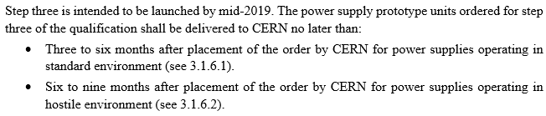
Procurement Timeline
MS related schedule
Step 2
Technical Qualification
Step 3
Price enquiry(ies) for Development and Prototyping
Q2-Q3 2019 Q4 2019
Detector's responsibility for PE and/or IT as well as tech qualification
PE/IT started to be launched October 2019
Writing detailed technical specification
User’s perpective

Slide 13
Power supply procurement status
Tech. Spec Proto PE Bid opening Proto PO Proto+Prod IT
ATLAS Inner tracker Pixel
ATLAS Inner tracker Strips
CMS Outer tracker
CMS Common IT, incl.:
ECAL Barrel, Barrel Timing Layer, Endcap Timing Layer, Endcap Calorimeter
27.1.20
4.2.20
26.8.20
PE: Price Enquiry (step 3)
PO: Purchase Order
IT: Invitation to Tender
Well defined needs/requirements may proceed directly with the IT (and bypass Step 3).

Slide 14
Procurement rules within the MS-4492/EP
Orders to be placed according the ranking of lowest compliant bids
If a project cannot afford paying prototypes for all vendors:
  The vendors concerned cannot be excluded and should be qualified for the production IT
  The prod. IT will then ask for a prototyping price again
  The whole prototyping + production cost will be taken into account for the adjudication
If no proto was ordered to the lowest compliant IT bidder, a second 'prototyping' delay will be added to the project planning
Acceptance tests must be defined and performed by the detectors
One does not have to pay for prototypes that fail the acceptance tests
Vendors whose prototype does not pass the acceptance test should be given an opportunity to remedy the issue within a reasonable timeframe before termination
PE: Price Enquiry (step 3)
PO: Purchase Order
IT: Invitation to Tender

Slide 15
Targeted procurement framework
Similar to what is in place today (for Wiener and Caen PS)
PS Procurement framework (after the MS)
Target: Common procurement and long-term maintenance frame contracts
Common blanket framework contracts
  Ok for large quantities
  Bulk orders for big quantities placed as needed by the detector groups
    Requests to be submitted via dedicated online DB (Alternatively registration to the DB by the users themselves)
Other release orders placed in common at the end of every quarter
  Requests to be submitted via dedicated online DB
  TID (money transfer) to a common account prior to common PO (DAI)
  Equipment tracked in the DB from the PO release on
User issues request via DB
TID (money transfer) by ESE
ESE issues Common PO (once TID is signed, quarterly)
User can pickup its units from the Epool reception

Slide 16
Thanks for your attention

Slide 17
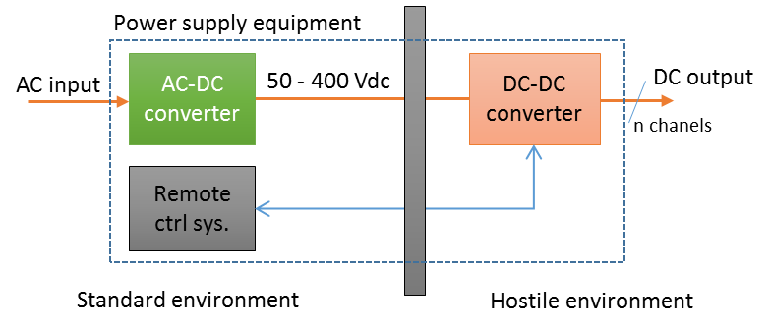
Technical description key elements (1/2)
Power supply technical description (for MS 1st step only)
Electrical input
  400/230V nominal, 50Hz three or single-phase supply
  DC input telecom industry 48V to 400V typically
Optional intermediate DC stage
  In specific cases, distributed power supply systems (AC-DC separated from DC-DC stage) might be required
DC output
  Grouped in 3 main types, ELV, LV and HV
  Detailed requirements specific to each detector
Efficiency
  Overall efficiency better than 85% above 40% of nominal load
n channels
Implementation example
PS types examples, used in the MS technical description

Slide 18
Technical description key elements (2/2)
Power supply technical requirements
Monitoring and control
  OPC-UA compliant monitoring and control SW. See Ben Farnham’s presentation after the coffee break
Environment
  Standard
    No significant radiation or magnetic fields present – a “normal” industrial environment
  Hostile (maximum numbers, specific to each sub-detector)
    Radiation and/or magnetic fields present
    Stray magnetic fields up to 5500 Gauss (550 mT)
    Total ionising radiation up to 1 kGray
    Neutrons fluence up to 6x10¹² 1 MeV eq. neutrons/cm2
  Underground area
    CERN safety instructions - Halogen free cable isolation and PCB substrate
Cooling
  In most cases, equipment installed in ventilated racks (vertical bottom up recirculating airflow)
  Where stray magnetic field is present fans with electric motors may not function. Other means
  of heat removal may be foreseen for PS equipment cooling

Slide 19
Procurement process and status
Status of MS + IT process for the ATCA shelves + rectifier system
First draft of MS documents April 2020
Finalisation of MS documents End April
Technical auditing Mid May
Dispatch of MS documents Mid May
First draft of IT documents Beginning July
Finalisation of IT documents End July
Specification Committee date Mid August
Dispatch of IT documents Mid August
Submission deadline for bidders Mid September
Date of FC meeting Dec 2020
Blanket contract start date Jan 2021
June-July review of the tech specifications via the ECB
for both, the ATCA shelf and the rectifier system
Same steps for the -48V rectifier (PE only)
Comments on the specifications to be collected by the electronics coordinators in July.

Slide 20
Procurement framework for ATCA shelf and - 48V rectifier
Existing procurement framework
Obsolete; spending limit reached
Based on open commitment
  Only for limited quantities !
Release purchase orders as needed
  Individual DAI from users directly
  At fixed negotiated prices
  Order can be placed whenever needed
  No equipment tracking upon reception
New procurement framework (after the MS)
Targeted to be ready early 2021
Based on blanket framework contracts
  Ok for large quantities
Purchase orders placed in common at the end of every quarter
  Requests to be submitted via dedicated online DB
  Fixed negotiated prices
  TID (money transfer) to a common account prior to common PO (DAI)
  Equipment tracked in the DB from common PO on
Same procedure as for ordering VME crates today
User issues request via DB
TID (money transfer) by ESE
ESE issues Common PO (once TID is signed, quarterly)
User can pickup its units from the Epool reception

Slide 21
Outline
ATCA shelves for phase 2 – Procurement process
Existing procurement process and motivation for Market Survey
Market survey process and status
Envisaged procurement framework
Power supplies for phase 2 – Prototype procurement requests
Technical description key elements (reminder)
Market survey context and results
MS and IT schedule

