Slide 1

Fundamental physics and accelerator science in developing countries
Christine Darve
Session M19: Physics for Development
March 4, 2020
Notes:
Introducing projects reflecting initiative from world wide scientists to transcend geographical boundaries and share our knowledge with students from developing countries

Slide 2
Outline
Scientific and technological paradigms
Platforms to accelerate developing countries transformation
  African School of Fundamental Physics and Applications
  Nordic Particle Accelerator Project
Particle Accelerators as tools for transformation
APS2020 Fundamental physics and accelerator science in developing countries / C. Darve
03/04/20
2

Slide 3
Technological Paradigm Evolution
INFORMATION
economy
INDUSTRIAL
economy
MOLECULAR (NBIC)
economy
Organization
(decline)
The Adaptive
Enterprise
New media
IT services
Portals
Business
(maturity)
Nanotechnology
Biotechnology
Information technology
Cognitive science
Materials
Economic value added
Chips
Operating systems
WWW
Technology
(growth)
Solid state physics
Information theory
Science
(gestation)
Materials science facilities are keys to the new economy
1750s
1850s
1950s
2050s
Year
It's Alive - The Coming Convergence of Information, Biology, and Business Christopher Meyer 2003
APS2020 Fundamental physics and accelerator science in developing countries / C. Darve
03/04/20
3
Notes:
WW2; DNA discovery, sputnik launch; transistor invention, IC invention, desktop computer
→ Knowledge based economy
Courbes des developments des paradigmes / exemple / modele / courant technologique
Utilisant l’innovation et les developments scientifiques comme programmes/support/fondations
Releve le defi ! De la competivite europeenne afin de gerer de nouveaux emplois
Revolution technologique – industrielle – boulversement technologique
Information economy: data-driven society – societe dirigee par de large quantite de donnee
Provide foundation in new areas – apporte / fournisse les fondations
Values: Respect
Stakeholders: Intervenants, partie prenante, les acteurs, etre partie prenante
Use platfom to base the technology, dvp, INNOvation
Ex:
Nano bio information and cognitive → material research ..
Take the challenge now – european competiveness -- > new job
Devpt curve with technological paradigm
Slot in China

Slide 4
How to reach technological paradigms ?
IDEAL: Transform developing countries to reach technological paradigms
Support implementation of scientific infrastructures
Education as a vector for development !
Topics of interest: Fundamental physics and accelerator science
Platforms: From summer schools to Massive Open On-line Courses (MOOC)
Complementary to existing World Wide initiatives and gender balance !
Science Transcending Boundaries !
APS2020 Fundamental physics and accelerator science in developing countries / C. Darve
03/04/20
4

Slide 5
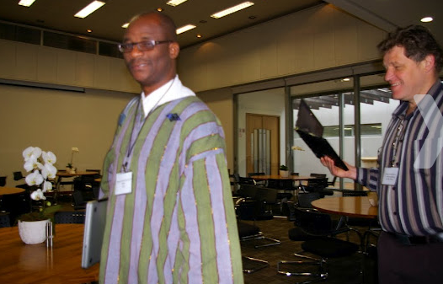
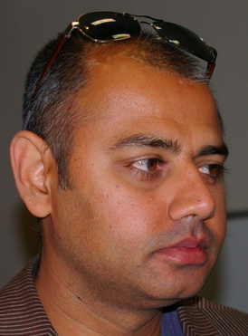
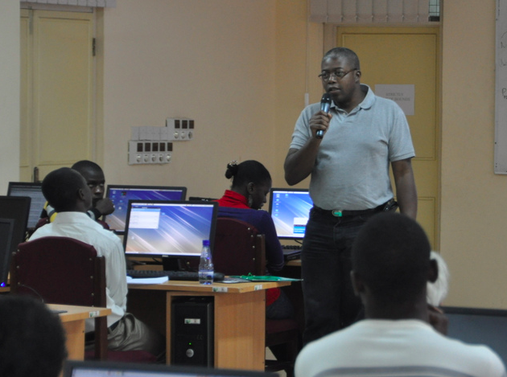
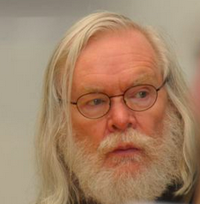
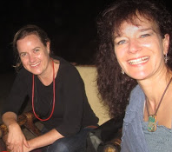
African School of Fundamental Physics and Applications (ASP) - as a start-up
Already 5 editions completed since 2010 !
ASP2020 to be conducted in Marrakesh
A non-profit organization created by a small group of worldwide scientists to stimulate and include more African talented physics students in the world scientific community
The aim of the school is to build capacity in African countries, to harvest, interpret, and exploit the results from physics experiments with particle accelerators, and to increase proficiency in related applications and technologies.
To contribute to a world w/ equal access to knowledge
To support financially up to 85 African students for 3-week classes attendance
To establish a biennial educative program to be hosted across Africa
To provide high quality classes by international re-known Scientists
APS2020 Fundamental physics and accelerator science in developing countries / C. Darve
03/04/20
5
Notes:
Based on the experience of few European and American scientists, we have created a network, an organization, to stimulate and include more African talented physics students in the world scientific community.
Our mission is to help increase the number of African students acquiring higher education.
We have felt that American and European big science programs, have a lot to share in order to improve the world condition, hence science transcending boundaries…
“Everything “ pass by knowledge, and education is the pillar of well-being, and a peaceful world. Our goal was also to contribute to limiting the brain drain, by increasing capacity within African universities and promote spin-off for large scale activities IN Africa (see SKA, Af LS)
---
This is achieved through an outreach effort, an increased awareness of the potential of high quality training offered by large scale experiments in context in various scientic disciplines, and a system of networking on the international scale.
There is a strong alignment between the mission and the vision of African governments and policy makers on education and capacity building and their programs with the goals of the ASP.

Slide 6
ASP2018 Students Profile
523 Applications
Total selected: 85 (+30 waiting list)
Selections constrained by budget and logistics
APS2020 Fundamental physics and accelerator science in developing countries / C. Darve
03/04/20
6

Slide 7

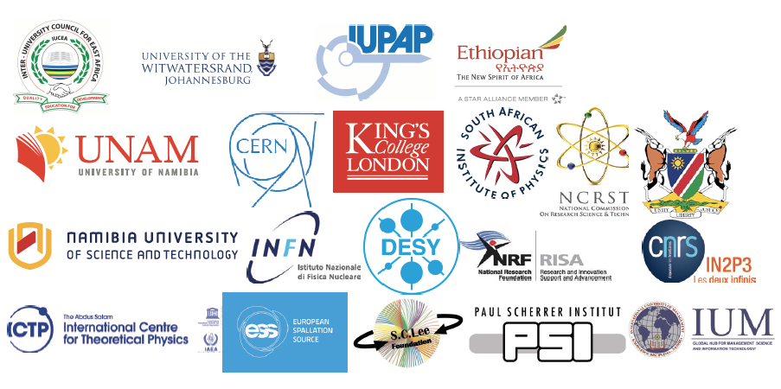

Sponsorship & financial support
ASP2018 Sponsors in addition to USA DOE Labs (BNL)
African Contributors:
- Namibia
- SA DST/NRF
- IUCEA
Integrated: ~50% of ASP2018 budget
ICTP Support major
Student participation
Management of application database
Arrange student travels
Fund Management
Funds centralized and managed by the South African Institute of Physics (SAIP)
Host Country Support Significant
In-kind support
Direct Financial contributions
Human Resources toward ASP Organization
Writes Proposals, Requests for Supports
Produces Final Reports of Activities
Seeking permanent financial backing
IOC
Lecturers and Organizers Supported by External Sources - Significant
Support received then used to maximize student participation
APS2020 Fundamental physics and accelerator science in developing countries / C. Darve
03/04/20
7
Notes:
Nothing can be done without financial support..
The approximate budget is 160 kE per edition, shared between 15-20 different institutes, embassies and foundation across the world. More In-Kind contribution is provided.
NB: During the ASP 2020: we will benefit from the support and the presence of several Laboratory directors, incl. Michel Spiro (CNRS), Philippe Chomaz (CEA), Faical Azaiez (I-ThembaLABS), Catarina Biscari (ALBA), Eugenio Coccia (Gran Sasso), Fernando Ferroni (INFN) and certainly Lenny Rivkin (PSI) before ASP2020.
The supporting institutes since the first edition are ICTP and CERN, BNL, Fermilab, J-Lab, IUPAP, PSI then joined INFN, DESY, EPS, the Shui-Chin Lee foundation for basic science, APS , Theorem Holdings Corporation, Metatron Global SA;
African contribution represents about 50 % of the income, with a continuous support from SA NRF and DST
Beyond its financial support, ICTP support the logistics necessary for events preparation (CERN too).
Host country shall guarantee significant In-Kind support e.g. accommodation, catering.
Lecturers are paying for their fee.
The example of the ASP2018 sponsors are shown. Sponsors will vary largely between editions.

Slide 8
ASP topics of interest
Theoretical Physics
Experimental Physics
Accelerators, Applications, HPC
Nuclear and Particle Physics
Beyond the Standard Model
Astro‐particle physics and Cosmology
Theoretical Heavy‐ion physics
Linux tutorials
Particle Detectors
Particle Identification and Data Analysis and statistics
Exp. Particle physics, current status of the field
Exp. Nuclear Physics
Exp. Heavy Ion Physics
Exp. Astro‐particle Physics
Accelerator physics and Technology
Physics of Particle Beams
Instrumentation
Medical Applications
Neutron and Light Sources
Energetics and solid state
GRID and High Performance Computing
Digital Library
Fundamental physics and accelerator science in developing countries / C. Darve
03/04/20
8
Example of ASP timetable:
ASP2018: https://indico.cern.ch/event/656460/timetable/?view=standard
Notes:
Which topics are we covering ?
Beyond our core topics of interested, based on our own background (th. Exp. App), we have continuously adapted the program, to reflect the African students level and preferences. E.g we have added more computing hands-on Linux Boot Camp).
- Th: describe the standard Model and quantum field theory.
- Exp: deals with detectors , data analysis and statistical treatment to give participants an introduction to how raw data is transformed into final measurements
- Appl: . The scientific disciplines are thr basics of particle accelerator technology, applied physics , medical physics and material science.
- The two-day sessions are dedicated to GRID computing session supported by the DOSAR Distributed Organization for Scientic and Academic Research (DOSAR) and the Open Science Grid (OS-Grid).
Medical applications , nuclear physics and astrophysics are systematically topics of interest in Africa.
We systematically include local lecturers to cover their topics.
Depending on the host country, different categories can be enhanced.
Timetable of African School of Fundamental Physics and Applications:
ASP2010: https://indico.cern.ch/event/78565/timetable/?view=standard
ASP2012: https://indico.cern.ch/event/145296/timetable/?view=standard
ASP2014: https://indico.cern.ch/event/276481/timetable/?view=standard
ASP2016: https://indico.cern.ch/event/528094/timetable/?view=standard
ASP2018: https://indico.cern.ch/event/656460/timetable/?view=standard

Slide 9
ASP Program Expansion
High School Teachers Program
1-week intensive workshop
Train High School Teachers for improved physics teaching
Student Program
3-week intensive school
3rd year of University to Ph.D.
Mostly African Students
70-80 Students; total > 320
ASP Conference
1-week International Conference
Participation of ASP Alumni
Part. Research Faculties
Networking & collaborations
Learners Program
1-week learners Outreach
10-12th grade learners
Encourage learners to develop and maintain interests in Physics and Applications
Forum and Outreach
2 events
Involve Regional policy makers
Promote spin-off activities in Africa
Introduce students to policy
Mentorship/ Coaching Program
Work with Academic Advisors
Connect Students w/ Researchers
Place students at Labs
Support students & help address their academic needs
Fundamental physics and accelerator science in developing countries / C. Darve
03/04/20
9
Notes:
Adaptivity
Since 2010, the core of the program, includes the academic lectures and exercises for the students and the Forum and outreach activities to involve the regional policy makers.
To improve the events, we have added more discussion sessions with the students (in French and English) so that they can digest the lecture content.
Since 2016, we have expanded our program by preparing in parallel to the students courses, a workshop for high-school teachers.
In order to further foster the interest of physics in the African world, we have added visits and teaching to local high-schools.
The introduction of a Conference to include more scientists, and encourage networking among alumni students and professionals.
Finally, the expansion includes, as well, a well-defined process for coaching Alumnin students.

Slide 10
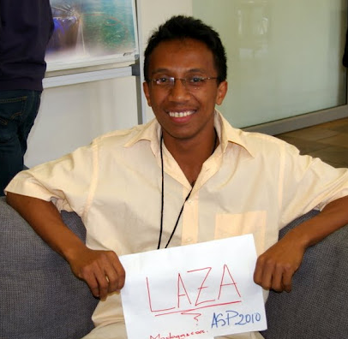
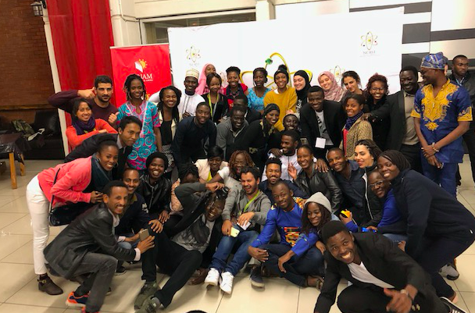
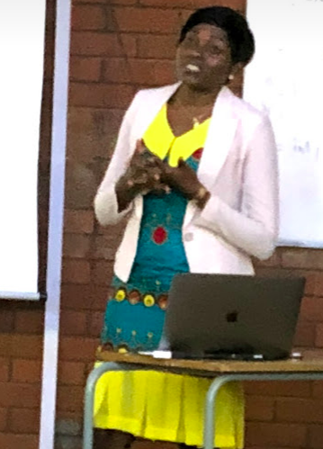
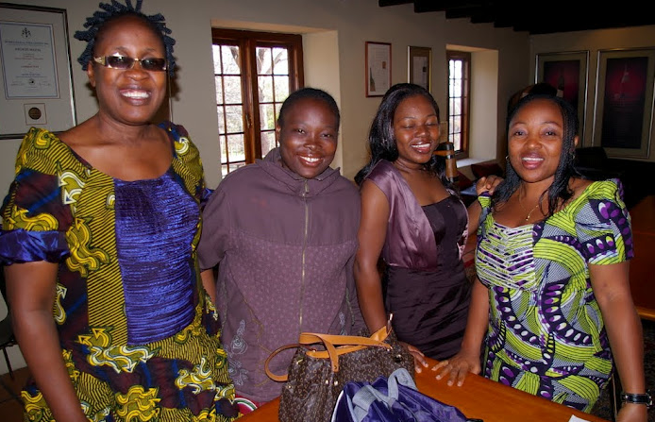
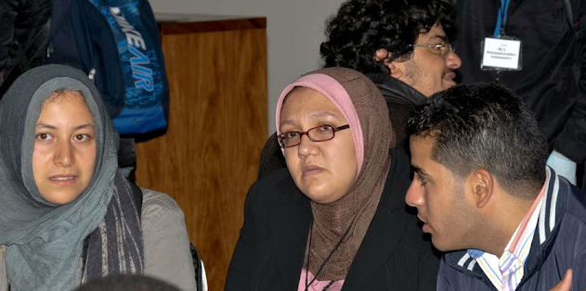
ASP STUDENTS
Provide partial or full financial support to students and create a scientific melting pot of cultural diversity
Diversity of academic levels
  Mainly Master and PhD students
Diversity of education background
  From theoretical physics to engineering sciences
Diversity of the countries of origin
  Priority to Sub-Saharan African students
Women/girls participation (~32%)
  Role of women/girls in LDC.
Local Universities
  Involve students and professors
APS2020 Fundamental physics and accelerator science in developing countries / C. Darve
03/04/20
10
Notes:
More than 320 students from most African countries, with presence of European , American and Asian students to create the perfect melting pot of culture, knowledge and diversities, fusing into a perfect scientific integrity

Slide 11
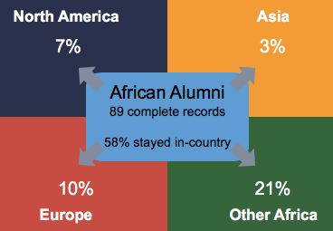
Current studies and employment
“What do you do now? (you can make multiple selections) “
Studies and employment | # of alumni
Full time undergraduate student | 2
Part time undergraduate student | 0
Full time masters student | 19
Part time master student | 1
Full time doctorate student | 39
Part time doctorate student | 4
Studying at a non-degree granting institution | 1
Full time postdoctoral researcher | 3
Part time postdoctoral researcher | 2
Full time professional work | 11
Part time professional work | 3
Full time work | 3
Part time work | 10
Internship | 5
Unemployed | 4
Looking for higher education opportunities | 26
Part time
Full time
Courtesy Julia Gray
APS2020 Fundamental physics and accelerator science in developing countries / C. Darve
03/04/20
11
Notes:
1/5 of the students need to combine more than one activity (e.g. working and progressing with their study).

Slide 12
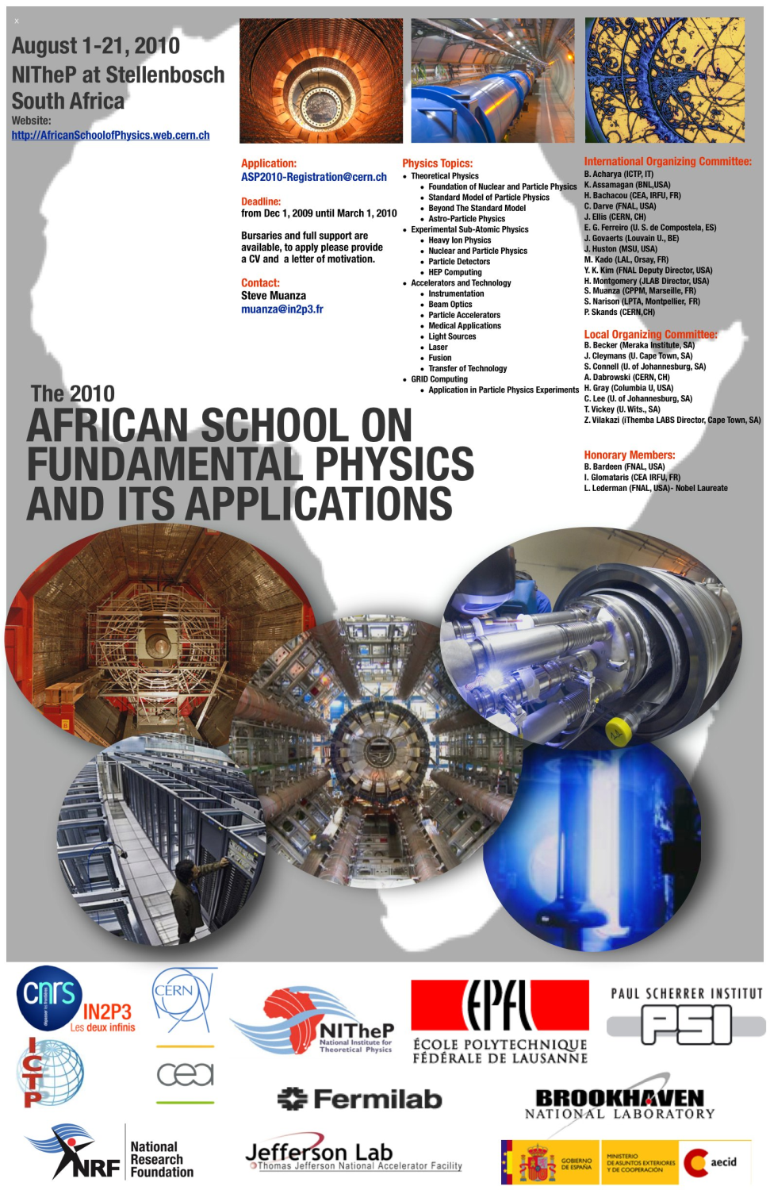
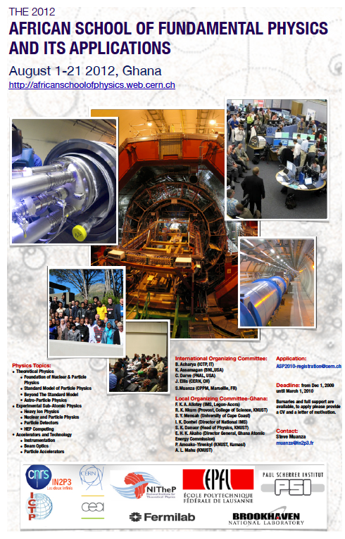
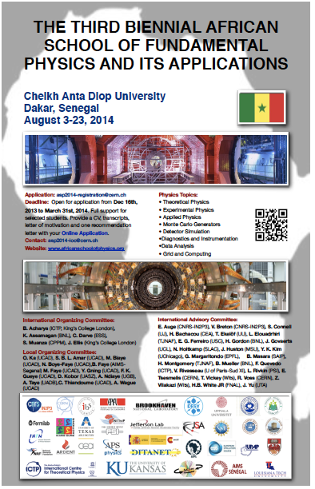
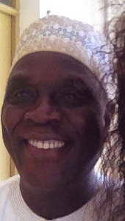
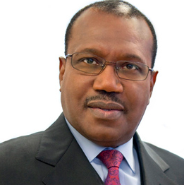
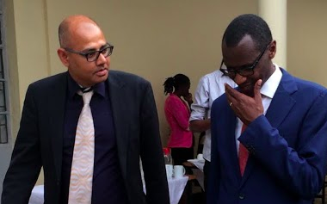
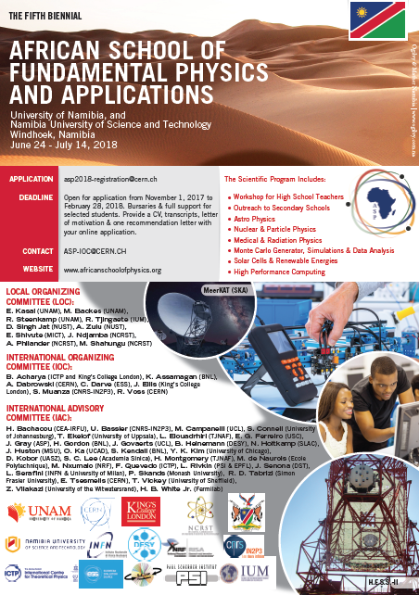
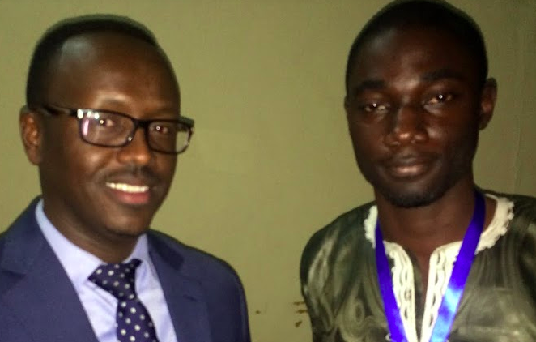
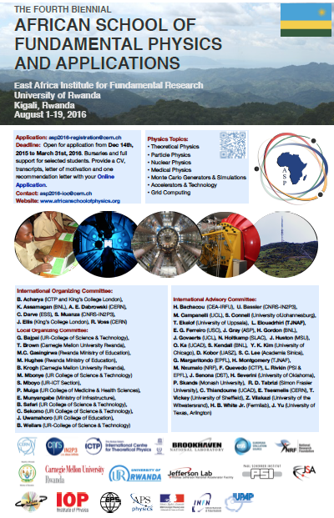
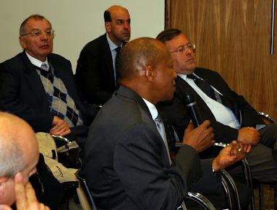
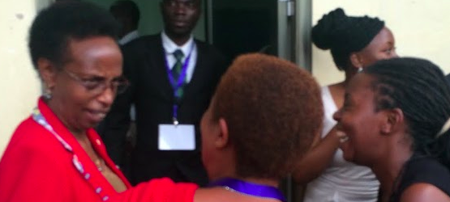
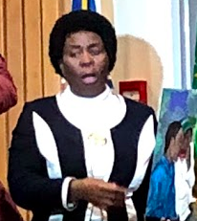
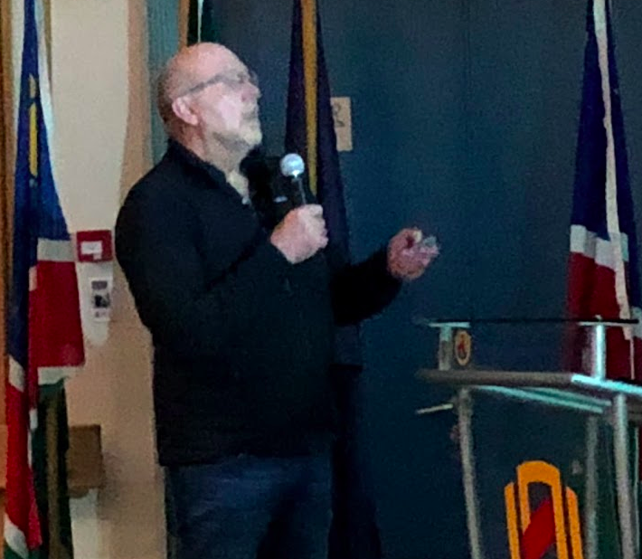
UN support
Dr. H. TOURE, UN ITU Secretary General.
Prof. A. WAGUE and O. KA
M. NGOM - US Embassy rep.
ASP2014
Dakar, Senegal
ASP FORUM AND OUTREACH DAY
ASP2010
Stellenboth, South Africa
AfLS and compact acc.
Prof. H. WINICK, Prof. Emeritus, SLAC and Prof. L. SERAFINI (INFN, IT)
ASP2012
Kumasi, Ghana
→ Launched the African Light Source steering committee
Dedicated to Knowledge and Transfer of Technology
Dr. D. ADAMS, chief director: Emerging Research areas & Infrastructure, Human Capital and Knowledge Systems.
East Afr. Science and New ICTP Center
Rwandan Ministry
of Education
Dr T. TJIVIKUA, Vice-Chancellor, Namibia University of Science and Technology (Namibia)
Dr. R. ADAM (SKA, SA)
ASP2018, Windhoek, Namibia,
ASP2016
Kigali, Rwanda
APS2020 Fundamental physics and accelerator science in developing countries / C. Darve
03/04/20
12
Notes:
Sharing ideas oriented towards building international collaborations and developing innovative technology in partnership with universities, national laboratories, the government and industry.
In 2010, immovation and technology transfer.
In 2012: compact accelerator, and Af LS as a conceptual idea
In 2014: Dr TOURE as a role model for science. His activity as head of the ITU, promoted widely ICT in Affrica. ”Many observers say he helped change the face of ICTs in the Third World.” He joined for one day forum, despide the breaking news of the Ebola crisis emerging in Senegal !!
In 2016: Political situations and visit of Rwandan ministry of education. The role of women has been emphasized.
In ASP2018, The forum day consisted of lively discussions and debate about education and capacity building in Namibia and Africa in general.
----------
Several high-profile South African scientists and government officials participated in the last day of the school. This outreach and forum day reviewed the practical aspects of fundamental physics, which could be used as a gateway to innovation and to enhance future collaborations.
The Forum Day, however, has a much wider appeal. It takes advantage of opportunity provided by the key visiting experts who would like to connect with experts in Government, Industry and Research. It is planned and delivered by a selection of the world’s top educators and practitioners of High Energy Physics, Research and also Applications.

Slide 13
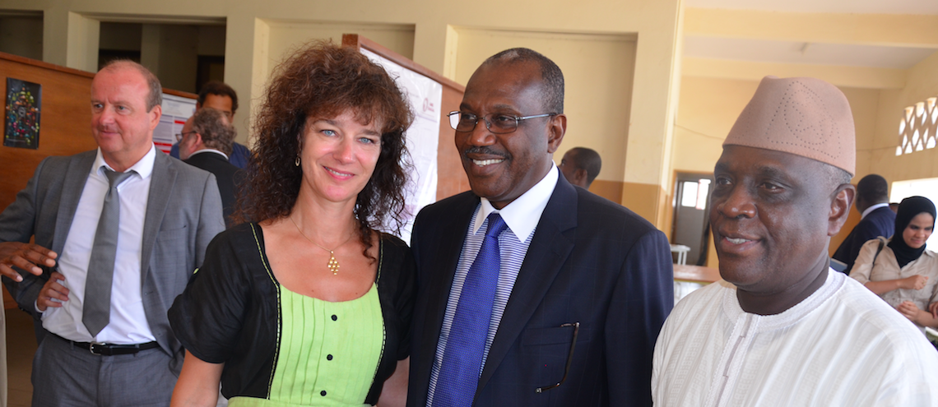
ASP2014 - FORUM DAY WITH Focus on ITU / ICT SPEECH
” In Africa, in the 21st century, it is not enough to have opportunities; you need to have digital opportunities. It is not enough just to be smart; you need to be digitally smart.
The most obvious example of this is the employment market, where digital literacy is now an essential prerequisite in all countries for getting a job or starting a business.
Prof. A. WAGUE and Dr. H. TOURE, former ITU Secretary General and Smart Africa CEO
- ”As you are all aware, the ICT sector in Africa has experienced quite extraordinary growth in recent years, especially in terms of mobile cellular communications – with penetration rates in sub-Saharan Africa almost doubling in the past five years, to reach 69.3% by the end of 2014. Here in Senegal, there are almost as many mobile cellular subscriptions as there are inhabitants.”
- ”When we talk about youth being critical to Africa’s success, that of course includes girls, and equal access to ICTs will be an essential part of the solution.”
- ” Fortunately, there have never been more or better opportunities for acquiring the necessary digital skills – whether formally, at school, or informally, online – and it is tremendously encouraging to see the proliferation of MOOCs, Massive Open Online Courses, as well as open courseware and mobile learning, hackathons, and mobile app competitions.”
https://indico.cern.ch/event/276481/contributions/1620267/attachments/502040/693352/AT_Speech_ASP_Physics_v8.pdf

Slide 14

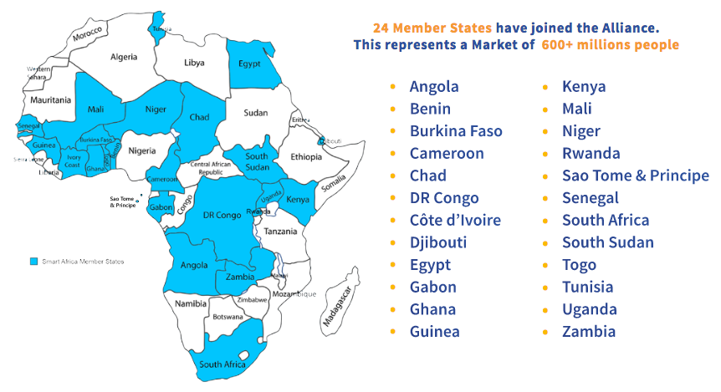
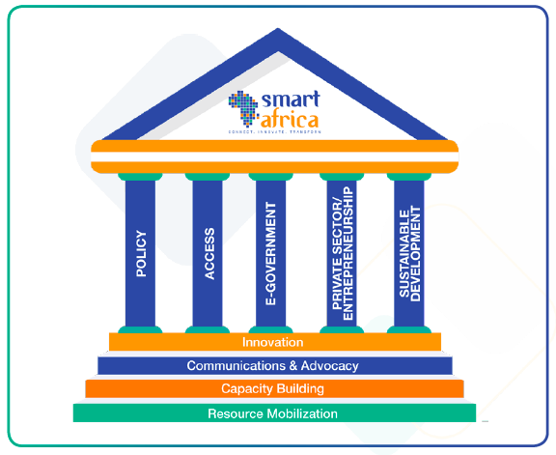
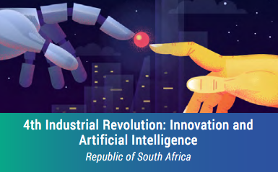
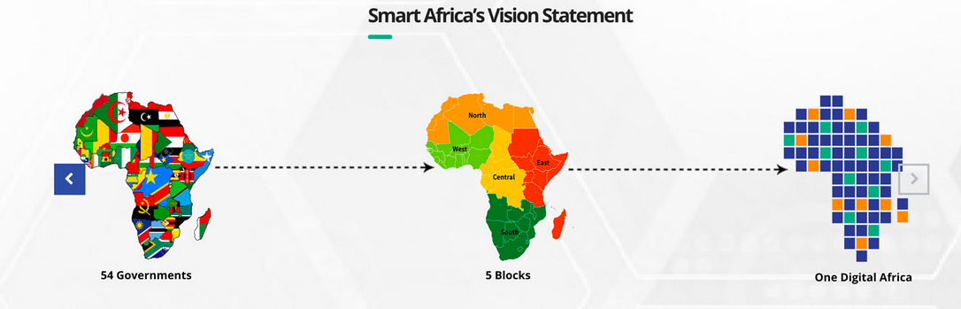
SMART AFRICA
www.smartafrica.org
APS2020 Fundamental physics and accelerator science in developing countries / C. Darve
03/04/20
14

Slide 15
Outline
Scientific and technological paradigms
Platforms to accelerate developing countries transformation
  African School of Fundamental Physics and Applications
  Nordic Particle Accelerator Project
Particle Accelerators as tools for transformation
APS2020 Fundamental physics and accelerator science in developing countries / C. Darve
03/04/20
15

Slide 16
  MOOC AND NORDIC PARTICLE ACCELERATOR PROJECT
www.npap.eu
Develop capacity in Northern Europe with emphasize on MAXIV and ESS
➔ Intrinsically use it as tools for distant teaching, hence support developing countries !
Existing educative platforms and programs:
Particle Accelerator schools: JUAS, CAS, HASCO, USPAS, ACAS, ASP, etc
University Unit (e.g. Aarhus, LU)
EU-TIARA and other market surveys
EU-ARIES: Accelerator Research & Innovation for European Science and Society
Why do we need new Pedagogical tools for Accelerator science?
School levels are typically advanced
Domains/Field complementarity
To provide sustainable and “users-friendly” tools
APS2020 Fundamental physics and accelerator science in developing countries / C. Darve
03/04/20
16
Notes:
Students with basic knowledge in physics
Worldwide Universities
Employees at accelerators
Companies
Users
In-Kind ESS collaborations
Hospitals

Slide 17


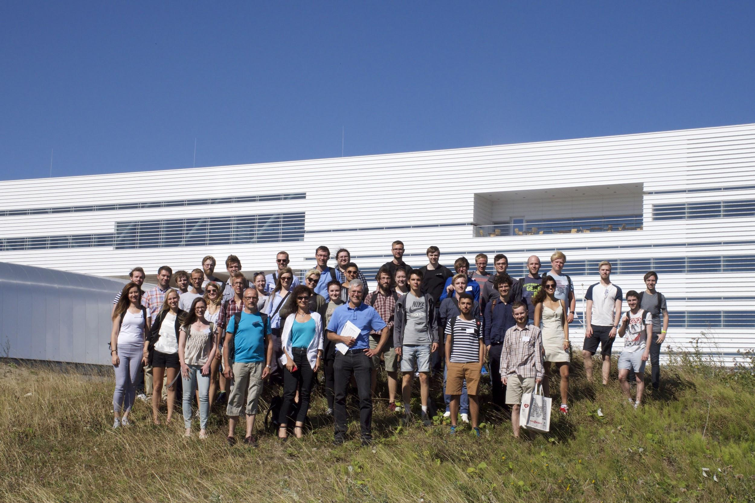

NPAP - Team building
A first summer school operated in 2015 has served as a proof of concept to identify the team and the topics to be developed in our MOOC
Grant for the Nordic Particle Accelerator Program
Main deliverables: 2 summer schools and 3 MOOCs
Strategic partnership and building cross-sectoral bridges
Support innovative practices from international to regional to organisational and individual levels
APS2020 Fundamental physics and accelerator science in developing countries / C. Darve
03/04/20
17
Notes:
Based on the observations listed earlier, we built a team to create the NPAS2015:
The objective is to teach the basics of accelerator physics and technology, and to demonstrate for the students that this is an interesting and broad subject, carried out in an international environment. The initiative shall encourage students to pursue a career in accelerator physics and technology.
Limited cost by institutional support.
--
Strategic partnership and building cross sectoral bridges: Ultimately, we believe that inviting more people to creatively take part in the knowledge of the area, will enhance engagement and at length expand the field with more creative and innovative minds. But not only that! By bringing more people in from other fields, we have seen that cross sectoral work increases and bridges are being built! As a result, we see innovation opening up and the impact as well as use of accelerator technology increase, benefiting society in a whole other way which would otherwise be impossible if knowledge is left isolated.
The interconnectivity between different fields and sectors, both nationally and transnationally is an important step for us. In fact, our three year transnational project is specifically an Erasmus + programme for strategic partnership and networking (KA2) (have a pic of the funding from EU in PP) This type of programme aims to support the development, transfer and implementation of innovative practices at everything from international, European, national and regional to organisational and individual levels.
Three Summer Schools
90 students
Education in accelerator technology
Visit of MAXIV and ESS

Slide 18
MOOC1: Particle Accelerators introduction
→ Launched in August ’19
More than 505 learners enrolled
MOOC2: Fundamentals of accelerator technology
→ Launched in March ’19
More than 716 learners enrolled
MOOC3: Medical App.
of Particle Accelerators
Launched in Nov. ’18
More than 1044 learners enrolled (on 28 Feb 2020)
Accelerators for Synchrotron Light Light and Light Sources Accelerator to make light The development of accelerators for synchrotron light Photon light sources and MAXIV Synchrotron radiation Bending magnets, wigglers and undulators Free Electron Lasers Spallation source and ESS Introduction and neutron science European Spallation Source Particles Colliders Introduction to Particles Colliders The LHC and its experiments Linear Colliders Future Circular Colliders Plasma Wakefield (to be completed) | RF-System Introduction to RF-systems RF cavities Waveguides RF Amplifiers More about cavities Magnets technology for accelerators Magnets part1/2/3 Beam Diagnostics An overview Beam intensity and position Transverse Beam Profile Longitudinal Beam Profile Beam Loss Monitoring Basics of Vacuum techniques An overview and motivation Residual gases and vacuum regions Vacuum equipment Other vacuum components | Introduction to the course and radiotherapy Introduction Biological rational for radiotherapy Intro. to the electron linac for radiation therapy Electron Linacs for radiation therapy The multi-energy electron Linac structure Dose delivery to the patient Proton therapy 1 Rationale of proton therapy Accelerators for proton therapy Treatment delivery of proton therapy Proton therapy II and production of medical radionuclides Heavy ion therapy Challenges in pr. th. and heavy ion th. Introduction to medical radionuclides Production of medical radionuclides
APS2020 Fundamental physics and accelerator science in developing countries / C. Darve
03/04/20
18

Slide 19
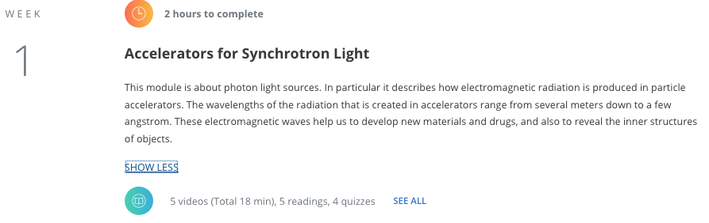
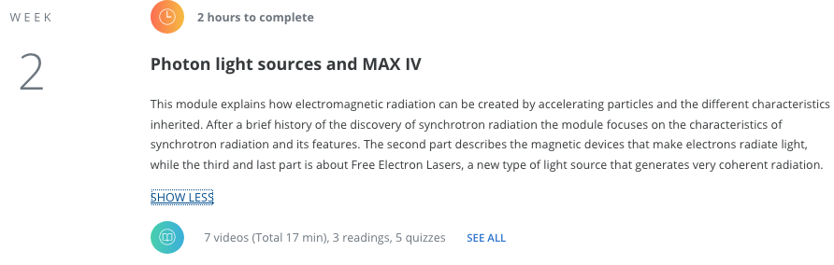
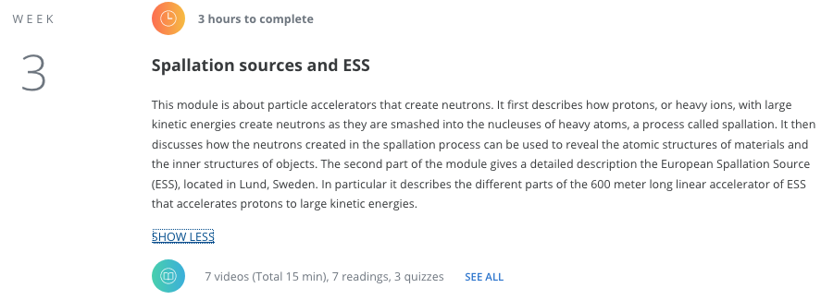
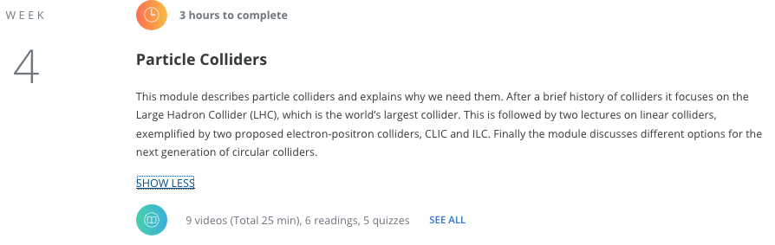
MOOC1: Introduction to Particle accelerator
APS2020 Fundamental physics and accelerator science in developing countries / C. Darve
03/04/20
19

Slide 20
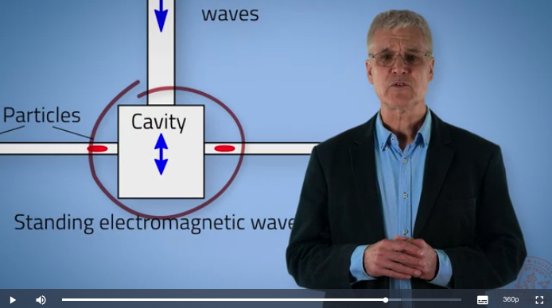
MOOC2: Fundamentals of accelerator technology
Example of Lecture
https://www.coursera.org/learn/fundamentals-particle-accelerator-technology
https://www.coursera.org/lecture/fundamentals-particle-accelerator-technology/general-introduction-wf3CB
https://drive.google.com/open?id=160EDKsTJiZruNpGNoDuu0hvxLYf0fafW
APS2020 Fundamental physics and accelerator science in developing countries / C. Darve
03/04/20
20

Slide 21
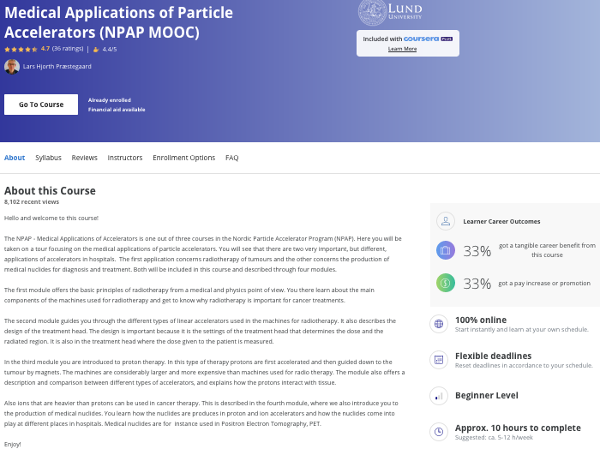
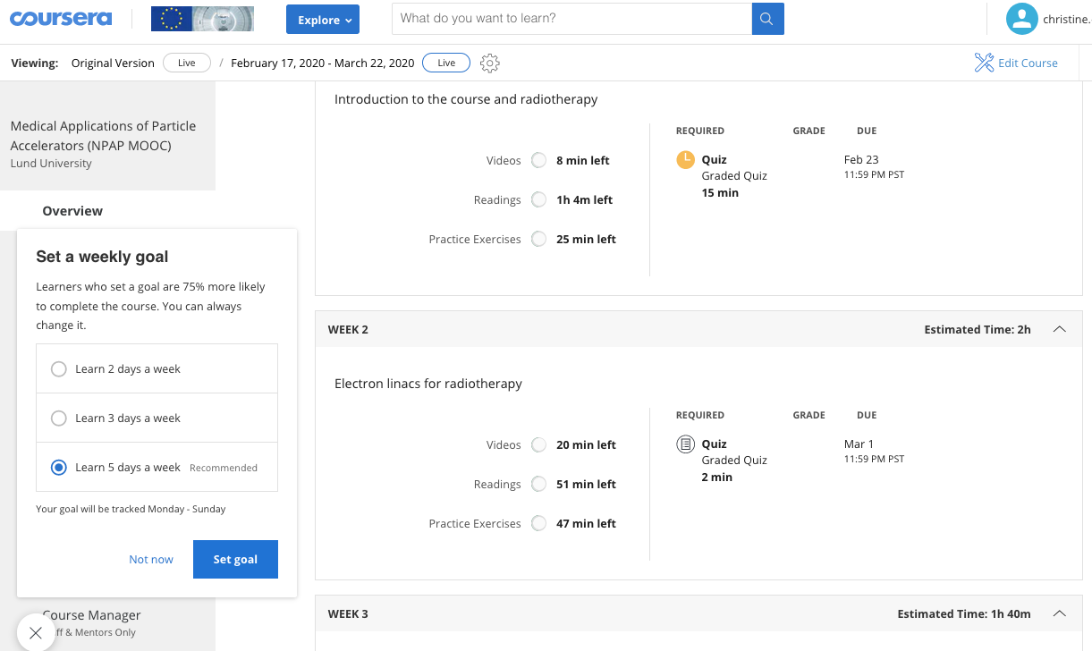
APS2020 Fundamental physics and accelerator science in developing countries / C. Darve
3/30/20
21

Slide 22
Outline
Scientific and technological paradigms
Platforms to accelerate developing countries transformation
  African School of Fundamental Physics and Applications
  Nordic Particle Accelerator Project
Particle Accelerators as tools for transformation
APS2020 Fundamental physics and accelerator science in developing countries / C. Darve
03/04/20
22

Slide 23
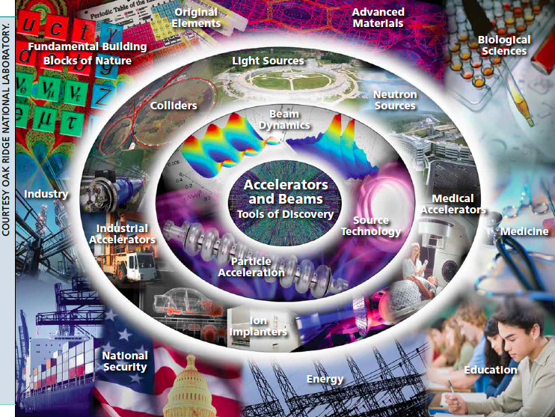
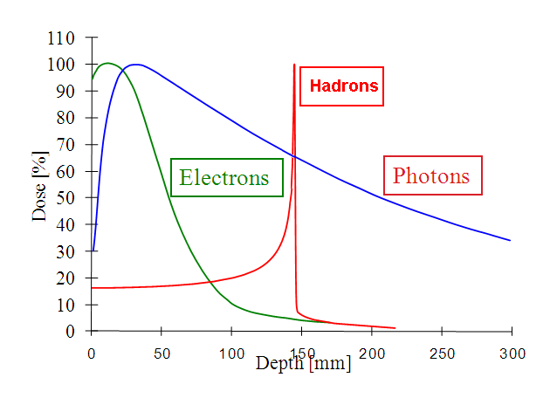
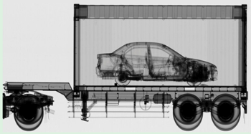
X-ray scanning
APS2020 Fundamental physics and accelerator science in developing countries / C. Darve
03/04/20
23

Slide 24
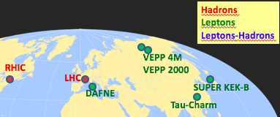
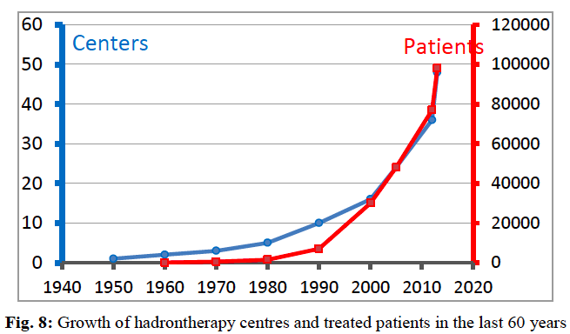
Nuclear research
Medical Isotopes
Non nuclear research
~ 60 Photon sources
Radiotherapy
Industry
+3 Proton LINAC for Neutron Sources
Colliders
”Medical Applications” by C. Biscari and L. Falbo CERN–2014–009
Hadrontherapy
Ion implantation
Accelerators in the world:
over 35000 (15000 in 2000)
APS2020 Fundamental physics and accelerator science in developing countries / C. Darve
03/04/20
24

Slide 25
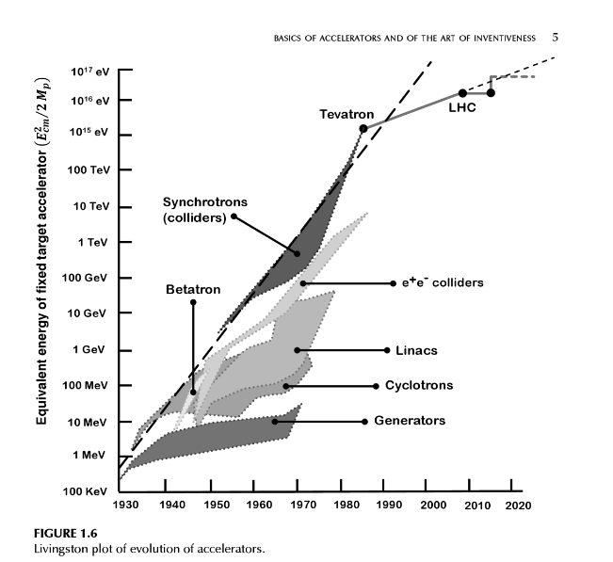
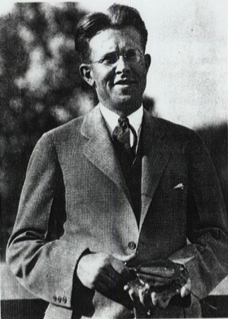
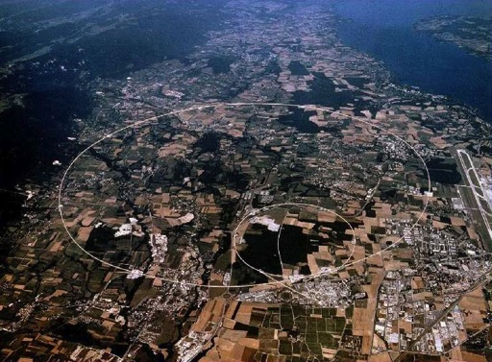
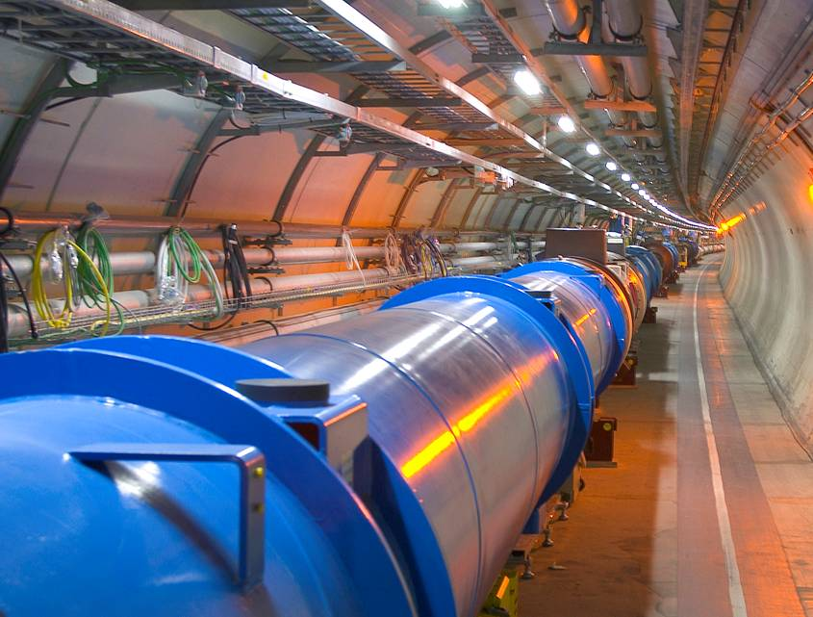
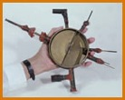
Type of Particle Accelerators
Each generation built on the accomplishments of the previous ones raising the level of technology ever higher
→ 1980 -Tevatron @ Fermilab
980 GeV
Ernest Lawrence
(1901 - 1958)
→2008 - LHC @ CERN
7-14 TeV
80 keV
Livingston’s diagram
03/04/20
25
Notes:
Nearly nine decades of continued growth in the energy reach of accelerators
Driven by continuous innovation in acceleration techniques
Many new acceleration techniques developed to keep pushing the energy frontier

Slide 26
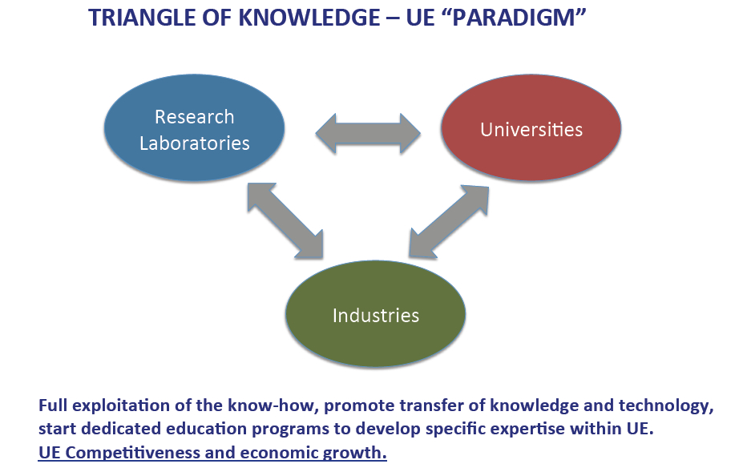


RICH DEVELOPED COUNTRIES /
INTERNATIONAL ORGANIZATIONS
Courtesy Luca Serafini
Big Accelerators
High Energy Frontier
All 3 Pillars are needed to design, build, commission a Big Accelerator
APS2020 Fundamental physics and accelerator science in developing countries / C. Darve
03/04/20
26

Slide 27
COUNTRIES UNDER-DEVELOPMENT
triangle of Knowledge and circle of Opportunity
Compact Accelerators
Based on Cutting Edge Technologies Driving Advanced Applications
Courtesy
Luca Serafini
APS2020 Fundamental physics and accelerator science in developing countries / C. Darve
03/04/20
27

Slide 28


Example of scientific infrastructure
All 3 Pillars are interested in designing, building and commissioning a Compact Advanced Accelerator based Systems.
Industry is not capable at the beginning, but will profit from Applications and, eventually, mass production (e.g. cmp. 200 MeV Proton Linacs, Radio-therapy electron linacs, etc)
University wants to contribute in education/training and show a significant social impact of its basic research activity
Research laboratories have the capability to transfer and integrate the expertise in accelerator science and technology generated by the High Energy Frontier challenge
STAR Schematic Layout
~1 m
11.4 GHz
RFdefl.
Beam dump
GUN
IV
1
2

Slide 29


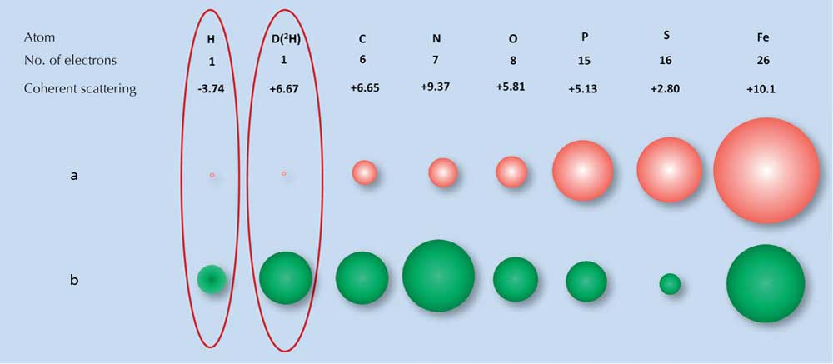


Light Source and Neutron source
X-Rays
Courtesy Lenny Rivkin
Neutrons
H atoms make up ~50% of atoms of biological macromolecules
(lipids, proteins, nucleic acids, carbohydrates).
APS2020 Fundamental physics and accelerator science in developing countries / C. Darve
03/04/20
29
30.03.20
Seite 29

Slide 30

Light Sources distribution
PETRA III
MAXIV
DELTA
ELSA
SSRC
ASTRIDII
SOLARIS
BESSYII
ANKA
DELSY
Courtesy Caterina Biscari
CLS
DIAMOND
SLS
KSRS
SPRING8
CHESS
SOLEIL
BSRF
NSSR
PFKEK
CANDLE
PLS
UVSOR
ALS
APS
NSLS II
ALBA
ILSF
NSRL
TSRF
SSRF
SUBARU
CAMD
SURF
DAFNE
INDUS
SRLI
HISOR
RITSSR
SSRL
ESRF
ELETTRA
TPS
SAGA
NSRRC
SESAME
HELIOS2
SIRIUS
LNLS
AS
IN OPERATION
IN CONSTRUCTION
https://laamp.iucr.org/__data/assets/pdf_file/0007/135754/brochure-for-web-cover2.pdf

Slide 31



From:
Courtesy Simon Connell
AfLS Steering Committee
Regions represented ….
55 members
See Summary talk at: https://www.dropbox.com/s/inxre3hnpa229gw/AfLS-AAS-ASI.pptx?dl=0
to:
Outcomes: https://docs.google.com/document/d/1dX2NX_FE07gipEWiS-LTUuhn7YkHdbRdRokhfOO_gHQ/edit
APS2020 Fundamental physics and accelerator science in developing countries / C. Darve
03/04/20
31

Slide 32




First African Light Source Conference November 2015
Courtesy Simon Connell
APS March 2018 meeting

Slide 33


Courtesy Ghaleb Natour
APS2020 Fundamental physics and accelerator science in developing countries / C. Darve
03/04/20
33

Slide 34

Science can transcend boundaries thanks to dedicated programs and by giving exposure to developing countries talents to fundamental physics and particle accelerators
Thanks to our ASP and NPAP sponsors, the dedication of lecturers and the perseverance of students contributing to developing countries transformation !
APS2020 Fundamental physics and accelerator science in developing countries / C. Darve
03/04/20
34

