Slide 1




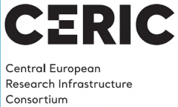
Radiation safety for particle accelerator – synergies between Research Infrastructures and Industry
Christine Darve
European Spallation Source
07 October 2020
cdarve.web.cern.ch

Slide 2
Outline
Context for Radiation Safety
Technological paradigms and particle accelerators
Test Cases
  CERN - Large hadron Collider
  European Spallation Source – Proton Linear Accelerator

Slide 3
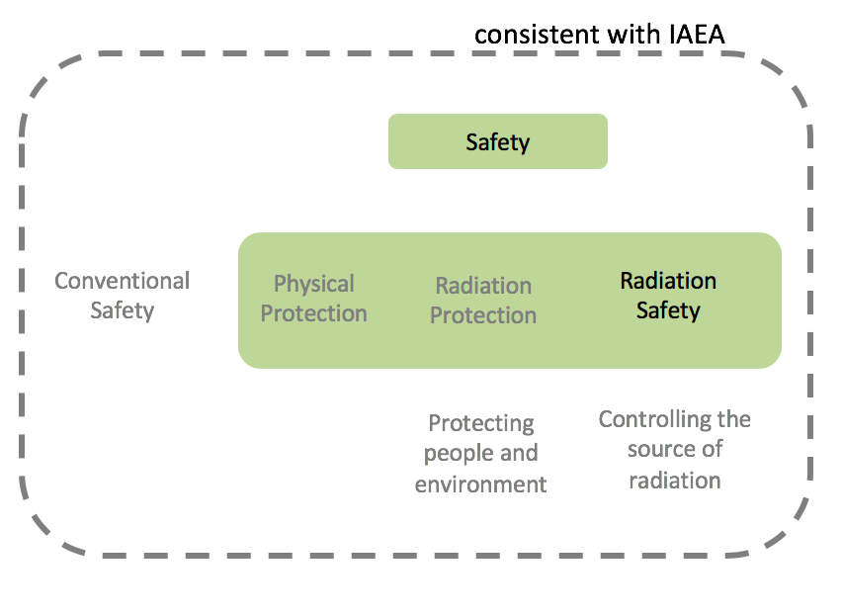
What is Radiation Safety ?
Radiation safety is one of the components of safety and is concerned with maintaining control over radiations sources, whereas radiation protection is concerned with controlling exposure to radiation and its effects.
Radiation safety consists of the implementation of provisions at all stages of the facility lifecycle (design, manufacturing, installation, commissioning, operation including maintenance, decommissioning) in order to prevent accidents and mitigate their consequences.
    Following the international recommendations by the IAEA, ICRP, EURATOM
Notes:
https://confluence.esss.lu.se/display/RADSAFE
Wilhelm C. Röntgen - 1895 Discovery of X rays
J.J. Thompson - 1897 “Discovery” of the electron

Slide 4
Technological Paradigm Evolution
INDUSTRIAL
economy
INFORMATION
economy
MOLECULAR (NBIC)
economy
Organization
(society)
The Adaptive
Enterprise
New media
IT services
Portals
Business
(maturity)
Nanotechnology
Biotechnology
Information technology
Cognitive science
Materials
Economic value added
Chips
Operating systems
WWW
Technology
(growth)
Solid state physics
Information theory
Science
(gestation)
Materials science facilities are keys to the new economy
1750s
1850s
1950s
2050s
Year
It's Alive - The Coming Convergence of Information, Biology, and Business Christopher Meyer 2003
Notes:
WW2; DNA discovery, sputnik launch; transistor invention, IC invention, desktop computer
→ Knowledge based economy
Courbes des developments des paradigmes / exemple / modele / courant technologique
Utilisant l’innovation et les developments scientifiques comme programmes/support/fondations
Releve le defi ! De la competivite europeenne afin de gerer de nouveaux emplois
Revolution technologique – industrielle – boulversement technologique
Information economy: data-driven society – societe dirigee par de large quantite de donnee
Provide foundation in new areas – apporte / fournisse les fondations
Values: Respect
Stakeholders: Intervenants, partie prenante, les acteurs, etre partie prenante
Use platfom to base the technology, dvp, INNOvation
Ex:
Nano bio information and cognitive → material research ..
Take the challenge now – european competiveness -- > new job

Slide 5
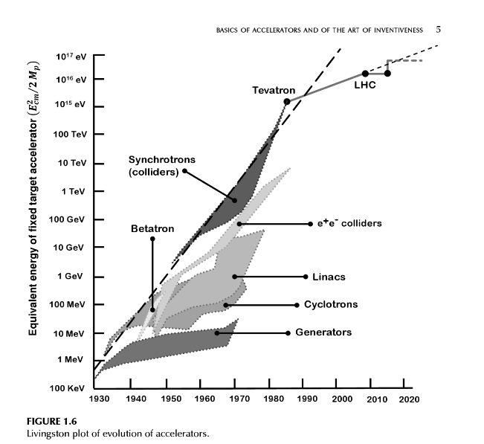
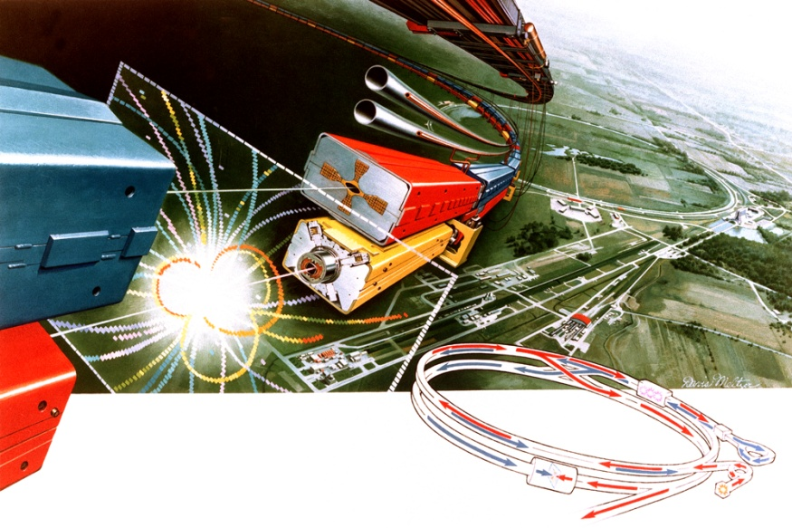
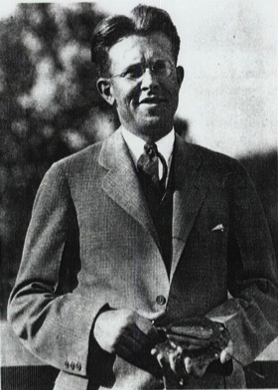
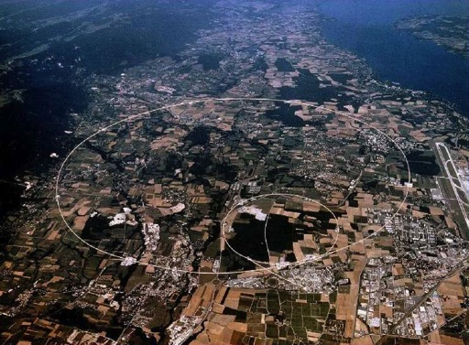
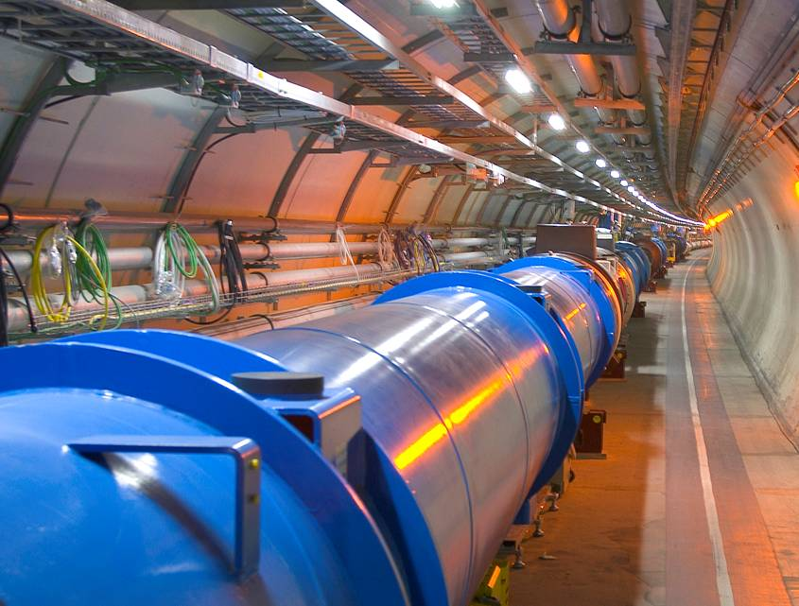
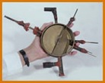
Type of Particle Accelerators
Each generation built on the accomplishments of the previous ones raising the level of technology ever higher
FNAL
→ 1980 -Tevatron @ Fermilab
980 GeV
Ernest Lawrence
(1901 - 1958)
→2008 - LHC @ CERN
7-14 TeV
80 keV
Livingston’s diagram
Notes:
Nearly nine decades of continued growth in the energy reach of accelerators
Driven by continuous innovation in acceleration techniques
Many new acceleration techniques developed to keep pushing the energy frontier

Slide 6
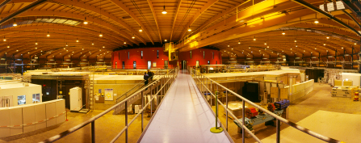
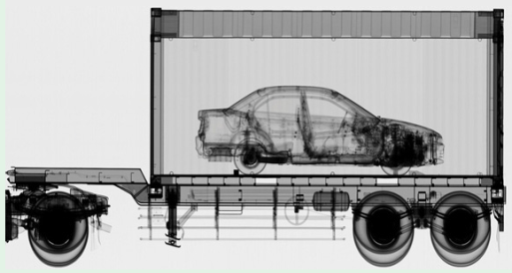
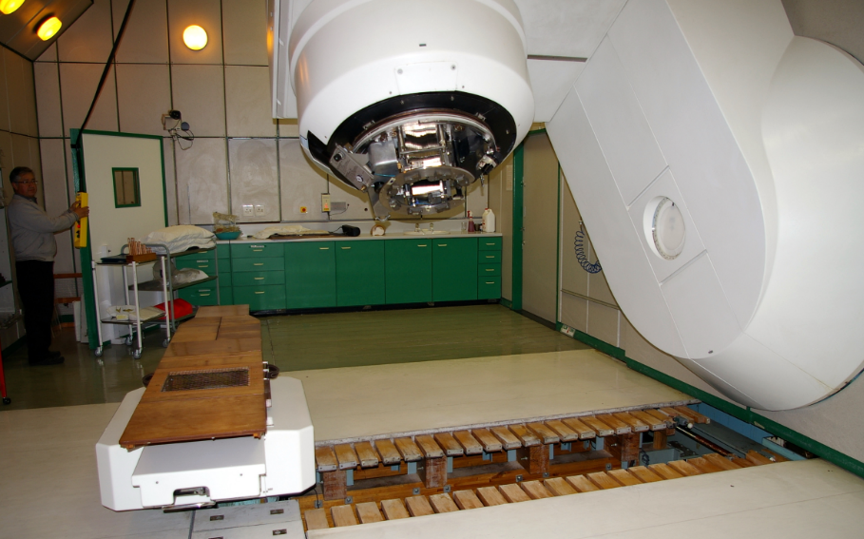
Type of Particle Accelerators
Discovery science: e.g. High Energy Physics
Materials research/manufacturing: e.g. light sources, spallation source, Accelerator Driven Systems (ADS)
National security
Medical Applications: e.g. Photon, Neutron and Proton
Therapies, MRI and NMR
Swiss Light Source
X-ray scanning
iThemba LABS
https://www.aps.org/units/dpb/news/edition4th.cfm
Notes:
Accelerator as tools: want Radiation and Protect from → design materials and process
Research fields – life science, materials , soft and hard matter
Medical applications: Use radiation for its benefice

Slide 7
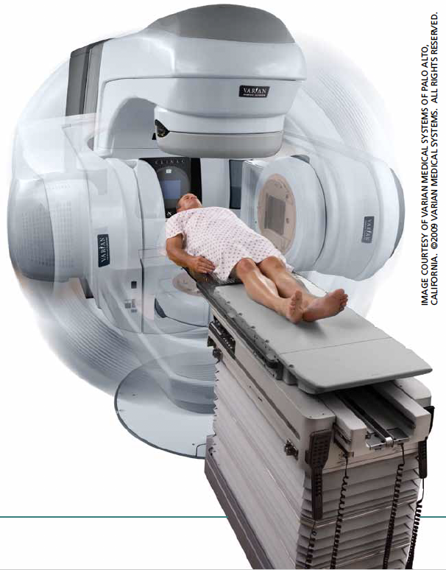
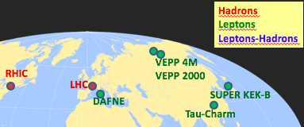
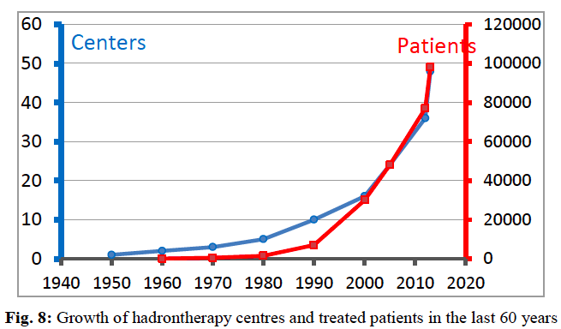
Nuclear research
Medical Isotopes
Non nuclear research
~ 60 Photon sources
Radiotherapy
Industry
+3 Proton LINAC for Neutron Sources
Colliders
An accelerator-based manufacturing technique called ion implantation modifies semiconductors’ electrical properties precisely and cost-effectively, leading to better, cheaper electronics
”Medical Applications” by C.Biscari and L. Falbo CERN–2014–009
Ion implantation
Hadrontherapy
More than 35,000 Accelerators in the world (15,000 in 2000)
03/04/20
7
Notes:
Ions are atoms with positive or negative charge. Implanting them very precisely in metal surfaces means greater toughness. In tools like drill bits, that means a longer working lifetime.
Ion implantation also means less corrosion. Greater toughness and less corrosion mean medical prostheses like artificial hips last longer.
Chip manufacturers create integrated circuits by intentionally introducing impurities–boron or phosphorus ions–into silicon wafers. Using an accelerator they create a beam of high-energy boron or phosphorus ions, and them move the silicon wafers into the beam for implantation of the ions into the wafers.
Expand on the Ion Implantation --- .. An accelerator-based manufacturing technique called ion implantation modifies semiconductors’ electrical properties precisely and cost-effectively, leading to better, cheaper electronics

Slide 8
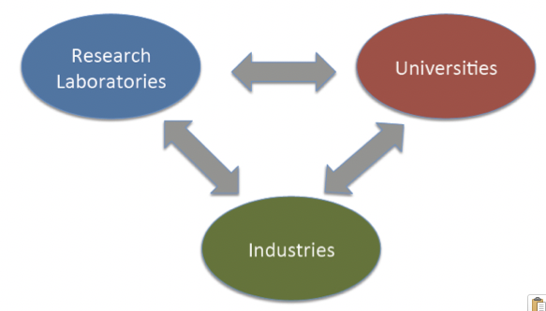
Triangle of knowledge – The Ecosystem
Particle Accelerators
All 3 Pillars are needed to design, build, commission a particle accelerator
Notes:
RI as infrastructure for test: CERN, FNAL, ESS, LS,
Industry to provide equipment/component to RI; gain know-ho university, follow project w/ RI via uni.
University: users of RI

Slide 9
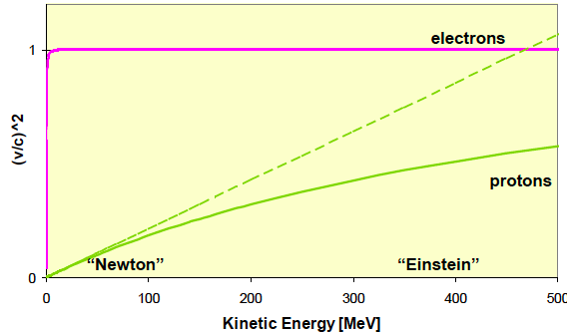
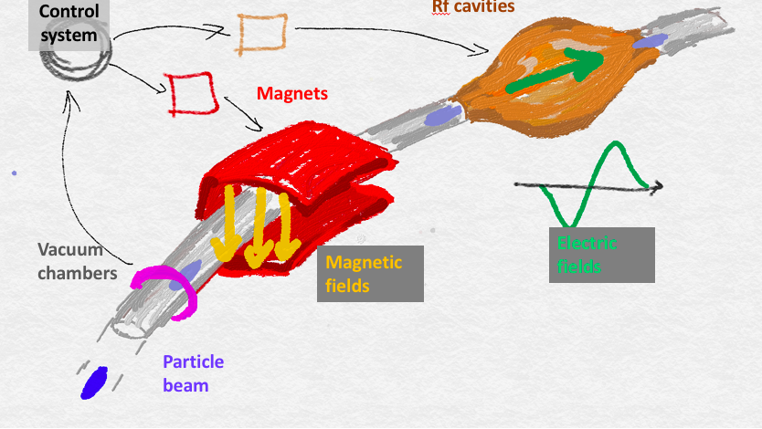
Particle Accelerator - Main Ingrédients
    1- Ion Source to produce the charged particles to be accelerated (H⁺ or H⁻); electron gun
    2- Accelerating structures to accelerate charged particles → SUPRACONDUCTOR
    3- Magnets are used to bend and focus the particle trajectories → SUPRACONDUCTOR
    4- Vacuum chamber to minimize scattering of the beam particles by gas particles
Courtesy Caterina Biscari
ASP2018
    5- Cooling systems to remove the heat dissipated in accelerator components; use of superfluidity for superconducting magnets and cavities
    6- Beam diagnostics to provide information about the beam intensity (current), position, beam profile and beam loss
    7- Control system to record and control each equipment
Notes:
ESS, boron nitride disk; beryllium foil
Cooling, He or water

Slide 10
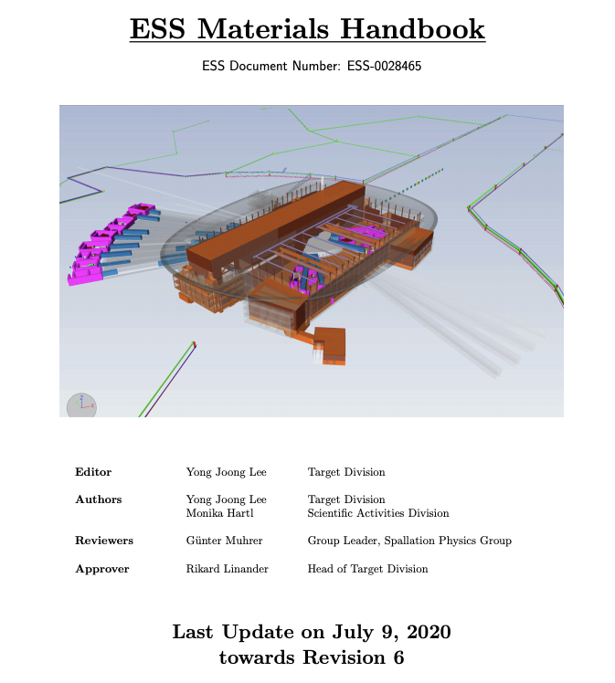
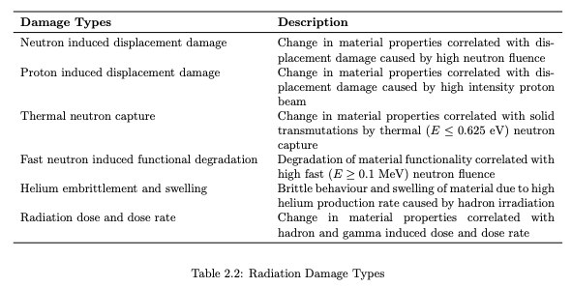
Engineering Design
Engineering process approach:
FNAL Engineering Manual
This risk-based graded approach provides safe, cost-effective and reliable designs.
The implementation flexible to loop within the given sequences.
Notes:
PROCESS FOR CALCULATION radiation -→ Design : System engineering
Choice material: Pavia test 9neutron irradiation, CERN gamma irradiation, polymer, grease
Used for ESS calculation : How implemented within IK and ESS calculation ?
Cobalt impurities ?
Specific material used ?

Slide 11
Test Case
CERN
LARGE HADRON COLLIDER
PROTON ACCELERATOR

Slide 12
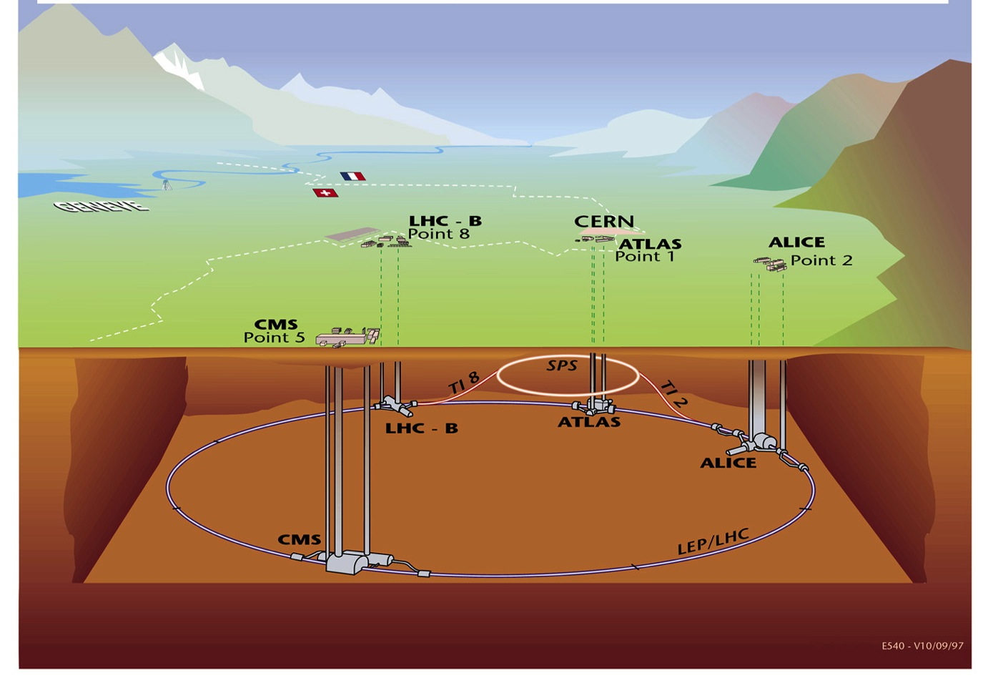
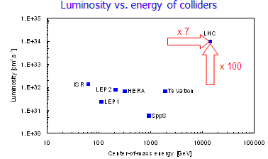
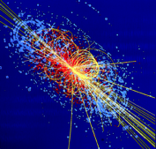
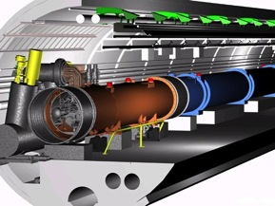
CERN and the Large Hadron Collider
Finding the Higgs boson !
E_{beam} 7 TeV
Luminosity 2 10³⁴ cm⁻².s⁻¹
Circumference 26.7 km
Bending field 8.3 T
Superconductor Nb-Ti @ 1.9 K
1232 SC dipoles, 400 SC quadrupoles
120 tons helium (of which 80 superfluid)
High Radiation
Tunnel was built in 1985 for the LEP

Slide 13
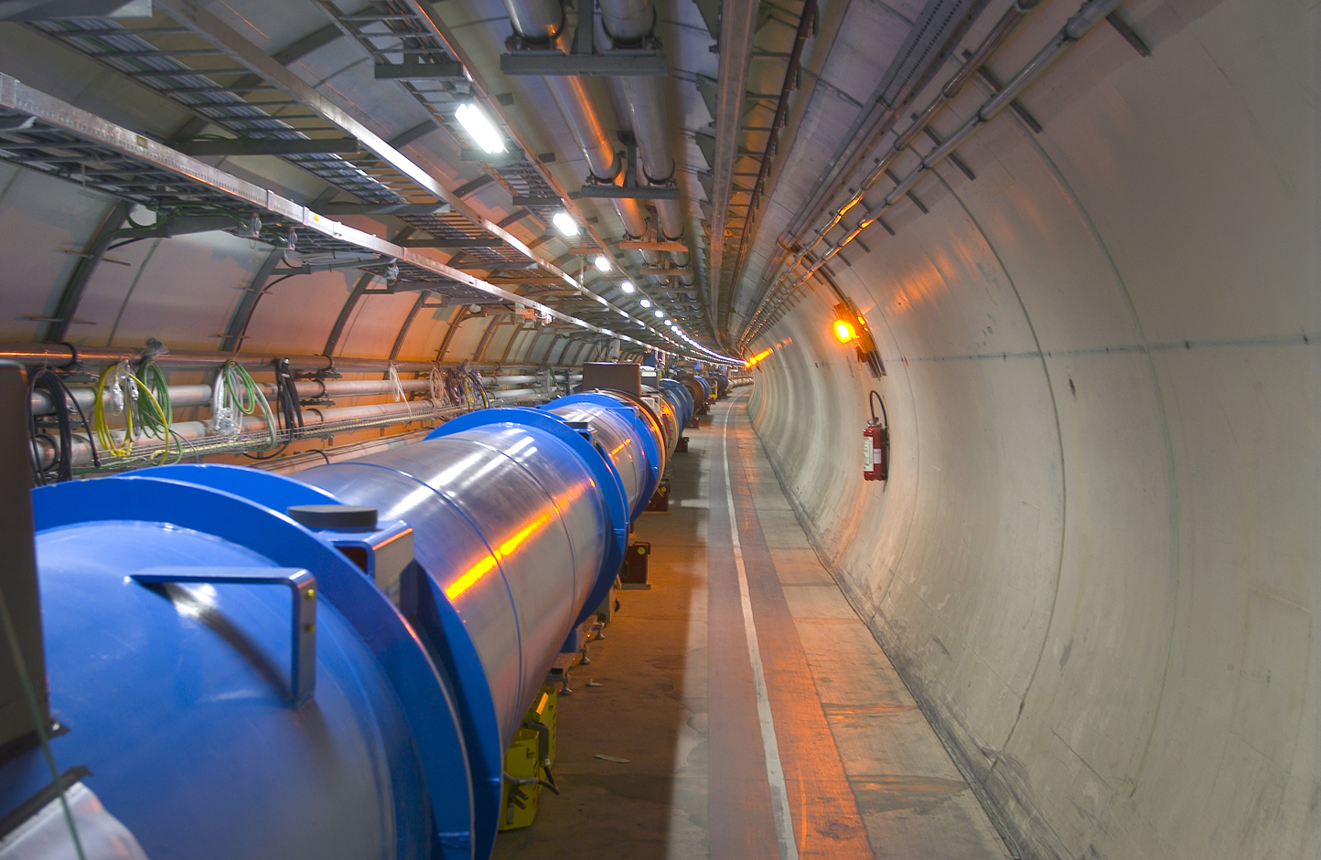
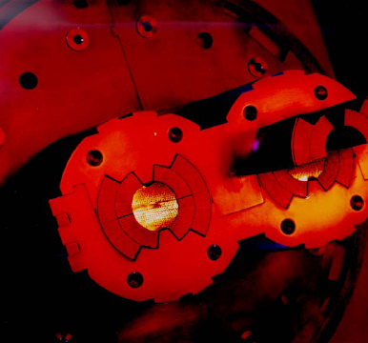
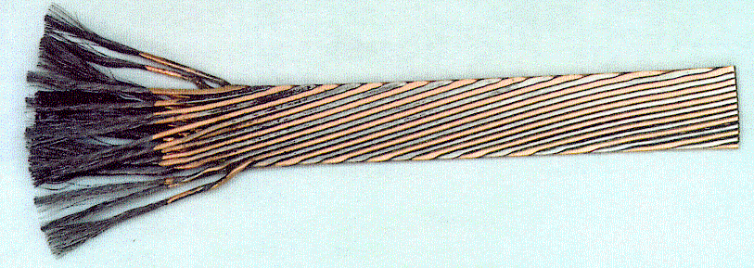
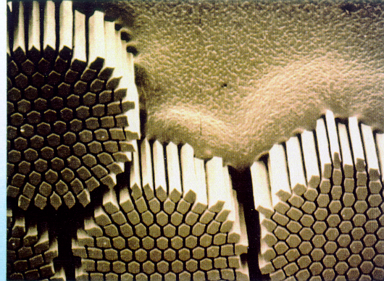
The LHC Magnets
 | Inner Cable | Outer Cable
Number of strands | 28 | 36
Strand diameter | 1.065 mm | 0.825 mm
Filament diameter | 7 µm | 6 µm
Number of filaments | ~ 8900 | ~ 6520
Cable width | 15.1 mm | 15.1 mm
Mid-thickness | 1.900 mm | 1.480 mm
Keystone angle | 1.25 ° | 0.90 °
Transposition length | 115 mm | 100 mm
Ratio Cu/Sc | ≥ 1.6 | ≥ 1.9
7,600 km of cable made of 270,000 km of strand (6 earth circumferences)
→ filaments : 6 times back and forth to the Sun + 150 trips to the moon

Slide 14
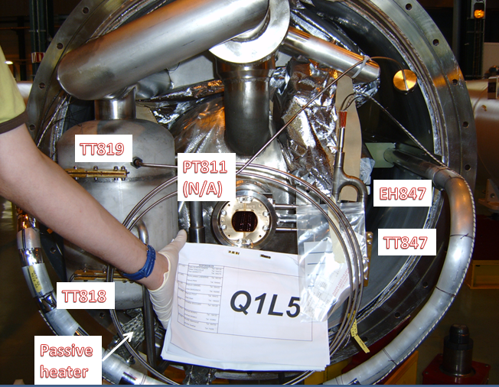
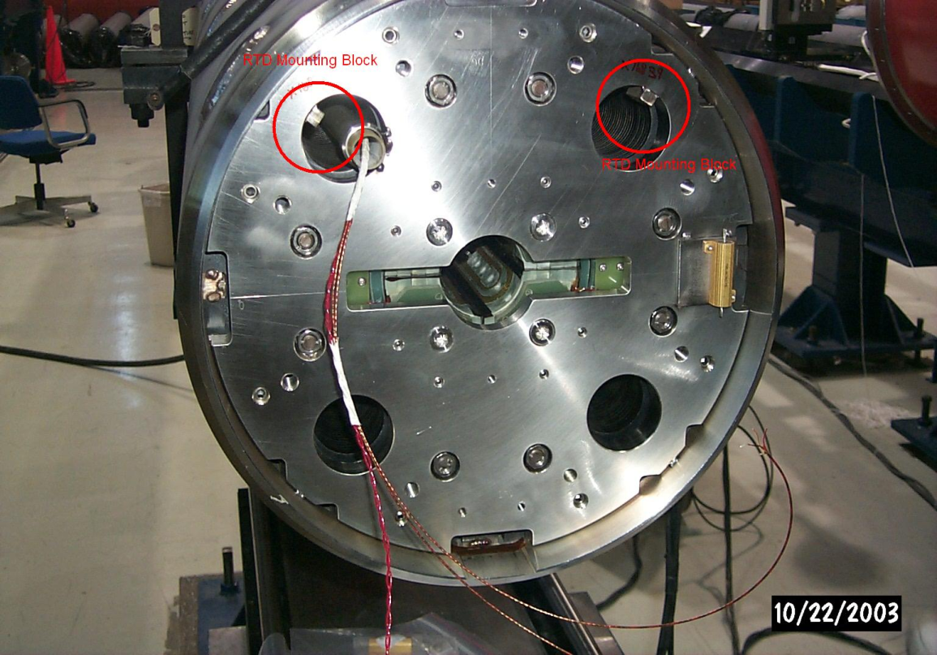
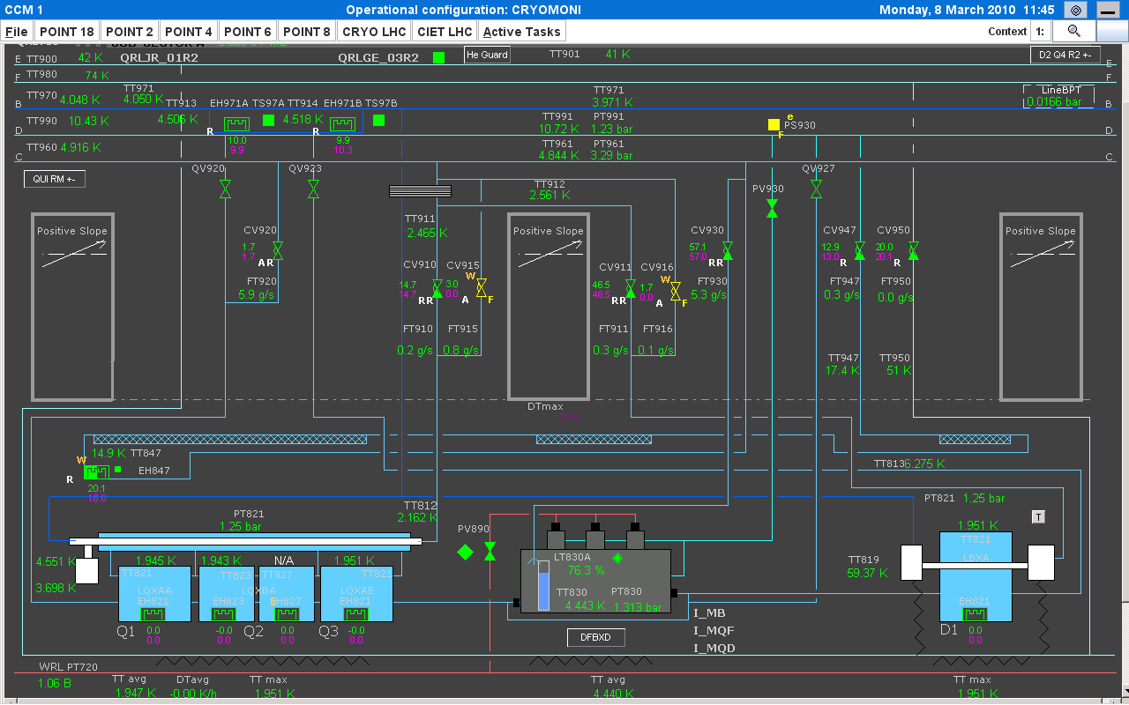
Type of instrumentation
TT821
EH821
Interface with QRL
EH8xx: cryo-electrical heaters
PT8xx: based on passive strain gauge
TT8xx: Pt100, CernoxTM
Low-beta system
Notes:
5 mK at 2 K
Instrumentation, radiation damage – precision, decay, calibration
Replacement, maintenance.. , think procedure to recalibrate , in-situ… P&ID
Access difficult and Removing magnet…
Robustness
Response time
Magnetic field effects

Slide 15
CRYOmagnet system safety specification
Design and operation requirements:
Critical system for LHC performance. The system operation and maintenance should remain safe for personnel and for equipment, e.g. escape path, absorbed radiation dose, embrittlement, polymer prop. decay.
Equipment, instrumentation and design shall comply with the CERN requirements
Radiological → Use materials resistant to the radiation rate permitting an estimated machine lifetime, even in the hottest spots, exceeding 7 years of operation at the baseline luminosity of 10³⁴cm⁻²s⁻¹
Personnel safety: Keep residual dose rates on the component outer surfaces of the cryostats below 0.1 mSv/hr
Apply the ALARA principle (As Low As Reasonably Achievable)
Risk Analysis → Failure Mode and Effect Analysis (FMEA), Use the Maximum Credible Incident (MCI) = Worst case scenario
Notes:
Safe for personnel: escape possible, radiation dose
Safe for equipment: embrittlement (carbon steel), polymer decay w/ ionization irradiation

Slide 16
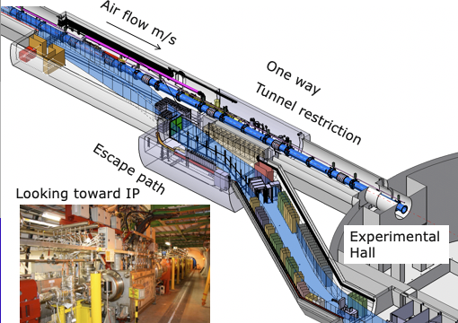
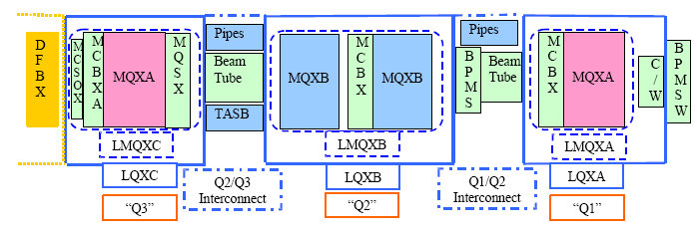
Radiological risk
Engineering process approach:
FNAL Engineering Manual
Identify & Assess
Simulations: Geometry, material (e.g. density)
Power density estimation
Mitigation
Component design optimization
Operation parameters optimization
Maintenance Modes
“Protecting LHC IP1/IP5 Components Against Radiation Resulting from Colliding Beam Interactions”, by N.V. Mokhov et. al
Notes:
Animation and Flow chart to add for process to design

Slide 17
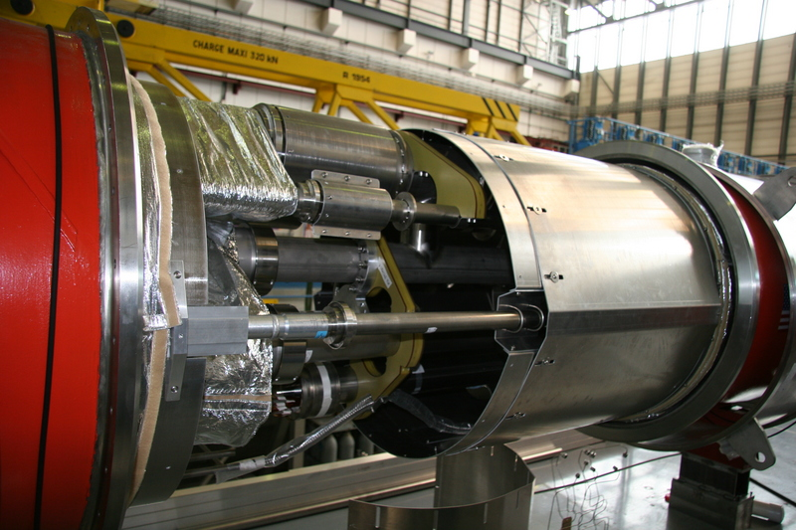
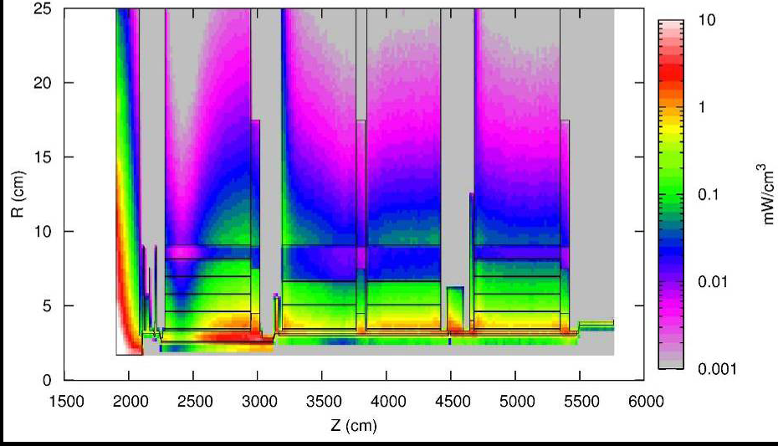
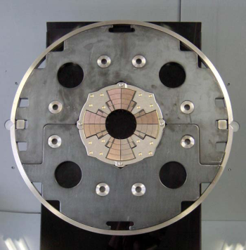
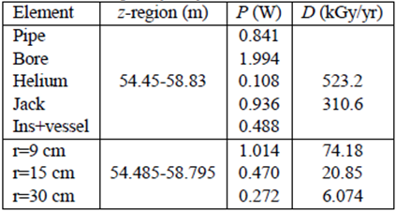
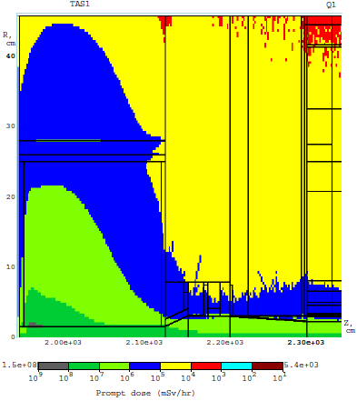
Radiological risk
Magnet quench limit =1.6 mW/g
IR5 azimuthally averaged power distribution
➔ Maximum of 12.5 mW/g (or 100 MGy/yr) at 15 cm (z=1960 cm) is determined by photons and electrons coming to the absorber
Radial distribution of azimuthally averaged dose (Gy/yr)
→ For comparison : Arc magnet ~ 1 Gy/yr

Slide 18
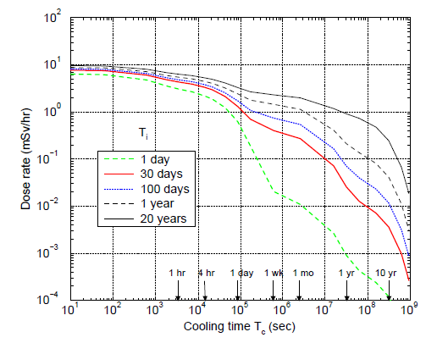
Radiological risk mitigation
Averaged over surface residual dose rate (mSv/hr) on the Q1 side (z=2125 cm, bottom) of the TAS vs irradiation and cooling times.
Based on Risk analysis:
Conceptual/Design choice
  The inner-triplet final design included additional radiation shielding and copper absorber
  Material choice: e.g. PEEK versus Kel-F for the DFBX low temperature gas seal
  The chosen instrumentation and equipment are radHard and halogen free (neutron irradiation experiment performed on temperature sensors : fluence values close to 10¹⁵ neutrons/cm², corresponding to 2.10⁴ Gy).
  Operating Modes: Process control w/ interlocks and alarm level for each operating mode
- Procedures written based on lessons learned
  Radiological survey systematical performed < 0.1mSv/hr for low occup. high radiation zone
  LHC tunnel accesses modes were defined, e.g. control and restricted modes
  Limit the personnel exposition time
Notes:
Choice cable, insulation

Slide 19
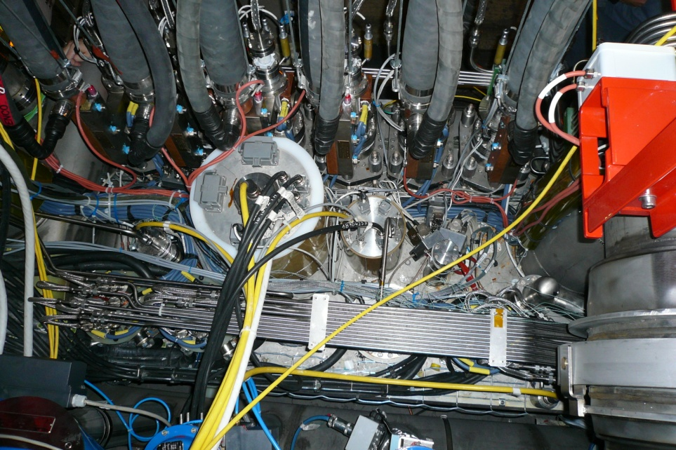
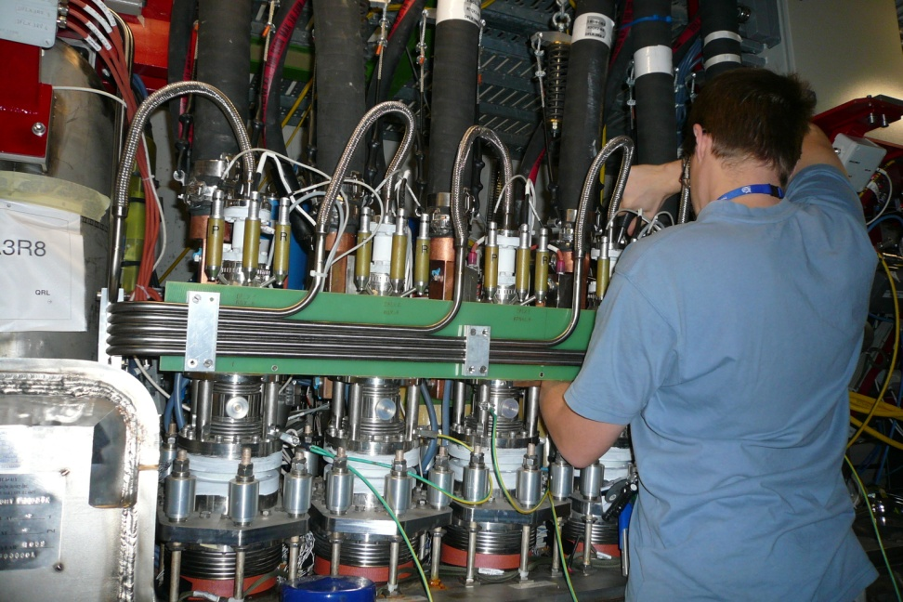
Risk mitigation : personnel training
In addition to the use of software and hardware interlocks to limit risks, personnel’s training is of prime importance.
Courses to comply with the CERN safety policy. They train the personnel to behave safely in a cryogenic and radiation environment.
Awareness and preventive actions are mandatory to complete each technical task. Dedicated hazard analyses are enforced to work in the low-b magnet system area.
“Compact” DFBX area
Notes:
Monitoring etc.. Personal dosimeter, global detector

Slide 20
Test Case
EUROPEAN SPALLATION SOURCE
PROTON LINEAR ACCELERATOR

Slide 21
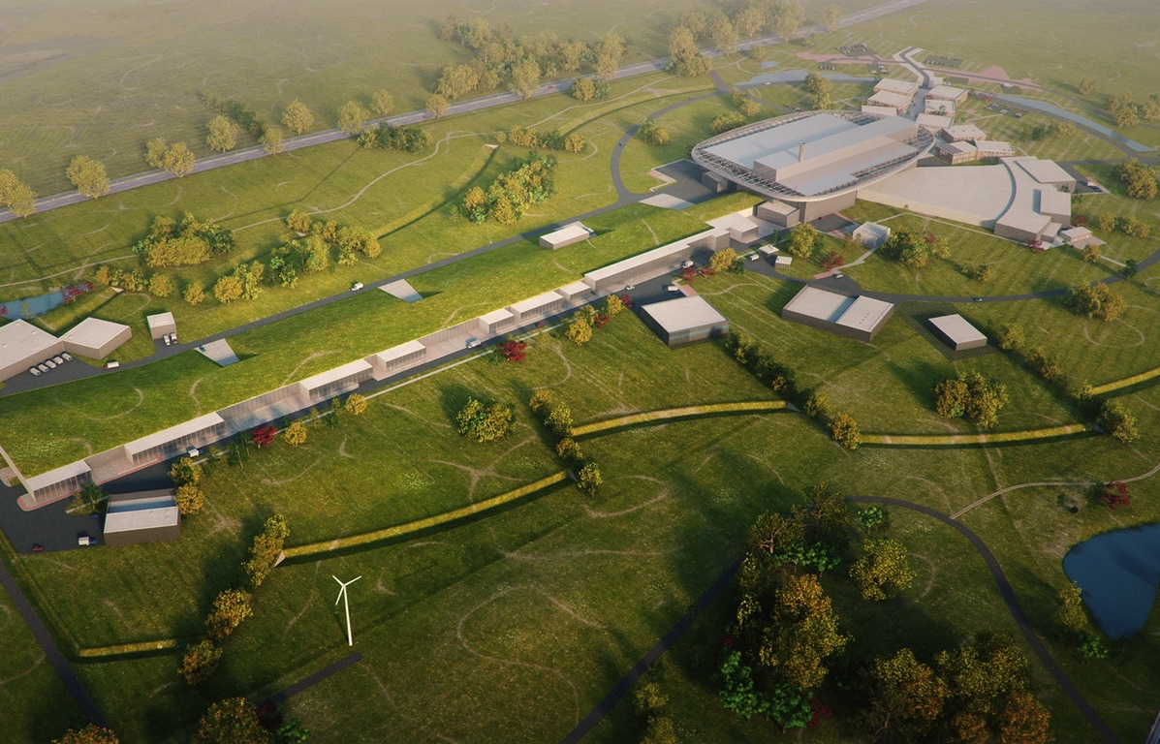
European Spallation source - Linac
High Power
Linear Accelerator:
Energy: 2 GeV
Rep. Rate: 14 Hz
Current: 62.5 mA
Target Station:
He-gas cooled rotating
W-target (5MW average
power)
42 beam ports
16 Instruments in Construction budget
Committed to deliver 22 instruments by 2028
Peak flux ~30-100 brighter than the ILL
Ion Source
Total cost: 1843 MEuros ₂₀₁₃

Slide 22
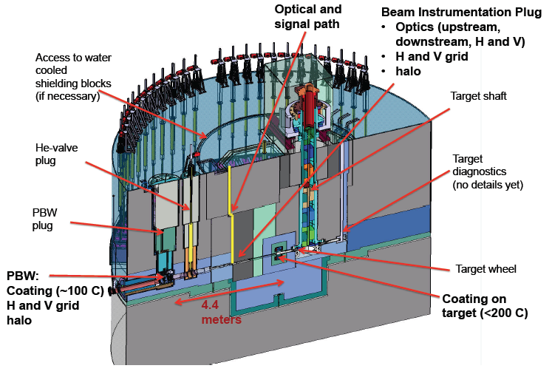
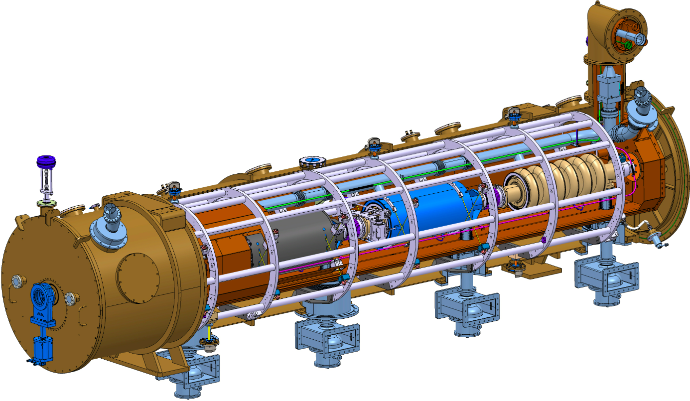
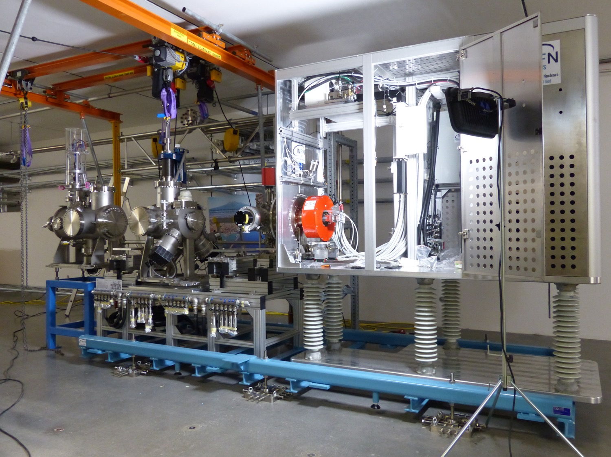
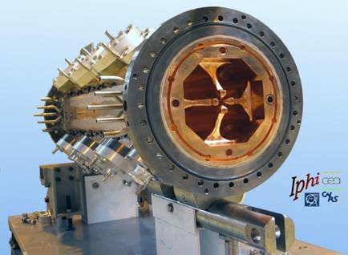
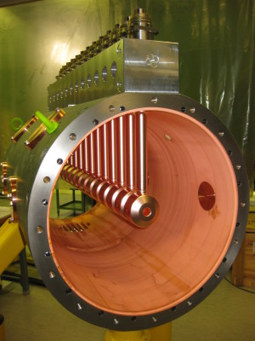
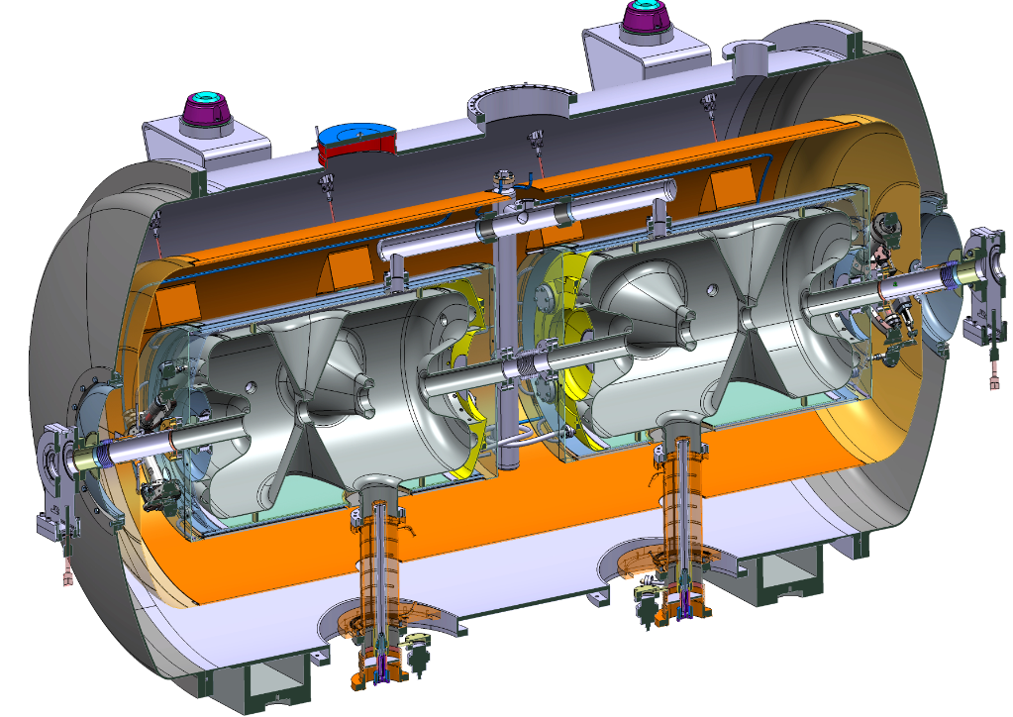
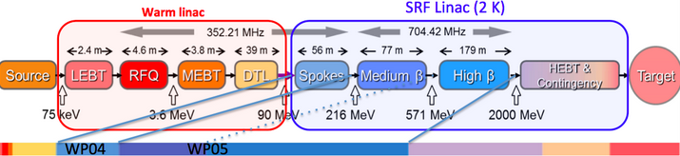
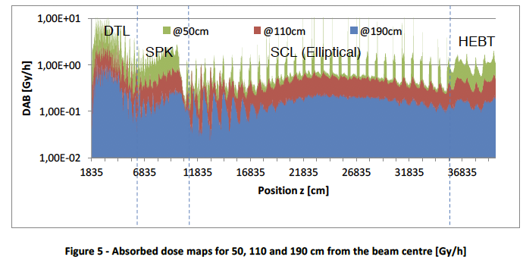
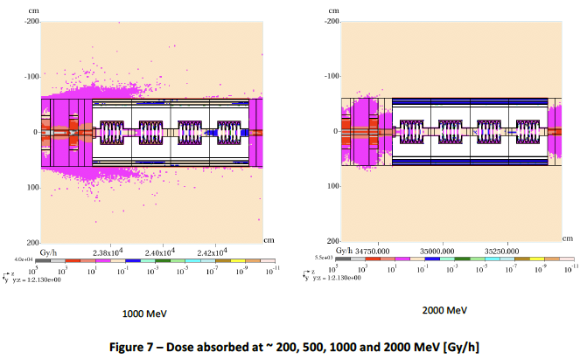
Linear Accelerator (SRF)
(see also October 21, 2020)
Specification:
- Radiation-hard components
(e.g. electronics, materials, instrumentation,)
- Risk Analysis
- Preventive maintenance and monitoring
d=βλ/2
SUITE AU PROCHAIN EPISODE …
Notes:
312 m SC+ 50 m NC
400 m/ 600 m tunnel = SRF
CO2 neutral..

Slide 23
Learn more about particle accelerators
Massive Open-Online Courses: www.npap.eu
US-Particle Accelerator School, http://uspas.fnal.gov/materials/materials-table.shtml
CERN Accelerator School http://cas.web.cern.ch/cas
ASP2018: “Introduction to Accelerator” by Caterina Biscari
ASP online Course: Radiation Measurements and Dosimetry by Marco Silari
  https://indico.cern.ch/event/926495; https://indico.cern.ch/event/926500/; https://indico.cern.ch/event/926502/; https://indico.cern.ch/event/926503/
Few books:
RF Linear Accelerators, T.P. Wangler, Wiley, 2008
RF Superconductivity for Accelerator, H. Padamsee, J. Knobloch, T. Hays, Wiley, 2011
An introduction to particle accelerators, E.J.N. Wilson, Oxford Univ. Press, 2001
An introduction to the physics of high-energy accelerators, D.A. Edwards & M.J. Syphers, Wiley, 1993
The principles of circular accelerators and storage rings, P.J. Bryant & K. Johnsen, Cambridge Univ. Press, 1993

Slide 24



Radiation safety applied to particle accelerators permits us to design, fabricate, install and commission state-of-the-art equipment
Each accelerator generation built on the accomplishments of the previous ones, raising the quality of equipment performance and transferring knowledge and technology to industries
Synergies between Research Infrastructures and Industry are keys to an innovative Ecosystem
Thank you for your attention!
24

Slide 25
Extra slides

Slide 26

Nordic particule Accelerator Project
(npap.eu)
MOOC1: Particle Accelerators introduction
→ Launched in August ’19
→ 2272 learners enrolled
MOOC2: Fundamentals of accelerator technology
→ Launched in March ’19
2000 learners enrolled
MOOC3: Medical Applications of Particle Accelerators
Launched in Nov. ’18
3067 learners enrolled
@ 6 October 2020
Accelerators for Synchrotron Light Light and Light Sources Accelerator to make light The development of accelerators for synchrotron light Photon light sources and MAXIV Synchrotron radiation Bending magnets, wigglers and undulators Free Electron Lasers Spallation source and ESS Introduction and neutron science European Spallation Source Particles Colliders Introduction to Particles Colliders The LHC and its experiments Linear Colliders Future Circular Colliders Plasma Wakefield (to be completed) | RF-System Introduction to RF-systems RF cavities Waveguides RF Amplifiers More about cavities Magnets technology for accelerators Magnets part1/2/3 Beam Diagnostics An overview Beam intensity and position Transverse Beam Profile Longitudinal Beam Profile Beam Loss Monitoring Basics of Vacuum techniques An overview and motivation Residual gases and vacuum regions Vacuum equipment Other vacuum components | Introduction to the course and radiotherapy Introduction Biological rational for radiotherapy Intro. to the electron linac for radiation therapy Electron Linacs for radiation therapy The multi-energy electron Linac structure Dose delivery to the patient Proton therapy 1 Rationale of proton therapy Accelerators for proton therapy Treatment delivery of proton therapy Proton therapy II and production of medical radionuclides Heavy ion therapy Challenges in pr. th. and heavy ion th. Introduction to medical radionuclides Production of medical radionuclides

Slide 27

Example
MOOC2: Fundamentals of accelerator technology
https://www.coursera.org/learn/fundamentals-particle-accelerator-technology

Slide 28

Coursera Architecture

Slide 29

Example of Lecture
https://www.coursera.org/lecture/fundamentals-particle-accelerator-technology/general-introduction-wf3CB
https://drive.google.com/open?id=160EDKsTJiZruNpGNoDuu0hvxLYf0fafW

Slide 30



Accelerator Characteristics
Family of Linac component
RF Quadrupole
Drift Tube Linac
At low energy proton, the RFQ permits:
        1. Bunching of the beam
        2. Focusing quadrupole
        3. Accelerating
Every cell is different, focusing quadrupoles in each drift tube
If f >10 MHz, the DTL acts like an antenna and radiates energy instead of using it for the acceleration
RF cavity
EM fields enclosed in a cavity with resonant frequency matching that of RF generator

Slide 31


Accelerator Characteristics
    ESS LINAC is 600 m long (350m of acceleration) and reaches an energy of 2 GeV
    Assuming we need a 7 TeV machine (LHC), the Linac should be 1,225 km long !
    Linac over and over ?
    → Synchrotron Accelerators:
    Space charge effect becomes small
    * Cover range where particle velocity is nearly cst.
    e.g. LHC, Tevatron
Linac 2 GeV
31

Slide 32

Ionizing Radiation
Ionizing radiation is radiation composed of particles that individually carry enough energy to liberate an electron from an atom or molecule without raising the bulk material to ionization temperature.
When ionizing radiation is emitted by or absorbed by an atom, it can liberate a particle.
Such an event can alter chemical bonds and produce ions, usually in ion-pairs, that are especially chemically reactive.
Note: Neutrons, having zero electrical charge, do not interact electromagnetically with electrons, and so they cannot directly cause ionization by this mechanism.
➔ High precision non-destructive probe … why ?

Slide 33


Slide 34


Slide 35


Slide 36



Slide 37


Slide 38


Slide 39


