Slide 1
High Throughput Grid Computing
and My 1000 Year Dreams
and High Energy Particle Physics
ASP Colloquium Series 2020
August 25, 2020
Dr. Jaehoon Yu
Department of Physics
University of Texas at Arlington
  Outline
Introductions
The problem
A solution using the Computing Grid
Performance of the Grid
Conclusions

Slide 2
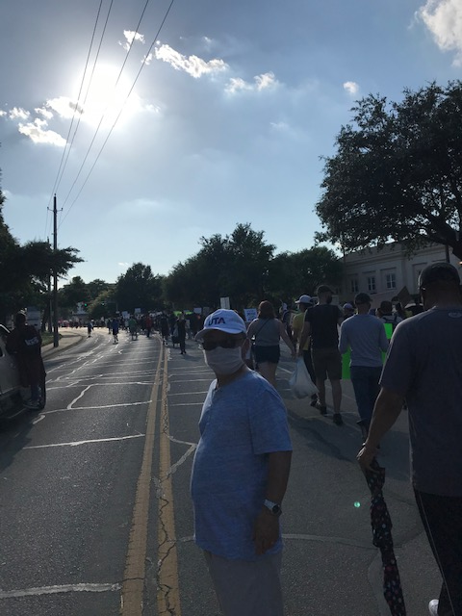
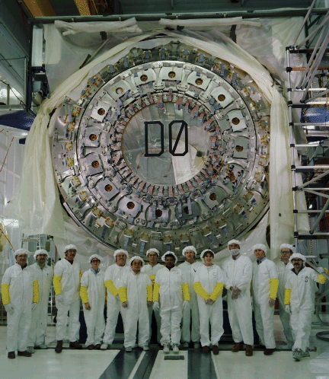
Who am I? – 1
@ the BLM Protest
Arlington, TX, June 6, 2020
My full name is Jaehoon Yu but goes by Jae Yu
Lived in South Korea through 1987 under a military dictatorship
  I take freedom, democracy and fundamental human decency very seriously
  Obtained BS and MS in physics and did the compulsory military service in the Korean Army
Joined the Ph.D. program at Stony Brook U. in NY in 1987 and obtained Ph.D. in 1993
  Ph.D. thesis was on the D-Zero experiment at Fermilab ➔ Participated in prototyping, beam testing, construction, assembly, commissioning, data taking, data analysis, thesis writing and publication of the thesis
  All my 3 children were born during this period 2 years apart from each other
1st postdoc at D-Zero with U. of Rochester (93 – 96) followed by 2nd postdoc at Fermilab (96 – 98) on a neutrino experiment (NuTeV) building the calibration beamline, run calib program and published
Fermilab staff scientist (98 – 2001) led D-Zero upgrade commissioning
D-Zero Central Calorimeter
Fermilab, Batavia, IL, January 1990,

Slide 3

Who am I? – 2
Professor at U. Texas Arlington (2001 – present)
  Led the design and implementation of D-Zero computing grid
    Led the group on discovery of Higgs in WW final states
  Led International Linear Collider detector R&D beam testing
  Joined ATLAS @ LHC 2005 and led the grid computing user services
  Led a subgroup in LHC Higgs Cross section working group
  Contributed to 2012 Higgs discovery (see live TV interview) and the subsequent precision property measurements
  Moved to neutrino experiment and created and leading the Beyond the Standard Model physics group from 2013 (1st ever in the community!)
  Constructed a prototype DUNE field cage (2018) for Prototype @CERN
  To construct half the field cage for first two 17kt modules

Slide 4
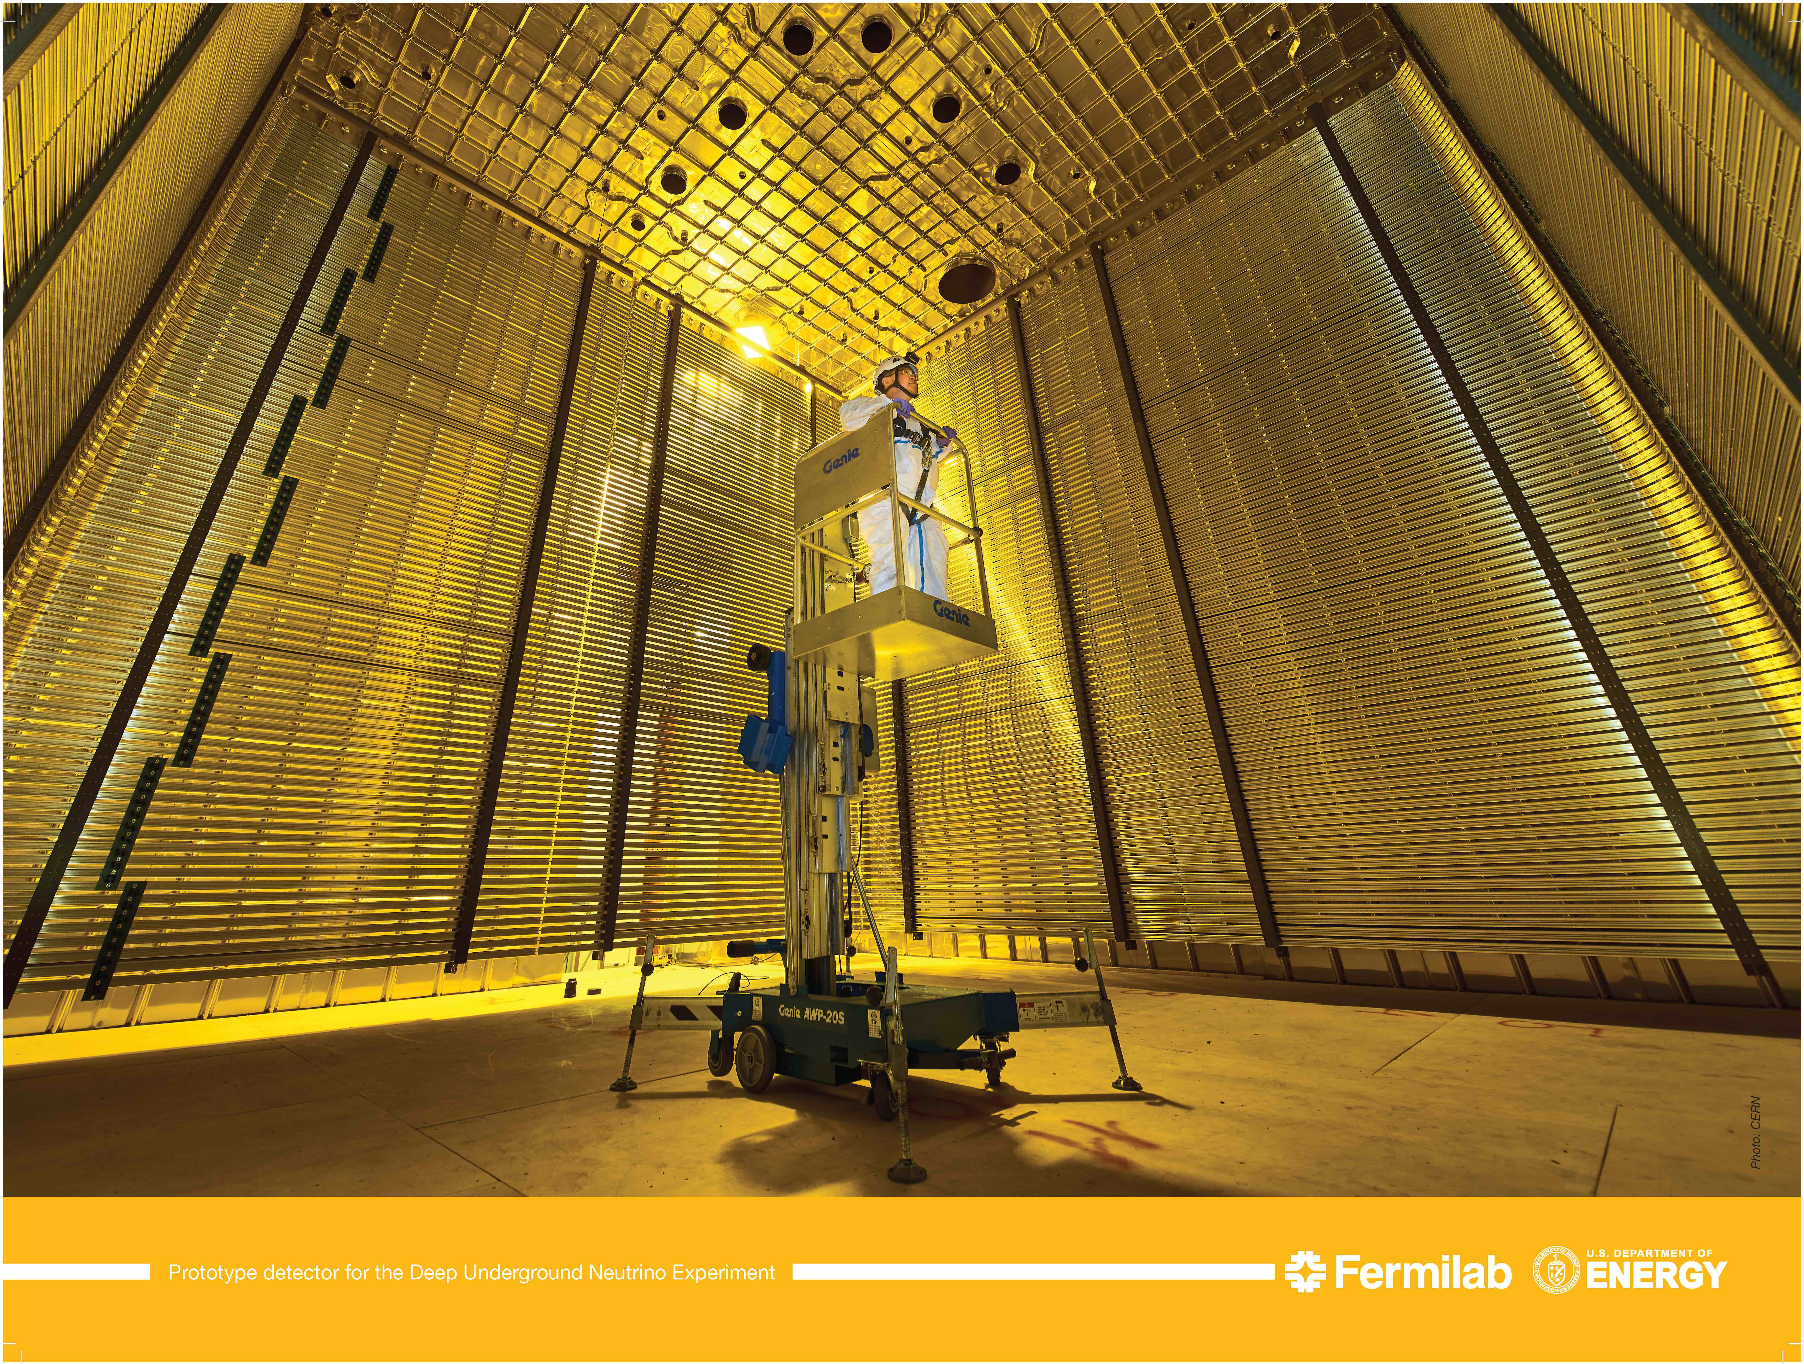
DUNE Prototype Detector @ CERN
6m
6m

Slide 5

How am I related to ASP?
Organized the 1st high-performance computing program in ASP2012 at Ghana
  Secured funds through US National Science Foundation
Serving as an international advisory committee member
  Continually securing funds for lecturer and student supports with US NSF
  Arranged additional funding from South Korea for 2014 school
Worked hard to open Ph.D. opportunities for ASP grads
  Last Feremenga (ASP2010 Grad): Obtained Ph.D. in 2016 on ATLAS
    Quantitative Analytics Specialist at Wells Fargo, DFW
  Bright Izudike (ASP2012 Grad: Obtained M.S. in 2015
    Manager at Blicma since Apr. 2016
In March 2020 w/ his wife and the newborn son!!

Slide 6
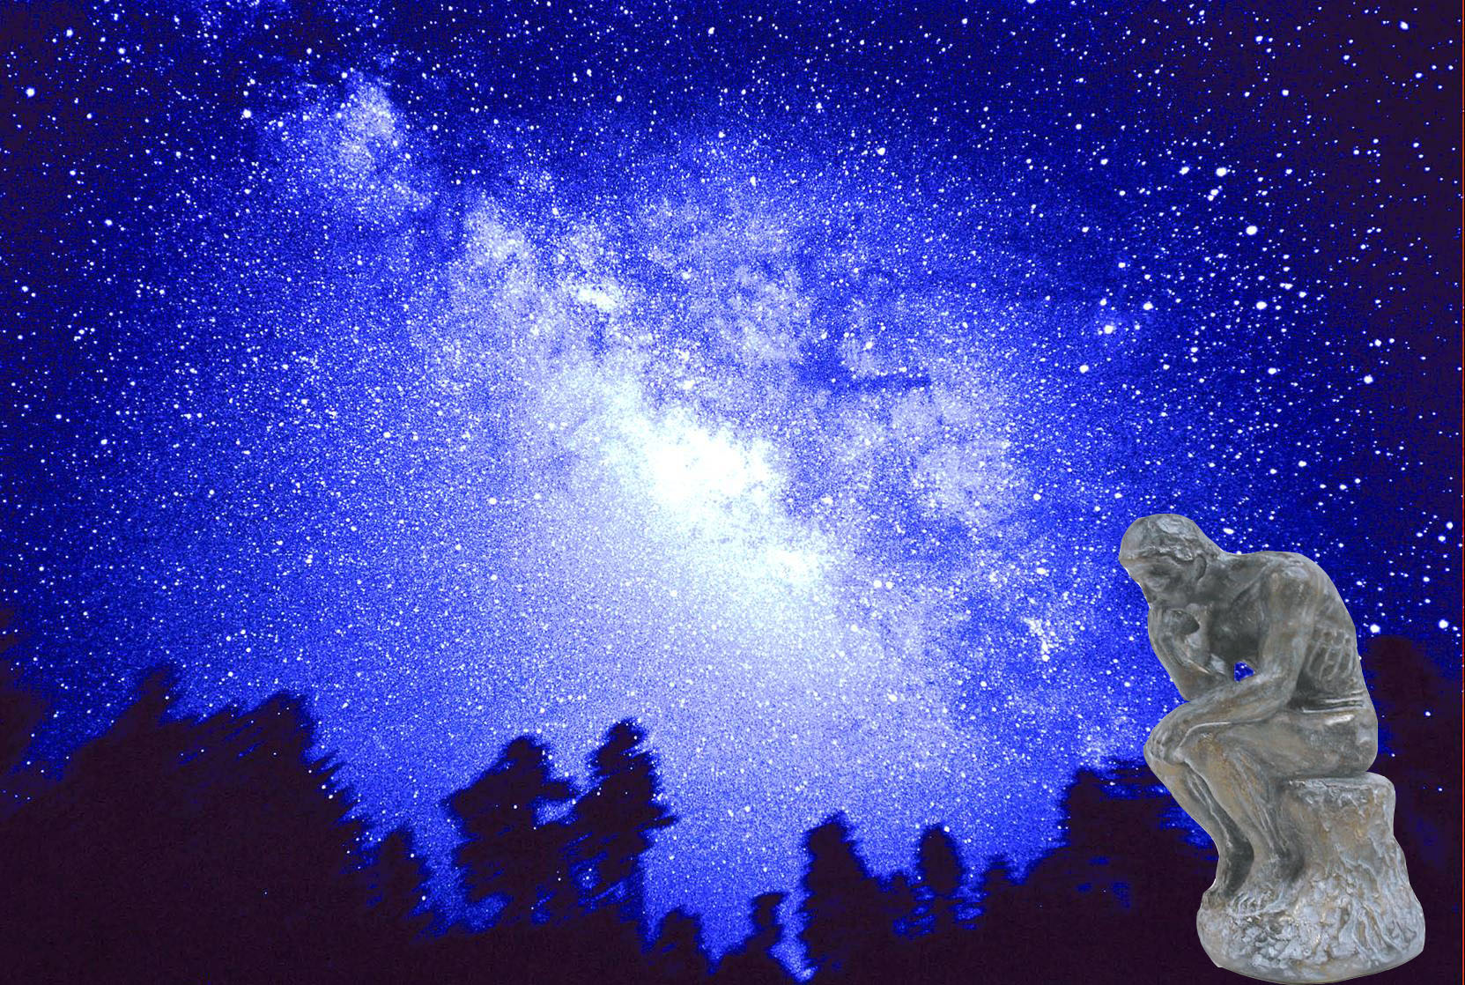

We always wonder…
What makes up the universe?
How does the universe work?
Where do we all come from?

Slide 7
High Energy Physics
Definition: A subfield of physics that pursues understanding the fundamental constituents of matter and basic principles of interactions between them.
Known interactions (forces):
  Gravitational Force
  Electromagnetic Force
  Weak Nuclear Force
  Strong Nuclear Force
Current theory: The Standard Model of Particle Physics (SU3xSU2XU1)

Slide 8
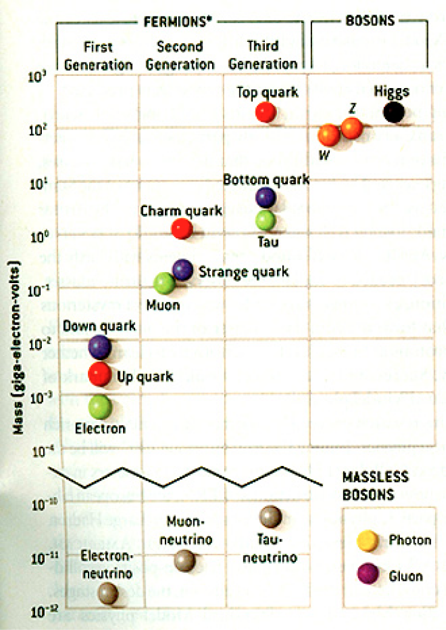
HEP and the Standard Model
Total of 16 particles (12+4 force mediators) make up all the visible matter in the universe! ➔ Simple and elegant!!!

Slide 9
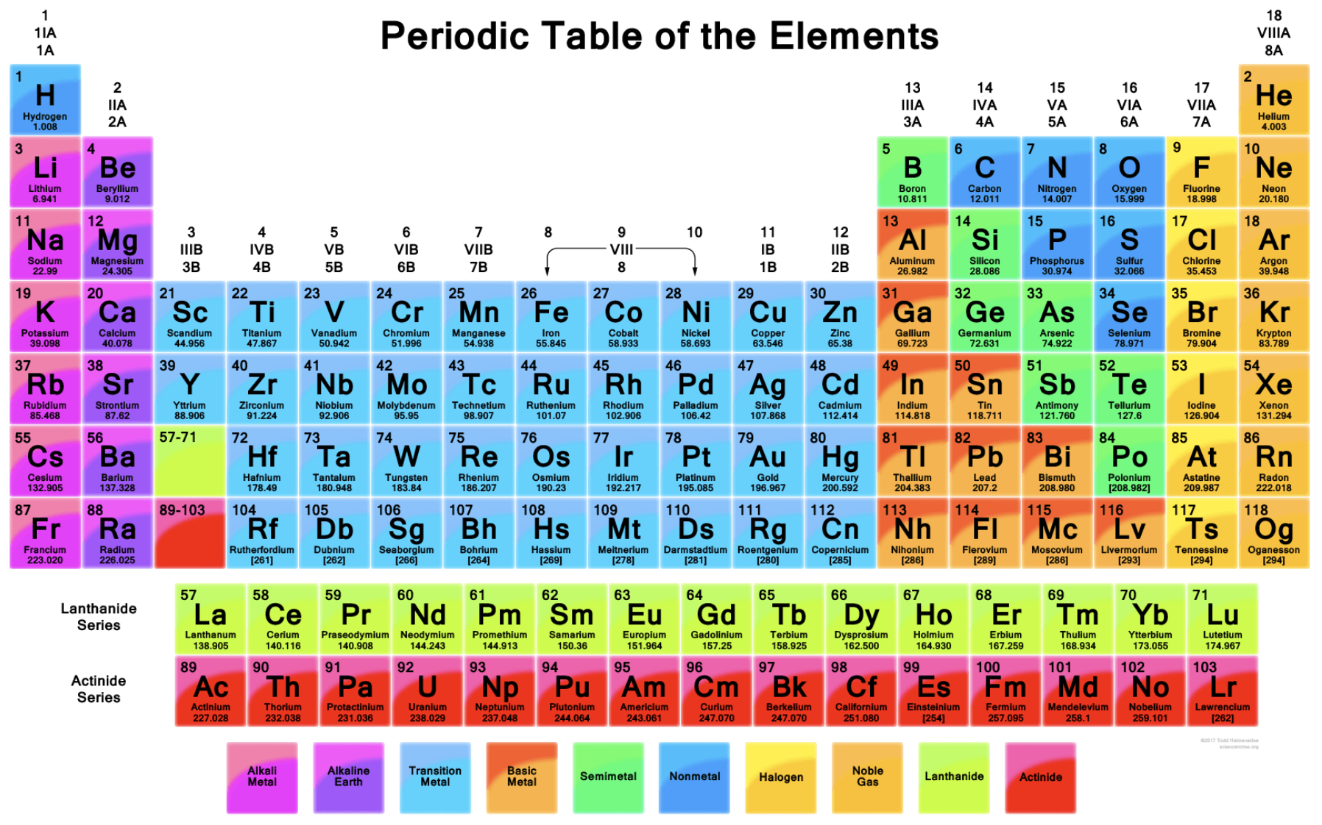

Slide 10
HEP and the Standard Model
Discovered in 1995, ~175m_{p}
Make up most ordinary matters ~0.1m_{p}
Total of 16 particles (12+4 force mediators) make up all the visible matter in the universe! ➔ Simple and elegant!!!
Tested to a precision of 1 part per million!

Slide 11

What are some issues in HEP?
Why is the mass range so large (0.1m_{p} – 175 m_{p})?
Is the particle discovered at the LHC really the Higgs particle?
Why is the matter in the universe made only of particles?
Neutrinos have mass!! (OMG!! The SM is broken!!! )
  What are the mixing parameters, particle-anti particle asymmetry and the neutrino mass ordering?
Why are there only four apparent forces?
  Were they all unified at the Big Bang?
Me!
Notes:
----- Meeting Notes (2/12/14 10:16) -----

Slide 12
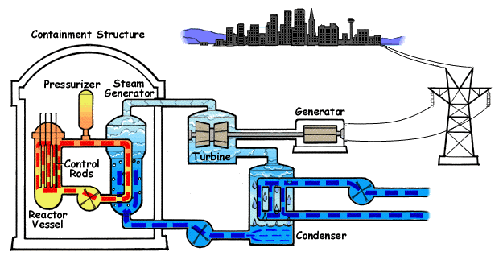
How does a nuclear power plant work?
Duke Energy
My 1000 year dream: Skip the whole thing!
Make electricity directly from nuclear forces!

Slide 13
So what’s the problem?
Why is the mass range so large (0.1m_{p} – 175 m_{p})?
Is the particle we discovered really the Higgs particle?
Why is the matter in the universe made only of particles?
Neutrinos have mass!! What are the mixing parameters, particle-anti particle asymmetry and mass ordering?
Why are there only four apparent forces?
  Were they all unified at the Big Bang?
Is the picture we present the real thing?
Notes:
----- Meeting Notes (2/12/14 10:16) -----

Slide 14
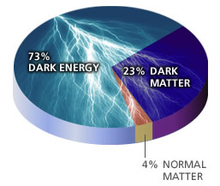
What makes up the universe?
~95% unknown!!
Notes:
----- Meeting Notes (2/12/14 10:16) -----

Slide 15
So what’s the problem?
Why is the mass range so large (0.1m_{p} – 175 m_{p})?
Is the particle we discovered really the Higgs particle?
Why is the matter in the universe made only of particles?
Neutrinos have mass!! What are the mixing parameters, particle-anti particle asymmetry and mass ordering?
Why are there only four apparent forces?
  Were they all unified at the Big Bang?
Is the picture we present the real thing?
  What makes up the remaining ~95% of the universe?
Are there any other particles we don’t know of?
  Big deal for the new LHC Run and in the new experiment in the US!
Where do we all come from?
How can we live well in the universe as an integral partner?
Notes:
----- Meeting Notes (2/12/14 10:16) -----

Slide 16
Accelerators are Powerful Microscopes.
They make high energy particle beams
that allow us to see small things.
seen by
low energy beam
(poorer resolution)
seen by
high energy beam
(better resolution)

Slide 17
Accelerators are also Time Machines.
They make particles last seen
in the earliest moments of the universe.
Energy
particle beam
energy
anti-particle beam
energy
Particle and anti-particle annihilate.
E = mc²

Slide 18
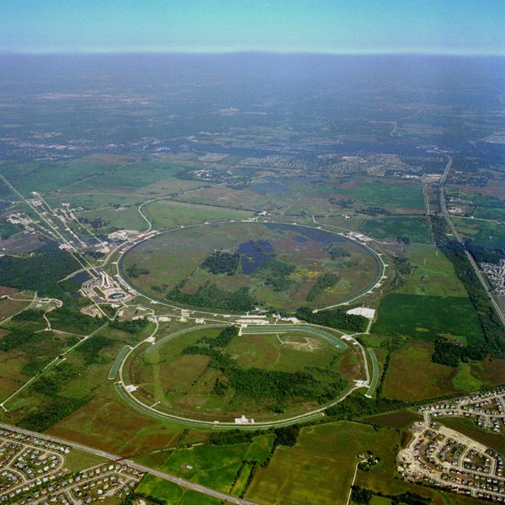
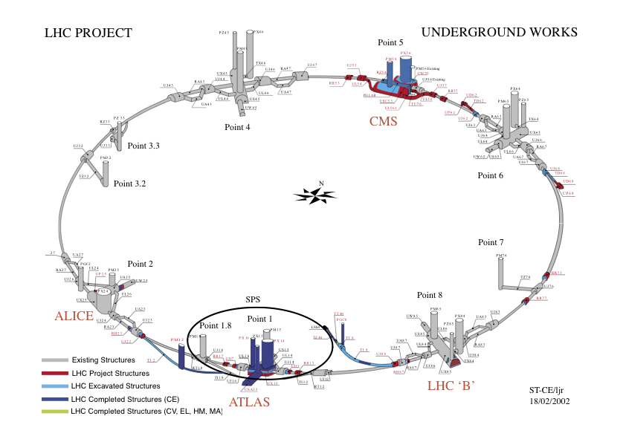
Fermilab Tevatron and LHC at CERN
World’s Highest Energy proton-anti-proton collider
  4km (2.5mi) circumference
  E_{cm}=2 TeV (=6.3x10⁻⁷J/p➔ 13M Joules on the area smaller than 10⁻⁴m²)
  Equivalent to the kinetic energy of a 20t truck at the speed 130km/hr
    ~100,000 times the energy density at the ground 0 of the Hiroshima atom bomb
  Tevatron was shut down in 2011
  New frontiers with high intensity proton beams including the search for dark matter with beams!!
World’s Highest Energy p-p collider
  27km (17mi) circumference, 100m (300ft) underground
  Design E_{cm}=14 TeV (=44x10⁻⁷J/p➔ 362M Joules on the area smaller than 10⁻⁴m²)
  Equivalent to the kinetic energy of a B727 (80tons) at the speed 310km/hr
    ~3M times the energy density at the ground 0 of the Hiroshima atom bomb
Discovered a new heavy particle that looks Higgs in 2012
Search for new particles has been ongoing!!
Shut down for HL LHC➔ About to resume!!
Chicago
CDF
p
DØ
Tevatron
p

Slide 19
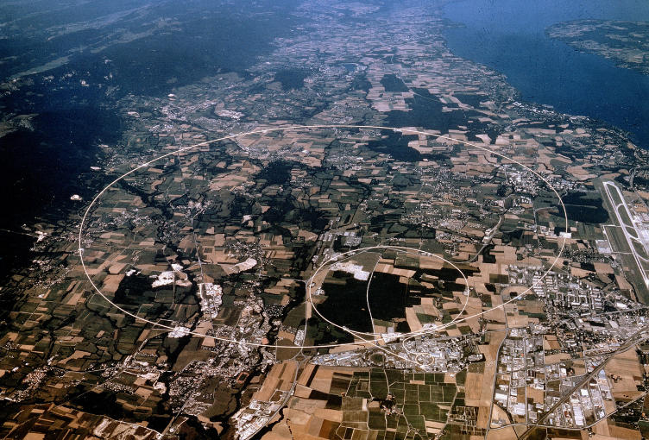

LHC @ CERN Aerial View
CMS
France
Geneva Airport
ATLAS
Swizerland

Slide 20
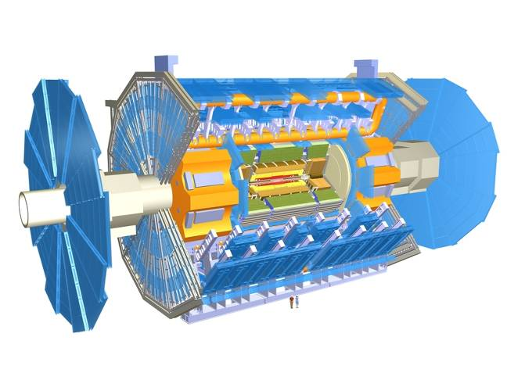
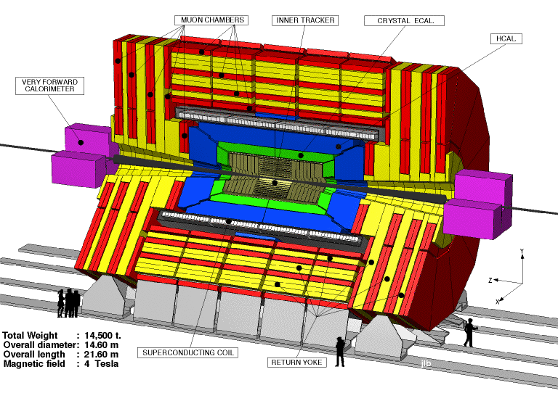

The ATLAS and CMS Detectors
Weighs 7000 tons and ~10 story tall
Records 200 – 400 collisions/second (out of 50million)
Records approximately 350 MB/second
Records ~2 PB per year ➔ 200*Printed material of the US Lib. of Congress
200x

Slide 21

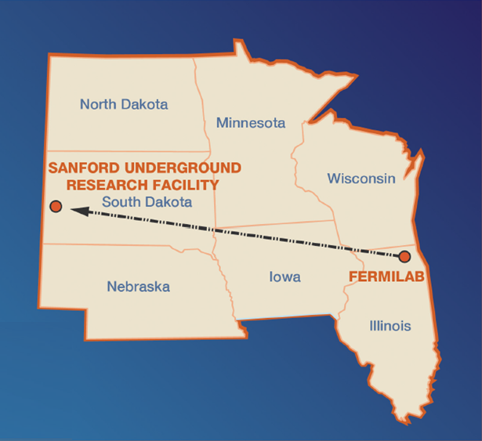
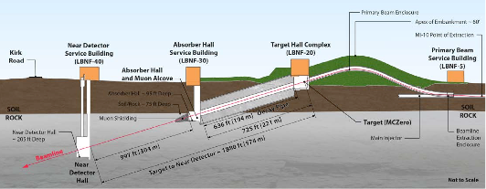
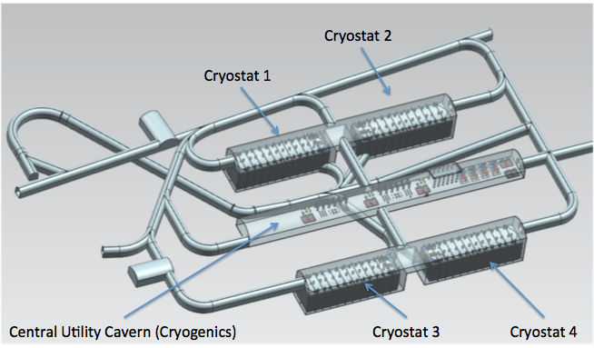
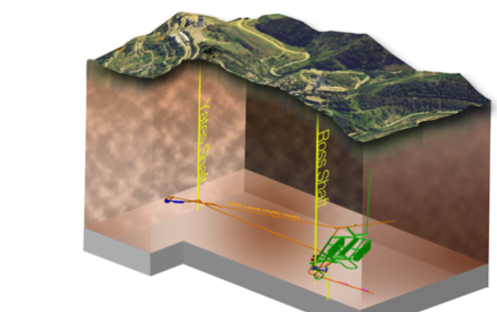
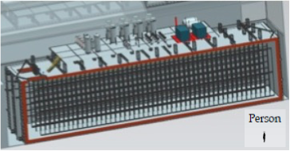
The Next Big Thing - DUNE
Stands for Deep Under Ground Neutrino Experiment
The $1.5B US flagship long baseline (1300km) ν experiment
  1500m underground in South Dakota
1300km (800 miles)
4 caverns with ~80,000t of Liquid Argon total
15m
66m
15m

Slide 22
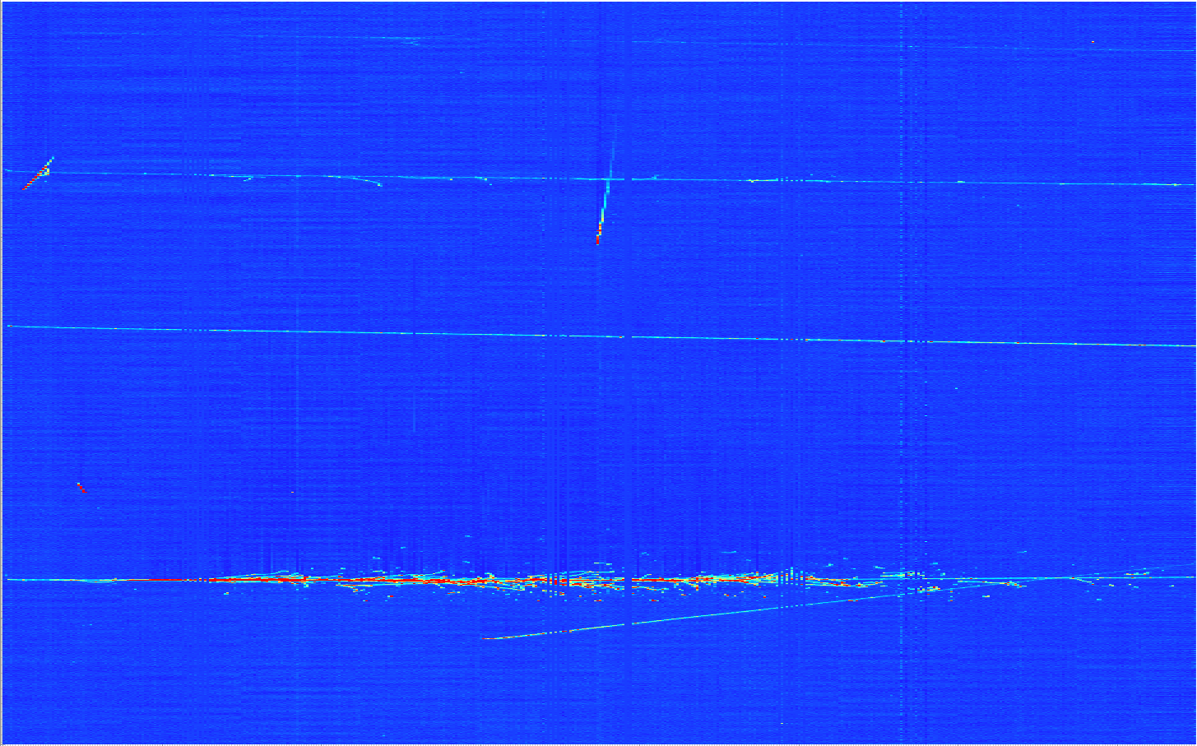
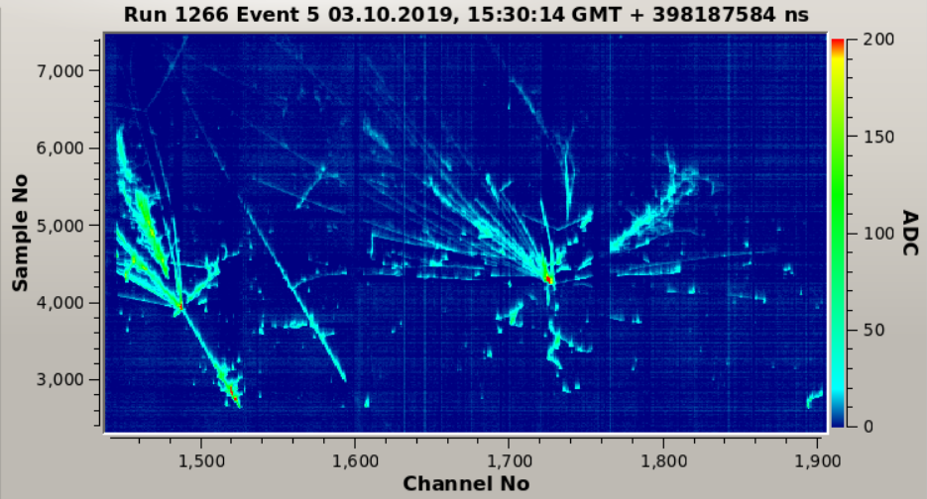
ProtoDUNE Event
Beam halo (high energy) muon with bremsstrahlung initiated E.M. shower
Collection plane view

Slide 23
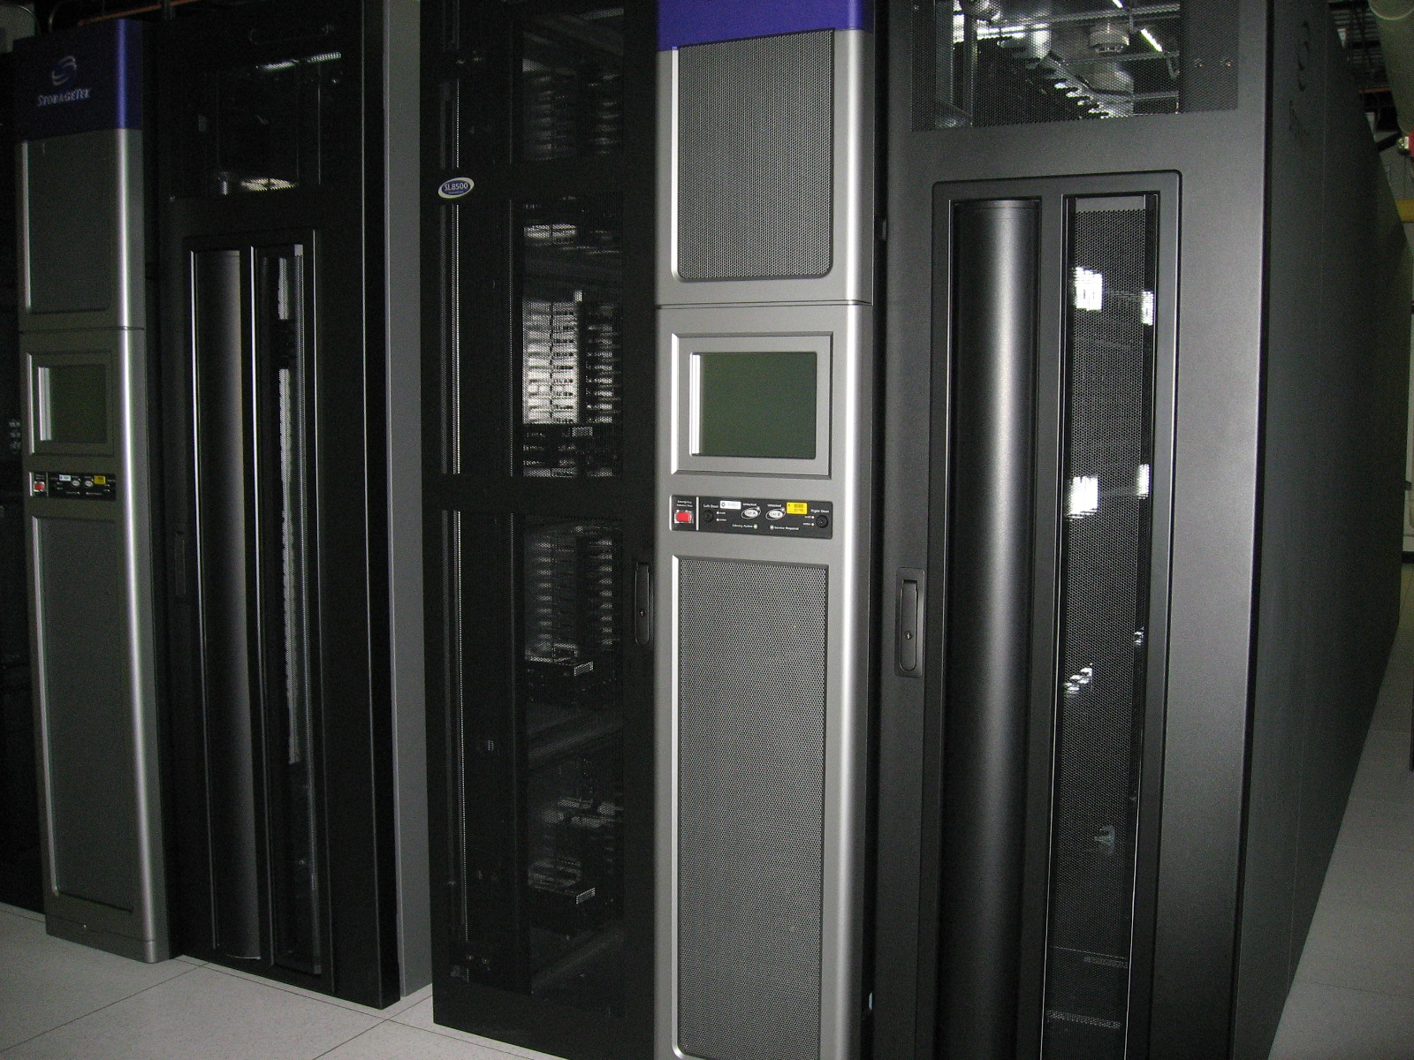
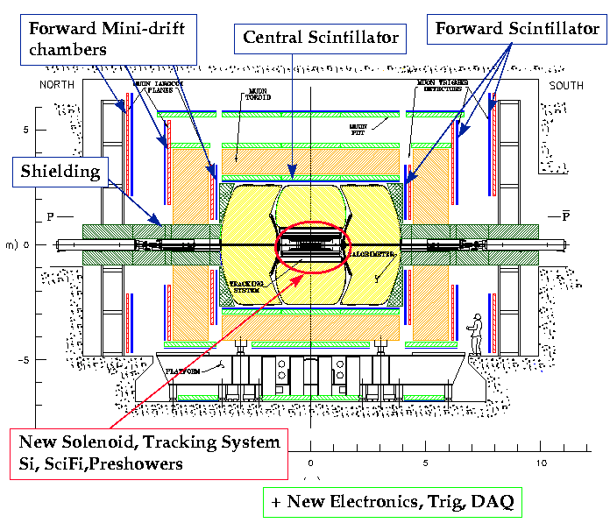
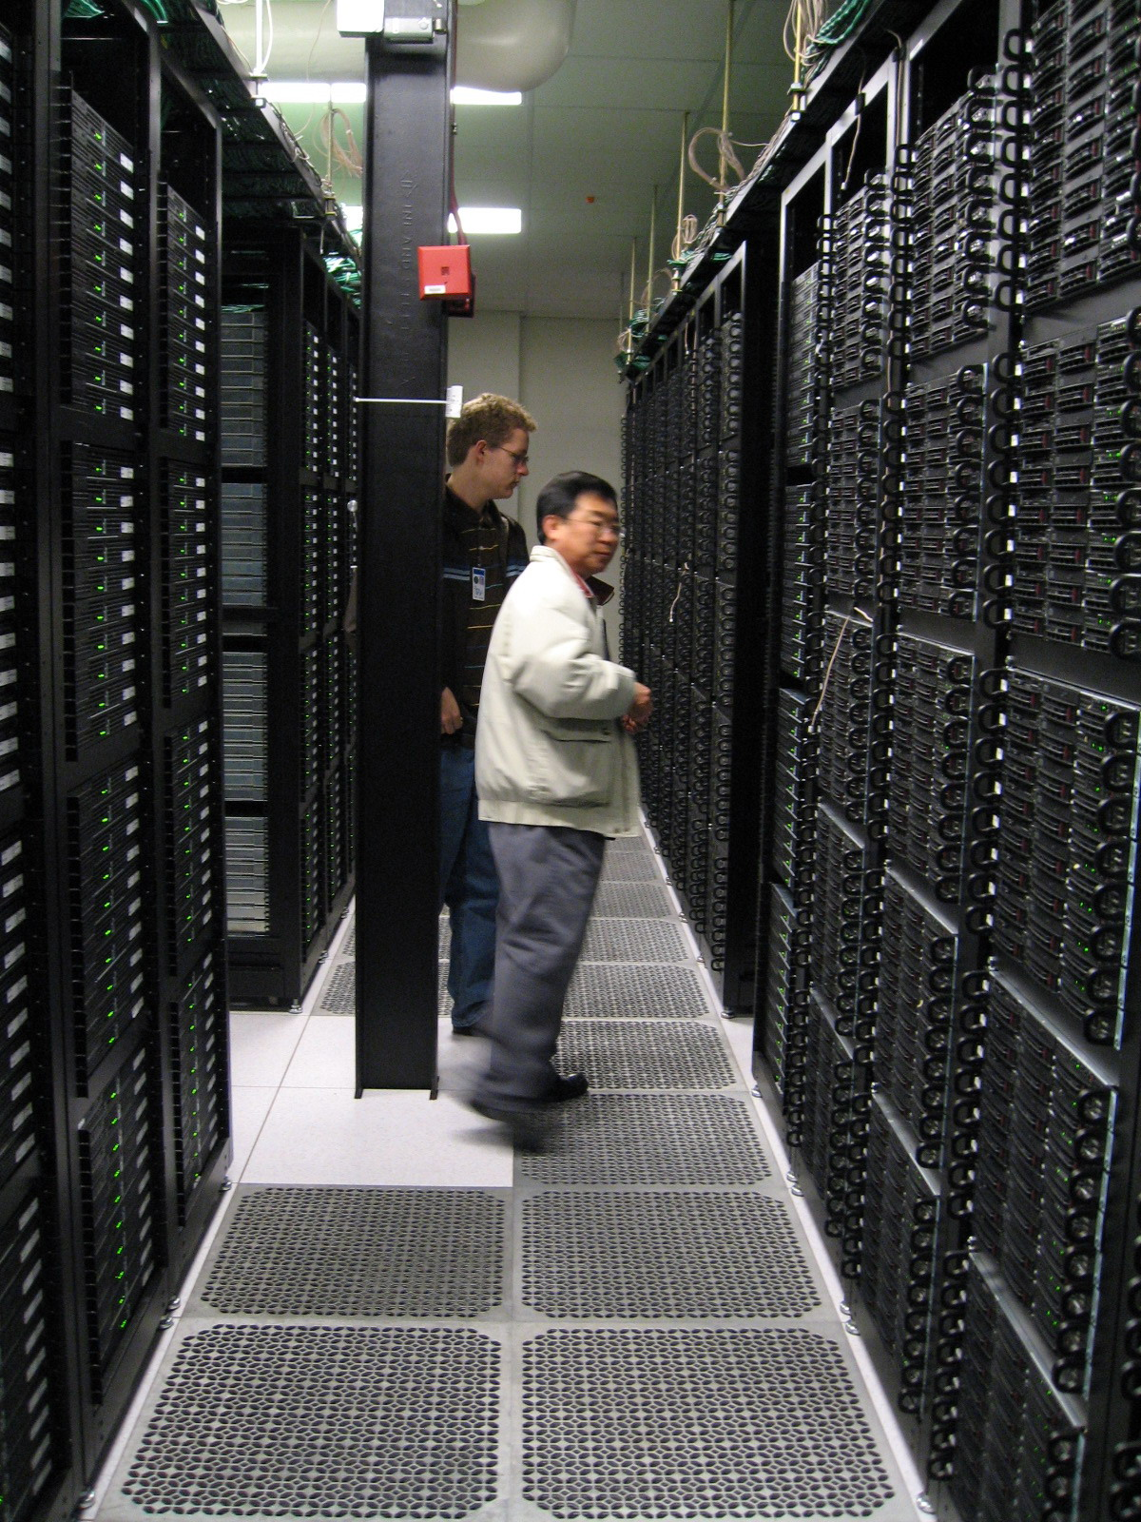
Computers put together a picture
Digital data
p
‾p
Data Reconstruction

Slide 24
The Problem
Detectors are complicated and large ➔ Need large number of collaborators
  They are scattered all over the world!

Slide 25
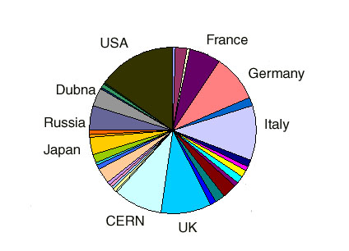
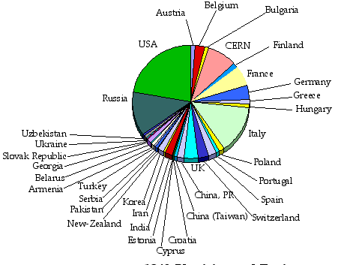
LHC Collaborations
ATLAS
CMS
ATLAS+CMS 6000 Physicists and Engineers
Over 60 Countries, 250 Institutions

Slide 26
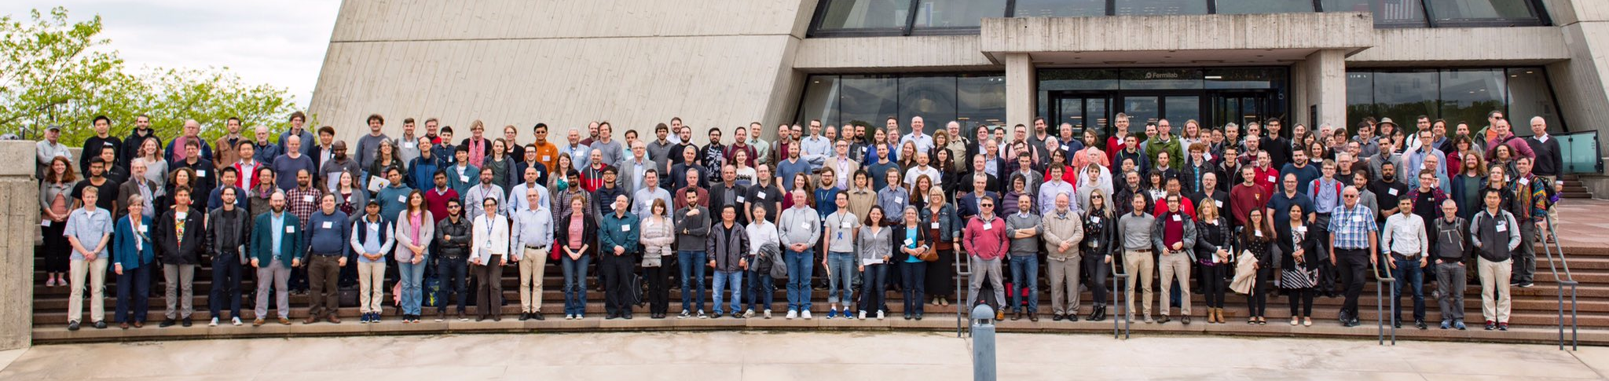
The Map of the DUNE Experiment
1106 collaborators
184 institutions
31 countries

Slide 27
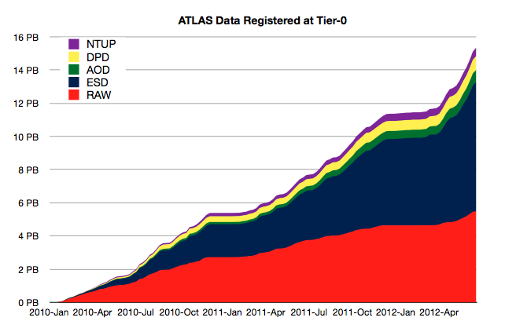
The Problem
Detectors are complicated and large ➔ Need large number of collaborators
  They are scattered all over the world!
  How do we get them communicate quickly and efficiently?
  How do we leverage collaborators’ capabilities?
  How do we utilize all the computing resources?
Data size is large ~ 10 PB per year for raw data only
  Entire data set 15+PB on discovery
  Where and how to store the large amount of data?
  How do we allow collaborators scattered all over the world to access data in an efficient fashion?
ATLAS Data at CERN 2010-Jun 2012
15+ PBytes

Slide 28
The Problem, cont’d
How do we allow people’s analysis jobs to access data and make progress rapidly and securely?
  What is the most efficient way to get jobs’ requirements matched with resources?
  Should jobs go to data or data go to jobs?
  What level of security should there be?
How do we allow experiments to reconstruct data and generate the large amount of simulated events quickly?
  How do we garner the necessary compute and storage resources effectively and efficiently?
  What network capabilities do we need in the world?
How do we get people to analyze at their desktops?

Slide 29
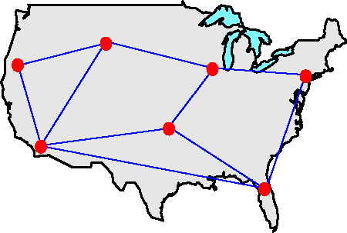

What is a Computing Grid?
Grid, the definition: Geographically distributed computing resources configured for a coordinated use
Physical resources & good network provide hardware capability
The “Middleware” software ties them together
I.Foster and C.Kesselman

Slide 30
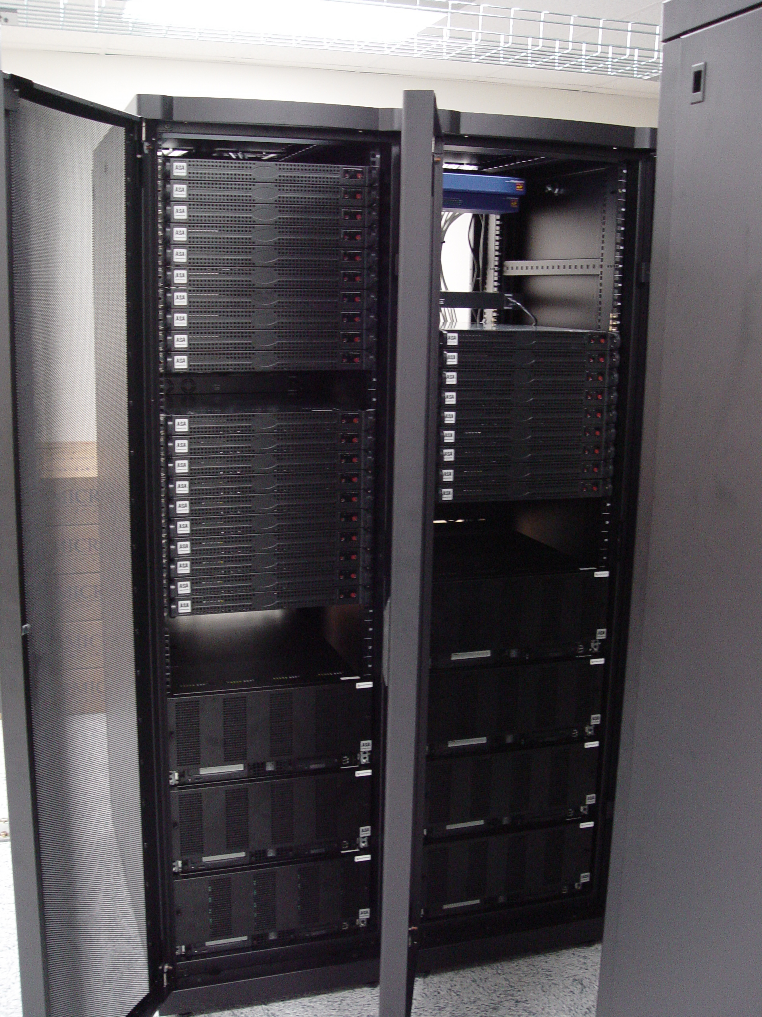
How does a computing Grid work?
JDL
Grid
Ded. Clst.
Desktop. Clst.
Client Site
Ded. Clst.
Desktop. Clst.
Sub. Sites
Exe. Sites
Reg. Grids
DDM

Slide 31
Initial Idea of HEP Computing Model
Cloud
Tier 0
CERN
Normal Interaction
Communication Path
Occasional Interaction
Communication Path
….
Tier 1 Centers
Tier 1
Tier 1
Data and Resource hub
MC Production
Data processing
Tier 2 Centers
...
…
Reduced data
MC Production
Data processing
Tier 2
Tier 2
Tier 2
Tier 2
Tier 3 Centers
Tier 3
….
Tier 3
Tier 3
….
Tier 3
User data analysis

Slide 32
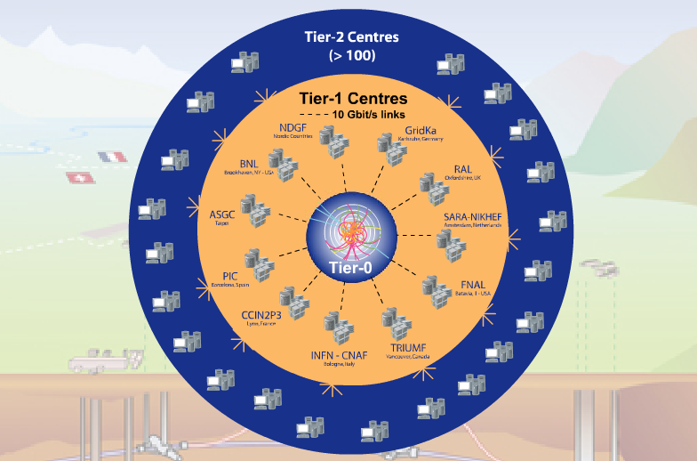





Implemented ATLAS Grid Structure
Tier-0 (CERN): (15%)
  Data recording
  Initial data reconstruction
  Data distribution
Tier-1 (11 centres): (40%)
Permanent storage
Re-processing
Analysis
Connected by direct 10 Gb/s network links
Tier-2 (~200 centres): (45%)
Simulation
End-user analysis
15%
45%
40%
Notes:
The Tier 0 centre at CERN stores the primary copy of all the data. A second copy is distributed between the 11 so-called Tier 1 centres. These are large computer centres in different geographical regions of the world, that also have a responsibility for long term guardianship of the data. The data is sent from CERN to the Tier 1s in real time over dedicated network connections.
In order to keep up with the data coming from the experiments this transfer must be capable of running at around 1.3 GB/s continuously. This is equivalent to a full DVD every 3 seconds.
The Tier 1 sites also provide the second level of data processing and produce data sets which can be used to perform the physics analysis. These data sets are sent from the Tier 1 sites to the around 130 Tier 2 sites.
A Tier 2 is typically a university department or physics laboratories and are located all over the world in most of the countries that participate in the LHC experiments. Often, Tier 2s are associated to a Tier 1 site in their region. It is at the Tier 2s that the real physics analysis is performed.

Slide 33
Tiered Example – US Cloud
BNL T1
MW T2
UC, IU
NE T2
BU, HU
SW T2
UTA, OU
SLAC T2
GL T2
UM, MSU
IU OSG
UTA T3
OU Oscer
Tier 3’s
Wisconsin
UC Teraport
UTD
LTU
Many more T3s
SMU/UTD

Slide 34

ATLAS Production and Distributed Analysis System, Panda
Designed for analysis as well as production
Works with OSG, EGEE/LCG and others
A single task queue and pilots
  Apache-based Central Server
  Pilots retrieve jobs from the server as soon as CPU is available low latency
Highly automated with an integrated monitoring system
Requires low operation manpower
Integrated with ATLAS Distributed Data Management (DDM) system
Not exclusively ATLAS and has spread throughout many different entities in various disciplines

Slide 35
How to look for rare particles?
Many of these rate particle are so heavy they decay into other lighter particles instantaneously
When one searches for a new particle, one looks for the easiest way to get at them
Of many signatures of the rare particle final states, some are much easier to find ➔e.g. for the Standard Model Higgs particle
  H→ γγ
  H → ZZ* → 4e, 4μ, 2e2μ, 2e2ν and 2μ2ν
  H→ WW*→2e2ν and 2μ2ν
  And many more complicated signatures

Slide 36
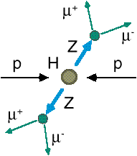
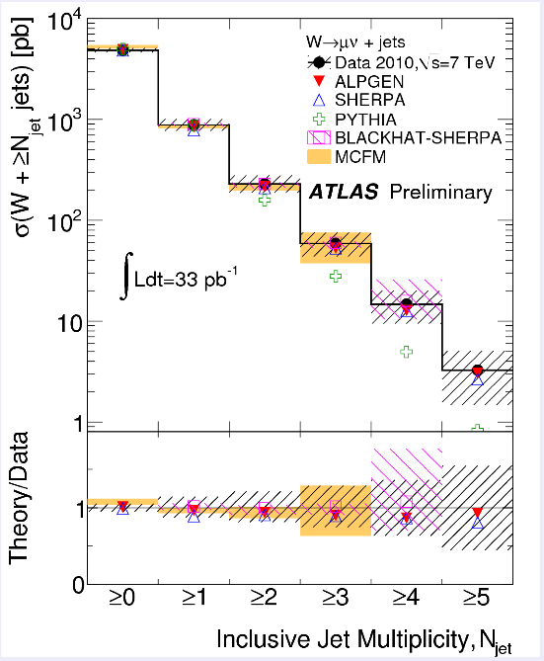
How do we look for a rare particle?
Identify Higgs candidate events
Understand fakes (backgrounds)
Look for a bump!!
  Large amount of data absolutely critical
e⁺ (μ⁺)
e⁻ (μ⁻)
e⁺
e⁻

Slide 37
Amount of LHC Data
2018 data taking
Peak inst. luminosity:
~ 2 x10³⁴ cm⁻² s⁻¹
Superb performance!!
2012: 21.2fb⁻¹
Total at 7 and 8 TeV ~1fb⁻¹/week
The discovery announcement
2011
5.6 fb⁻¹
at 7 TeV
2015
3.1 fb⁻¹
at 13 TeV

Slide 38
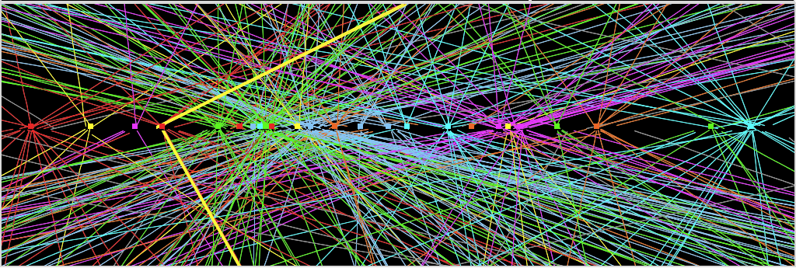
Challenges? No problem!
An interesting collision event with 25 collisions at once!!
Here it is!!

Slide 39

What did statistics do for Higgs→ γγ?
Excess of 7.4 σ at M_{H}=126.5GeV

Slide 40

ATLAS Mass Bump Plot (H→4l )?
6.5σ Excess!!

Slide 41
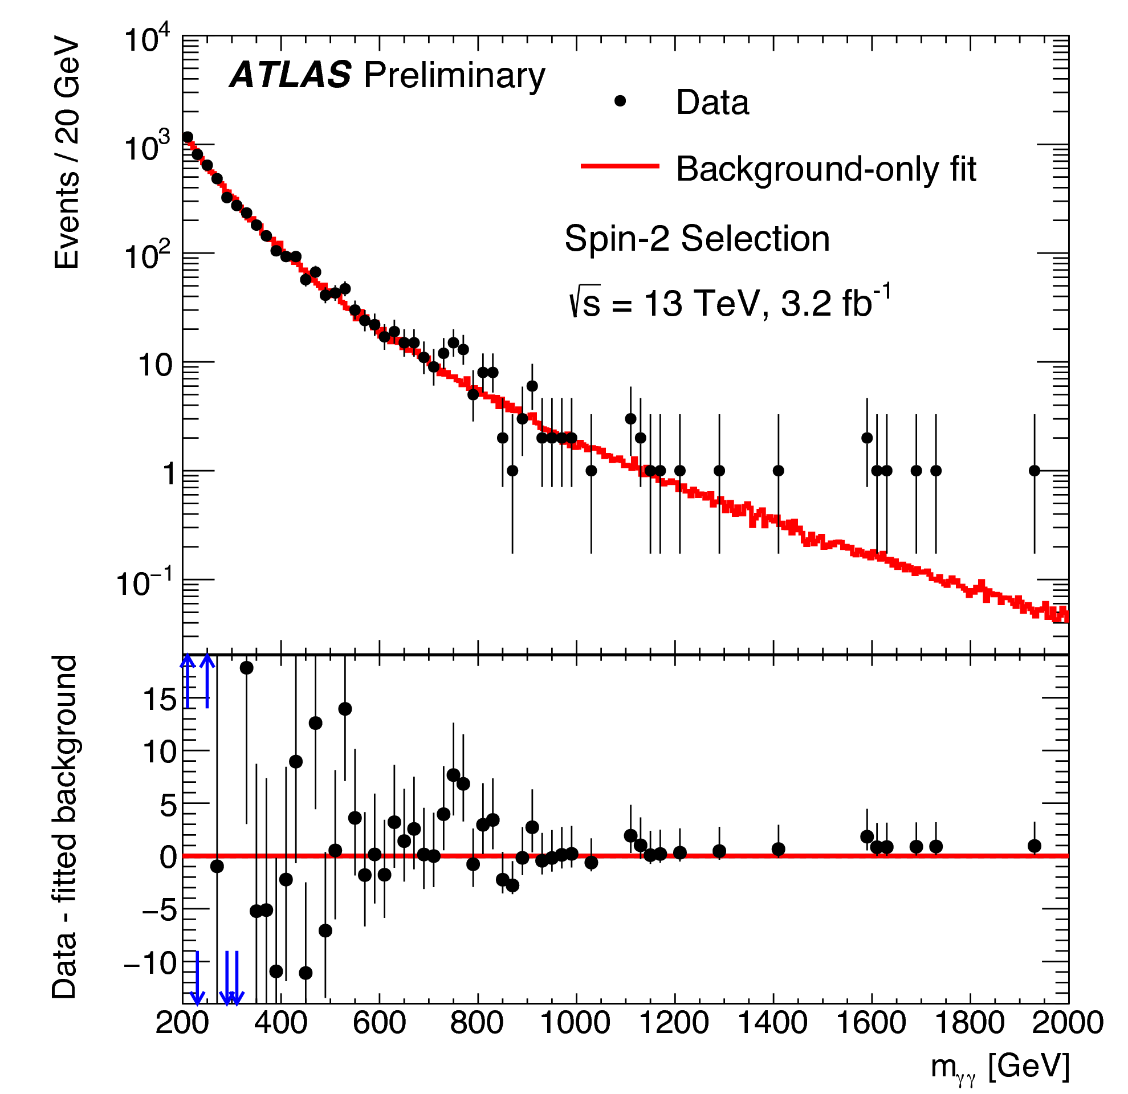
A hint of something new?
~760GeV
(2015 data)
Hmm!
~4.6σ Excess!!

Slide 42
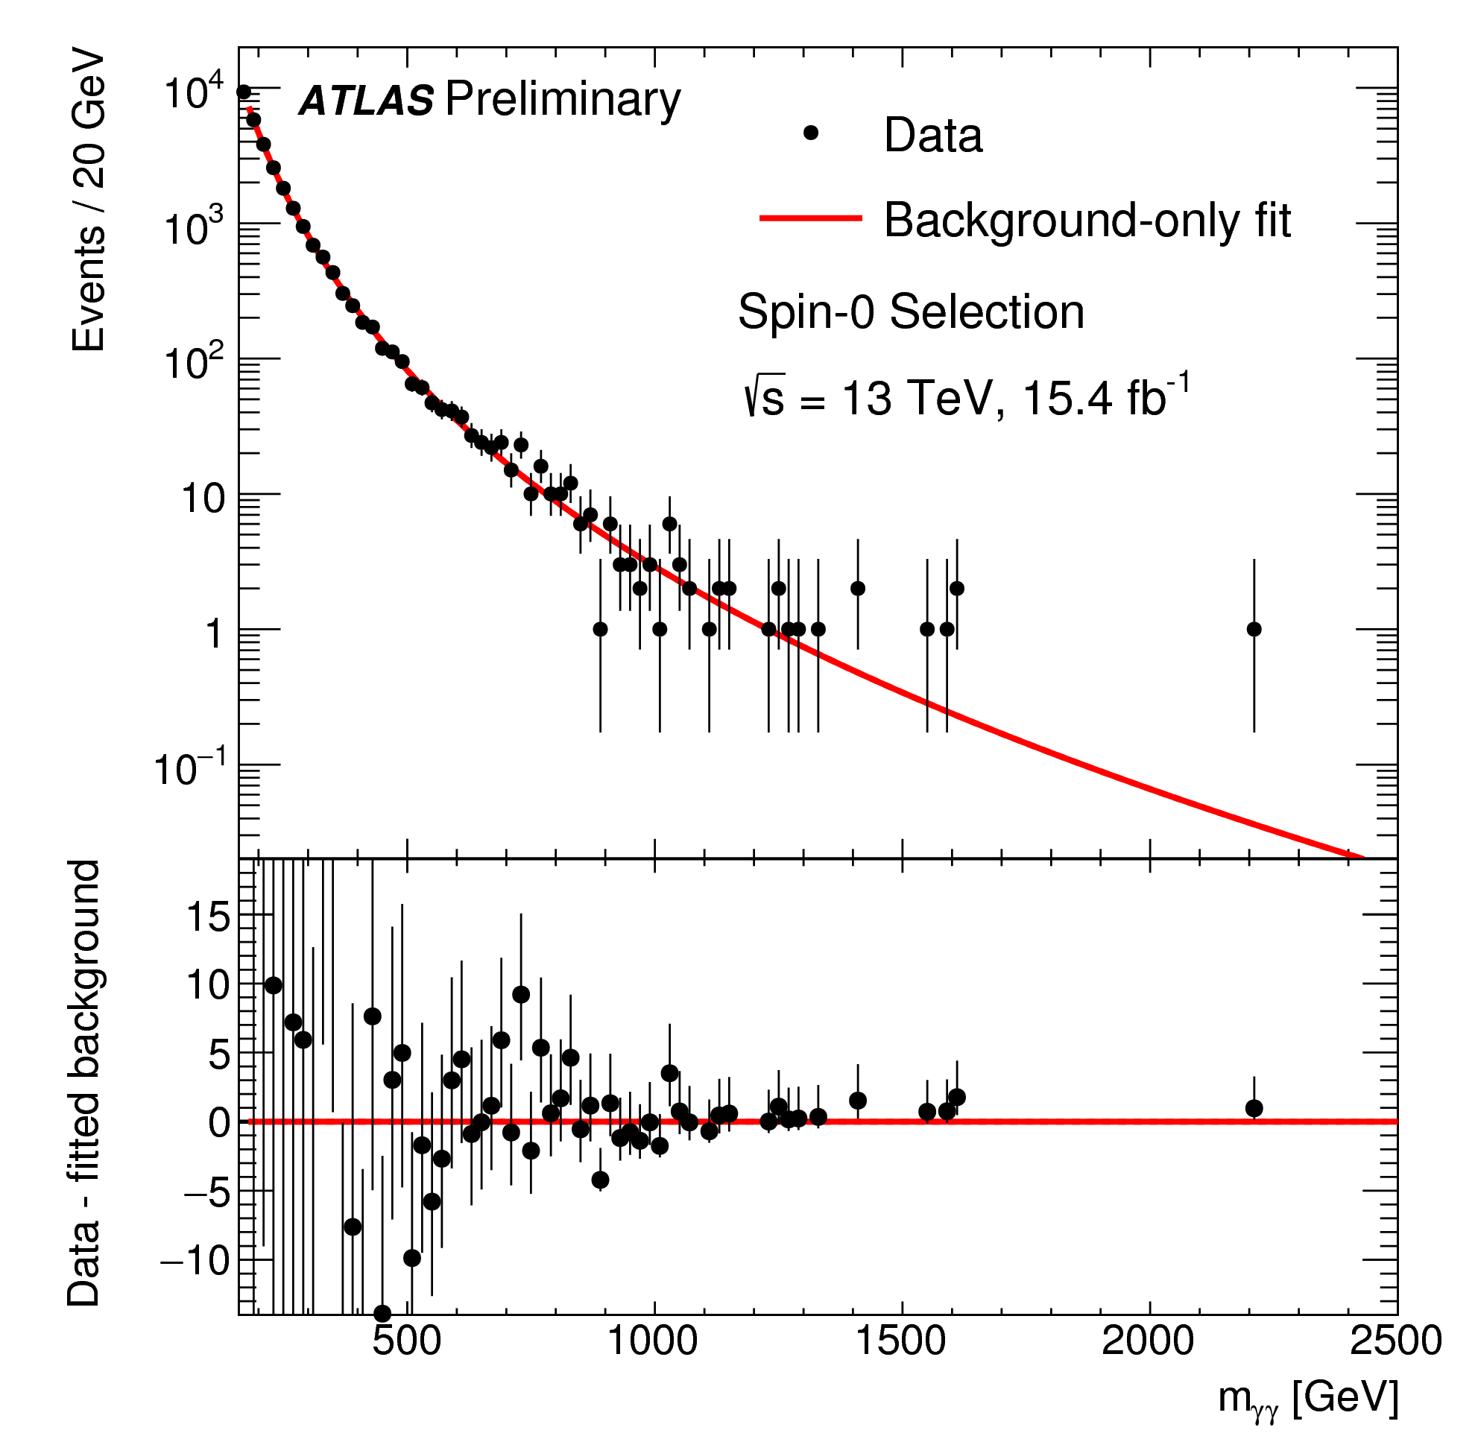
Disappeared after x4 data!!
~760GeV
(2015+2016 data)
Not there anymore!
<2σ!!

Slide 43
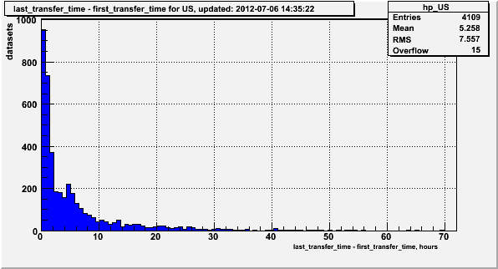
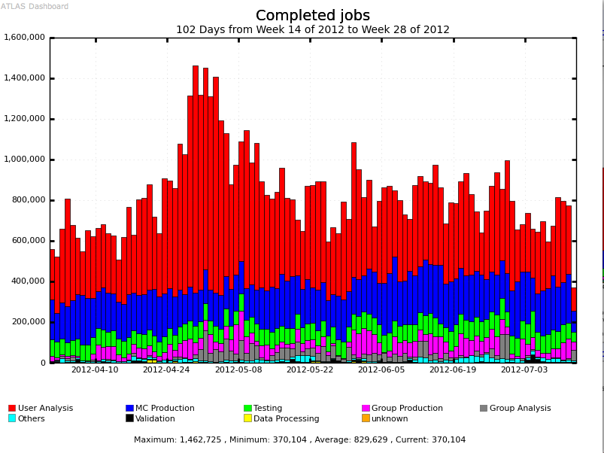
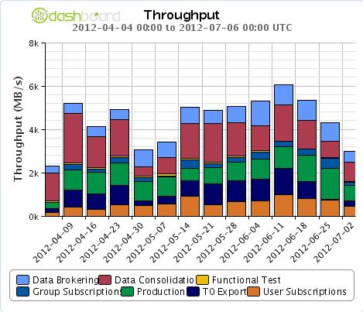
Performance of the Grid for LHC
ATLAS Distributed Computing on the Grid : 10 Tier-1s + CERN + ~70 Tier-2s +…(more than 80 Production sites)
High volume, high throughput process through fast network!!
ATLAS 2012 dataset transfer time.
Apr 1 – Jul 12 2012 Completed Grid Jobs
5h
Data available for Physics analysis in ~ 5h
~830K daily average
completed ATLAS Grid jobs
Analysis
MC prod
Apr 1 – Jul 4 2012 Data Transfer Throughput (MB/s)
All ATLAS sites
Up to 6GB/s week average

Slide 44
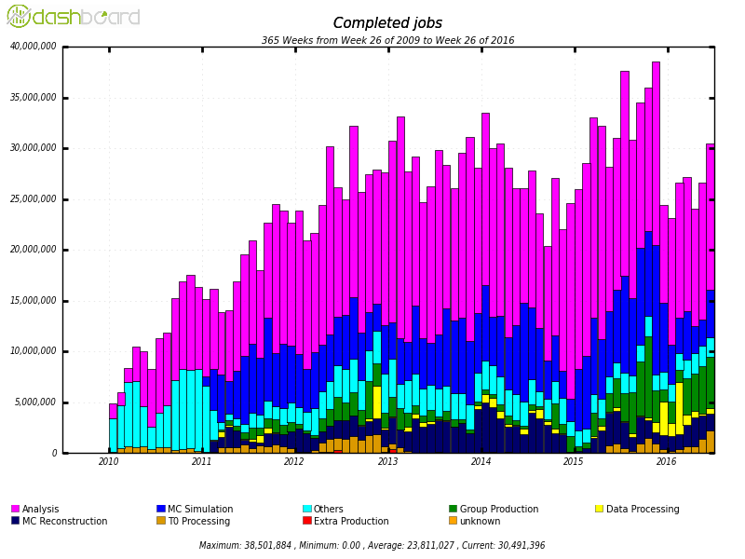
PanDA Performance
  Current scale – 25M jobs completed every month at >hundred sites
  First exascale system in HEP – 1.2 Exabytes processed early in the LHC run
Kaushik De

Slide 45
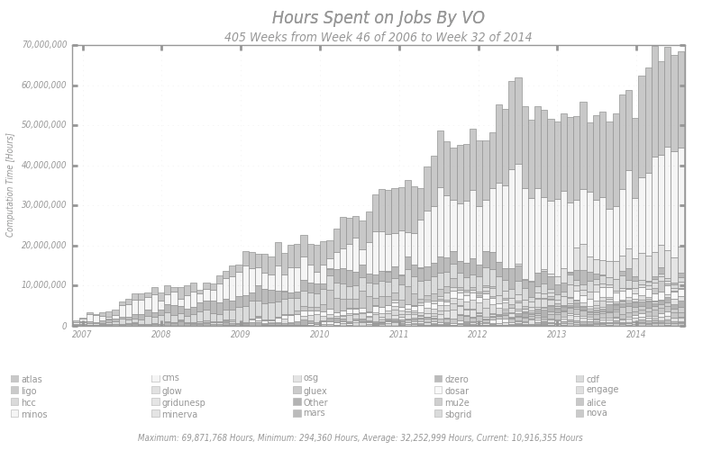

Growing Use of “Owned” and of
“Opportunistic” Resources
  Opportunistic use of resources
  by “Campus Users”
  equally increasing
  Supporting a rather diverse
  group of sciences and
  researchers
Opportunistic
Use?
>90M CPU hours
opportunistic use
past 12 Months
Lotha

Slide 46





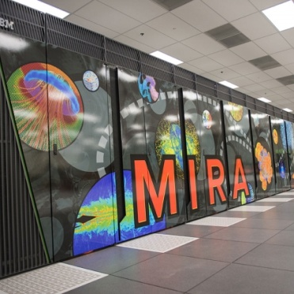


Resources Accessible via PanDA
Many
Others
  About 250,000 job slots used continuously 24x7x365

Slide 47
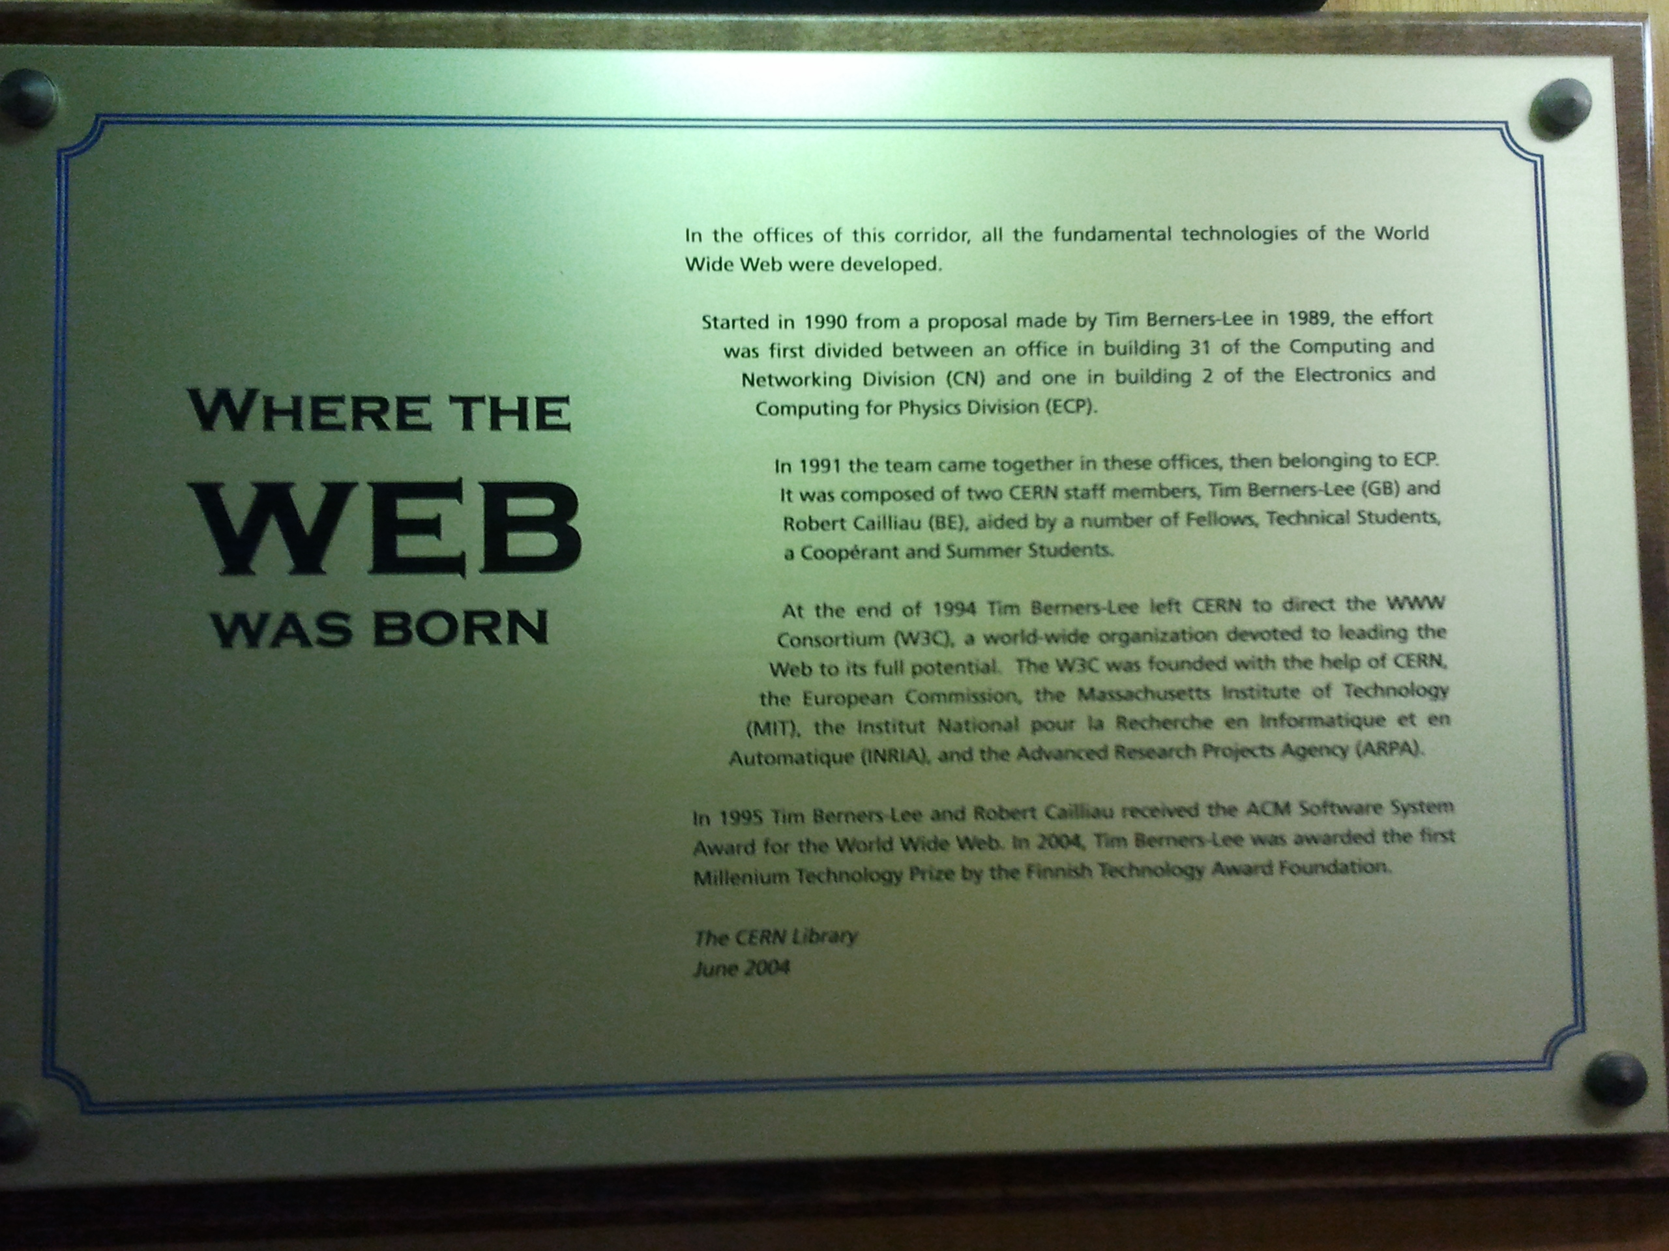







Now the commercial world picked up..
Early 90’s
2004
1996
2006
1998
Many private entities fully utilized the internet communication we’ve developed to multi-trillion dollar venture!!
Now the concept of cloud being picked up, though not exactly the same idea behind it…

Slide 48
So why is HEP relevant to me?
HEP explores the most fundamental nature of the Universe!
Discoveries will realize our 1000 year dreams
The discovery of the dark matter and making of dark matter beams will take us to the next Quantum level

Slide 49
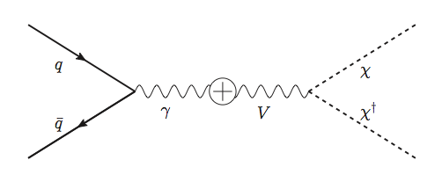
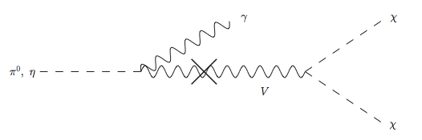
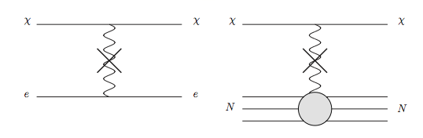
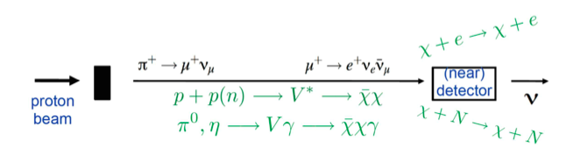
Light DM Production at High Intensity Accelerator
Now the Higgs particle, a part of only 5% of the universe, may’ve been seen
It is time for us to look into the 95% of the universe using high intensity beams, like 1.2 – 2.3MW beams at Fermilab in the US!
Detection of DM:
How does a DM event look in an experiment?:
Higher E_{P} @ LBNE
Lower E_{P} @ MiniBooNE
High Intensity Proton Beam

Slide 50
Smart Dark Matter Beam Line!!
Now the Higgs particle, a part of only 5% of the universe, may’ve been seen ➔ Time to look for and study the 95% of the universe
We can have a beamline that separates neutrinos and anti-neutrinos from DM’s ➔ Use a string of magnets
Give parent particles of ν’s a magnetic kick to do this separation
Add a dipole after the mesons are fully focused with the 2nd horn
dipole
High Precision Detector
Dark Matter Experiments
p
p, π⁰, χ
Beam Dump
ν target
π⁺⁽⁻⁾, charged mesons
Focusing
horns
Precision Neutrino Experiments
Decay pipe
DUNE detector system

Slide 51
So why is HEP relevant to me?
HEP explores the most fundamental nature of the Universe!
Discoveries will realize our 1000 year dreams
The discovery of the dark matter and making of dark matter beams will take us to the next Quantum level
Outcome and bi-products of HEP research improves our daily lives directly and indirectly
  WWW came from HEP

Slide 52
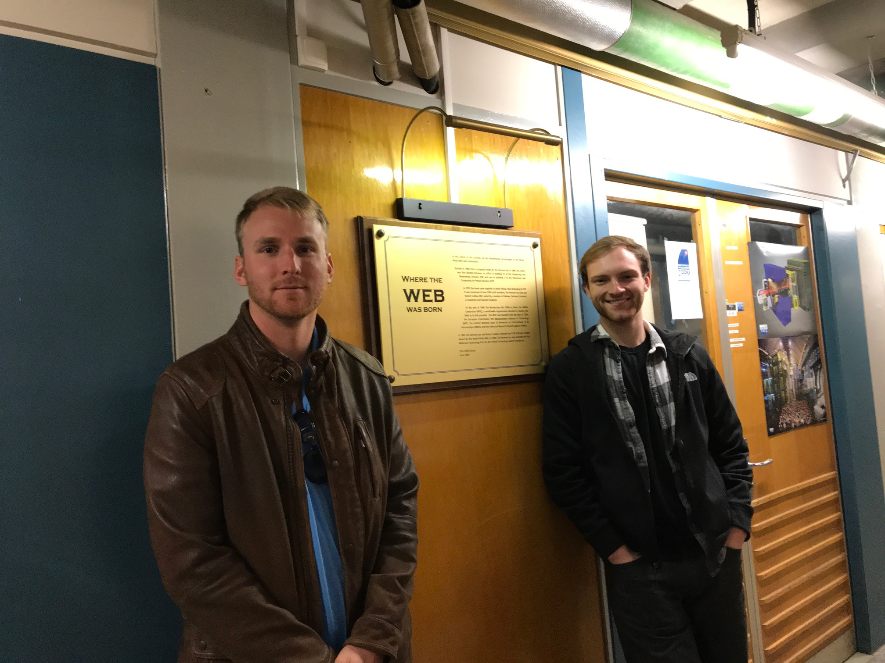

Slide 53
So why is HEP relevant to me?
HEP explores the most fundamentals of the Universe!
Discoveries will realize our 1000 year dreams
The discovery of the dark matter and making of dark matter beams will take us to the next Quantum level
Outcome and bi-products of HEP research improves our daily lives directly and indirectly
  WWW came from HEP
  Advanced detector technologies like GEM will make a large screen low dosage X-ray imaging possible

Slide 54
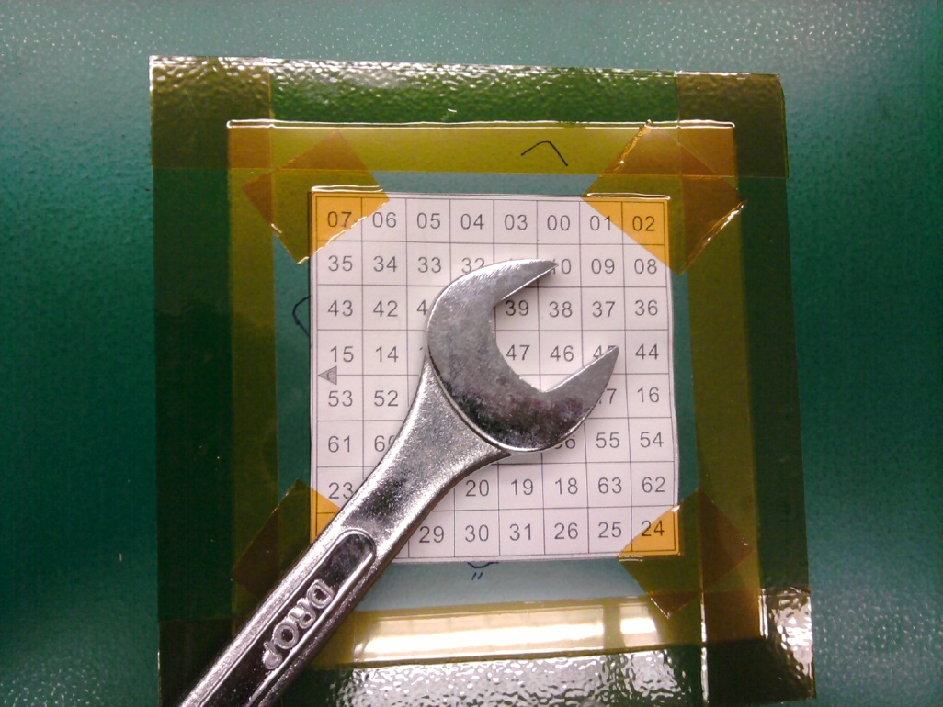
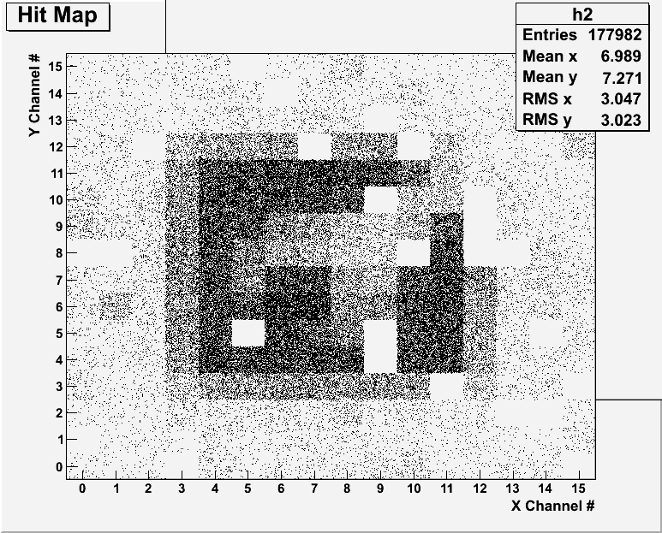
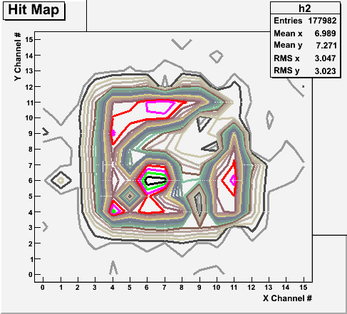
Bi-product of High Energy Physics Research
Can you see what the object is?
(GEM Detector X-ray Image)

Slide 55
So are we done with the grid?
LHC has performed extremely well!
The data size will increase by 10 fold or more in HLLHC
  Computing will be under even more stress
Grid computing infrastructure has served well thus far
  1500 ATLAS users process PBs of data & billions of jobs
High Intensity Experiments, like DUNE, could record as much or even larger amount of data than the LHC
Identified limits in databases scalability, CPU resources, storage utilization, etc, are being addressed
Planning for HEP and utilize quantum computing and Machine learning technologies

Slide 56
Conclusions
In the quest for the origin of the universe, High Energy Physics
  Uses accelerators to look into extremely small distances
  Uses large detectors to explore nature and unveil secrets of universe
  Uses large number of computers to process data in a timely fashion
  Large amount of data gets accumulated ➔ computing grid performed marvelously for expeditious data analyses
HEP is an exciting endeavor in understanding the universe
Physics analyses at one’s own desktop using computing grid sitting behind has happened!!
Computing grid needed for other disciplines with large data sets
Computing grid now outside of HEP into everyday lives
A true computing grid is revolutionizing everyday lives .…

Slide 57
not just for tomorrow,
Let’s all dream,
not just for the next year,
but for 1000 years into the future for the whole humanity!!

Slide 58
FFT: Number of beam particles per sec?
What is the number of particles per second for an accelerator facility that can provide:
  P MW of total beam power
  of charged particles of energy E GeV?
  What is the number of protons per second for 120GeV beams at 1.2MW?
  What is the beam current?

