Slide 1

106th Technical Coordination Meeting
Update on WP6a
A. Ballarino and P. Cruikshank
11/06/2020

Slide 2
Table of contents
Topics retained from last PSM:
Baseline for DFX, DFM, DFHX and DFHM cryostats
ECR on DFH design
Space needed for cables in cryostat
DEMO 2 status

Slide 3
Baseline for DFX, DFM, DFHX and DFHM

Slide 4
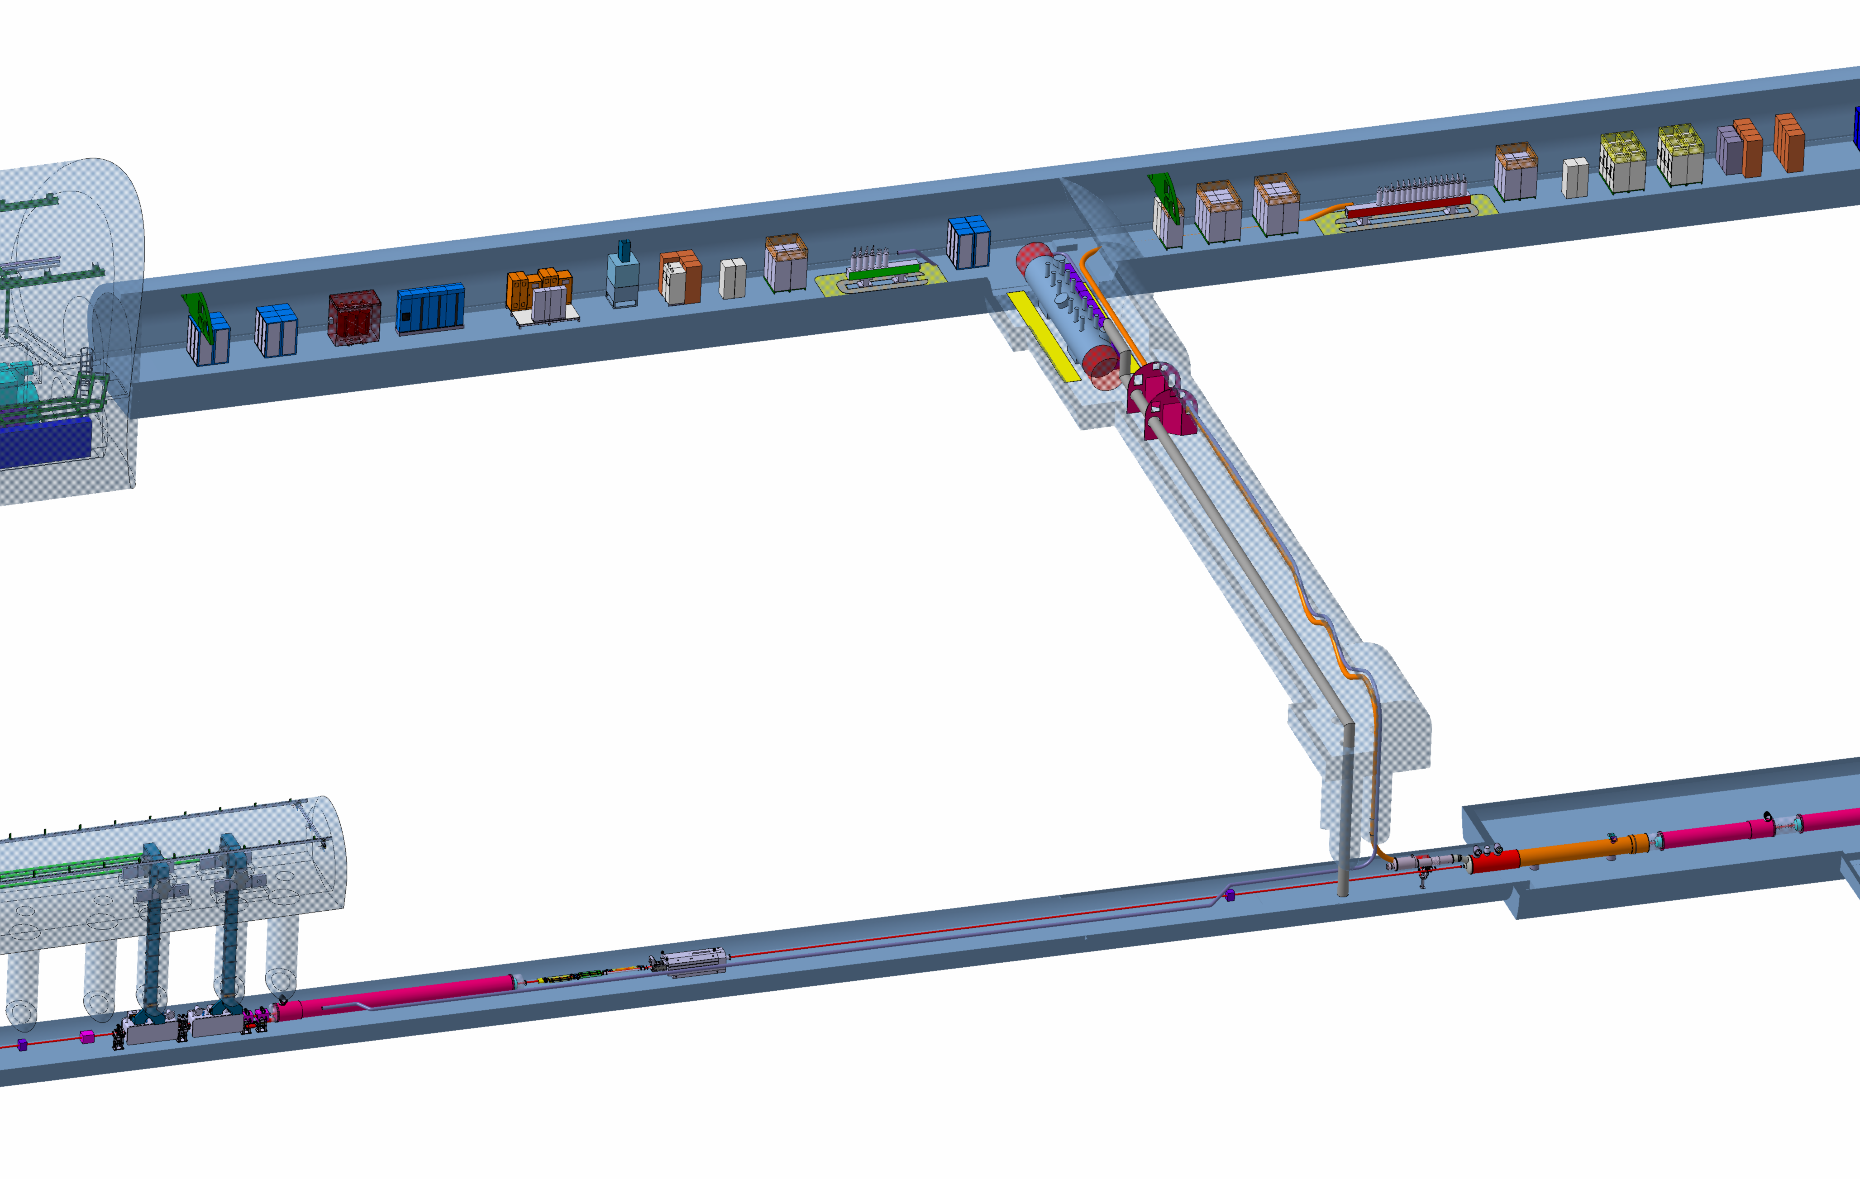
Cryostat and leads
Cryostat and leads
DFHX
DFHM
SC Link for Triplets
SC Link for
Matching Sections
DFX
D1
DFM

Slide 5
Overview - DFX, DFM, DFHX and DFHM
Design of components at CERN progressed well during the COVID period
Several iterations with WP17 – with meetings on integration aspects on a weekly basis. Forum for discussing and reviewing also interfaces with other WPs
DFX first unit (spare for HL-LHC) designed and being produced via UK1 (Univ. of Southampton). Excellent collaboration between CERN and University of Southampton during all phases – from conceptual to detailed design. All interfaces, in particular with WP9 for cryogenic and operational aspects, discussed and reviewed
DFX and DFM series production via UK2 (Univ. of Southampton) approved at FC of December 2019. Working on writing-up of collaboration agreement
DFHX and DFHM prototypes and series production via collaboration agreement with Uppsala University approved at FC of December 2019. Working on writing-up of collaboration agreement

Slide 6
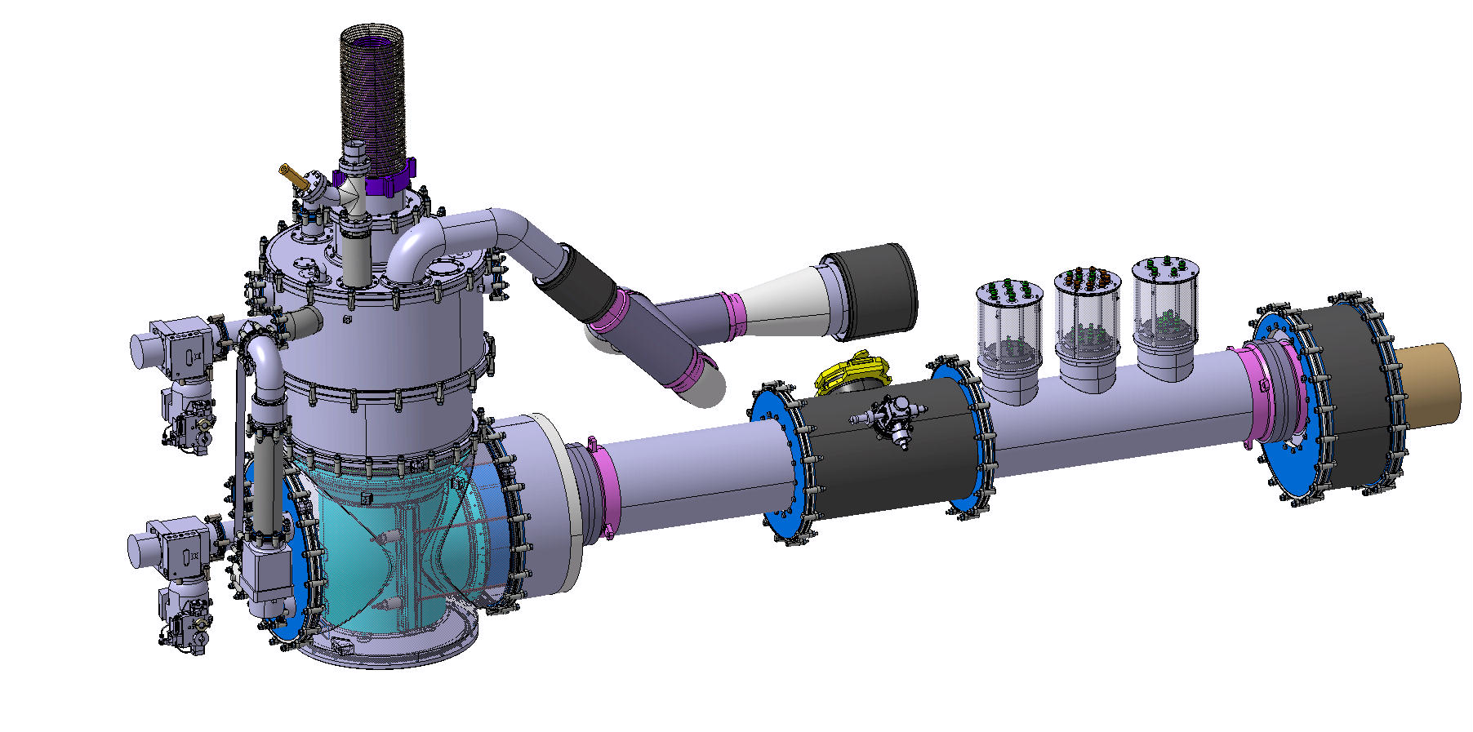
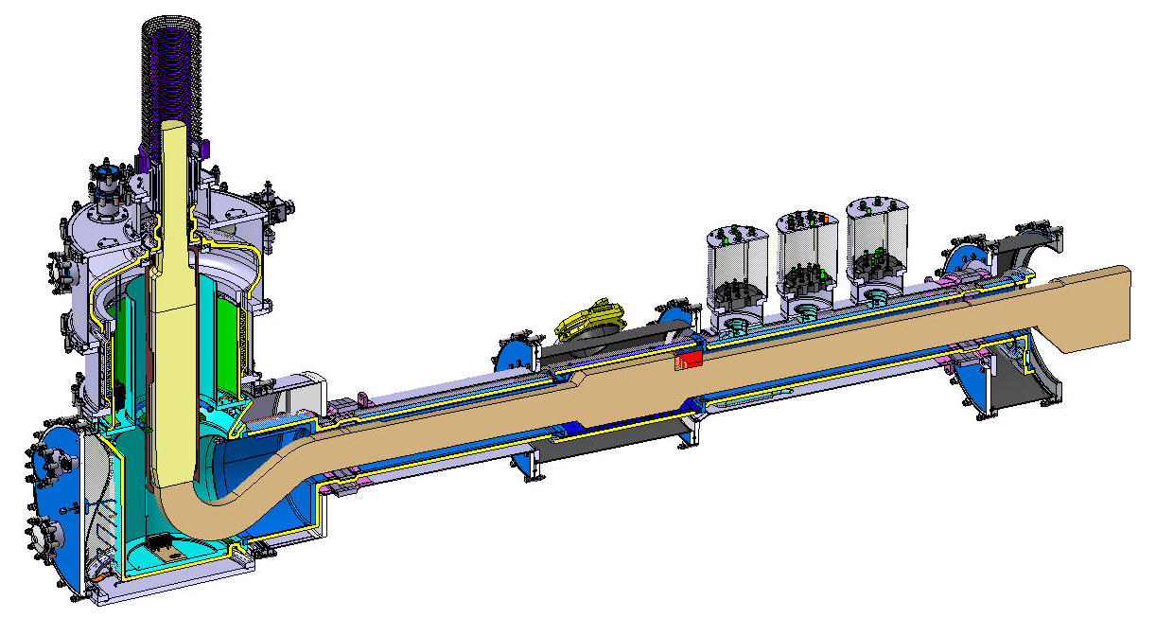
DFX - Triplets
2D detailed drawings completed
PRR at CERN/SOTON on 03/03/2020
All materials sourced and Co compliant
COVID-19 affects material procurement
Still expect to meet Q1 2020 delivery
University of Southampton
GHe
MgB₂
LHe
Nb-Ti

Slide 7
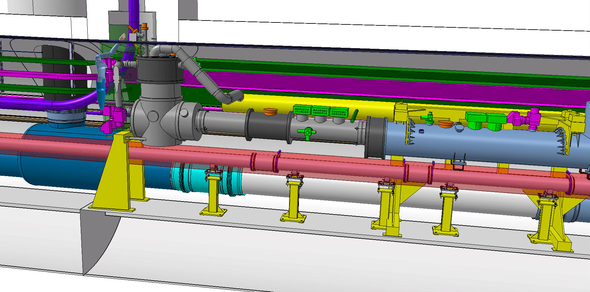
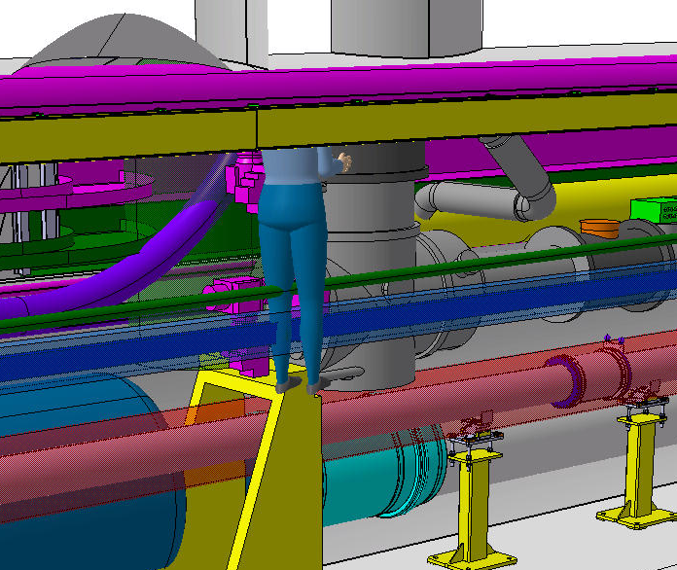
DFX - Triplets
Integration drawings updated
Interfaces defined

Slide 8
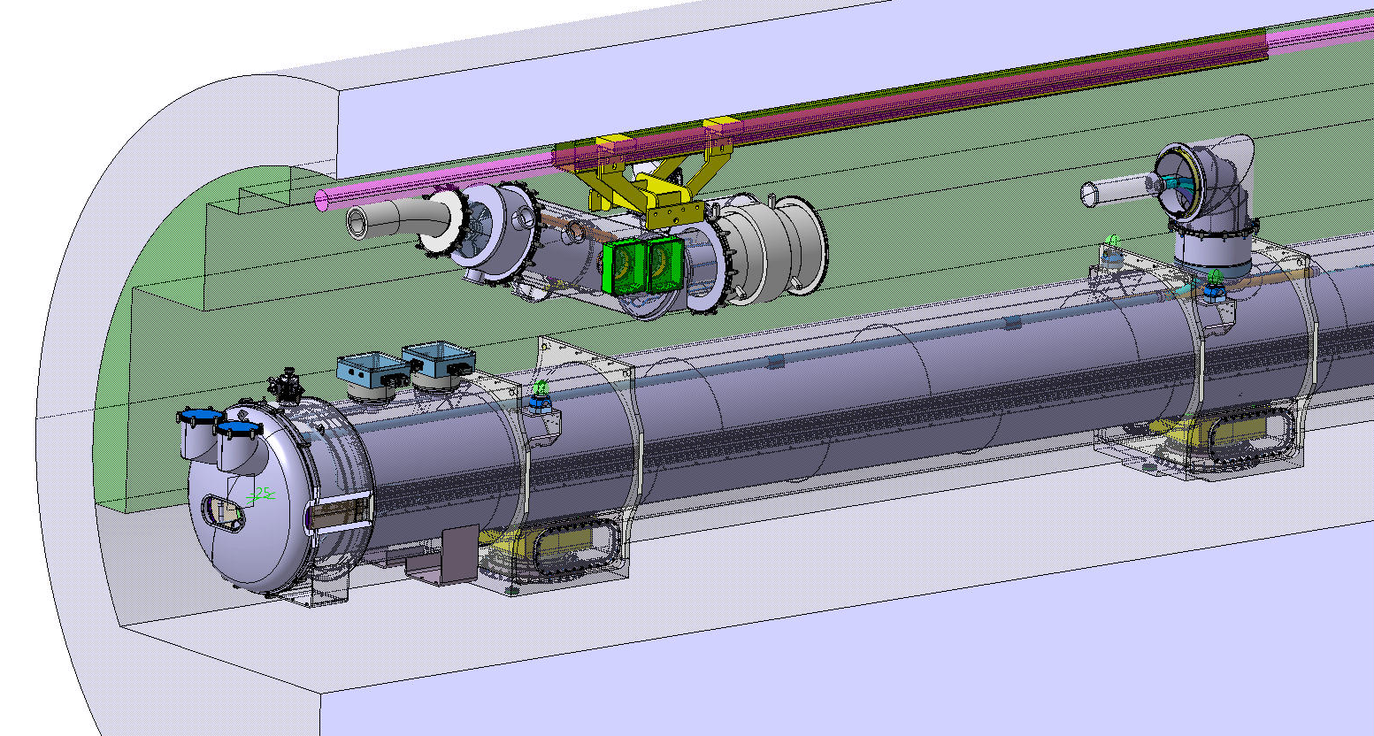
DFM – Matching Sections
3D conceptual drawings available and used for integration studies
Elaborated routing of SC Link for connection to DFM
Modifications on D2 bus-bar on-going within WP3: interface to be defined

Slide 9
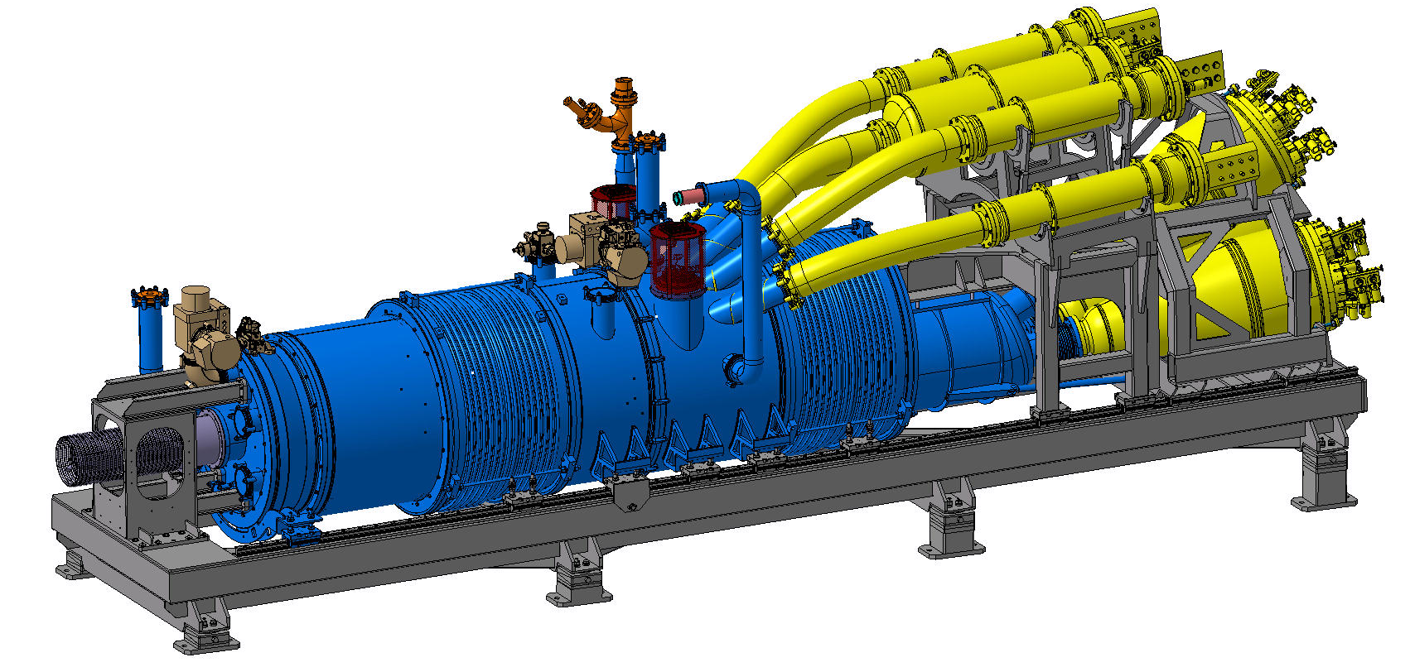
DFHX - Triplets
GHe from SC Link
HTS-REBCO (50 K)
MgB₂ (25 K)
3D Drawings completed. 2D Drawings well advanced
Integration drawings in the tunnel well advanced, with definition of interfaces Detailed Design Review on the 16th of June

Slide 10
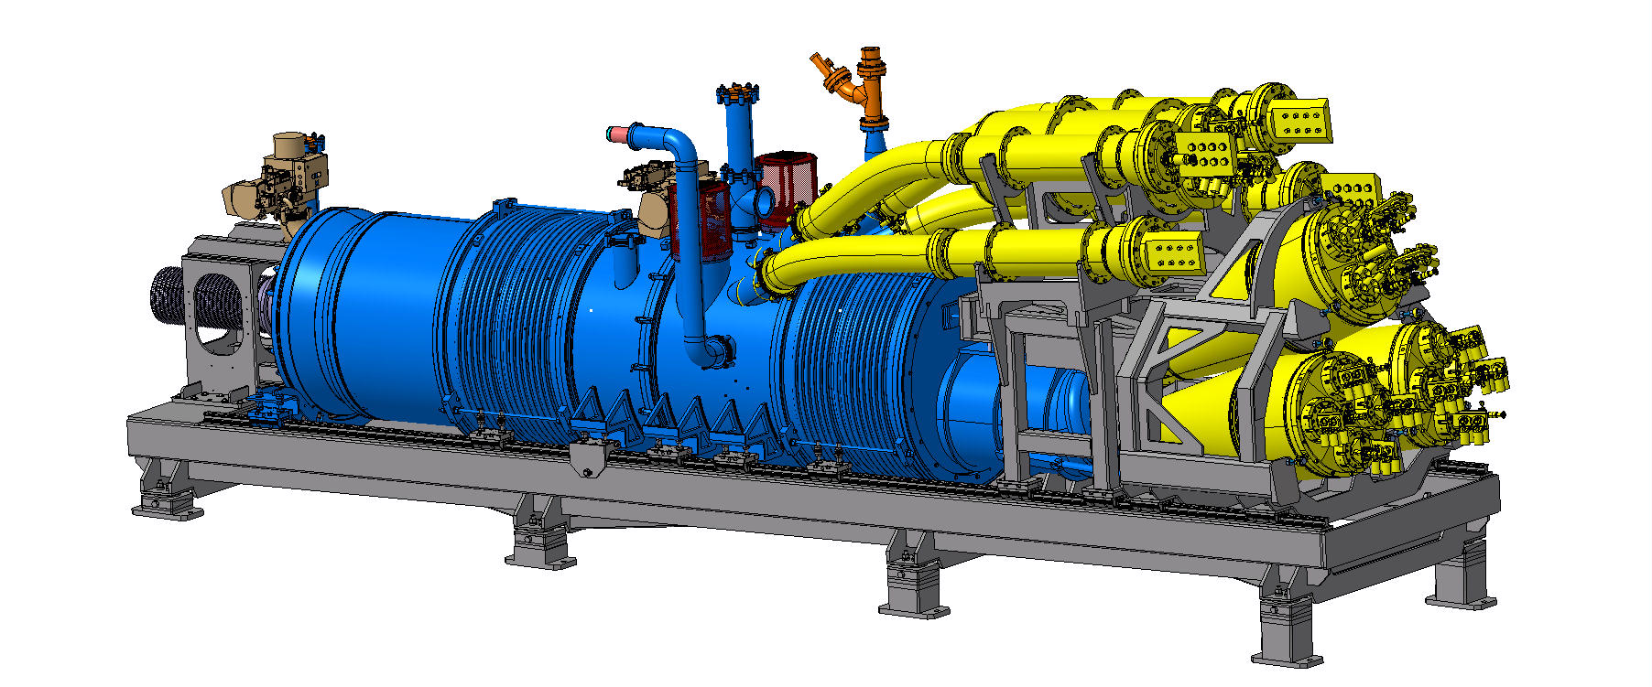
DFHX - Triplets
Electrical interface with WP6b (current leads to RT bus) defined

Slide 11
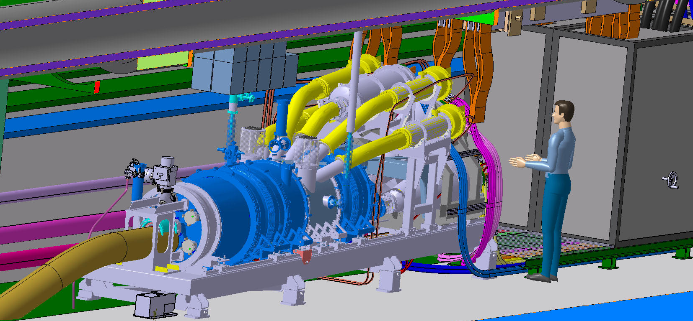
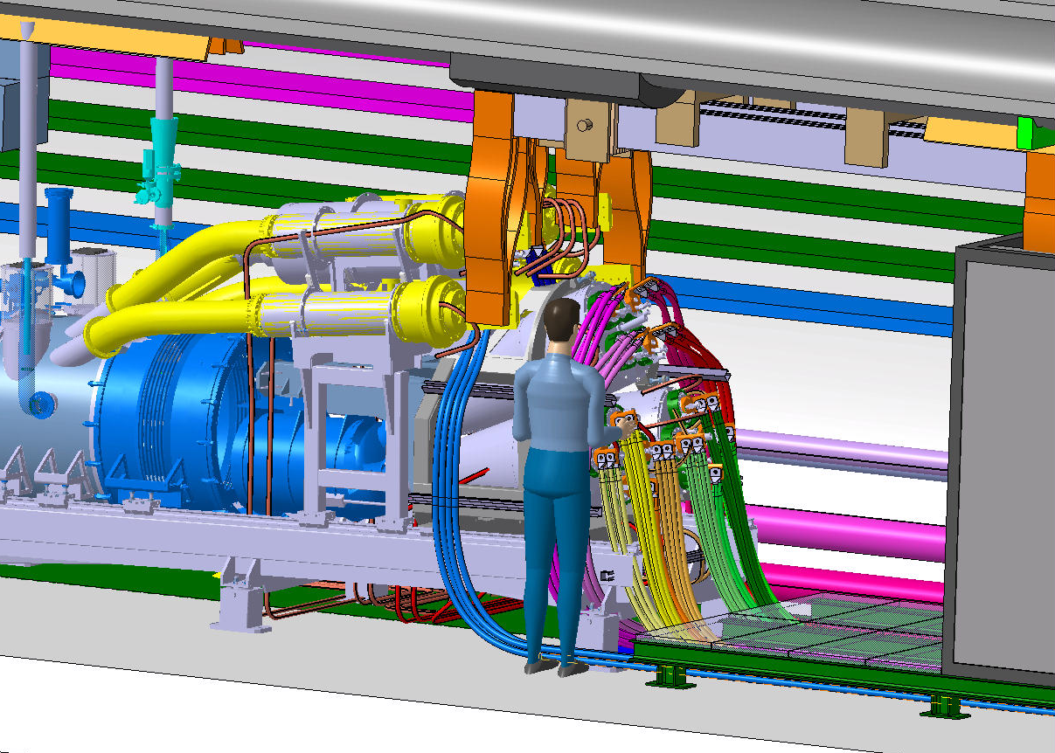
DFHX - Triplets

Slide 12
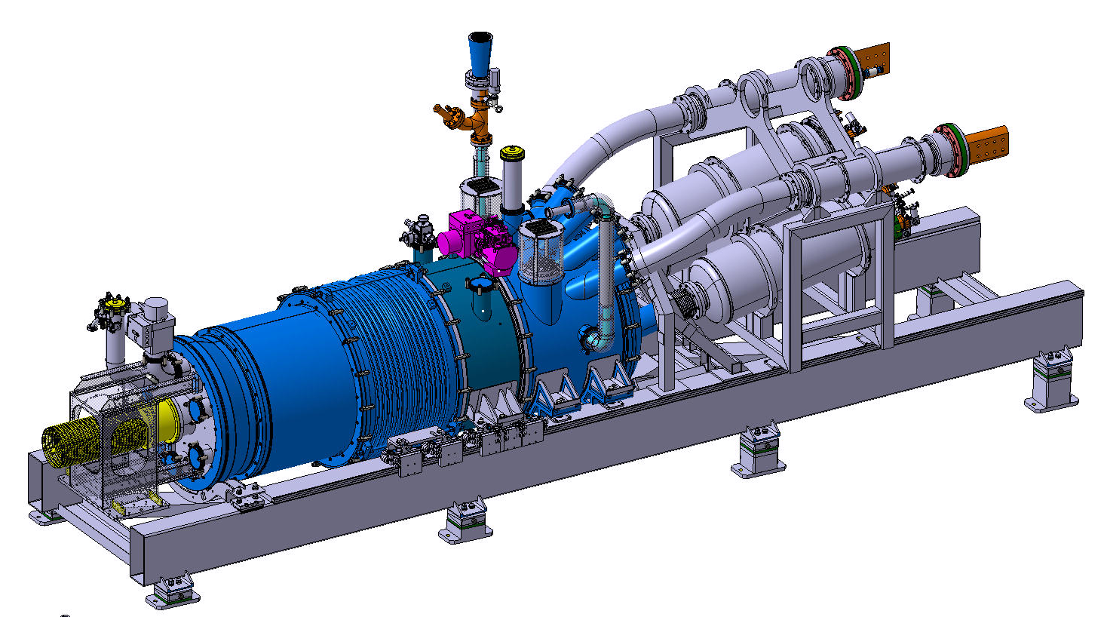
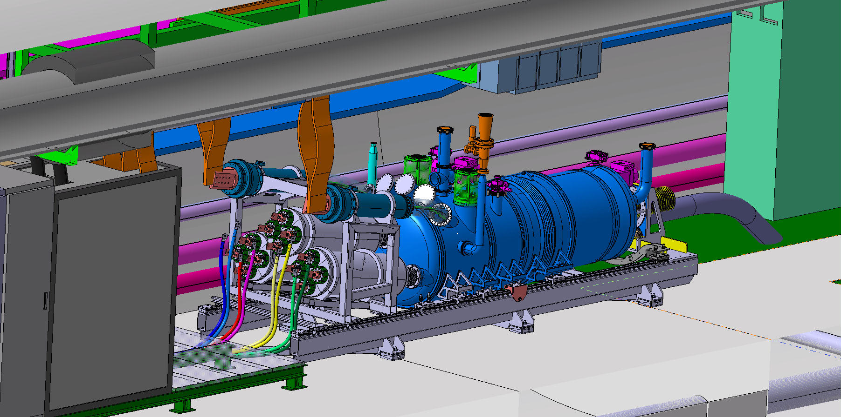
DFHM
Adopted same design of DFHX – with two instead of three modules
2D drawings ∼ 70 % common to DFHX
Integration studies proceeding well in collaboration with WP17 and WP6b

Slide 13
ECR on DFH design

Slide 14
ECR on DFH
1. LHC DFBA cryostat in the HL-LHC gallery. It would have occupied a length of 10 m
2. Intermediate concept of DFHX. Two modules electrical connected via an additional SC Link. It would have occupied a length of about 29 m, including about 12.4 m of SC Link in between the modules
3. HL-LHC DFHX baseline in the HL-LHC gallery. It occupies a length of 5.8 m

Slide 15

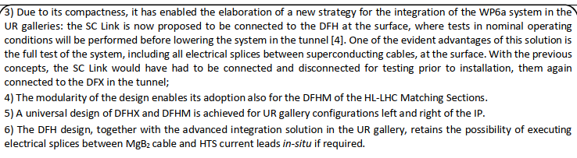
ECR on DFH
2383175 v.1.0, LHC-DFH-EC-0001 v.1.0, WP6a, WP15
No impact on schedule. Cost within estimation

Slide 16
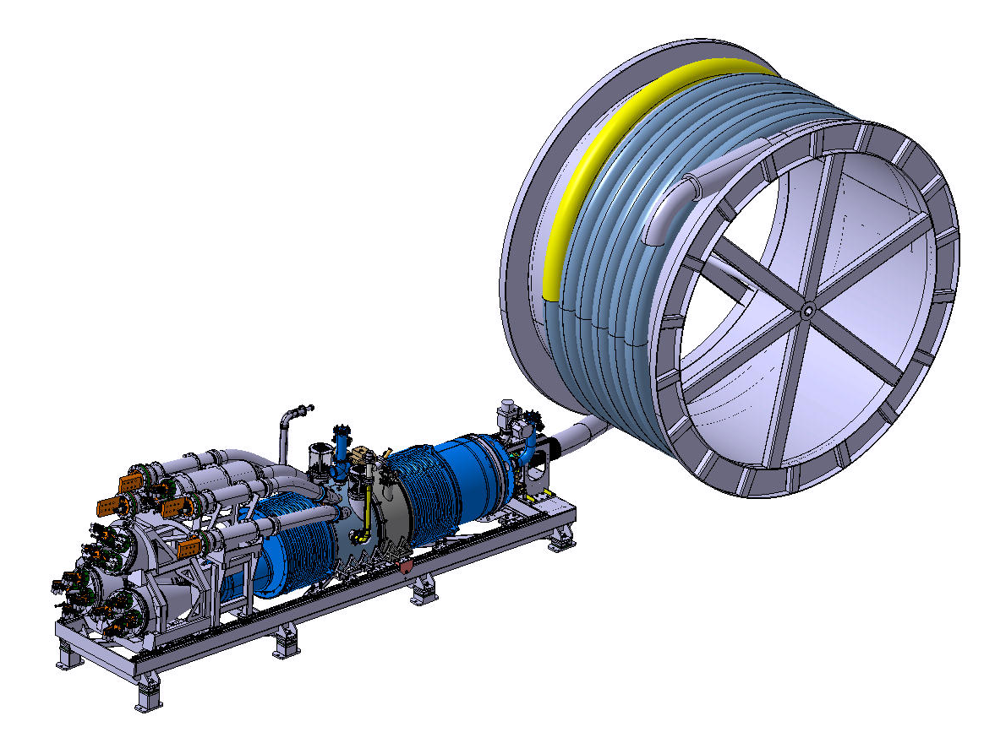
System lowered in the tunnel after cold tests
SC Link
System cold tested at the surface
DFHX/DFHM
Many thanks to the transport team and design
office for the detailed transport study

Slide 17
Space requirements

Slide 18
Updated and quantified space need
Defined: working sequence, volumes and services
for both ITs and MSs systems
Active iteration with the TE department representatives

Slide 19
Demo 2: status

Slide 20
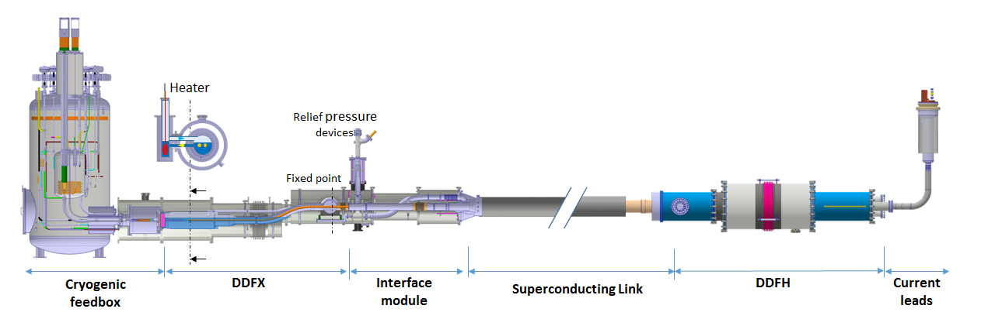
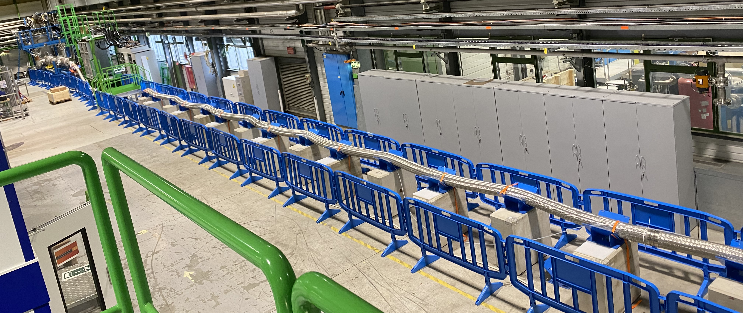
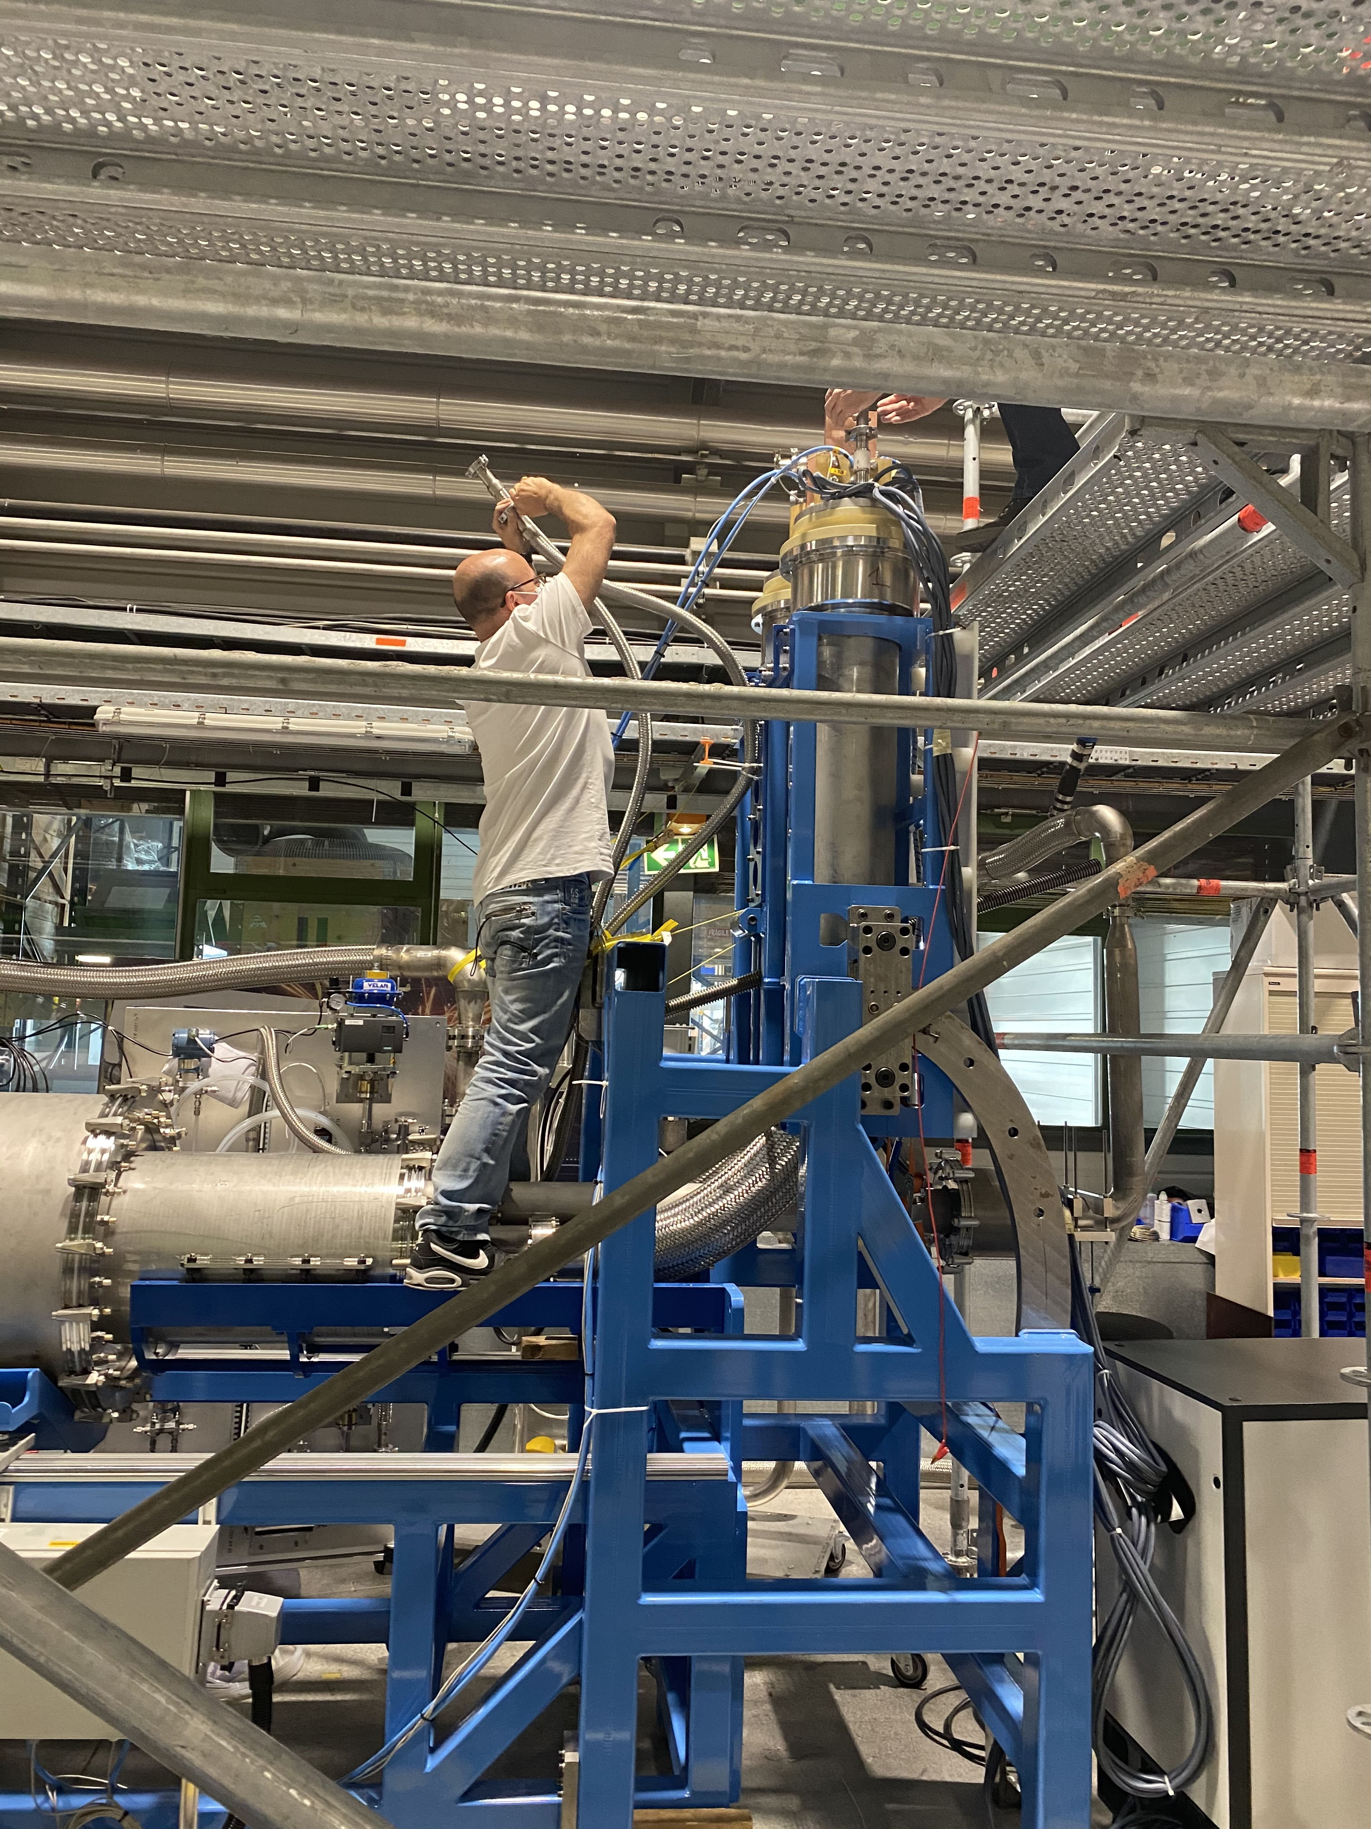
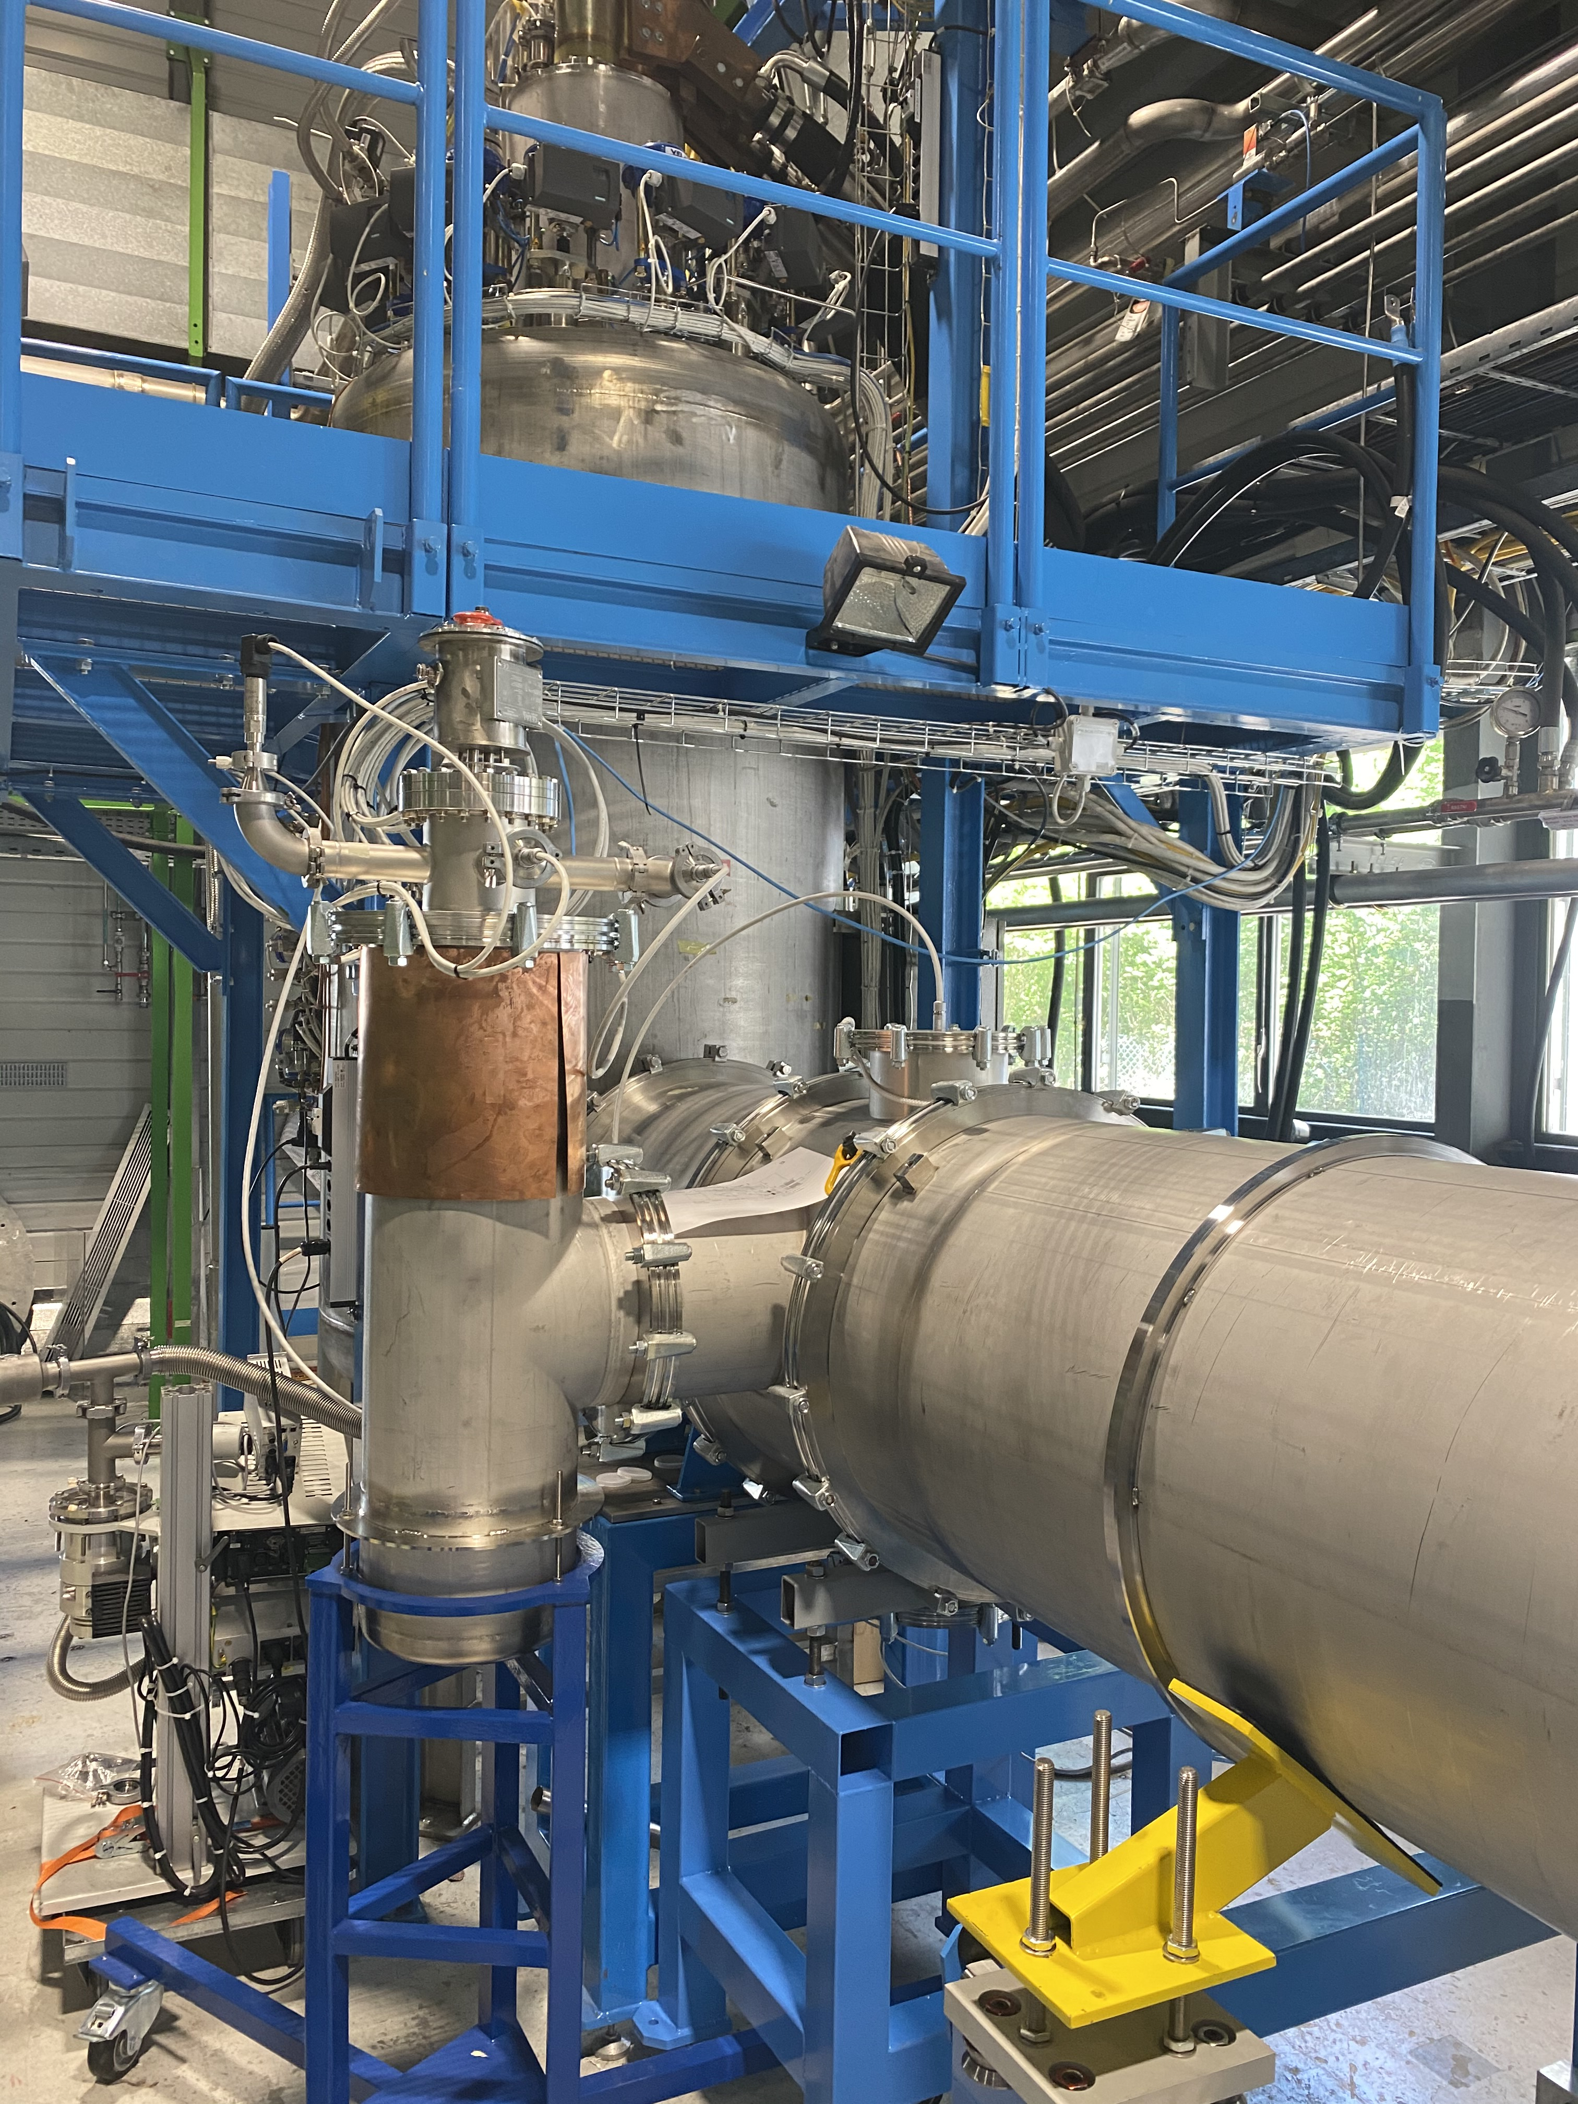
Demo 2: a System Demonstrator for the Triplets
Key milestone: the end of the R&D phase
50 K
25 K
HTS, REBCO
60 m, MgB₂
DDFX
SC Link for Triplets, 60 m long
DDFH
MgB₂
Nb-Ti
HTS REBCO

Slide 21
Demo 2
PC1: up to 18 kA
PC2: up to 7 kA
RT
50 K
LHe
25 K
Short of cables
powered by PC2
Short of cables
powered by PC1
Φ∼ 90 mm
Qualification of:
Prototype ∼ 100 kA MgB₂ industrialized cable assembly for Triplets;
SC Link cryostat final performance;
Assembly operations (spooling, cable integration inside cryostat);
Splices (MgB₂ to Nb-Ti in LHe and MgB₂ to HTS REBCO in GHe);
Simultaneous powering of different circuits to verify electro-magnetic compatibility;
Cryogenic operation/control parameters.

Slide 22
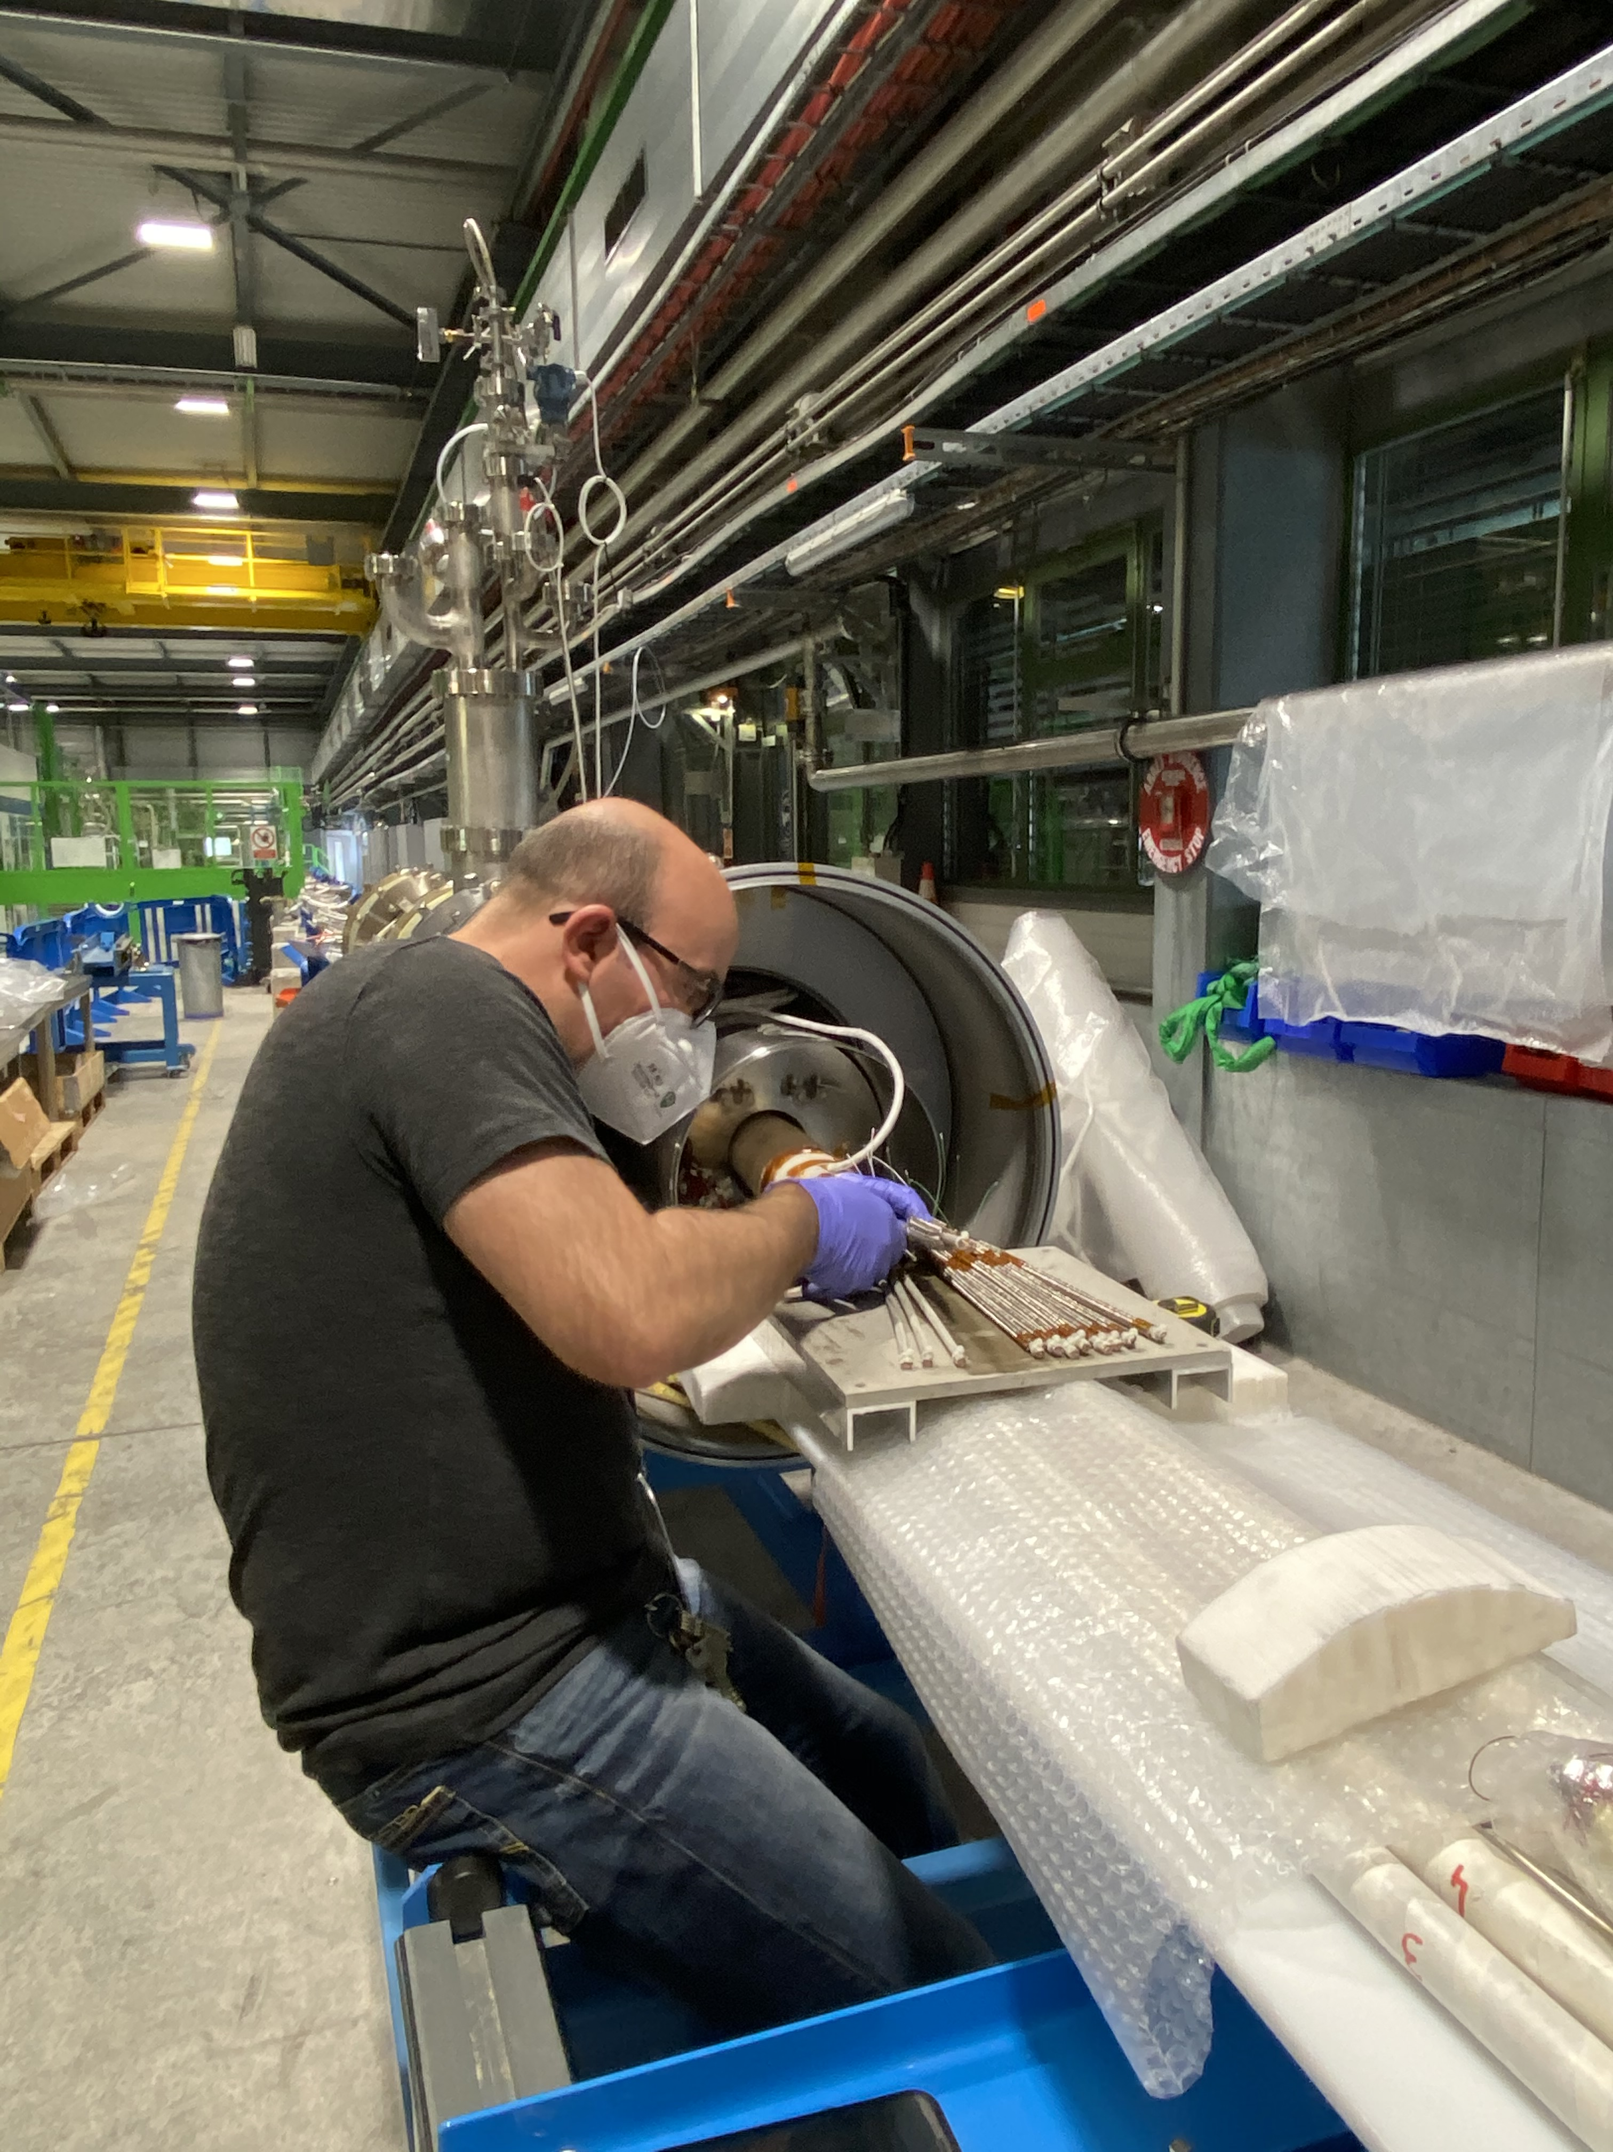
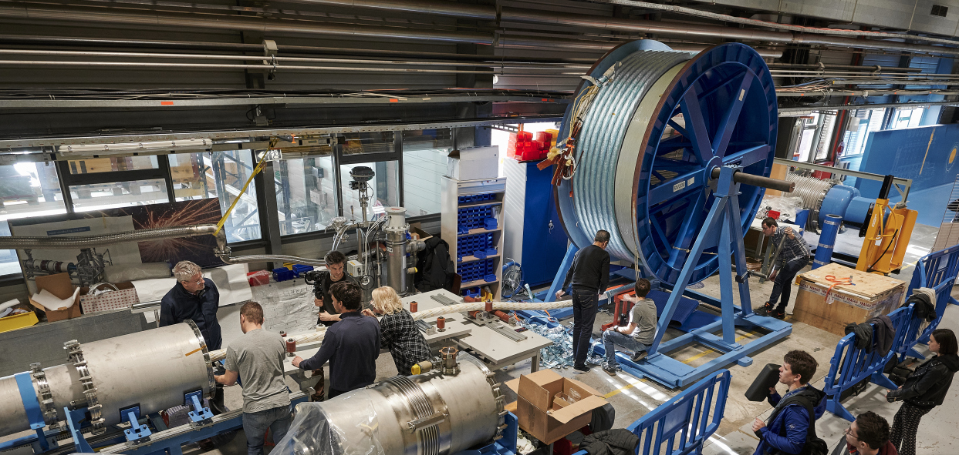
Demo 2
MgB₂
To HTS
Work re-started with limited personnel on the last week of April 2020
System completed and closed by mid-May: performed HV tests of MgB₂ cables (20 kV at the company ! between cables and to ground, 10 kV at CERN before and after insertion in the SC Link cryostat), pressure test, leak tightness tests

Slide 23
Demo 2
Successful cool-down of the full system last week (week 20)
Excellent cryogenic control
Cooled down 1.5 tons of MgB₂ cable in a representative final system
Δp of GHe across the SC Link ∼ 2-3 mbar for up to 3 g/s in nominal operating conditions (4.5 K to 25 K)

Slide 24
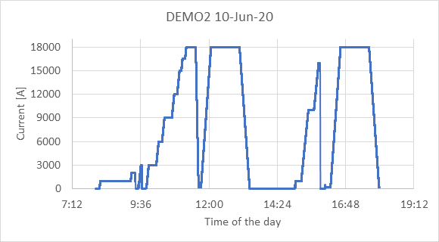
Demo 2
Successful powering of 18 kA circuit on 10/06/2020
Plateau @ 18 kA with no voltage drift and stable low-resistance joints
MgB₂: 17 K or 25 K, REBCO: 50 K

Slide 25
Thanks for your attention

